Slide 1


A Broadband Receiver for Parkes
R. N. Manchester
Many Parkes projects need a wide frequency range to investigate and compensate for intrinsic and interstellar frequency-dependent effects, e.g. pulse dispersion
Currently at Parkes we use the 10cm/50cm receiver and a 20cm system for most pulsar observations
A sensitive broadband receiver covering 0.7 – 4.0 GHz would improve pulsar frequency-dependent corrections and have many other applications

Slide 2
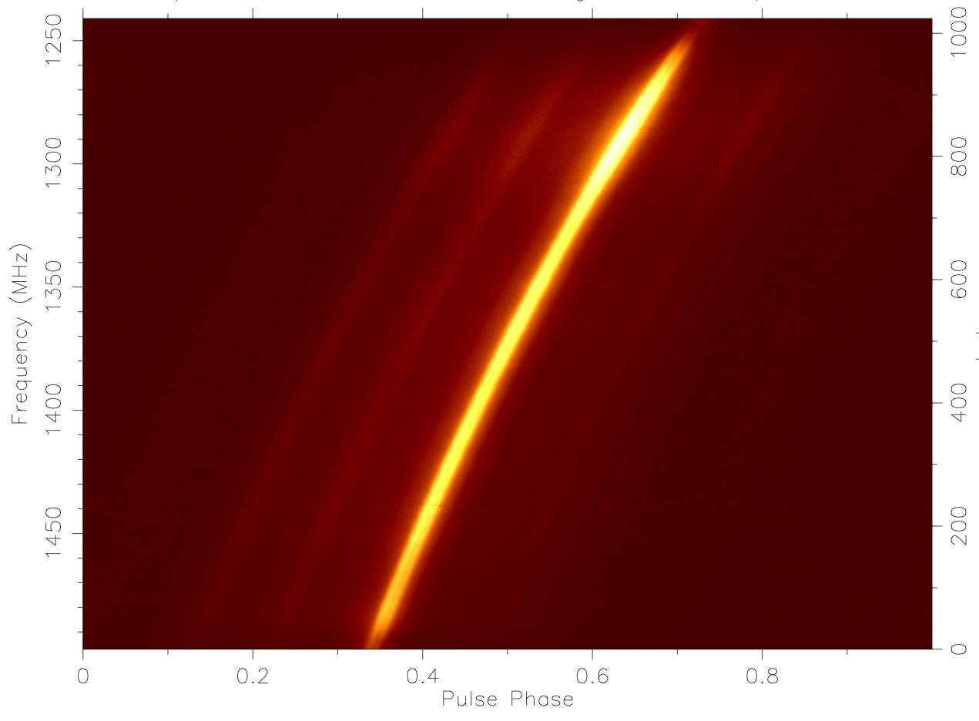
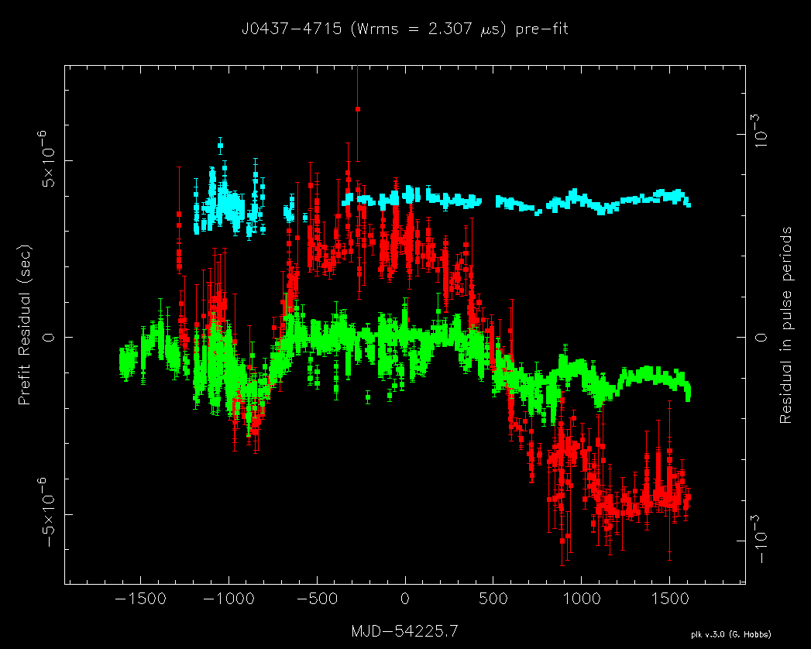
Correction for DM Variations
Currently limiting precision of PPTA data for some pulsars
20cm
PSR J0437-4715
Effect of DM variations
1 μs
10cm
DM delay across band
20cm
Timing residuals after subtraction of mean DM delay
50cm

Slide 3
RM Synthesis
Fourier decomposition of frequency dependence of Stokes Q & U
Emission intensity as function of RM
Polarised intensity of Galactic background emission: Parkes 300-480 MHz
(Wolleben, Landecker et al. 2010)

Slide 4
Proposed Receiver
Based on 2-12 GHz feed developed by Sandy Weinreb and students at JPL
Scaled to 0.7 – 4.0 GHz bandwidth
Cryogenically cooled OMT/feed and preamplifiers, Tsys < 25 K over most of band
Fully digital receiver; Nyquist sampling of entire RF band at receiver for each poln, >= 8 bits per sample
FPGA polyphase filter after digitiser, allowing rejection of strong RFI bands
Data fed to 20-processor GPU cluster for quasi-real-time processing, e.g. coherent de-dispersion of pulsar signals

Slide 5
Proposed Receiver (ctd)
Essentially all pulsar observations at Parkes (except multibeam surveys) could be done with this receiver
Many other applications, e.g., spectral-line observations, continuum polarisation (Galactic bkgnd, point sources), e-VLBI, zero-spacing data for ASKAP, etc., etc.
Approximate cost (incl. labour and o/h): $800K
Timescale: design ~ 1 yr, construction ~ 1.5 yr
Collaborative effort with Swinburne, MPIfR
Could have PAF, 0.7- 4 GHz, 4 – 24 GHz on translator
Will assist with optimisation of Parkes operations
Will develop technologies needed for SKA

Slide 7
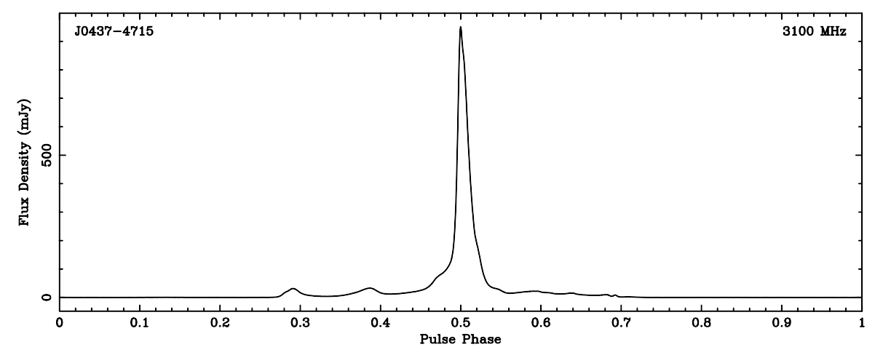
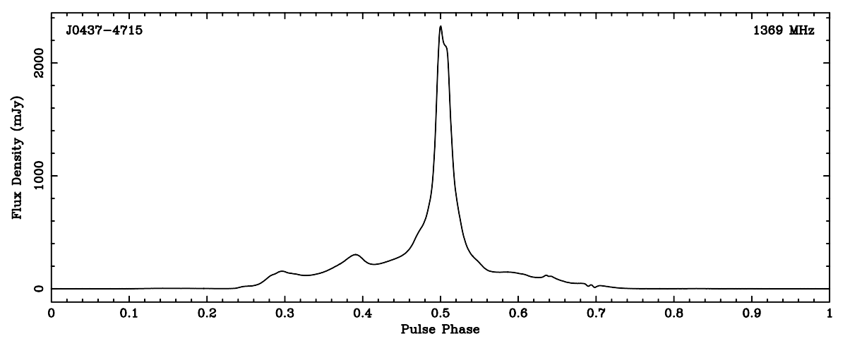
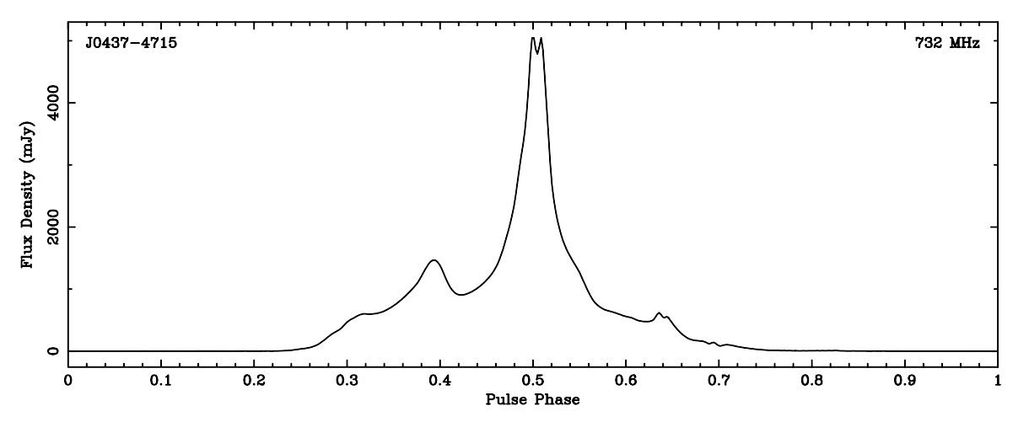
Frequency Dependent Effects
Pulse Profiles
10cm
PSR J0437+4715 at:
3100 MHz (10cm)
1400 MHz (20cm)
700 MHz (50cm)
20cm
Full pulse period (5.75 ms) plotted
50cm

