Slide 1
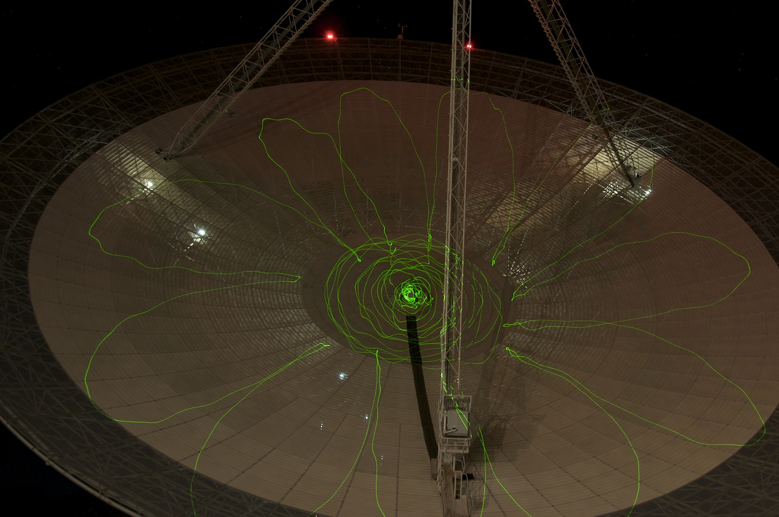
(Psshhh aaahhh sssss push it)
The Case for High Frequency Line Observations with Parkes
Andrew Walsh, James Cook University
Narrated by James Green (CASS) – thanks Jimi!
Notes:
v

Slide 2
Receiver Rationalisation on Parkes
Early stages of planning to make Parkes future operations more streamlined
Suggestion to replace receiver fleet with two wideband receivers
Nominal frequency range is 0.7 – 4 GHz and 4 – 24 GHz
Possible/likely use of Phased Array Feeds (PAFs)
– more likely for low frequency
Notes:
Slide 2:
This is an overview of the situation, as I understand it, at Parkes.
Probably most people already know this and probably know it better than me.
But this serves as a fundamental point so people know where I am coming
from.

Slide 3
The (relevant) Story of HOPS
Fast efficient mapping became available partly due to the broadband receiver and backend.
Survey multiple spectral lines simultaneously
Key to HOPS: observe during summer months
→ No great demand for Mopra (General feeling the time was unusable at 12mm)
→ Testing showed Mopra usable any time when not cloudy
→ Take a hit in sensitivity, but main aim is to look for bright lines
CONCLUSION: You can do great science if you… Push it!!!
Notes:
Slide 3:
Overall, the idea is to convey the message that a major survey like HOPS was
only possible because we decided to push the boundaries of what the standard
thinking said was possible.

Slide 4
The (relevant) Story of HOPS
A quick example:
H₂O masers
NH₃ (1,1)
10 8 6 4 2 0 -2
Galactic Longitude (degrees)
The CMZ shows copious NH₃ emission, but not many H₂O masers
→ Significant deficit of ongoing star formation
Notes:
Slide 4:
An example of the success of HOPS. The important ingredients here are:
* two strip images of water masers and NH3 emission. There is a great
concentration of NH3 in the CMZ (within about 3 degrees of the centre) but
no great concentration of water masers. NH3 is supposed to be gas that will
form stars, but water masers trace active star formation. Conclusion: plenty
of gas available to form stars, but it just ain't forming stars out of this
gas.
* This result is only in perspective from blind surveys of both NH3 and
water masers.
* The full HOPS survey (100 square degrees) puts the result in the
perspective of the whole Galaxy and shows this anomaly is a factor of
20-50x.

Slide 5
The Understated Usefulness of Water and Ammonia
Arguably, the two most important spectral transitions for radio astronomy are HI and CO J = N – N-1, mainly because they are ubiquitous.
Arguably, the second two most important spectral transitions for radio astronomy are the H₂O maser at 22 GHz and the NH₃ inversion transitions at 24+ GHz.
Both H₂O and NH₃ are ubiquitous, but perhaps not as ubiquitous as HI and CO (sububiquitous?)
Notes:
Slide 5:
Just to put context on where I think the NH3 and water lines sit in
importance. Yes, I know you'd have methanol up there too, but I am
deliberately trying to be contentious at this point to get people to pay
attention and think about this comparison of the lines everyone knows and
loves (HI and CO) and those weird lines that no one except those star
formation nutcases take an interest in.
This slide is also there to try and make you stuff up saying sububiquitous
:)

Slide 6
The Understated Usefulness of Water and Ammonia
H₂O masers are found in a wide variety of situations:
Both low- and high-mass star formation within the Milky Way (typically trace outflows)
Evolved stars such as post-AGB stars (again tracing outflows)
Megamasers around the centres of other galaxies
H₂O masers can be used for a wide variety of diagnostics:
Studying outflows in star formation and evolved stars – particularly high velocity outflows
Constraining the ages of high-mass star-forming regions
Study of circumnuclear disks in other galaxies
LBA high resolution studies
Notes:
Slide 6:
Just giving the straight facts on water masers' usefulness

Slide 7
The Understated Usefulness of Water and Ammonia
NH₃ inversion transitions are particularly useful because:
Multiple transitions are close together in frequency that probe a wide range of densities (few × 10³ → 10⁵ cm⁻³) and temperatures (15 – 400 K)
Lower transitions like NH₃ (1,1) and (2,2) probe currently modelled conditions for star formation (where you see ammonia, you *should* see star formation)
Lower transitions show hyperfine structure, which can be used to more reliably measure column densities.
The NH₃ molecule is particularly useful because:
It is robust against freeze out in coldest, densest regions (pre-stellar clouds)
It does not appear in outflows (consumed by outflow tracers CO and HCO⁺)
→ NH₃ is the most reliable tracer of dense, quiescent, star-forming gas
Notes:
Slide 7:
Similar for NH3, although I don't think most people realise how important
ammonia can be. The hammer home message is down the bottom: NH3 is the BEST
tracer of gas associated with star formation. Ignore inherent contradiction
with Slide 4.

Slide 8
A Parkes Survey of the Milky Way in Water and Ammonia
HOPS is not sensitive enough to detect typical clouds right across the Galaxy
Common spectral lines like HI and CO can be detected across the Galaxy. But they trace low density gas not necessarily associated with star formation, as well as gas in inter-spiral arm regions, making Galactic structure difficult to discern.
A sensitive Parkes survey for water masers and ammonia would use both molecules to map the Galactic structure in star-forming gas more clearly than ever before!
Note that only Parkes can see the southern Galactic plane and can do such a survey!
Notes:
Slide 8:
Pretty straight forward. Nothing else to say here.

Slide 9
A Parkes Survey of the Milky Way in Water and Ammonia
What is needed?
Make sure that any high frequency receiver includes the water and ammonia line frequencies.
            H₂O maser 22.235 GHz
            NH₃ (1,1) 23.694 GHz
            NH₃ (2,2) 23.722 GHz
            NH₃ (3,3) 23.870 GHz
            NH₃ (4,4) 24.139 GHz
NOTE: These frequencies are a no-brainer, given the current rough specs
BUT PLEASE DON’T FORGET THEM!!!
Notes:
Slide 9:
I think the message in red is pretty clear. Just stare deeply into their
eyes and shout at them ;)

Slide 10
A Parkes Survey of the Milky Way in Water and Ammonia
What is needed?
To efficiently survey the Galaxy, a PAF is needed:
A 10×10 array will survey the Galaxy with 20× the sensitivity of HOPS in ~2000 hours
The benefits of such a survey will be far-reaching in the fields of understanding star formation both within our Galaxy and other galaxies, as well as understanding the structure of the Milky Way.
→ Developing such a PAF may be challenging, but this is where CASS needs to Push It!!!
Notes:
Slide 10:
Just providing a rough guideline of what might be needed in a PAF. So the
10x10 PAF is very flexible. We don't have to go for 20x sensitivity and we
don't have to spend 2000 hours either. Just gives an idea of what can be
achieved.

Slide 11
Summary
A Parkes high frequency receiver should be designed to include spectral lines of water and ammonia.
A PAF at high frequency will bring great benefits to studying star formation and g(G)alactic structure
Salt-n-Pepa’s here!
Notes:
Slide 11:
Just the two take-home messages. Time to start dancing :)

