Slide 1
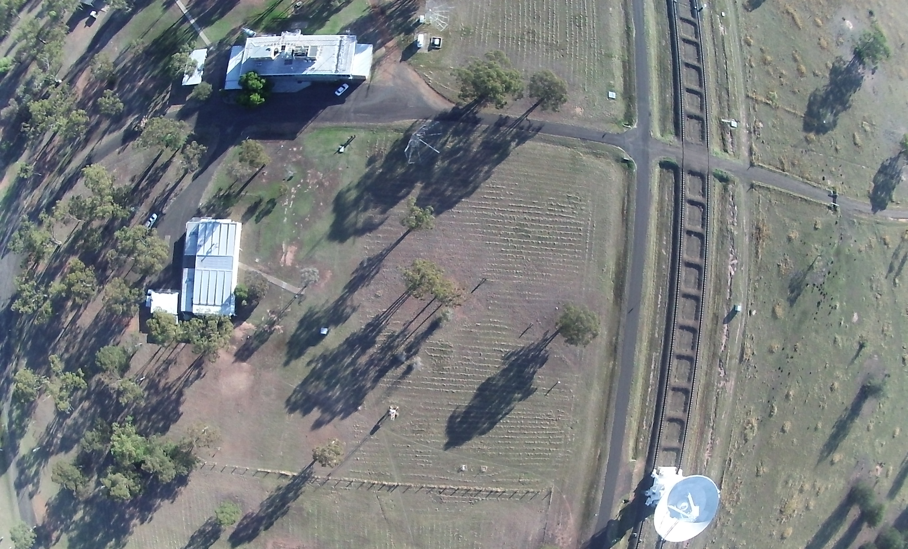
Future CABB Data Reduction
Mark Wieringa | Science Data Processing | Australia Telescope National Facility
ATUC - 11th June 2013
CSIRO Astronomy and Space Science

Slide 2
Miriad improvements for CABB
Cope with increased data size (>8GB)
up to 70000 channels, image sizes up to 32768²
Calibration in up to 16 frequency bins (gpcal, selfcal)
Solutions interpolated in time and frequency
Fixes phase slope across band
Removes effect of secondary calibrator spectrum
Solves leakage terms vs frequency
Better data flagging capabilities
New flagging task pgflag with automatic flagging mode (SumThreshold alg.)
Blflag improvements – plot vs channel, cope with more data
Source fitting with spectral index and curvature (uvsfit, uvfit binning)
Frequency dependent primary beam correction
Linmos bw parameter, restor mfs option

Slide 3
Miriad limitations
Imaging algorithms
Mfclean – intensity and spectral index term only (limits fractional bandwidth to <50%, errors on edge of primary beam)
Clean algorithms don’t cope well with extended emission, MEM algorithms don’t do MFS
Mosaicing – no MFS (mosmem, mossdi), primary beam at fixed frequency
No major cycle clean that subtracts from ungridded data – DR limitations
No automatic source detection and cleaning
Image cubes use single beam plane
Ad hoc analysis
No tools to get easy access to data from scripts

Slide 4
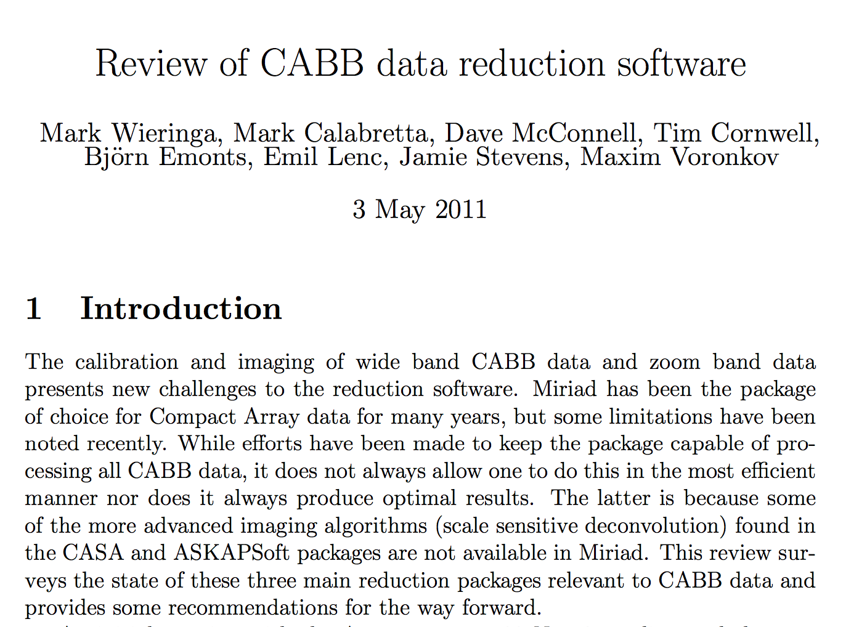

Slide 5
Report Conclusion
“The committee has surveyed the shortcomings of Miriad when faced with the calibration and imaging of recent CABB data.
Taking into account the limited resources available, a number of minor improvements to Miriad have been suggested and prioritised, totaling a few months of development.
In addition the committee suggests that both the CASA and ASKAPSoft packages are used to supplement the imaging and analysis tasks available in Miriad.
Documentation of the process to get data into these packages (and back) and recipes or scripts for further processing should be provided.”

Slide 6
CABB data reduction with CASA
Latest release: CASA 4.1.0 (31 May 2013)
Main features of interest:
Multi-scale, multi-frequency clean (MSMFS) – now working well for single fields
Can use multi-scale clean (but not yet MFS) for mosaics
Cube imaging with beam per channel, can clean planes in parallel
A-projection – cope with time and baseline dependent primary beam effects (no MFS yet)
Drawbacks:
No native filler for rpfits yet. Use FITS export/import or new uv2ms task in linux Miriad
Imaging can be slow – factor 10-20 compared to Miriad
EVLA has all of CABB’s problems and more (non-coplanar, beam squint)
Solutions will appear in CASA over time (research topic)
CASA/CABB data reduction workshop
Jamie Stevens will organize this if there is sufficient community interest
Can now calibrate & image CABB Stokes I, continuum & spectral line data in CASA
Polarization still needs testing

Slide 7
Data Reduction Recommendations
Load data into Miriad for calibration and flagging
Produce first pass images
If quality of images limited by
extended emission
spectral structure
primary beam structure
Apply calibration, Convert to MeasurementSet
Produce images with CASA
MSMFS algorithm
A-projection algorithm (need Voltage patterns for ATCA antennas)

Slide 8
Plans for Miriad
Bug fixes
Minor features, calibration improvements
No major work on imaging
Provide easy transfer to CASA

Slide 9
Plans for CASA
Workshop
ATCA CASA Data Reduction Cookbook
Start contributing ATCA/CABB specific work
Primary beam models
Calibrator models
Contribute ASKAPSoft imaging algorithms
Re-implement in CASA

Slide 10
Thank you
CSIRO Astronomy and Space Science
Mark Wieringa Science Data Processing
t +61 2 67904040
e mark.wieringa@csiro.au
w www.atnf.csiro.au
CSIRO Astronomy and Space Science

