Slide 1
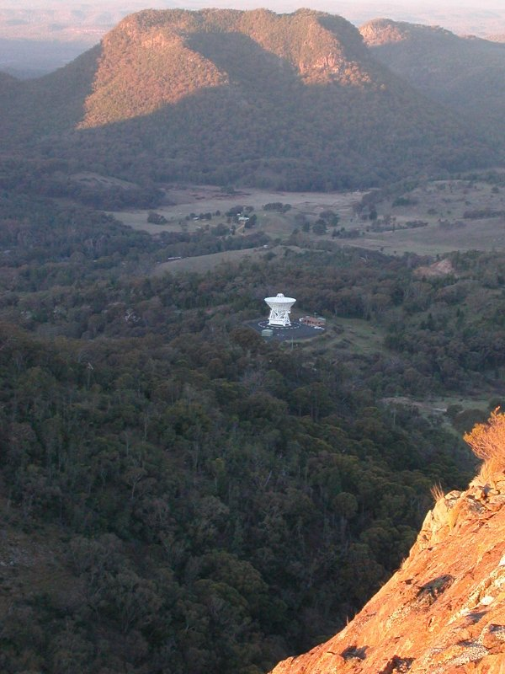
Technologies for Radio Astronomy
Graeme Carrad
Assistant Director - Engineering
11 June 2013
CSIRO Astronomy and Space Science

Slide 2
Centimetre Upgrade
Production receivers on six antennas
Spare receiver (was the prototype) under construction-anticipated to be available as the spare at the end of June.
It is important to note the remaining work needed and not to dismiss the project as being ‘done’. Modification of the spare receiver, LNA spare production, C/X noise coupler rollout and three different module modifications are yet to occur along with finalising documentation. This is why the project continues until June 31.

Slide 3
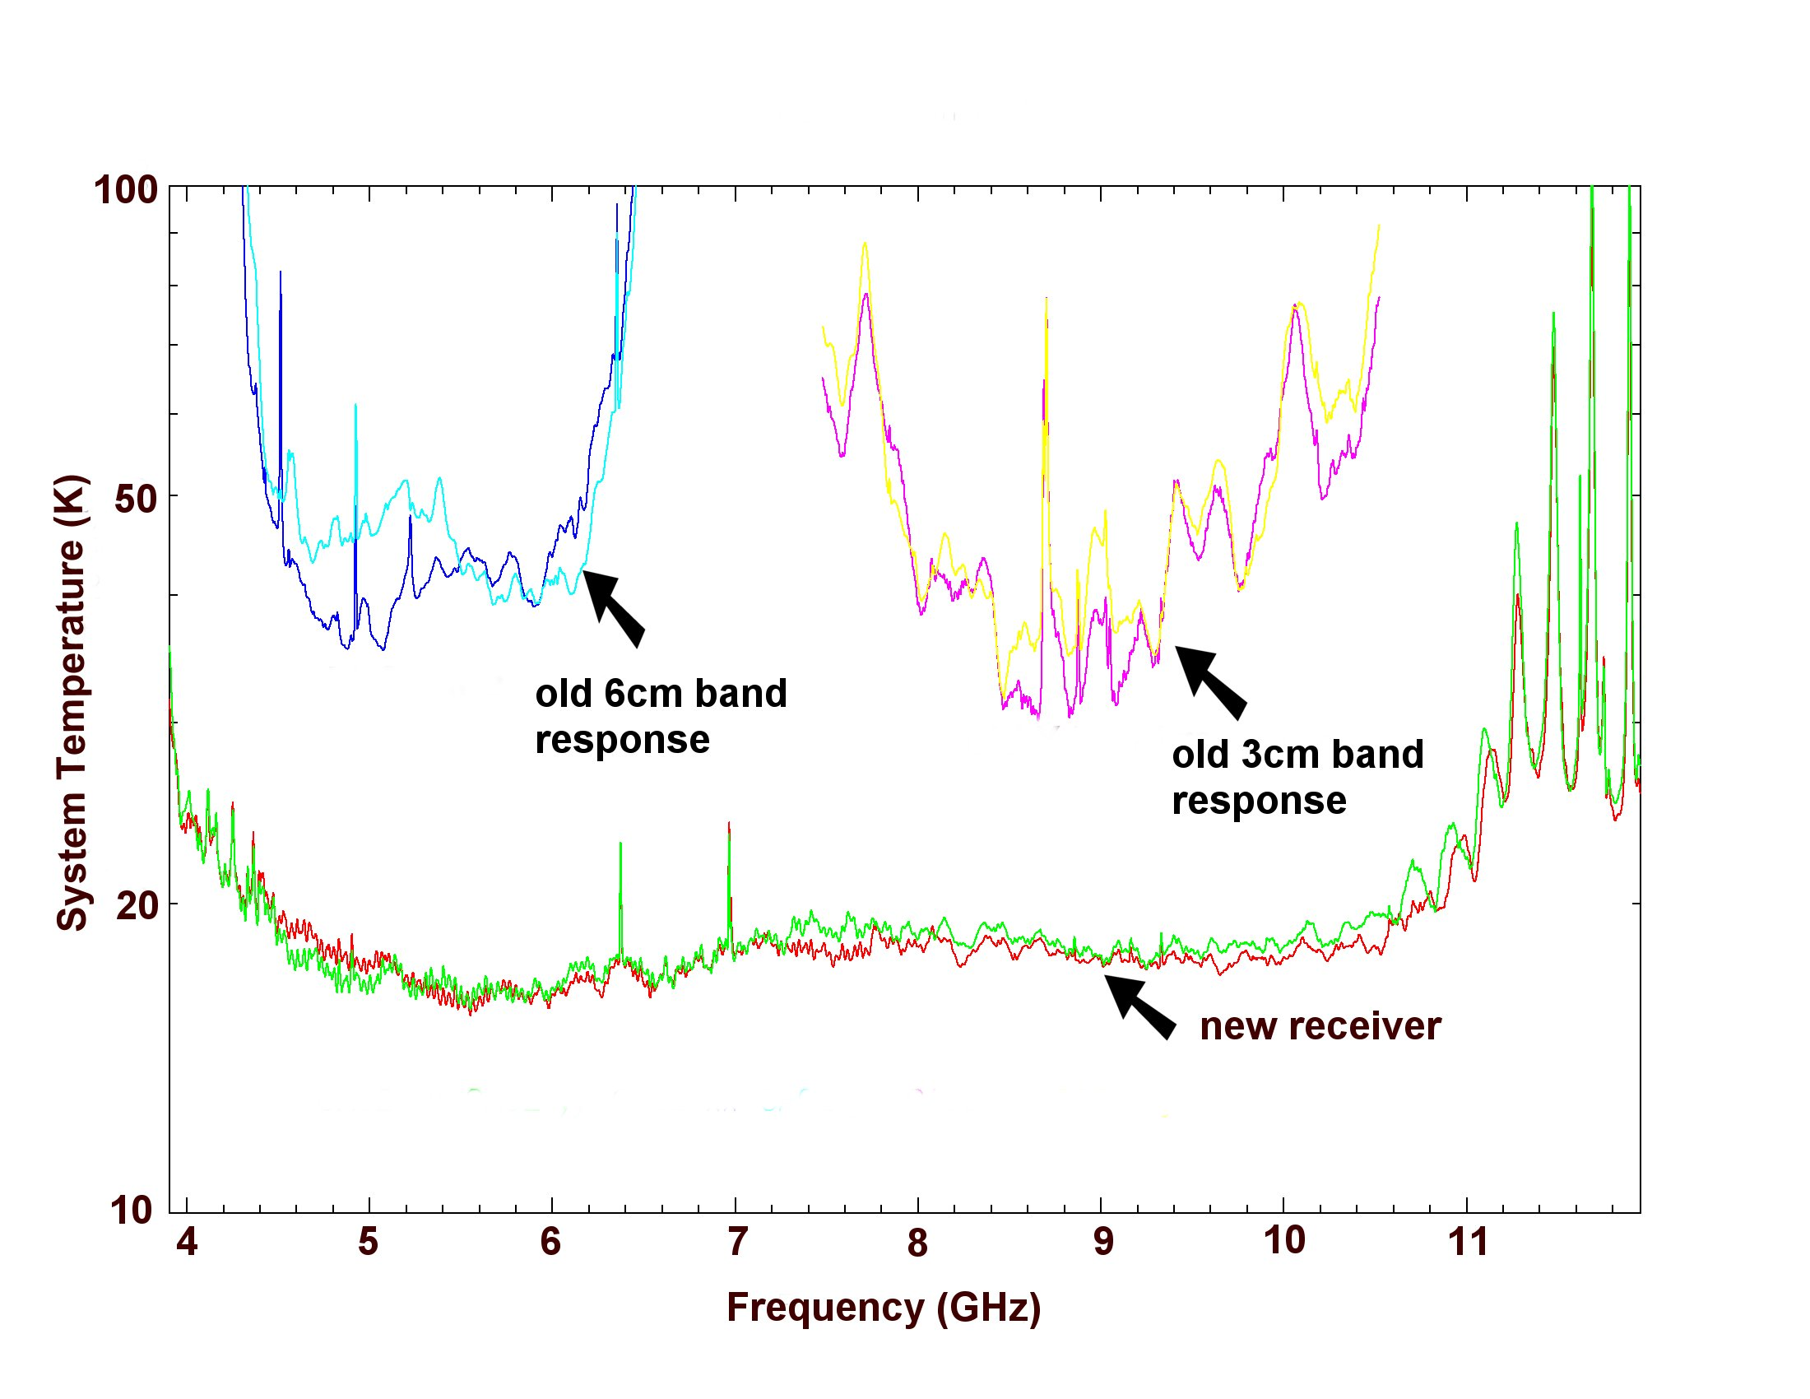
Centimetre Upgrade - results

Slide 4
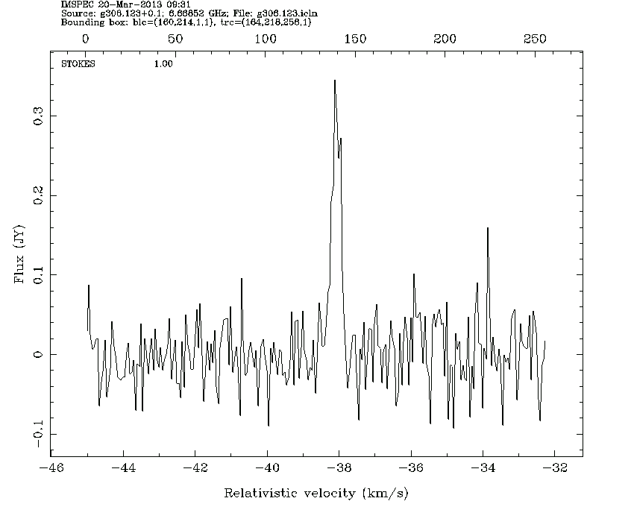
Centimetre Upgrade – results
Simon Ellingsen. …the noise is about what we expected from the theoretical prediction…this was 5 x better than the old system at this frequency. The result is that we are able to do better with 25 mins integration with the new system than we were doing in 6 hours with the old system. Since we had ~80 sources to observe in this project, it meant that we did all of our sources in 5 days, compared to the 40+ days it would have taken with the old receivers.
G306.125+0.133

Slide 5
Centimetre Upgrade – outcomes
A patent has been applied for covering the innovation displayed in the 4-12 GHz OMT
Two papers (so far) to Microwave conference. OMT and filter with a deep notch to exclude narrowband RFI signals
Highly commended Sydney Engineering Excellence Awards; Finalist Australian Innovation Awards

Slide 6
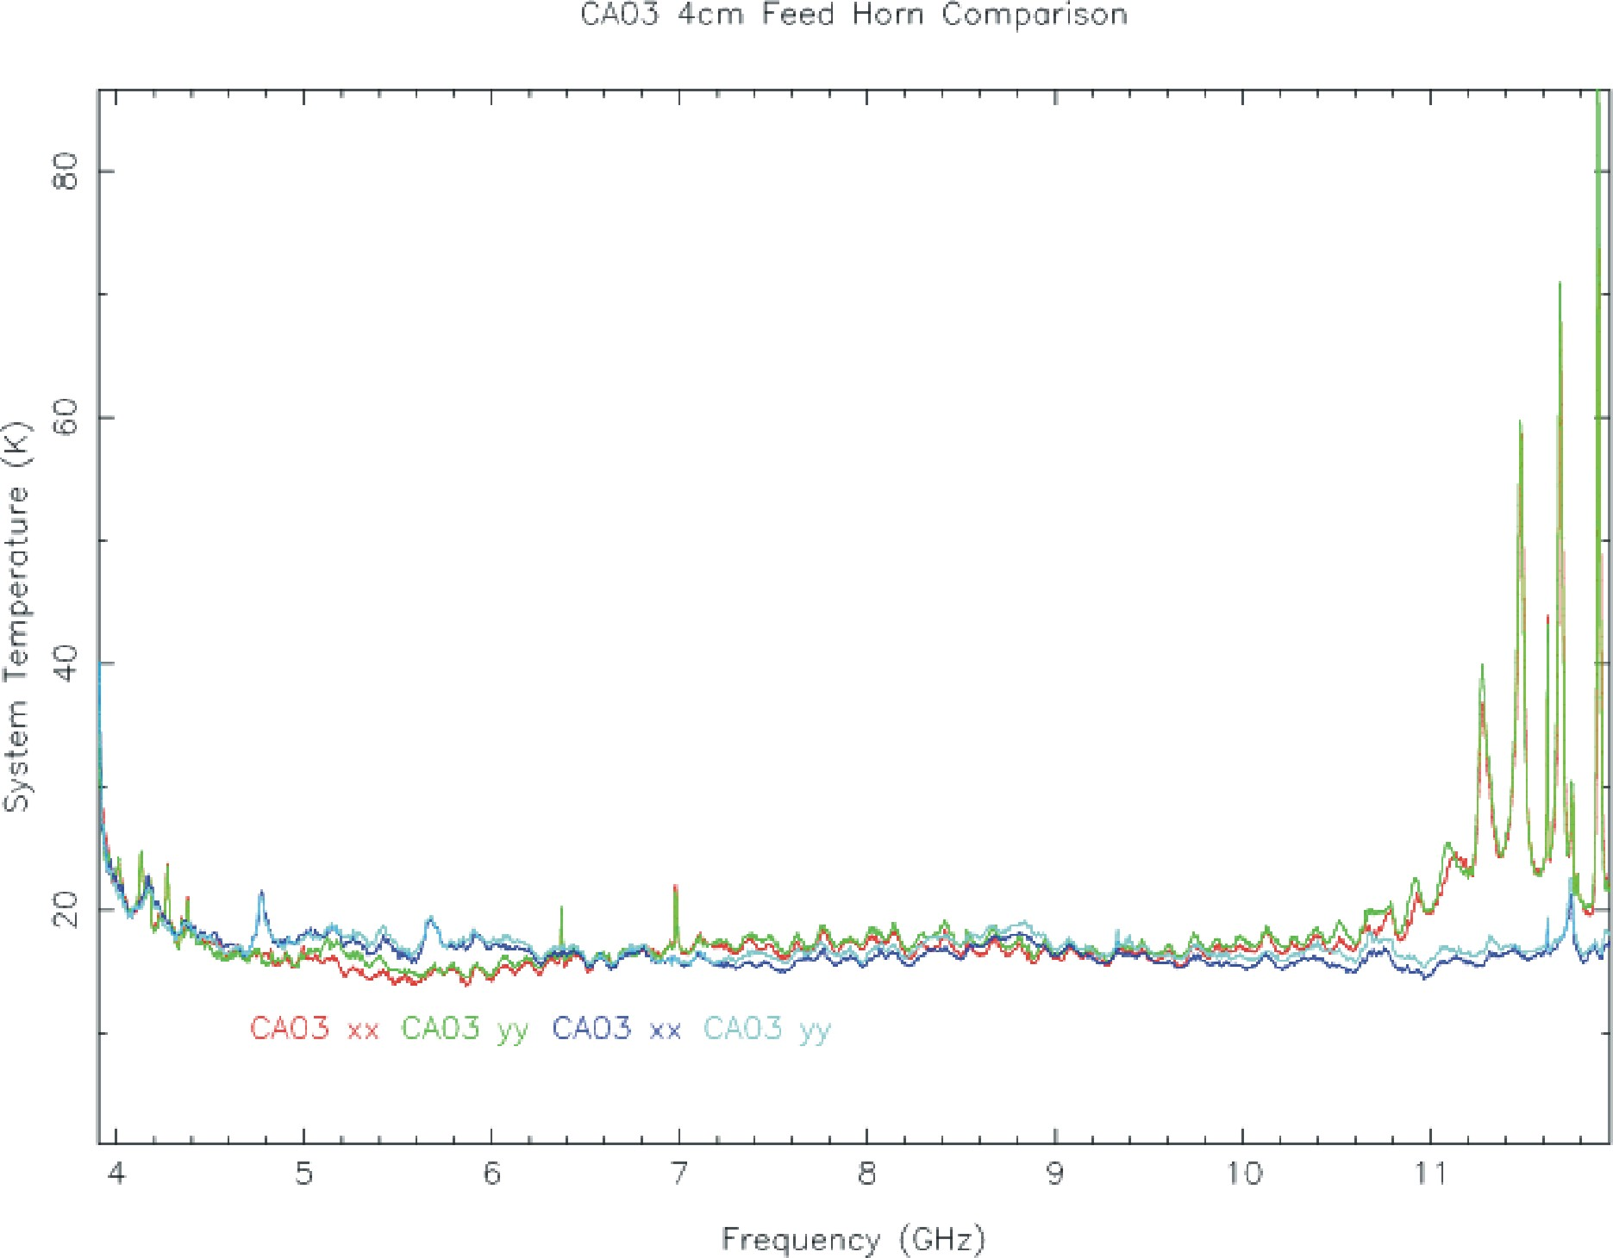
Centimetre Upgrade - going to 12.25 GHz
Planned and costed option- not ‘gold plated’
Not funded
Feeds look OK in performance
CABB needs modification – would tie in beautifully with fixing troublesome CL1 (LO module)
 | 12.25GHz Frequency Extension
Labour | $122k
Materials | $159k
Travel | $4k
Total | $285k
The new feed extends the high sensitivity performance past 11 GHz

Slide 7
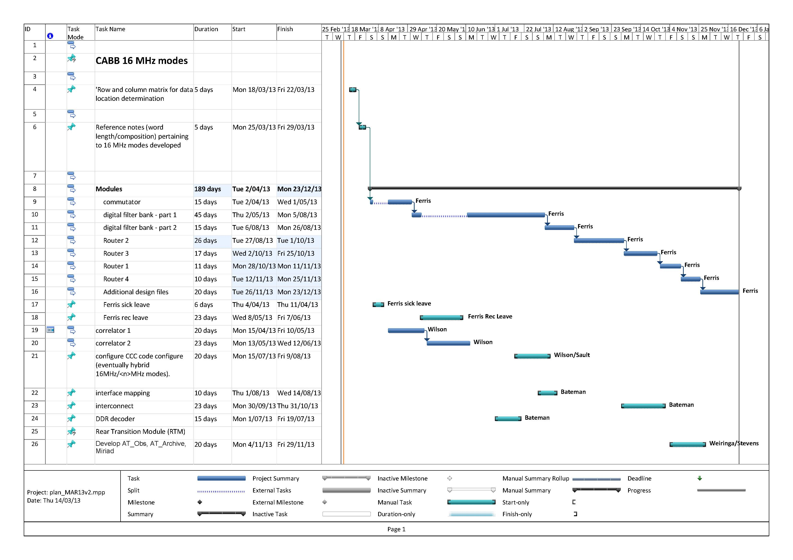
CABB
In line with the recommendations of a Firmware review there is now a more detailed plan showing firmware modules to be written and estimates of the times required to write these modules.
This indicates that the 16 MHz mode, including zooms, is estimated to be complete at end of CY 2013. It is currently on track against the time line. Some of this 16 MHz effort can be used for the 4 MHz mode thus avoiding duplication of effort.

Slide 8
CABB - Reliability
Effort to troubleshoot the inconsistencies in configuration have offered up potential sources for the problems but there has been no resolution to date.
Emulation system in Marsfield can’t reproduce the problems at the CA despite its similarity
Wilson and Bateman to spend ‘quality’ time at the CA in early July with devoted telescope time to undertake intensive testing.
Their findings will determine the path of further actions
Questions of whether to continue CABB past the 16 MHz mode. Resources might be directed to other areas.

Slide 9
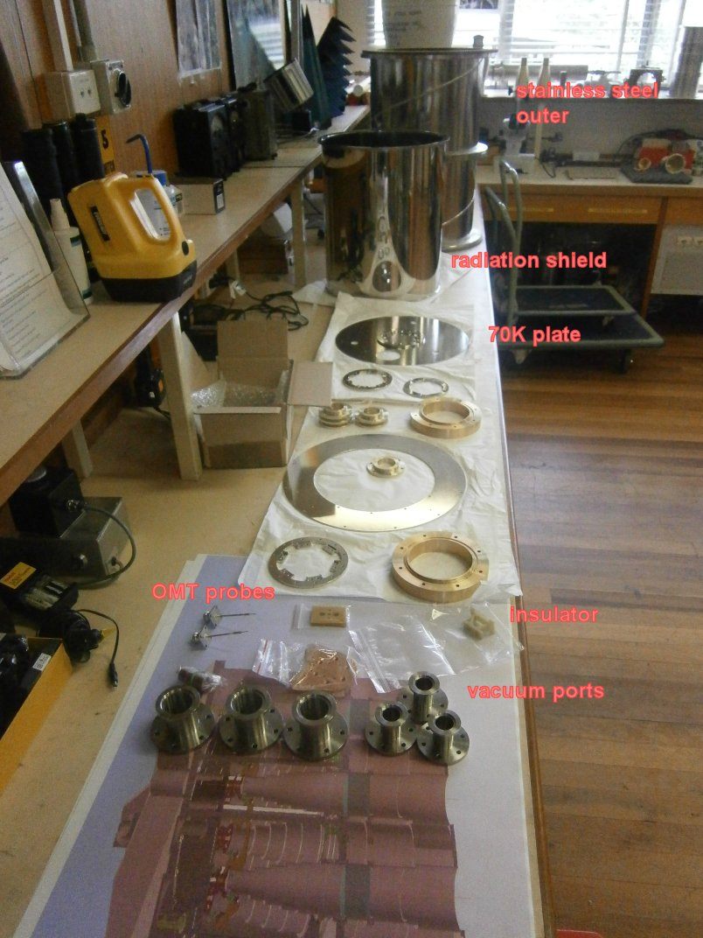
FAST – 19 beam 1.3 GHz receiver feasibility
Test elements being fabricated for a cooled single pixel demonstration. Feed OMT cryostat
Amplifier made but because of export controls the COTS devices we have been forced to use are lesser performers. Noise temps of 6K instead of 3K
Anticipated to complete in Sept 2013
No indication of a request to build.

Slide 10
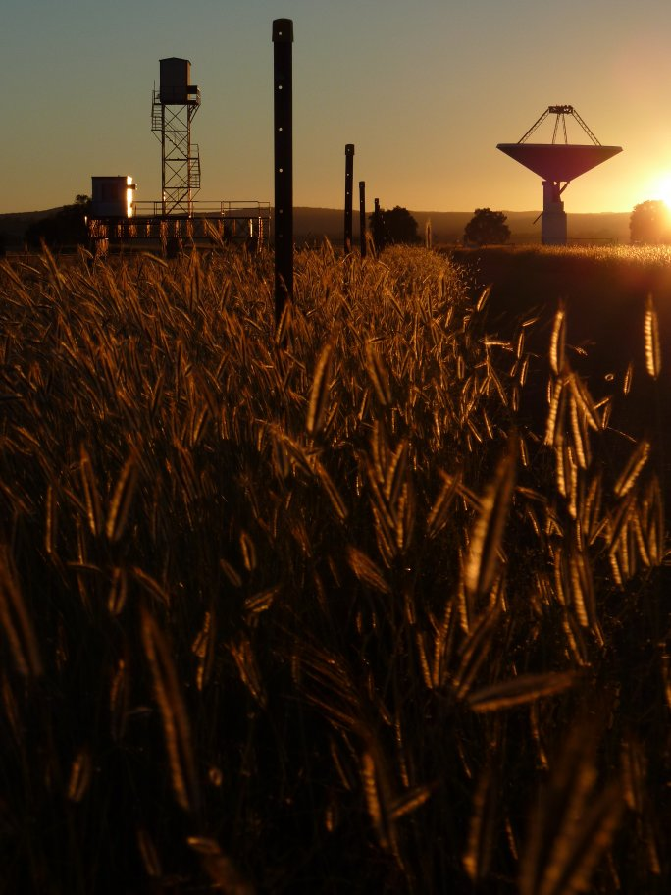
UWB Receiver – So Far
RF design of feed and simple design of amplifier. The feed is a frequency independent structure so previously we were concerned about leaping into the low frequency first but that concern has dissipated somewhat.
Using this modelling as the foundation, the estimated sensitivity might well match that of current systems (20 cm MB and 10/50 cm ). It seems worth pursuing.

Slide 11
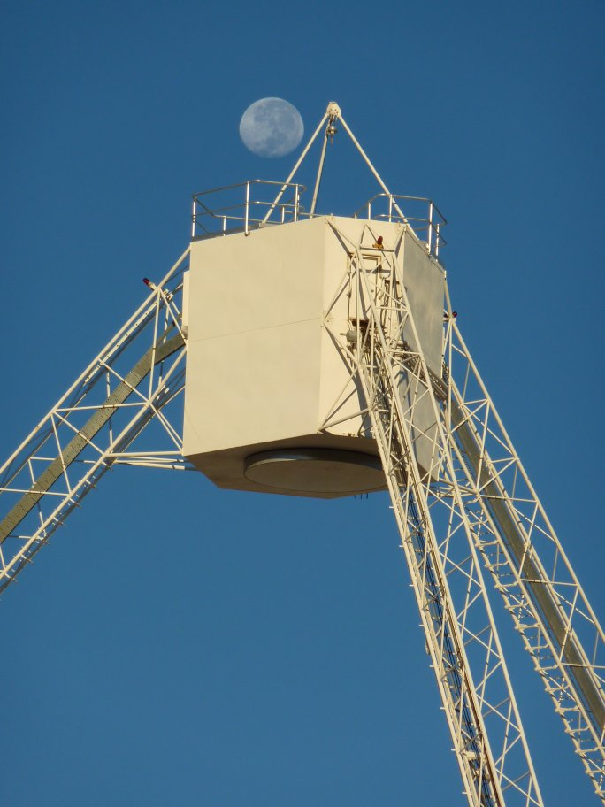
UWB Receiver – Unknowns
Feed/OMT – Needs further development. Sidelobes might be a concern. 2 port or 4 port OMT? A better result may be achieved with balanced amplifiers and a combiner. Not scary, but not done before. Where do you combine?.
Cryostat – can we cool/maintain vacuum? Needs preliminary feed design to be able to go ahead as this determines the structure. Finite Element Analysis (FEA) will help remove some uncertainty.

Slide 12
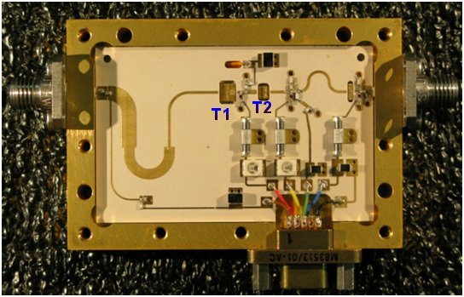
UWB Receiver – Unknowns
Amplifiers – need further development. ‘Just tweak the ATCA 1-3 GHz’. Not that easy. Desire for physical closeness of transistors may dictate MMIC is needed. Try 1-3GHz technology or go straight into what we think will definitely work. Use the 1-3GHz to start and make better over time. FAST LNA work has also been instructive. Buy LNA from someone else?
Noise Calibration – where and how, pre or post LNA?

Slide 13
UWB Receiver – Unknowns
Digitisation – Push for doing this in cabin – need to prove we can do this and not degrade the RFI environment.
Explore RF over fibre – Concern over phase and gain stability.
Use CASS designed digitisation – Development required, manpower is limited. Commercial off-the-shelf solution? Tektronix might have a solution used in their oscilloscopes.

Slide 14
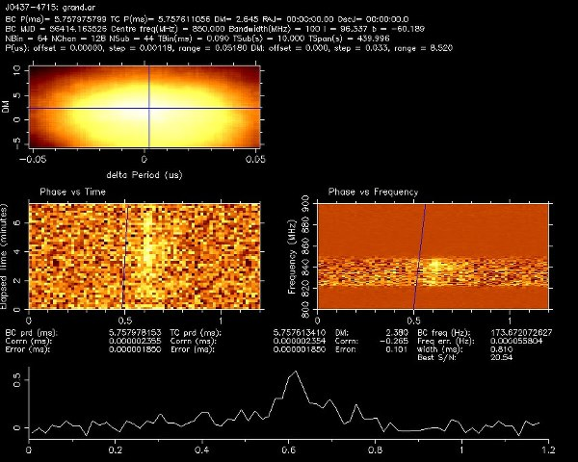
SKAMP contribution
Small effort continues. Tim Bateman has helped Syd Uni and Swinburne to realise a system based on GPUs.
Swinburne supplied a new backend to transform Molonglo into a pulsar machine/burst
finder and FX correlator. Tim has managed to catch the data from the receivers and successfully
pass it into the PFB and send this via 10Gb ethernet to the Swinburne server. Their software pulsar processor has detected three pulsars already.
first millisecond pulsar detection.

Slide 15
PAF for MPIfR
Permission from Defence Export Control obtained
This will be an extra ADE PAF
Assistance to ASKAP
Where and when possible for BETA and ADE
BETA – RFI remediation of PAF #1 and #6.
– Dry air RFI enclosure cabling.
ADE – Measurement of dielectrics for Mk 2 chequerboard.
– Procurement.

Slide 16
Thank you
Astronomy & Space Science
Graeme Carrad
t +61 2 9372 4305
E Graeme.Carrad@csiro.au
w www.csiro.au/cass
Astronomy and Space Science

