Slide 1
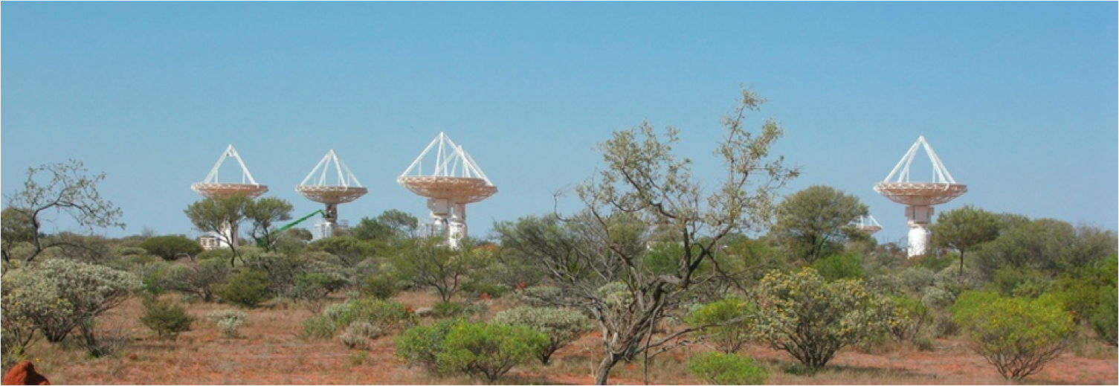
ASKAP Central Processor: Design and Implementation
Calibration and Imaging Workshop 2014
Ben Humphreys | ASKAP Software and Computing Project Engineer
3rd - 7th March 2014
Astronomy and Space Science

Slide 2
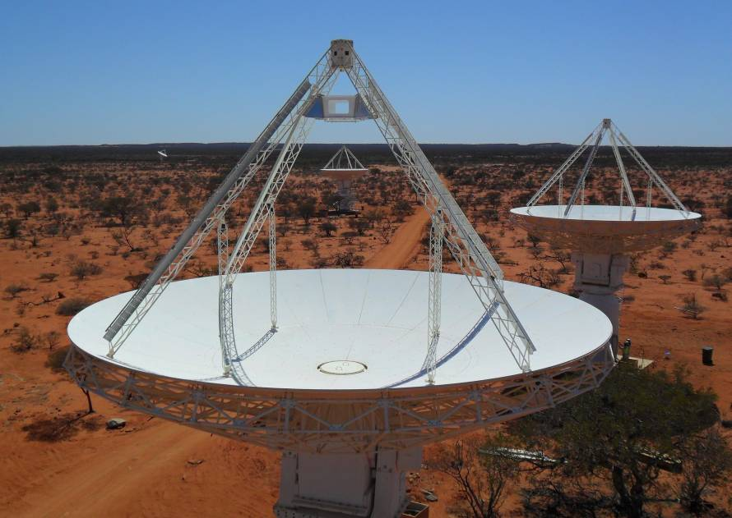
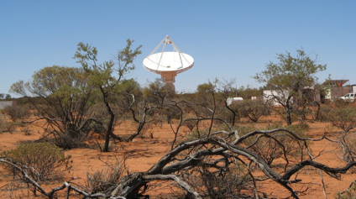
Australian SKA Pathfinder (ASKAP)
Sited at the Murchison Radio Observatory, Western Australia
Observes between 0.7 and 1.8 GHz
36 antennas, 12m diameter
Started construction July 2006
Data rate from correlator ~2.5GB/s
  A DVD every two seconds!
Science processing requirement 200TF/s for basic capabilities
  800+TF/s for high angular resolution spectral line imaging

Slide 3
28 Gbit/s
~20 Gbit/s

Slide 4
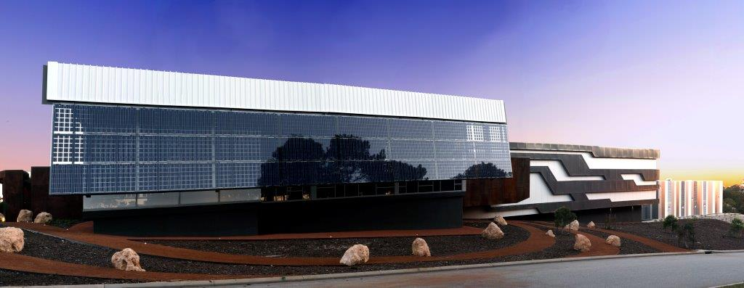
The Pawsey High Performance Computing Centre for SKA Science
AUD$80M super-computing centre
Supports storage and processing of data from the Australian SKA Pathfinder and the Murchison Widefield Array
Construction completed April 2013

Slide 5
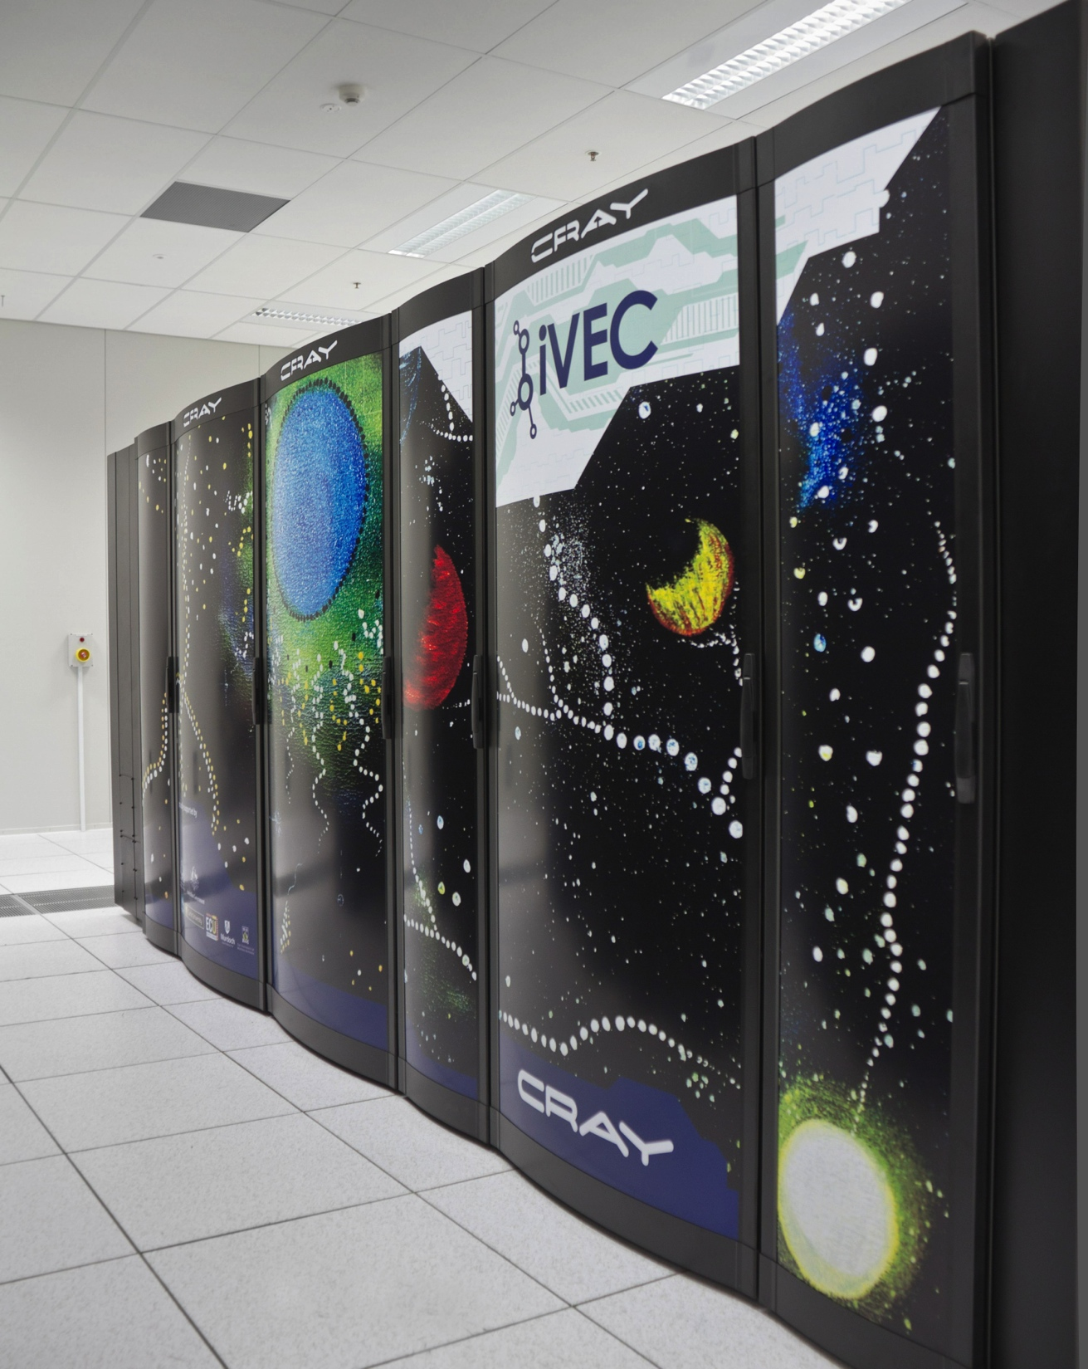
ASKAP Central Processor
472 x Cray XC30 Compute Nodes
  200 TFlop/s Peak
Cray Aries (Dragonfly topology)
Cray Sonexion Lustre Storage
  1.4 PB usable
  480 x 4TB Disk Drives, RAID 6 + Hot Spares
  Approximately 30 GByte/s I/O performance

Slide 6
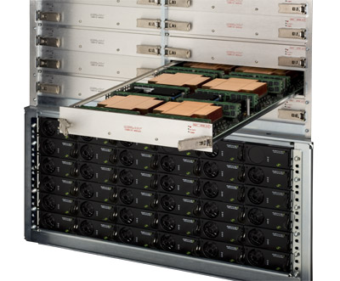
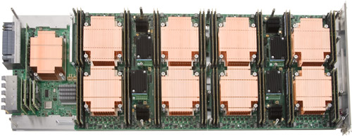
Cray XC30 Compute Nodes
472 x Cray XC30 Compute Nodes
2 x 3.0 GHz Intel Xeon E5-2690 v2 (Ivy Bridge) CPUs
10 Cores per CPU (20 per node)
64 GB DDR3-1866Mhz RAM
Image Credit: Cray

Slide 7
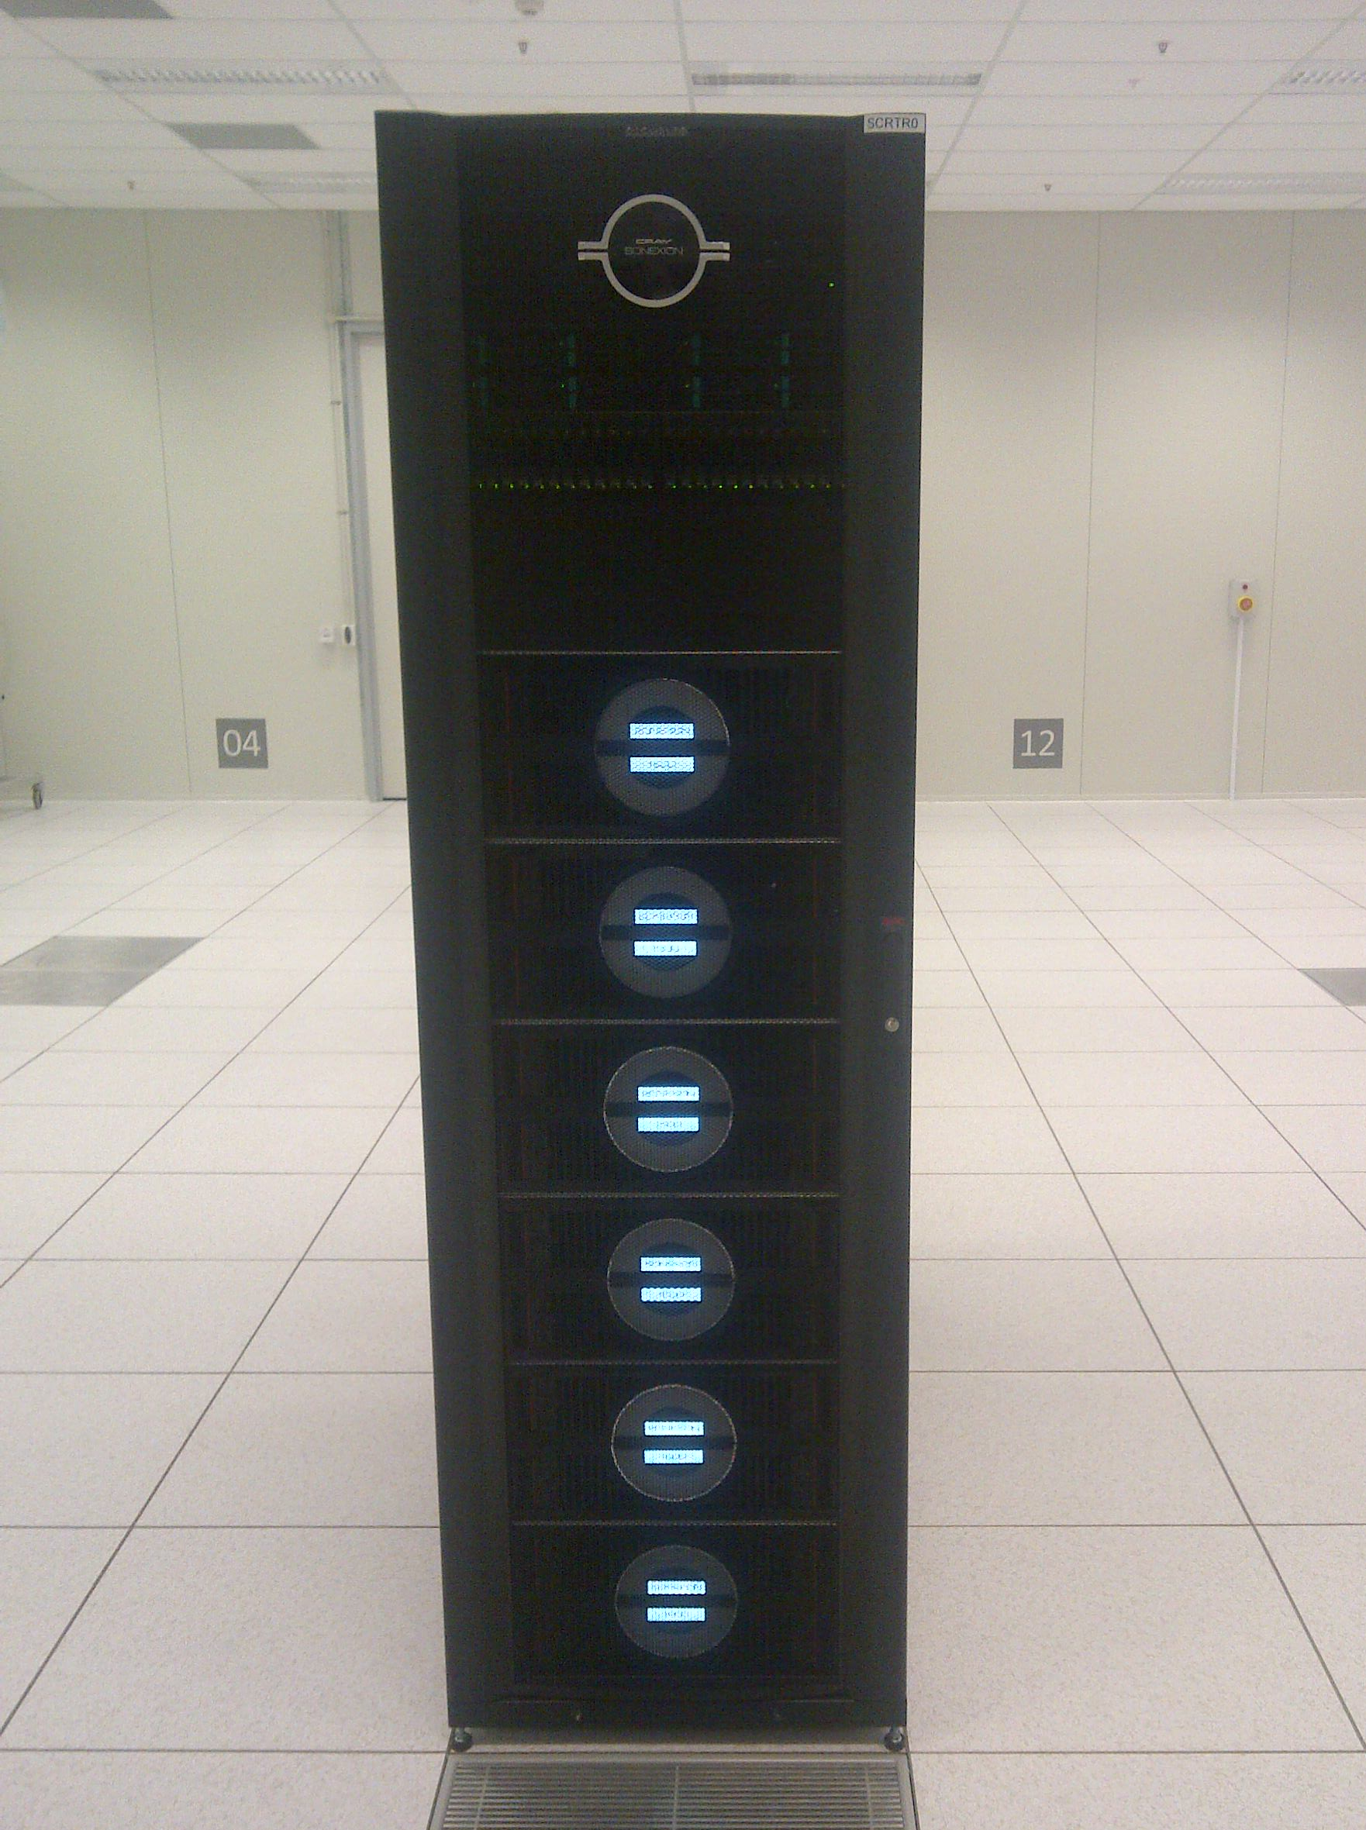
ASKAP Central Processor
16 x Ingest Nodes
  2 x 2.0 GHz Intel Xeon E5-2650 (Sandy Bridge) CPUs + 64GB RAM
  10 GbE connectivity to MRO
  4x FDR Infiniband connectivity to compute nodes and Lustre filesystem
2 x Login Nodes
2 x Data Mover Nodes (dedicated to external data transfers)
1.4 PB (usable) Cray Sonexion
Lustre storage

Slide 8
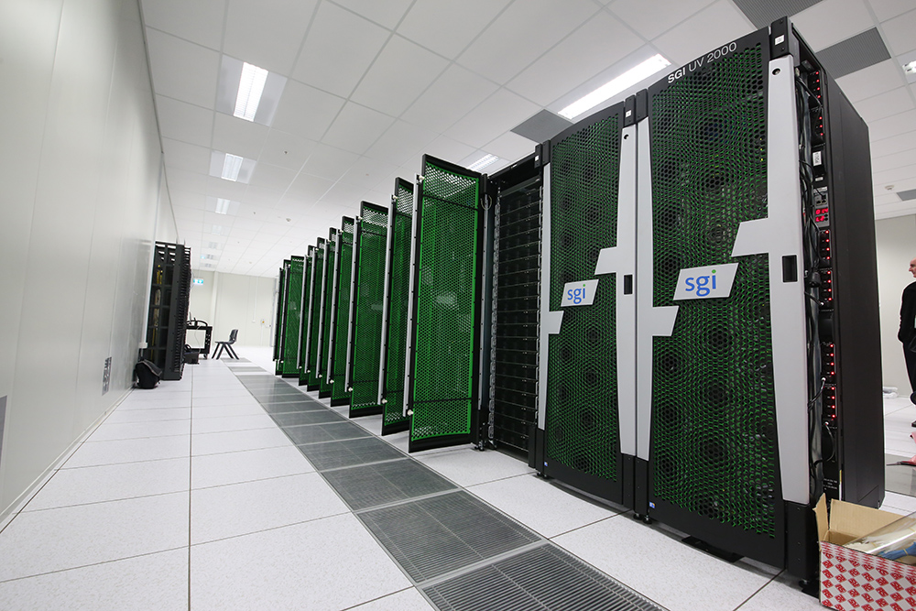
I/O & Network Hall

Slide 9
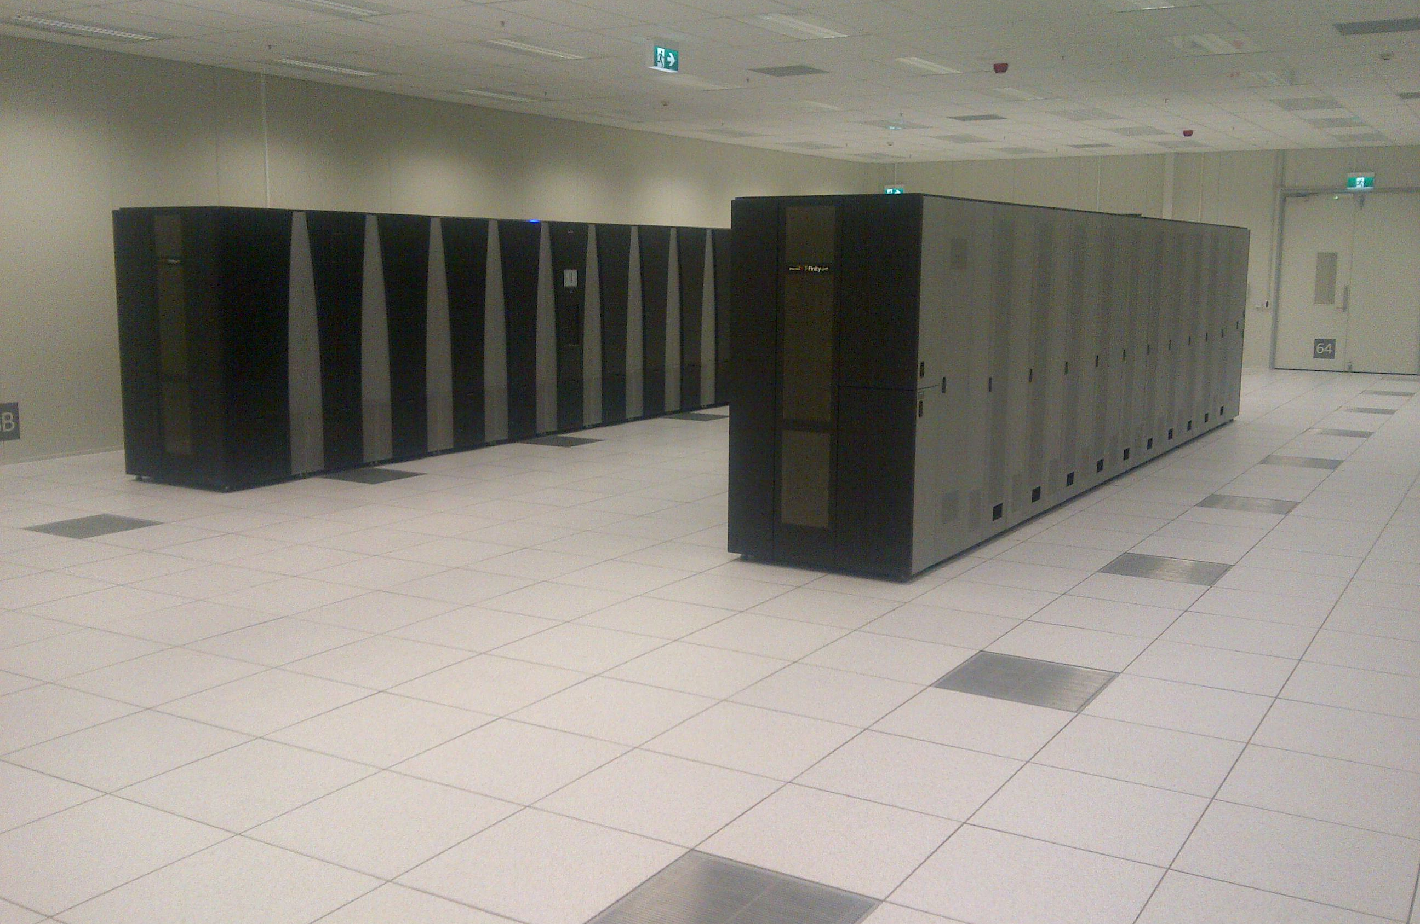
Tape Hall

Slide 10
2 x 56 Gbit/s IB per node
2 x 10 GbE per node

Slide 11
Ingest Pipeline

Slide 12
Calibration and Imaging Pipelines

Slide 13

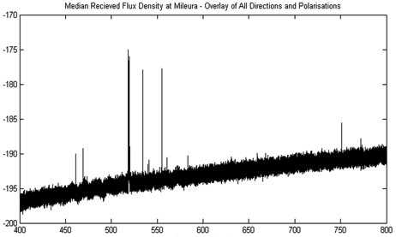
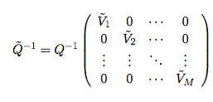
Data Services
Sky Model Service
Provides access to the Global Sky Model (GSM), an all-sky database with flux measurements in an appropriate frequency range to ASKAP
RFI Source Service
Responsible for managing and providing access to a database of known RFI sources that may impact ASKAP observations
Calibration Data Service
Provides an interface to a database containing calibration parameters

Slide 14
Challenges and Lessons Learned
Per process memory footprint
Disk I/O
Fault Tolerance & Error Handling

Slide 15
Thank you
CSIRO Astronomy and Space Science
  Ben Humphreys
  ASKAP Computing Project Engineer
    t +61 2 9372 4211
    e ben.humphreys@csiro.au
    w www.csiro.au
Astronomy And Space Science

