Slide 1
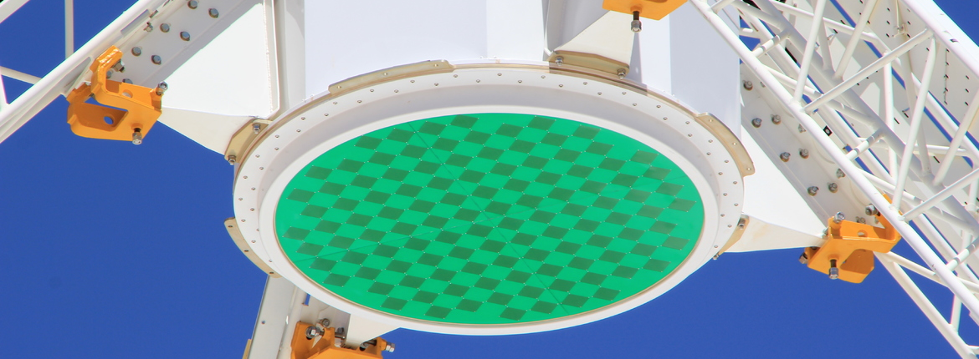
Stability of Maximum S/N Beams
SKA Workshop on Calibration and Imaging
Aidan Hotan | ASKAP Deputy Project Scientist
4th March 2014
CSIRO Astronomy and Space Science

Slide 2
Background
Phased array feeds on radio telescopes offer flexibility, adaptability and simultaneous wide field of view capabilities.
The advantage is lost if we cannot also achieve good sensitivity and high dynamic range (which requires stable, well-understood beams).
Need to test the primary beam shape, side-lobes, frequency dependence, de-rotation capability and stability in time.
The flexibility of the PAF comes from its complexity – but this also provides many degrees of freedom that need to be controlled.
Image processing capability is still catching up.
For example, ASKAP software currently assumes that offset beams are all identical in shape to the boresight beam.

Slide 3
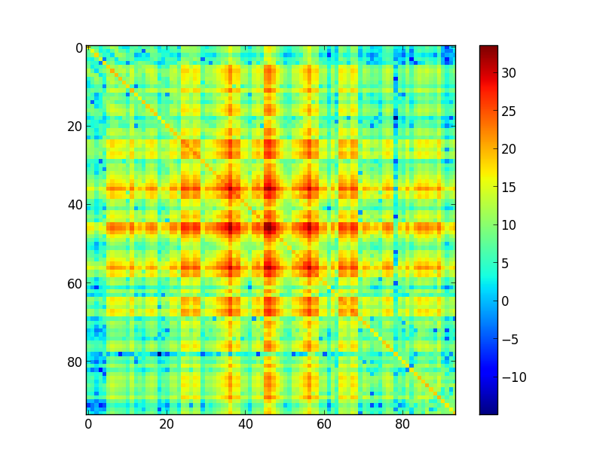
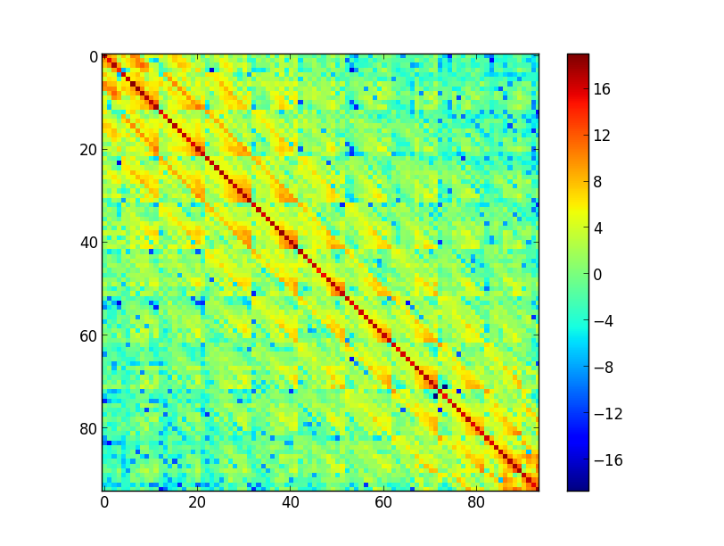
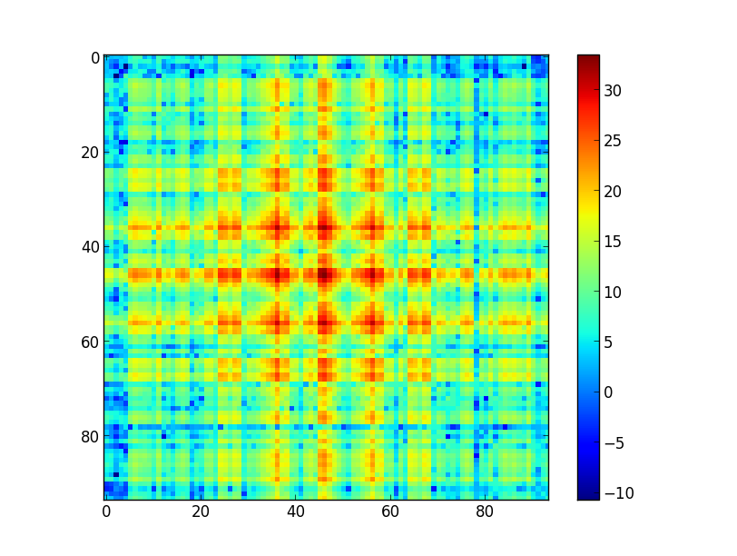
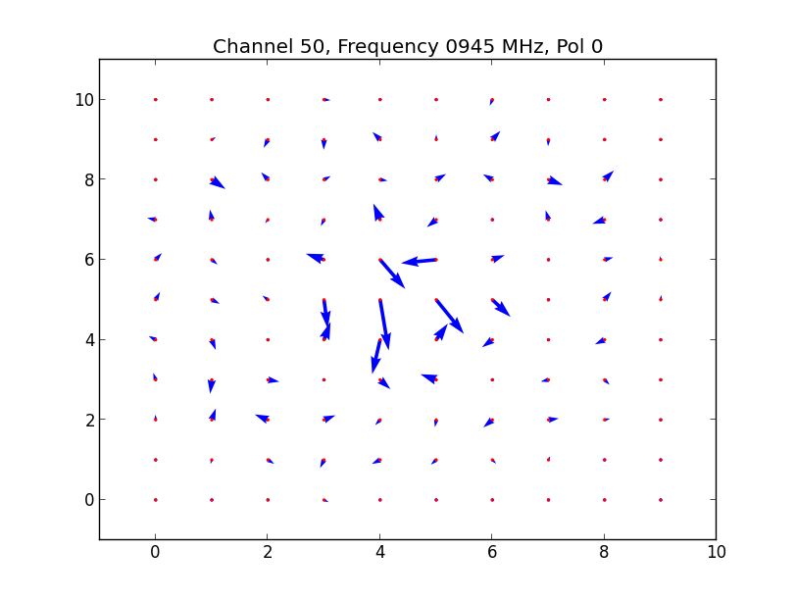
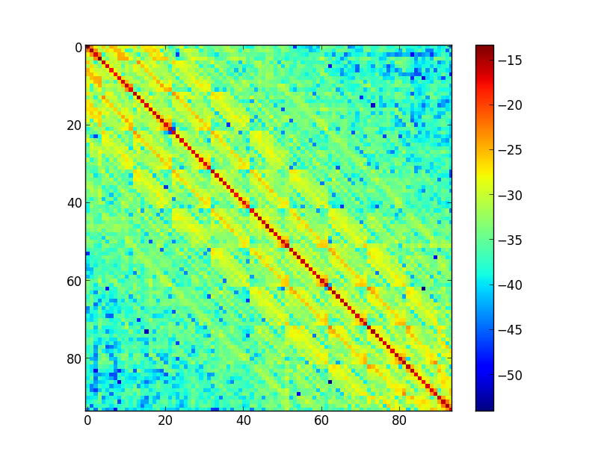
Maximum S/N Beamforming
Signal + Noise
Noise
Signal
-
=
Array Covariance Matrix
(c.f. Brian Jeffs’ talk)
Inverse
Dominant
Eigenvector
=
x

Slide 4
Practicalities of Beam-forming
The maximum eigenvector of the “signal” matrix should correspond to the observed reference source.
If the gain of the antenna is small, other solutions can dominate.
Origin of these spurious solutions is not clear – could be external interference, internal cross-talk, etc.
Need a very strong reference source. In the Southern hemisphere, no traditional radio astronomy calibrator is bright enough for a 12m.
We use the Sun for ASKAP single-dish work (c.f. Brian Jeffs’ talk yesterday).
Poor S/N of the beam-forming reference source limits the repeatability of the weight solution and impacts image quality / dynamic range.
Other beam-forming algorithms exist, but fundamentally they all require a detailed understanding of PAF receptor sensitivity patterns.
We need to use interferometry to form beams on small antennas.

Slide 5
The Parkes Test Facility
Photo by Ettore Carretti
PAF-equipped 12m separated from 64m by a 400m baseline.
RF over Fibre connects 64m feed into PAF receiver as 2 extra ports.
Special beam-former firmware correlates up to 9 dual-pol beams with the 64m signals.
Delays are compensated in whole-sample increments (1.3 ns).

Slide 6
Beam Pattern Measurement at Parkes
Beam-former weights for the 12m PAF can be calculated using single dish methods, or from data correlated with the 64m.
Once weights are uploaded, the 64m constantly tracks the reference source and the 12m is scanned over a test field.
Roughly 3 hours to complete one 10x10 degree field, providing a low-resolution image of the beam pattern.
With a suitably large test field, several beams can be measured simultaneously.
The prototype antenna is not equipped with 3rd axis rotation.
Some feed rotation is possible, but we have so far kept the angle fixed.

Slide 7
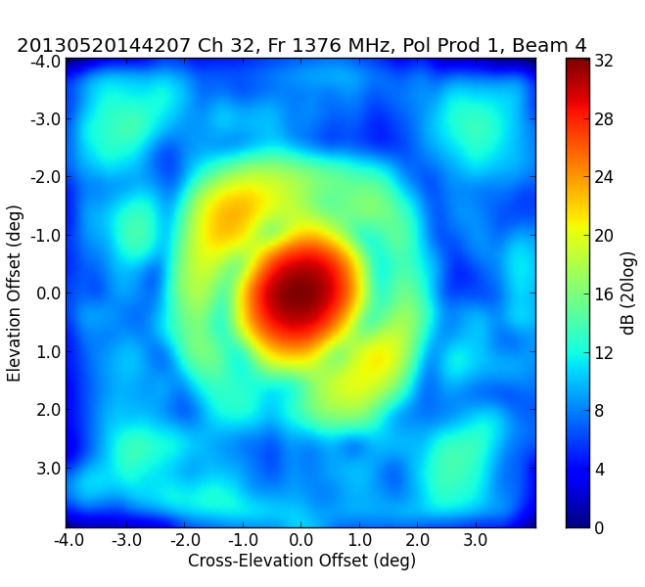
Example Beam Pattern Image
The 12m-64m interferometer is sensitive to the first, and maybe the second side-lobe levels.
This provides a unique opportunity to study beam characteristics.
Our first goal was to test the worst case of multiple PAF beams formed using single-dish methods with no corrections applied.

Slide 8
Selecting a Multi-Beam Arrangement
Based on the desire for a compact arrangement that can tessellate.
Sarah Hegarty’s single-dish multi-beam sky survey project (in preparation).
7 beams that touch at half-power.
64 channels of 1 MHz width independently beam-formed.
Pattern measurements of each beam set were made over a 6 month period to search for evolution.
Mia Walker’s beam stability project.

Slide 9
Summary of Observations
Observation intervals were defined by the 64m schedule.
Irregular and infrequent sampling.
Frequency band selection fixed by availability of 64m receivers.
Required to observe at 1.3 GHz where the Mk I PAF has 200K Tsys
RFI is a big problem (especially with raster scan observations).
We have 12 hexagon data sets, using weights made at different times throughout our observing program.
The first two sets were discarded while we perfected beam offsets.
The 3rd set and the 5th set exhibit “odd” behaviour.
The 7th set suffered from an antenna pointing error.
Sets 6, 8, 9 show what appears to be consistent behaviour.
More recent sets have too few data points to be useful.

Slide 10
Analysis and Uncertainty
Our initial thought was to search for systematic trends in basic parameters as a function of time.
Location of beam peak, full width at half maximum, circular symmetry.
Uncertainties are dominated by poorly-understood systematic effects (above and beyond the gain & phase stability of the components):
This makes it very difficult to run a controlled experiment.
Ambient temperature variations, phase stability across configuration changes and power cycles, hour angle and elevation of reference sources, etc.
These first results are preliminary and highly qualitative.
As a guide, we can use beam shape as a function of frequency to assess the measurement uncertainty.
Beams for each channel are formed independently, from simultaneous data.

Slide 11
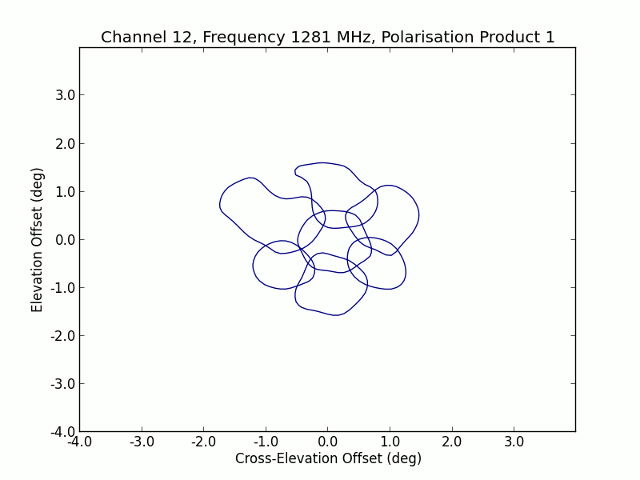
Frequency Stability of Beam Patterns

Slide 12
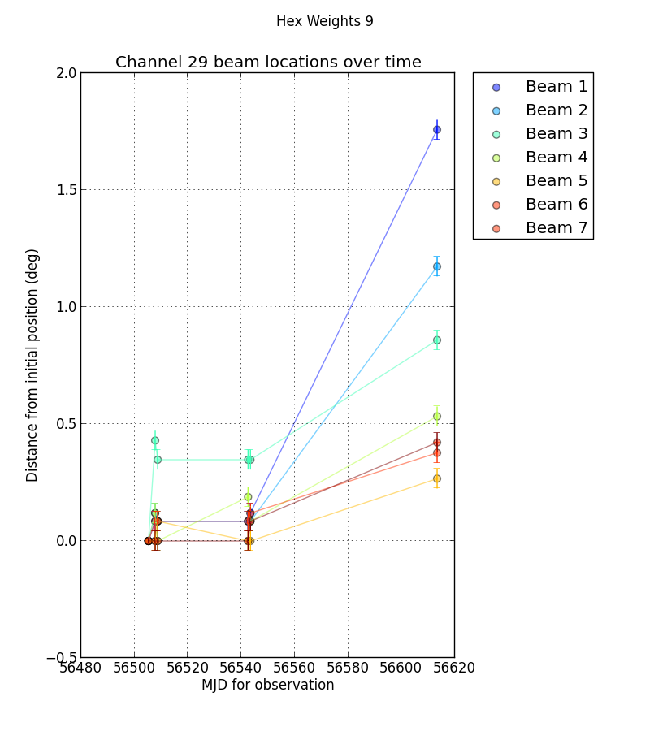
Temporal Stability of the Hexagon Pattern

Slide 13
Temporal Stability of the Central Beam

Slide 14
Preliminary Conclusions
Noticeable “wobbles” are seen in the beam shapes from channel to channel and from day to day.
Need to determine whether these are intrinsic, or a reflection of our measurement uncertainty (probably the later).
Weights seem to last of order a few weeks, if the system configuration remains unchanged.
This is encouraging. Even a naïve approach involving (say) weekly calibration should work to first order.
Given the plethora of things that can change, active tracking will still be essential for achieving maximum dynamic range.

Slide 15
Further Considerations
Beam-forming methods for ASKAP will need to maximise the science output, not necessarily the sensitivity.
All beam-forming is effectively a linear combination of the patterns of the individual receptor elements.
Maintaining a database of these pattern shapes will be necessary.
This will require a viable interferometry-based measurement technique that can be applied to ASKAP antennas (without a 64m reference antenna).
Work underway with Aaron Chippendale and others.
ASKAP hardware supports the correlation of each PAF element with a reference signal from an on-dish radiator.
This allows direct tracking of complex gain, but we have yet to show it works.
These methods will be developed and tested in future.

Slide 16
Thank you
CSIRO Astronomy and Space Science
Aidan Hotan ASKAP Deputy Project Scientist
t +61 2 9372 4425
e aidan.hotan@csiro.au
w www.atnf.csiro.au
CSIRO Astronomy and Space Science

