Slide 1
Calibration with StEFCal: progress, advances and successes
Stef Salvini, Stefan Wijnholds

Slide 2
The Problem
Given
D the observed visibility matrix , M the model sky visibility matrix, n the number of antennas
Minimise
where the Frobenius norm is
the complex gains matrix G is diagonal with 2x2 blocks (one per antenna)
Where each block is given by

Slide 3
The Problem
Poor scalability of traditional algorithms
Convergence of StEFCal proven for non-polarized case
O(n²) operations
Extended here to polarized case
O(n²) operations
Iteratively minimize (normal equations method for SVD):
where and the two columns of Z and D for the j-th antenna are referred by Z_{j} , D_{j} namely
The problem has split into n 2x2 systems of equations

Slide 4
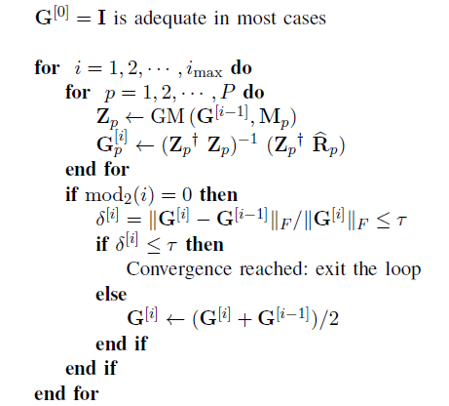
Algorithm
Cost per iteration
44 n² real operations
Small memory footprint
Only 2-4 extra vectors required
Data access
Unit stride across all items of data.
Parallelism
Very fine grain (each antenna computed independently)
Synchronization
1 per iteration
Typical number of iterations
Varied, <= 100 for adequate convergence
Basic Polarized StEFCal

Slide 5
Algorithm Validation
Alternative Algorithms Used for Results Comparison
Name | Description
BFGS | Alternative method using the BFGS method (developed and written by S.Salvini)
Levenberg-Marquardt | Using the LM routine available from MATLAB (lsqnonlin)
Other validation and skies
Description
Computation and checking of the gradient of the minimised function (its entries should be very small at a minimum)
Simulated skies up to 100,000 sources, up to 1,000 calibration sources calibration sources with various degrees of separation from others (between 1 and 10 factor) corruption of gains: random phases; amplitude of diagonal elements between 0.2 and 2; off-2diagonal elements between 0 and 0.2
Real skies (ongoing) LOFAR (thanks to Tammo and Stefan) Meqtrees (Oleg Smirnov): using StEFcal routinely

Slide 6
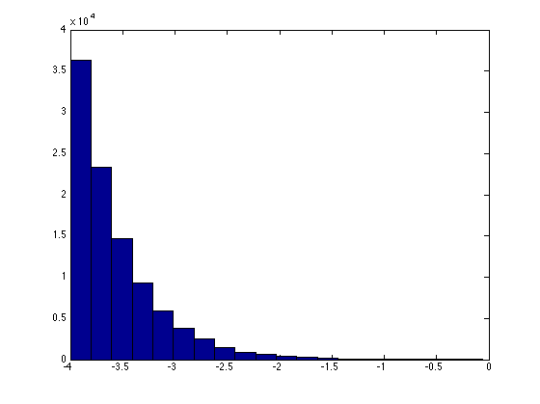
Example
100,000 sources
Random position
Intensity exponentialy distributed between 10⁻⁴ and 1
Random source polarization
Geometric instrumental polarization included
256 antennas (512 dipoles)
Baseline up to 250 metres
For ease of imaging
Simple DFT imaging
All calibrations using Stefcal1c
Histogram of source intensities

Slide 7
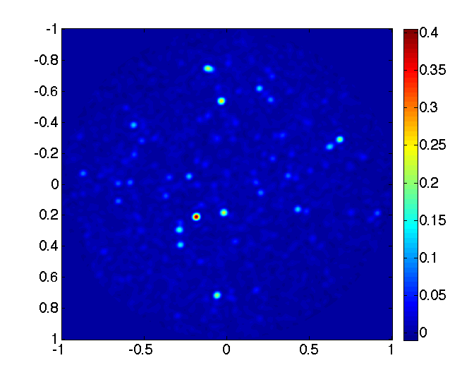
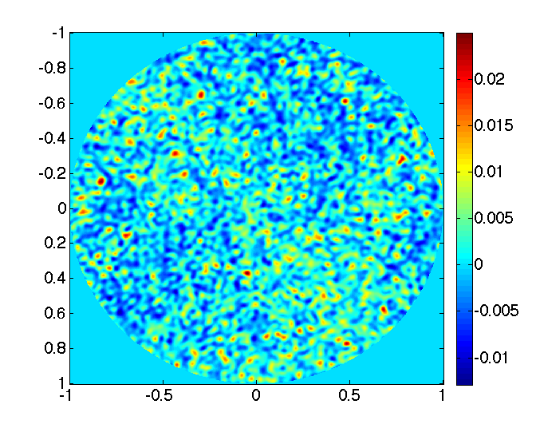
Example
Exact Sky
Observed Sky

Slide 8
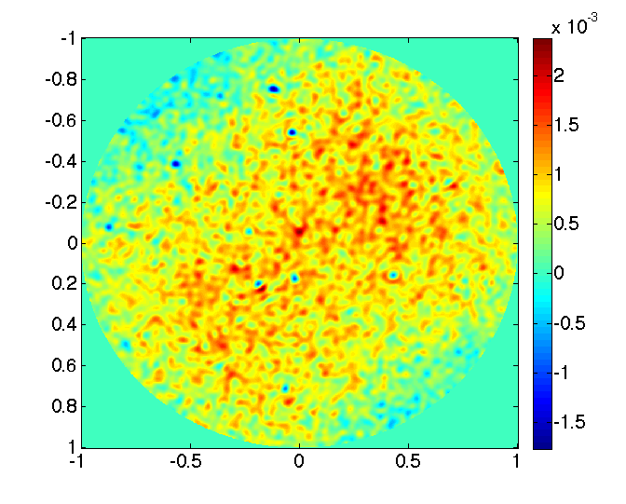
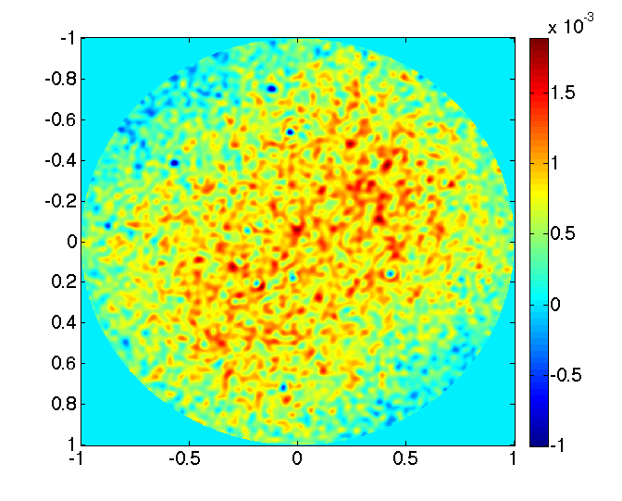
Example
Model include sources up to x % intensity of brightest
Pictures show difference between exact and calibrated sky
10 %
1 %

Slide 9
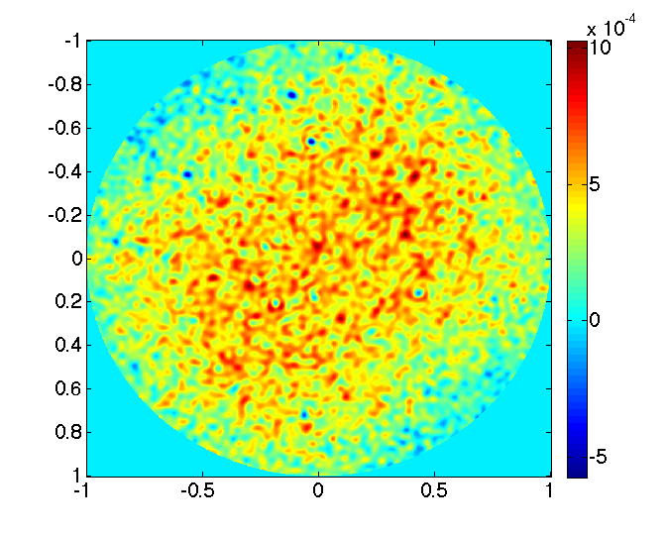
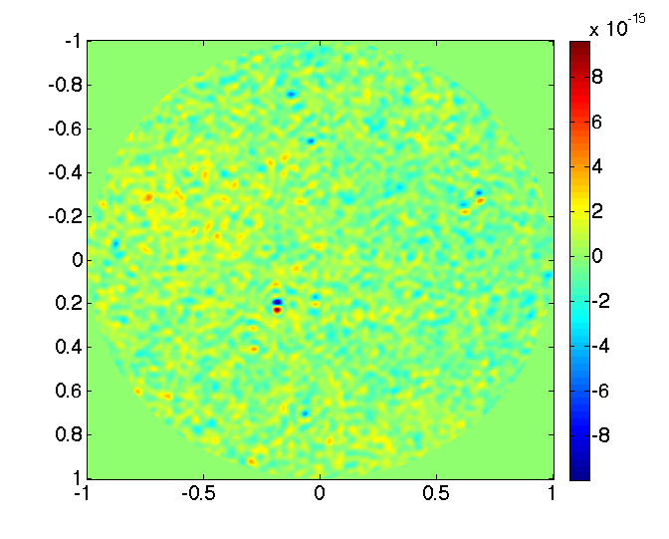
Example
Model include sources up to x % intensity of brightest
Pictures show difference between exact and calibrated sky
0.1 %
All sources

Slide 10
Algorithm Variants
Name | Description
1-basic | The basic algorithm Highly parallel (GPUs)
1-relax | stefcal1a modified to use also G^{[i-2]} and G^{[i-4]} to compute G^{[i]} (relaxation) Highly parallel (GPUs)
1-monitor | Stefcal1b modified to act on convergence issues, monitoring the termination conditions Highly parallel (GPUs)
2-basic | Stefcal1a using the latest value of G rather than from the previous iteration (cfr Gauss-Seidel vs. Jacobi iterations) No averaging step Parallel dependencies within each iteration (no GPUs)
2-relax | Stefcal2a with relaxation No averaging step Parallel dependencies within each iteration (no GPUs)
“Bootstrapping” StEFcal consists of solving a smaller problem to low
accuracy to provide initial values for the iteration.
Very effective!

Slide 11
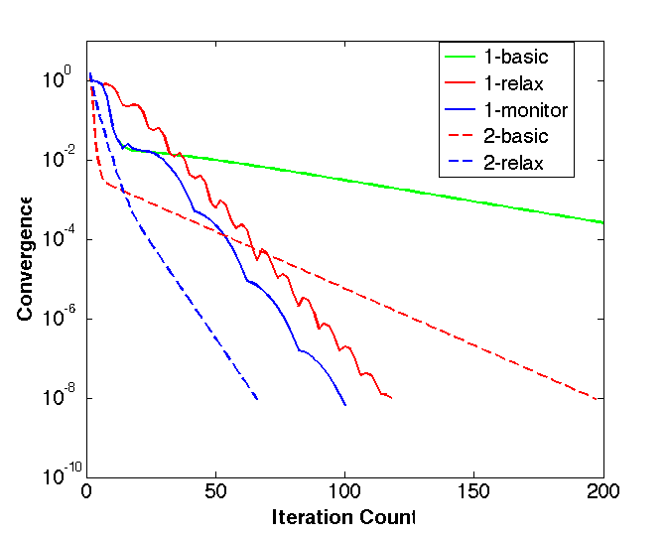
Comparing StEFCal Versions

Slide 12
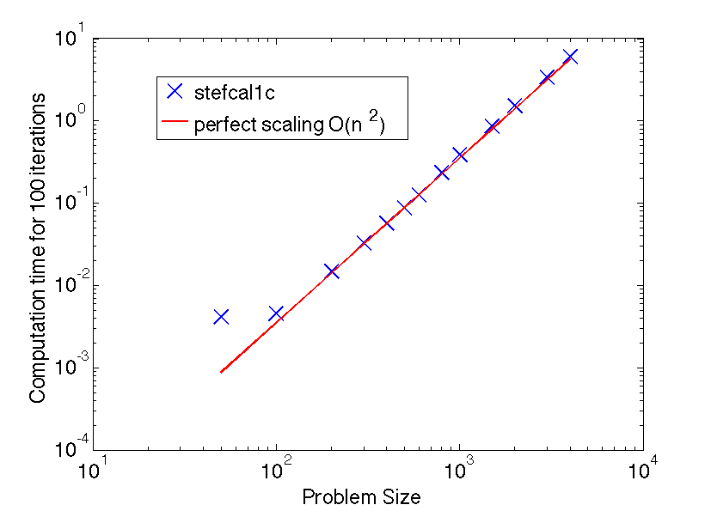
Performance with Problem Size
Sky model including
512 dipoles
10,000 sources
30 calibration sources
100 iterations for all sizes
Intel Xeon 2650
2.0 GHz (2.8 with turbo)
1 core used
Double Precision
Peak ~22 Gflops/sec per core from ZGEMM
“Perfect” scaling
Normalised to n = 500
Computational costs O(n²)

Slide 13
Computational Costs
Problem size | No. iterations | Time (sec) | Gflops/sec | % Peak (ZGEMM)
50 | 136 | 0.005 | 3.10 | 14.1%
100 | 122 | 0.005 | 10.85 | 49.3%
200 | 128 | 0.019 | 11.95 | 54.3%
300 | 84 | 0.027 | 12.19 | 55.4%
400 | 90 | 0.051 | 12.40 | 56.4%
500 | 82 | 0.072 | 12.56 | 57.1%
600 | 100 | 0.125 | 12.67 | 57.6%
800 | 76 | 0.177 | 12.07 | 54.8%
1000 | 96 | 0.370 | 11.43 | 52.0%
1500 | 72 | 0.617 | 11.54 | 52.5%
2000 | 74 | 1.121 | 11.62 | 52.8%
3000 | 84 | 2.849 | 11.68 | 53.1%
4000 | 80 | 4.794 | 11.75 | 53.4%

Slide 14
SKA-1 LFAA Station Calibration - 1
Description | Value
Number of antennas | 256
No. dipoles per antenna | 2
Total number of dipoles | 512
Number of frequencies | 1024
Precision | Single
Convergence required | 1.00E-05
Half-bandwidth for bootstrapping StEFcal | 50
Total Number of iterations for bootstrapping StEFcal | 31875
Average N. Iteration for bootstrapping per frequency | 31.1
Total Number of iterations for full StEFcal | 19814
Average N. Iteration for full StEFcal per frequency | 19.3
Total no. flops for bootstrap | 6.33E+10
Total no. flops for full-size StEFcal | 2.08E+11
Total number of operations (real flops) | 2.71E+11

Slide 15
SKA-1 LFAA Station Calibration - 2
No. cores | Time (sec) Total (all freq) | Gflops/sec | % CGEMM n-core | peak (CGEMM)
1 | 16.63 | 17.9 | 41.8% | 42.9
2 | 8.34 | 35.8 | 41.9% | 85.4
3 | 5.57 | 53.5 | 42.2% | 126.9
4 | 4.19 | 71.2 | 41.8% | 170.5
6 | 2.90 | 102.9 | 42.0% | 244.9
8 | 2.35 | 127.0 | 42.2% | 300.9
10 | 1.92 | 155.3 | 41.3% | 375.6
12 | 1.72 | 173.3 | 38.3% | 452.0
14 | 1.63 | 182.9 | 36.5% | 501.4
16 | 1.54 | 194.2 | 41.7% | 466.0

Slide 16
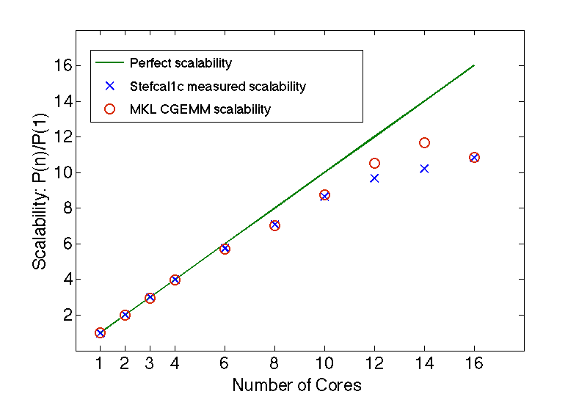
Scalability

Slide 17
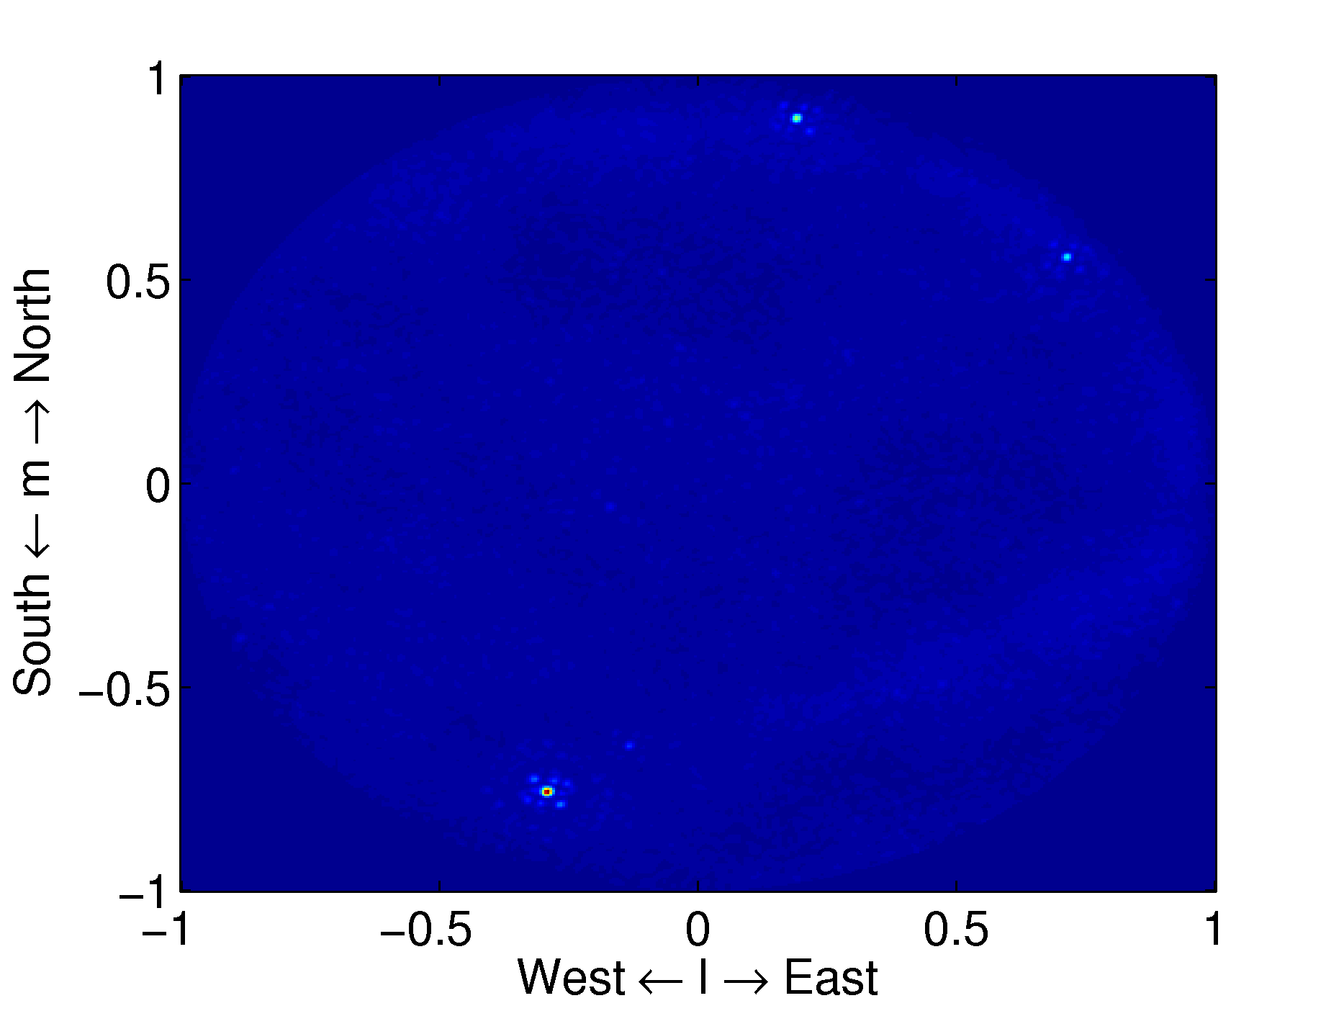
StEFCal in AARTFAAC (1)
AARTFAAC: 288-antenna all-sky monitor for LOFAR
Bi-scalar calibration: non-polarized StEFCal
Factor 35 speed-up!
N² instead of N³
~8x more iterations
Net: 288/8 = 36

Slide 18
StEFCal in AARTFAAC (2)
Tracking calibration
Idea: exploit smooth behavior of gains over time
Method:
Use gain solution from previous iteration as initial guess
Do only one (!) full-iteration of StEFCal
Result: another factor of ~8 reduction
Risk of solution wandering off with time
Solution: calibration to convergence at regular intervals
Ref: Prasad et al., A&A, in prep. (to be submitted soon)

Slide 19
Current work
Non-polarized StEFcal
Extensions
Minimization of phases only
Minimization over multiple snapshots
Linear and Polynomial calibration over multiple snapshots (both over time and frequency)
Experimental code being tested and assessed
Non-polarized case
Polarized case
Full-Pol StEFCal
Testing within pipelines and real data (LOFAR, etc)
Tammo’s previous talk
Oleg Smirnov: sliding window, deep imaging with VLA
Implementation on GPUs

Slide 20
Any Questions ?
Thank you!
Any Questions?

