Slide 1
Using Carbon to Measure Space-Time Variation of Fundamental Constants: Prospects with ALMA
S. J. Curran¹, J. K. Webb¹, J. C. Berengut¹, A. A. Stark², F. E. Koch¹, A. Tanna¹ and V. V. Flambaum¹
1 - University of New South Wales
2 - Smithsonian Astrophysical Observatory

Slide 2
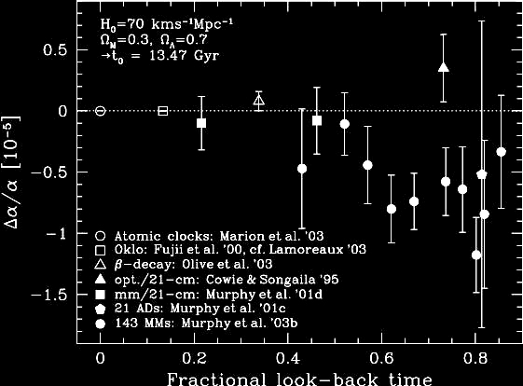
Δα / α = -0.57 +/- 0.10 x10⁻⁵
over 0.2 < z <3.7
Murphy et al. 2003, MNRAS 345, 609
Look –back times of 2.4 to 11.8 Gyr
Notes:
Have been some contention, but differences may be explained by spatial variation

Slide 3
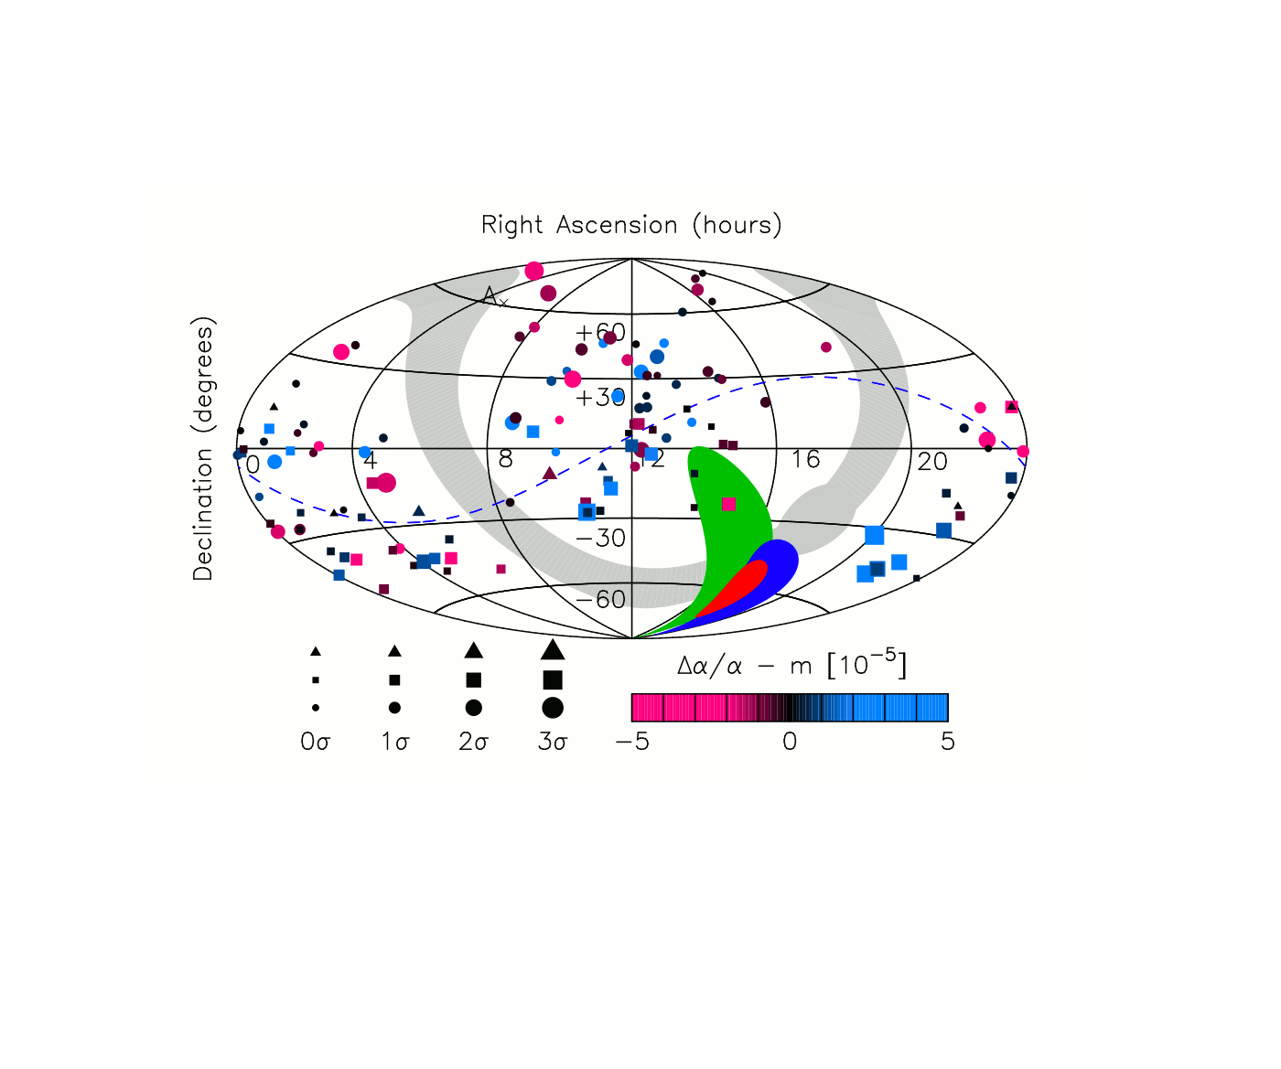
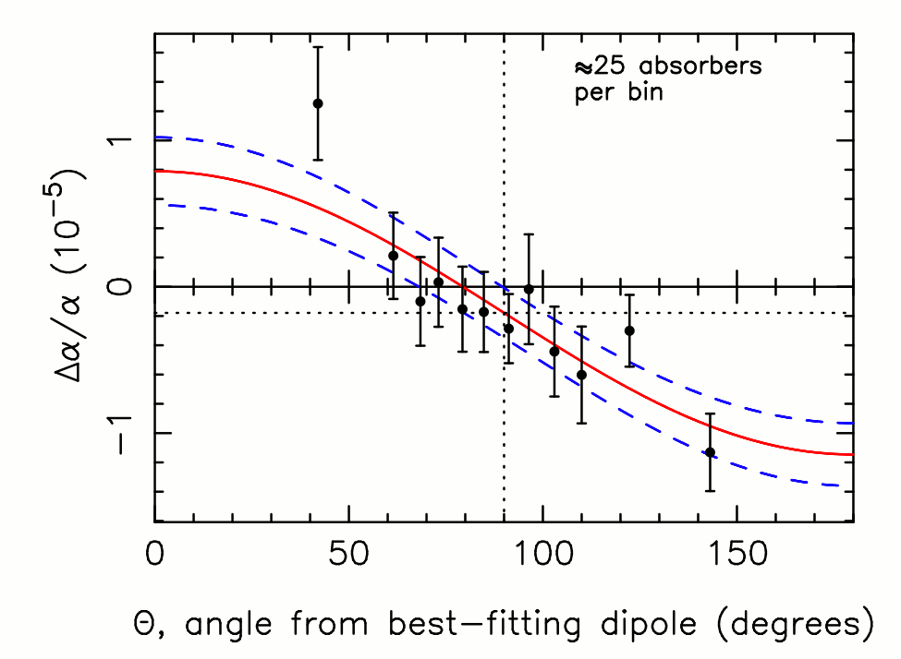
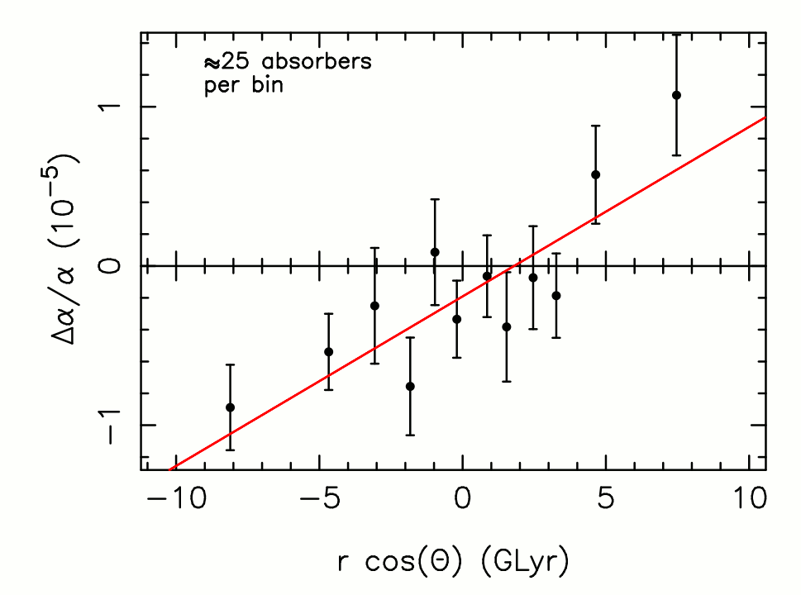
Webb et al.
(arXiv: 1008.3907)
Keck
VLT
Relative shifts in α²/μ expected to be ~50 times that of α alone – compare fine structure (carbon) and rotational (carbon monoxide) lines
Combined
17.4±0.6h
-62±6 deg

Slide 5
Webb et al., Δα/α = (0.97± 0.21) x 10⁻⁵ cosθ – (0.18 ± 0.08) x 10⁻⁵ Δα/α = (1.1 ± 0.2) x 10⁻⁶ LBT cosθ – (1.9 ± 0.8) x 10⁻⁶
F = α²/μ
Δμ/μ = 2Δα /α – ΔF/F
Once α dependence on dipole removed, points just flipped around μ = 0 => points are dominated by scatter. Although some models do predict that
|Δμ| ≈ 40 |Δα| (Reviews of Modern Physics 75, 403)
Notes:
No change as change in alpha very small compared to scatter of points

Slide 6
ΔF/F -> 0 for n_{det}> 10 i.e. the higher the quality the spectrum the lower the variation
APM 08279+5255

Slide 7
Need much higher signal-to-noise/spectral resolution. Current bests are > 50 kms⁻¹
At 100 GHz (z = 3.9) and T_{sys} = 250 K, after 10 hours observation, r.m.s. noise level is …
For CO at 50 km s⁻¹ resolution for CI at <10 km s⁻¹ need ALMA

Slide 8
CII ²P_{3/2} -> ²P_{1/2}
Notes:
Least square fit Indicates that current CI detection are the most luminous
10 hours of observations

Slide 9
With the ALMA Full Array ( >50 x 12-m antennas):
Capable of detecting CI in all (101) z > 1 CO emitters currently known at < 10 km s⁻¹ resolution
Maximum angular resolution of 0.05” – 0.04” over 84 – 116 GHz (band-3) => linear resolution of 300 pc at z = 3.2 – 4.9
All five current detections are gravitationally lensed – only need magnifications of ≥ 3 to resolve individual GMCs at 12 Gyr look-back
From the current CO detections alone – hundreds of CI emitters within which GMCs may be resolved
i.e. CO and CI from same individual complex in a sample size which rivals that of the optical data

Slide 10
Notes:
ONTO TONY’S GRAV LENSE STUFF – MAY HAVE TO CHANGE SPATIAL RESOLUTION OF ALMA TIME ESTIMATE

