Slide 1
Sensitivity
Mark Wieringa
Australia Telescope
CSIRO Astronomy and Space Science

Slide 2
Take-home messages
Ultimate signal to noise depends on many things
  the source,
  the array configuration,
  bandwidth,
  integration time,
  quality of the telescope,
  the observing conditions,
  the calibration,
  the field (crowded/strong source/empty)
See the Observing Characteristics Calculator
  http://www.atnf.csiro.au/observers/docs/at_sens/

Slide 3
Overview
Units
System temperature and sources of noise
Basic sensitivity – point-source and brightness
Imaging settings and resolution effects
mm considerations
Other figures of merit
Ways to increase the sensitivity
Practical limitations on sensitivity
Claiming confidence in detections

Slide 4
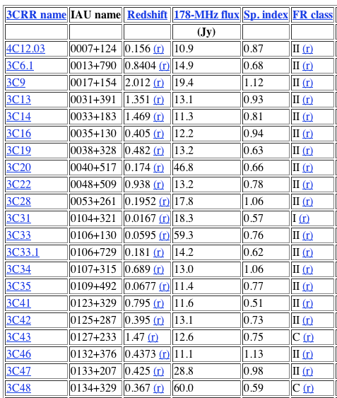
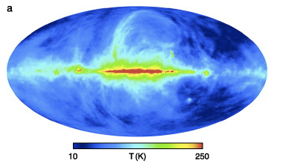
Units of source strength
Intensity or brightness
Brightness temperature
Flux density
e.g.,
  3C catalogue units are Janskys
  Haslam 408 MHz image units are Kelvin

Slide 5
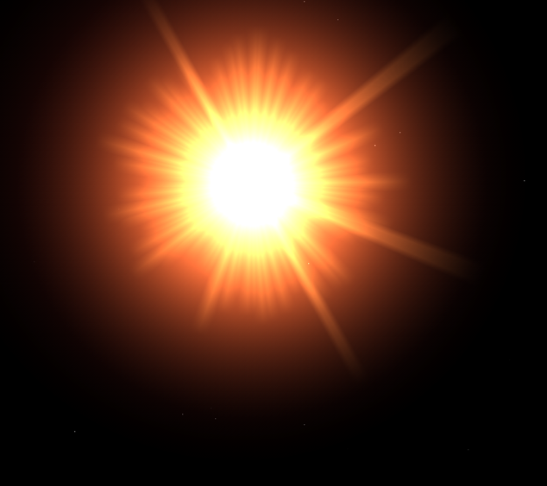
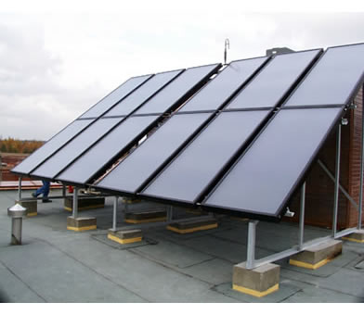
Planck’s Law
How much power can we collect from the Sun?
Brightness or Intensity in
W/m²/ster/Hz given by:
Power in Watts:

Slide 6
Rayleigh-Jeans approximation
For
Planck’s Law simplifies to
Known as the Rayleigh Jeans approximation

Slide 7
Brightness temperature
Assuming the Rayleigh-Jeans approximation is valid, at a given frequency, the source brightness can be associated with an equivalent blackbody temperature.
Brightness temperature is a convenient way of measuring the strength of diffuse emission, particularly for thermal sources.

Slide 8
Flux density
Flux density is the brightness integrated over some solid angle
Radio astronomers use the units
  1 Jy = 10⁻²⁶ W/m²/Hz, 1mJy, and 1μJy

Slide 9
Units of images
Clean (deconvolved+restored) image has units of Jy/beam – a brightness distribution.
  For an extended source, the peak value will depend on the resolution.
  For an unresolved source, the peak value will equal the flux density of that source
Images before restoration have units of flux density (“Clean component images”, MEM images)
Dirty images (before deconvolution) have ill-defined units – except for unresolved sources. Use with caution!

Slide 10
Review
Intensity and brightness
Brightness temperature
Flux density
Units of CLEAN, dirty images and “clean component” images.

Slide 11
System noise
Unwanted power (noise) makes its way into the detection system through a number of ways
  Noise power from the receiver itself
  Noise power from ohmic losses in the optics path
  Noise power from spill-over – the hot ground (~300 K) refracting into the receiver
  Noise power from the atmosphere
    Most important at high freq.
  Noise power from the sky!
    CMB
    Galaxy

Slide 12
System noise (cont)
These noise powers can be represented by an equivalent blackbody temperature (Rayleigh-Jeans approx) or temperature of a resistor
The sum of all these is known as the system temperature

Slide 13
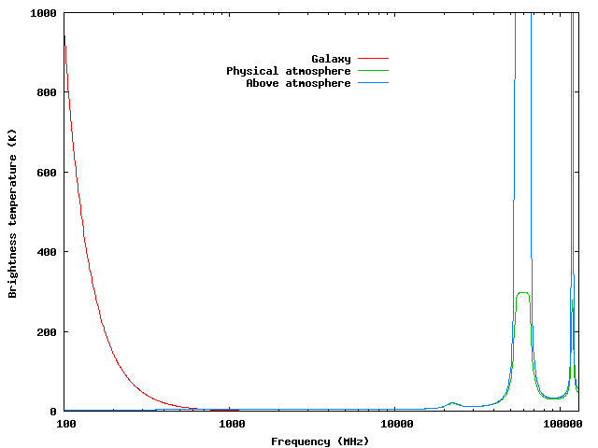
Atmosphere/sky contribution

Slide 14

Noise in a visibility measurement
System Gain in Jy/Kelvin
ATCA: K~13 Jy/K for cm bands to ~30 for 3 mm
Effective collecting area
Correlator efficiency

Slide 15
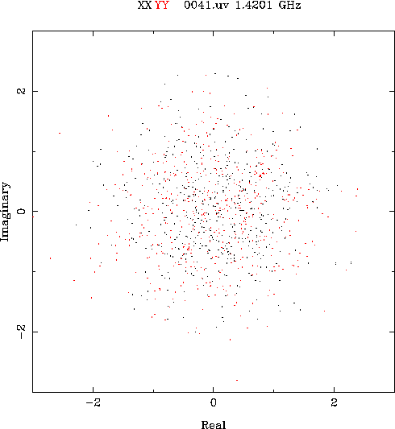
Visibility Noise

Slide 16
Image noise
  For arbitrary weighting of the visibilities in forming an image, the variance in an image pixel is
  If all visibilities are given the same weight, and all visibilities have the same variance

Slide 17
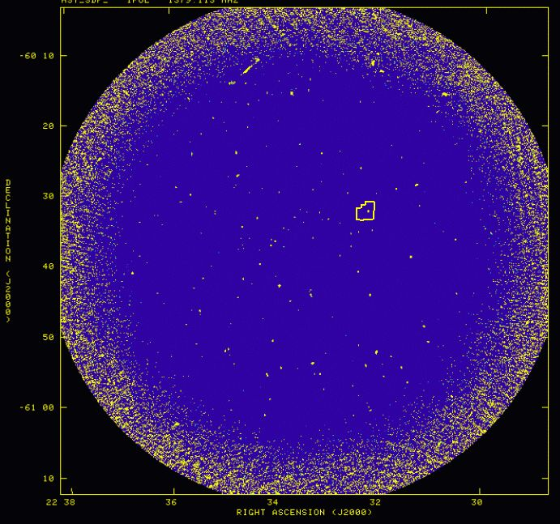
Image noise
Sensitivity
  a measure of the weakest detectable radio emission
E.g., this image:
  5-σ sensitivity of 50 µJy/beam
  1 σ = rms noise (or standard deviation) of the image.
This assumes:
  Noise is Gaussian
  Noise is uniform
Are these good assumptions?

Slide 18
Why weight visibilities differently …
To minimise noise level
  “Natural weighting”: weight by
    (in Miriad use sup=0 options=systemp)
To mimimise rms sidelobe levels
  “Uniform weighting”: weight by inverse of local uv sampling density function (default in Miriad)
Compromise – “robust” weighting, superuniform weighting
  Uniform weighting typically has a few times higher noise levels than natural weighting.
  Robust weighting is often a good compromise.
    Use robust=0 as first try

Slide 19
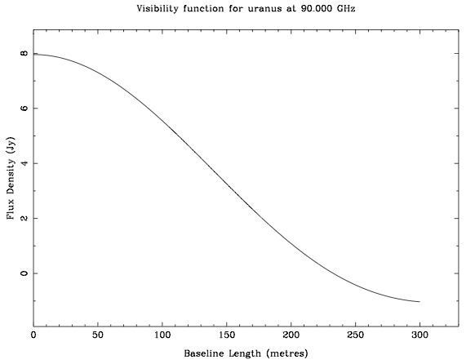
Resolved out ?
To see extended sources you need compact configurations
Large array – Sensitive to compact sources
Small array – Sensitive to extended sources : SB sensitivity

Slide 20
Tapering to enhance sensitivity
The array configuration must be chosen to match the spacings of interest in the source structure.
If long spacings contain no signal of interest, then they are just contributing noise. Better to weight them down.
Optimum detection sensitivity is achieved with a “matched filter”. Tapering is a simple approximation to a matched filter.

Slide 21
Brightness sensitivity
The brightness temperature sensitivity
for
Synthesised beam solid angle
Clean image rms (Jy/beam)

Slide 22
mm Observations
At high frequencies, atmospheric opacity can be significant
Effect of attenuation of signal can be incorporated in “above atmosphere” system temperature
The system temperature is an effective system temperature being the “physical” system temperature divided by the atmospheric attenuation.

Slide 23
3mm system gain
Dish efficiency becomes a function of elevation, temperature, wind etc.
Maximum efficiency is at an elevation of 60 degrees.

Slide 24
Figures of merit
Raw sensitivity
  a deep image of a small area.
Survey speed
  flux limited survey of a large area.
Maximise number of detections
  detect as many sources as possible.
Transient detection
  maximise the chances of catching a transient going off.

Slide 25
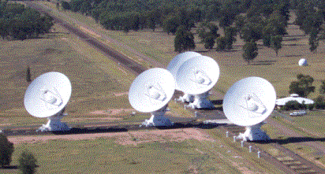
Sensitivity of a synthesis array
(of n identical antennas )
ATCA/CABB
  2 GHz bw @ 5.5GHz
τ = 10 m
  σ= 91 µJy/beam
τ = 12 h
  σ= 11 µJy/beam
τ = 30 x 12 h
  σ= 2 µJy/beam
The theoretical noise
“The thermal limit”
Best image rms we can expect

Slide 26
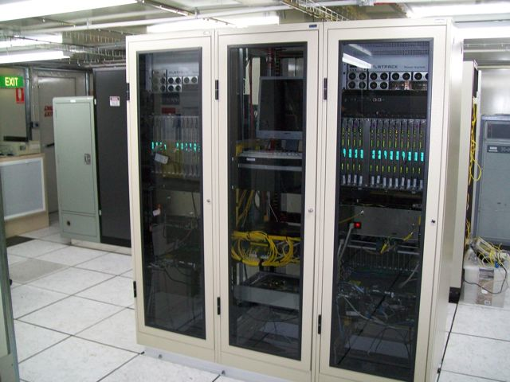
How to increase the sensitivity
(i.e., reduce σ)
Increase the correlator efficiency
CABB does this by increasing the number of bits in digitization

Slide 27
How to increase the sensitivity
(i.e., reduce σ)
Increase the correlator efficiency
Reduce the system temperature
New receivers
Approaching limit at most frequencies

Slide 28
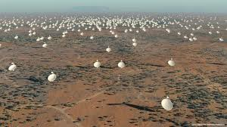
How to increase the sensitivity
(i.e., reduce σ)
Increase the correlator efficiency
Reduce the system temperature
Increase number of antennas
Expensive for existing arrays
ASKAP and SKA are going this way

Slide 29
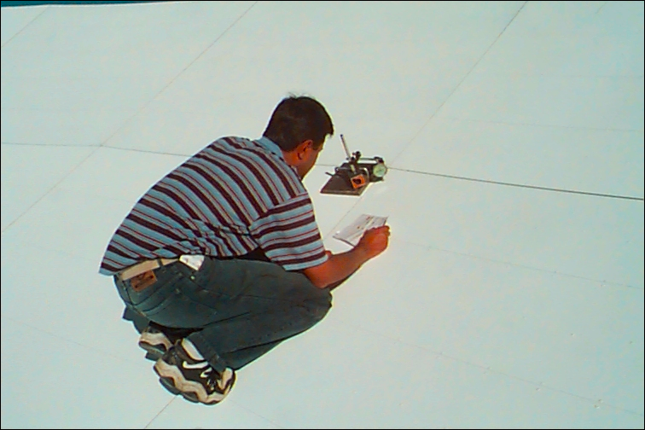
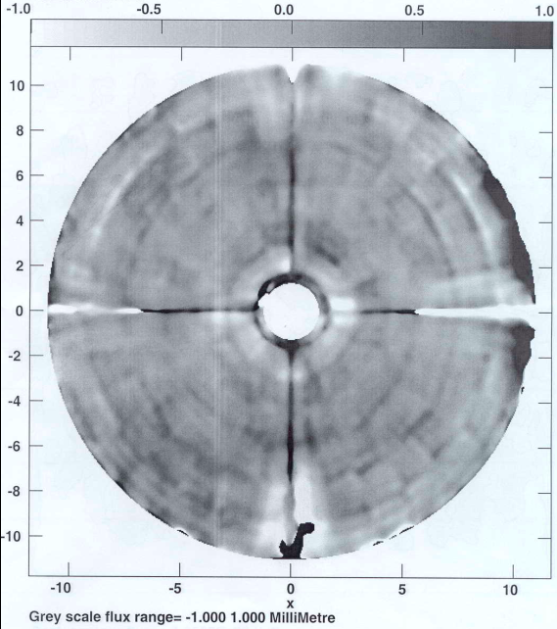
How to increase the sensitivity
(i.e., reduce σ)
Increase the correlator efficiency
Reduce the system temperature
Increase number of antennas
Increase area or area efficiency
Expensive: cost ~ D³
Most dishes close to optimum efficiency

Slide 30
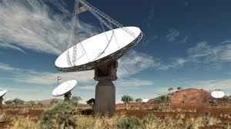
How to increase the sensitivity
(i.e., reduce σ)
Increase the correlator efficiency
Reduce the system temperature
Increase number of antennas
Increase area or area efficiency
Increase integration time
Write better proposal
Some large surveys close to practical limit
Diminishing returns
ASKAP soln: phased array feed
  observe more sky at once
  gives more time per pointing

Slide 31
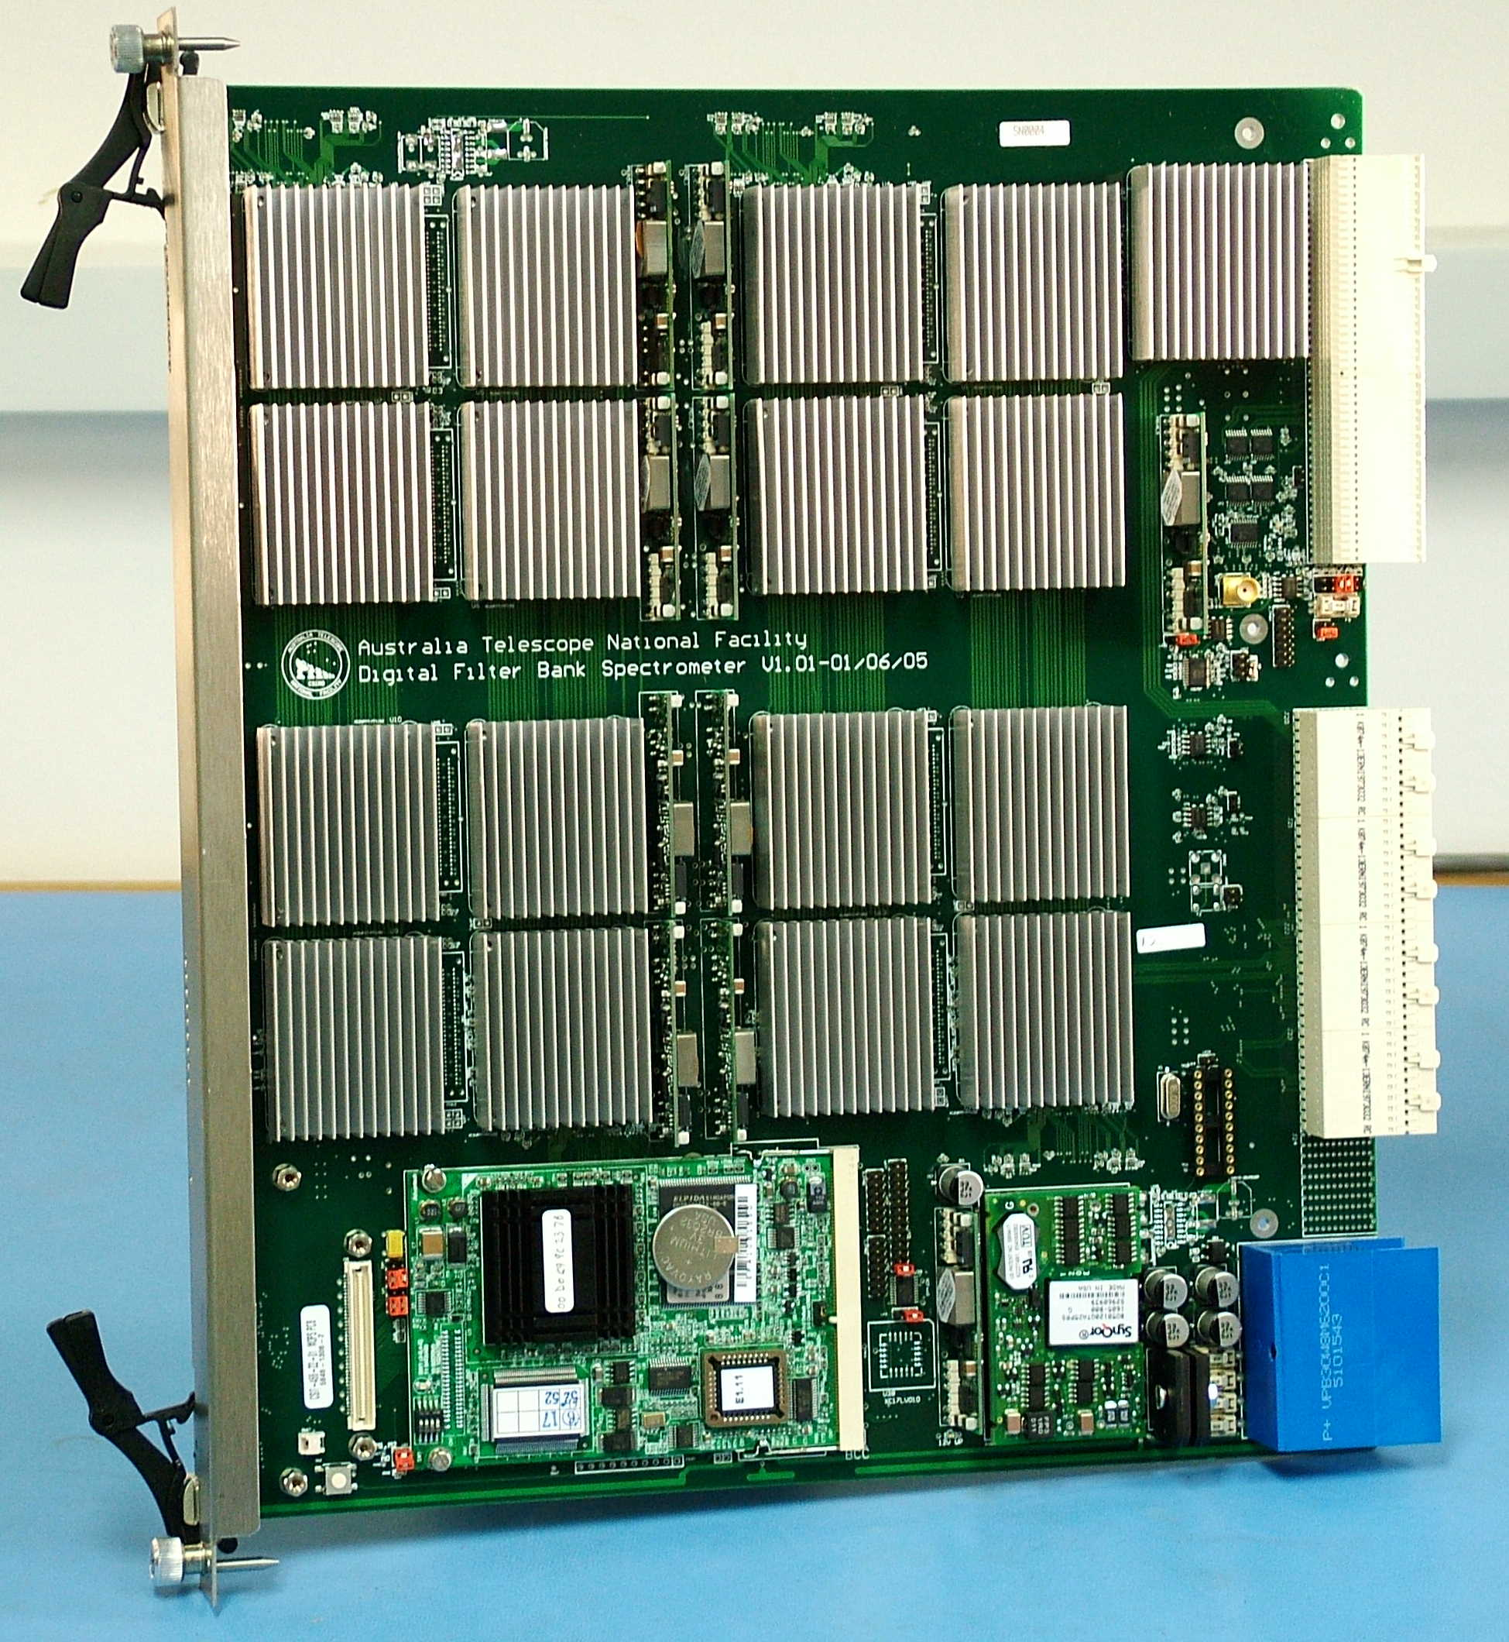
How to increase the sensitivity
(i.e., reduce σ)
Increase the correlator efficiency
Reduce the system temperature
Increase number of antennas
Increase area or area efficiency
Increase integration time
Increase bandwidth
Primary goal of CABB
RFI limits at low freq

Slide 32
So why doesn’t every image reach the “theoretical limit”?
Dynamic Range
Confusion

Slide 33
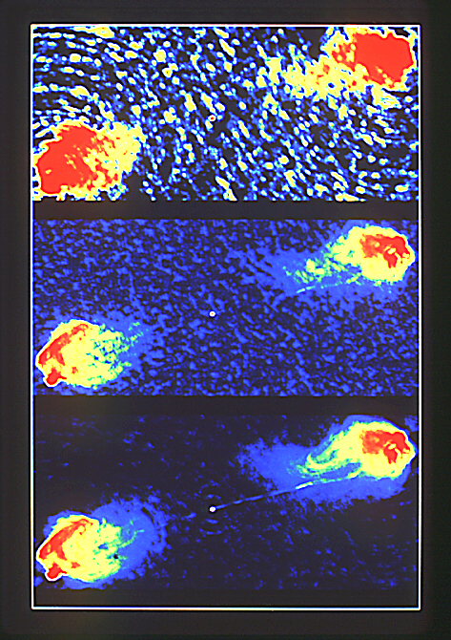
Dynamic range
Usually defined as
peak flux in the image divided by the rms in an `empty’ region of the image.
Dynamic ranges of 100’s are common
Dynamic ranges of 10⁵ have been achieved with great care
  e.g., rms =10 µJy/beam,
  peak = 1 Jy/beam
Cygnus A

Slide 34
Dynamic range limited by incomplete uv coverage
Missing uv information means that the solution is unconstrained in some regions of the image
  i.e. the imaging algorithm can “invent” sources.
This often limits the sensitivity of snapshot images
For deep surveys, ATCA with MFS can get close to “complete uv coverage”
Current deep surveys generally have good (but not perfect) uv coverage
  Central gap – trouble with extended emission
  Outer cutoff – trouble with (strong) barely resolved sources
Not yet clear if this will be a serious limit for deep surveys.

Slide 35
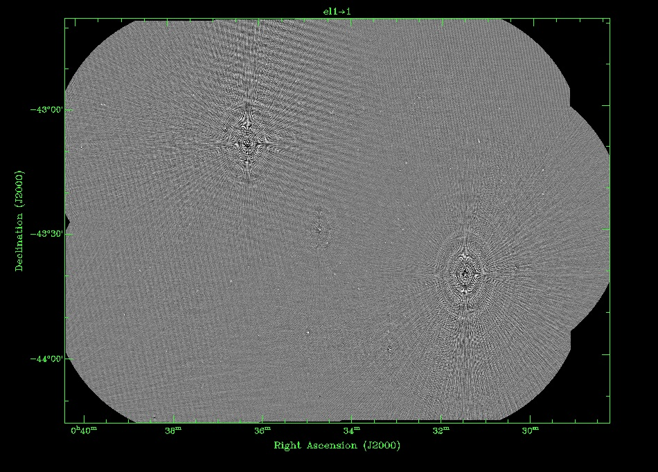
Dynamic range limited by calibration errors
Selfcal can correct antenna-based gain errors
  requires strong sources in the field
  depends on quality of model (deconvolution)
What about gain errors that vary across primary beam?
In 2006, CDFS/ELAIS observations were limited at about σ ~ 20 µJy by a combination of effects such as these.
Work in progress (Emil Lenc) to fix this
  Latest: proper modelling of problem sources in uv data gets rid of most of the sidelobes

Slide 36
Confusion (1)
A problem affecting deep surveys of compact radio sources
  Not really an issue when imaging extended structure
  Not often a problem above 10 GHz (small beam & FOV, less sensitive)
Given a sufficiently sensitive observation, sources will start to overlap.
Eventually, every beam will be filled with a source.
  Image noise will increase
This is the confusion limit, and depends on beam size and astrophysical source distributions.
For the ATCA at 20 cm,
fundamental confusion limit = 0.05 µJy/beam

Slide 37
Confusion (2)
Beam confusion
  Sources are closer together than the instrumental resolution
Fundamental (non-instrumental) confusion
  sources themselves overlap,
  cannot be separated by ANY instrument, regardless of beam size
Sidelobe confusion
  noise added to image because of sources in sidelobes (even with perfect calibration).

Slide 38
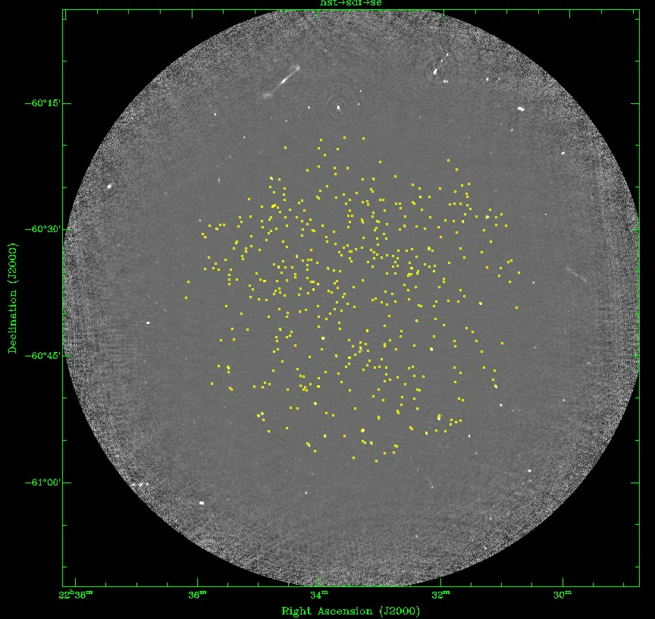
Confusion (3)
A commonly adopted rule of thumb is that only 1% of beams should contain a source
For the ATCA at 20 cm with 6km array
S_{instrumental} ~ 20 µJy/beam
We have already passed
this point.

Slide 39
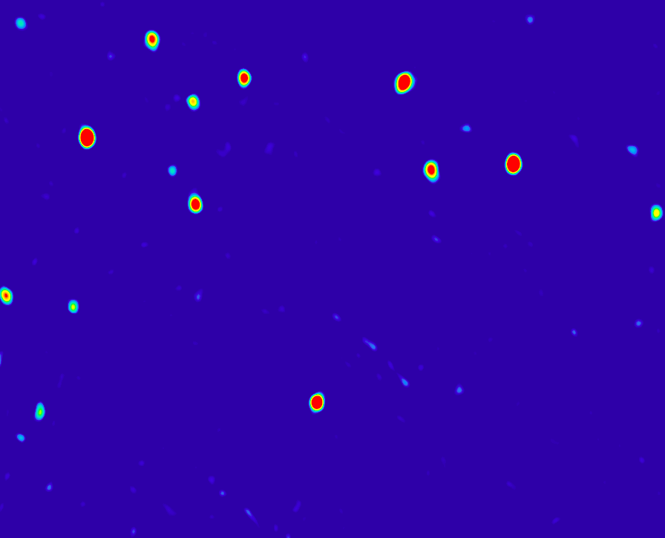
Deciding what level to “believe” (1)
This image has ~ 4.10⁴ independent beams,
so Gaussian noise would suggest
  50 peaks > 3σ
  ~1 peak > 4σ
  No peaks > 5σ
In practice, probably several noise peaks > 5σ
Most astronomers will not “believe” anything at about this level.
The trouble is: noise in synthesis images is NOT Gaussian!
  So Normal distribution statistics do not apply

Slide 40
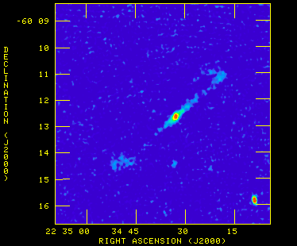
Deciding what level to “believe” (2)
So what level of source do you believe?
Problem is not trivial, and a simple cut-off is unlikely to be useful.

Slide 41
Deciding what level to “believe” (3)
Radio-astronomical noise is strongly non-Gaussian
And yet, quoting an rms noise is still regarded as a useful rule-of-thumb guide to sensitivity.
E.g. 10-σ detections are probably OK!
Other techniques:
Look at the statistics of “negative sources”
Look at the statistics of sources in the V image
Compare with other wavelengths, or use other information
Use cross-identifications with shifted data
Use simulations

Slide 42
Recap
Units – Jy, K, Jy/beam
Sensitivity – how to calculate
Sensitivity – how to improve
Image noise
Practical limits: DR, Confusion
Interpreting images – confidence in detections
Acknowledgements
  This talk is based on earlier talks on this topic by Bob Sault and Ray Norris

