Slide 1

Error/defect recognition (in interferometric data/images): a pictorial précis.
following the lectures of Ron Ekers (and others)
Prof. Steven Tingay
ICRAR, Curtin University
With thanks to: Emil Lenc, Hayley Bignall, and James Miller-Jones

Slide 2
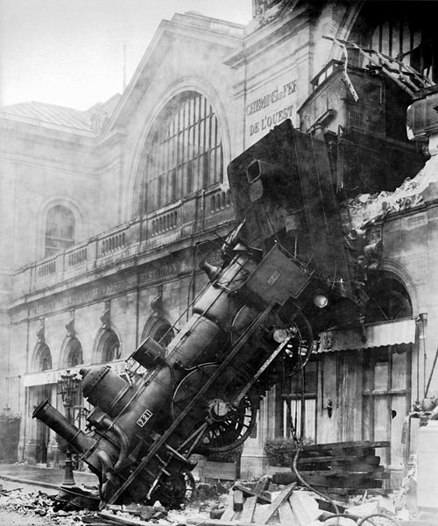
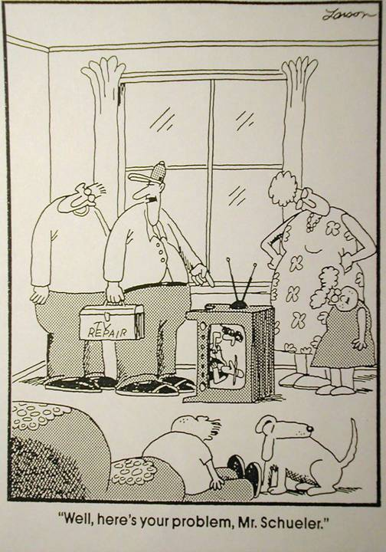
Some errors are easy to recognise
Some are hard to fix
Some are easy to fix

Slide 3


Slide 4
Where do errors occur?
Most errors/defects occur in the (u,v) plane:
  Actual measurement errors (imperfect calibration);
  Approximations made in the (u,v) plane;
  Approximations/assumptions made in the transform to the image plane;
  But also due to manipulations in the image plane (deconvolution).
Usually what we care about (mostly) are effects in the image plane.
Need to work between the (u,v) plane and the image plane. Need to get a feel for each of the two domains and how they relate to each other.

Slide 5
The (u,v) and image domains
The sky is real valued. The Fourier transform of a real function is a Hermitian function:
  F[I(l,m)]=V(u,v) and V(-u,-v)=V(u,v)*
    (a+ib)* = (a-ib)
  Need only measure half the (u,v) plane;
  Need only consider Fourier relationships between real and Hermitian functions
Bracewell (1978 or later editions) is a book you need in your bookshelf.

Slide 6
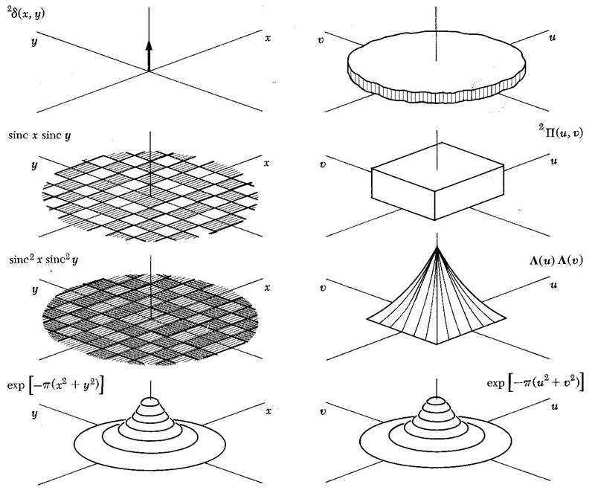

Slide 7
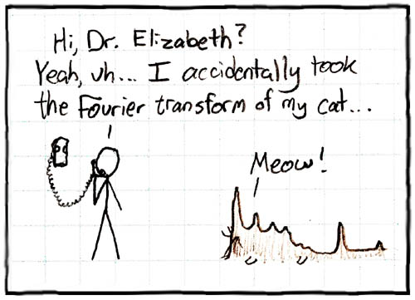

Slide 8
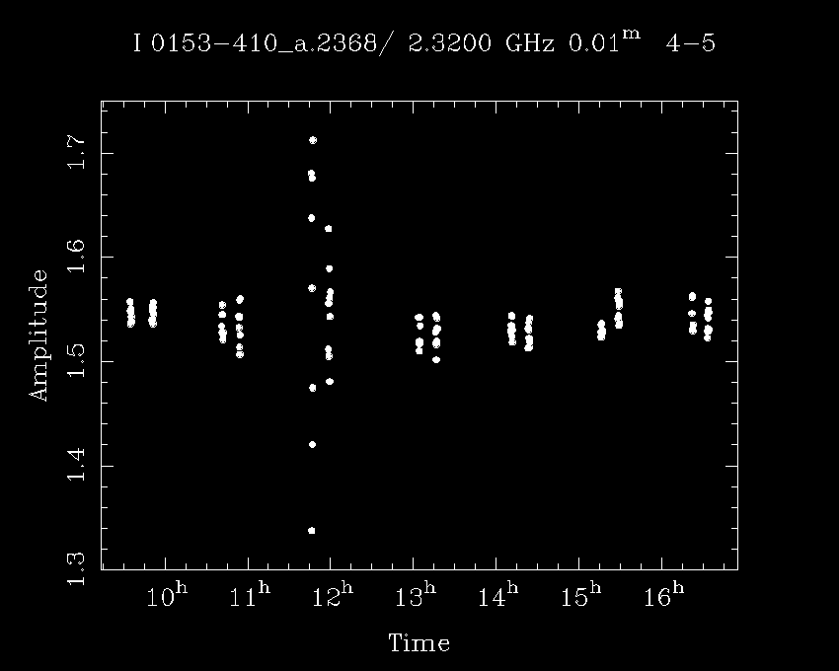
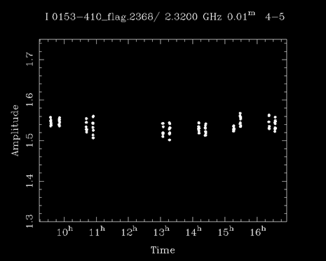
Which domain to look at?
Unflagged:
Flagged:

Slide 9
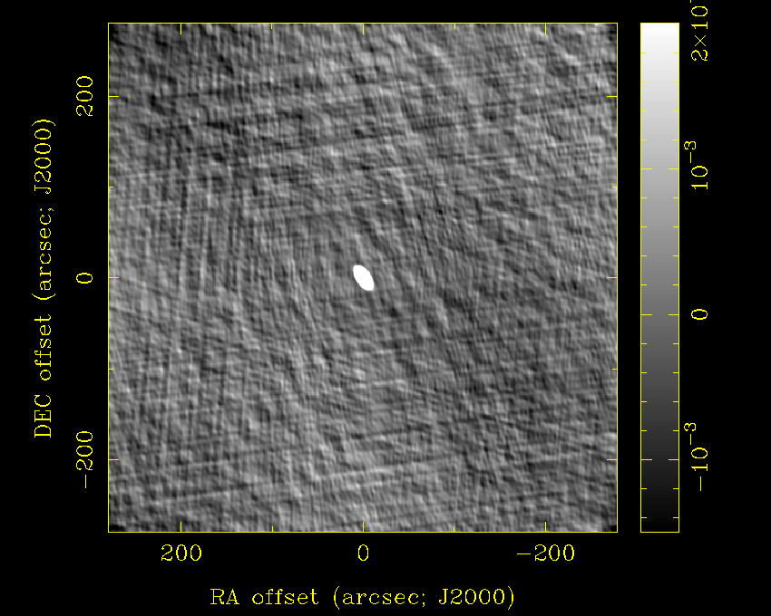
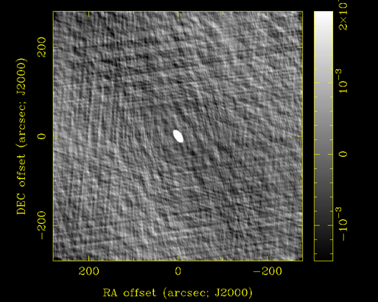
Unflagged:
Flagged:

Slide 10
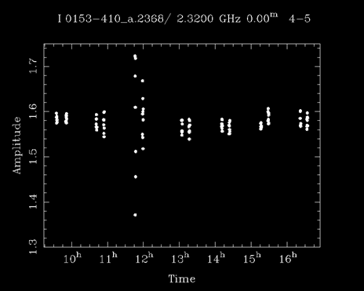
2.5% Gain error one ant:
Properly Calibrated:

Slide 11
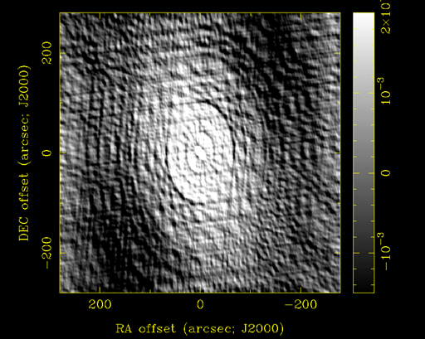
2.5% Gain error:
Properly Calibrated:

Slide 12
General form of errors in the (u,v) plane and their Fourier transforms (image defects)
Additive errors:
  V + ε ➔ I + F[ε]
Multiplicative errors:
  Vε ➔ I ★ F[ε]
Convolutional errors:
  V★ε ➔ IF[ε]
Other errors/defects:
  Bandwidth and time average smearing;
  Non-co-planer effects;
  Deconvolution errors.
Sun, interference, cross-talk,
baseline-based errors, noise
(u,v) coverage effects, gain
calibration errors,
atmospheric/ionospheric effects
Primary beam effect,
convolutional gridding.

Slide 13
Real and imaginary parts of errors
If ε is pure real, then the form of the error in the (u,v) plane is a real and even function i.e. F[ε] will be symmetric;
  ε(u,v) = ε(-u,-v)
If ε contains an imaginary component, then the form of the error in the (u,v) plane is complex and odd i.e. F[ε] will be asymmetric:
  ε(u,v) ≠ ε(-u,-v)

Slide 14
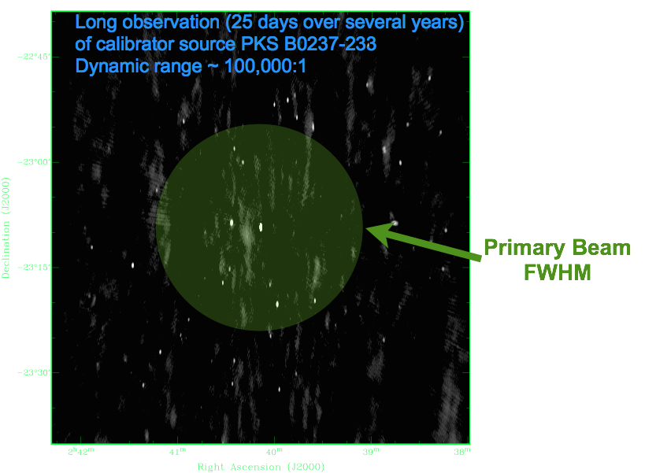
Additive errors: example
Emil Lenc

Slide 15
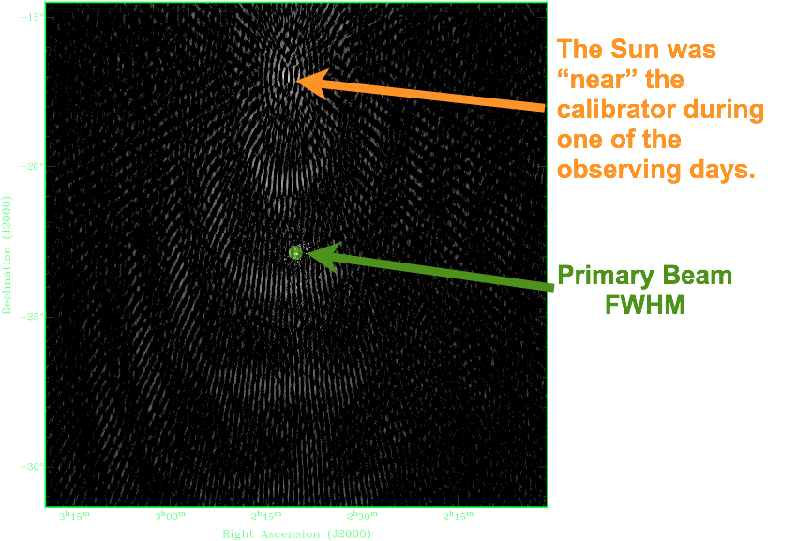

Slide 16
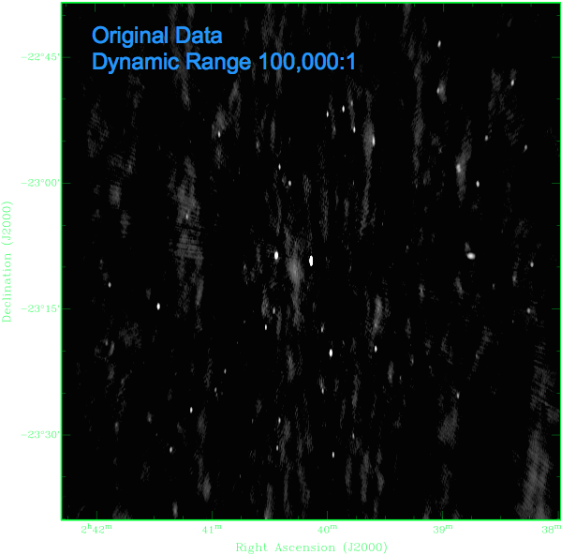
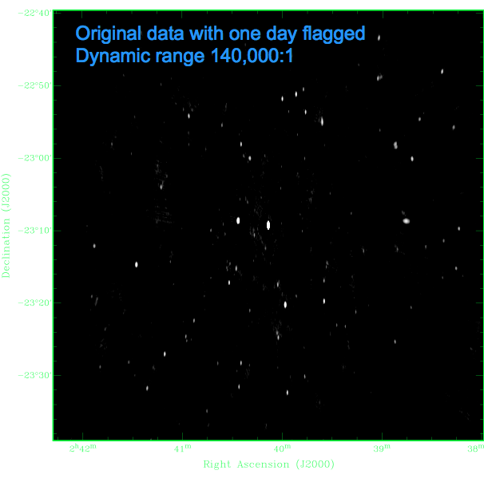

Slide 17
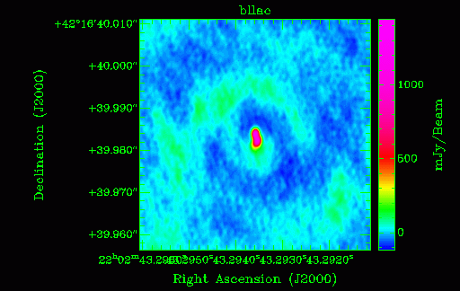
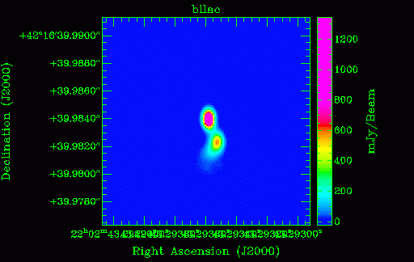
Multiplicative errors: example (gain phase error)
http://www.jive.nl/iac06/wiki (self-cal practicum: Hayley Bignall)

Slide 18
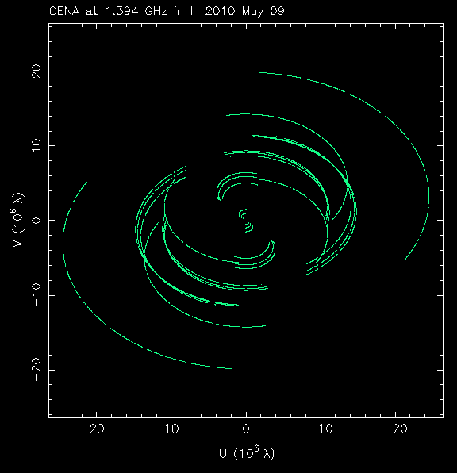
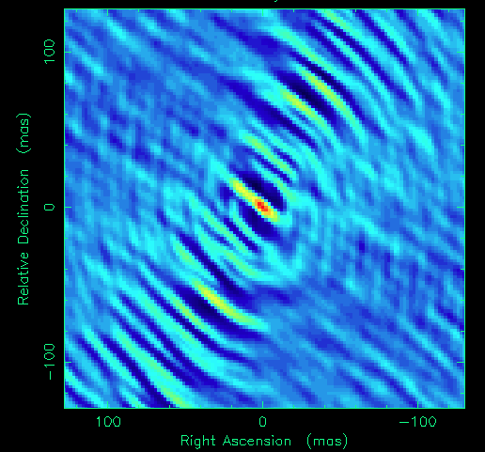
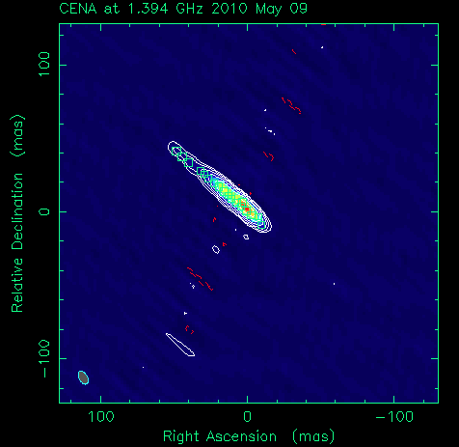
Gain amplitude error

Slide 19
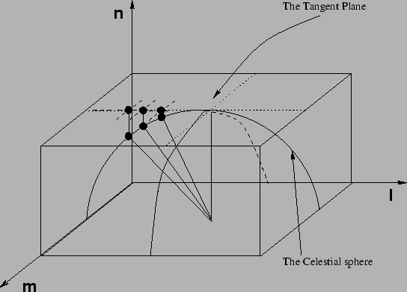
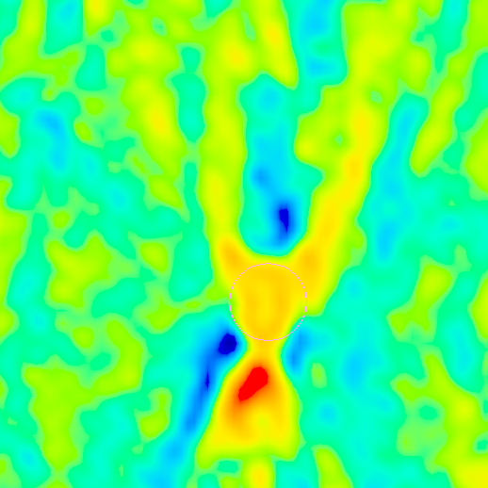
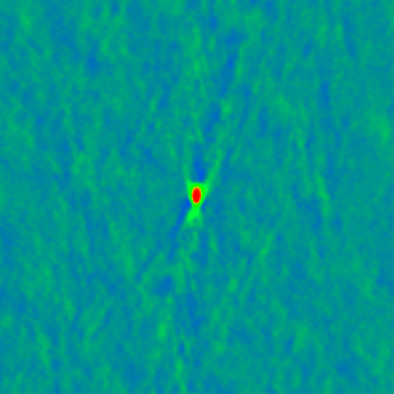
Phase error due to w-term error

Slide 20
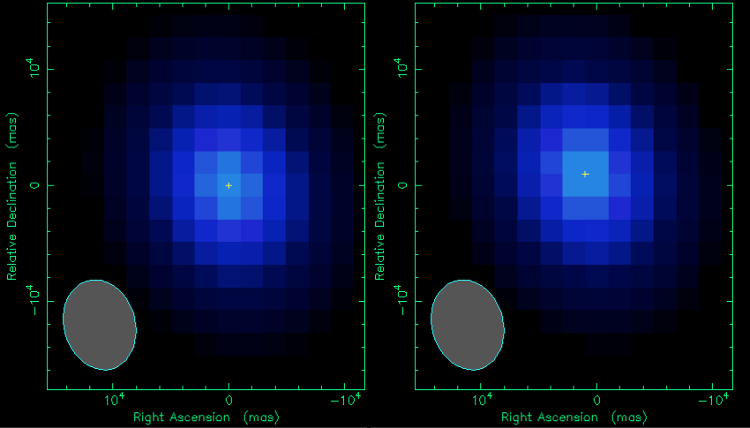
Errors confined to the image plane
Pixel centred
Pixel not centred

Slide 21
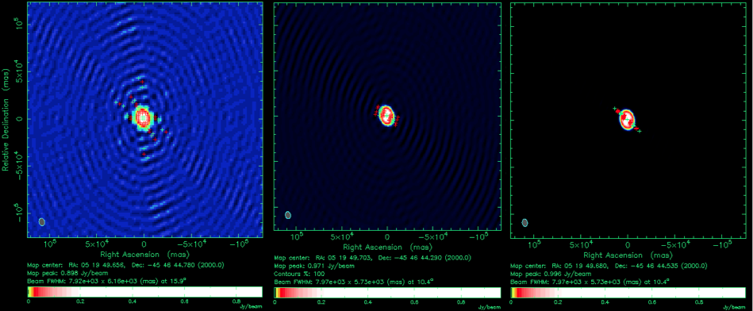
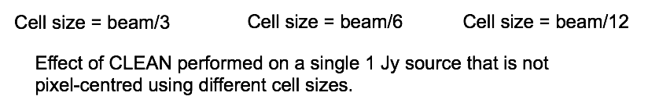

Slide 22
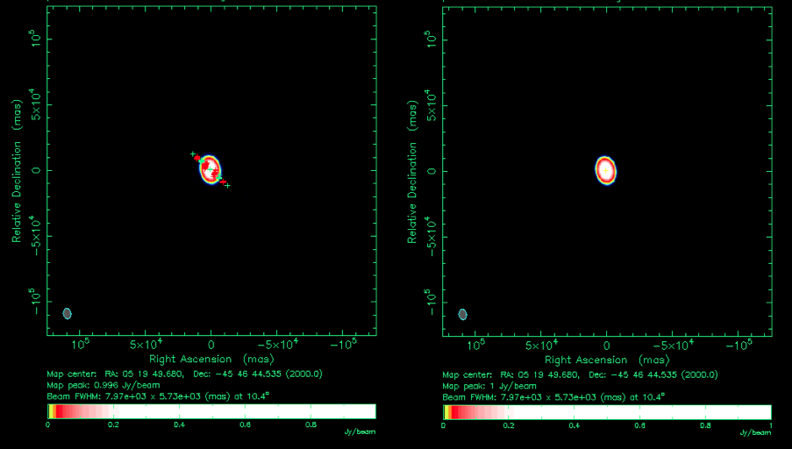

Slide 23
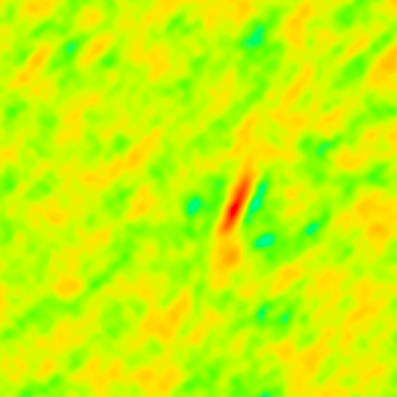
Bandwidth smearing
James Miller-Jones
Phase centre

Slide 24
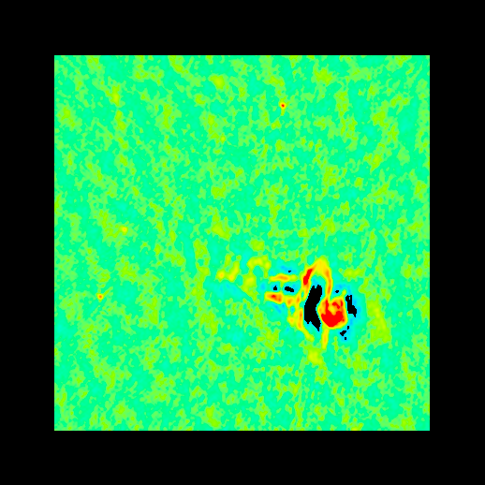
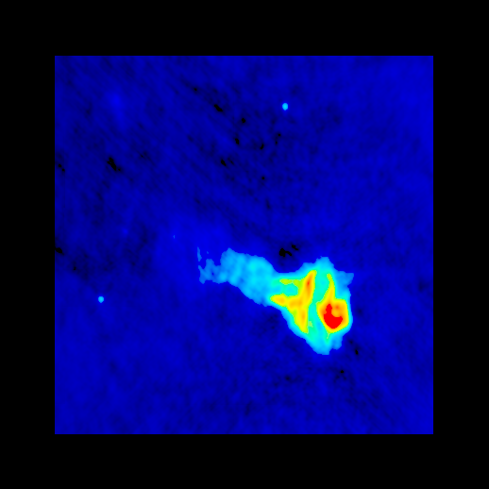
Missing short baselines
James Miller-Jones
Tornado nebula: VLA

Slide 25
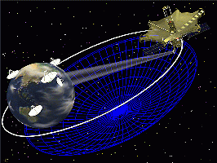
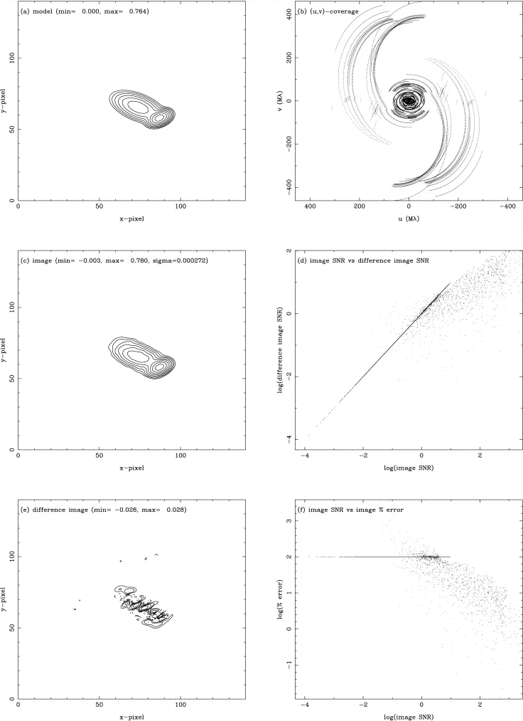
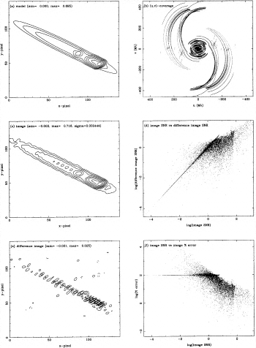
On-source errors

Slide 26
How to avoid publishing rubbish
Get to know how to recognise errors and defects;
Use plotting and graphical tools intensively, regularly and effectively (at every step in your data reduction, if practical);
Avoid cranking the handle (see Tara’s talk);
Use your peers/colleagues. Ask others for an independent assessment of your dataset;
Simulations can be very powerful to illuminate problems and separate multiple effects.

