Slide 1
Principles of Interferometry I
CASS Radio Astronomy School
R. D. Ekers
24 Sep 2012

Slide 2
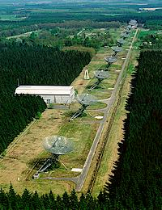
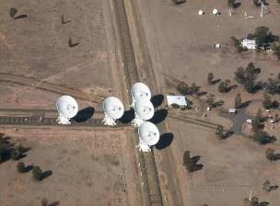
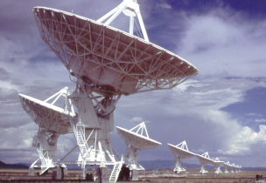
WHY?
Importance in radio astronomy
  ATCA, VLA, WSRT, GMRT, MERLIN, IRAM...
  VLBA, JIVE, VSOP, RADIOASTON
  ALMA, LOFAR, MWA, ASKAP, MeerKat, SKA
Notes:
Add MWA, remove ATA
Need to move ALMA… into line 1

Slide 3
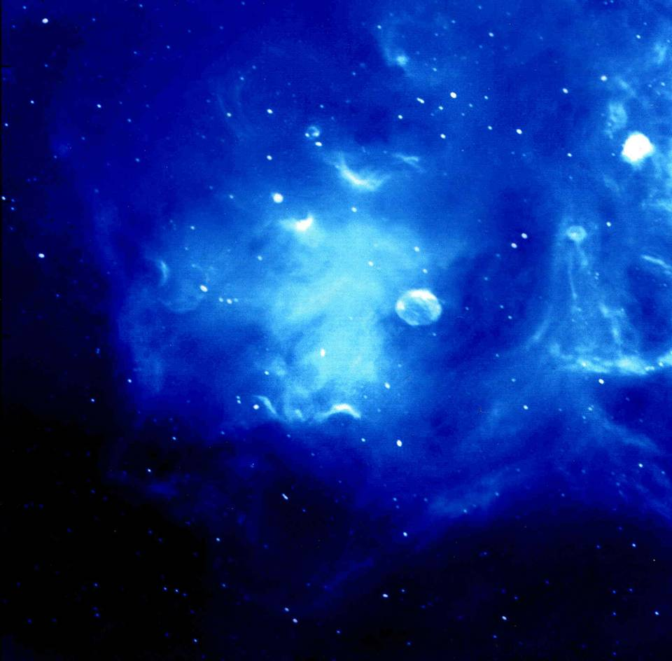
Cygnus region - CGPS (small)
Radio Image of
Ionised Hydrogen in Cyg X
CGPS (Penticton)
Notes:
Cygnus region - CGPS (small)

Slide 4
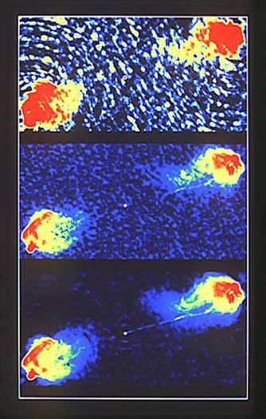
Cygnus A
Raw data
    VLA continuum
Deconvolution
    correcting for gaps between telescopes
Self Calibration
    adaptive optics

Slide 5
WHY?
Importance in radio astronomy
  ATCA, VLA, WSRT, GMRT, MERLIN, IRAM...
  VLBA, JIVE, VSOP, RADIOASTRON
  ALMA, LOFAR, ASKAP, SKA
AT as a National Facility
  easy to use
  don’t know what you are doing
Cross fertilization
Doing the best science

Slide 6
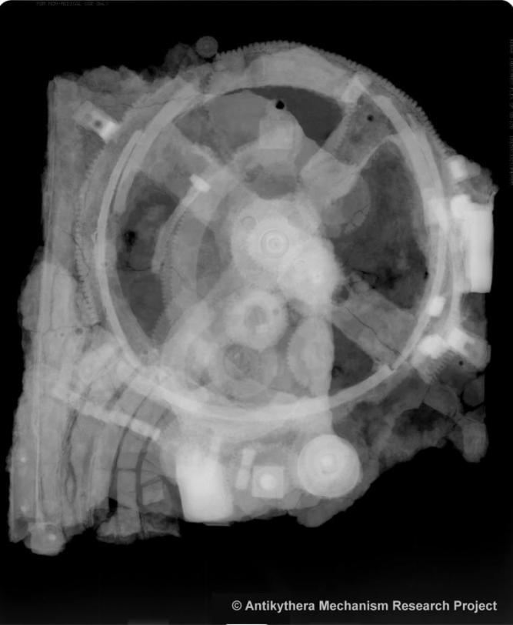
Indirect Imaging Applications
Interferometry
  radio, optical, IR, space...
Aperture synthesis
  Earth rotation, SAR, X-ray crystallography
Axial tomography (CAT)
  NMR, Ultrasound, PET, X-ray tomography
Seismology
Fourier filtering, pattern recognition
Adaptive optics, speckle
Antikythera
Notes:
Added X-ray tomography (industrial materials investigations – antikythera)

Slide 7
Doing the best science
The telescope as an analytic tool
  how to use it
  integrity of results
Making discoveries
  Most discoveries are driven by instrumental developments
  recognising the unexpected phenomenon
  discriminate against errors
Instrumental or Astronomical specialization?
Notes:
The vast majority of observations use the ATCA as an analytic tool to observe known phenomena and to make specific measurements relating to a hypothesis about the object or class of objects under study. The information we cover in this course will provide the background needed to plan for this type of observation.
The VLA and ATNF represent such major instrumental developments that new and exciting discoveries should be possible with these telescopes, but in order to be able to recognize the unexpected you must understand the instrument well.

Slide 8
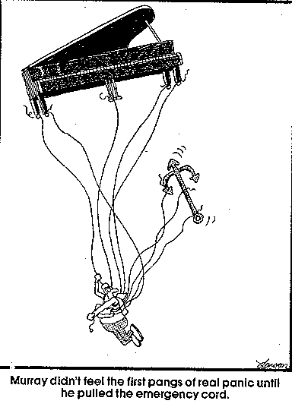
HOW ?
Don’t Panic!
  Many entrance levels

Slide 9
Basic concepts
Importance of analogies for physical insight
Different ways to look at a synthesis telescope
  Engineers model
    Telescope beam patterns…
  Physicist em wave model
    Sampling the spatial coherence function
    Barry Clark Synthesis Imaging chapter1
    Born & Wolf Physical Optics
  Quantum model
    Radhakrishnan Synthesis Imaging last chapter

Slide 10
Spatial Coherence
P₁ & P₂
spatially incoherent sources
P₁
P₂
At distant points Q₁ & Q₂
The field is partially coherent
Q₁
Q₂
van Cittert-Zernike theorem
  The spatial coherence function is the Fourier Transform of the brightness distribution

Slide 11
Physics: propagation of coherence
Radio source emits independent noise from each element
  Electrons spiraling around magnetic fields
  Thermal emission from dust, etc.
As electromagnetic radiation propagates away from source, it remains coherent
By measuring the correlation in the EM radiation, we can work backwards to determine the properties of the source
Van Cittert-Zernicke theorem states that the
Sky brightness and Coherence function are a Fourier pair
Mathematically:
Notes:
Juan Uson

Slide 12
Physics: propagation of coherence
Simplest example
  Put two emitters (a,b) in a plane
  And two receivers (1,2) in another plane
Correlate voltages from the two receivers
Correlation contains information about the source I
Can move receivers around to untangle information in g’s
Notes:
Juan Uson

Slide 13
Analogy with single dish
Big mirror decomposition
Notes:
Links to Emerson’s .pdf file

Slide 14
Notes:
Consider how a parabolic dish forms an image in the focal plan

Slide 15
Notes:
Now lets break the dish into multiple patches of refector

Slide 16
Free space
Guided
( Σ Vi )²
Notes:
We can replace each patch by a small dish, combine the signals using guided transmission rather than free space and detect the signal

Slide 17
Free space
Guided
(Σ Vi )²
Notes:
And we can now easily move the “focus” to another place

Slide 18
Free space
Guided
Delay
Phased array
(Σ Vi )²
Notes:
Its difficult to lift all the small dishes up in the air so lets put then back on the ground and introduce extra delay to compensate for the extra path

Slide 19
Free space
Guided
Delay
Phased array
(Σ Vi )²
Notes:
And take away the big dish and the large mechanical structures. This is known as a tied array and has the same sensitivity and resolution as the single dish of the same area. We could now change the locations of the small dishes but we will return to this later.

Slide 20
Free space
Guided
Delay
Phased array
(Σ Vi )² = Σ (Vi )² + Σ (Vi × Vj )
Notes:
Expand the detected sum of the voltages. Note that the Σ (Vi )² terms are large and hard to work with.

Slide 21
Free space
Guided
Ryle & Vonberg (1946) phase switch
Delay
✗
Phased array
(Σ Vi )² = Σ (Vi )² + Σ (Vi × Vj )
Correlation array
Notes:
Remove them by making a correlation interferometer. Originally the Ryle and Vonberg (1946) phase switch.

Slide 22
Notes:
Now lets go back and look at a second source (or in general a more complex image)

Slide 23
Phased
Array
θ
Split signal
no S/N loss
x2
x2
x2
x2
x2
x2
Δt
Phased array
(Σ Vi )²
(Σ Vi )²
I(θ)
I
Notes:
OLD VERSION
We could amplify the signal and split the signal path so could get a second output for the second source. The fact that we can amplify the signal and split it with no loss in s/n is an interesting consequence having radiation in the Raliegh-Jeans domain. This analogy fails at optical wavelengths.

Slide 24
Phased
Array
θ
Split signal
no S/N loss
x2
x2
x2
x2
x2
x2
Δt
Phased array
(Σ Vi )²
(Σ Vi )²
Tied array
Beam former
I(θ)
I
Notes:
We could amplify the signal and split the signal path so could get a second output for the second source. The fact that we can amplify the signal and split it with no loss in s/n is an interesting consequence having radiation in the Raliegh-Jeans domain. This analogy fails at optical wavelengths.

Slide 25
Synthesis
Imaging
Δt
correlator
<Vi × Vj>
Δϕ= Δ t/λ
Fourier Transform
van Cittert-Zernike
theorem
I(r)
Notes:
All the information about the structure in the image is in the Vij products in the square of the sum of the voltages so we can drop the total poer terms and just calculate the products in a correlator. Now instead of building many different delays we can assume a monochromatic signal and just apply a different phase shift for each point in the image. This is a Fourier transform of the complex correlation and this relationship is the famous van Cittert-Zernike theorem.

Slide 26
Analogy with single dish
Big mirror decomposition
Reverse the process to understand imaging with a mirror
  Eg understanding non-redundant masks
  Adaptive optics
Single dishes and correlation interferometers
  Darrel Emerson, NRAO
  http://www.gb.nrao.edu/sd03/talks/whysd_r1.pdf
Notes:
Links to Emerson’s .pdf file

Slide 27
Filling the aperture
Aperture synthesis
  measure correlations sequentially
  earth rotation synthesis
  store correlations for later use
Redundant spacings
  some interferometer spacings twice
Non-redundant aperture
Unfilled aperture
  some spacings missing

Slide 28
Redundancy
1unit 5x
2units 4x
3units 3x
4units 2x
5units 1x
15
n(n-1)/2 =
1 2 3 4 5 6
Notes:
Not measuring as much information as possible
Robust against errors and missing data
Provides strong image independent calibration constraints

Slide 29
Non Redundant
1unit 1x
2units 1x
3units 1x
4units 1x
5units 0x
6units 1x
7units 1x
etc
1 2 3 4 5 6 7 8
Notes:
Can measuring more information – eg more resolution for the same number of array element
Not so robust against errors and missing data
No image independent calibration constraints

Slide 30
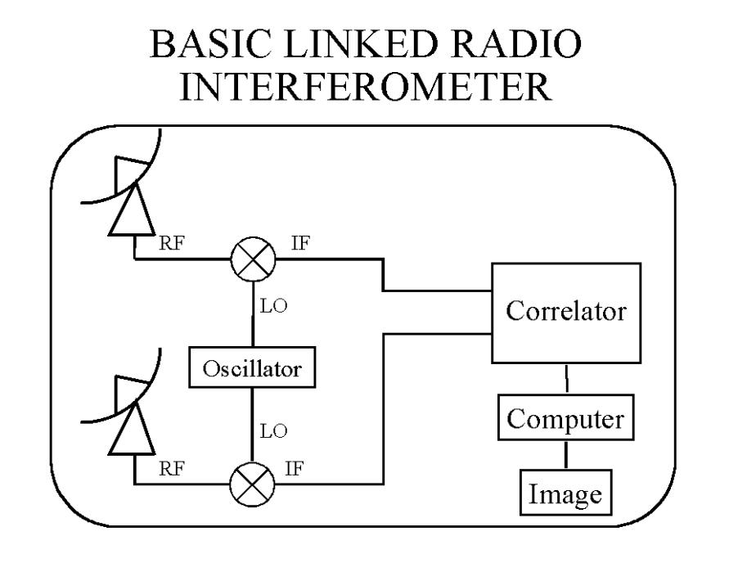
Basic Interferometer
Notes:
From Juan Uson

Slide 31
Storing visibilities
Can manipulate the coherence function and re-image
Storage
Notes:
From Juan Uson

Slide 32
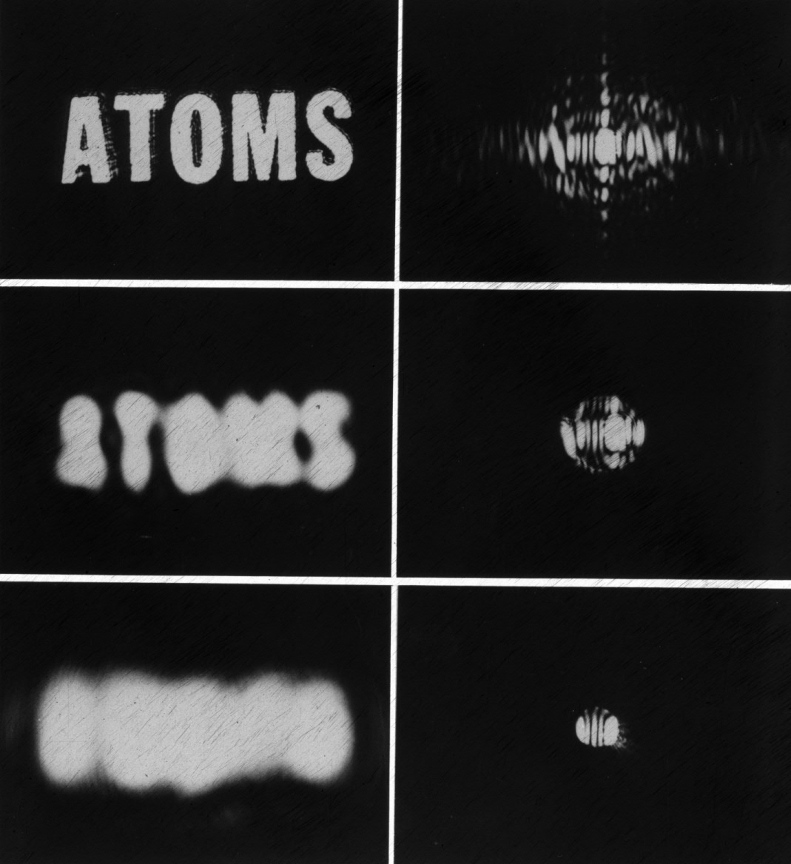
Fourier Transform and Resolution
Large spacings
  high resolution
Small spacings
  low resolution

Slide 33
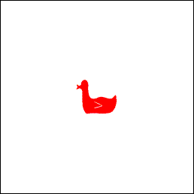
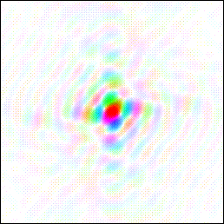
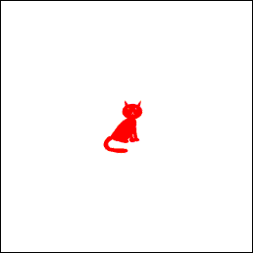
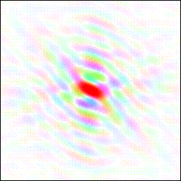
Fourier Transform Properties from Kevin Cowtan's Book of Fourier
FT
⬄
FT
⬄
http://www.ysbl.york.ac.uk/~cowtan/fourier/fourier.html
Notes:
http://www.general.uwa.edu.au/u/vpatrick/fourier/magic.html
http://www.ysbl.york.ac.uk/~cowtan/fourier/fourier.html

Slide 34
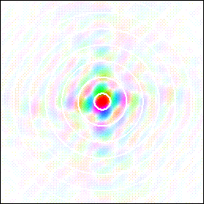
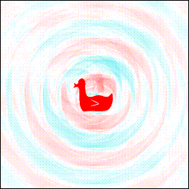
Fourier Transform Properties
FT
⬄
10% data omitted in rings
http://www.general.uwa.edu.au/u/vpatrick/fourier/magic.html

Slide 35
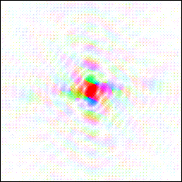
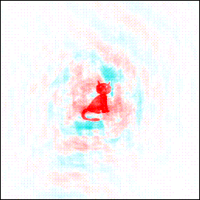
Fourier Transform Properties
FT
⬄
Amplitude of duck
Phase of cat
http://www.general.uwa.edu.au/u/vpatrick/fourier/magic.html

Slide 36
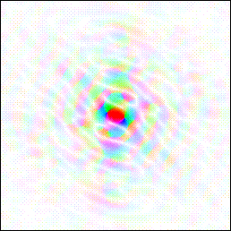
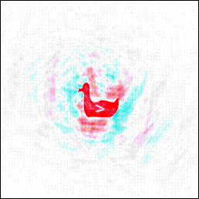
Fourier Transform Properties
FT
⬄
Amplitude of cat
Phase of duck
http://www.general.uwa.edu.au/u/vpatrick/fourier/magic.html

Slide 37
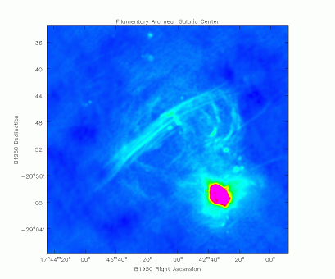
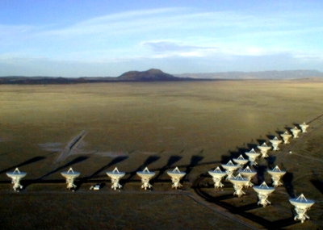
In practice…
Use many antennas (VLA has 27)
Amplify signals
Sample and digitize
Send to central location
Perform cross-correlation
Earth rotation fills the “aperture”
Inverse Fourier Transform gets image
Correct for limited number of antennas
Correct for imperfections in the “telescope” e.g. calibration errors
Make a beautiful image…

Slide 38
Aperture Array or Focal Plane Array?
Why have a dish at all?
  Sample the whole wavefront
  n elements needed: n ∝ Area/( λ/2)²
  For 100m aperture and λ = 20cm, n=10⁴
    Electronics costs too high!
Phased Array Feeds
  Any part of the complex wavefront can be used
  Choose a region with a smaller waist
  Need a concentrator
Computer

Slide 39

Find the Smallest Waist use dish as a concentrator
D₂
D₁
D₁ < D₂
n₁ < n₂
Notes:
Adapted from Sardinia Nov 2001, to include aperture array

Slide 40

Radio Telescope Imaging image v aperture plane
λ
Computer
Active elements
~ A/λ²
Dishes act as concentrators
Reduces FoV
Reduces active elements
Cooling possible
Computer
Increase FoV
Increases active elements
Notes:
Adapted from Sardinia Nov 2001, to include aperture array

Slide 41
Analogies
RADIO
  grating responses
  primary beam direction
  UV (visibility) plane
  bandwidth smearing
  local oscillator
OPTICAL
  aliased orders
  grating blaze angle
  hologram
  chromatic aberration
  reference beam

Slide 42
Terminology
RADIO
  Antenna, dish
  Sidelobes
  Near sidelobes
  Feed legs
  Aperture blockage
  Dirty beam
  Primary beam
OPTICAL
  Telescope, element
  Diffraction pattern
  Airy rings
  Spider
  Vignetting
  Point Spread Function (PSF)
  Field of View

Slide 43
Terminology
RADIO
  Map
  Source
  Image plane
  Aperture plane
  UV plane
  Aperture
  UV coverage
OPTICAL
  Image
  Object
  Image plane
  Pupil plane
  Fourier plan
  Entrance pupil
  Modulation transfer function

Slide 44
Terminology
RADIO
  Dynamic range
  Phased array
  Correlator
  no analog
  Receiver
  Taper
  Self calibration
OPTICAL
  Contrast
  Beam combiner
  no analog
  Correlator
  Detector
  Apodise
  Wavefront sensing (Adaptive optics)

