Slide 1
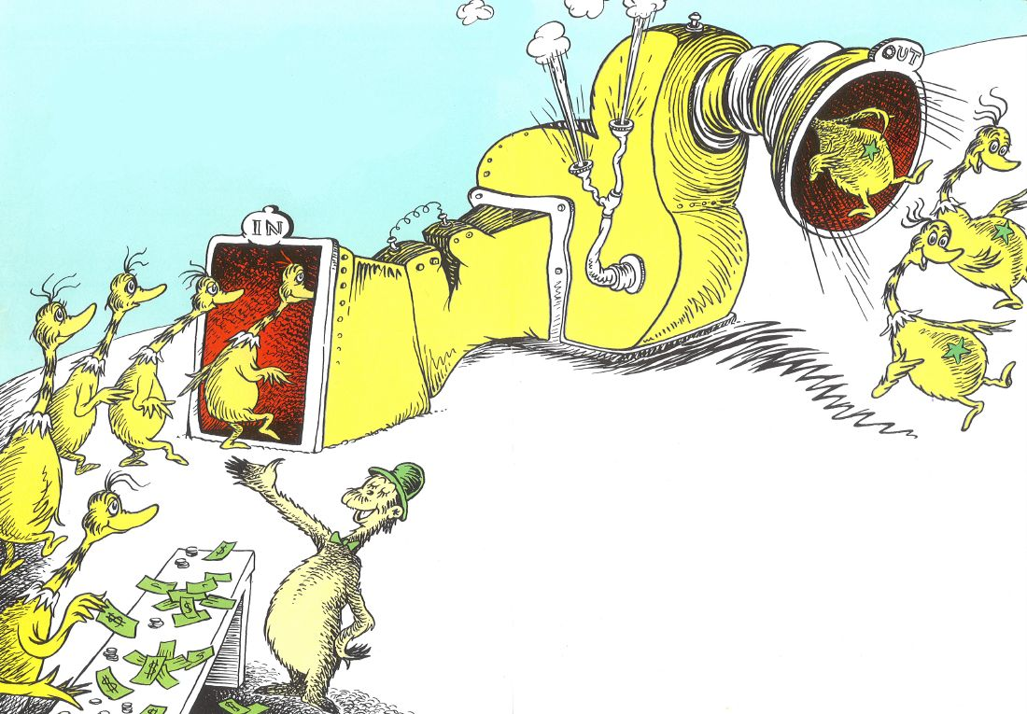
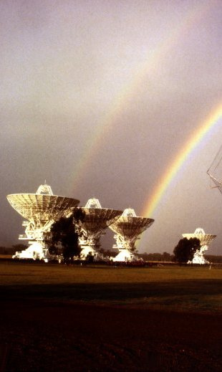
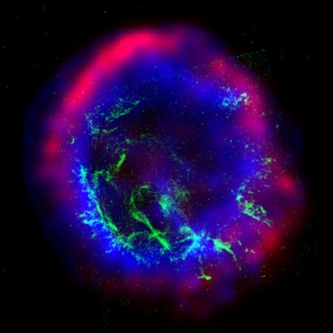
Back-end signal processing
Star-on Machine
Dr. Seuss - The Sneetches and Other Stories
John Tuthill | Digital Systems Engineer
25 September 2012
CSIRO Astronomy and space science

Slide 2
Outline
What is “back-end signal processing”
FX vs XF correlators
Filterbanks
Sampling and ADCs
CABB and ASKAP digital back-ends
Calculation engines
Further reading

Slide 3
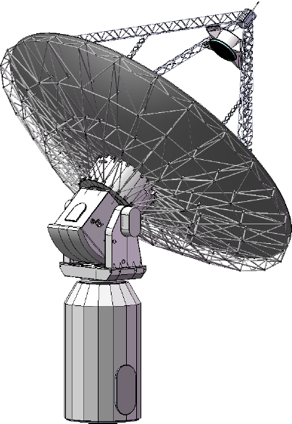
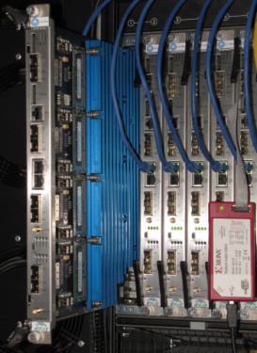
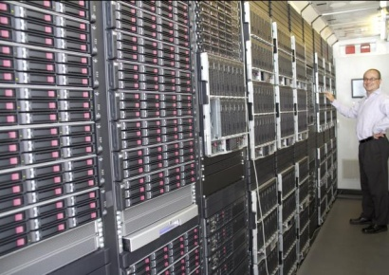
Back-end processing for Synthesis Imaging
Electric field at the remote source propagated to the observing points
Spatial Coherence function or “visibilities”
Intensity distribution of the source
X
X
down-conversion
Sampling
Image:
Shaun Amy
Back-End
Digital Signal Processing
Imaging: calibration, 2D FFT, deconvolution
Correlator

Slide 4
Spectral Channelisation
Interested in obtaining the cross-correlations (visibilities) across a range of separate frequency channels:
Spectral line observations – narrow bandwidth
Continuum – wide, contiguous bandwidth
Excising channels with high RFI
Others? Fast transients
Different astrophysics will have different requirements for frequency resolution, total bandwidth and band segmentation.
The back-end signal processing has to be flexible to cater for many conflicting science requirements.

Slide 5

Correlation
Bring the desired signals up out of the noise
Produce the visibilities for synthesis imaging
Noise
Noise
+
Delay
1.134s
+
Correlator
Delay = 1.134 seconds
Note:
Temporal not spatial coherence
0 seconds delay

Slide 6
FX and XF Correlators
Convolution theorem
XF architecture
FX architecture
D
D
D
Frequency Channelisation (eg FFT)
NxD
FFT
Frequency Channelisation (eg FFT)
ATCA before CABB
EVLA (FXF)
ALMA (FXF)
CABB (PFX)
ASKAP (PFX)
DiFX

Slide 7
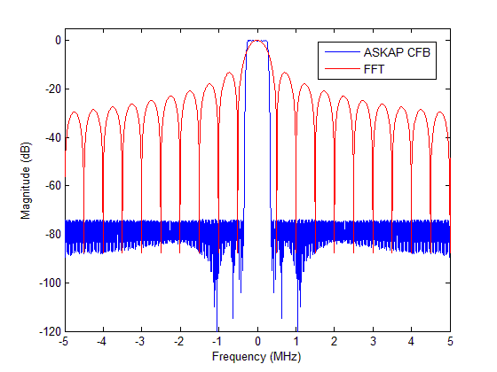
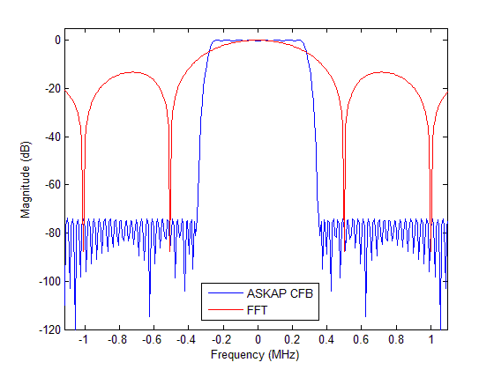
Filterbanks: FFT vs Polyphase Filters
One sub-band
768-point FFT
12,288-tap polyphase filter + 768-point FFT

Slide 8
Filterbanks: Polyphase decomposition
M-path Polyphase
down converter
Standard single-channel
down converter
Digital
low-pass filter
M-to-1
down-sampler
x(n)
y(nM,k)
Σ
x(n)
H(Z)
y(nM,k)
y(n,k)
Equivalency Theorem
Exchange mixer and low-pass filter with a band-pass filter and a mixer.
Re-write the band-pass filter in “M-path form”
Noble Identity
Move a down-sampler back through a digital filter
M-path Polyphase
channeliser
r(nM,0)
x(n)
r(nM,1)
M-point
FFT
r(nM,M-1)

Slide 9
Sampling:
The Sampling Theorem: A band-limited signal having no frequency components
above f_{max} can be determined uniquely by values sampled at uniform intervals
of T_{s} satisfying:
signal in
anti-alias
filter
ADC
Aliasing
-f_{s}
f_{s}
2f_{s}
f_{s}
2f_{s}
Clean
Aliased
-f_{s}
Notes:
Albinoni Oboe Concerto D minor

Slide 10
Sampling: ”ideal” Analogue to Digital Converter (ADC)
anti-alias
filter
ADC
signal in
Discrete-time series of digital numbers out
at N-bits of resolution
2^{N}-1 discrete levels
between full-scale inputs
Quantisation in
amplitude
For a full-scale sinusoidal input:
Quantisation in
time
SNR for an 8-bit converter = 50 dB
Notes:
Under reasonable assumptions: Uncorrelated with input
Quantisation efficiency

Slide 11
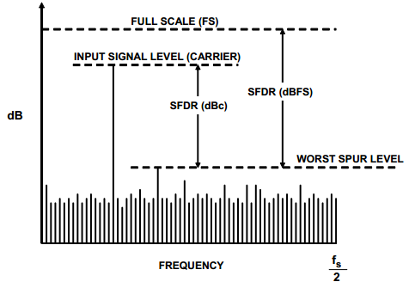
Sampling: the real-world (especially for high-end ADC’s )
Effective Number Of Bits (ENOB)
ADC characteristics:
Aperture delay/width
Acquisition time
Aperture jitter
Crosstalk
Missing codes
Differential/Integral nonlinearity
Digital feed-through
Offset and Gain error
Intermodulation distortion
Interleaving errors (high-speed ADC’s)
Dynamic performance relative to
the ideal ADC quantisation noise
Spurious-free dynamic range (SFDR)
Ratio of the rms amplitude of the fundamental to the
rms value of the next-largest spurious component (excluding DC)

Slide 12
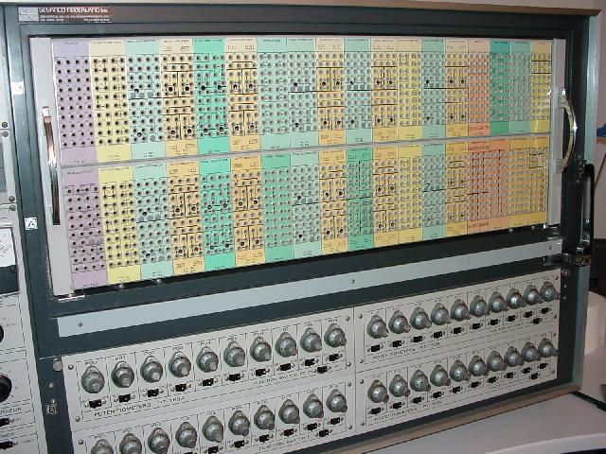
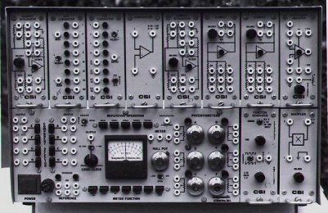
Sampling…why go digital at all?
At an instance of time, a digital signal can only represent a value from a finite set of distinct symbols.
By contrast, an analogue signal can represent a value from a continuous (infinite) range.
Surely analogue is more ‘economical’.
So why are digital systems so common place?

Slide 13
Sampling…why go digital at all?
Digital Systems:
5V
are, to a degree, immune to noise.
3.3V
1.7V
Noisy digital signal
0V
5V
5V
Logic 0
Logic 1
3.3V
3.3V
are amenable to regeneration after noise contamination/signal dispersion, without the introduction of errors.
1.7V
1.7V
Inverter
0V
0V
Noisy input
Clean output
can be coded in order to facilitate error detection.
systems with repeatable and reliable functionality
Much of the effort in the design of the digital back-end hardware/firmware is to ensure these properties hold.

Slide 14
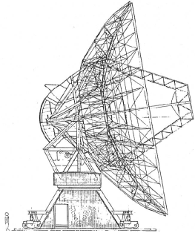
Compact Array Broadband Backend (CABB)
Secondary filterbanks
16 overlapping windows 2048 channels/window
(resolution depends on primary filterbank mode)
Per antenna
Spectral line
2GHz bands
4.096GS/s 9-bits
(6-ENOB)
Fine Delay and Fringe rotator
f₁
Coarse delays
“F” outputs to
correlator
engines
Pol. A
D
Continuum
Pol. B
Dual-band,
dual polarisation down conversion
f₂
Primary filterbanks
up to 2048 channels
4 modes: 1, 4, 16 and 64MHz resolution
auto- and cross-polarisation correlations
(calibration)
Analogue-to-Digital converters
e-VLBI

Slide 15
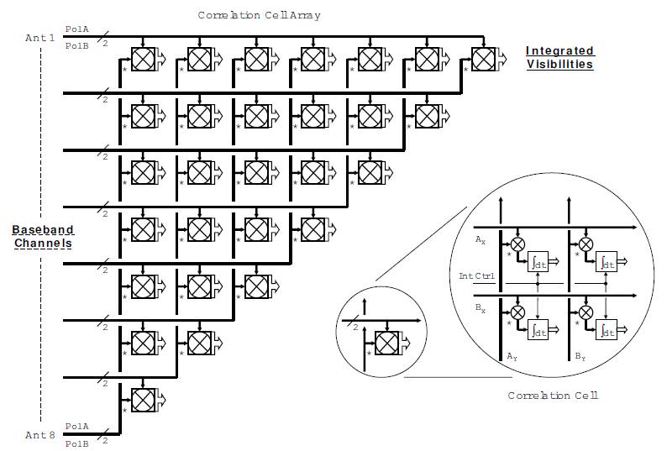
CABB Correlator
6 x (6-1)/2 = 15 baselines
Full Stokes parameters

Slide 16
CABB Configurations
CABB Configuration | Primary band | Secondary band (zoom)
CFB 1M-0.5k | 1.0 MHz | 0.488 kHz
CFB 4M-2k* | 4.0 MHz | 1.953 kHz
CFB 16M-8k* | 16.0 MHz | 7.812 kHz
CFB 64M-32k | 64.0 MHz | 31.250 kHz
* Not yet implemented

Slide 17

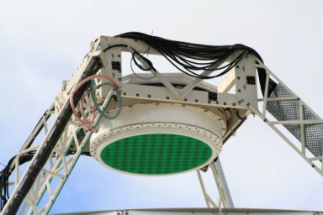
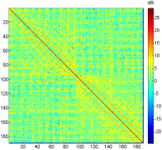
ASKAP digital back-end
Data throughput reduced by a factor of 3
188 PAF ports
768 MS/s, 8-bits
36 dual-polarised beams on the sky
16,416 x 18.52kHz channels
304 x 1 MHz channels
2Tbits/s
Σ
To correlator engine
Analogue-to-Digital converters
First stage filterbank
Cross-connect
NarrowbandBeamformers
Second stage filterbank
Per antenna
Array Covariance Matrix
Off-line beam weight computation
36 dual-polarised beams from 36 antennas, 16,416 fine channels
D
To remote imaging supercomputer
D
~720 Tbits/s
Cross-connect
Fine Delay and Fringe rotator
Hardware Correlator
Notes:
Three important differences:
PAF
Mid-stage Beamformer
Fine channels are computed for ALL the input bandwidth (averaged after the correlator for continuum observing)

Slide 18
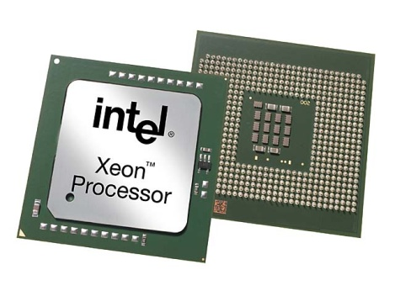
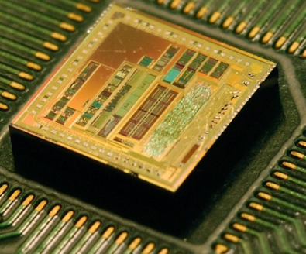
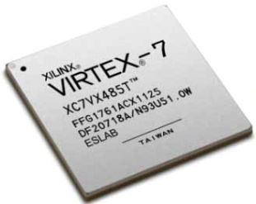
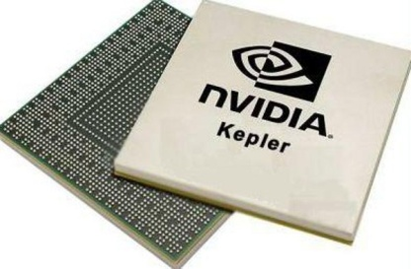
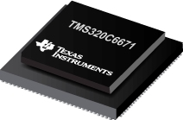
Calculation Engines: so many choices…
Hard-wired logic
Stored (programmed) logic
ASIC’s
FPGA’s
GPU’s
CPU’s/DSP’s
Application-Specific Integrated Circuit
Field Programmable Gate Array
Graphics Processing Unit
Central Processing Unit/ Digital Signal Processor
DiFX
CABB
ASKAP
MWA
MeerKAT
EVLA
ALMA
Less flexible
Lower power/computation
Higher initial development
More flexible
Higher power/computation
Lower initial development

Slide 19
Further Reading…
Radio Astronomy:
H. C. Ko, “Coherence Theory in Radio-Astronomical Measurements,” IEEE Trans. Antennas & Propagation, pp. 10-20, Vol. AP-15, No. 1, Jan. 1967.
G. B. Taylor, G. L. Carilli and R. A. Perley, Synthesis Imaging in Radio Astronomy II, Astron. Soc. Pac. Conf. Series, vol. 180, 2008.
CABB
W. E. Wilson, et. al. “The Australia Telescope Compact Array Broadband Backend (CABB): Description & First Results,” Mon. Not. R. Astron. Soc., Feb. 2011
ASKAP
D. R. DeBoer, et.al, “Australian SKA Pathfinder: A High-Dynamic Range Wide-Field of View Survey Telescope,” Proc. IEEE, 2009.
Filter Banks
R. E. Crochiere and L. R. Rabiner Multirate Digital Signal Processing, Prentice Hall, 1983.
f. j. harris, Multirate Signal Processing for Communication Systems, Prentice Hall, 2008.
P. P. Vaidyanathan, Multirate Systems And Filter Banks, Prentice Hall, 1992.
Beamforming
B. D. Van Veen and K. M. Buckley, “Beamforming: A Versatile Approach to Spatial Filtering,” IEEE ASSP Magazine, April 1988

Slide 20

Thank you
CASS
Dr John Tuthill Digital Systems Engineer
t +61 2 9372 4392
e John.Tuthill@csiro.au
w www.csiro.au/
CASS - Digital Systems

