Slide 1
Receiver Systems
Suzy Jackson – based on previous talks by Alex Dunning & Graeme Carrad

Slide 2
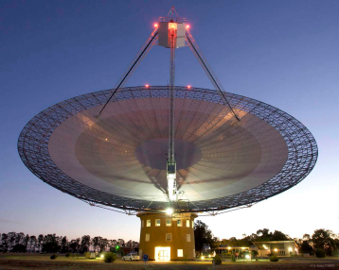
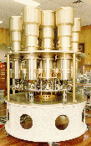
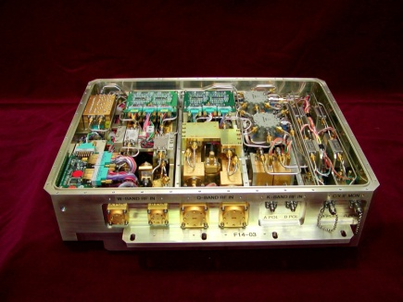
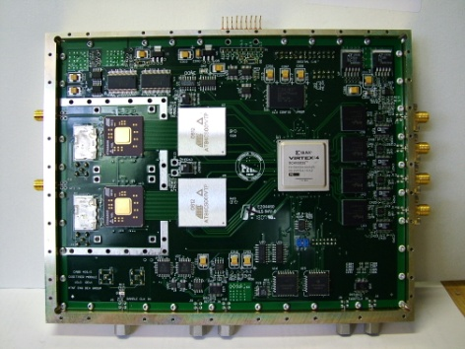
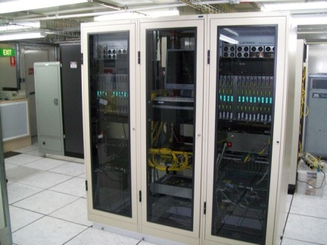
The Basic Structure of a typical Radio Telescope
Receiver
Conversion
Digitiser
Signal Processing / Correlator
Antenna

Slide 3
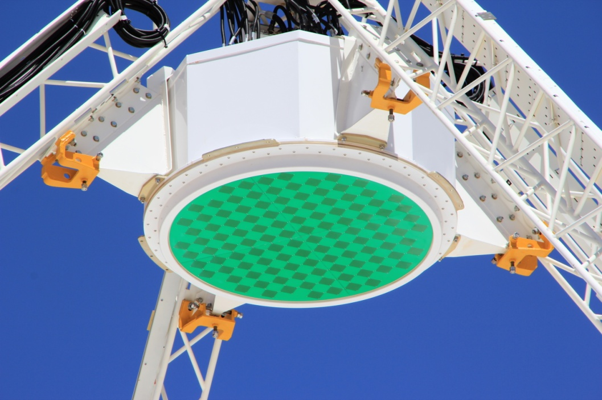
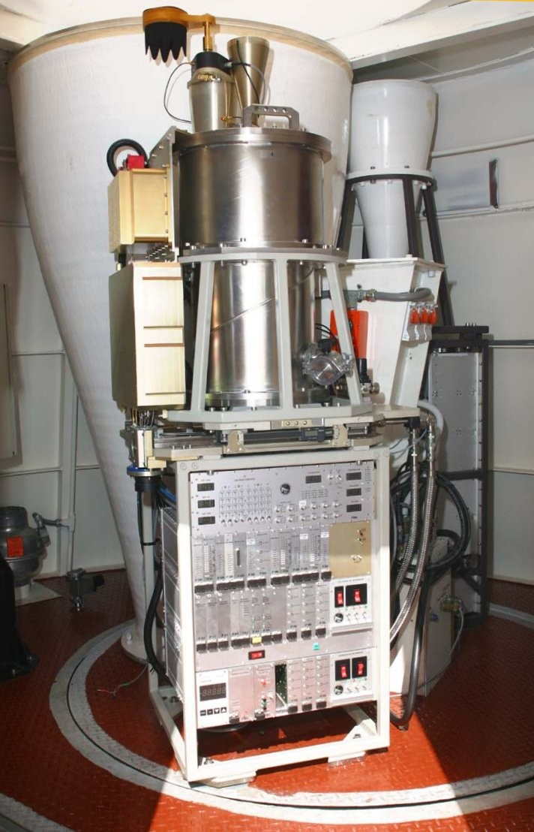
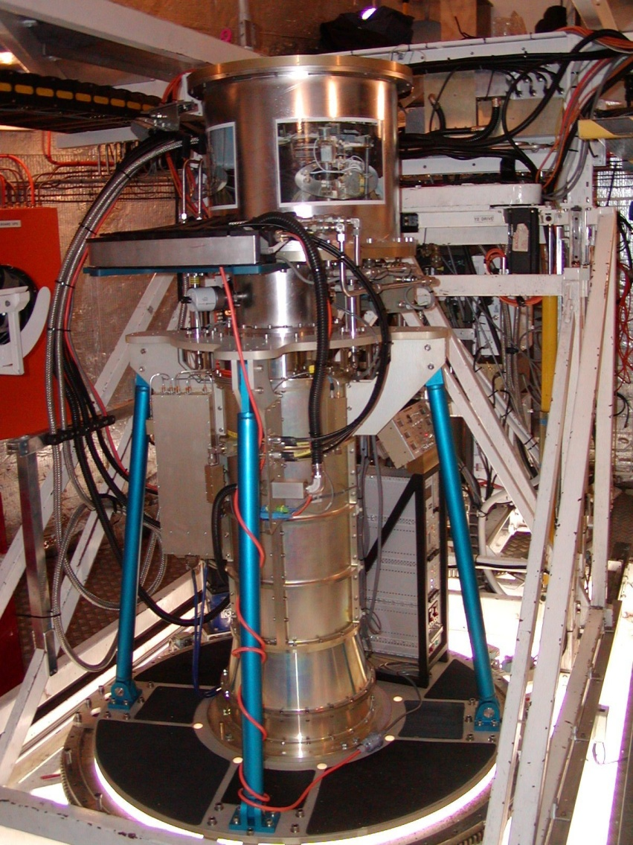
Ours look like this...
MRO PAF
ATCA
3/7/12mm
Parkes
10/50cm

Slide 4
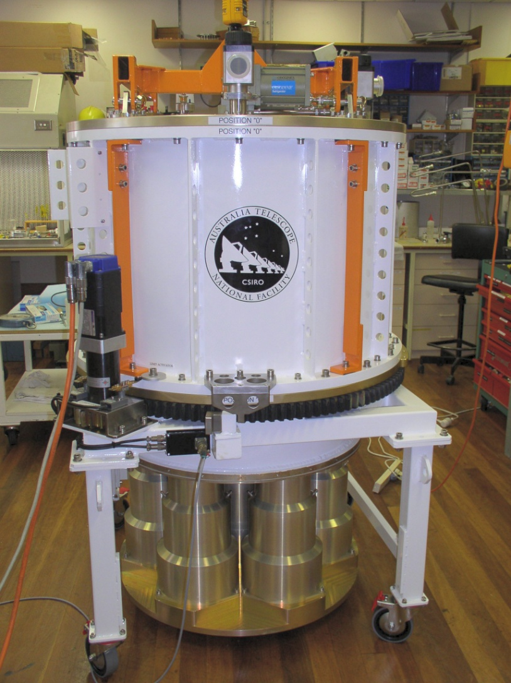
The Receiver
On the outside...
Vacuum Dewar
Feed Horns

Slide 5
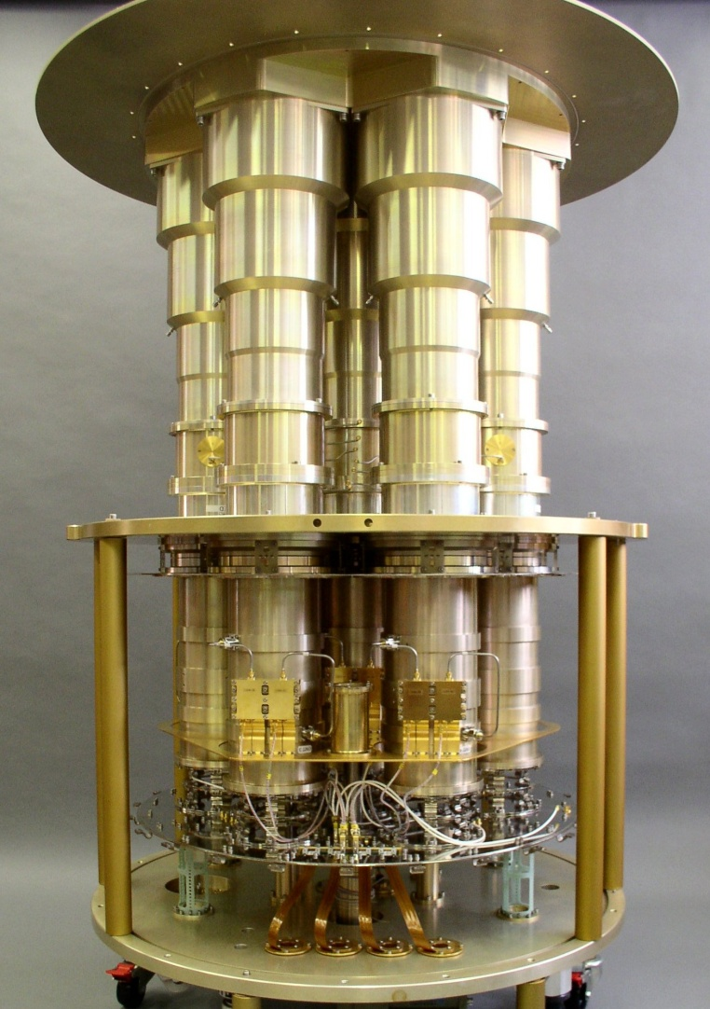
The Receiver
On the inside...
Amplifiers
Ortho-Mode Transducers

Slide 6
system temperature
minimum detectable flux
Integration Time
Effective Collecting Area
Observing Bandwidth

Slide 7
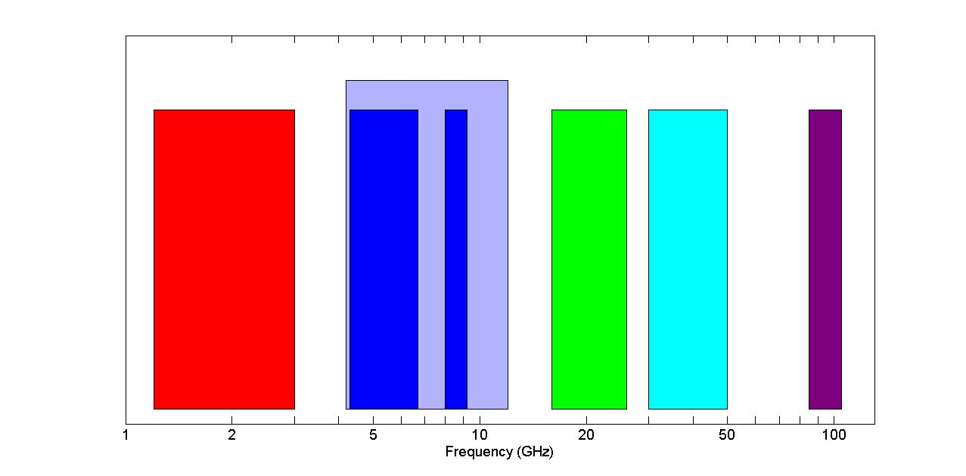
The Australia Telescope Receivers
Current upgrade
C/X
L/S
K
Q
W
10cm-25cm
4.6cm-6.7cm
2.5cm-7cm
12mm-18.7mm
6mm-10mm
O₂ absorption
3.2cm-3.7cm
2.8mm-3.5mm

Slide 8
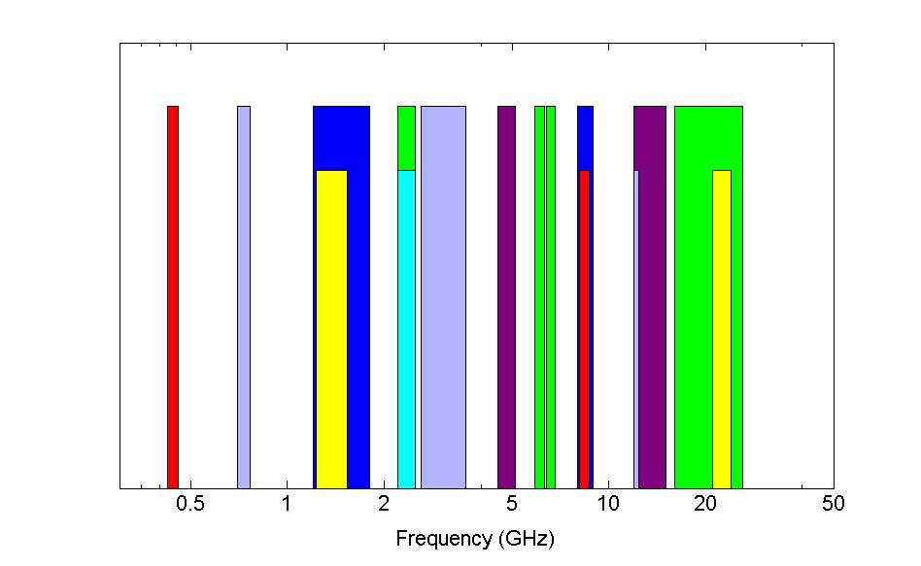
Parkes Receiver Bands

Slide 9
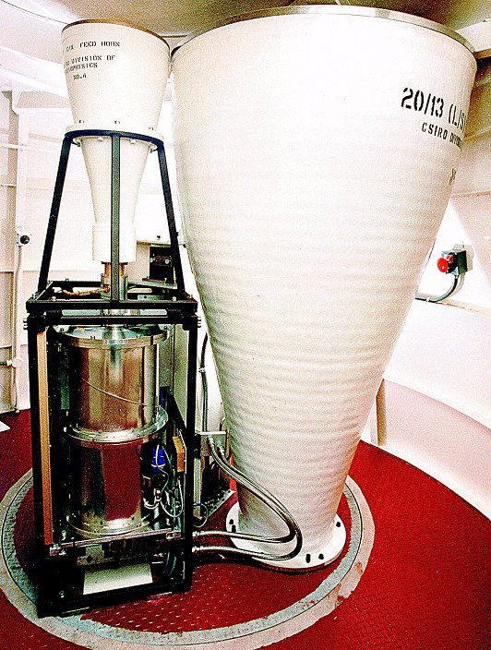
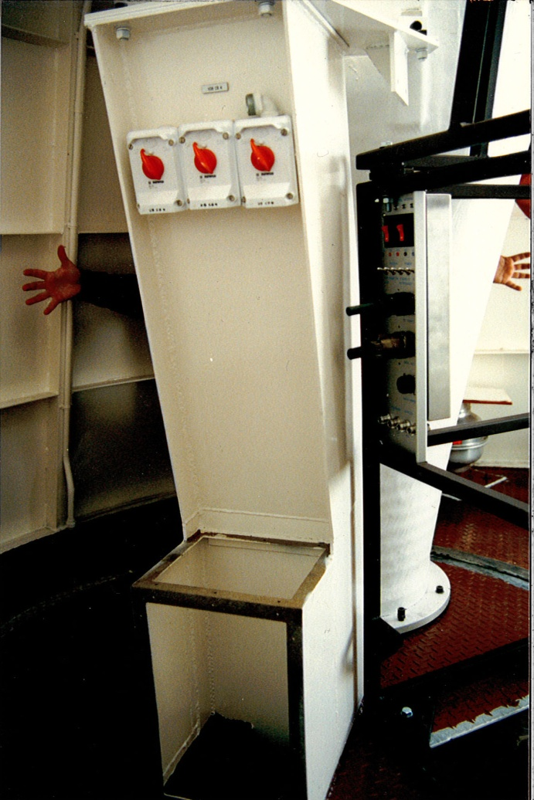
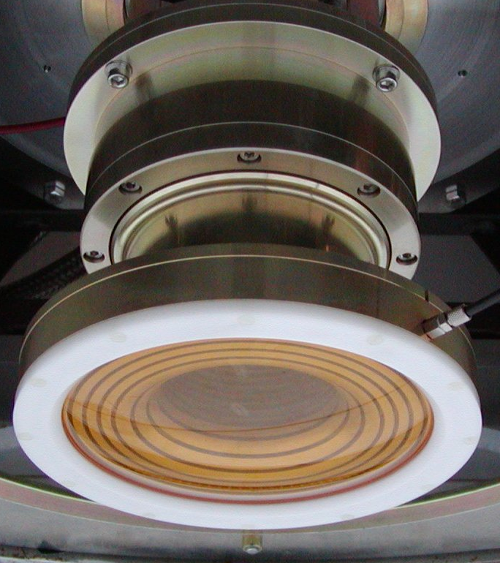
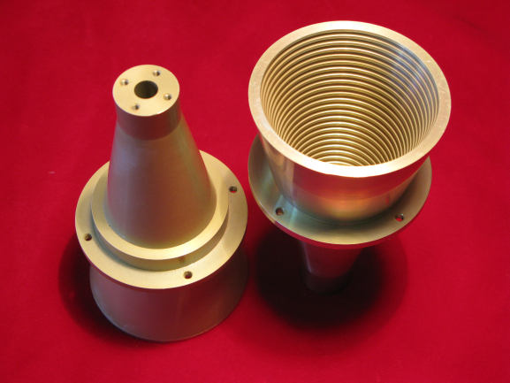
Receiving the signal – Feed horns
Feed
Signal
Captures the focused microwaves into a waveguide output
Waveguide output

Slide 10
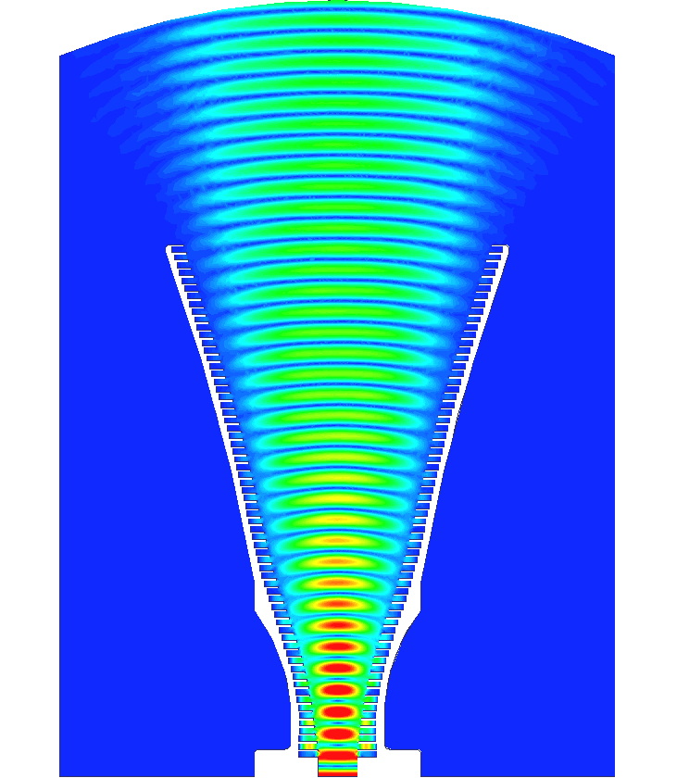
Feed Horns
Designed to match the focal ratio of the antenna
Matches the waveguide impedance to free-air impedance
Design compromises:
  Size & weight
  Spillover/efficiency
  Bandwidth
  Loss

Slide 11
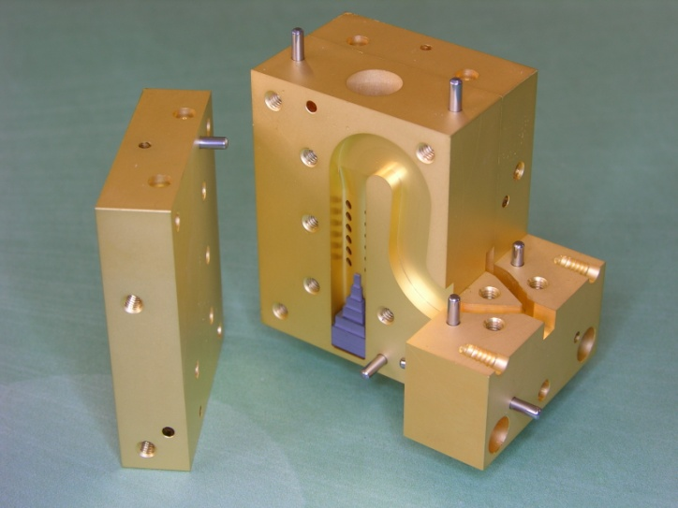
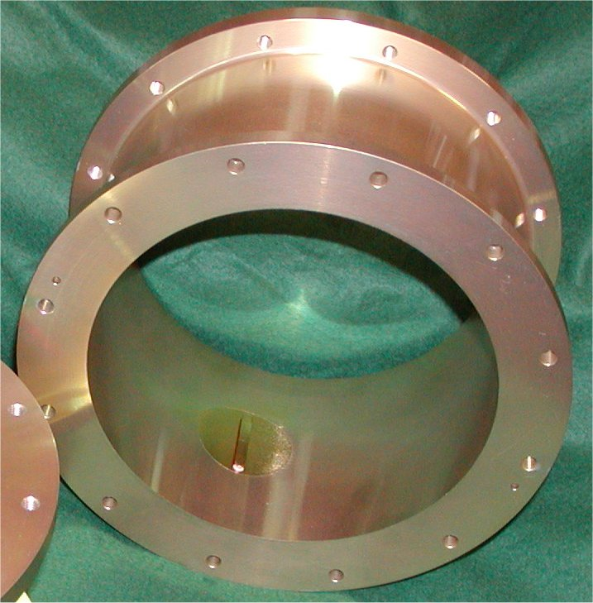
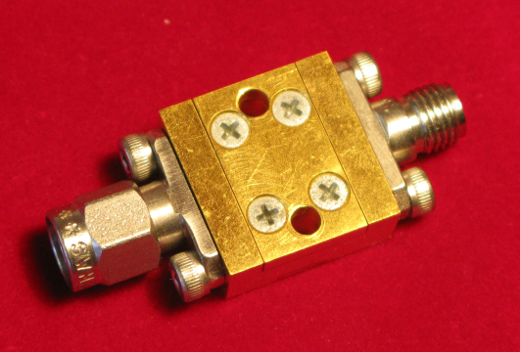
Coupling noise into the System
Feed
Coupler
Signal
Noise source
Noise coupled in through small holes
7mm waveguide coupler
Noise coupled in through vane
21cm waveguide coupler
12mm noise source

Slide 12
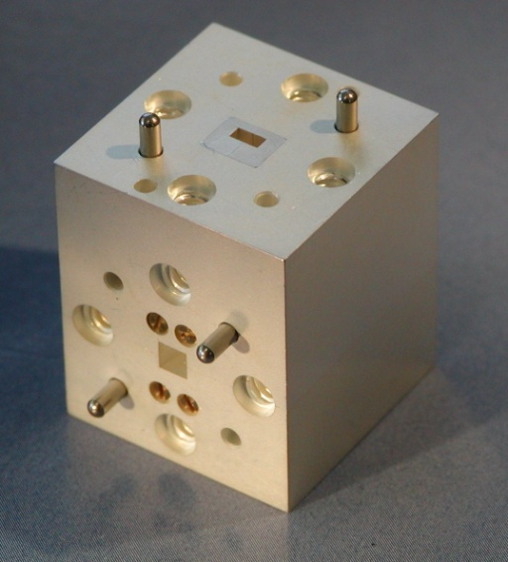
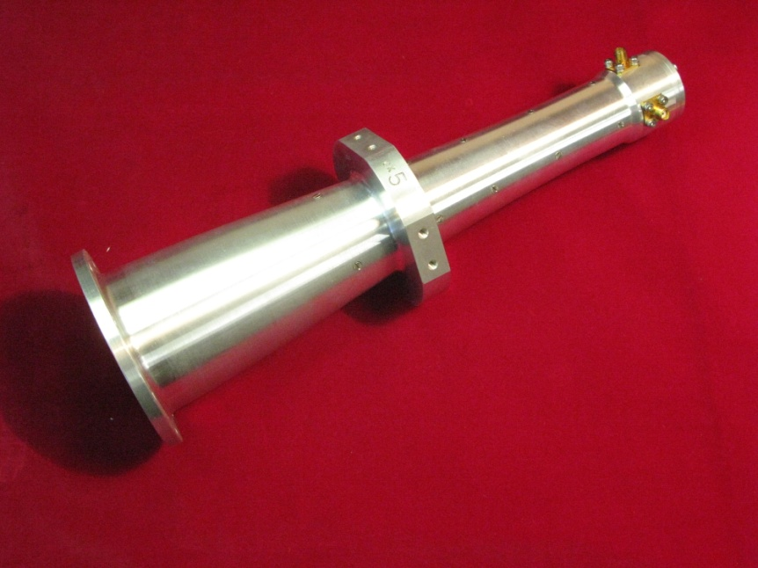
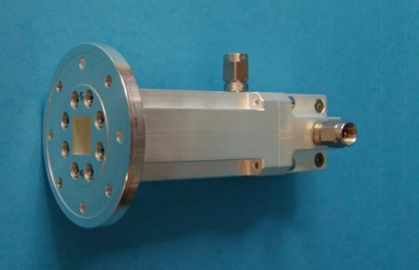
Separating Polarisations –
Ortho-mode Transducers (OMTs)
3mm Ortho-mode transducer
Feed
Polariser
Pol A
Coupler
Signal
Noise source
Pol B
Separates incoming signal into two linear or circular polarisations
Linear OMTs exhibit higher polarisation purity over broad frequency bands (usually)
12mm Ortho-mode transducer
4cm Ortho-mode transducer

Slide 13
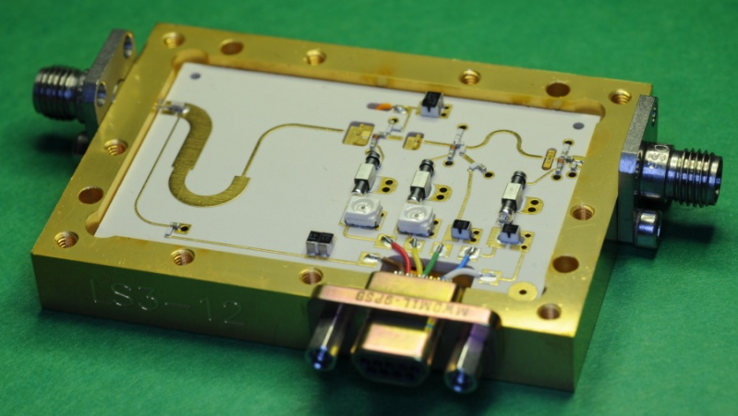
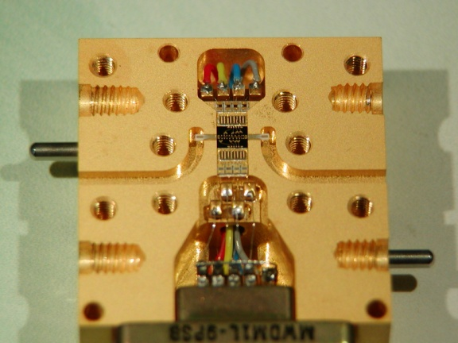
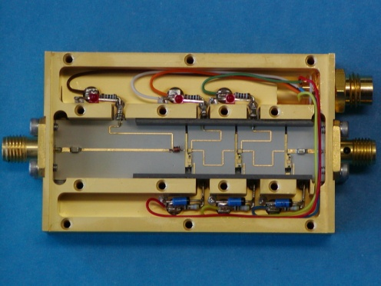
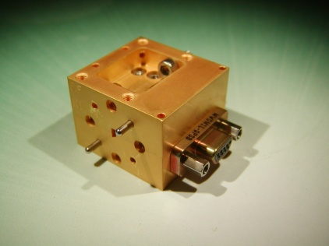
Low Noise Amplifiers (LNA)
Feed
Polariser
Pol A
Coupler
LNA
Signal
To conversion System
Noise source
Pol B
LNA
High Electron Mobility Transistor (HEMT)

Slide 14
Why is the first Low Noise Amplifier so important?
T₁
T₂
T₃
Feed
Signal
LNA
Second Stage Amplifier
Third Stage Amplifier

Slide 15
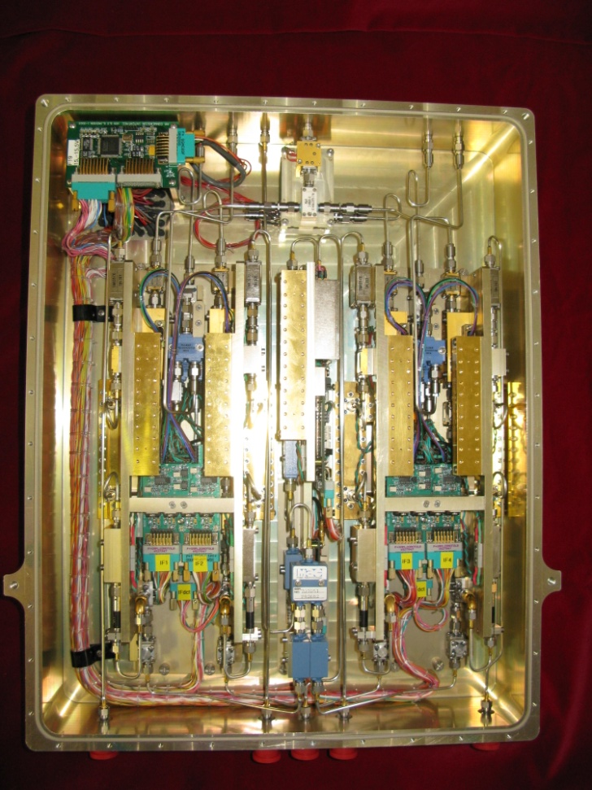
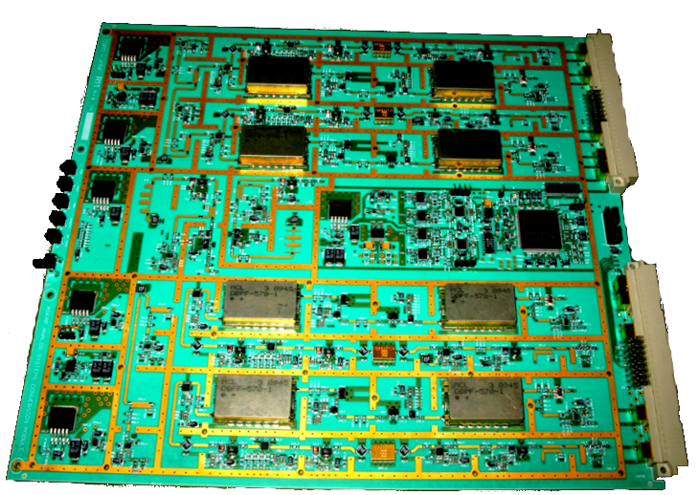
The Conversion System
Frequency Conversion
Level Adjustment
Amplifier
Filter
Signal
To Digitiser
Contains:
more amplification
band defining filters
frequency conversion
level adjustment
signal detection
band shaping

Slide 16
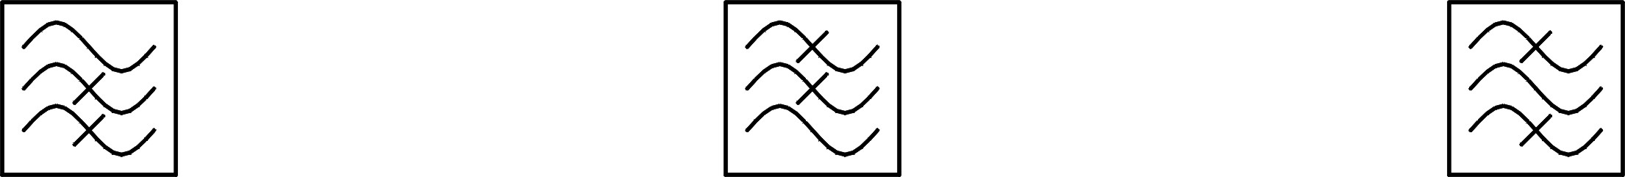
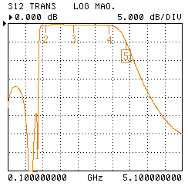
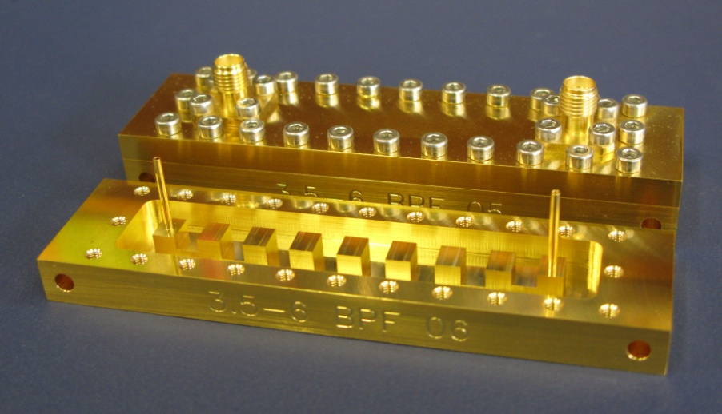
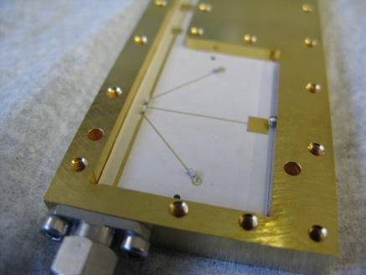
Filters
High Pass Filter
Low Pass Filter
Band Pass Filter
21cm band filter

Slide 17
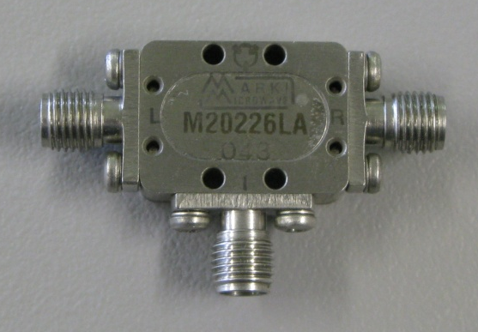
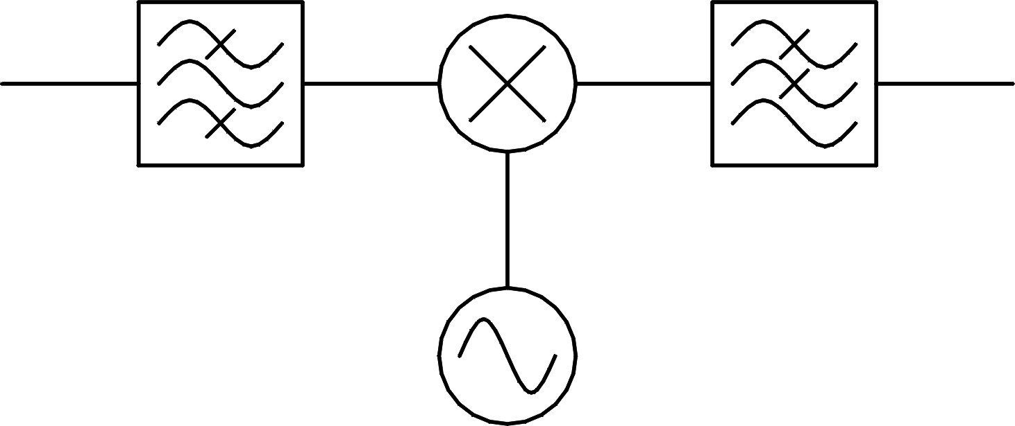
Mixing it down – Frequency Conversion
Mixer (Multiplier)
Signal 1
Signal 1 × Signal 2
Signal 2
cos(ω₁t)cos(ω₂t)=½[cos((ω₁+ω₂)t)+ cos((ω₁-ω₂)t)]
Power
Power
Frequency
Frequency
Δf
Δf

Slide 18
Mixing it down – Frequency Conversion
Mixer (Multiplier)
Signal 1
Low pass filter
Signal 2
cos(ω₁t)cos(ω₂t)=½[cos((ω₁+ω₂)t)+ cos((ω₁-ω₂)t)]
Power
Power
Frequency
Frequency
Δf
Δf

Slide 19
Mixing it down – Frequency Conversion
Mixer (Multiplier)
Signal 1
Local Oscillator
cos(ω₁t)cos(ω_{LO}t) → ½cos[(ω₁-ω_{LO})t]
Power
Power
f_{lo}
Upper Side Band (USB)
Frequency
Frequency
Δf
Δf

Slide 20
Mixing it down – Frequency Conversion
Mixer (Multiplier)
Signal 1
Local Oscillator
cos(ω₁t)cos(ω_{LO}t) → ½cos[(ω_{LO}-ω₁)t]
Power
Power
f_{lo}
Lower Side Band (LSB)
Frequency
Frequency
Δf
Δf

Slide 21
Mixing it down – Frequency Conversion
Mixer (Multiplier)
Signal 1
Local Oscillator
Band pass filter
Power
Power
f_{lo}
Frequency
Frequency
Δf
Δf

Slide 22
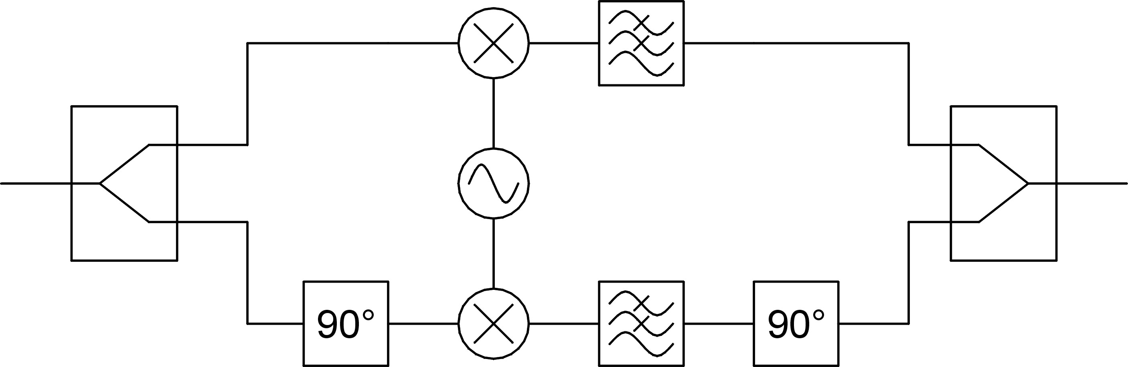
Single Sideband Mixers
2cos(ω₁t)
cos[(ω₁- ω_{LO})t] (USB)
cos[(ω_{LO}- ω₁)t] (LSB)
2√2cos(ω₁t)
0 (USB)
√2cos[(ω₁- ω_{LO})t] (LSB)
RF Signal
-cos[(ω₁- ω_{LO})t] (USB)
cos[(ω_{LO}- ω₁)t] (LSB)
sin[(ω₁- ω_{LO})t] (USB)
-sin[(ω_{LO}- ω₁)t] (LSB)
2sin(ω₁t)

Slide 23
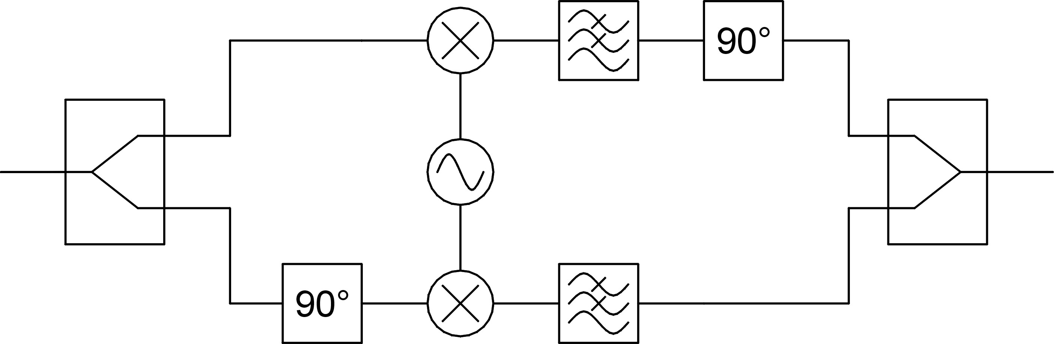
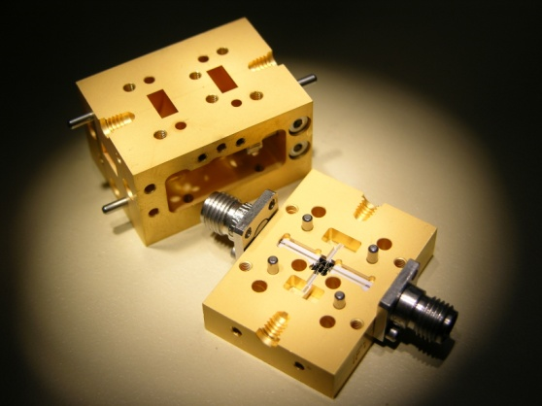
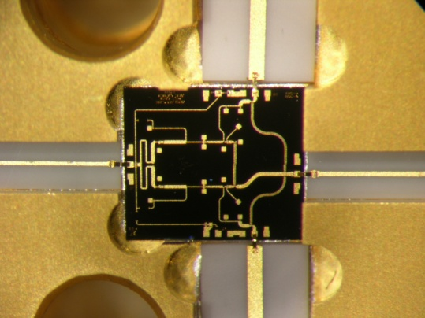
Single Sideband Mixers
2√2cos(ω₁t)
√2cos[(ω_{LO}- ω₁)t] (USB)
0 (LSB)
RF Signal
Upper sideband
Local Oscillator
Signal
Lower sideband

Slide 24
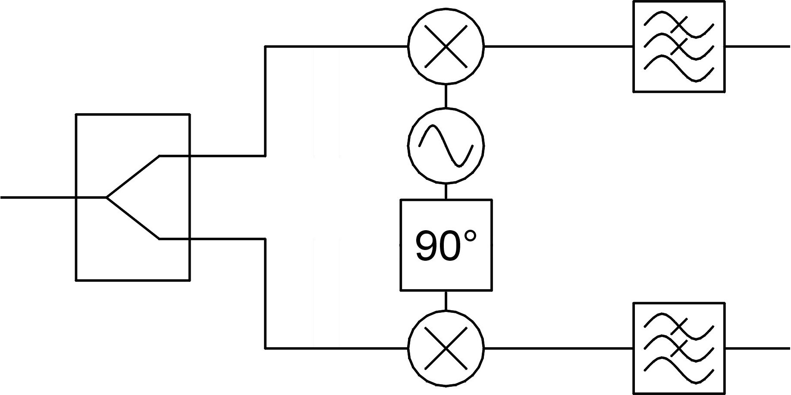
I/Q Mixers
2cos(ω₁t)
cos[(ω₁- ω_{LO})t]
+cos[(ω₁+ω_{LO})t]
cos[(ω₁- ω_{LO})t]
2√2cos(ω₁t)
I/Q Baseband Signal
RF Signal
-sin[(ω₁- ω_{LO})t]
2cos(ω₁t)
sin[(ω₁+ ω_{LO})t]
-sin[(ω₁-ω_{LO})t]

Slide 25
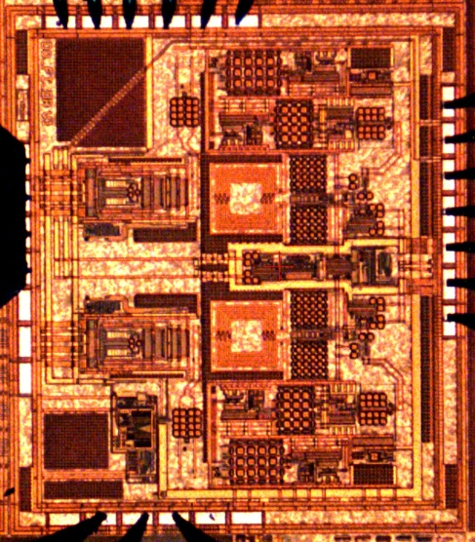
Or Graphically
I/Q Baseband Signal
RF Signal
Power
Power
f_{lo}
Frequency
Frequency
Δf
Δf

Slide 26
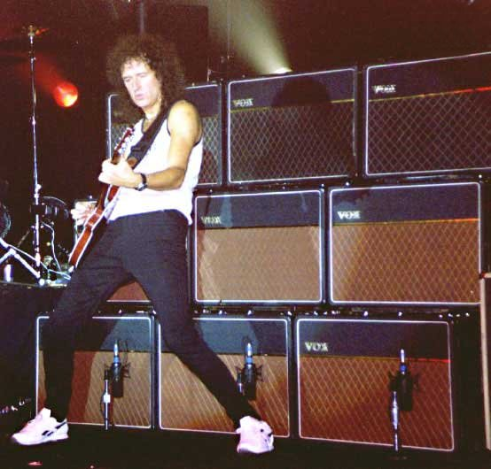
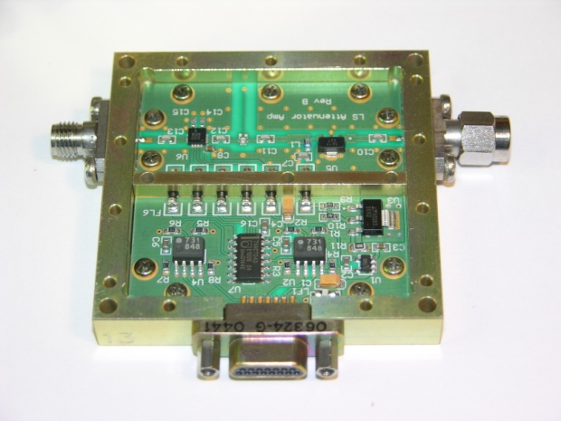
Attenuators – The Volume Knob
Allow the signal level to be varied
May be several in the system
Usually set automatically
Just like some other systems if you turn the signal down too far all you get is noise and if you turn it up to far you get distortion!

Slide 27
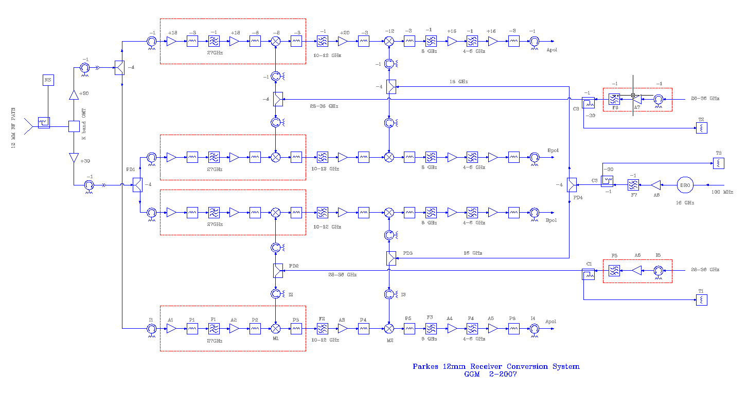
Of course real systems are a little more complicated.
They often contain multiple conversions and many amplification and filter stages....
But that’s the gist of it.

Slide 28
What is the rest of the stuff?
What’s this?
What’s this?

Slide 29
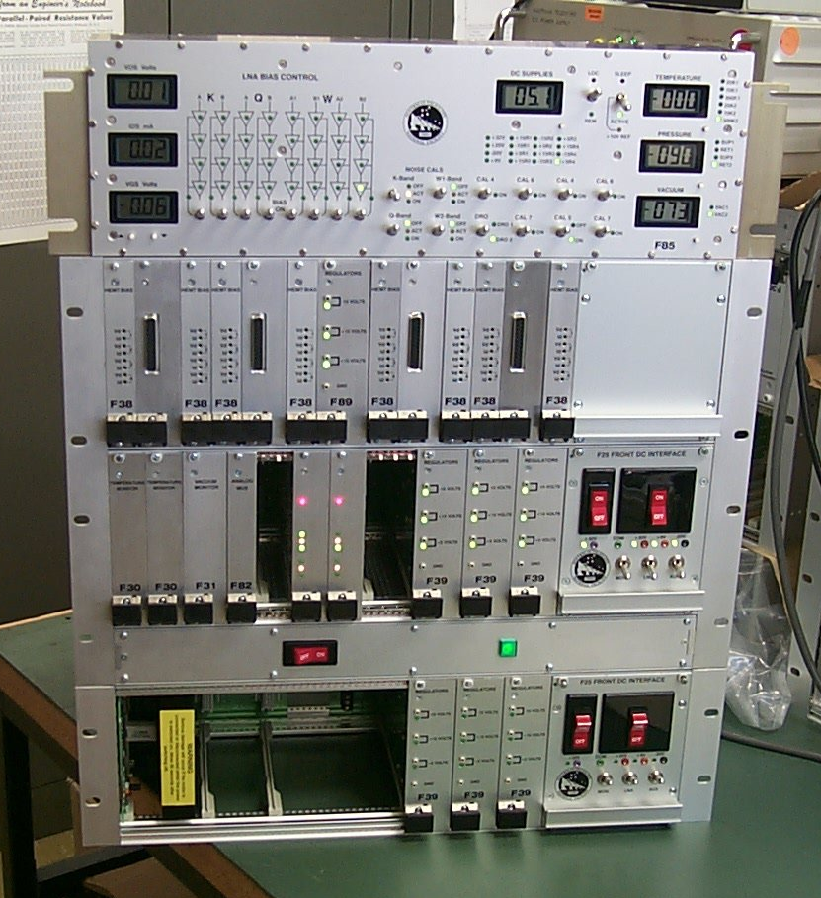
Electronics
Supplies and monitors all amplifier voltages and currents
Monitors system temperatures and pressures

Slide 30
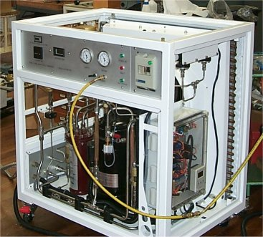
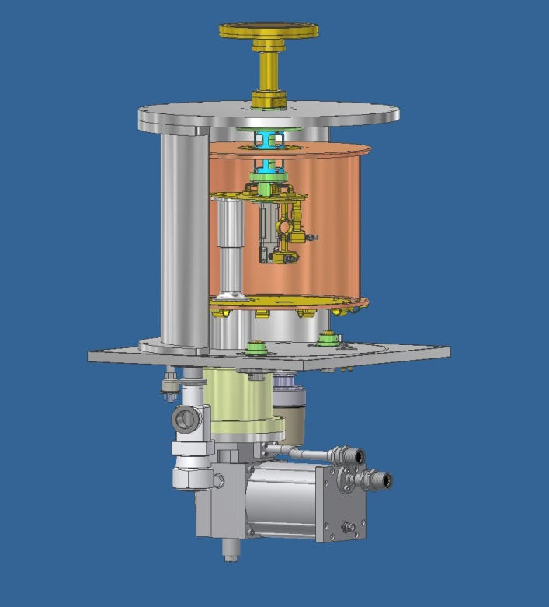
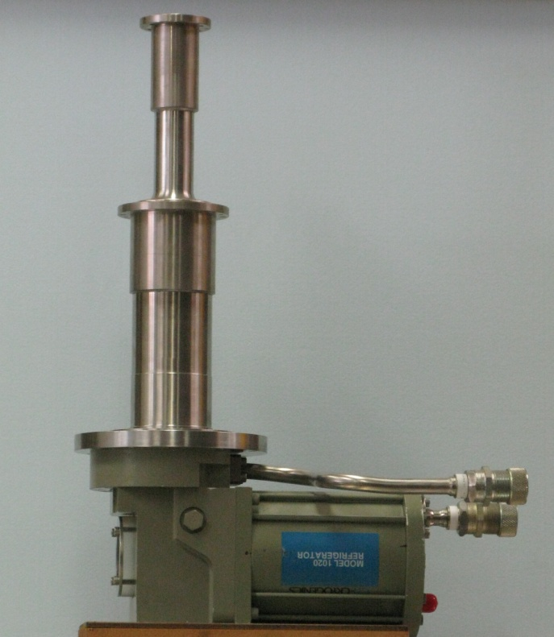
Cryogenics
15K section
80K section
Helium Compressor
Cold finger
Refrigerator in the Parkes 12mm receiver
Helium Lines
Helium Refrigerator

Slide 31
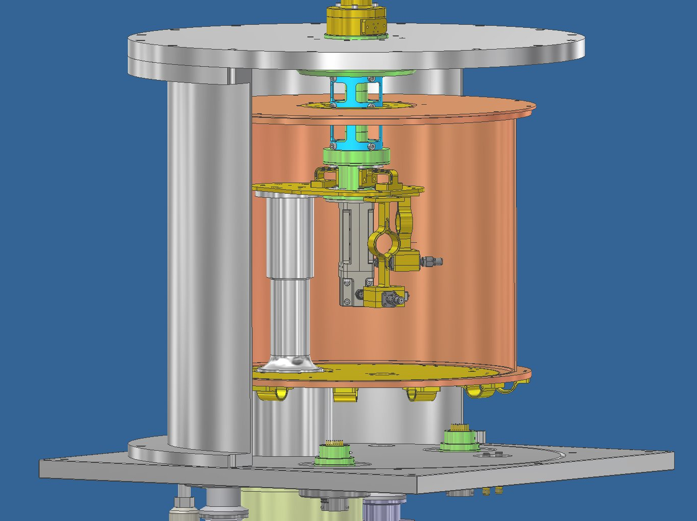
Gap
Thermal Isolation waveguide
Vacuum Dewar
15K section
Low Noise Amplifiers
Helium Refrigerator cold finger
Copper Radiation Shield 80K

Slide 32
….but why do we need to cool our receivers at all?

Slide 33
How weak is the signal?
Effective area of Parkes telescope dish
10Jy radio source →
10 × 10⁻²⁶ W m⁻²Hz⁻¹ × 1900m² × 1 × 10⁹ Hz
= 2× 10⁻¹³ W
Bandwidth of Digital Filter Bank 3
Boltzmann's constant
Your hand →
1.38× 10⁻²³ W Hz⁻¹K⁻¹ × 300K × 1 × 10⁹ Hz
= 4 × 10⁻¹² W
Mobile Phone →
≈ 1W
Lunar Distance
Mobile Phone on the moon→
≈ 1W ÷ 4π (3.8×10⁸m)² ÷ 5×10⁶Hz
≈ 10Jy
3G transmit bandwidth

Slide 34
Like your hand all the components in the receiver system contribute a thermal noise signal which masks the astronomical signal we are trying to observe.
By cooling the receiver we reduce these thermal sources of noise and improve the sensitivity of the receiver by 7-10 times.

Slide 35
Reduce noise by cooling
visible
output
amplify
Electronic device generates a signal
audio
output
Cold stuff (liquid nitrogen) – good for making ice cream.

Slide 36


Thank you
CSIRO Astronomy and Space Science
Suzy Jackson
RF Engineer
Phone: 02 9372 4359
Email: Suzy.Jackson@csiro.au
Web: www.csiro.au/org/CASS
Contact Us
Phone: 1300 363 400 or +61 3 9545 2176
Email: enquiries@csiro.au Web: www.csiro.au

