Slide 1


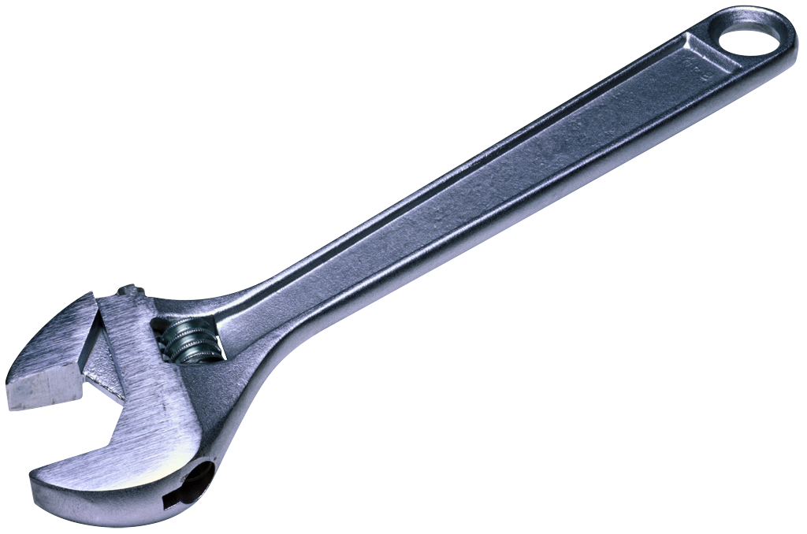
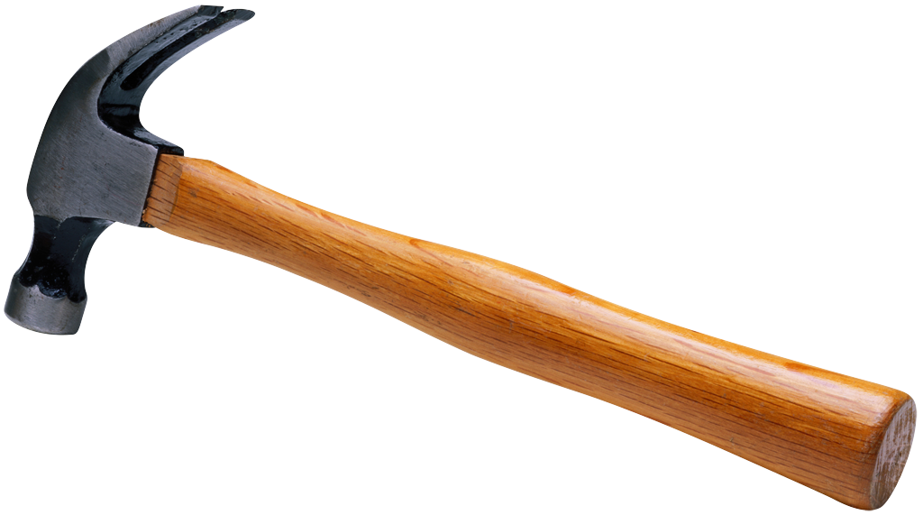
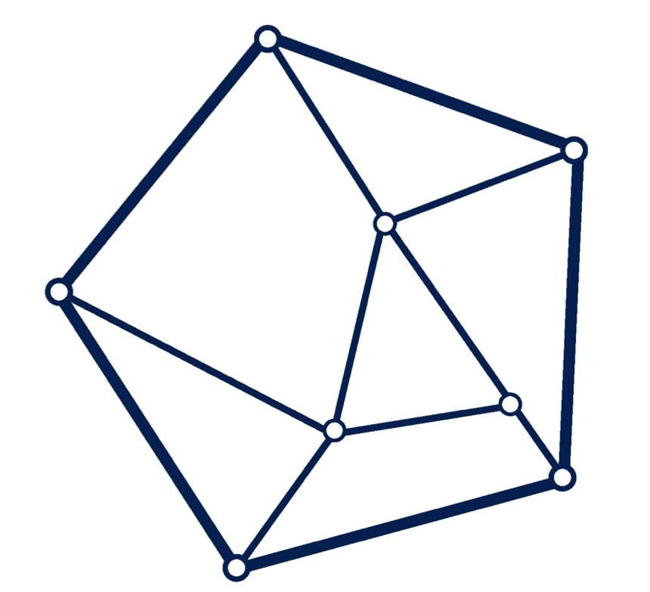
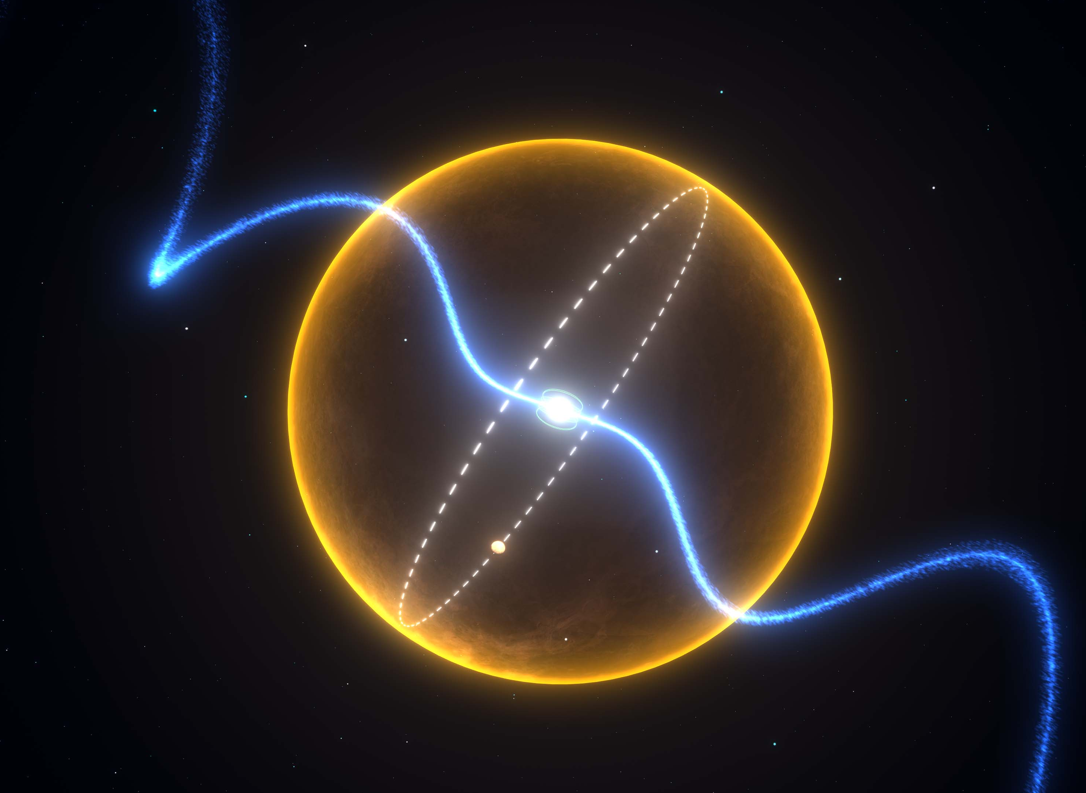
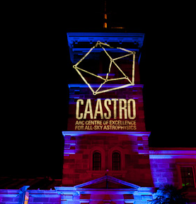
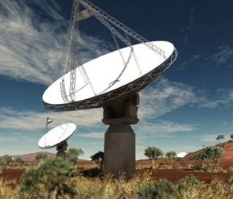
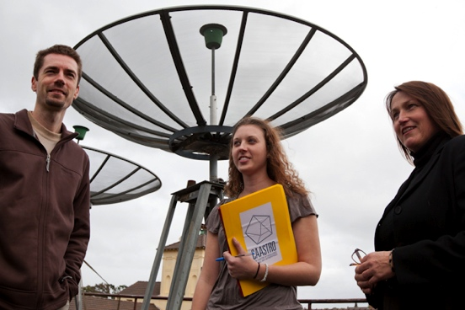
Calibration & Editing
Emil Lenc
University of Sydney / CAASTRO
www.caastro.org
CASS Radio Astronomy School 2014
Based on lectures given previously by Mark Wieringa and John Reynolds
See also “Calibration and Editing”, Fomalont E.B., Perley, R.A., Synthesis Imaging in Astronomy II, 1999, vol. 180, p.79
CSIRO; Swinburne

Slide 2
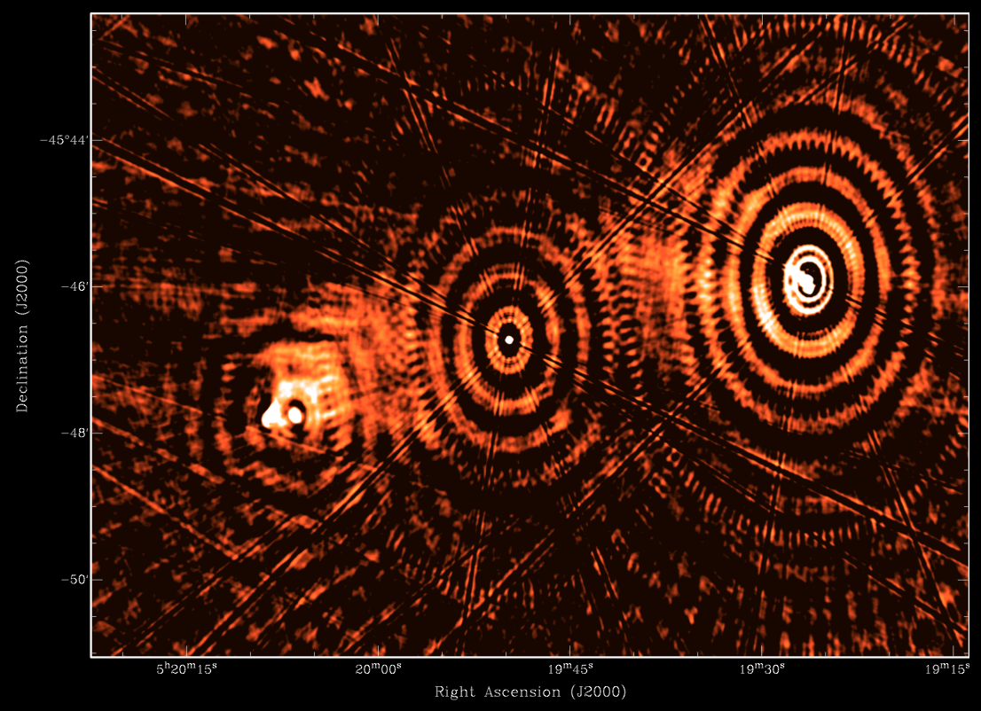
An inconvenient truth
FT(Observed Visibilities) ≠ Pretty Image
Atmosphere
  Ionosphere
  Troposphere
Antenna/Feed
  On-axis gain/sensitivity vs El
  Primary beam correction
  Pointing
  Position (location)
LNA+conversion chain
  Clock
  Gain, phase, delay
  Frequency response
Digitiser/Correlator
  Auto-leveling
  Sampling efficiency
  Birdies
Measureables
  Amplitude
  Phase
  Delay
  Rate
  Polarization
  Spectrum

Slide 3
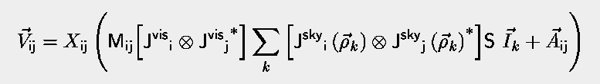
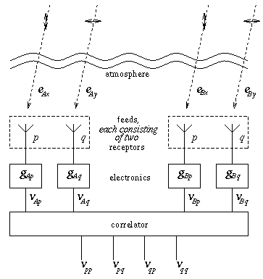
The Measurement Equation
i
j
V_{pp}
V_{pq}
V_{qp}
V_{qq}
V_{ij}=
J_{p}
J_{q}
J_{i}=
V_{ij}

Slide 4
The Measurement Equation
Antenna based:
J^{vis} = B G D P
B = bandpass
G = complex gain
D = pol leakage
P = receptor pos angle
(2x2 matrices)
Sky Intensity Distribution
Polarization Conversion
Antenna beam + pointing
Faraday Rotation
Baseline based additive
A_{ij} = noise + RFI + offsets
Baseline based gain errors
Correlation corrections

Slide 5
Simplified Model
V_{ij}^{obs} = (J_{i} ⊗ J_{j}) V_{ij}^{mod} + noise (vectors of 4 polarizations)
Just look at antenna based gain, leakage and bandpass
  Ignore or separate out other terms
  Troposphere
Antenna based terms: J_{i} = B_{i} (v) G_{i}(t) D_{i} (vectors of 2 pol.)
Solve iteratively, one/two component(s) at a time
  Minimize χ² ⁼ ∑_{ij,t} |V_{ij}^{obs}(t) - (J_{i}(t) x J_{j}(t)) V_{ij}^{mod}⏐²
Use calibration sources (calibrators) to simplify the process
  Strong point source
    Can ignore noise and source structure
  Known, stable flux-density
    No time dependence, fixes flux scale
  Little or no polarization
    Can determine instrumental polarization terms easily
Similar scheme works for more complex sources
  Need to build up a model of the field iteratively
  See High DR Imaging lecture

Slide 6
Visibility corruption
RFI – interference
  Transmitters, Lightning, Solar, Internal RFI
Antenna/Receiver/Correlator failures
  no signal, excess noise, artificial spectral features
Bad weather
  effect gets worse for higher frequency (very low frequency too)
  decorrelation, noise increase, signal decrease (opacity)
Shadowing
  one antenna (partially) blocked by another

Slide 7
Flagging / Editing
Rule 1. Don’t be afraid to throw out data
  Corrupted data can reduce the image quality significantly
  Effect of missing data (even 25%) is often minor and easily corrected in deconvolution
Rule 2. Flag data you know is bad early
  Save your sleuthing skills for the hard stuff
    See “Error recognition” talk
Rule 3. Use shortcuts where possible
  Detailed visual inspection of all data is rapidly becoming impossible
  Collapse, average, difference & automate using scripts

Slide 8
Flagging / Editing
1st pass: use on-line flags (automatic)
  Flags when antennas are off source or correlator blocks offline.
2nd pass: Use the observing logbook! Saves lots of time later.
  Note which data is supposed to be good & discard data with setup calibration, failed antennas, observer typos etc.
3rd pass: Use automatic flags
  Correlator birdies, Common RFI sources (options=birdie, rfiflag)
  Shadowed data: select=shadow(25)
  Data with bad phase stability: select=seeing(300)
4th pass: Check calibrators - plot amp-time, phase-time, amp-freq
  investigate outliers & flag, flag source as well if you can't trust data
5th pass: (After calibration) Inspect & flag source data
  Use Stokes V to flag data with strong sources

Slide 9
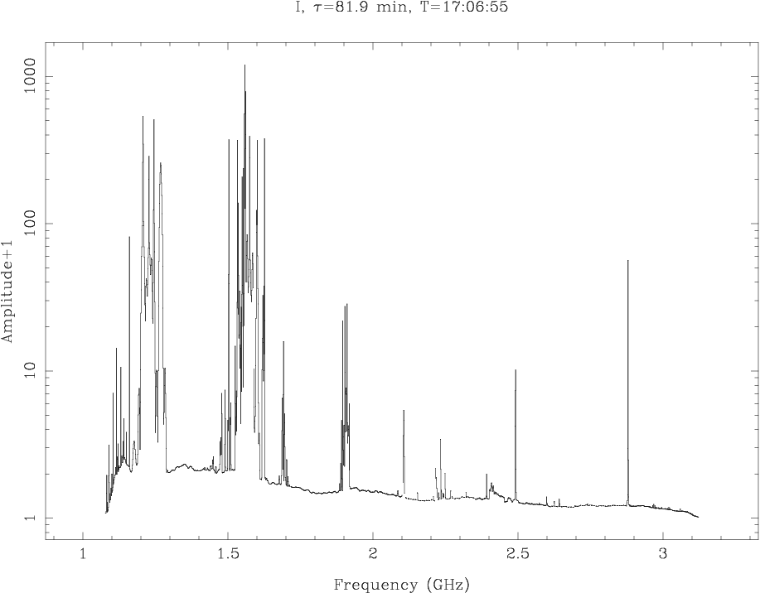
Flagging / Editing
RFI: 1-3 GHz

Slide 10
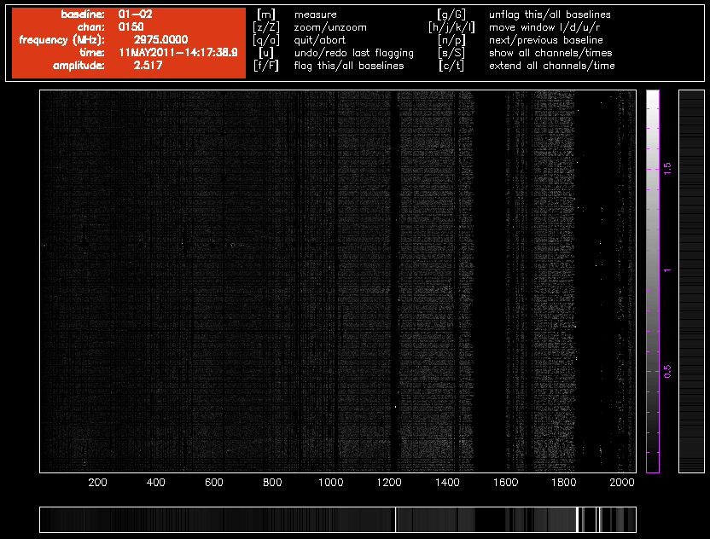
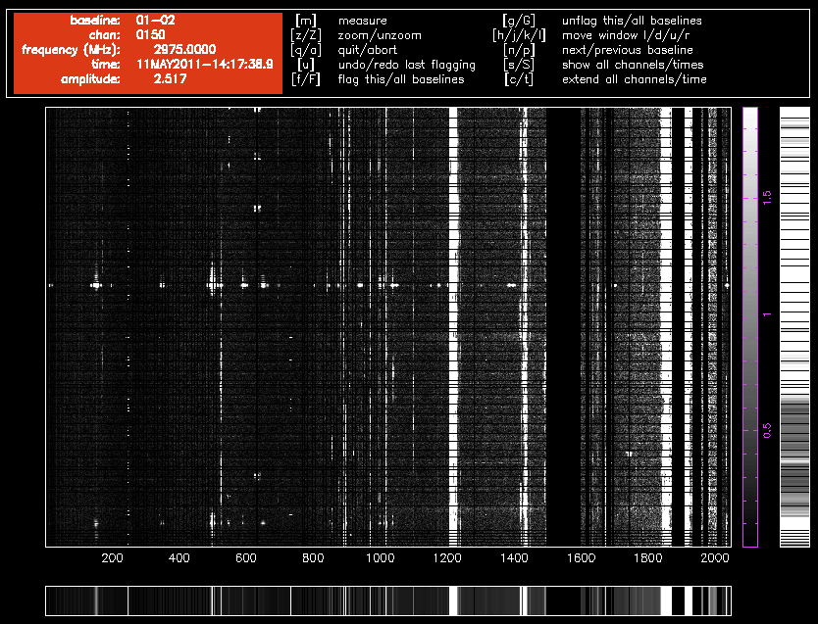
Flagging / Editing
_{PGFLAG}
- Interactively flag, tune params
- Automatic flagging from script
_{SumThreshold flagging}
_{- Subtracts smooth background}
- Clips on running mean in x and y

Slide 11
ATCA Calibration Sequence
Observatory – done after reconfiguration
  Bulk delay (cable lengths)
  Baseline (antenna location) – good to 1-5 mm
  Antenna Pointing – good to 10”-20”
User
  Schedule preparation (observing strategy)
  dcal/pcal/acal: “Real-time” first-pass approximation
  Post-observation calibration

Slide 12
Calibration at reconfiguration
antenna pointing (global pointing model derived from sources in all Az/El directions)
  generally correct to better than 10", occasional 20" error single antenna
  may need reference pointing with nearby cal above 10 GHz
baseline lengths (relative antenna positions)
  generally correct to better than 1-2 mm (depending on weather)
  error significant at 3mm - correct phase with nearby calibrator
global antenna delay (bulk transmission delay in cables)

Slide 13
Calibration – Schedule Planning
Observe primary calibrator 1934-638(cm), Uranus(mm)
  5-15 min, to calibrate the absolute flux scale
  cm/1934: can also solve for polarization leakage and bandpass
  mm:
    Observe separate bandpass calibrator
    Use secondary for polarization leakage
Observe secondary calibrator (close to target)
  1-2 min every 15-60 min
  Atmospheric, instrumental phase variation,
  System gain variations; optional: solve leakage, bandpass
Observe pointing calibrator (above 10 GHz)
  a POINTing scan every 30-60 minutes

Slide 14
ATCA / VLA Calibrator List
Ideal secondary calibrator is strong, small (θ<λ/B_{max}) and close to the target (<15°)
  ATCA + VLA lists ~1000 sources
  Calibrator database lets you make the optimal choice
Primary flux calibrators are also stable with time: PKS1934-638, PKS0823-500
Above 20GHz , the planets are essentially the only primary flux calibrators
  all bright compact sources seem to vary at high frequency
  Planets not ideal – resolved on longer baselines / seasonal variation but recent work has been done to constrain these.

Slide 15
Calibration – Starting up
Calibration done at start of observation:
  Delay calibration
    Correct residual path length for your particular frequency & correlator setup
    Fixes phase slope across band
  Amplitude & Phase
    Equalize gains, zero phases, sets Tsys scale
      helps to detect problems during observation.
  Polarization
    zero delay & phase difference between X & Y feeds
    uses noise source on reference antenna to measure phase.
    generally correct to a few degrees at 3-20 cm

Slide 16
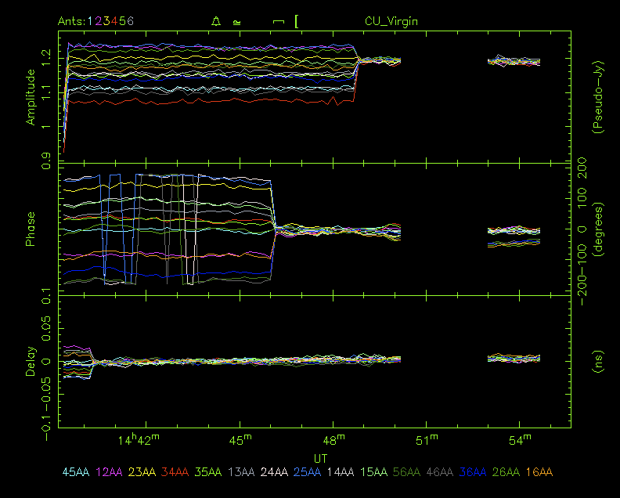
Initial Array Calibration
acal
pcal
ddcal

Slide 17
Calibration – During Observation
Observations of secondary calibrator [+ pointing cal]
  Tsys correction
    estimates system temp from injected noise
    corrects for e.g., ground pickup & elevation, but not for atmospheric absorption
    At 3mm: use Paddle scan calibration instead
Calibration data recorded during the observation:
  Tsys – system temperature
  XY-phase difference on each antenna
  (experimental) Water Vapour Radiometer path length

Slide 18
Calibration – Post Observation
Primary flux calibrator : “bootstrapping” to secondary calibrator
Solve for polarization leakages (cross-terms)
Use secondary calibrator to correct (“straighten”) the phases
Use primary, secondary or other strong point source as bandpass calibrator

Slide 19
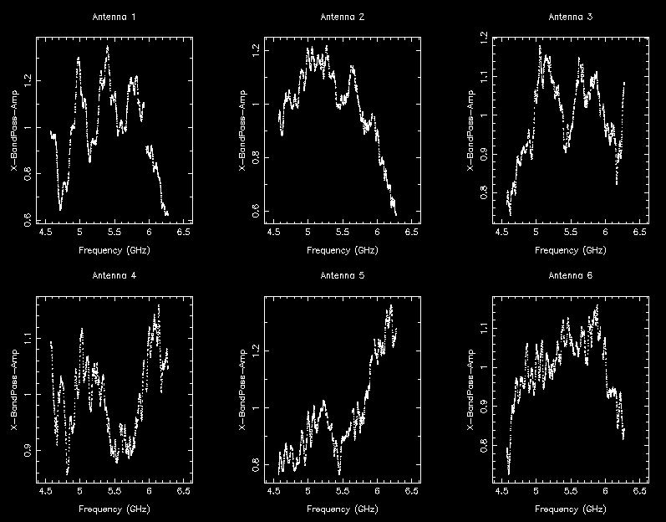
Calibration – Bandpass

Slide 20
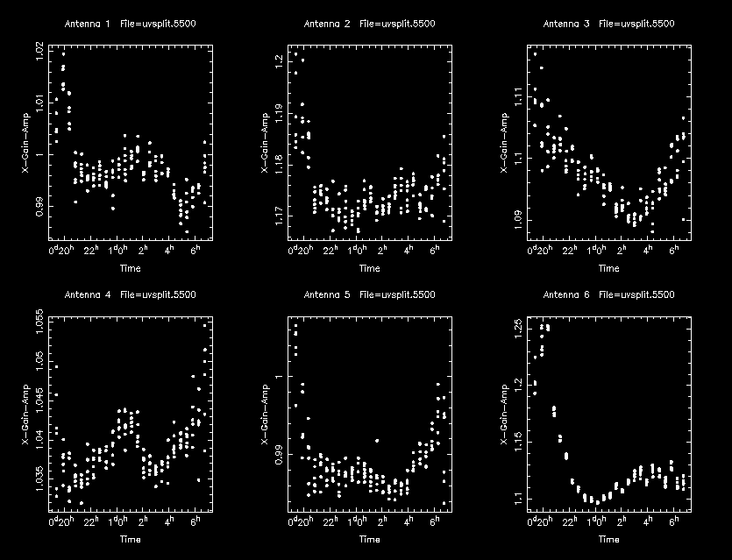
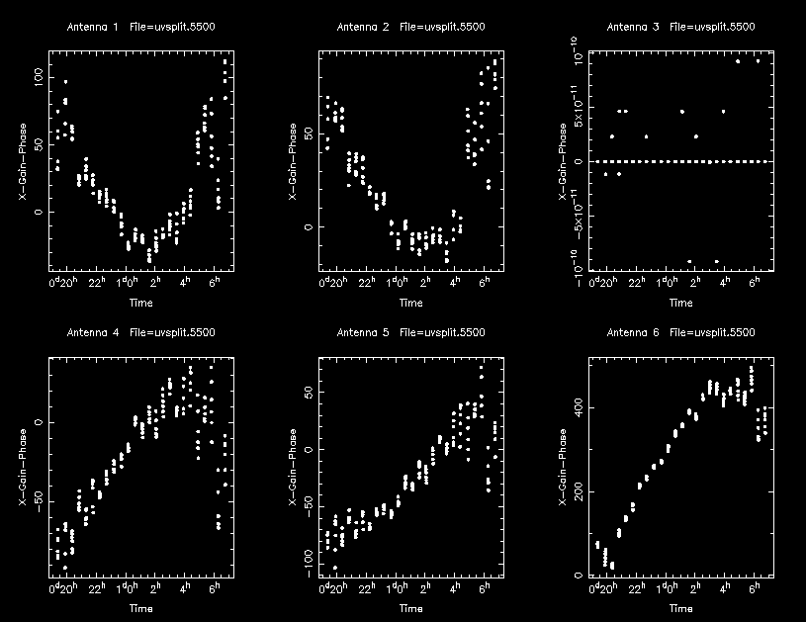
Calibration – Secondary gains

Slide 21
Calibration – Wideband
Gain, Phase and Calibrator flux vary across a 2GHz band
Two approaches possible in Miriad:
  Divide and conquer [uvsplit maxwidth=0.256]
    Split data into 4-16 narrow bands, calibrate independently
  Solve in frequency bins [gpcal nfbin=8]
    Solve independently, interpolate solutions
    Advantages:
      Interpolation fixes phase slope
      Quicker / less bookkeeping
Imaging – combined (PB issue) or separate (SN issue)
  CASApy has better imaging options

Slide 22
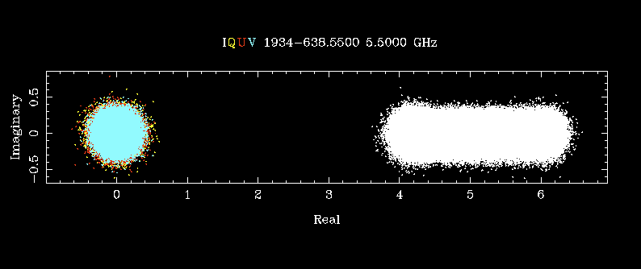
Primary Calibration
6.5GHz
4.5GHz
Calibrated plot of all channels – Imaginary vs Real
Unpolarized; Variation of calibrator flux with Frequency

Slide 23
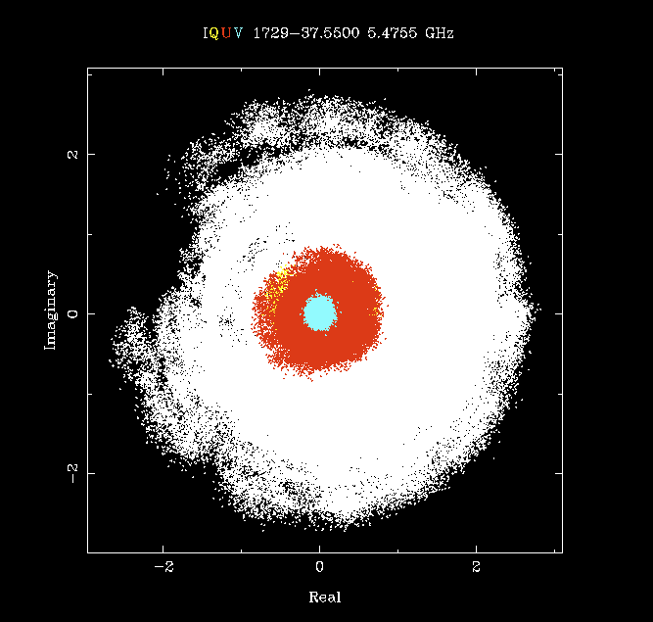
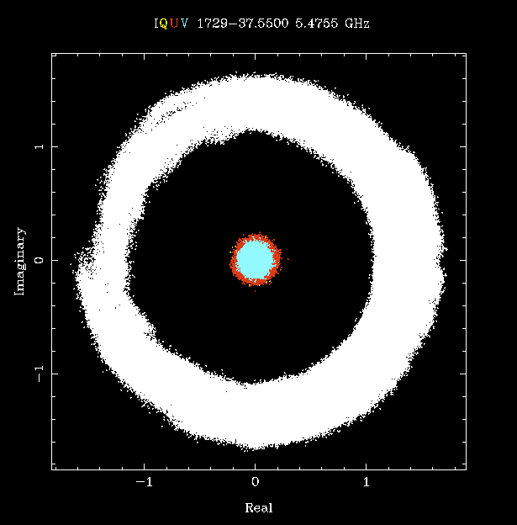
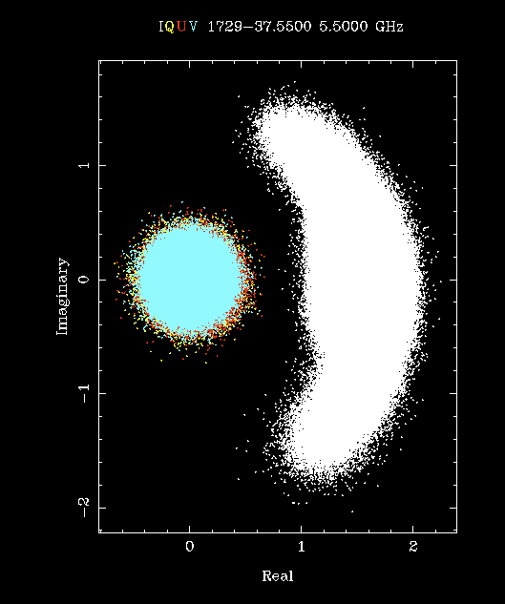
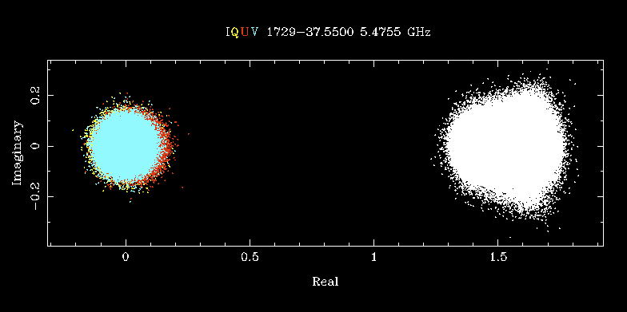
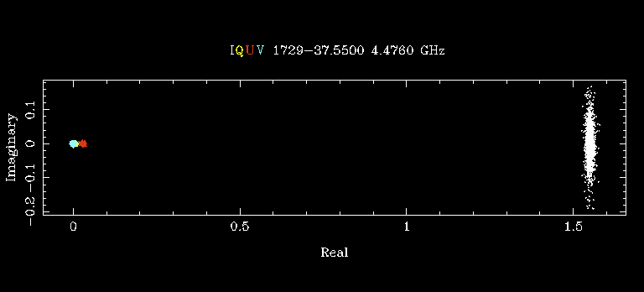
Secondary Calibration
4.5-6.5 GHz
Uncalibrated
BP, pol
Calibrated
Calibrated in 8 freq bins
Freq Averaged

Slide 24
Calibration Recipe
Select primary calibrator
  Solve for complex gain vs time
  Solve bandpass gain vs frequency
  Solve polarization leakage (crosstalk between feeds)
Select secondary calibrator(s)
  Apply bandpass and leakage from primary
  Solve for complex gain vs time
  Bootstrap absolute flux scale (from primary)
Select sources of interest
  Apply bandpass and leakage from primary and complex gains from secondary
  Use calibrated data in subsequent imaging and analysis

Slide 25
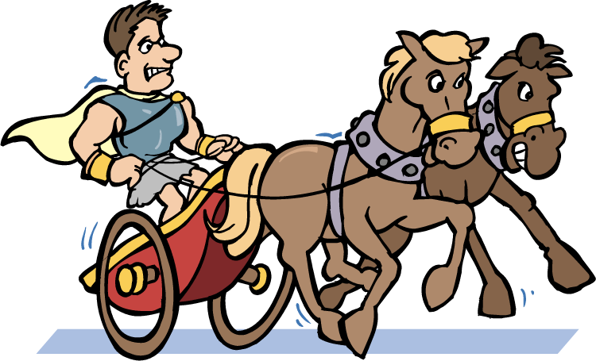
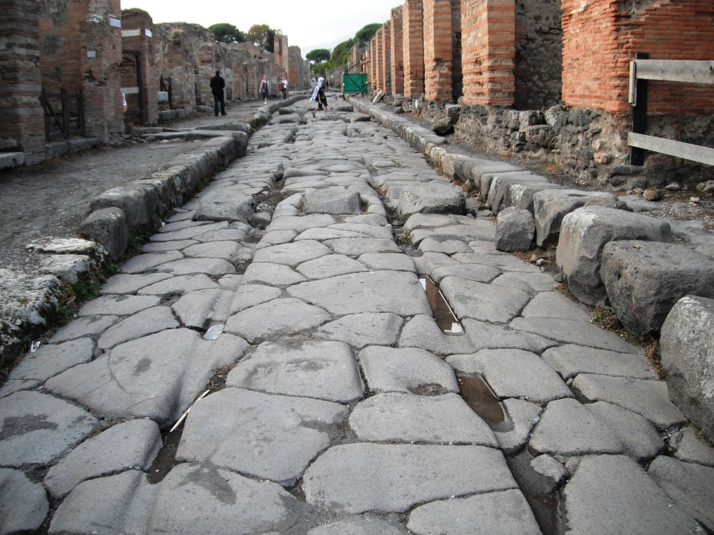
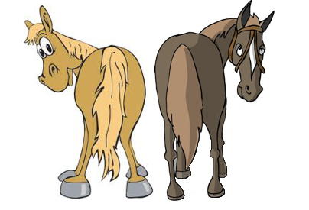
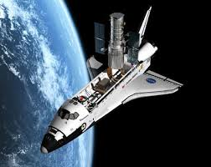
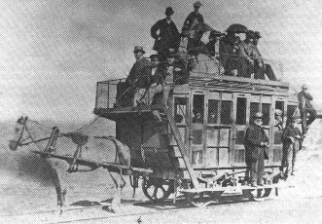
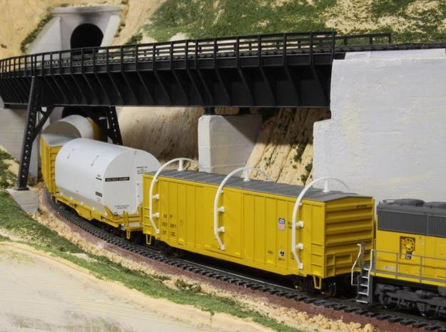
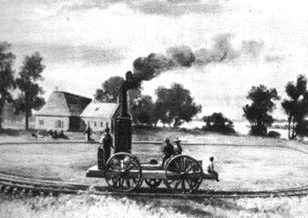
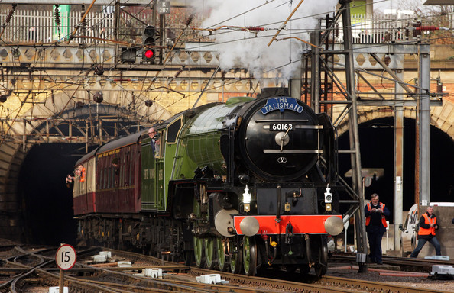
Real “Primary” Flux Calibration

Slide 26
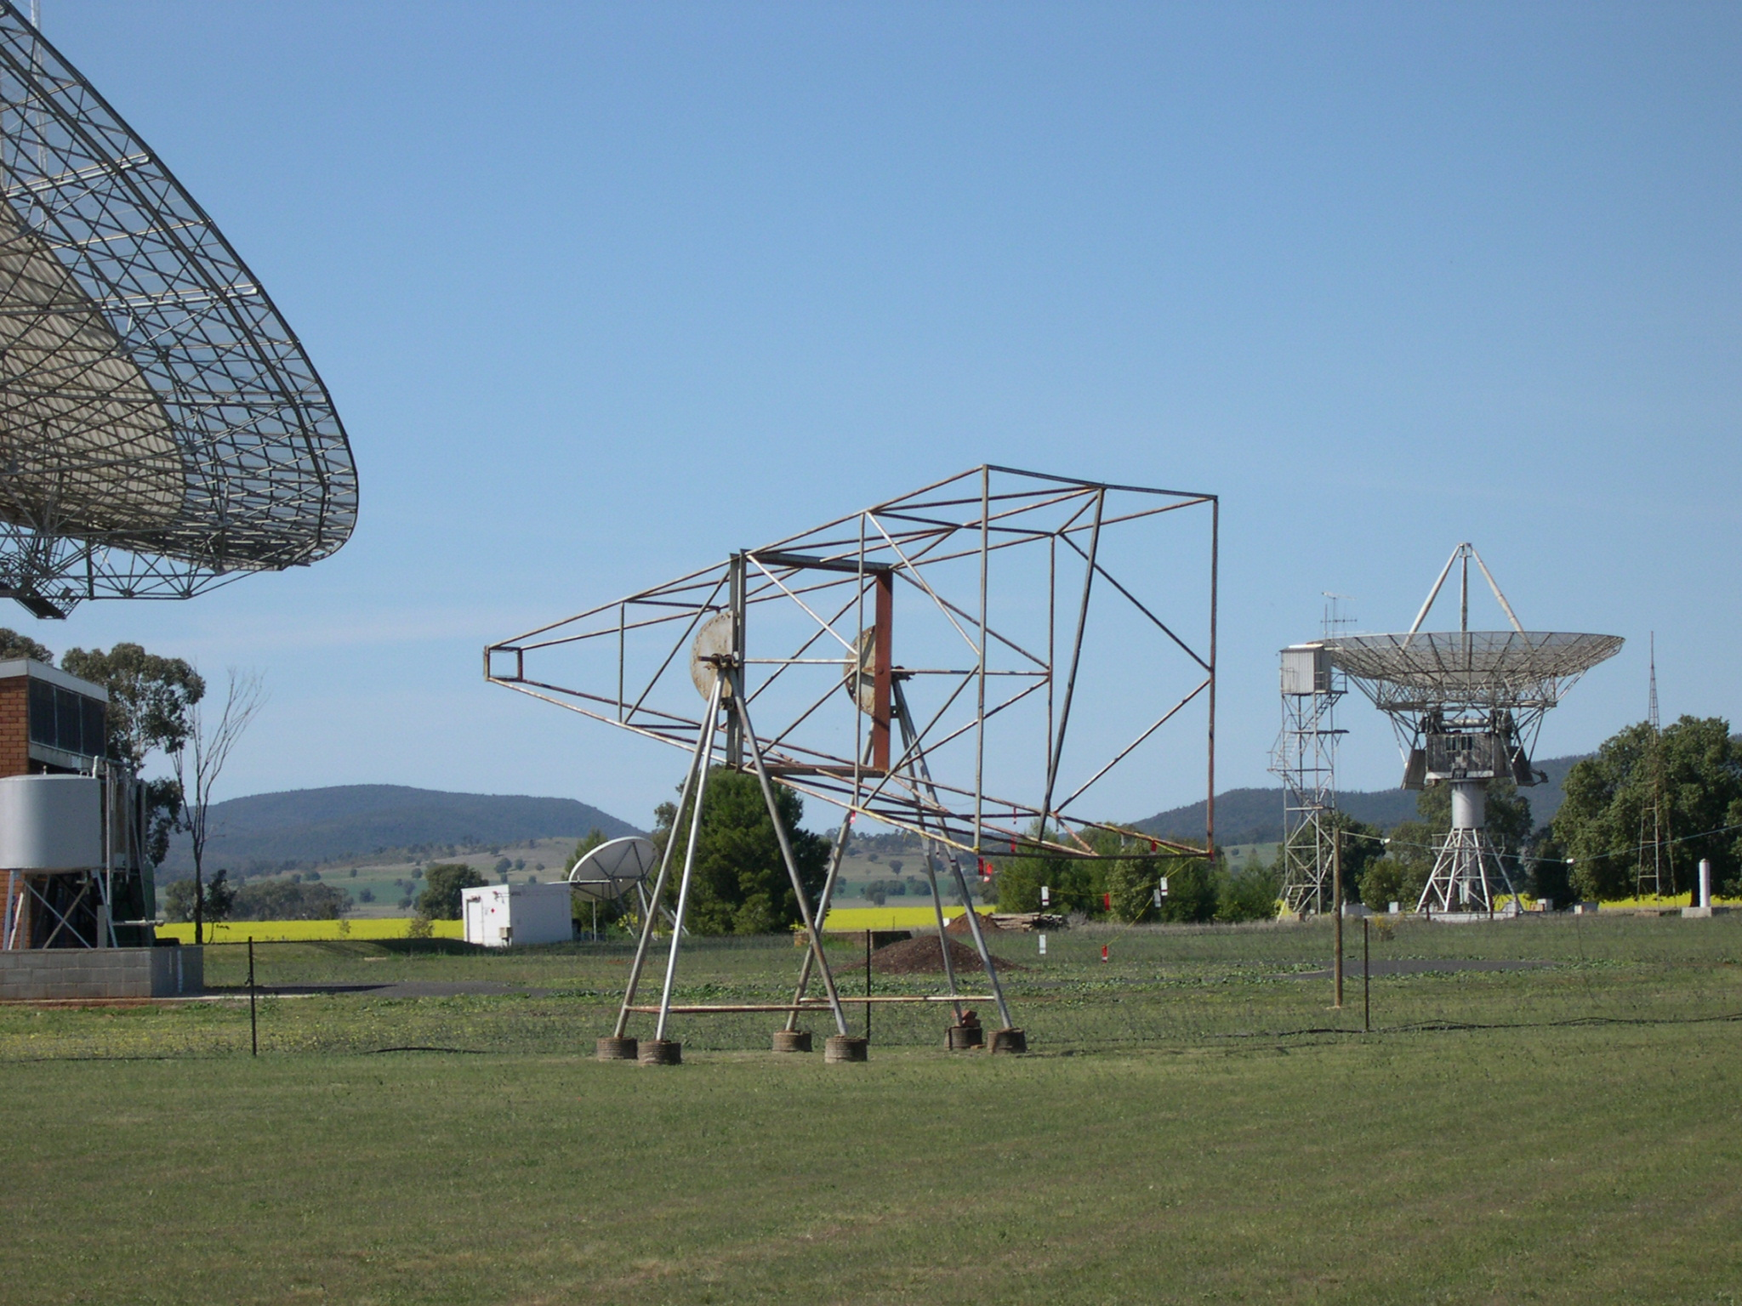
Absolute Flux Calibration
1Jy = 10⁻²⁶ W/m²/Hz
how??

Slide 27
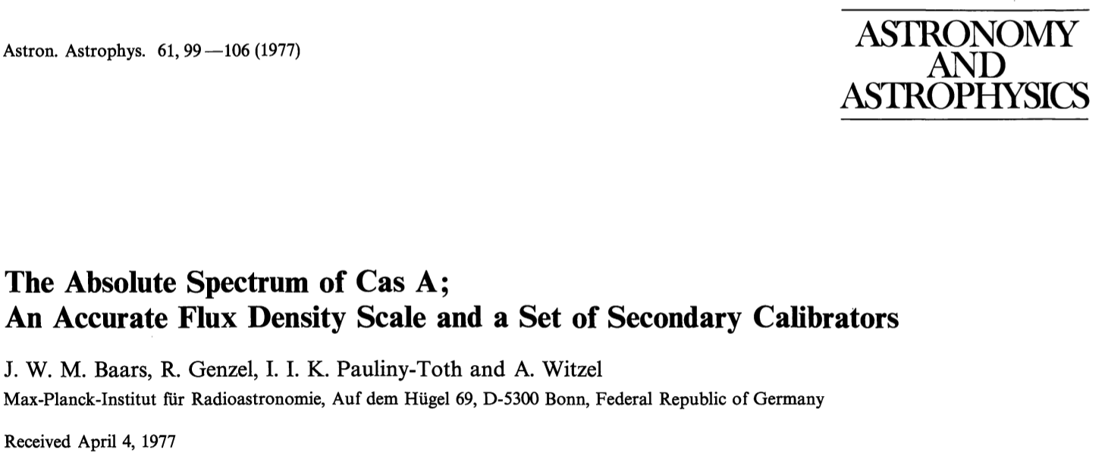
Real “Primary” Flux Calibration

Slide 28
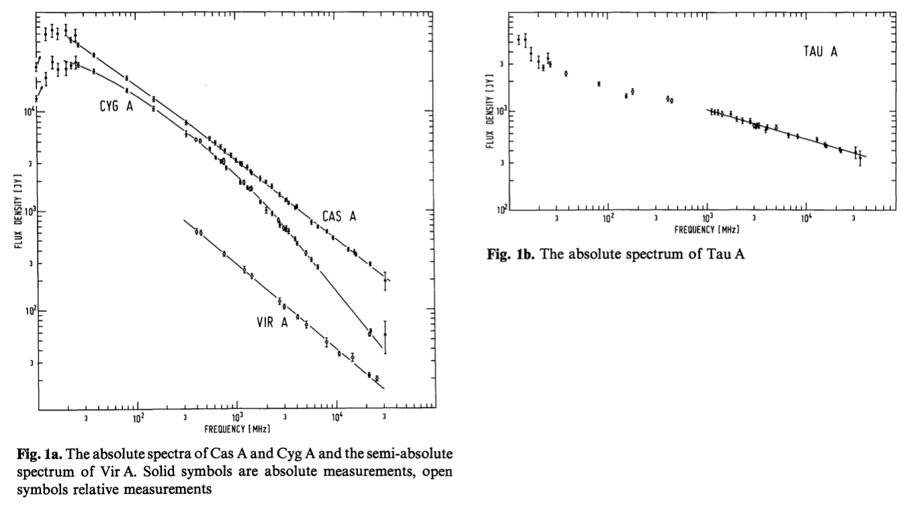
The Big Four
Cas. A
Cyg. A
Vir. A
Tau. A
Transferred to ‘secondary’ cals
3C138, 1934-638, Hydra A

Slide 29
Summary of Reduction Steps
For ATCA/CABB data we still mostly use MIRIAD (CASA for power users)
Load the data from the archive format (RPFITS)
Apply ‘logbook flags’ and check for bad data on calibrators
Calibrate primary calibrator (G,B,D), transfer to secondary (B,D)
Calibrate secondary calibrator (G), transfer to source (G,B,D)
Flag bad data on source (PGFLAG, BLFLAG)
Analyze data (imaging, statistics, source fitting)

Slide 30
Acknowledgements
This talk is based on:
  Mark Wieringa version of talk (2001, 2008, 2012)
  John Reynolds’ version of this talk (2003,2006)
  ASP Conference Series Vol. 180, p.79 – available online

