Slide 1


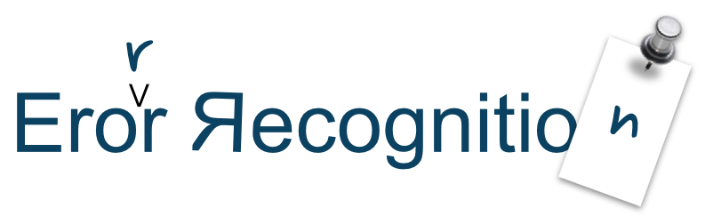
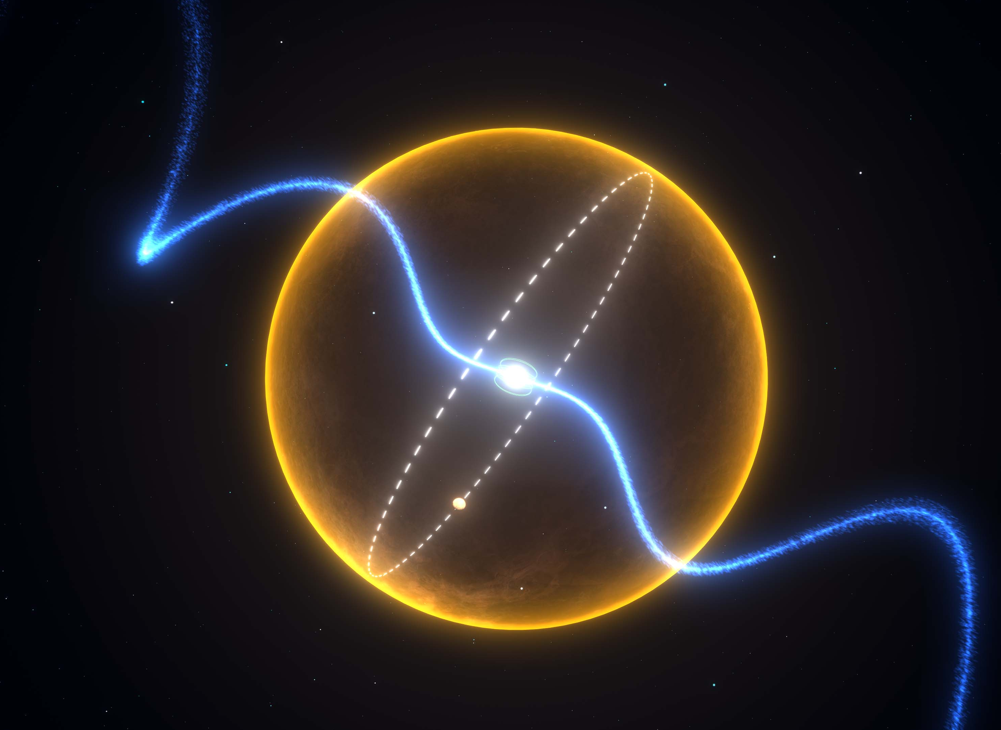
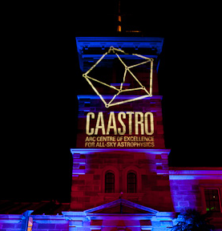
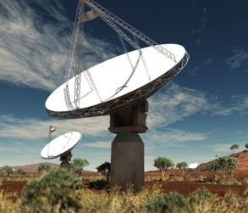
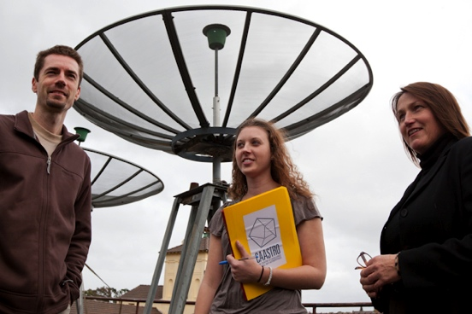
Error Recognition
Emil Lenc (and Arin)
University of Sydney / CAASTRO
www.caastro.org
CASS Radio Astronomy School 2014
Based on lectures given previously by Ron Ekers and Steven Tingay
CSIRO; Swinburne

Slide 2
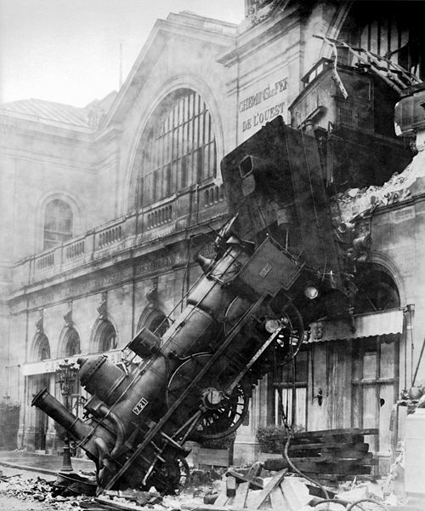
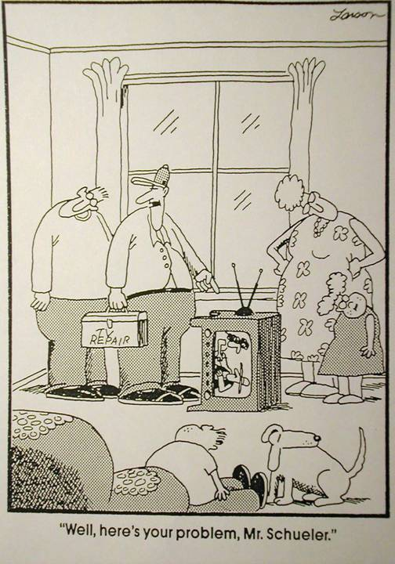
Error Recognition
Some errors are easy to recognise
Some are hard to fix
Some are easy to fix

Slide 3
Where do errors occur?
Most errors and defects occur in the uv plane
  Measurement errors (imperfect calibration – see Emil Lenc’s Calibration and Editing talk).
  Approximations made in the uv plane.
  Approximations made in the transform to the image plane.
Some are due to manipulations in the image plane.
  Deconvolution (see Rick Perley’s talk).
What we usually care about are effects in the image plane (not always e.g. spectral line).
The relative contribution of certain errors will vary depending on the nature of the observation.

Slide 4
Image or uv plane?
We need to work between the uv plane and the image plane.
  Different types of errors may be more obvious in one plane than the other.
  A good understanding of the relationship between both planes helps (see John Dickey’s talk on Fourier Transforms).
Errors obey Fourier transform relations.
  Narrow features transform to wide features and vice versa.
  Symmetries important – real/imaginary, odd/even, point/line/ring.
  The transform of a serious error may not be serious!
  Some effects are diluted by the number of other samples.

Slide 5
General form of errors
Additive errors (out-of-field sources, RFI, cross-talk, baseline-based errors, noise)
  V + ε ➔ I + F[ε]
Multiplicative errors (uv-coverage effects, gain errors, atmospheric effects)
  V•ε ➔ I ★ F[ε]
Convolutional errors (primary beam effect, convolutional gridding)
  V ★ ε ➔ I•F[ε]
Other errors
  Bandwidth and time average smearing.
  Non-coplanar effects (see Wide Field Imaging talk by Martin Bell)
  Deconvolutional errors (see Deconvolution talk by Rick Perley)
  Software!!! (see everyone!)

Slide 6
Error Diagnosis
If ε is pure real, then the form of the error in the uv plane is a real and even function i.e. F[ε] will be symmetric.
  Such errors are often due to amplitude calibration errors.
If ε has an imaginary component, then the form of the error in the uv plane is complex and odd i.e. F[ε] will be asymmetric.
  Such errors are often due to phase calibration errors.
Short duration errors
  Localized in uv plane but distributed in image plane.
  Narrow features in uv are extended in orthogonal direction in image.
Long timescale errors
  Ridge in uv plane causes corrugations in image plane
  Ring in uv plane causes concentric “Bessel” rings in image plane

Slide 7
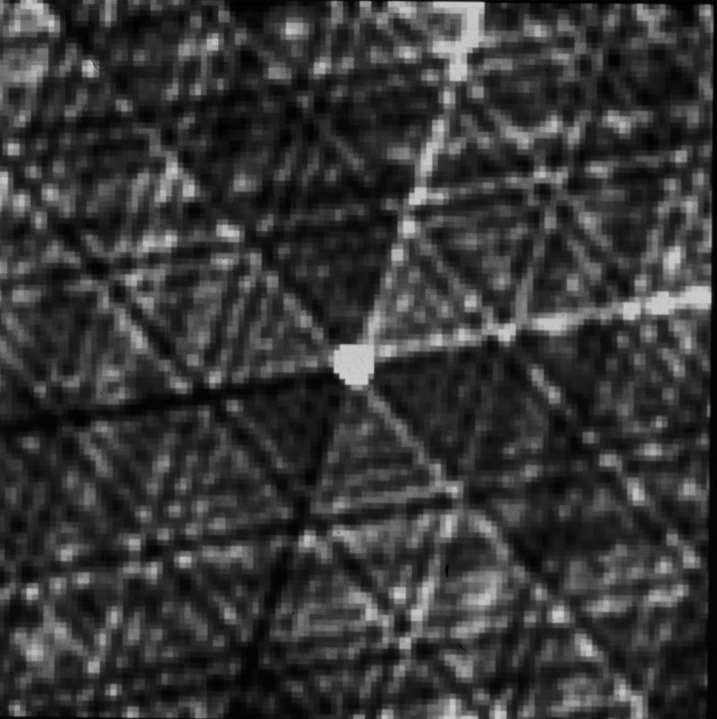
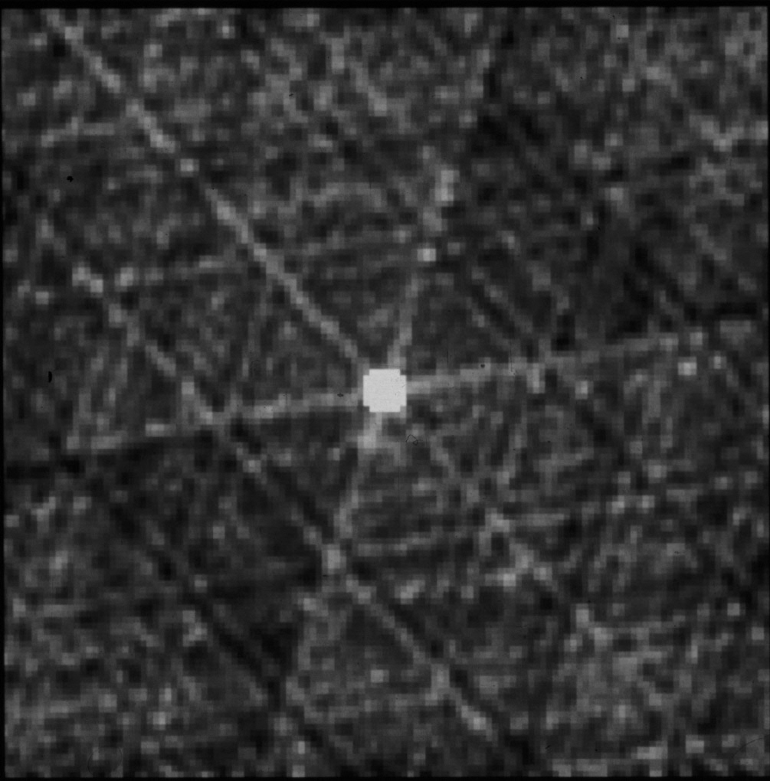
Gain Errors
10 deg phase error
20% amp error
anti-symmetric ridges
symmetric ridges
_{Adapted from Myers 2002}

Slide 8
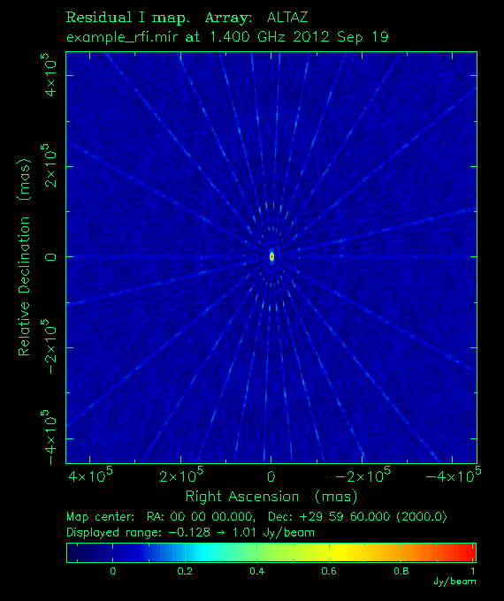
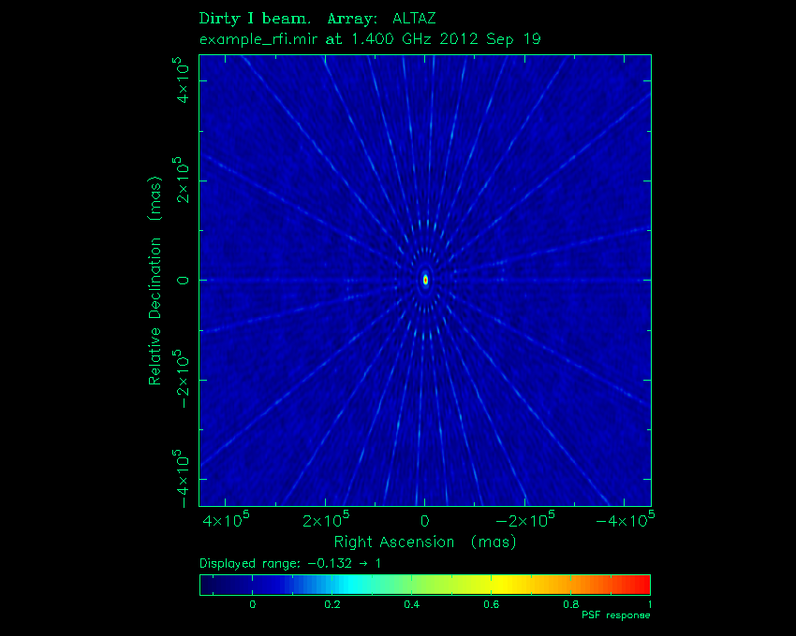
_{Additive Errors: RFI}
Dirty Map
PSF
Observation of 1 Jy source

Slide 9
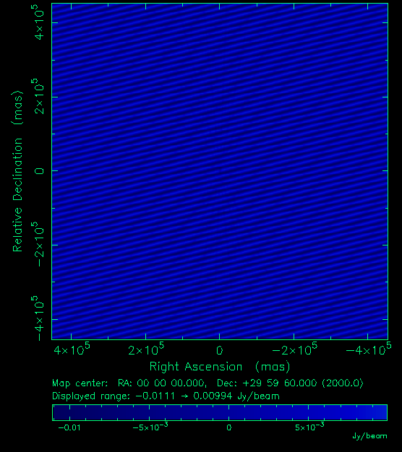
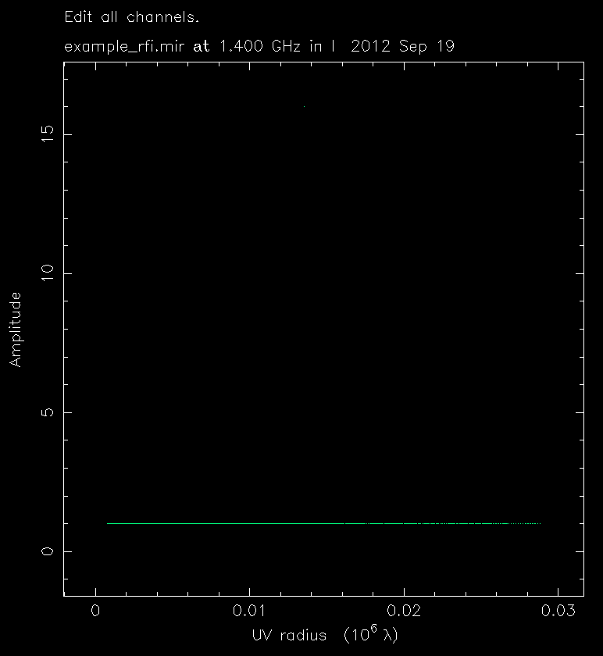
_{Finding RFI}
Observation of 1 Jy source
See Mark’s talk for more on removing RFI.

Slide 10

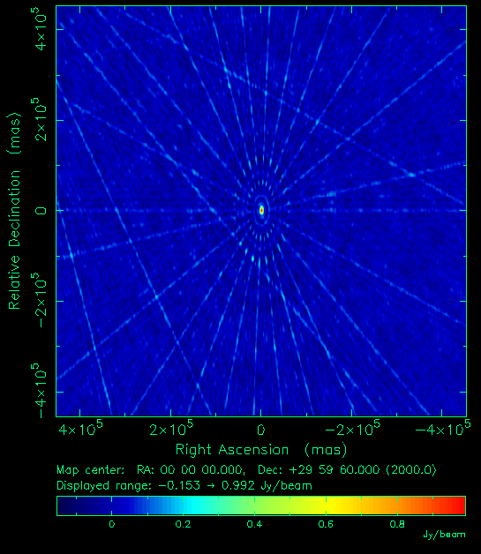
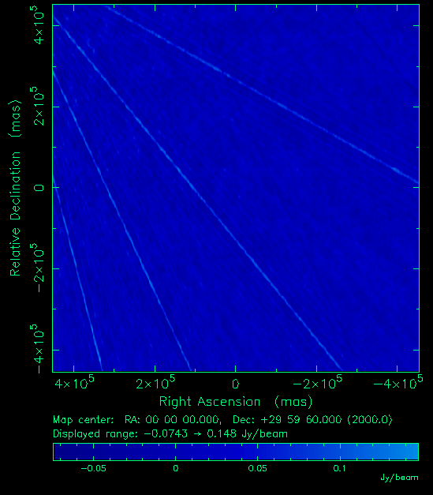
The Bigger Picture

Slide 11
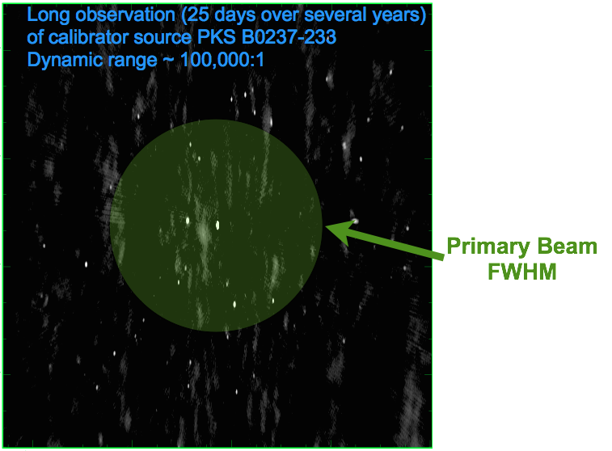
The Bigger Picture

Slide 12
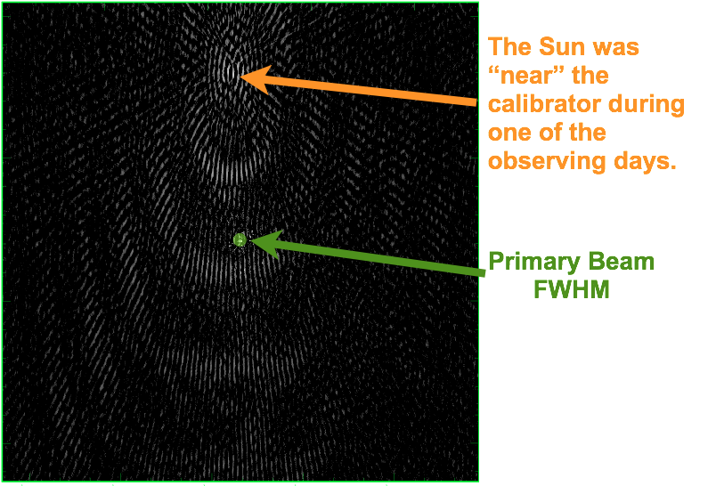
The Bigger Picture
>6 deg!

Slide 13
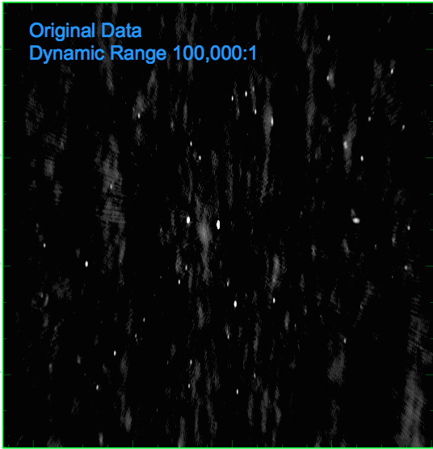
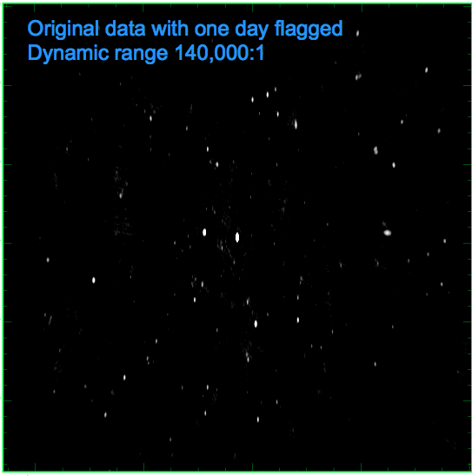
The Bigger Picture

Slide 14
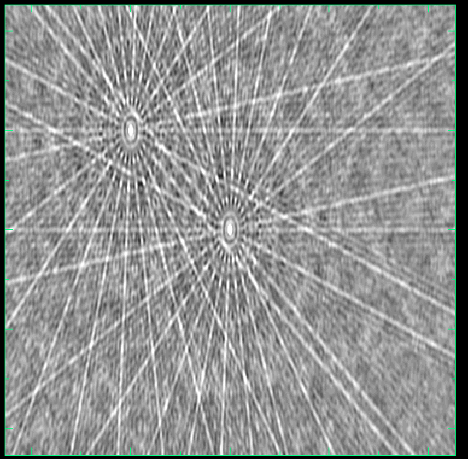
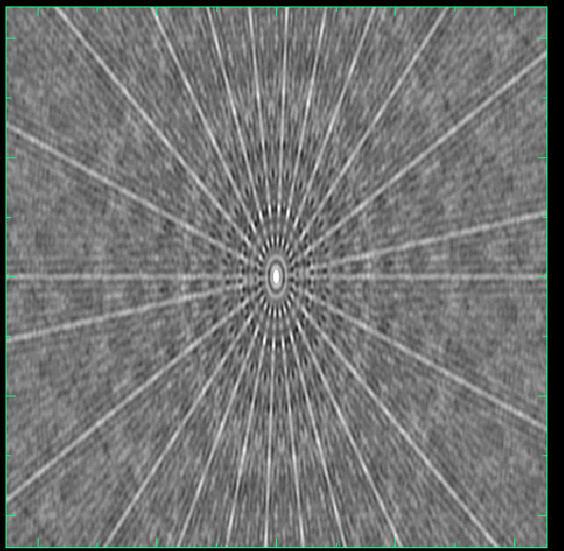
Multiplicative Errors
Dirty Map
PSF

Slide 15
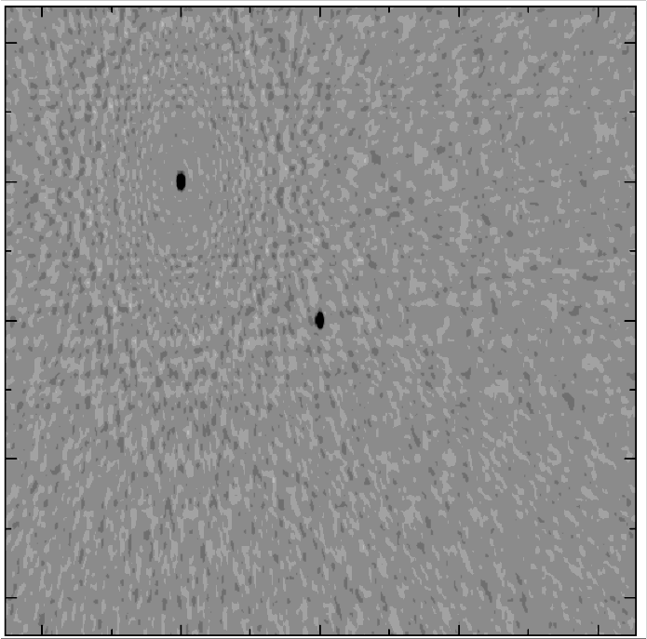
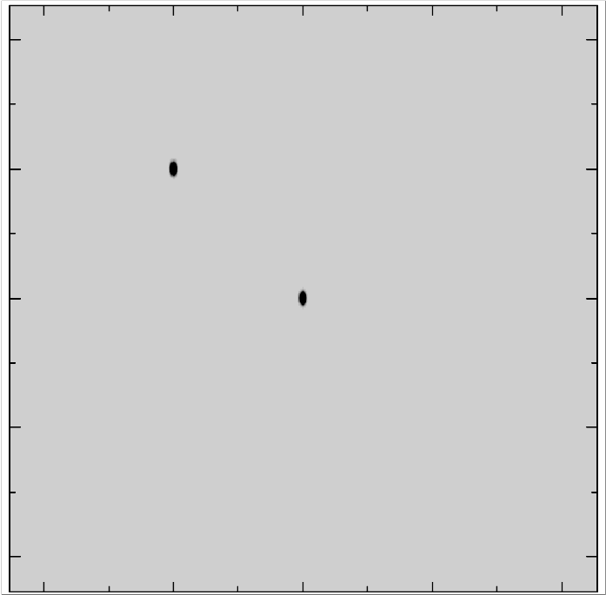
Primary Beam Error
Common in widefield imaging/instruments
Deconvolved
Peeled
Peeling applicable to transient and variable sources too.

Slide 16
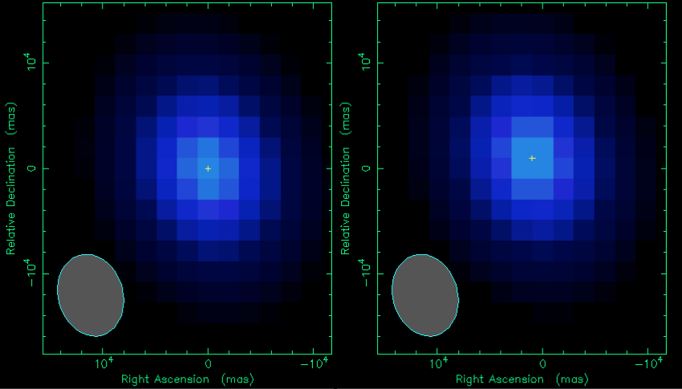
Point Deconvolution Errors
Pixel centred
Pixel not centred

Slide 17
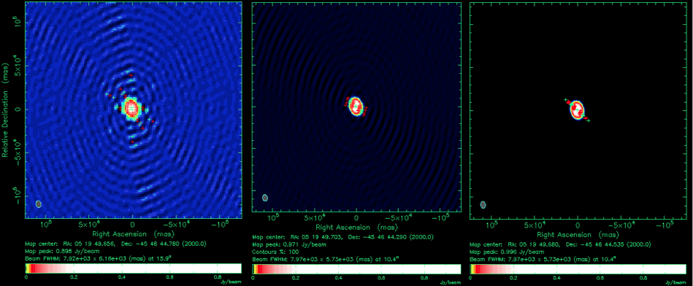
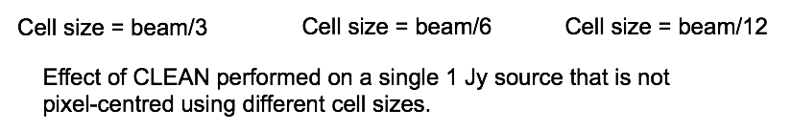
Point Deconvolution Errors

Slide 18
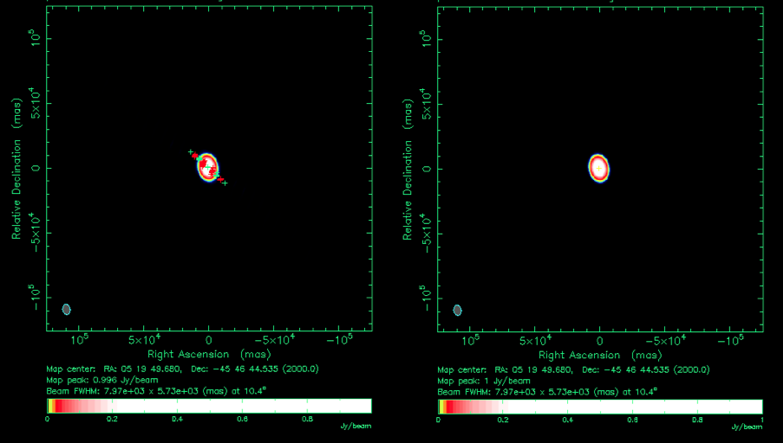
Point Deconvolution Errors

Slide 19
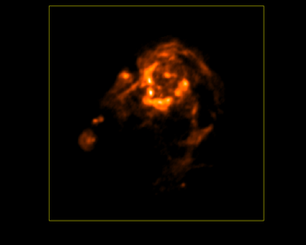
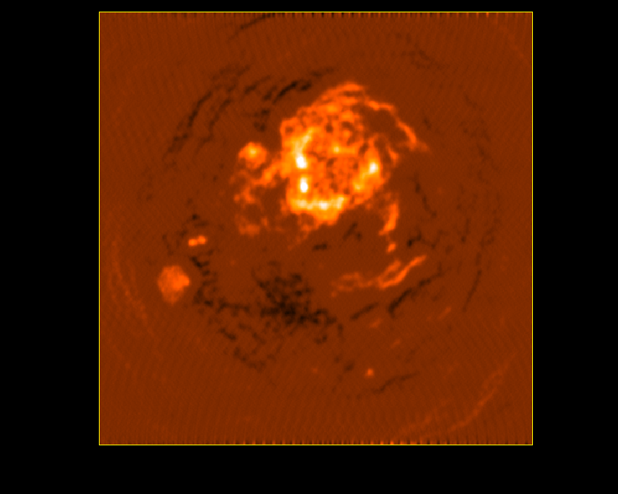
Deconvolution Errors
(Large-scale Structure)
True sky
Standard CLEAN
Standard CLEAN does not handle large-scale structure well – results in negative bowls. More modern algorithms such as Multi-scale CLEAN are necessary to minimise deconvolution errors (see Rick Perley’s talk).

Slide 20
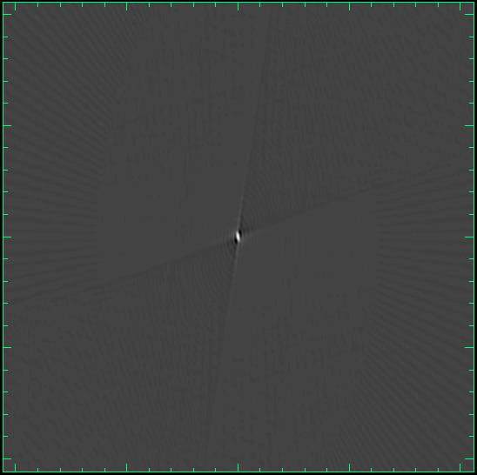
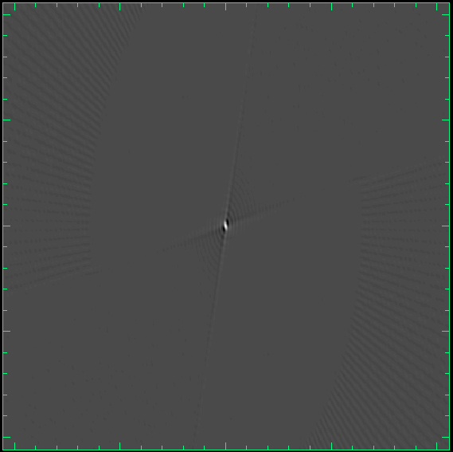
Wideband Deconvolution Errors
Dirty Image (2.1 GHz CABB Obs)
PSF

Slide 21
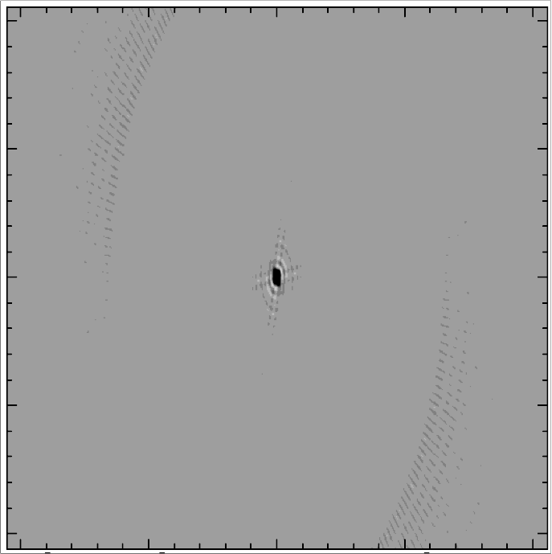
Wideband Deconvolution Errors
Deconvolved Image
Standard CLEAN

Slide 22
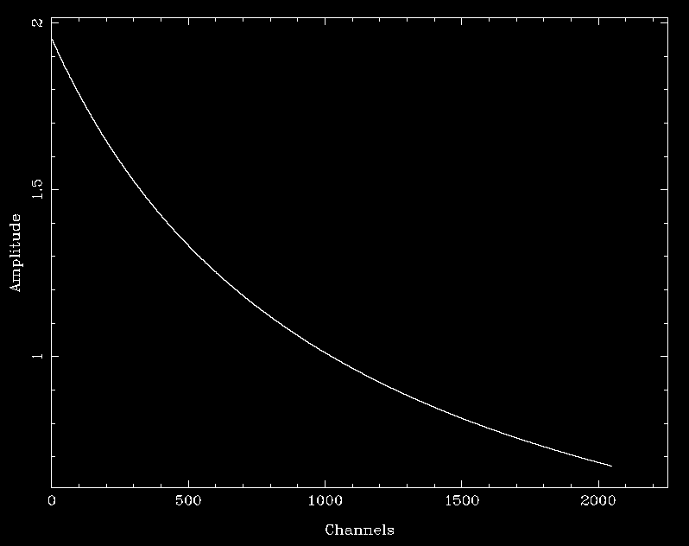
Wideband Deconvolution Errors
Source SED
What standard CLEAN fits with

Slide 23
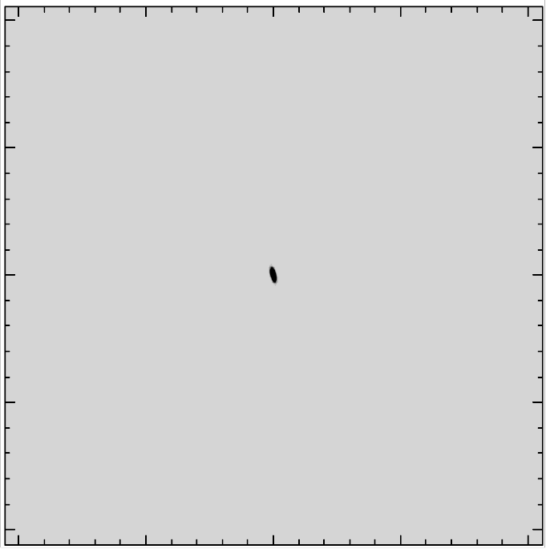
Wideband Deconvolution Errors
Deconvolved Image
Multi-frequency CLEAN (see Rick Perley’s talk)

Slide 24
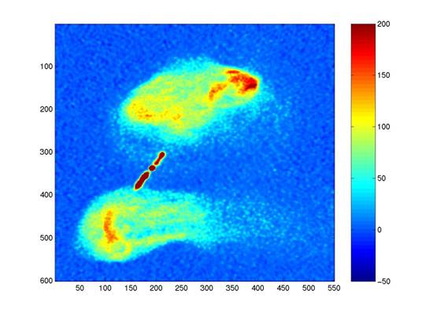
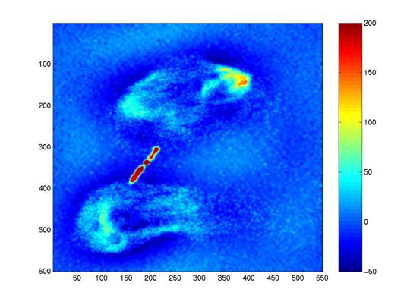
Missing short baselines
No short baselines
_{Paul Rayner 2001}
Can only be fixed with additional data. See Shari’s talk on observing strategies.

Slide 25
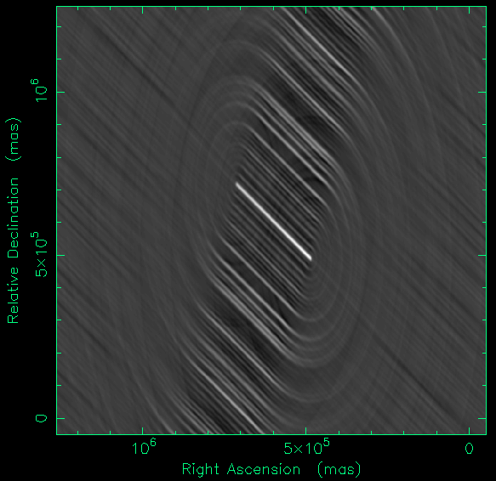
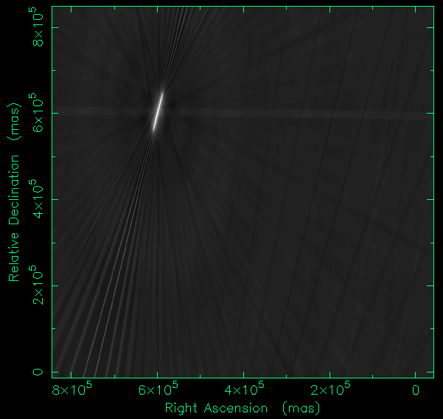
Smearing Errors
Bandwidth average smearing
Average 512x1MHz band
Time-average smearing
Averaging 1000s

Slide 26
_{Finding the errors in your way}
Avoid sausage factory processing (at least initially)
  Try to understand each processing step.
  Look closely at the data after each step, check and image calibrators.
  Does the data look plausible.
Take a different perspective
  Look at your data in different domains (time, uv, image, frequency).
  Plot different combinations of variables in different spaces.
  Look at residuals, FT your dirty image, FT your beam.
Process your data in different ways
  Try different software, algorithms.
  Partition and process your data in different ways
  Try split in time chunks, split up frequency band
  Different weighting, different uv tapers.

Slide 27
Error reduction …
Process
Have errors been beaten to submission?
Attempt to reduce effect of error
Yes
Determine greatest contributing error
No
Do Science

Slide 28
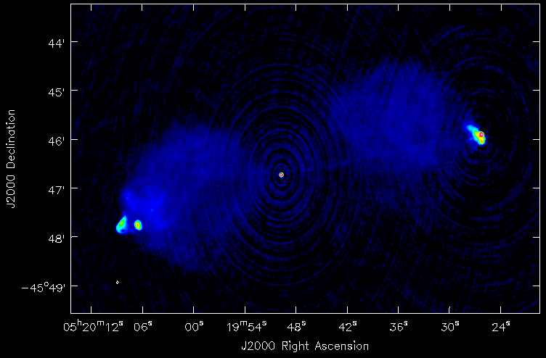
What’s happening?
5.5 GHz observation, 3 configurations, 2 GHz bandwidth
2000:1 dynamic range

Slide 29
What’s happening
Amplitude calibration errors.
Hot spot near edge of 4.5 GHz beam (outside 6.5 GHz beam)
  Causes steepening of source spectra.
  Causes position dependent effects.
  Will need to consider peeling techniques.
Spectral variation throughout the image (flat and steep)
  Must use multi-frequency deconvolution.
Structures on many different scales.
  Must use appropriate deconvolution algorithms.
North-west hot spot is bright and slightly extended.
  Difficult to deconvolve accurately.
  Small cell size or uv-subtract component.

Slide 30
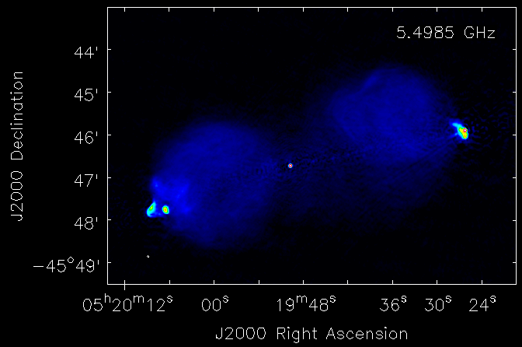
What’s happening?
38,000:1 dynamic range

Slide 31


Slide 32
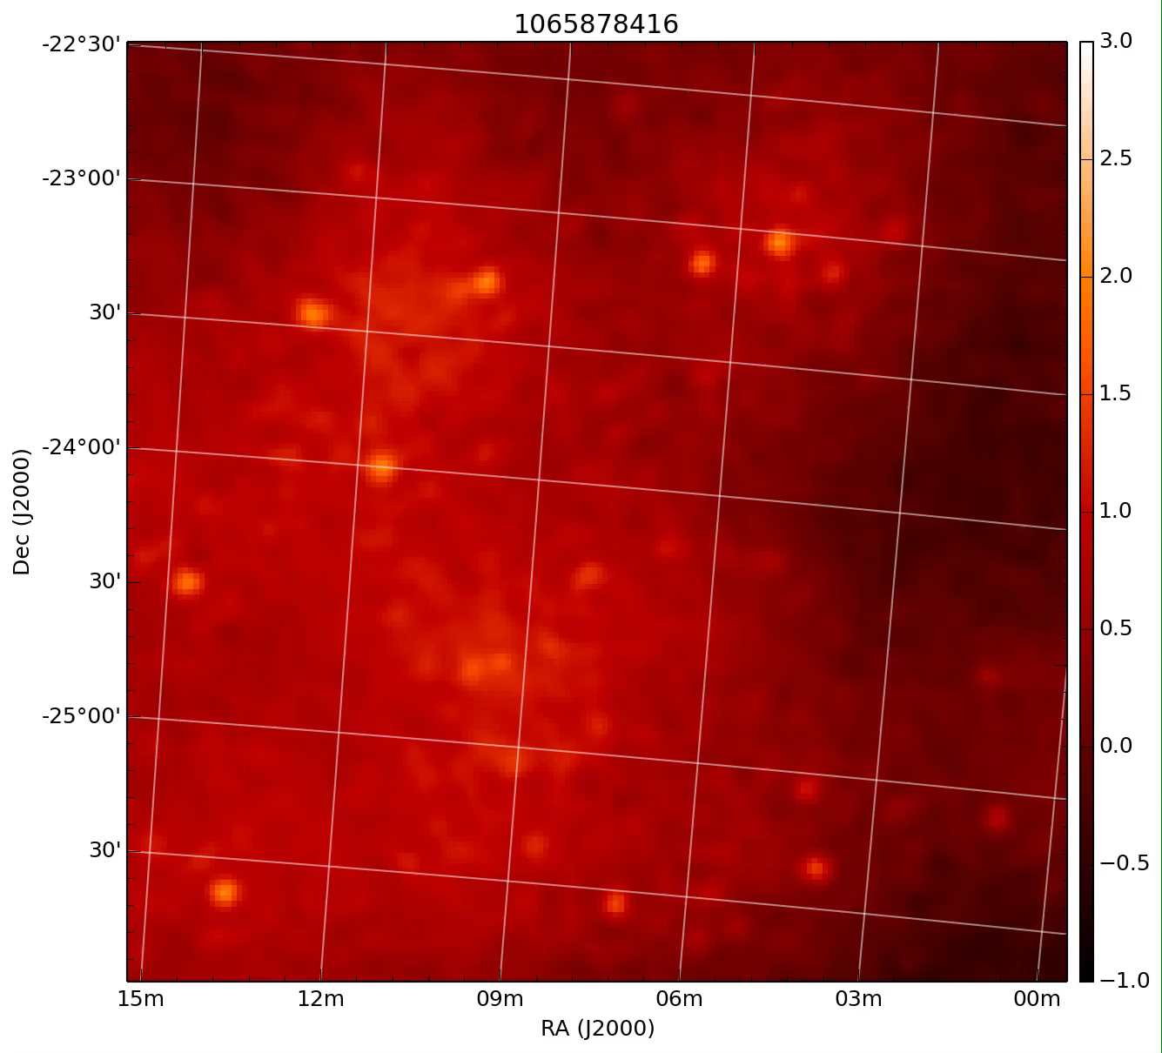
1. Can you deal with something new?
What’s happening?
Low frequency MWA obs.
Heat haze
Antenna deformation
Ionosphere
Compression artifacts
✔

Slide 33
2. Be daring in your search
What’s happening?
Primary Beam error
RFI
Venetian blinds left open
Deconvolution error
✔

Slide 34
3. Can you work this out?
What’s happening?
Amplitude errors
Cosmic ray
Bandwidth smearing
RFI
✔

Slide 35
4. Dare to solve this!
What’s happening?
Amplitude errors
Phase of moon incorrect
Position-dependent errors
Source outside imaged field
✔

Slide 36
5. Don’t give up!
What’s happening?
RFI
Bandwidth smearing
Daylight savings not set
Position-dependent errors
✔

Slide 37
6. Are you able to solve this?
What’s happening?
✔
Amplitude errors
Tartan from wrong clan
Data stored in HEX
Phase errors

Slide 38
7. A tricky problem
What’s happening?
✔
Missing short baselines
Missing long baselines
Missing astronomer
Alien Resurrection

Slide 39
8. End of game question
What’s happening?
Amplitude errors
Phase errors
Deconvolution errors
Position-dep. errors
Almost everything
✔

Slide 40
Acknowledgements
This talk is based on talks by:
  Steven Tingay
  Ron Ekers
  ASP Conference Series Vol. 180, p.321 – available online
Special thanks to Arin Lenc for running the pop quiz.

