Slide 1

Fourier Transform Insights and Techniques
Synthesis Imaging School -- Narrabri, Sept. 2014
John Dickey
University of Tasmania
Including slides from
Bob Watson

Slide 2
Outline
One dimensional functions
Fourier Series equations and examples
Fourier Transform examples and principles
Deconvolution and aliasing
Two dimensional functions
deconvolution
Combining single-dish and interferometer data
Reference: The Fourier Transform and its Applications, R.N. Bracewell (John Wiley)

Slide 3
Statement of Fourier’s Theorem
Suitable periodic functions, with a period of 2π, may be represented as (called a Fourier series)
Notes:
#RDW #sph200 #nolect2 #useOH ##
______________________________________
↓ Plus have OH for reference

Slide 4
Here The word “suitable” covers most functions you meet in physics
Notes:
#RDW #sph200 #nolect1 #nolect2 #useOH ##
______________________________________
a₀ case is also covered by the n = 0 case of the a_{n} formula

Slide 5
Complex form of Fourier’s Theorem Suitable periodic functions, with a period of 2π, may be represented as where j = √-1 and
Notes:
↓ Complex
Complex
↓ Real
#RDW #sph200 #nolect2 ##
______________________________________
this is just the analogy of writing etc
here the series sum runs from n = -∞ to +∞, not n = 0 to +∞ as in the real case, but only half the terms are independent here

Slide 6
Triangular wave
h
θ
−π
π
Notes:
#RDW #sph200 #nolect2 ##
______________________________________

Slide 7
Waves: 5
Triangular wave
First 3 series terms:
Notes:
#RDW #sph200 #nolect2 ## Source: RW prog “rw_wave2.ma”, adapted from code for plot of the partial Fourier series of an triangular wave
without 8h/π², and scaled by 300% in ppt ______________________________________

Slide 8
Waves: 5
Triangular wave
Sum of first 2 terms:
Notes:
#RDW #sph200 #nolect2 ## Source: RW prog “rw_wave2.ma”, n = 1, f(x) plot without 8h/π², and scaled by 300% in ppt ______________________________________

Slide 9
Waves: 5
Triangular wave
Sum of first 3 terms:
Notes:
#RDW #sph200 #nolect2 ## Source: RW prog “rw_wave2.ma”, n = 2, f(x) plot without 8h/π², and scaled by 300% in ppt ______________________________________

Slide 10
Waves: 5
Triangular wave
Sum of first 5 terms:
Notes:
#RDW #sph200 #nolect2 ## Source: RW prog “rw_wave2.ma”, n = 4, f(x) plot without 8h/π², and scaled by 300% in ppt ______________________________________

Slide 11
Waves: 5
Triangular wave
Sum of first 10 terms:
Notes:
#RDW #sph200 #nolect2 ## Source: RW prog “rw_wave2.ma”, n = 9, f(x) plot without 8h/π², and scaled by 300% in ppt ______________________________________

Slide 12
Triangular wave
All partial series sums up to 20 terms:
Notes:
#RDW #sph200 #nolect2 ## Source: RW prog “rw_wave2.ma”, n = 19, f(x) plot scaled by 300% in ppt, graylevel 0.3 ______________________________________

Slide 13
Half-wave rectifier
h
θ
−π
π
Notes:
#RDW #sph200 #nolect2 ##
______________________________________

Slide 14
Waves: 5
Half-wave rectifier
First 3 series terms:
Notes:
#RDW #sph200 #nolect2 ## Source: RW prog “rw_wave2.ma”, adapted from code for plot of the partial Fourier series of an half-wave rectifier
without h/π over (-0.75,4) , and scaled by 300% in ppt ______________________________________

Slide 15
Waves: 5
Half-wave rectifier
Sum of first 2 terms:
Notes:
#RDW #sph200 #nolect2 ## Source: RW prog “rw_wave2.ma”, n = 0, f(x) plot without h/π over (-0.75,4), and scaled by 300% in ppt ______________________________________

Slide 16
Waves: 5
Half-wave rectifier
Sum of first 3 terms:
Notes:
#RDW #sph200 #nolect2 ## Source: RW prog “rw_wave2.ma”, n = 1, f(x) plot without h/π over (-0.75,4), and scaled by 300% in ppt ______________________________________

Slide 17
Waves: 5
Half-wave rectifier
Sum of first 5 terms:
Notes:
#RDW #sph200 #nolect2 ## Source: RW prog “rw_wave2.ma”, n = 3, f(x) plot without h/π over (-0.75,4), and scaled by 300% in ppt ______________________________________

Slide 18
Waves: 5
Half-wave rectifier
Sum of first 10 terms:
Notes:
#RDW #sph200 #nolect2 ## Source: RW prog “rw_wave2.ma”, n = 8, f(x) plot without h/π over (-0.75,4), and scaled by 300% in ppt ______________________________________

Slide 19
Even square wave
h
θ
−π
π
Notes:
#RDW #sph200 #nolect2 ##
______________________________________

Slide 20
Waves: 5
Even square wave
First 3 series terms:
Notes:
#RDW #sph200 #nolect2 ## Source: RW prog “rw_wave2.ma”, adapted from code for plot of the partial Fourier series of an even square wave
without 4h/π, and scaled by 300% in ppt ______________________________________

Slide 21
Waves: 5
Even square wave
Sum of first 2 terms:
Notes:
#RDW #sph200 #nolect2 ## Source: RW prog “rw_wave2.ma”, n = 1, f(x) plot without 4h/π, and scaled by 300% in ppt ______________________________________

Slide 22
Waves: 5
Even square wave
Sum of first 3 terms:
Notes:
#RDW #sph200 #nolect2 ## Source: RW prog “rw_wave2.ma”, n = 2, f(x) plot without 4h/π, and scaled by 300% in ppt ______________________________________

Slide 23
Waves: 5
Even square wave
Sum of first 5 terms:
Notes:
#RDW #sph200 #nolect2 ## Source: RW prog “rw_wave2.ma”, n = 4, f(x) plot without 4h/π, and scaled by 300% in ppt ______________________________________

Slide 24
Waves: 5
Even square wave
Sum of first 10 terms:
Gibbs’ phenomenon
Notes:
#RDW #sph200 #nolect2 ## Source: RW prog “rw_wave2.ma”, n = 9, f(x) plot without 4h/π, and scaled by 300% in ppt ______________________________________
Gibbs’ phenomenom gives an overshoot to 4h/π = 1.27 h
you can test the freq response of an amplifier, for example, by putting a square wave into it

Slide 25
Even square wave
All partial series sums up to 20 terms:
Notes:
#RDW #sph200 #nolect2 ## Source: RW prog “rw_wave2.ma”, n = 19, f(x) plot scaled by 300% in ppt, graylevel about 0.3 ______________________________________

Slide 26
The Fourier Series Spectrum:
Even square wave
h
θ
−π
π
a₁ = 4h/π
a_{n}
a₁/5
-a₁/3
n
1
2
3
4
5
Notes:
#RDW #sph200 #nolect2 ##
______________________________________

Slide 27
Example: Odd square wave
h
θ
−π
π
b₁ = 4h/π
b_{n}
b₁/3
b₁/5
n
1
2
3
4
5
Notes:
#RDW #sph200 #nolect1 #nolect2 #useOH ##
______________________________________

Slide 28
Spectra for complex transform coefficients
Notes:
#RDW #sph200 #nolect1 #nolect2 #useOH ##
______________________________________
do all this on board

Slide 29
Waves: 5
-5ω₁
-3ω₁
ω₁
-ω₁
3ω₁
5ω₁
ω
Notes:
#RDW #sph200 #noprint #nolect1 #nolect2 #useOH ##
______________________________________

Slide 30
Temporally periodic case
If we have a function f(t) , with temporal period T , which we wish to express as a Fourier series, then change our f(θ) series using
Notes:
← On Board
←
←
↓ On Board
#RDW #sph200 #nolect1 #nolect2 ##
______________________________________
e.g. We have to convert f(θ) to the required f(t) form
← Bd

Slide 31
Waves: 5
So the Fourier series for f(t) =
where
Notes:
#RDW #sph200 #nolect2 ##
______________________________________
here the 1/π form in the original f(θ) has changed to

Slide 32
T is the fundamental period of f(t) and ω₁ = 2π/T is the fundamental angular frequency
Notes:
#RDW #sph200 #nolect1 #nolect2 ##
______________________________________
discuss all the above verbally
On Bd
On Bd

Slide 33
Waves: 5
Using ω₁:
f(t) =
where
Notes:
#RDW #sph200 #nolect2 ##
______________________________________
here the θ of the general form is replaced by (ω₁t) , and the “1/π” by “2/T”

Slide 34
The corresponding complex form of f(t) in terms of ω₁ is
where
Notes:
#RDW #sph200 #nolect1 #nolect2 #useOH ##
______________________________________
i.e. θ = (2π/T)t = ω₁t in previous general complex form statement
←On Bd

Slide 35
Taking T→ ∞ in the complex form
and substitute
Notes:
#RDW #sph200 #nolect2 ##
______________________________________

Slide 36
Hence As T → ∞
Notes:
#RDW #sph200 #nolect1 #nolect2 #useOH ##
______________________________________
an equivalent thing to (t,ω) and (x,k) exists for any pair of variables that are, as a product, dimensionless

Slide 37
F(ω) gives the continuous spectrum of real and imaginary parts (or amplitude and phase) that must be present to faithfully represent f(t) over an infinite interval.
Notes:
#RDW #sph200 #nolect1 #nolect2 ##
______________________________________
↓Verbally

Slide 38
Waves: 5
-5ω₁
-3ω₁
ω₁
-ω₁
3ω₁
5ω₁
ω
Notes:
#RDW #sph200 #noprint #nolect1 #nolect2 #useOH ##
______________________________________

Slide 39
Waves: 5
Fourier transform visualization
ω
Notes:
#RDW #sph200 #nolect2 ##
______________________________________
emphasize that for f(x) we have similarly F(k)
this plot is the continuous limit of the plot of the real and imaginary parts of C_{n}

Slide 40
FOURIER TRANSFORM DERIVATIONS
Example 1: The rectangular or “slit” function
f(t)
h
t
-(1/2)τ
+(1/2)τ
Notes:
#RDW #sph200 #nolect1 #nolect2 #useOH ##
______________________________________
this is an example of a non-periodic function over ±∞

Slide 41
Derivation:
Notes:
#RDW #sph200 #nolect2 ##
______________________________________
here hτ is the area under the function

Slide 42
Thus F(ω) has the form
Notes:
#RDW #sph200 #noprint #nolect1 #nolect2 ##
Source: RW prog “rw_osc1.xls” ,sheet=SINC with
Amp 10 Spread 0.2 Mean 100 Samples 200
______________________________________
On Board

Slide 43
Waves: 2
Thus F(ω) has the form
F(ω)
ω
-2π
+2π
-π
+π
-4π/τ
+4π/τ
-2π/τ
+2π/τ
Notes:
#RDW #sph200 #nolect2 ##
Source: RW prog “rw_osc1.xls” ,sheet=SINC with
Amp 10 Spread 0.2 Mean 100 Samples 200
______________________________________
zeros are α = nπ for n = 1, 2, 3, ...

Slide 44
Example 2: Dirac delta-function ( By definition )
f(t)
h
t
h⁻¹
Notes:
#RDW #sph200 #nolect1 #nolect2 #useOH ##
______________________________________
the normal maths notation for this is δ(t)

Slide 45
Derivation: Take the rectangular pulse of Example 1 and
let τ = h⁻¹
Since first zero is at
Then F(ω) = 1 (constant for all ω).
Notes:
#RDW #sph200 #nolect2 ##
______________________________________

Slide 46
Note: 1. F(ω) is again real and even, as expected for an even f(t)
F(ω)
1
ω
Notes:
#RDW #sph200 #nolect1 #nolect2 ##
______________________________________
← On Board

Slide 47
Example 3: The Gauss function
f(t)
h
σ
t
h e^{-1/2}
Notes:
#RDW #sph200 #nolect2 ##
Amp 10 Spread 0.03 Mean 100 Samples
200
______________________________________

Slide 48
Derivation: Convert this to the form e^{- s2} by the change of variables
Notes:
#RDW #sph200 #nolect1 #nolect2 ##
______________________________________
I would not expect them to guess the change of variables intuitively
these terms are in the exponent of F(ω)

Slide 49
Hence and since we have i.e. If f(t) is Gaussian with [h , σ] then F(ω) is Gaussian with [h(2π)^{1/2}σ , σ ⁻¹]
Notes:
#RDW #sph200 #nolect1 #nolect2 ##
______________________________________
do on board and discuss verbally

Slide 50
Form 1: Replace ω by the frequency ν = ω/2π Thus
Notes:
#RDW #sph200 #nolect2 ##
______________________________________
this is the form mostly used by Pain
I have to use “ν” for frequency since I have used “f” for the function
this form is quite symmetric in ν and t (i.e. no 2π here)

Slide 51
PROPERTIES OF FOURIER TRANSFORMS
Fourier transforms are sometimes of use in physics due to their direct physical interpretation (see later), but often their usefulness is more indirect
Notes:
#RDW #sph200 #nolect1 #nolect2 ##
______________________________________
On Board
↓Verbally

Slide 52
In particular, a great usefulness comes from their help in solving awkward differential equations
Here we list several general transform properties of benefit in this and other contexts
(Note that these properties are listed here without proofs. Most proofs follow from the defining equations)
Notes:
#RDW #sph200 #nolect1 #nolect2 ##
______________________________________
e.g. take a transform of both sides of the DE and in this way you may get an equation that is easier to solve. Then take the inverse transform
↓Verbally

Slide 53
1. Linearity If
then
Notes:
#RDW #sph200 #nolect2 ##
______________________________________
these properties permit tables of useful transforms to be constructed. Examples are listed in the formulae sheets

Slide 54
Scale change If then
Thus compressing a time function expands its spectrum in frequency and vice-versa
Notes:
#RDW #sph200 #nolect2 ##
______________________________________
if a > 1 this means f(at) is compressed in scale and F(aω) is spread in scale

Slide 55
This expresses the idea of “Time × Bandwidth” invariance and is demonstrating in a general way the Bandwidth Theorem
(i.e ΔωΔt ~ 2π )
Notes:
#RDW #sph200 #nolect1 #nolect2 ##
______________________________________
← On Bd

Slide 56
Example: A sine or cosine form extending (-∞, +∞) requires only one frequency to represent the function exactly. It is a strictly monochromatic signal
However all real data must start and stop. Such real physical data are truncated sinusoids. They are not monochromatic signals and require a range of frequencies to represent exactly. The shorter the sinusoidal pulse, the wider the range of required frequencies
Notes:
#RDW #sph200 #nolect1 #nolect2 ##
______________________________________
↓Verbally

Slide 57
3. Delay and modulation If then
Notes:
#RDW #sph200 #nolect2 ##
______________________________________
i.e. shape is about ω₀ instead of 0

Slide 58
Thus : ... delaying a time function f(t) simply adds a linear phase (-ωt₀) to the original F(ω) phase ... modulating f(t) by e^{jω0t} shifts the spectrum by ω₀
Notes:
#RDW #sph200 #nolect1 #nolect2 ##
______________________________________
↓Verbally

Slide 59
Similarly, if one modulates by the real function cos(ω_{o}t) we have Thus this real modulation gives a spectrum which is the average of two copies of the original form, one shifted by +ω₀ and the other by -ω₀
Notes:
← On Board
#RDW #sph200 #nolect1 #nolect2 ##
______________________________________
since

Slide 60
i.e. if f(t) transforms to then [ cos(ω_{o}t) f(t) ] transforms to
ω
ω
-ω₀
+ω₀
Notes:
#RDW #sph200 #nolect2 ##
______________________________________

Slide 61
4. Differentiation and integration If then
Notes:
#RDW #sph200 #nolect1 #nolect2 #useOH ##
______________________________________
this is why it is easier to handle DE’s in the transform domain

Slide 62
Thus taking the transform reduces differentiation and integration to the simpler operations of multiplication or division by jω in the frequency domain. Then finding the inverse transform gives the final result in the time domain
This is analogous to the taking of logarithms to reduce “ × and ÷ ” to the simpler operations of “ + and - ”. In that case finding the anti-log gave the final result
Notes:
#RDW #sph200 #nolect1 #nolect2 ##
______________________________________
↓Verbally

Slide 63
5. Multiplication and convolution If
then
Notes:
#RDW #sph200 #nolect2 ##
Bottom eqn scaled to 85%
______________________________________
a spectral line f₁(x) sampled by a spectrograph which has some response function f₂(x) is an example of this case

Slide 64
Thus : ... a product of functions has a transform that is the convolution of the individual transforms ... conversely if you convolve functions you multiply their individual transforms
Notes:
#RDW #sph200 #nolect1 #nolect2 ##
______________________________________
↓Verbally

Slide 65
6. Parseval’s theorem If then
Notes:
#RDW #sph200 #nolect2 ##
______________________________________
the 1/(2π)² term only appears where it does because of the Form2 that we adopted

Slide 66
The delta function is the indentity operation for convolution:

Slide 67
Next: A nicely illustrated example from an old paper by Brault and White (1971 Astron. & Astrophys. 13, 169).
sampling theorem
aliasing
apodizing
deconvolution

Slide 68
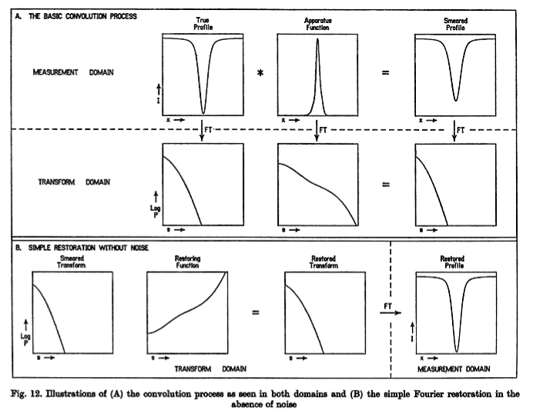

Slide 69
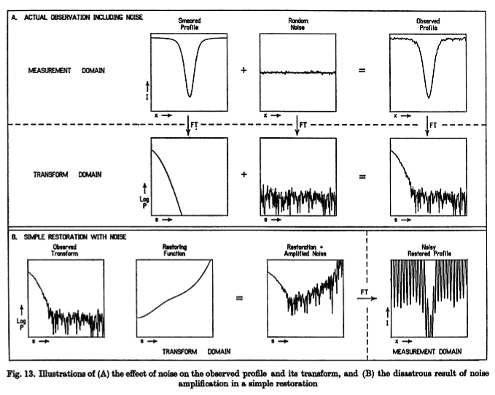

Slide 70
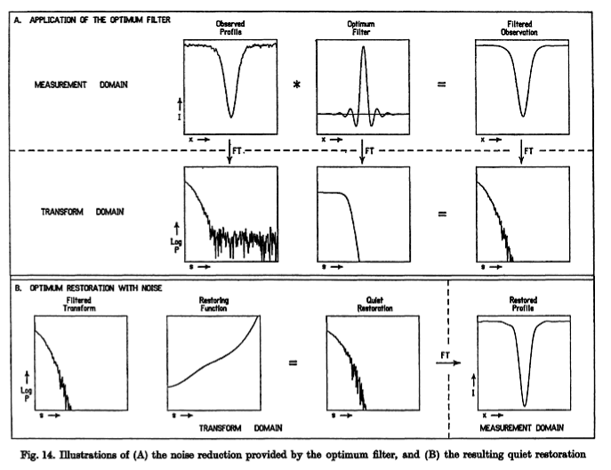

Slide 71
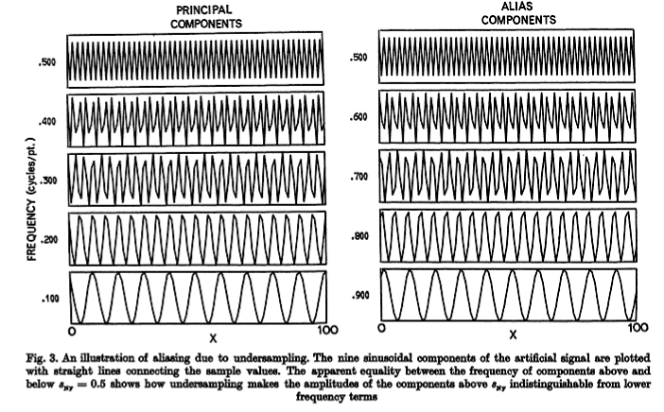
Deconvolution Example from Brault and White,
1971 Astron. & Astrophys 13, 169.
First: Sampling Theorem

Slide 72
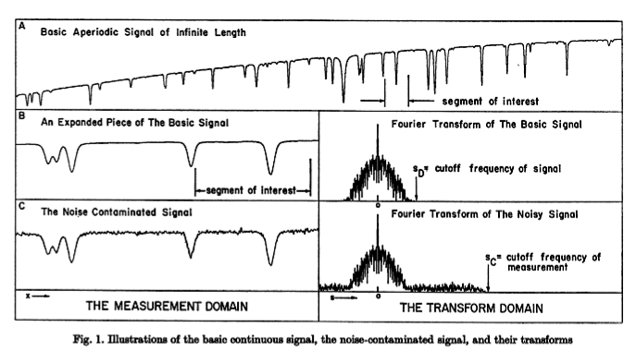
A continuous data function and its Fourier Transform.

Slide 73
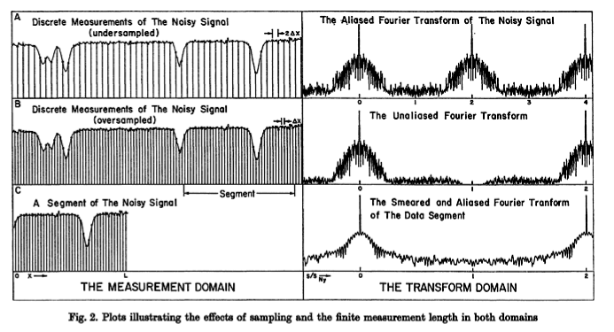
Sampling (digitizing) the continuous function at different intervals.

Slide 74
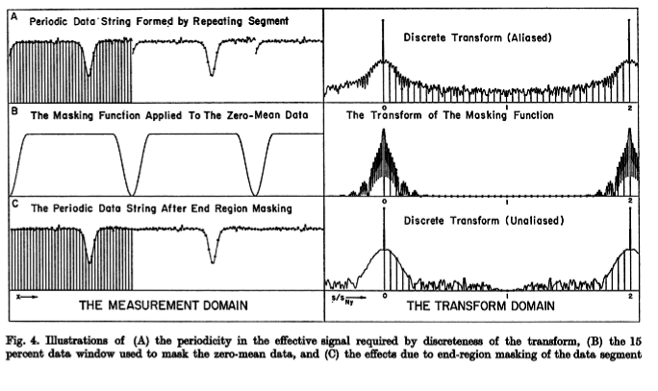
After removing the mean, multiply by an apodizing or masking
function to eliminate the discontinuity between the two ends.

Slide 75
Two Dimensional Fourier Transforms
For a function of two dimensions, the Fourier
Transform is done by transforming in each dimension separately.

Slide 76
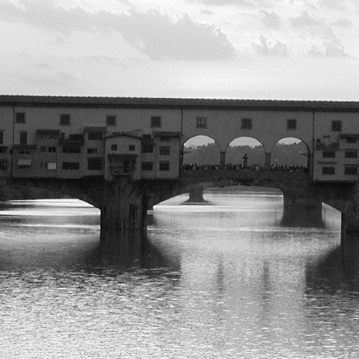

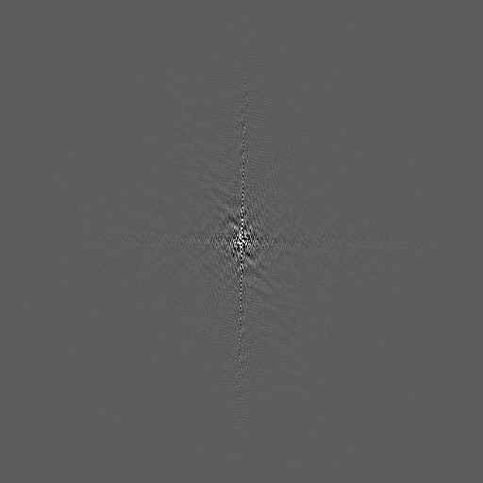
Example : Ponte Vecchio in Florence…
real
imag

Slide 77

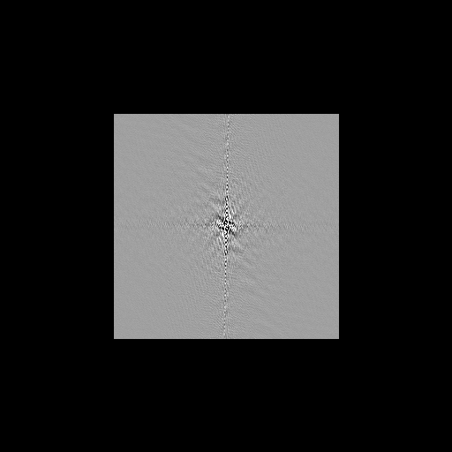

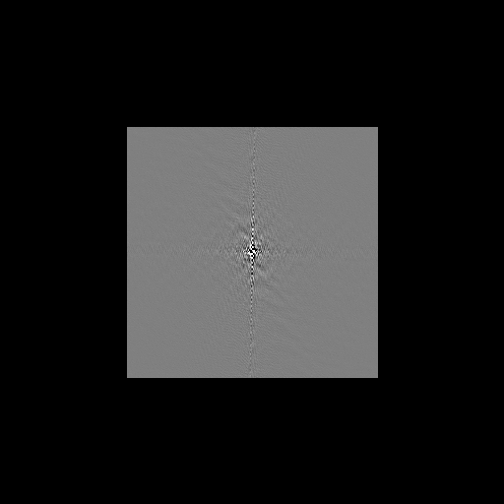
Example : Ponte Vecchio in Florence… data compressed by 4 :
real
imag

Slide 78



Example : Ponte Vecchio in Florence… (raw image 512x512)
saving 16 x16 pixels in the centre of transform
saving 64 x 64
saving 32 x 32
saving 128 x128

Slide 79




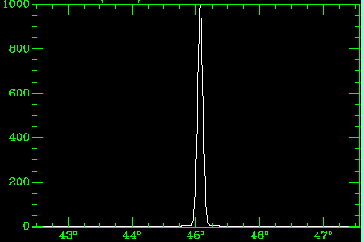
Convolving the image with a Gaussian:

Slide 80


Convolving the image with a Gaussian:
Deconvolution with noise floors:

Slide 81
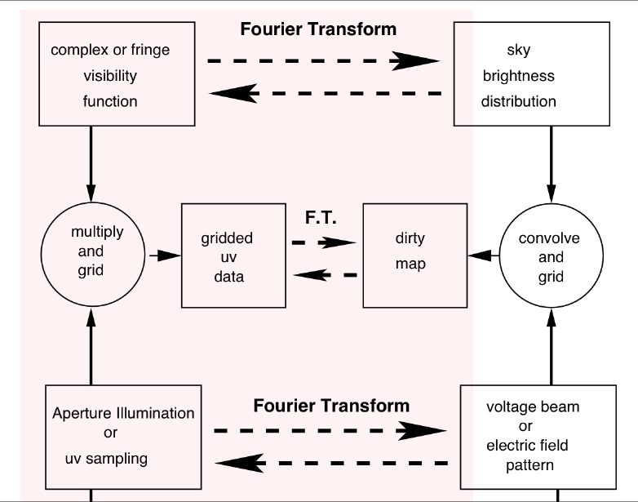
How can we
get from here
back to here?
Most of the rest of the workshop will describe how to optimize the image making process.

Slide 82
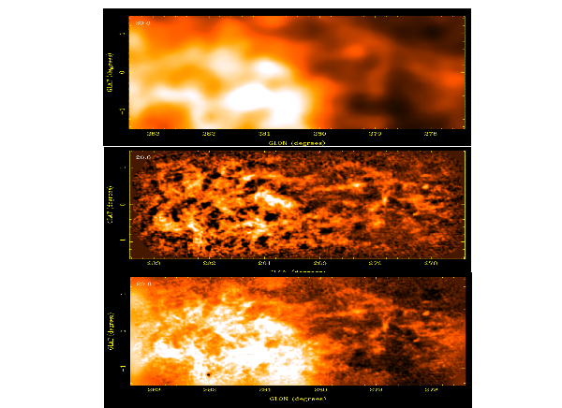
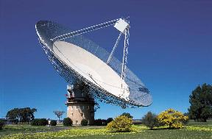
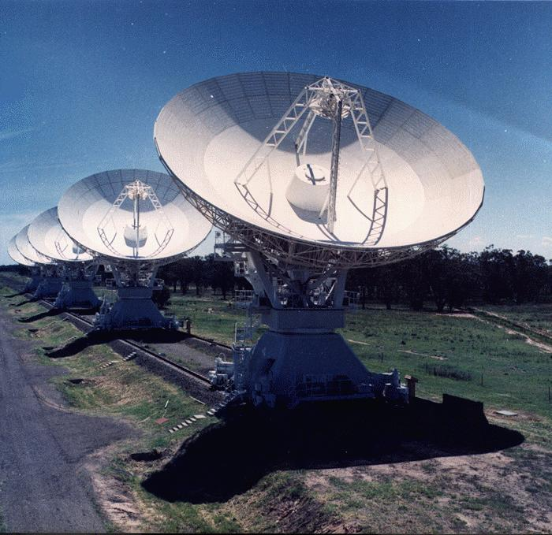
Parkes
Compact Array
Combined
data
see McClure-Griffiths et al. 2000 and Stanimirovic 1999

Slide 83
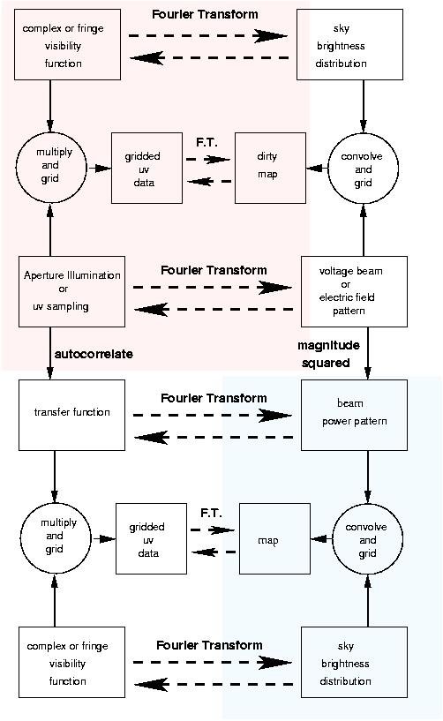
Aperture or uv plane
Image or lm plane
Aperture
synthesis
mapping
Single
dish
mapping

Slide 84
Conclusions:
To understand aperture synthesis and interferometry in general review your Fourier transforms.
Understanding the telescope and how it samples the sky requires visualization of the uv plane sampling function.
Improving images by “deconvolution” of unsampled parts of the uv plane requires interpolation using some assumptions.
Writing new algorithms often involves clever ways of using Fourier transforms.

Slide 85
The Fourier Transform is the Radio Astronomer’s best friend.

