Slide 1
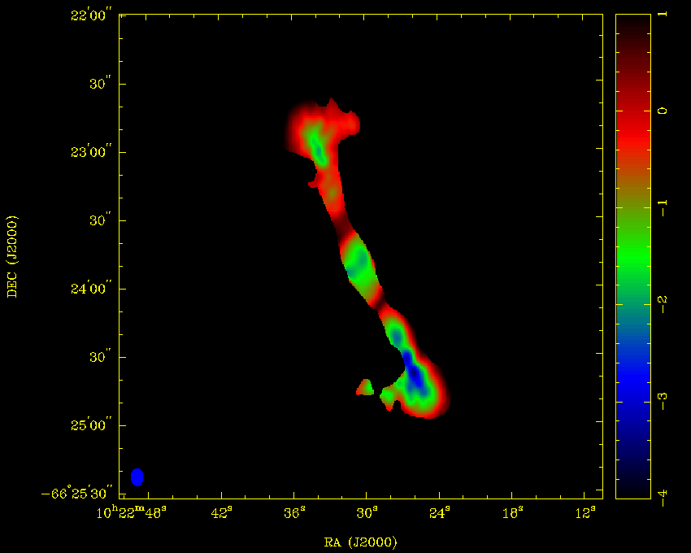
Wideband Imaging and Measurements
Jamie Stevens | ATCA Senior Systems Scientist / ATCA Lead Scientist
2 October 2014
Astronomy and space science

Slide 2
Outline
Why are wide bandwidths useful?
How are wide bandwidth images made?
How do we make accurate measurements from wide bands?
What problems might we have with wide bandwidths?

Slide 3
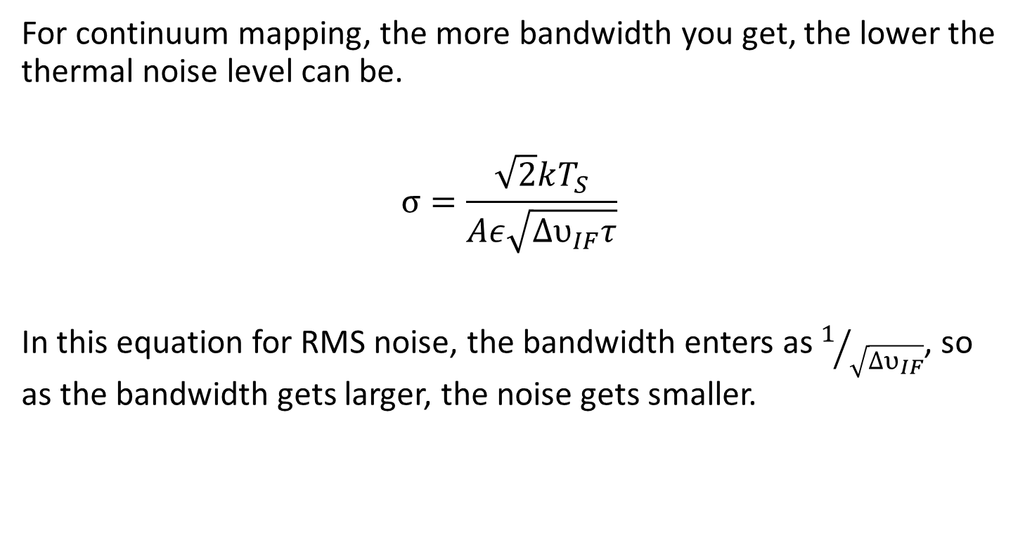
Wide Bandwidths
For continuum mapping, the more bandwidth you get, the lower the thermal noise level can be.
$$σ=\frac{\sqrt{2}kT_{S}}{Aε\sqrt{{∆υ}_{IF}τ}}$$
In this equation for RMS noise, the bandwidth enters as $1/{\sqrt{{∆υ}_{IF}}}$, so as the bandwidth gets larger, the noise gets smaller.
Notes:
We heard from Rick on Monday about how bandwidth complicates life for interferometry, and how we need clever engineering to get around these complications. But why exactly do we want wider bandwidths, if they just make life harder for our engineers, and means that our computers need to be faster.
The most immediately apparent reason for wider bandwidths, at least for continuum studies, is that the thermal noise level achievable in an image depends on the bandwidth used to make that image. This is because we assume that for a continuum source, the signal from the source remains basically constant across frequency, while the frequency behaviour of the system’s thermal noise is uncorrelated and random. Averaging over more bandwidth then drives the thermal noise level lower while leaving the source signal untouched.

Slide 4
Not only advantageous for continuum!
Spectral-line observations can also benefit from an increase in bandwidth.
Although a line is the same width regardless of the receiver bandwidth, having larger bandwidths available allows you to:
more quickly search frequency-space for line emission at an unknown velocity
observe more than one line simultaneously
better estimate the bandpass in the emission-free bandwidth, and thus more accurately measure the line emission

Slide 5
Divide and Conquer
Wide bandwidths cause issues.
Simplest solution: split up your bandwidth, and make several smaller-bandwidth images, do your measurements on each separately, or stack the images together.
This is sometimes the only solution (think Ryan’s frequency-changing polarisation that averages to 0), but often this approach does not let you get everything you can from your data.

Slide 6
Imaging Wideband Continuum
The imaging process for wideband continuum images is call multi-frequency synthesis.
In our most popular CABB mode, the 2048 MHz of bandwidth is split into 2048 channels, each channel being 1 MHz wide. Each channel is individually gridded to make a single image covering the entire band.
This can have benefits not only for sensitivity but for uv-coverage as well.
Notes:
But we also heard from Rick that unless we have small bandwidths we get plenty of problems with integration time limits and there are some other issues that we’ll discuss later in this talk. And as we heard the way to solve this issue is to break up our large bandwidth into a lot of channels, each of which has much smaller bandwidth. For example in our CABB system, each of our 2048 MHz frequency bands is broken up into a binary integer number of channels. Currently we have two modes; the most popular mode breaks up the band into 2048 1 MHz channels, and we have another mode that breaks up the band into 32 64 MHz channels. To make a continuum image then that uses all the bandwidth from the entire band we use something called multi-frequency synthesis. This takes each individual channel and puts its information on a single uv grid, which we then Fourier transform to get a single image. Having a bunch of narrow channels can also help with uv coverage.

Slide 7
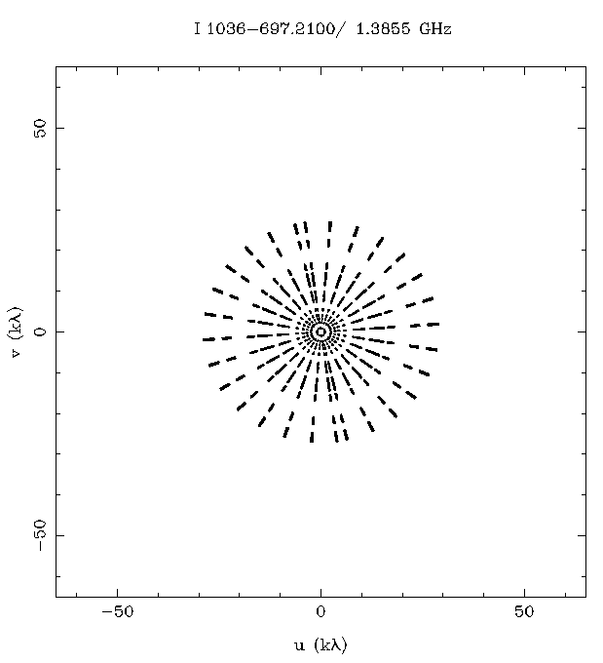
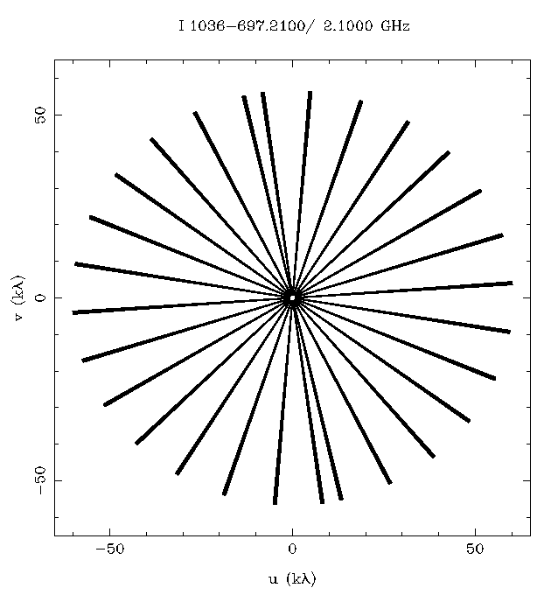
uv coverage improvement
6 km array, 128 MHz bandwidth
(old ATCA correlator)
6km array, 2048 MHz bandwidth
(CABB correlator)
Notes:
The picture we see here on the left is what ATCA used to generate (in terms of uv coverage) for a 6km array with our old correlator, which only had 128 MHz of bandwidth split into 32 channels. Over 12 hours with a number of cuts we get this wheel of uv coverage. You’ll notice that there are gaps in the coverage, and to fill these gaps we offer four different configurations for each class of array. Each configuration would fill in a different part of the uv plane, but of course that meant that a 12 hour observation needed to be done in each configuration over the many months/years that would be required to get a shot at each individual configuration. But then CABB came along, and let’s look at what the uv coverage looks like with 2048 MHz of bandwidth looks like. On the right, you can see the same wheel of cuts over twelve hours, but now there aren’t any gaps in the radial distribution. Such is the power of extra bandwidth; now you can choose whatever configuration you like, take 12 hours and you’re done.

Slide 8
Multi-frequency synthesis
The observing bandwidth is split into channels, and each channel’s real and imaginary components are placed on a uv grid, and the entire thing is Fourier transformed to make the image.
Very easy in principle! But in reality we have a couple of complicating factors.

Slide 9
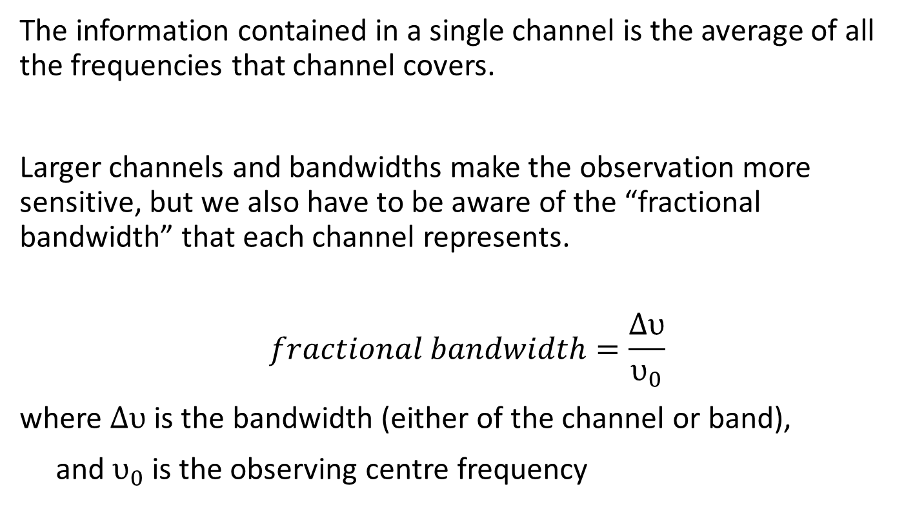
Fractional Bandwidth
The information contained in a single channel is the average of all the frequencies that channel covers.
Larger channels and bandwidths make the observation more sensitive, but we also have to be aware of the “fractional bandwidth” that each channel represents.
$$fractional bandwidth=\frac{∆υ}{υ_{0}}$$
where $∆υ$ is the bandwidth (either of the channel or band),
and $υ_{0}$ is the observing centre frequency

Slide 10
Fractional Bandwidth
For the ATCA with CABB, we have a bandwidth of 2048 MHz.
In the 16cm band, which is centred at 2100 MHz, the fractional bandwidth we can observe is ≈ 1. The lowest frequency we routinely observe is 1076 MHz.
Using 1 MHz channels, the fractional channel bandwidth at the lowest frequency is 0.09%. Using 64 MHz, it is 6%.
Such a large fractional channel bandwidth can cause “bandwidth smearing”.

Slide 11
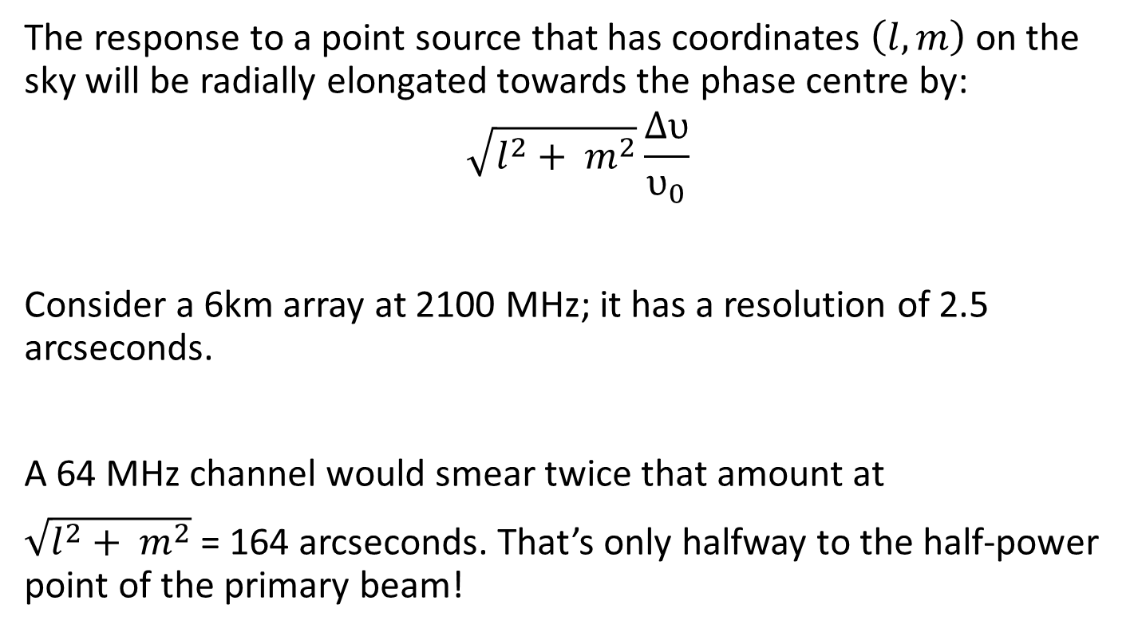
Bandwidth Smearing
The response to a point source that has coordinates $\left(l,m\right)$ on the sky will be radially elongated towards the phase centre by:
$$\sqrt{l^{2}+ m^{2}}\frac{∆υ}{υ_{0}}$$
Consider a 6km array at 2100 MHz; it has a resolution of 2.5 arcseconds.
A 64 MHz channel would smear twice that amount at
$\sqrt{l^{2}+ m^{2}}$ = 164 arcseconds. That’s only halfway to the half-power point of the primary beam!

Slide 12
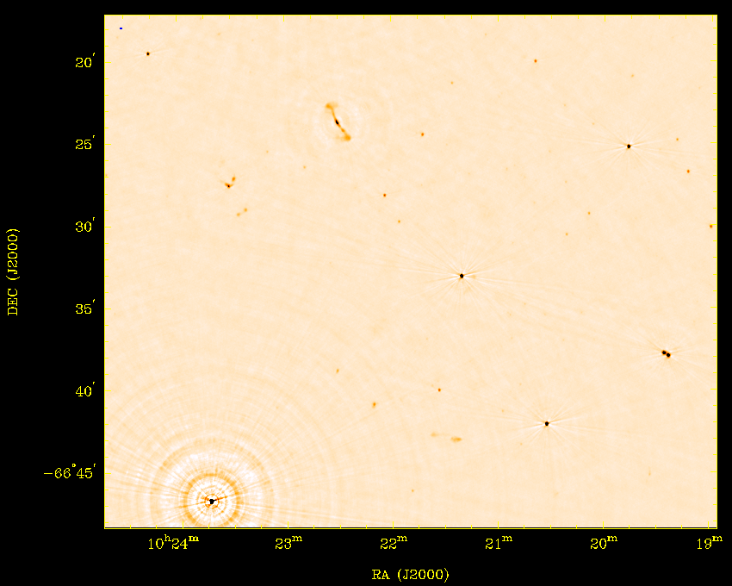
Bandwidth Smearing
2048 x 1 MHz channels

Slide 13
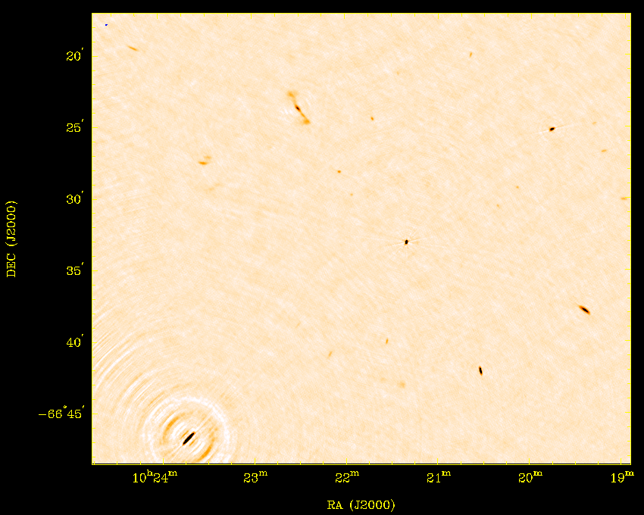
Bandwidth Smearing
32 x 64 MHz channels

Slide 14
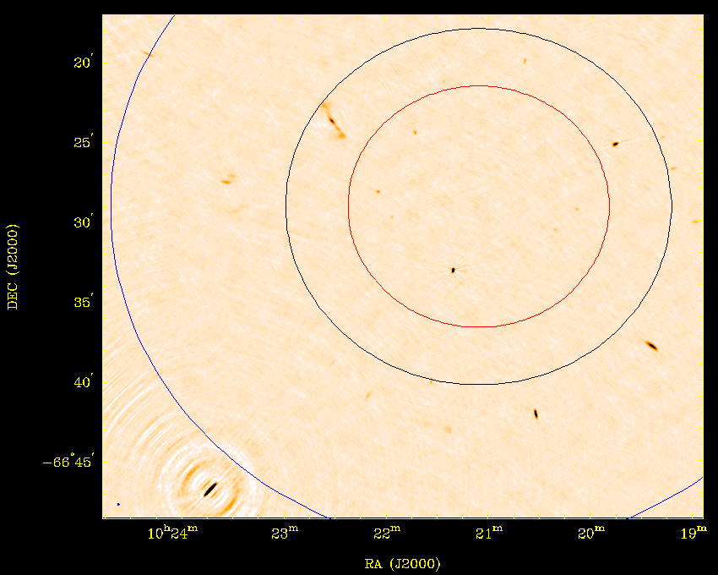
Bandwidth Smearing
32 x 64 MHz channels
Primary
Beams
3.1 GHz
2.1 GHz
1.1 GHz

Slide 15
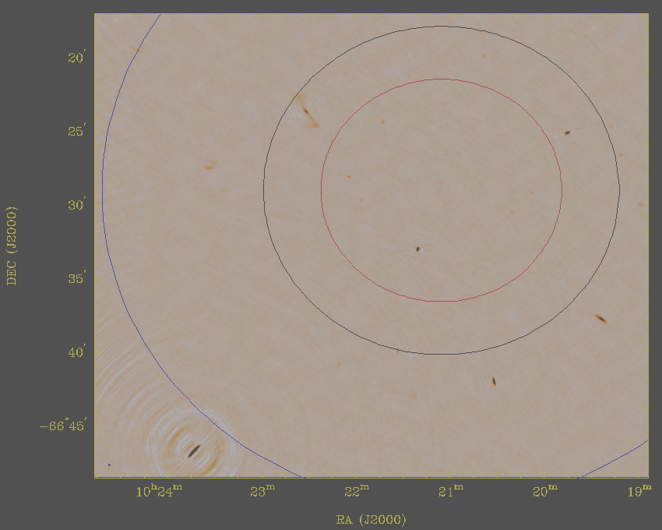
Bandwidth Smearing
This is why we don’t let
observers use the 64 MHz
mode for low-frequency
continuum observations

Slide 16
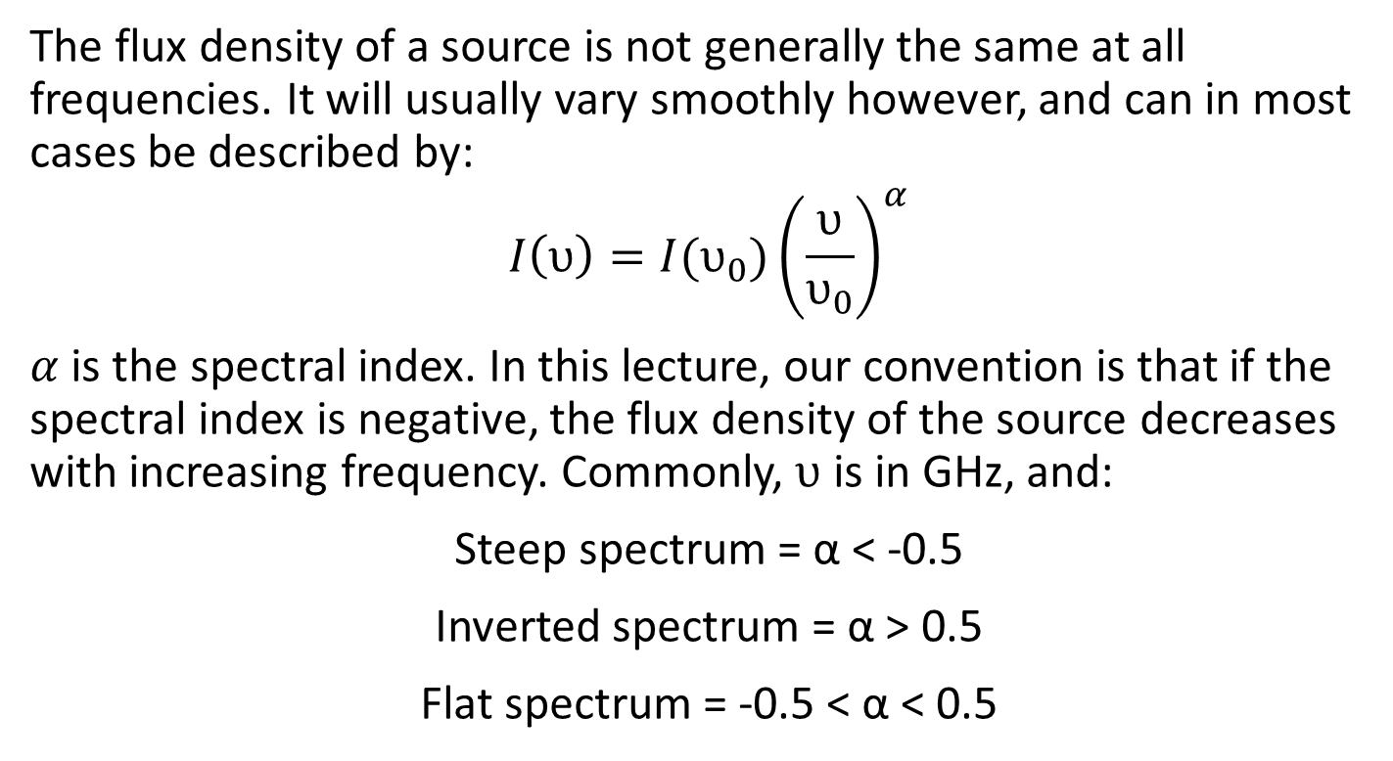
Spectral Index
The flux density of a source is not generally the same at all frequencies. It will usually vary smoothly however, and can in most cases be described by:
$$I\left(υ\right)=I(υ_{0}){\left(\frac{υ}{υ_{0}}\right)}^{α}$$
$α$ is the spectral index. In this lecture, our convention is that if the spectral index is negative, the flux density of the source decreases with increasing frequency. Commonly, $υ$ is in GHz, and:
Steep spectrum = α < -0.5
Inverted spectrum = α > 0.5
Flat spectrum = -0.5 < α < 0.5

Slide 17
Calibration of Spectral Index
It is very important to ensure that you account for spectral index during calibration.
Ideally, the bandpass calibration can be performed with a source that has a known flux density model, such as 1934-638. This is not always possible though, since many very strong sources are quite variable.
Correction of the bandpass response function can be done later if required though, as it is usually just a slope adjustment.

Slide 18
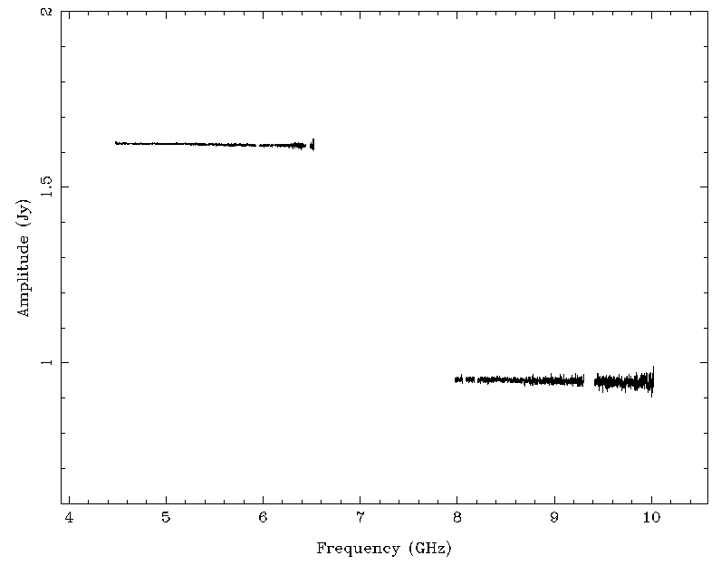
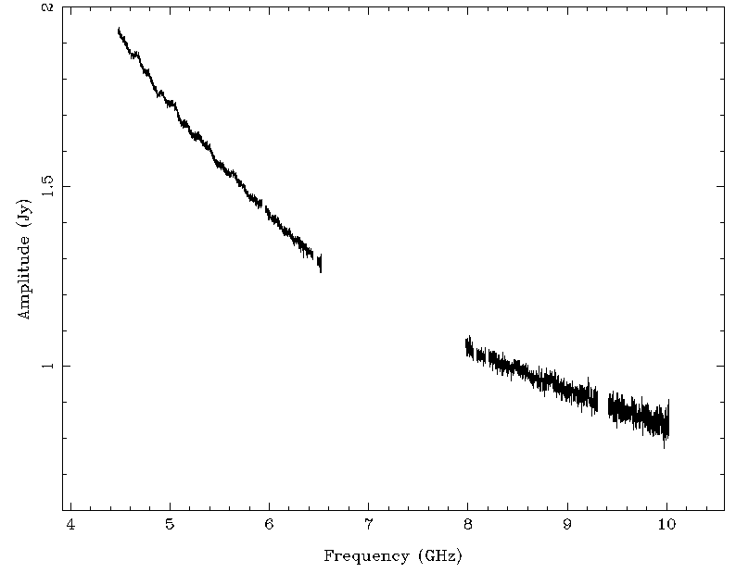
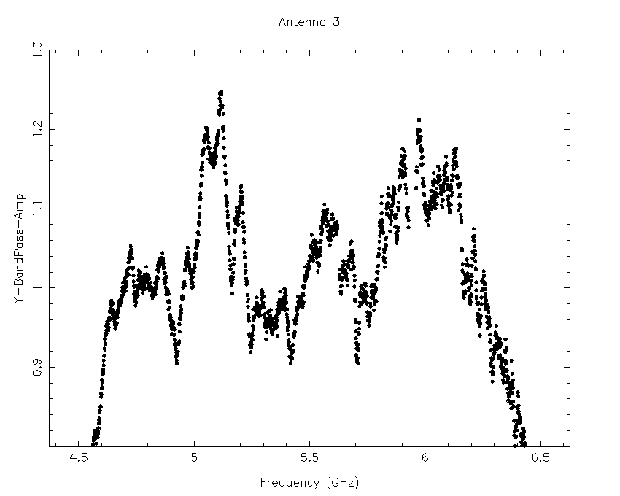
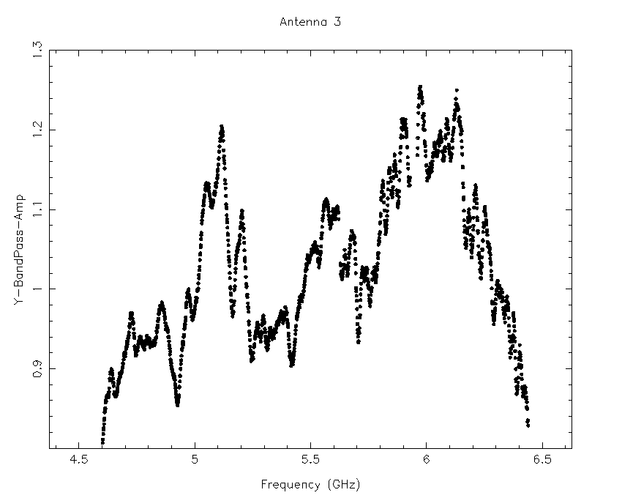
Bandpass Correction
Incorrect Bandpass
Correct Bandpass

Slide 19
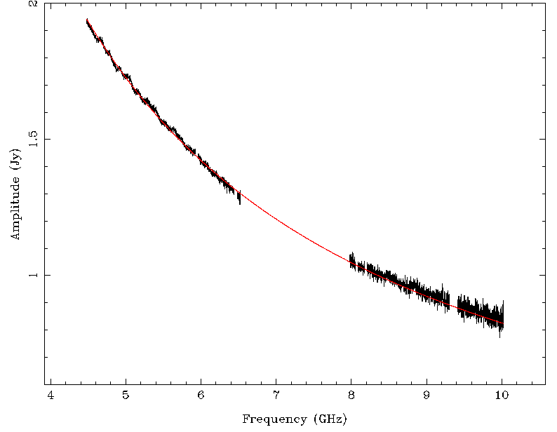



Measuring Flux Density
For a bright source at the phase centre, it is easy to do a linear fit for flux density as a function of frequency.
This is how all flux density measurements are made in the ATCA Calibrator Database.
$$\log{S\left(υ\right)=0.9814−1.064\log{υ}}$$
OR
$$S\left(υ\right)=9.581{\left(\frac{υ}{1 GHz}\right)}^{−1.064}$$
$S\left(5.5\right)=1.561$ Jy
$S\left(9\right)=0.924$ Jy

Slide 20
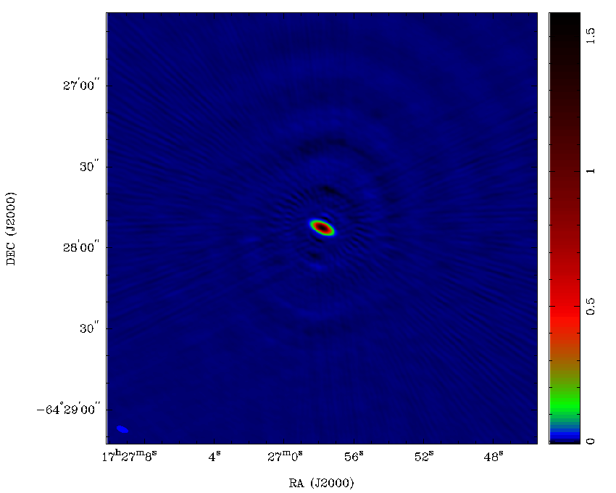
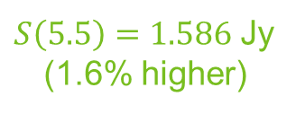
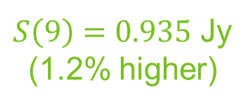
Measuring Flux Density
If you need to image the field to get the flux density, you might get a different answer though.
The same calibrator that we just measured via spectral fit has an image-measured flux density that is higher.
This is because the spectral index hasn’t been taken into account.
$S\left(5.5\right)=1.586$ Jy
(1.6% higher)
$S\left(9\right)=0.935$ Jy
(1.2% higher)

Slide 21
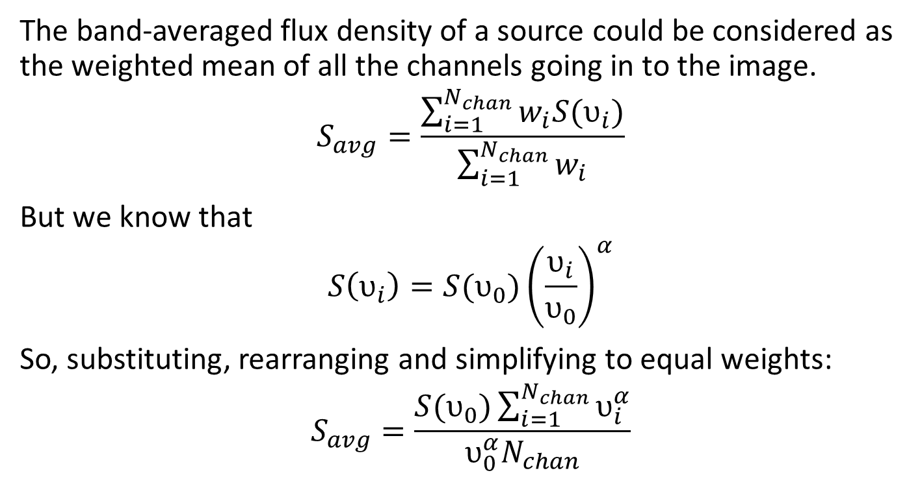
Correcting Image Flux Density
The band-averaged flux density of a source could be considered as the weighted mean of all the channels going in to the image.
$$S_{avg}=\frac{\sum_{i=1}^{N_{chan}}{w_{i}S(υ_{i})}}{\sum_{i=1}^{N_{chan}}{w_{i}}}$$
But we know that
$$S\left(υ_{i}\right)=S(υ_{0}){\left(\frac{υ_{i}}{υ_{0}}\right)}^{α}$$
So, substituting, rearranging and simplifying to equal weights:
$$S_{avg}=\frac{S(υ_{0})\sum_{i=1}^{N_{chan}}{υ_{i}^{α}}}{υ_{0}^{α}N_{chan}}$$

Slide 22
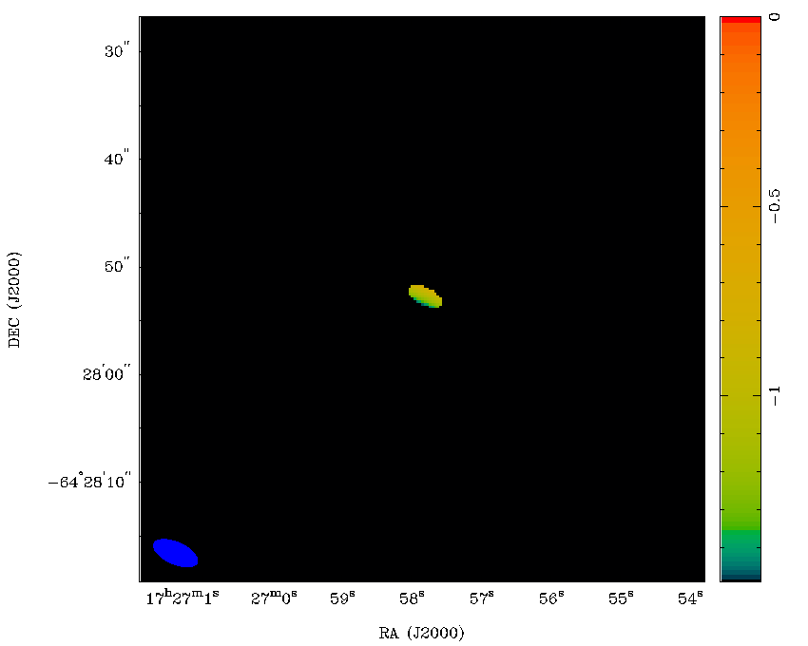
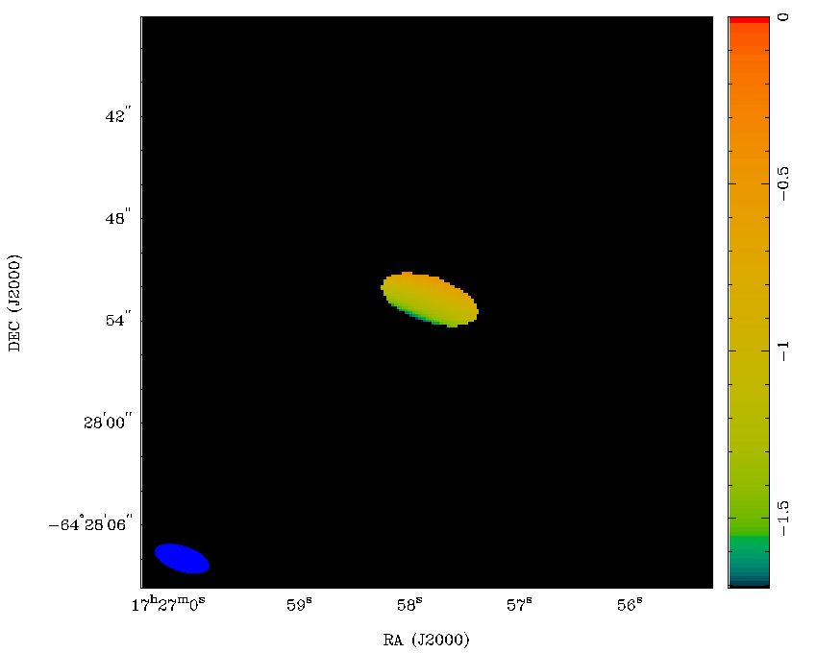

Correcting Image Flux Density
We can further rearrange to recover the flux density at the reference frequency:
$$S(υ_{0})=\frac{S_{avg} υ_{0}^{α} N_{chan}}{\sum_{i=1}^{N_{chan}}{υ_{i}^{α}}}$$
Measure the spectral indices from the images:
5.5 GHz
9.0 GHz
α = -1.094
α = -1.068

Slide 23
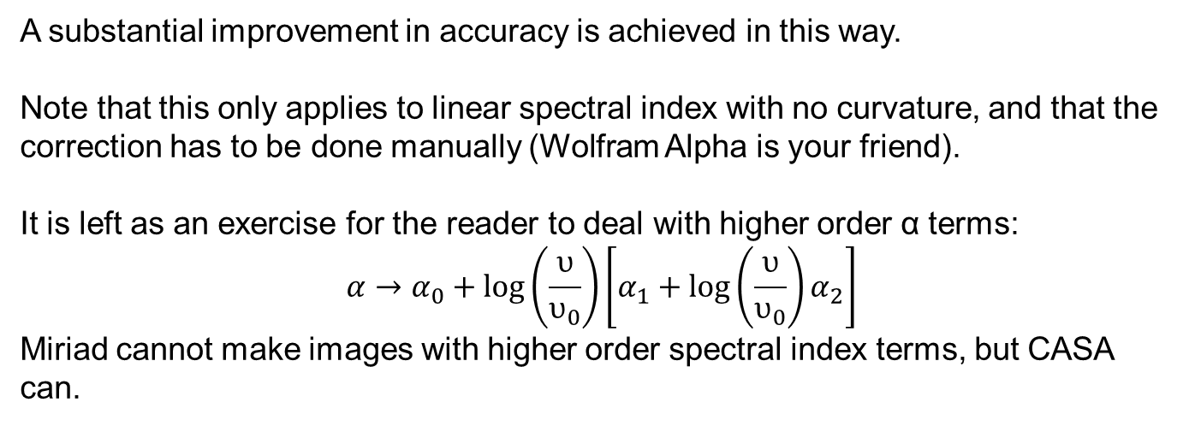
Correcting Image Flux Density
Frequency | Spectral f.d. | Image f.d. | Corrected Image f.d.
5.5 GHz | 1.561 Jy | 1.586 Jy (+1.6%) | 1.564 Jy (+0.2%)
9.0 GHz | 0.924 Jy | 0.935 Jy (+1.2%) | 0.930 Jy (+0.7%)
A substantial improvement in accuracy is achieved in this way.
Note that this only applies to linear spectral index with no curvature, and that the correction has to be done manually (Wolfram Alpha is your friend).
It is left as an exercise for the reader to deal with higher order α terms:
$$α→α_{0}+\log\left(\frac{υ}{υ_{0}}\right)\left[α_{1}+\log\left(\frac{υ}{υ_{0}}\right)α_{2}\right]$$
Miriad cannot make images with higher order spectral index terms, but CASA can.

Slide 24
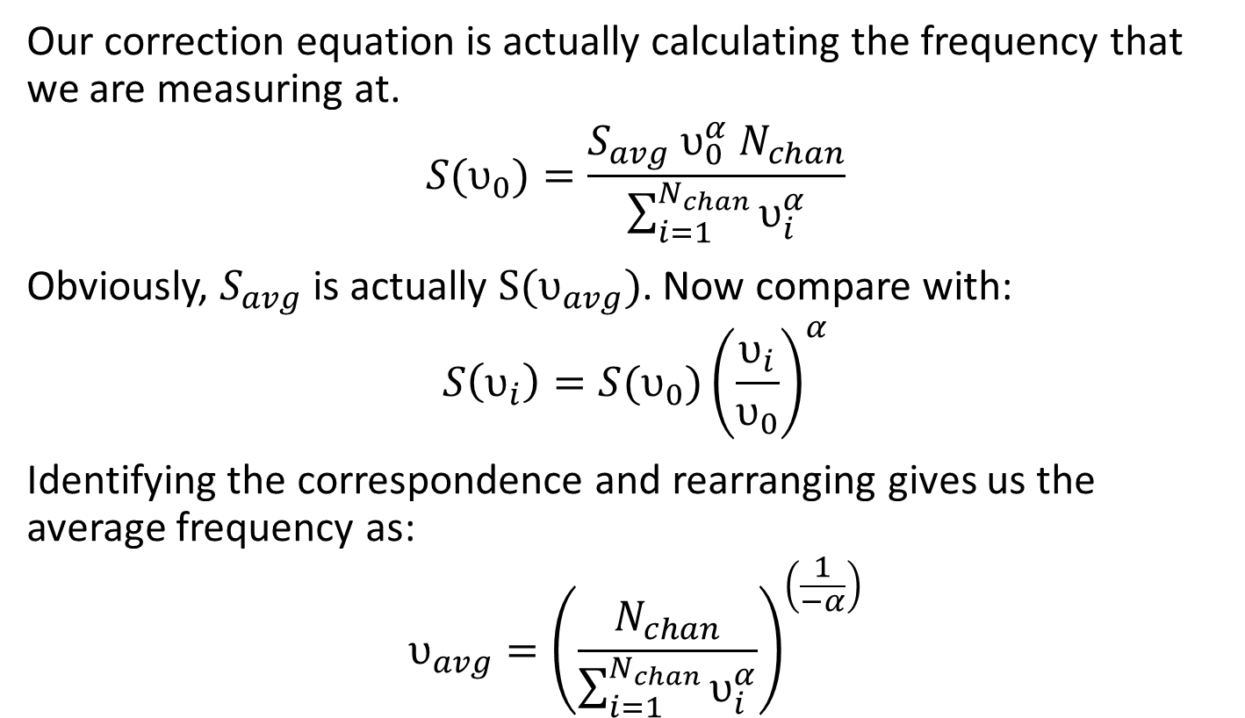
Average Frequency Calculation
Our correction equation is actually calculating the frequency that we are measuring at.
$$S(υ_{0})=\frac{S_{avg} υ_{0}^{α} N_{chan}}{\sum_{i=1}^{N_{chan}}{υ_{i}^{α}}}$$
Obviously, $S_{avg}$ is actually $S(υ_{avg})$. Now compare with:
$$S\left(υ_{i}\right)=S(υ_{0}){\left(\frac{υ_{i}}{υ_{0}}\right)}^{α}$$
Identifying the correspondence and rearranging gives us the average frequency as:
$$υ_{avg}={\left(\frac{N_{chan}}{\sum_{i=1}^{N_{chan}}{υ_{i}^{α}}}\right)}^{\left(\frac{1}{−α}\right)}$$

Slide 25
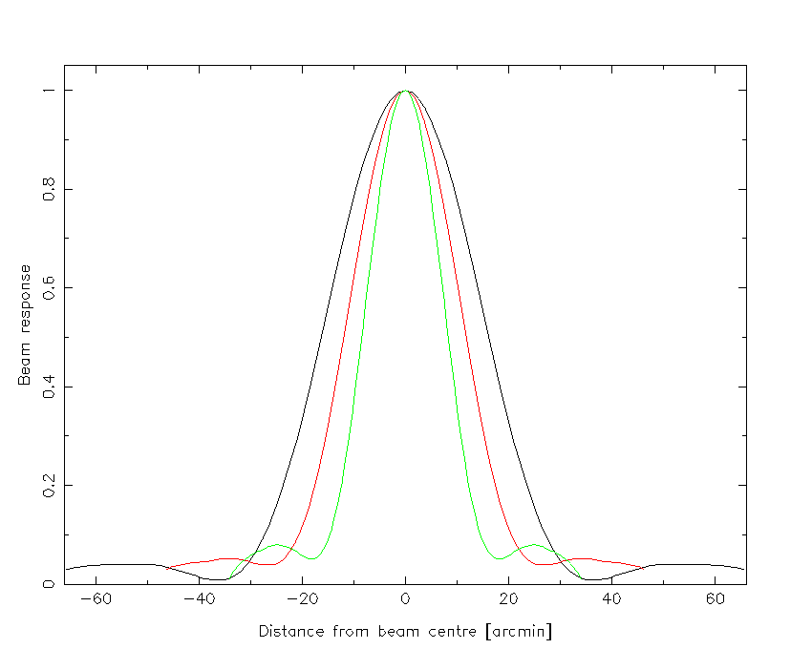
Correcting Spectral Index
Spectral index is dependent on the distance from the beam centre.
ATCA 16cm beam
1524 MHz
2164 MHz
2932 MHz
Response at the beam centre is frequency independent.

Slide 26
Correcting Spectral Index
Spectral index is dependent on the distance from the beam centre.
ATCA 16cm beam
1524 MHz
2164 MHz
2932 MHz
Response goes down with increasing frequency, which has the effect of steepening the spectral index.

Slide 27
Spectral Index Correction

Slide 28
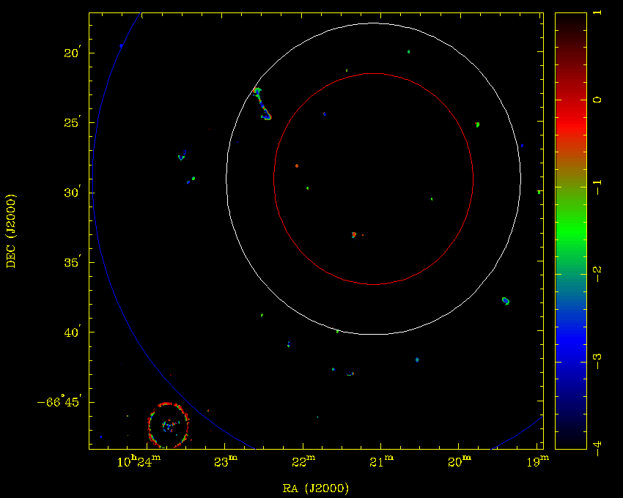
Spectral Index Correction
Not PB corrected

Slide 29
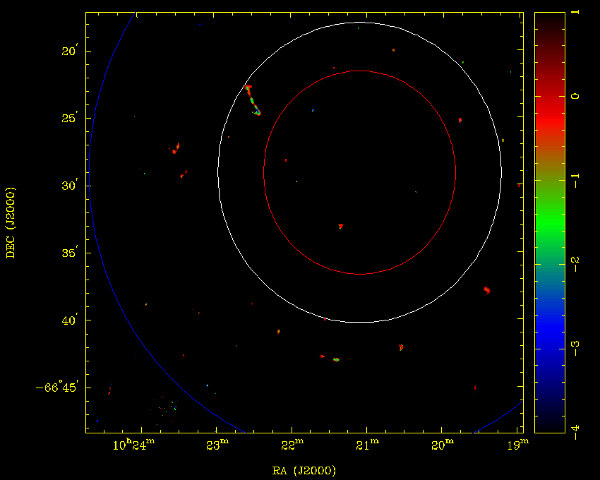
Spectral Index Correction
PB corrected

Slide 30
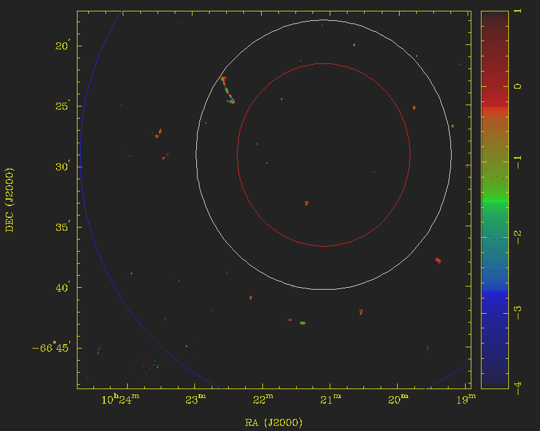
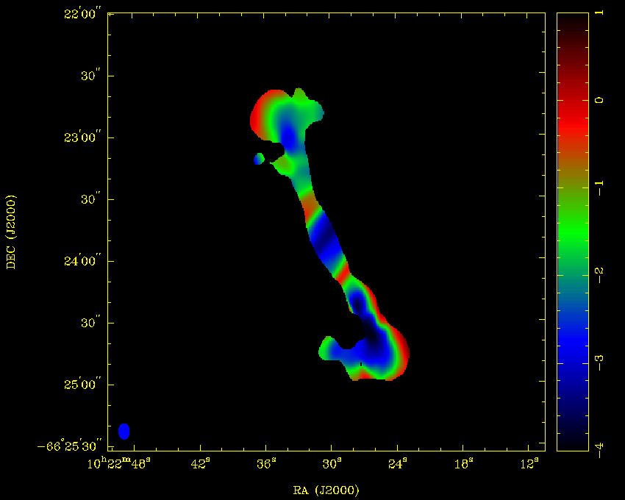
Spectral Index Correction
PB corrected
uncorrected
corrected

Slide 31
Summary
When imaging with wide bandwidths
DON’T | average over too much fractional bandwidth
DO | calibrate using the spectral index of the calibrators
DO | Correct for beam response changes with frequency when calculating spectral index
DO | Use the measured spectral index to correct any measured flux densities

Slide 32
Thank you
Astronomy and Space Science
Jamie Stevens ATCA Senior Systems Scientist
t +61 2 6790 4064
e jamie.stevens@csiro.au
w www.narrabri.atnf.csiro.au
Astronomy and space science

