Slide 1
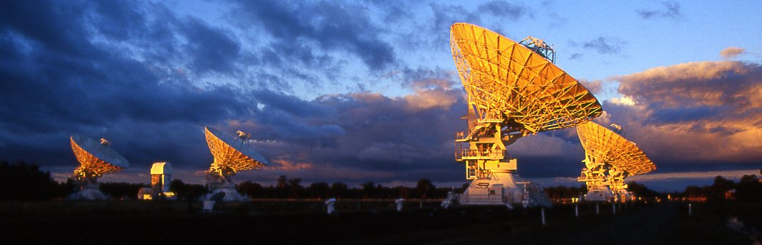
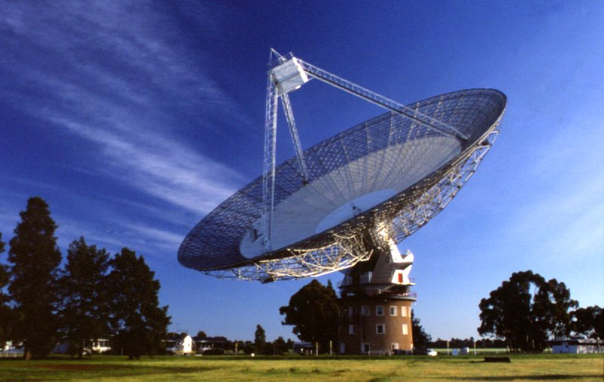
The Zero/Short Spacing Problem
ATNF Synthesis Imaging School 2014
ATCA – Australia Telescope Compact Array
+
Megan Johnson
2 October 2014
Parkes RadioTelescope
CSIRO Astronomy and Space Science
Notes:
ASKAP Picture by Maxim Voronkov (CASS).

Slide 2
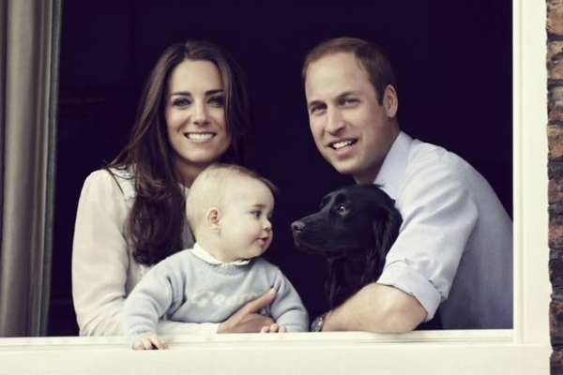
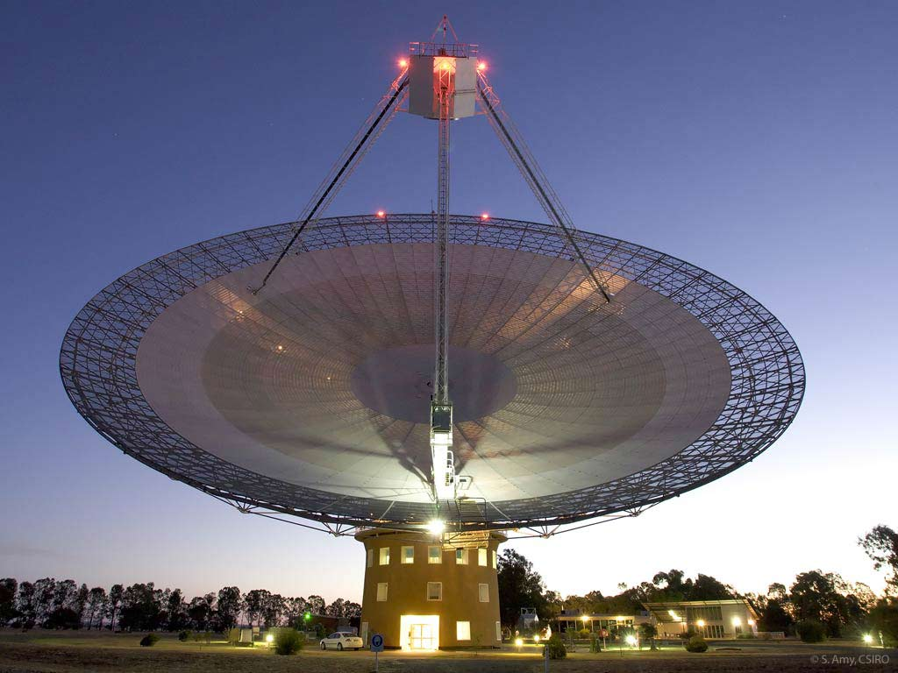
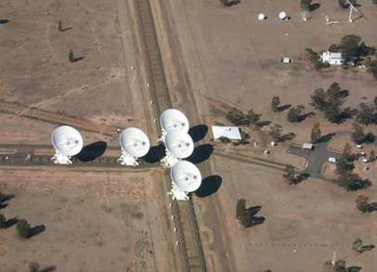
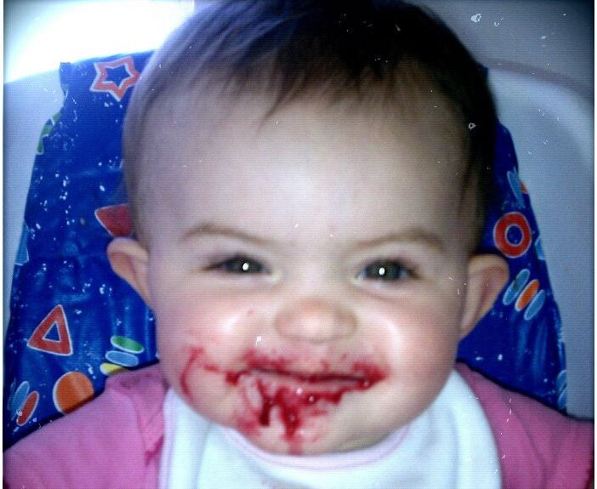
Introduction
What is Short Spacing?
Correcting for Short Spacing
Tools for Interferometer + Single Dish Data Combination

Slide 3
Introduction
What is Short Spacing?
Correcting for Short Spacing
Tools for Interferometer + Single Dish Data Combination

Slide 4
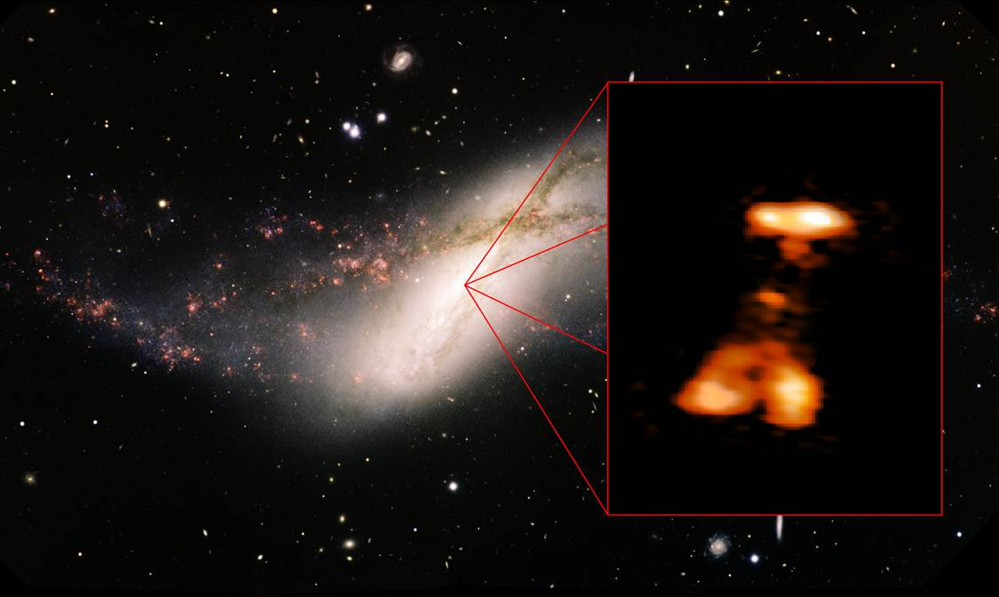
Higher resolution allows us to study details of objects like galaxies.
CREDIT: Minchin et al., NRAO/AUI/NSF (HSA);
Travis Rector, Gemini Observatory, AURA (optical).

Slide 5
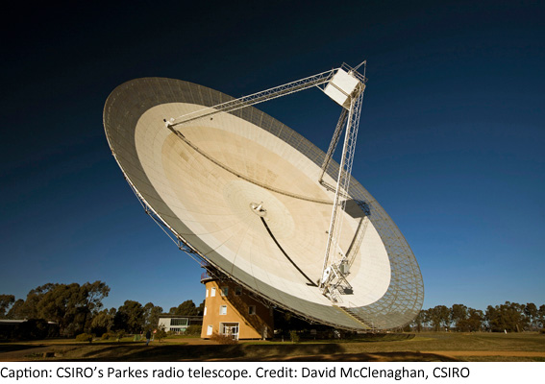
Bigger dishes have higher resolution.
θ[rad] ≈ λ / D
D
Notes:
Lovely demonstration from NGC 660 data of why higher resolution is cool

Slide 6
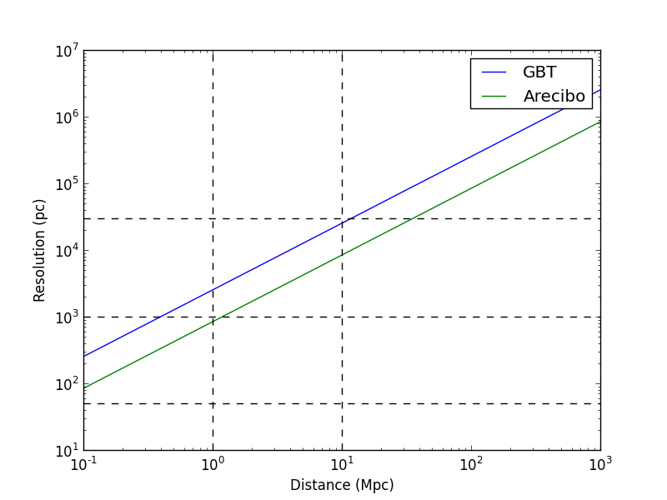
Telescopes with high resolutions are needed to study distant objects.
Local
Group
Local
Volume
Parkes
GBT/
Effelsberg
Arecibo
MW
1 kpc
20cm
HII region
Slide Courtesy of Amanda Kepley, NRAO

Slide 7
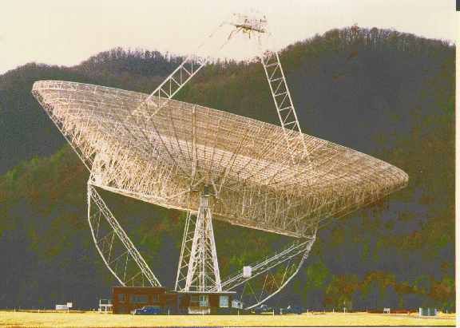
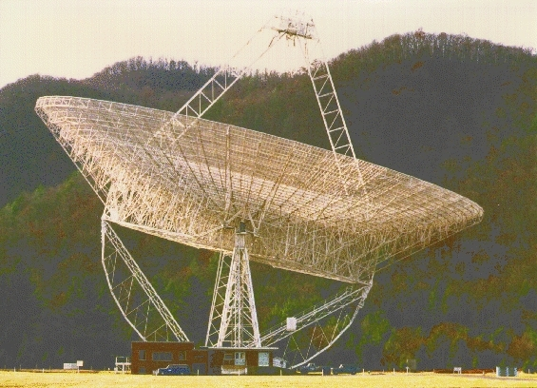
Very large dishes have to be supported against gravity/wind.
14 November 1988

Slide 8
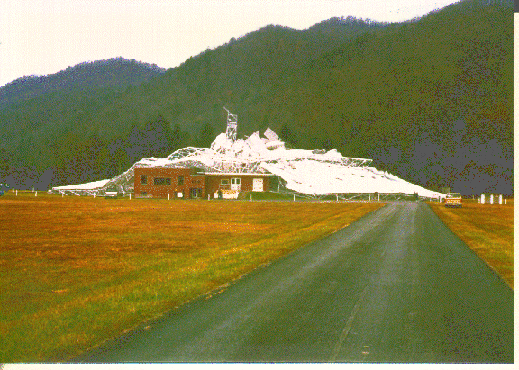
Very large dishes have to be supported against gravity/wind.
15 November 1988

Slide 9
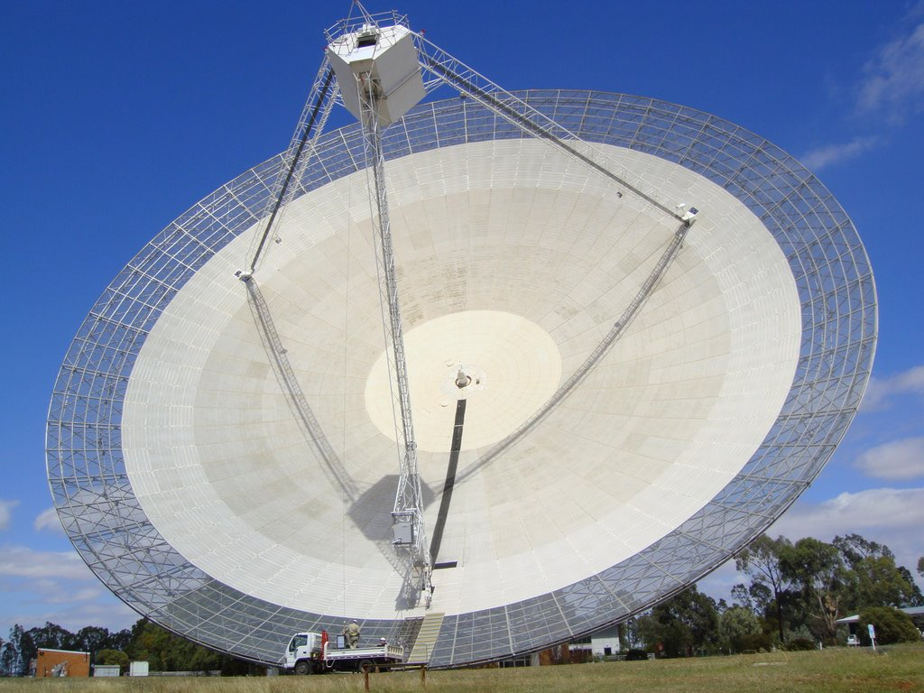
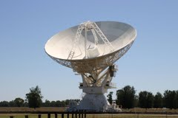
You can get higher resolution by splitting up a single dish into smaller dishes…

Slide 10
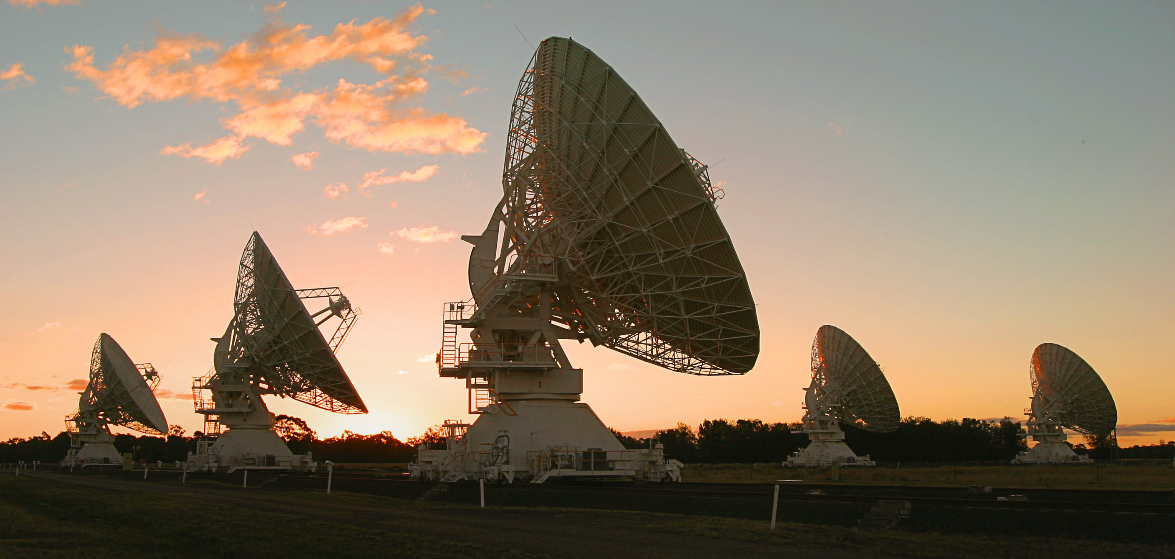
and placing them far apart.

Slide 11
Introduction
What is Short Spacing?
Correcting for Short Spacing
Tools for Interferometer + Single Dish Data Combination

Slide 12
The signals between the different dishes are correlated together.
d sin θ
θ
d = baseline
Fourier
Transform
Visibilities
Images
Slide Courtesy of Amanda Kepley, NRAO

Slide 13
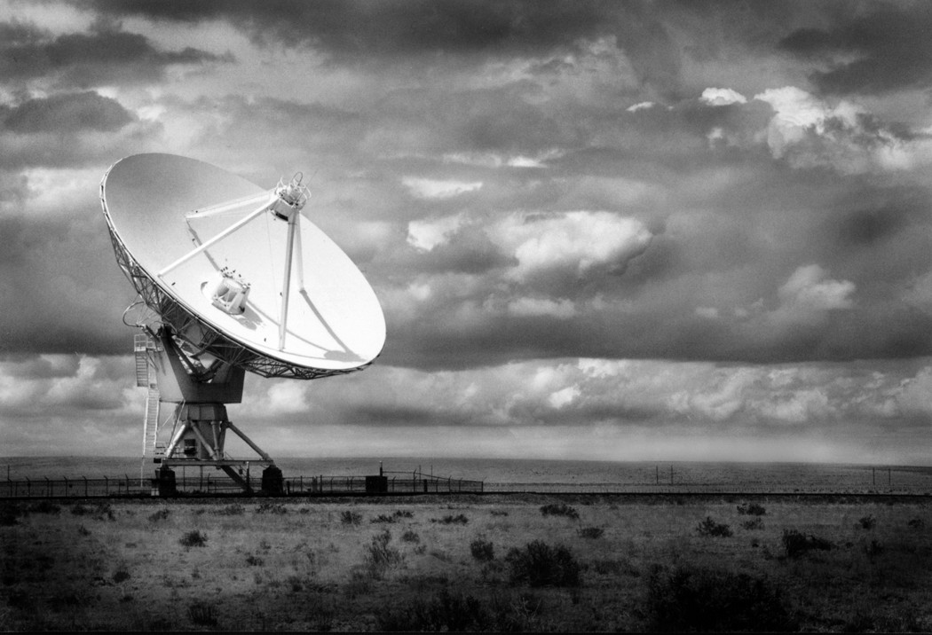
Interferometers are analogous to double slits!
λ / d
λ / D
λ / D
D
d = baseline
Slide Courtesy of Amanda Kepley, NRAO

Slide 14
The resolution goes as the distance between the dishes, not the dish size.
θ[rad] ≈ λ / d
d
Long baselines = high resolution
Short baselines = low resolution
Slide Courtesy of Amanda Kepley, NRAO

Slide 15
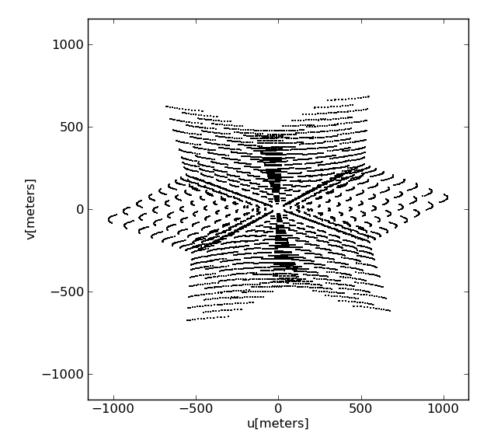
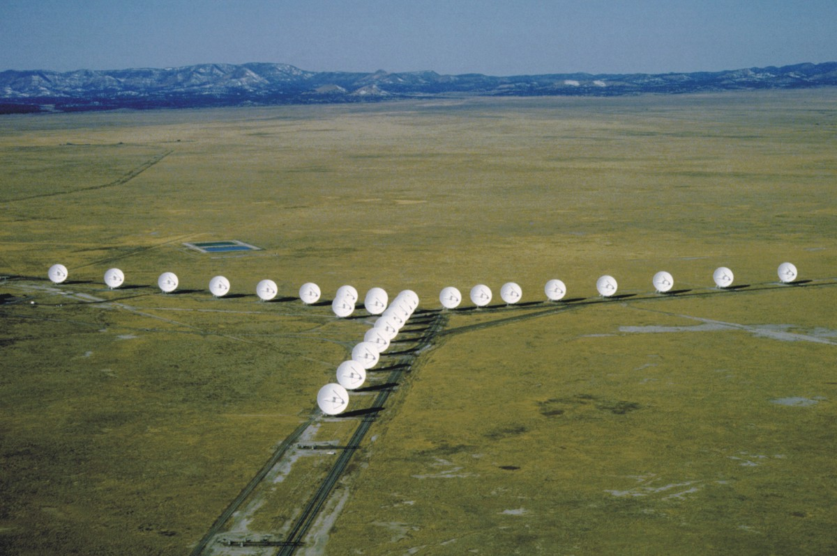
Interferometers are only sensitive to a range of spatial scales because d ≠ 0
Resolution
Largest Angular Scale
Slide Courtesy of Amanda Kepley, NRAO

Slide 16
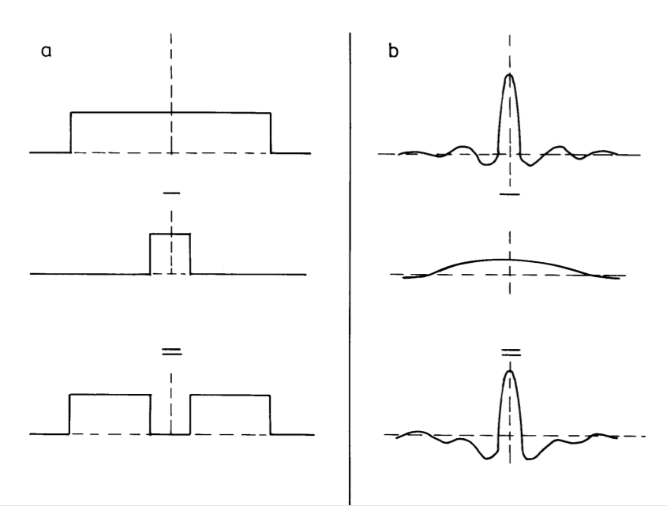
Short Spacing Problem
Observed Spatial Frequencies
Instrumental Response
Ideal
Minus Short
Spacing
Negative
Bowls
Effect of missing
short spacing
Braun & Walterbos 1985

Slide 17
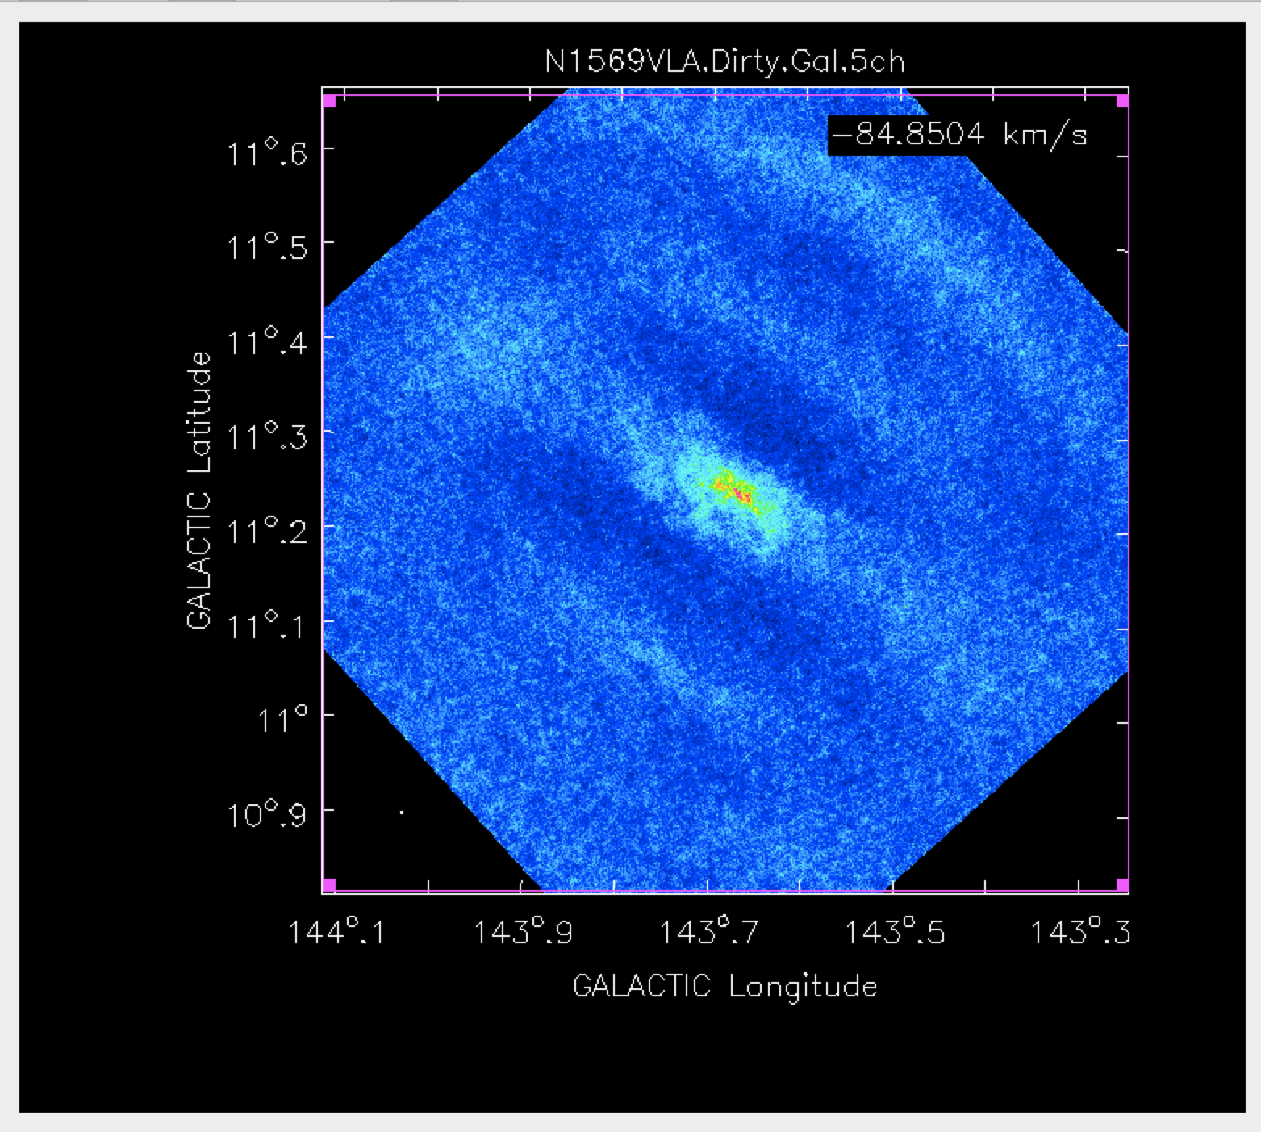
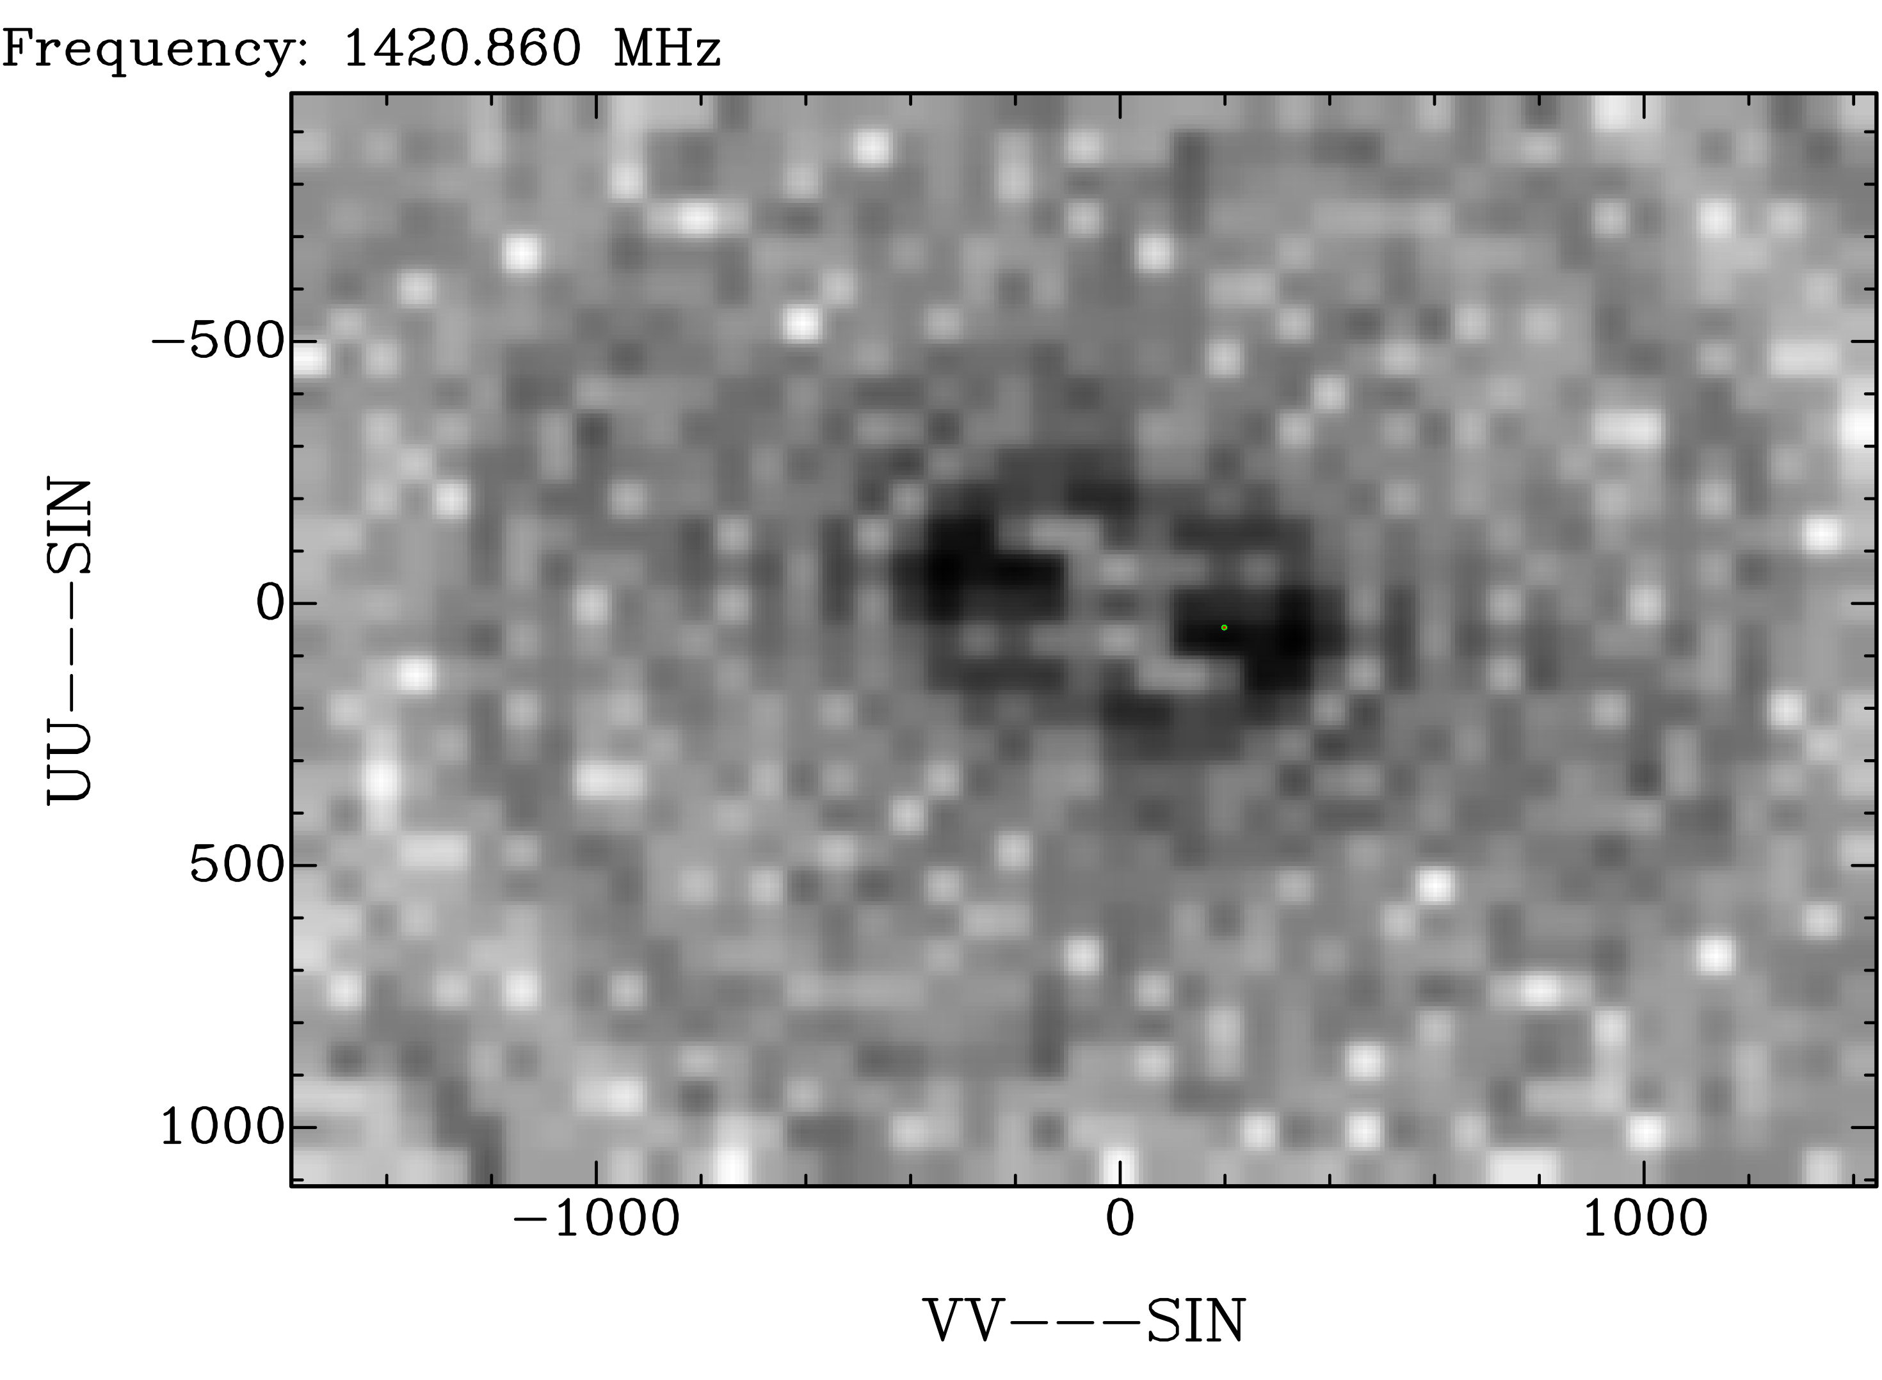
Short Spacing Problem – Interferometer FT View
NGC 1569
  Dirty Cube – single channel shows ugly negative bowls
  FFT of channel shows missing flux in center

Slide 18
Short Spacing Problem – Interferometer FT View
Looks insignificant, but the center pixel is where ALL of the flux in the image is defined!

Slide 19


BECAUSE…

Slide 20
Introduction
What is Short Spacing?
Correcting for Short Spacing
Tools for Interferometer + Single Dish Data Combination

Slide 21
CLEAN extrapolates inner flux
?
No information on extended structures!
?
FFT of “Dirty” Interferometer map
?
Amplitude
CLEAN model
uv-distance
Shortest Baseline
Observed

Slide 22
Ekers & Rots Theorem
An interferometer doesn’t just measure angular scales θ≈λ/d it actually measures λ / (d - D) < θ < λ / (d + D)
d + D
d - D
“Fourier Coverage”
D
d
d - D
d
d + D
(Slide courtesy of Juergen Ott, NRAO)

Slide 23
Ekers & Rots Theorem
Sounds great but you can’t get all that extra information from a single visibility
Interferometers measure a number per baseline and integration time, not a range
Similar to a single dish, you have to scan to get the extra “spacings”
Mosaicing is a way to perform this scanning and unlocks the extra information
(Slide courtesy of Juergen Ott, NRAO)

Slide 24
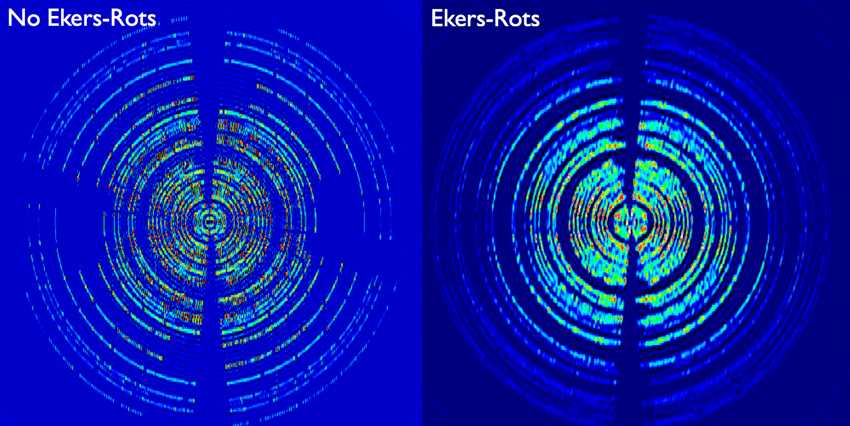
Ekers & Rots Theorem
(Slide courtesy of Juergen Ott, NRAO)

Slide 25
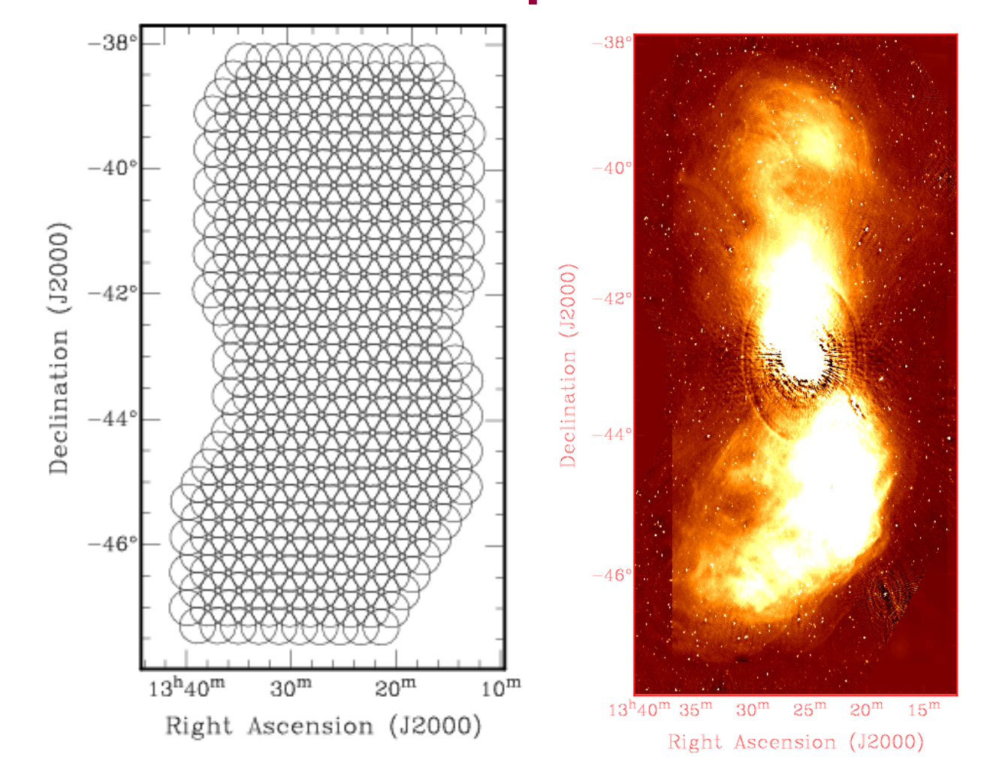
Centaurus A: 406 pointings!
(Slide courtesy of Juergen Ott, NRAO)
Feain et al. 2011

Slide 26
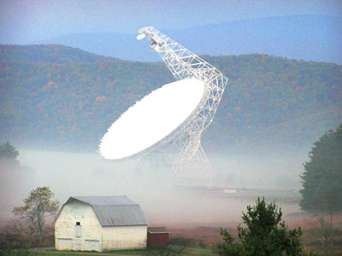
Interferometer + Single Dish
100 meters
43 meters
+

Slide 27
Interferometer + Single Dish
64 meters
31 meters
+

Slide 28
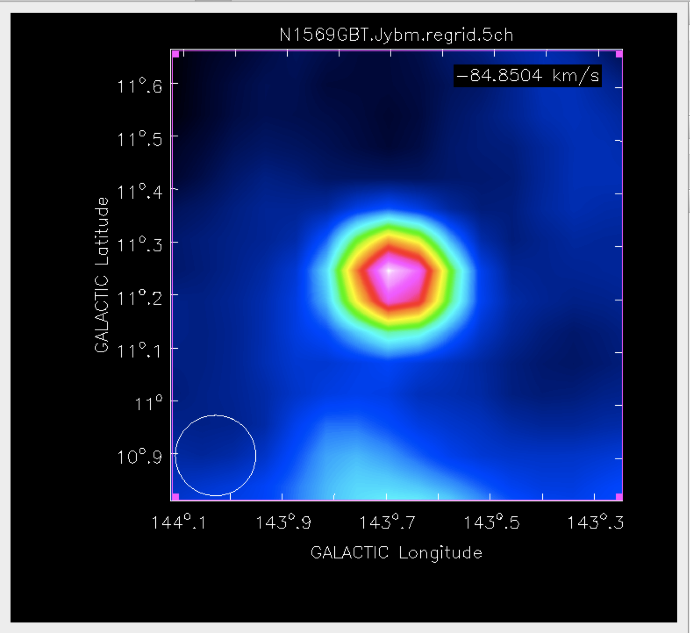
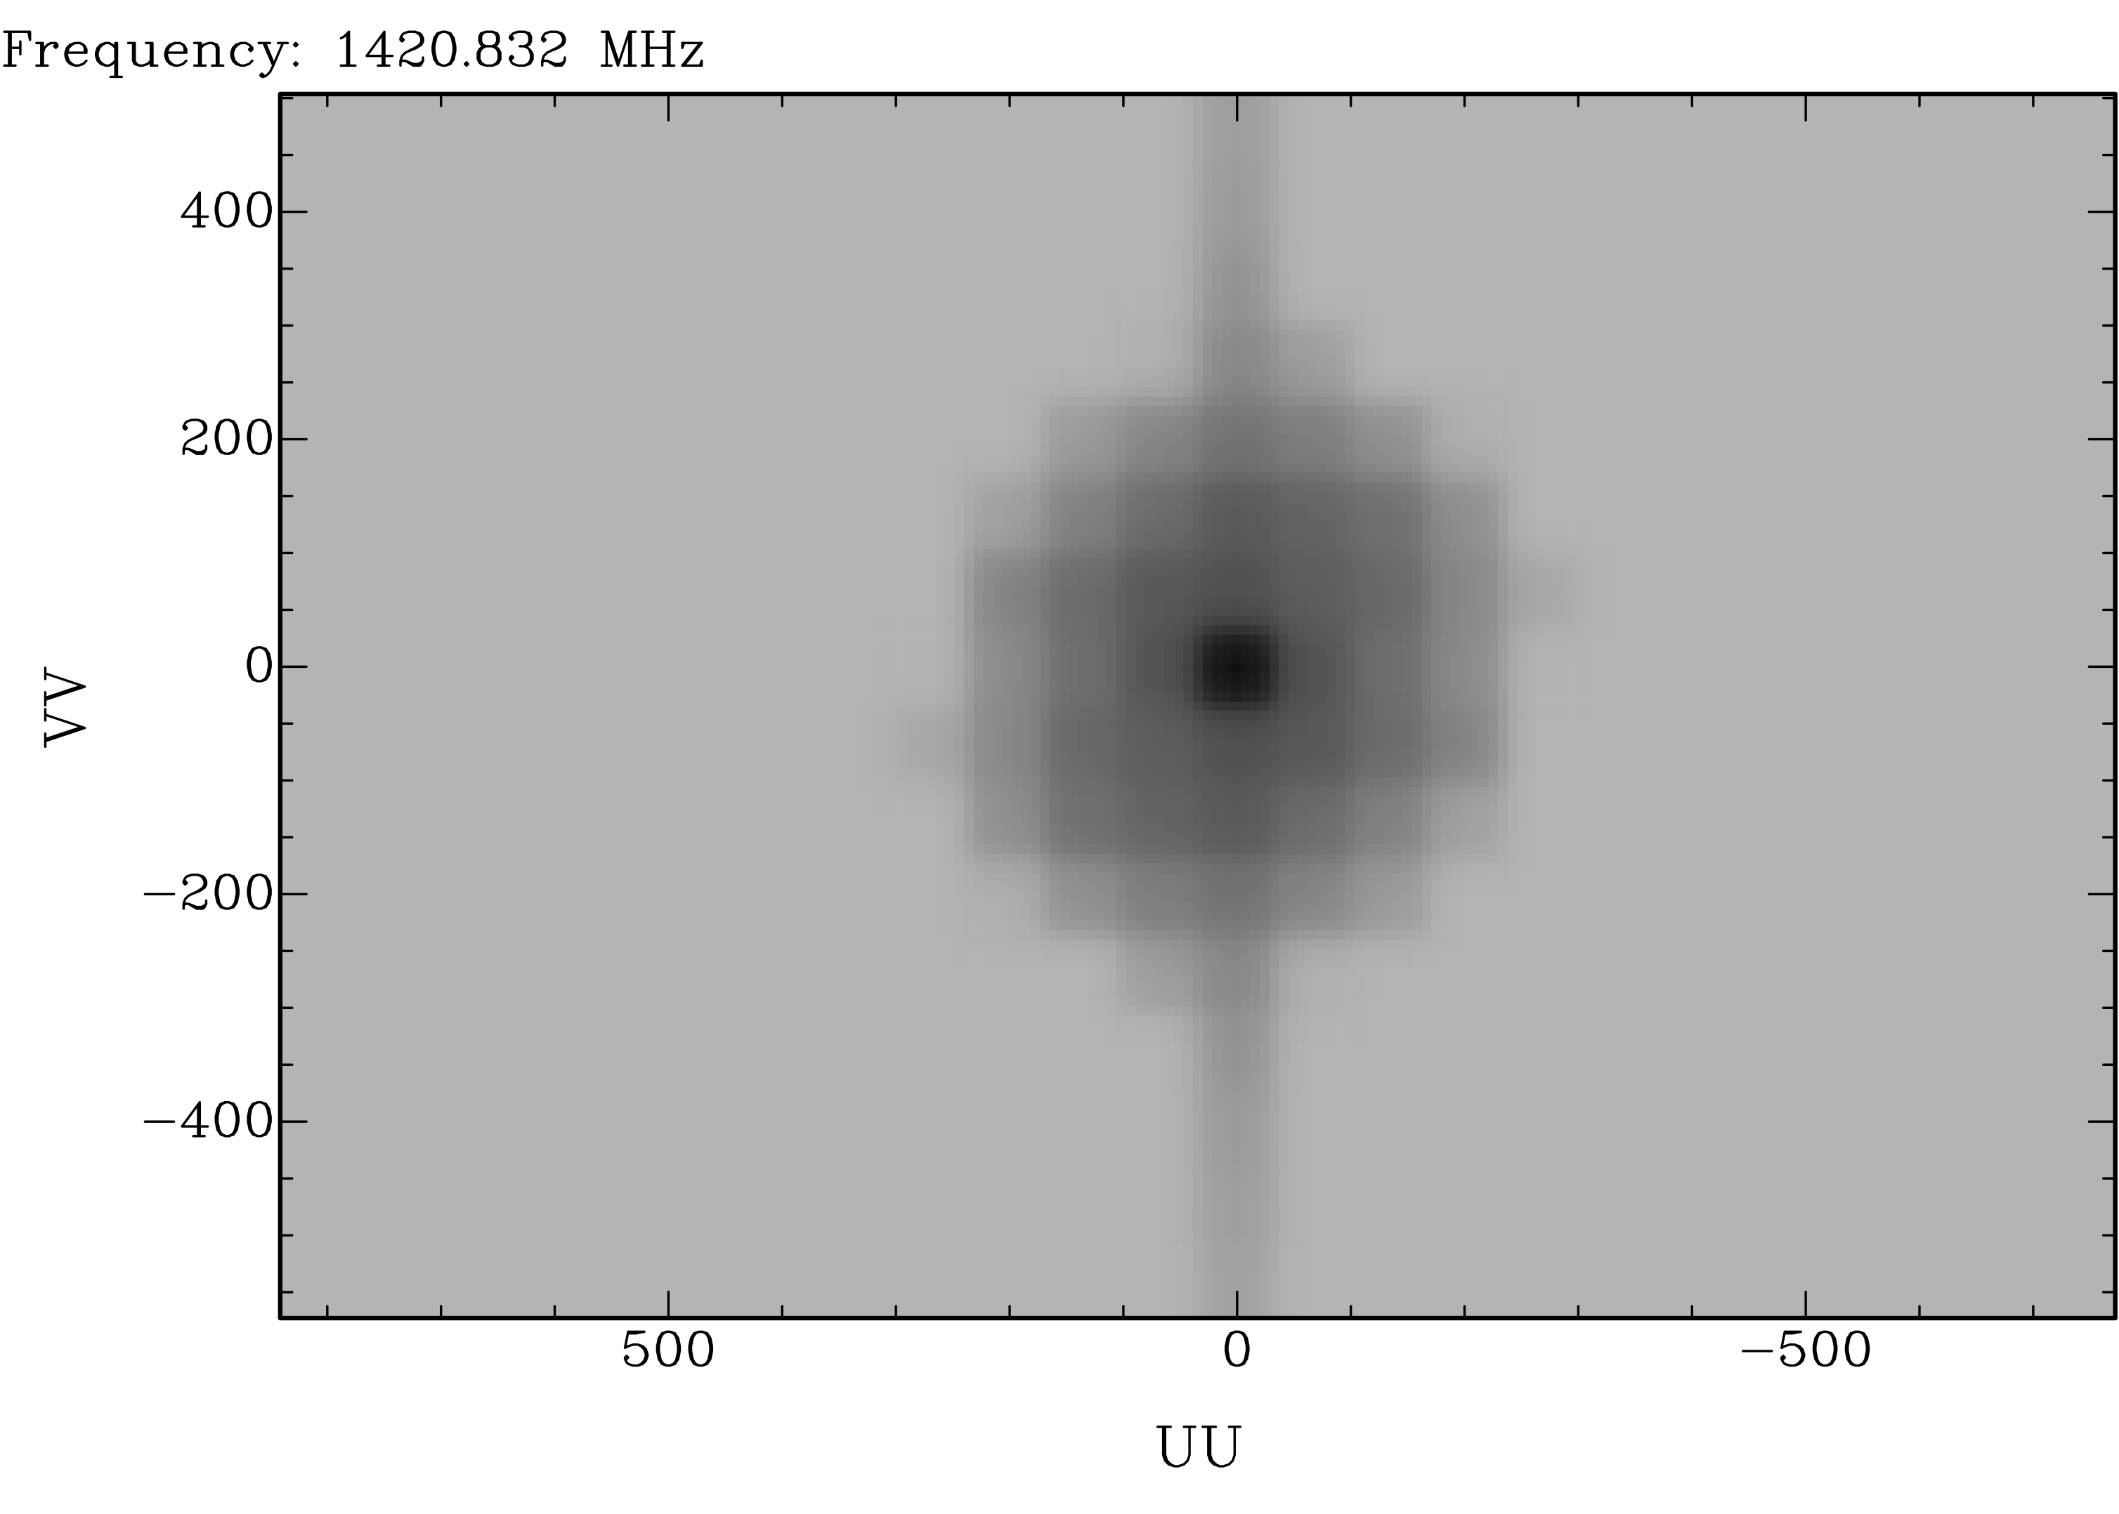
Single Dish – FT View
NGC 1569
  GBT Cube – single channel shows all flux
  FFT of channel shows all flux is in center

Slide 29
Using a Single Dish (SD) to Correct for Zero Spacing
Get an interferometric observation
Go to a SD and map the same region, use a SD with a diameter larger than the shortest baseline of your interferometric map
Goals:
Aim for (at least) same surface brightness sensitivity at shortest baseline and SD
Calibrate, calibrate, calibrate!
Methods for Combining:
Feathering: FT SD map → FT cleaned, interferometric map → combine both with weighting in uv-space → FT back to combined image
Use the SD map as a model for deconvolution with (multi-scale-)clean
Minimize Maximum Entropy χ² for both the SD and the interferometric map simultaneously
Linear Combination in image domain
(Slide courtesy of Juergen Ott, NRAO)

Slide 30
Using a Single Dish (SD) to Correct for Zero Spacing
Get an interferometric observation
Go to a SD and map the same region, use a SD with a diameter larger than the shortest baseline of your interferometric map
Goals:
Aim for (at least) same surface brightness sensitivity at shortest baseline and SD
Calibrate, calibrate, calibrate!
Methods for Combining:
Feathering: FT SD map → FT cleaned, interferometric map → combine both with weighting in uv-space → FT back to combined image
Use the SD map as a model for deconvolution with (multi-scale-)clean
Minimize Maximum Entropy χ² for both the SD and the interferometric map simultaneously
Linear Combination in image domain
(Slide courtesy of Juergen Ott, NRAO)

Slide 31
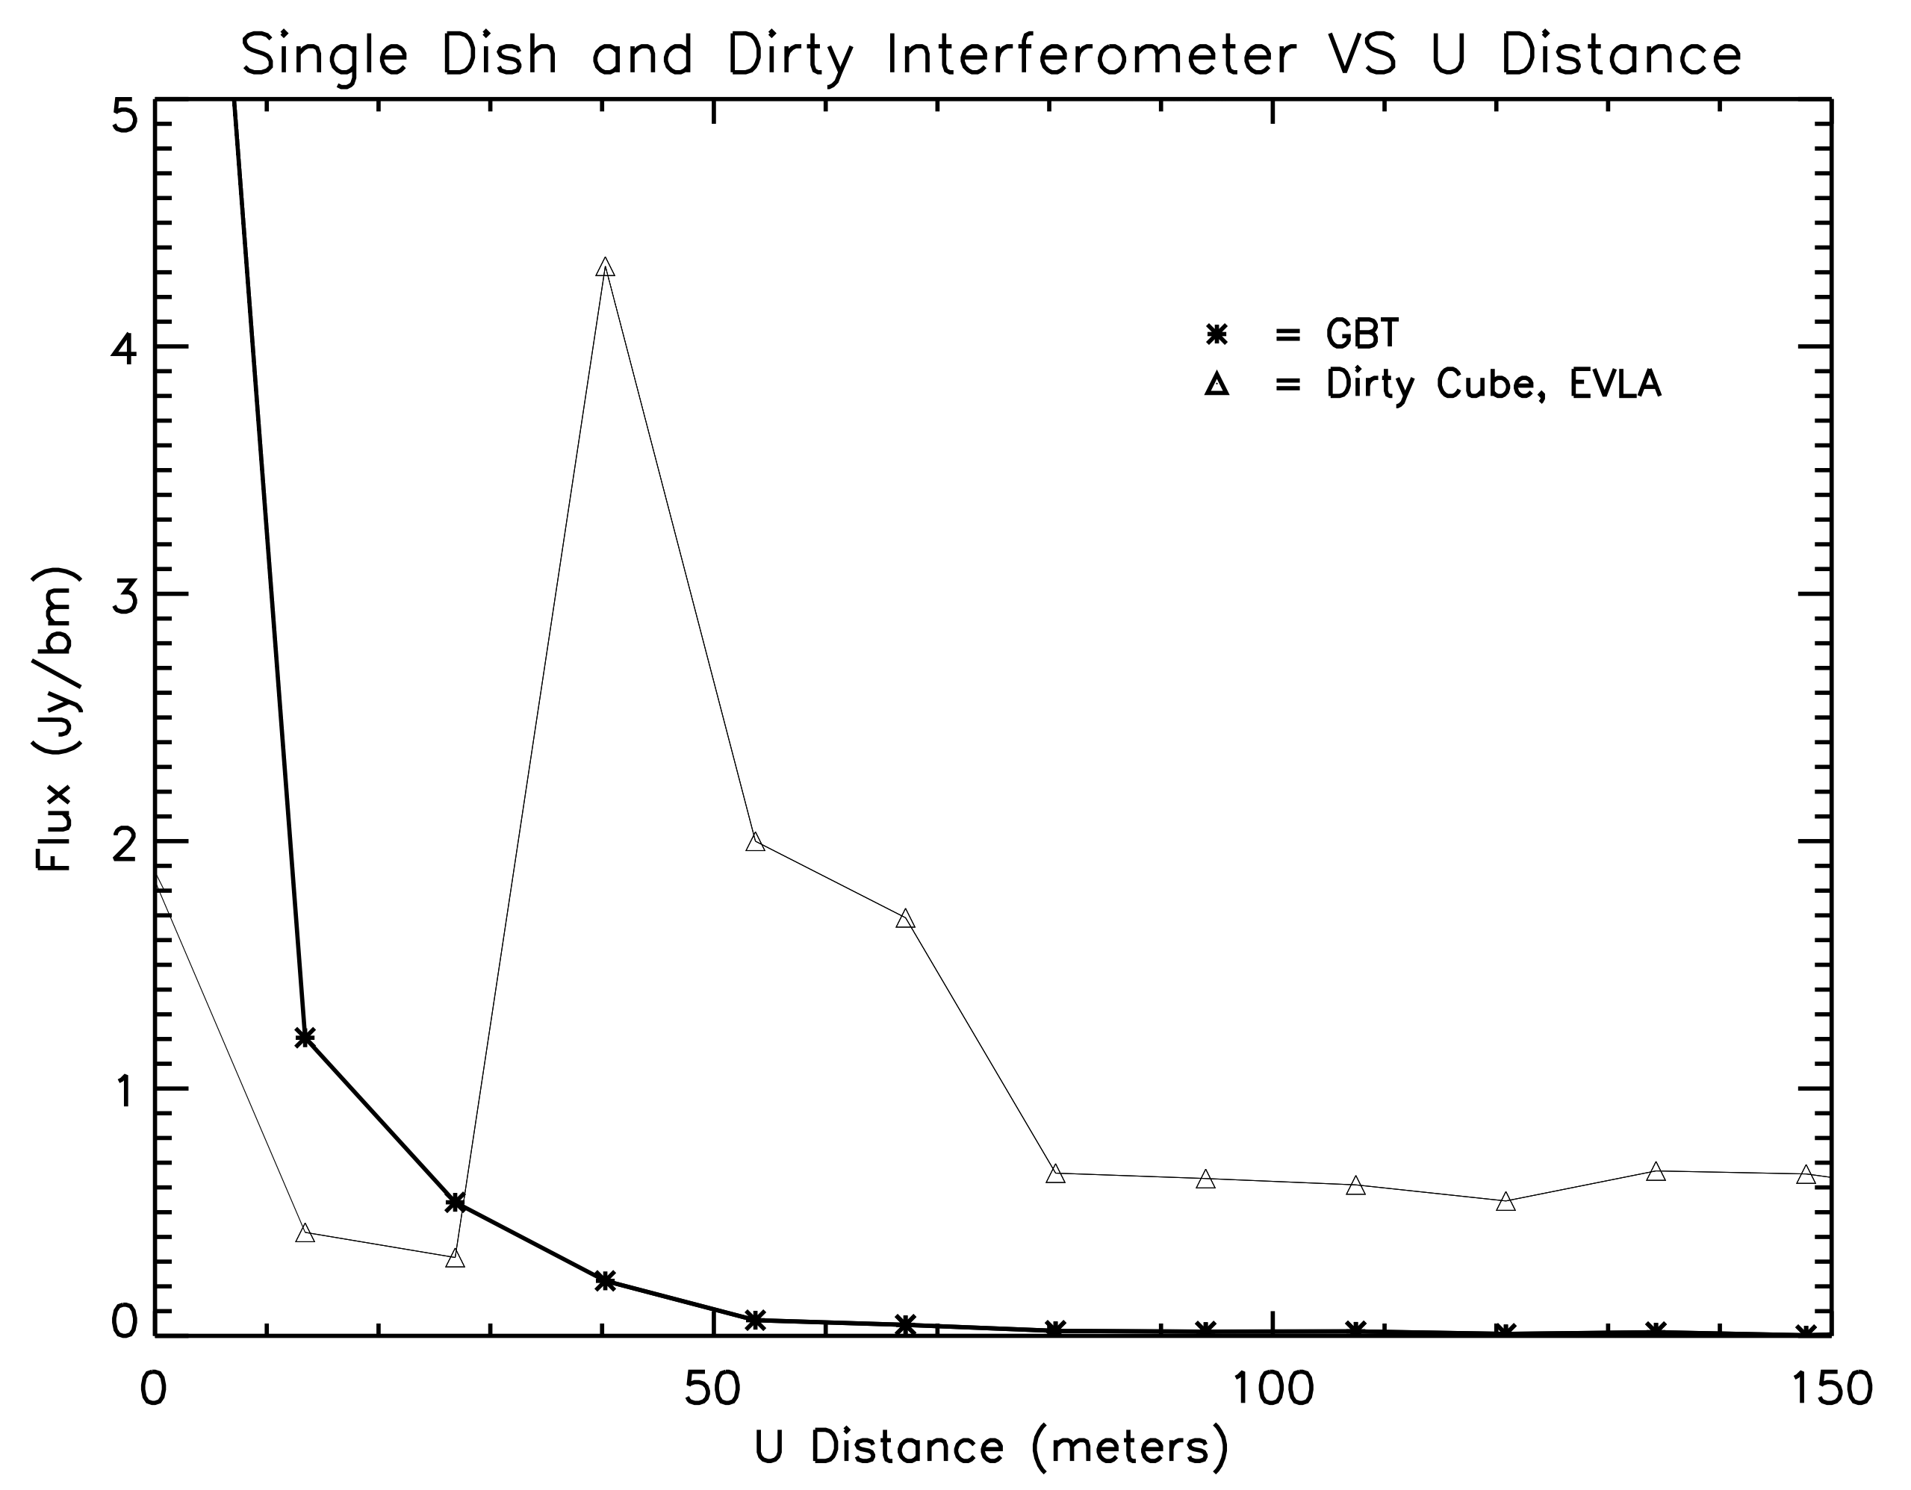
= 100 meter dish
= 43
meters for shortest baseline
Overlap Region = fluxes should be equal, but single dish is convolved with the beam

Slide 32
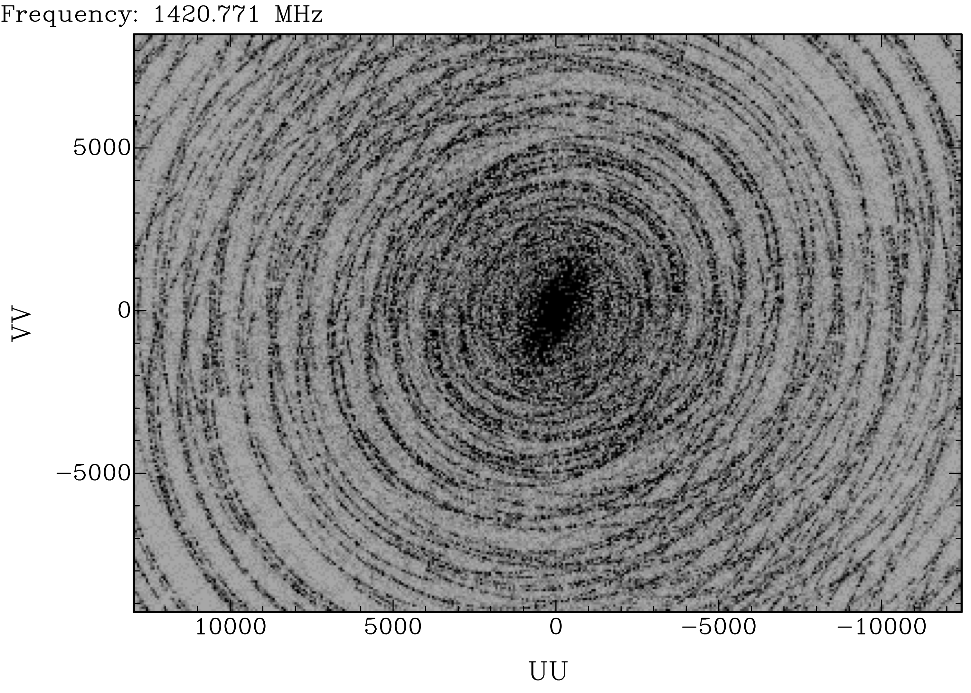
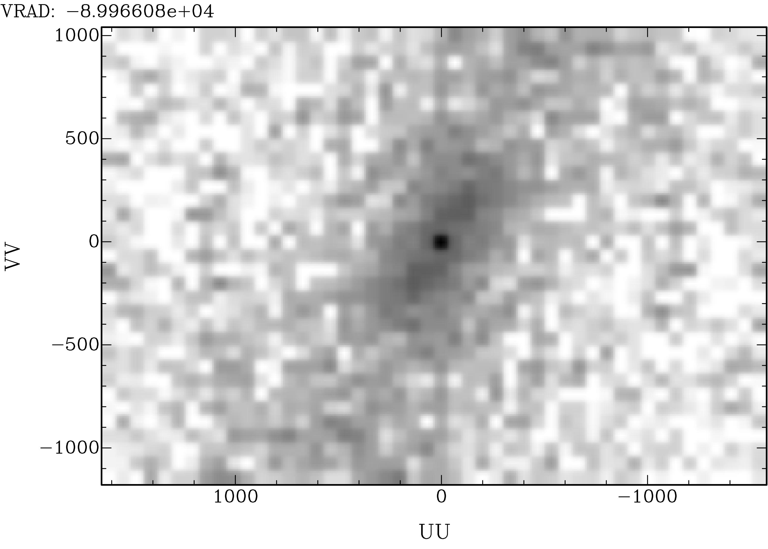
Feather – Combine in uv-plane
FT EVLA Clean Data Cube
FT GBT Data Cube
+
=

Slide 33
Feather – Weights
FFT of “Clean” Interferometer map
Amplitude
FFT of SD map
uv-distance

Slide 34
Feather – Weights
Interferometric weighting = 1-FFT(SD beam)
FFT of “Clean” Interferometer map
Amplitude
FFT of SD map
uv-distance

Slide 35
Feather – Weights
FFT of weighted SD + Interferometer map
Amplitude
uv-distance

Slide 36
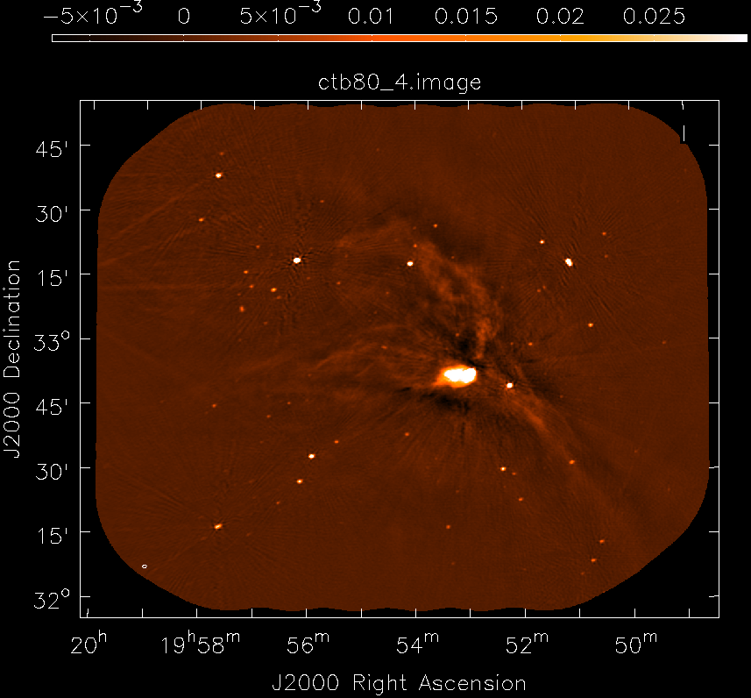
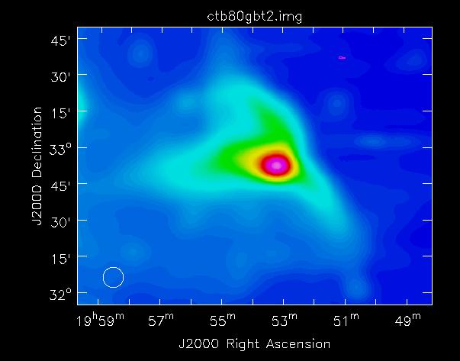
Example: Supernova Remnant CTB80
+
Images courtesy of Anish Roshi, NRAO

Slide 37
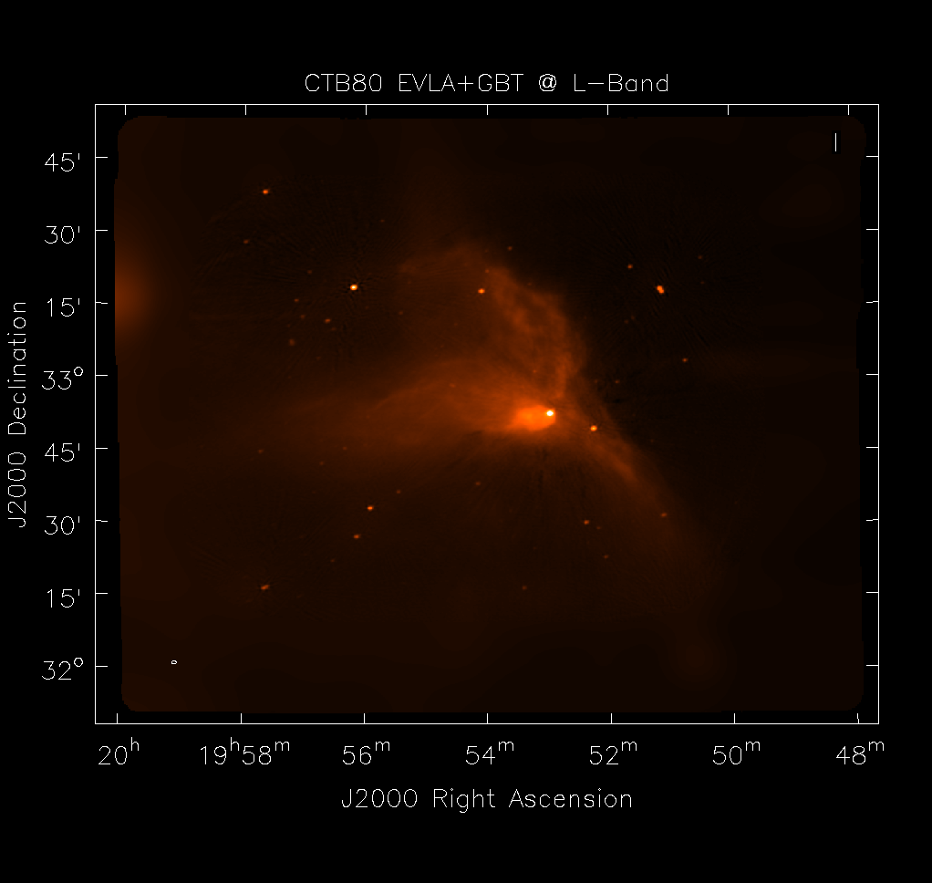
Image courtesy of Anish Roshi, NRAO

Slide 38
Introduction
What is Short Spacing?
Correcting for Short Spacing
Tools for Interferometer + Single Dish Data Combination

Slide 39
Software Packages for Data Combination using Feathering
AIPS
  task “IMERG”
  have to have input cubes on same pixel and frequency scale
MIRIAD
  task “Immerge” (similar to AIPS task)
CASA
  task “Feather”
  Re-grids input cubes and transforms coordinate system, if necessary
  New!! Lots of potential, still working on applications

Slide 40

CASA: Common Astronomical
Software Applications
(New) software package designed for ALMA (Atacama Large Millimeter/submillimeter Array) data reduction and for EVLA (Extended Very Large Array)

Slide 41
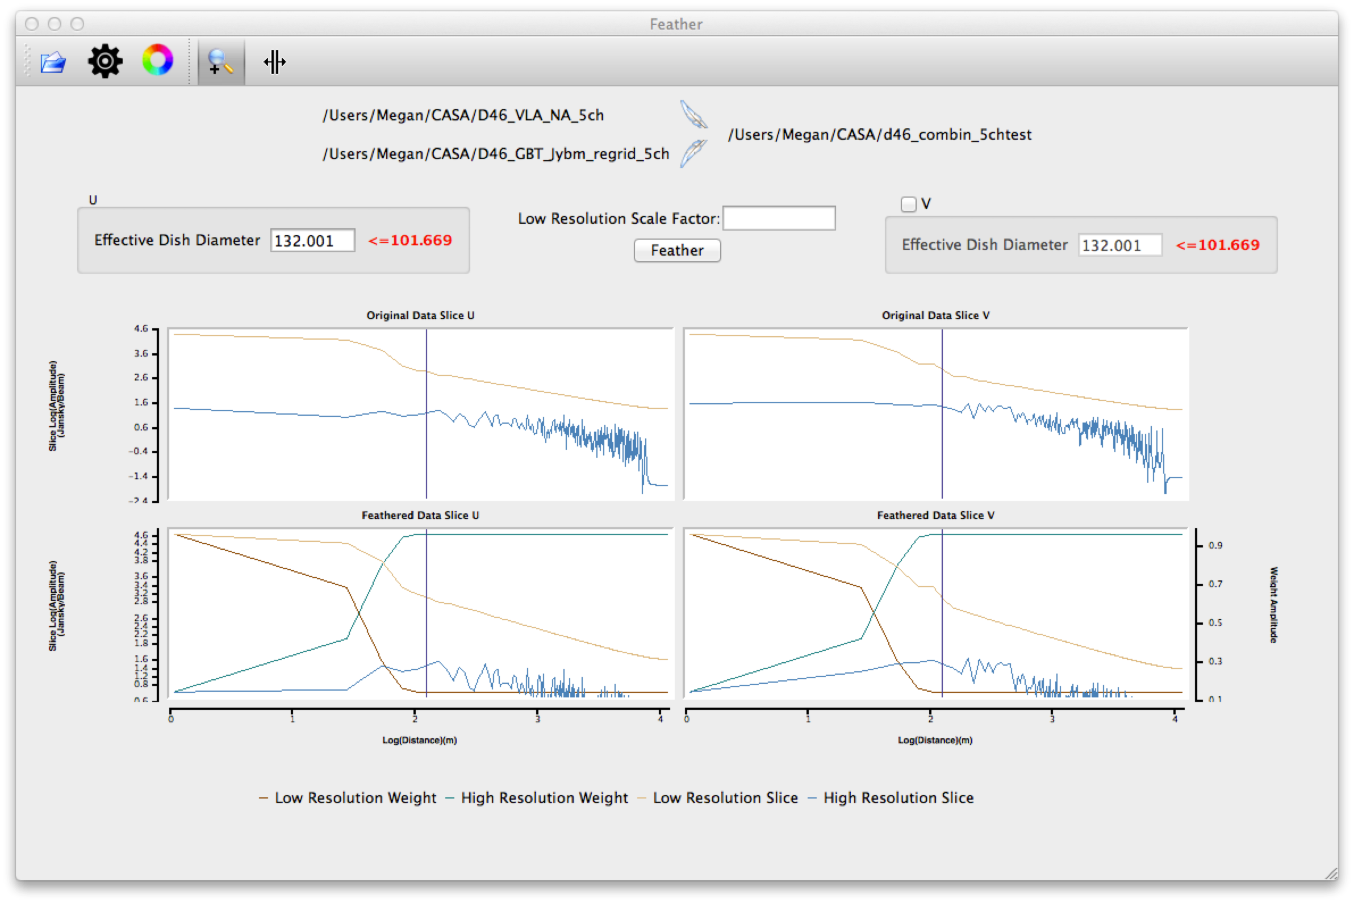
Feather GUI in CASA (ver 4.1)
New Feather Gui in CASA 4.1.0
  from command line, > casafeather

Slide 42
Combining ALMA and Mopra mm-data
HNCO mosaic of the Brick
ALMA (1.7”)
Mopra (38”)
Rathborne et al. (2014, in prep). – ALMA 13-point mosaic (5h, 25 antennas); field 3’ × 1.5’.
Images courtesy of Jill Rathborne, ATNF

Slide 43
Combining ALMA and Mopra mm-data
HNCO mosaic of the Brick
ALMA (1.7”)
ALMA+Mopra
Rathborne et al. (2014, in prep). – ALMA 13-point mosaic (5h, 25 antennas); field 3’ × 1.5’.
Images courtesy of Jill Rathborne, ATNF

Slide 44
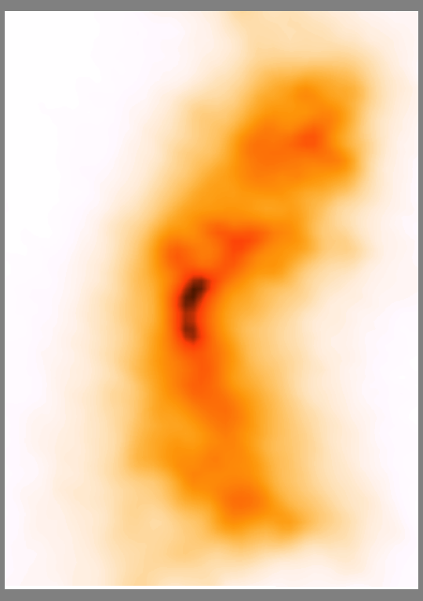
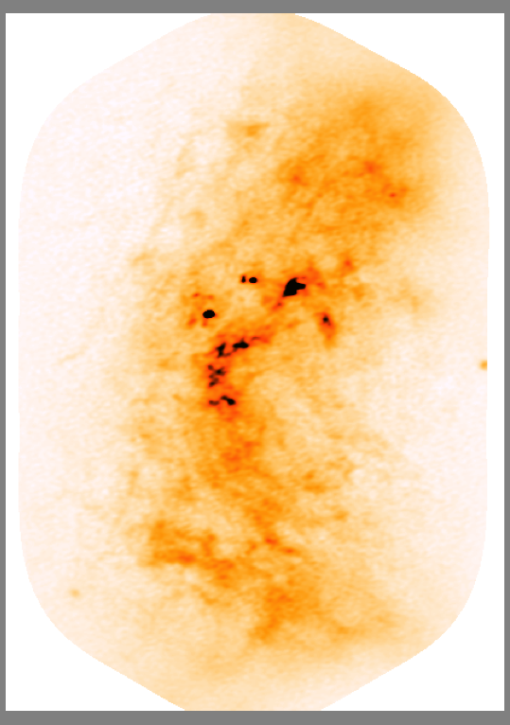
Rathborne et al. (2014, in prep). – ALMA 13-point mosaic (5h, 25 antennas); field 3’ × 1.5’.
Notes:
Fade from single dish to ALMA image (3mm continuum)
Beam is in the lower left corner

Slide 45
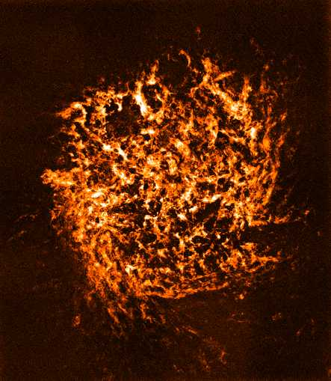
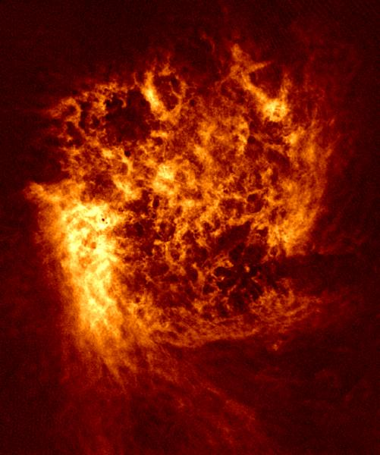
HI Single Dish + Interferometer Using MIRIAD task “IMMERGE”
LMC
ATCA
ATCA + Parkes
HI mosaic (1344 pointings) of the Large Magellanic Cloud by Kim et al. (1998, 2003).
Images courtesy of Bärbel Koribalski, ATNF

Slide 46
Summary
Interferometers are very good at increasing resolution at long wavelengths BUT…
Short-spacing is a problem in interferometry data
  Cannot image extended emission with interferometer if emission is larger than shortest baseline resolution
Methods to combine single-dish and interferometer data
  Feather data together – combine in uv-plane
  use single-dish as model for deconvolution
  Minimize maximum entropy χ² for both the SD and the interferometric map simultaneously
  combine in image plane with linear combination methods
Software packages available for data combination:
  MIRIAD
  AIPS
  CASA

Slide 47
Additional References:
Stanimirovic (2002) ASP Conf. Series 278
Sault & Killeen (2003) Miriad Users Manual
Holdaway (1999) ASP Conf. Series 180
Other work (partial list):
    Adler et al. (1992, ApJ, 392, 497); Bajaja & van Albada (1979, A&A, 75, 251); Cornwell, Holdaway & Uson (1993, A&A, 271, 697); Roger et al. (1984, PASA, 5, 560); Schwartz & Wakker (1991, ASP Conf. Ser. 19); Vogel et al. (1984, ApJ, 283, 655); Wilner & Welch (1994, 427, 898); Ye, Turtle & Kennicutt (1991, MNRAS, 249, 722); Kurono et al. (2009, PASJ, 61, 873)
Ekers & Rots (1979) Image Formation, IAU Coll 49, 61.
Cornwell (1988) A&A, 202, 316.
Cornwell (1989) ASPC 6.
Cornwell, Holdaway & Uson (1993) A&A, 271, 697.
Sault, Staveley-Smith & Brouw (1996) A&A Suppl., 120, 375.
Holdaway (1998) ASPC 180, ch.20.
Gueth & Guilloteau (2000) ASPC 217, 291.
Sault & Killeen, miriad manual, ch.21.
Subrahmanyan (2004) MNRAS, 348, 1208.
Bhatnagar, Golap & Cornwell (2005) ASPC 347, 96
Bunn & White (2007) ApJ, 655, 21.
Hull et al. (2010) PASP, 122, 1510.
Pety & Rodriguez-Fernandez (2010), A&A, 517, A12
Bibliography courtesy of Lister Staveley-Smith

