Slide 1
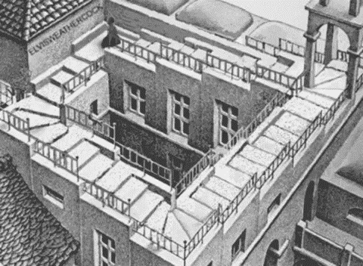

Slide 2
CSIRO Astronomy and Space Science
Radio Astronomy School
25−29 September 2017
Narrabri
Maarten de Jong
Nikhef & Leiden University

Slide 3
Energy not conserved
“birth of neutrino”

Slide 4
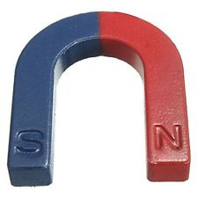

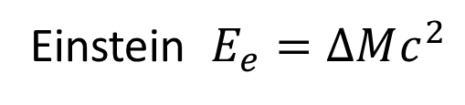
History of neutrino
Becquerel (1896))
electron
2-particle decay?
detector
Einstein $E_{e}=∆Mc^{2}$

Slide 5


History of neutrino
observed energy spectrum
number of events
$$E_{e}$$
$$∆Mc^{2}$$
Energy not conserved?

Slide 6
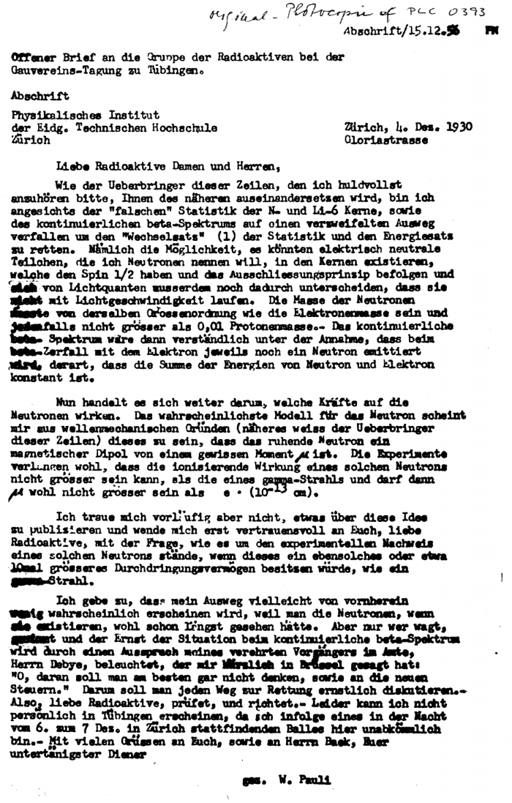
History of neutrino
Zürich, Dec. 1930
Dear radioactive ladies and gentlemen,
I may have found a solution to the energy crisis
in radioactive decays.
… the existence of electrically neutral particles
–which I call neutrons– in the atomic nucleus.
The measured spectrum can be understood if
such a neutral particle escapes together with the
electron such that the total energy is conserved.
I admit that this idea is unlikely because the
neutrons –if they exist– would have been found
already.
W. Pauli

Slide 7

History of neutrino
Fermi (1933)
Neutrino interaction cross section
$$σ\left(MeV\right)≅ {10}^{−42} {cm}^{2}$$
n
ν
The Nobel Prize in Physics 1999 was awarded jointly to
Gereard 't Hooft and Martinus J.G. Veltman
"for elucidating the quantum structure of
electroweak interactions in physics"
p
e
Theory of weak interaction

Slide 8

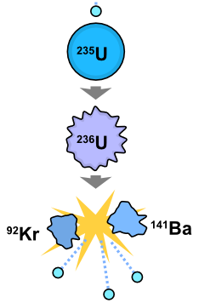
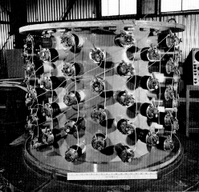
History of neutrino
1950 – Reines & Cowan “Poltergeist”, Savannah River
evidence existence
of neutrinos
neutrinos
neutrinos
nuclear reactor
detector

Slide 9
General relativity overruled
“superluminal neutrinos”

Slide 10
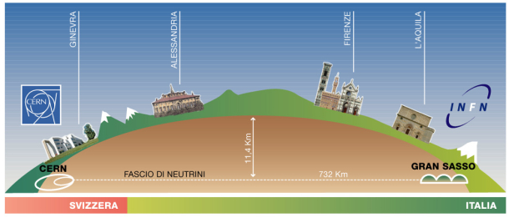
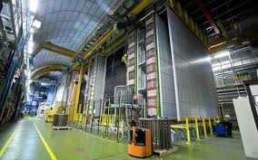
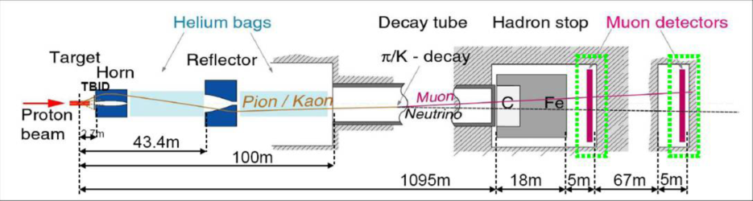
Measurement
production muon neutrinos
detection tau neutrinos
450 GeV
protons

Slide 11
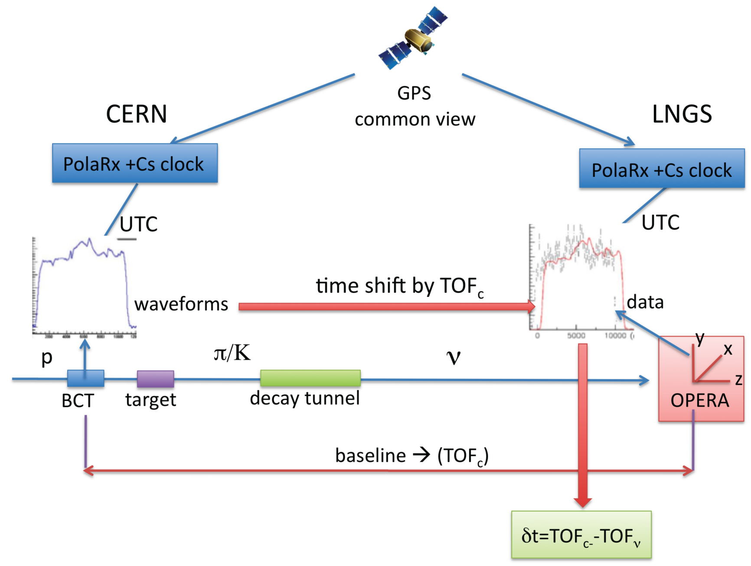
Measurement
730 km

Slide 12
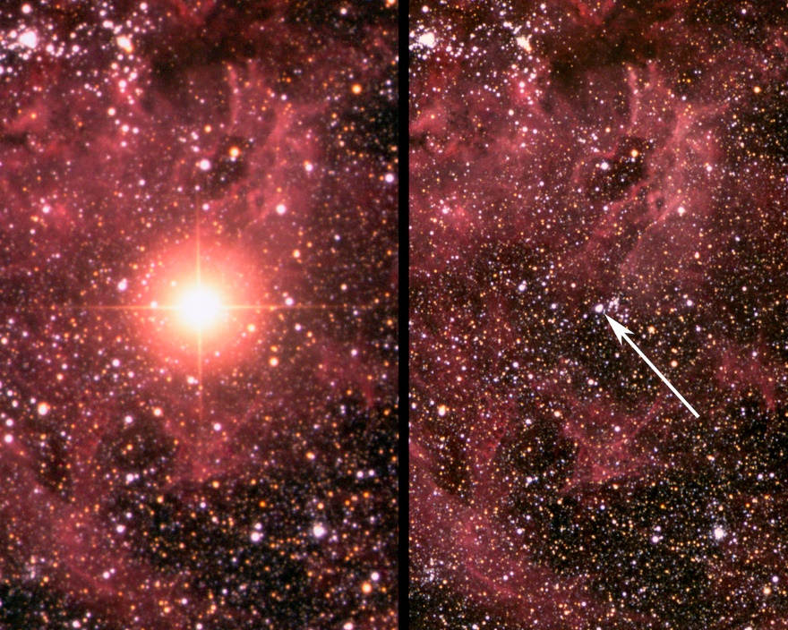
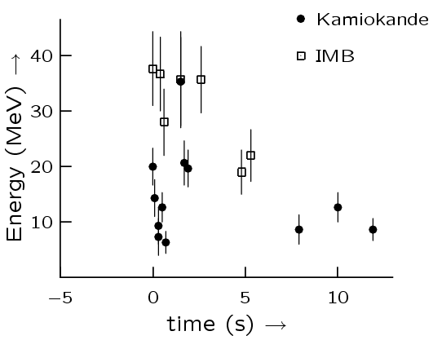
SN1987A
before
after
Supernova
160,000 year
Earth
anti-neutrino speed < 20 ppb over speed of light

Slide 13
superluminal?
Andrew Cohen and Sheldon Glashow predicted that superluminal neutrinos would radiate electrons and positrons and lose energy through vacuum Cherenkov effects
… not observed

Slide 14
Science 2 March 2012:
Edwin Cartlidge
“Anomalous data suggesting that neutrinos can travel faster
than light probably resulted from a faulty connection in
a GPS timing system, physicists from the OPERA collaboration
revealed last week.”

Slide 15
Quantum physics violated
“discovery of neutrino oscillations”

Slide 16
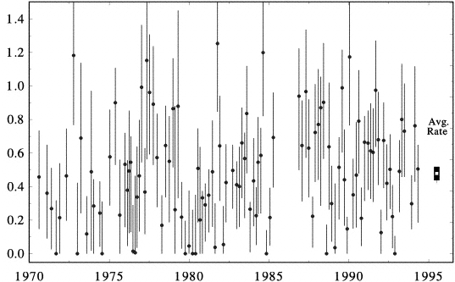

Solar neutrinos
Solar power
expected
radiation
$$4p+2e⟶{}_{}^{4}{He}$$
events/day
average
2 ν_{e}
year

Slide 17
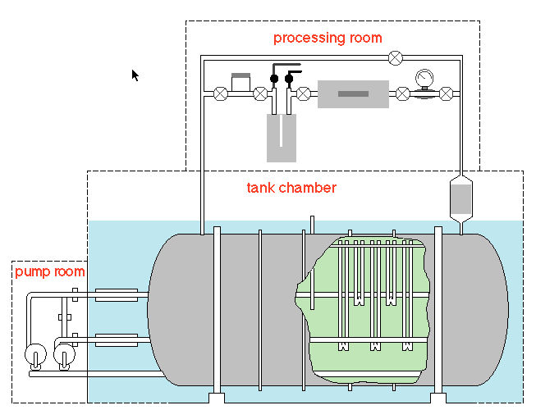
Solar neutrinos
Experiment is wrong
Solar model is wrong
‘pp’
extract
single Ar atoms
(~15 / month)
‘pep’
‘hep’
‘⁷Be’
130 tons of Chlorine
‘⁸B’

Slide 18
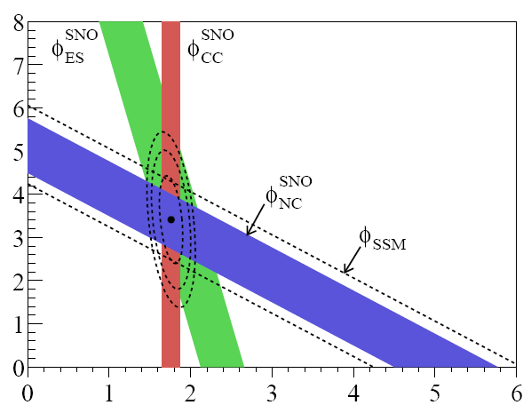
Solar neutrinos
Solar power
radiation
conserved
flux
other neutrinos [10⁶ cm⁻² s⁻¹]
$$4p+2e⟶{}_{}^{4}{He}$$
2 ν_{e}
no
oscillations
electron neutrinos [10⁶ cm⁻² s⁻¹]

Slide 19



Neutrino propagation
weak states
=
“what you see”
mass states
=
“what you get”
$$\left(\begin{matrix}{\text{n}}_{e} \\ {\text{n}}_{μ} \\ {\text{n}}_{τ}\end{matrix}\right)=U×\left(\begin{matrix}{\text{n}}_{1} \\ {\text{n}}_{2} \\ {\text{n}}_{3}\end{matrix}\right)$$
CP-violation
Majorana
U = $\left[\begin{matrix}1 & 0 & 0 \\ 0 & { c}_{23} & s_{23} \\ 0 & {−s}_{23} & c_{23}^{}\end{matrix}\right]\left[\begin{matrix}c_{13} & 0 & s_{13}e^{−iδ} \\ 0 & 1 & 0 \\ {−s}_{13}e^{iδ} & 0 & c_{13}\end{matrix}\right]\left[\begin{matrix}{ c}_{12}^{} & s_{12} & 0 \\ {−s}_{12} & c_{12} & 0 \\ 0 & 0 & 1\end{matrix}\right]\left[\begin{matrix}1 & 0 & 0 \\ 0 & e^{iα_{1}/2} & 0 \\ 0 & 0 & e_{}^{iα_{2}/2}\end{matrix}\right]$
$$c_{ij}=\cos{θ_{ij}} s_{ij}=\sin{θ_{ij}}$$
lepton number violated

Slide 20
Measurements
“human factor”

Slide 21
τ lifetime
1992 Review of Particle Properties
χ² = 2.0 for 10 degrees of freedom
CL = 0.9962
Steven R. Wasserbaech:
“other effects”
lifetime [fs]
year

Slide 22
… because as we know, there are known knowns; there are things we know we know.
We also know there are known unknowns; that is to say we know there are some things we do not know.
But there are also unknown unknowns – the ones we don't know we don't know.
Donald Rumsfeld

