Slide 1
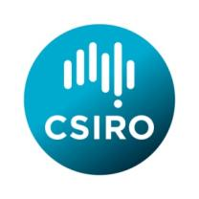
Radio Astronomy Then Now and Future
CASS Radio Astronomy School
Narrabri
1826 Sep 2017
Ron Ekers
CSIRO
Australia
Notes:
Closely based on Enabling Technologies – Reber Medal. Could make it a custom show.

Slide 2
Outline
History with emphasis on technical innovation in radio astronomy
Most advances and discoveries in radio astronomy are a direct consequence of technology development
How some of these innovative steps have occurred
pushing boundaries
cross fertilization between fields
sophisticated end users (i.e. the astronomers)
most depended on external developments
The future
George Santayana:
Those who cannot remember the past are condemned to repeat it
Notes:
History version
Omit: Norfolk Island Effect
Omit CASS: Where are we now
Add Santayana quote

Slide 3
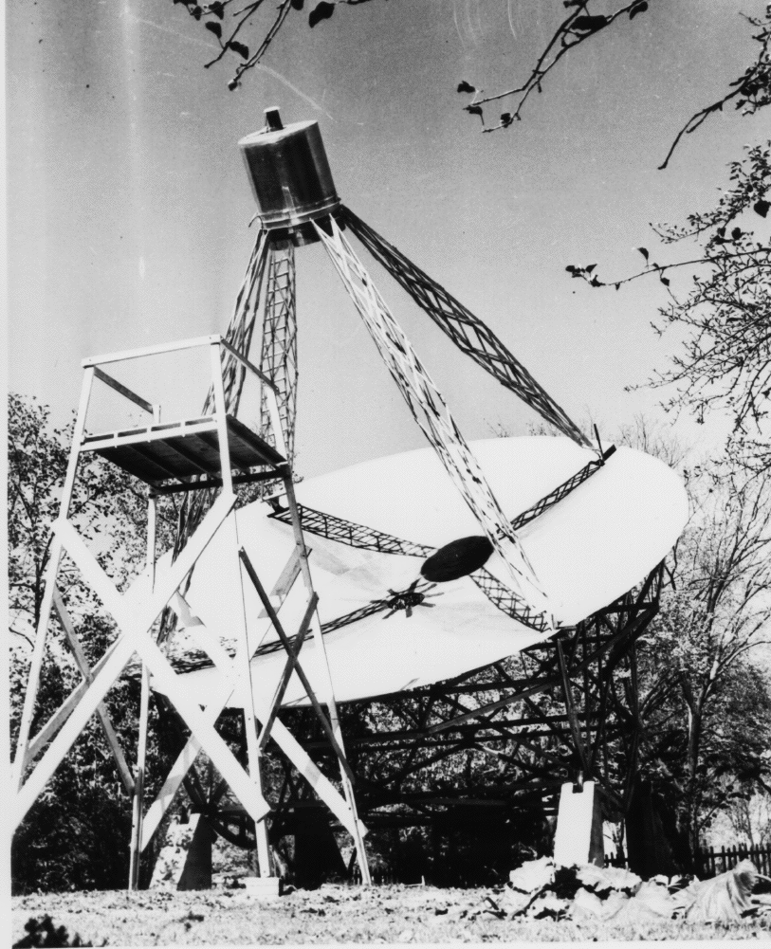
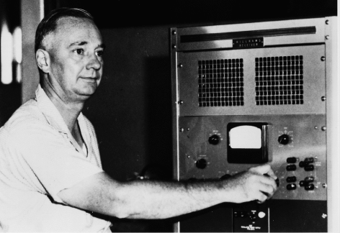
Grote Reber
Wheaton, Illinois 1937
Parabolic dish for frequency flexibility
32’ antenna, privately funded - $2K

Slide 4
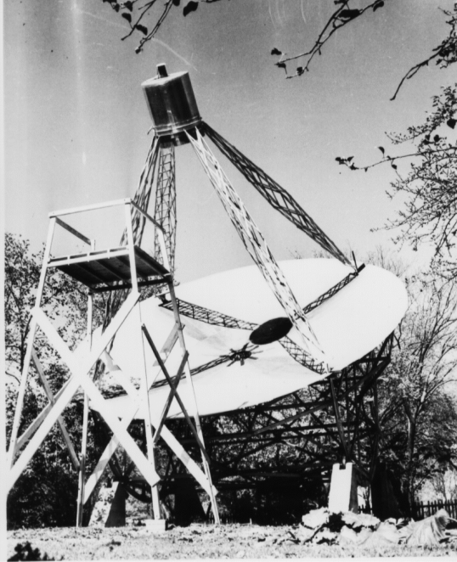
The Discovery of the Non-Thermal Universe
1939 detected cosmic static by going to longer wavelengths
3300 MHz
900 MHz
160 MHz
Radiation had to be non-thermal
No theoretical basis at the time
1950 Synchrotron radiation theory
10 years after Reber
First radio map of sky
Great difficulty getting published
Notes:
Confirming Jansky and making a map was not a serendipitous discovery but the non-thermal emission was.
Previously no concept of non-thermal astronomical emission

Slide 5
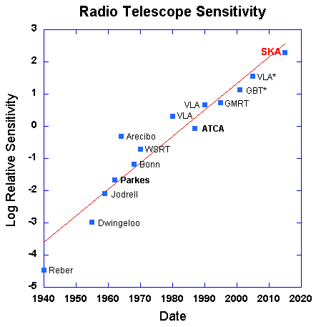
Radio Telescope Sensitivity
Earlier version shown at the URSI GA Prague 1990
General lecture
Exponential increase in sensitivity x 10⁵ since 1940 !
3 year doubling time for sensitivity

Slide 6
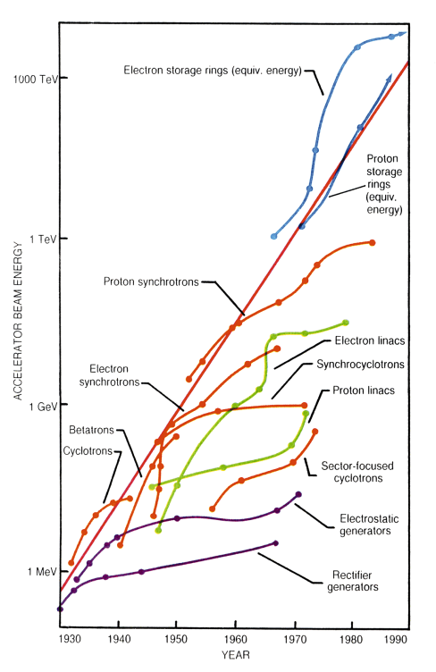
Exponential Growth
Livingstone Curve
Blewett, Brookhaven 1950
Fermi 1954
Livingstone 1962
Envelope is exponential
Each technology saturates
Notes:
Remove deSolla Price (separate slide)
De Solla Price 1963
exponential growth
Little science, big Science
The figure shows the rate of increase of operating energy in particle accelerators (Livingston, M.S. and Blewett, J.P., "Particle Accelerators" McGraw Hill Book Co. 1962., updated by Sessler, A.M., Physics Today, Jan. 1988, pp 26-34). Starting in 1930, each particle accelerator technology provided exponential growth up to a ceiling when a new technology is introduced. The envelope of the set of curves is itself an exponential with an increase in energy of 10**10 in 60 years. This example, originally presented by Fermi, has become known as the "Livingston Curve”

Slide 7
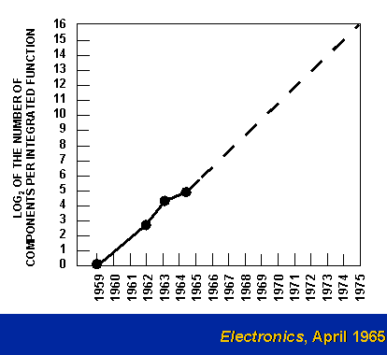
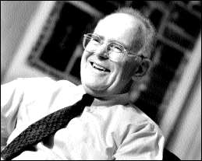
The Original Moore’s Law Plot
In 1965 Gordon Moore (co-founder of Intel) noted that the transistor density of semiconductor chips doubled roughly every 18 months.
Extrapolation accurate for another 35 years!
Notes:
Pair with Micro-processor performance – use fade

Slide 8
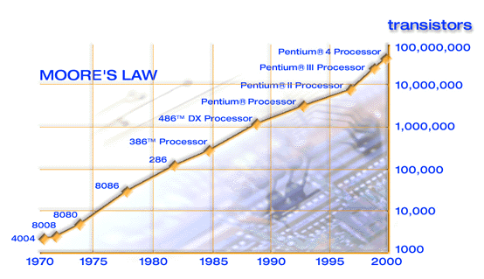
Microprocessor performance
Moore’s Law
Intel 2000
Enables all processing intensive radio astronomy
Notes:
Pair with original Moore,s law – use fade
Add link to future radio astronomy

Slide 9
Technology leads scientific discoveries
De Solla Price (1963):
most scientific advances follow laboratory experiments
Martin Harwit (1981):
Most important discoveries result from technical innovation
Discoveries peak soon after new technology appears
Usually within 5 years of the technical capability
Radio window is now old but survey parameter space can still be enlarged
Bandwidth (x10 – 50)
Field of View (x 100)
Sensitivity and FoV lead to discovery of new rare objects

Slide 10
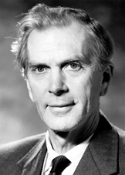
Nobel Prize 1974 Sir Martin Ryle
from the presentation
“The radio-astronomical instruments invented and developed by Martin Ryle, and utilized so successfully by him and his collaborators in their observations, have been one of the most important elements of the latest discoveries in Astrophysics.”
Notes:
And from the presentation for Ryle:
The radio-astronomical instruments invented and developed by Martin Ryle, and utilized so successfully by him and his collaborators in their observations, have been one of the most important elements of the latest discoveries in Astrophysics.

Slide 11
1938 van Cittert-Zernike theorem
The spatial coherence over a space illuminated by an incoherent extended source is described by the Fourier transform of the intensity distribution over the source.
Now considered the basis of Fourier synthesis imaging
Played no role in the early radio astronomy developments but appears in the literature after Born & Wolf Principles of Optics (1960)
11
Notes:
11
Only came to the attention of the radio astronomy community after Born and Wolf “Principles of Optics” was published in 1959. Initially published by van Cittert (1934) then simplified by Zernike (1938)

Slide 12
The discovery of aperture synthesis
1935: Pawsey PhD with Ratcliffe at Cambridge
Learns about the Fourier Transform (ionospheric reseach)
1936
Fourier synthesis calculations routine in X-ray crystallography
1946: Ryle and Vonberg
Michelson interferometer to measure size of sunspots
1947: McCready, Pawsey & Payne-Scott
It would be possible in principal to determine the brightness distribution by Fourier synthesis
1952: Ryle invents the phase switch (A+B)² - (A-B)² → AxB
Now practical to observe weak sources
1954: X-ray crystallographers
introduce Ryle’s group to EDSAC-1 for Fourier transforms
1960: Ryle & Hewsish
Synthesis of large radio telescopes
Notes:
1946: Ryle and Vonberg Nature 158, 339-340 (Aug 1946)
1947 McCready et al Proc Roy Soc, (Aug 1947)
Used the phase of the sea interferometer fringes to co-locate solar emission with sunspots
Updated Oct 2014 to include Ryle & Hewish MNRAS, 128, 220 (1960)

Slide 13
McCready, Pawsey & Payne-Scott 1947
Proc Roy Soc, Aug 1947 - received July 1946!
Used the phase of the sea interferometer fringes (lobes) to co-locate solar emission with sunspots
They note that its possible in principal to determine the actual distribution by Fourier synthesis using the phase and amplitude at a range of height or wavelength.
They consider using wavelength as a suitable variable as unwise since the solar bursts are likely to have frequency dependent structure.
They note that getting a range of cliff height is clumsy and suggest a different interference method would be more practical.
13
Notes:
13
Added Pawsey and Payne-Scott

Slide 14
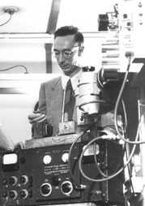
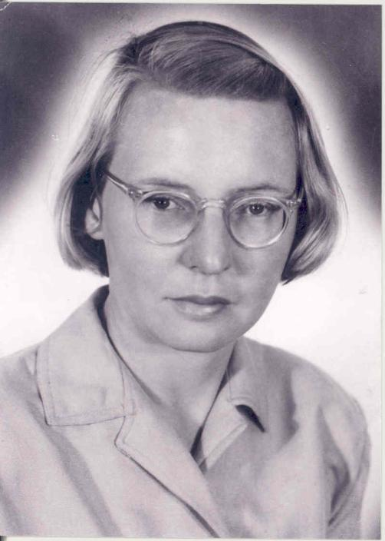
McCready, Pawsey & Payne-Scott 1947
Proc Roy Soc, Aug 1947 - received July 1946!
Used the phase of the sea interferometer fringes (lobes) to co-locate solar emission with sunspots
They note that its possible in principal to determine the actual distribution by Fourier synthesis using the phase and amplitude at a range of height or wavelength.
They consider using wavelength as a suitable variable as unwise since the solar bursts are likely to have frequency dependent structure.
They note that getting a range of cliff height is clumsy and suggest a different interference method would be more practical.
Joe Pawsey NRAO 1961
Ruby Payne-Scott
14
Notes:
14
Split for .pdf

Slide 15
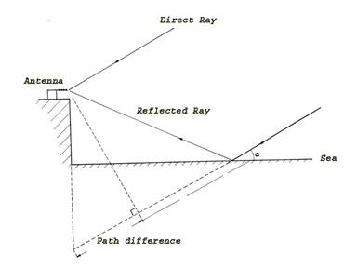
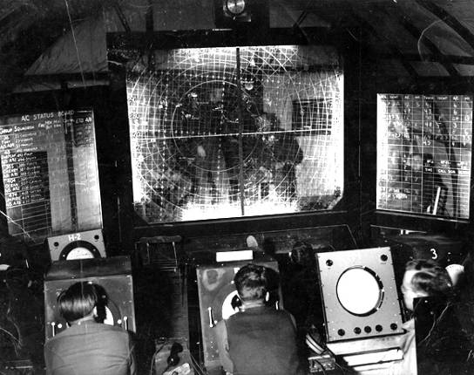
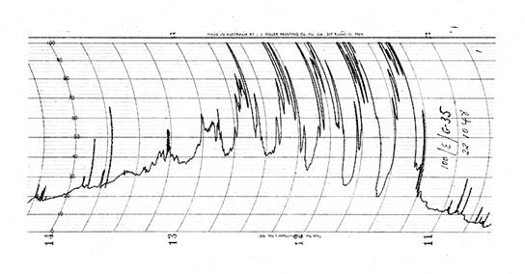
Why a Cliff Interferometer?
Concept from coastal radars in WW2
Loyds mirror
Notes:
At the end of May 1948, an ex-Army gun-laying radar trailer containing four 100Mhz Yagis, a
new 100MHz receiver, recorders, chronometers, and weather recording equipment were
shipped to New Zealand. This equipment was then moved to a site called ‘Pakiri Hill’ about
10km from a small fishing village called Leigh, about 70km north-west of Auckland. At this site
they obtained about 30 nights of observations of Cygnus-A and in mid-July five observations
of Taurus-A. A large number of observations were necessary to reduce the noise in the
sidereal time of the interference minima caused by irregular diffraction. One important
discovery that was made during these observations was that the observed amplitude
variations were of atmospheric origin and were not inherent in the source itself. Spaced aerial
observations between Leigh and Dover Heights showed almost complete correlation
between solar bursts at the two sites, but no correlation between source variations. At the
end of August 1948, the equipment was moved to a new site in New Zealand near Phia,
about 30 km north of Auckland. Over a three-week period, data was collected on four sources,
Cygnus-A, Taurus-A, Centaurus-A and Virgo-A.

Slide 16
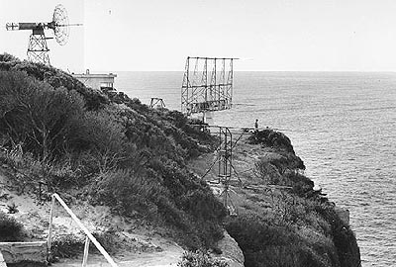
Dover Heights 1952
16
Notes:
16

Slide 17
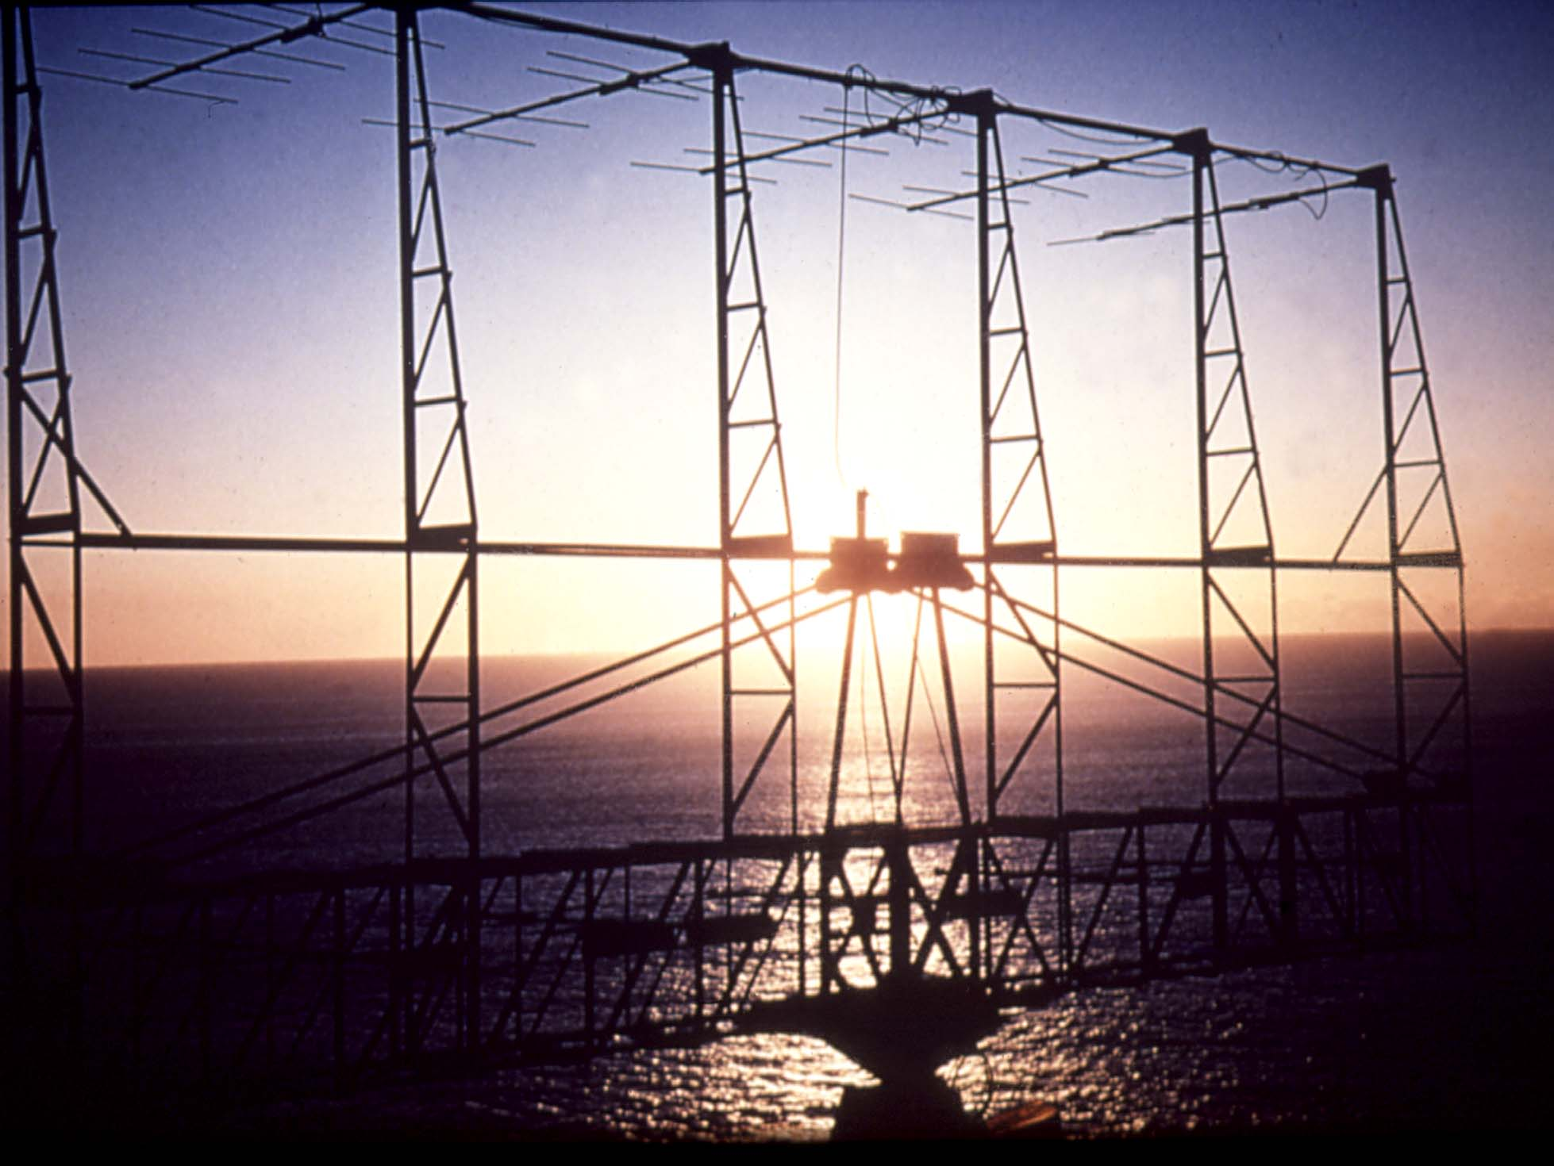
Cliff Interferometer
Cliff interferometer CSIRO, Australia (1948)
Built to identify the radio stars (John Bolton)
Idea from multiple path interference in ship borne radar
Discovery of extragalactic radio sources at great distances
Centaurus A , Virgo A, Cygnus A, Fornax A
Had to hedge on extragalactic origin to get paper published
Sydney, Australia 1948
Needed more accurate positions to identify the sources of radio emission
Notes:
Loyds mirror – use setting sun to explain
Perhaps the most spectacular discovery was made at Dover Heights where a telescope had been constructed on the cliff to measure the interference between the direct waves and those reflected by the sea (a Loyds mirror). Bolton and his colleges were able to use it to measure positions accurately enough to identify three of the strongest of the mysterious discrete sources of radio emission which were thought to be radio stars.
One was the Crab nebula, the remnant of a star that the Chinese had seen explode 900 years ago. The other two were an even greater surprise. They were both galaxies, far outside our own milkyway but undergoing such a violent explosion that they were among the brightest objects in the radio sky. This discovery, with some help from the now very enthusiastic optical astronomers at Mt Palomar in the US, lead to the identification of the strongest of all the radio sources. It was found to be a very faint galaxy so incredibly distant that it was immediately obvious that these new radio telescopes were probing the most distant reaches of the universe. A new field of astronomy was born.

Slide 18
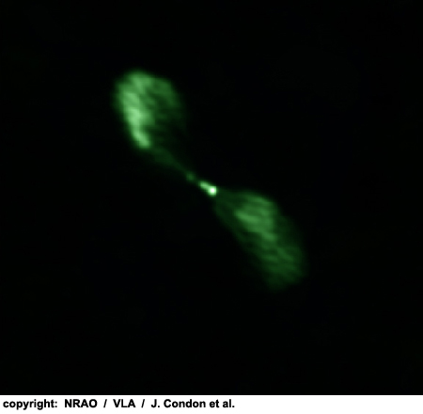
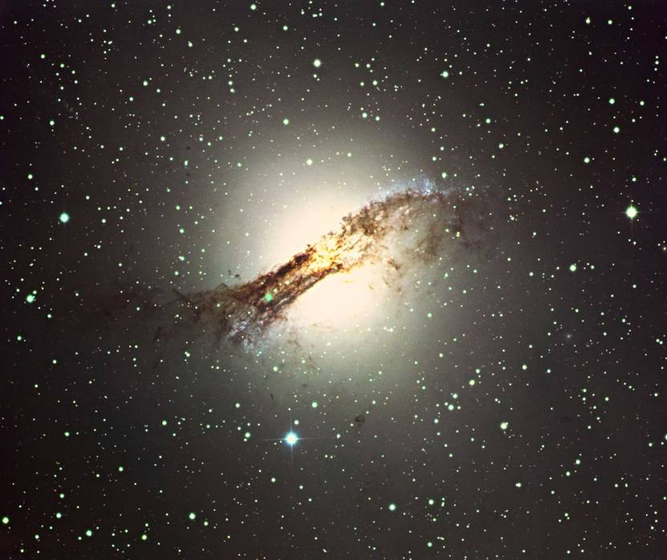
Centaurus A

Slide 19


Centaurus A
Notes:
Duplicate composite to zoom out from

Slide 20
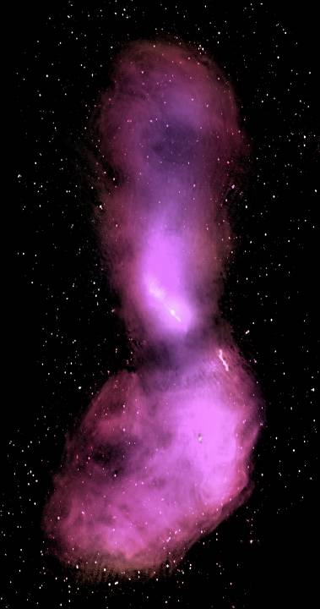
Centaurus A ATCA Mosaic
Notes:
Matched to zoom out image

Slide 21
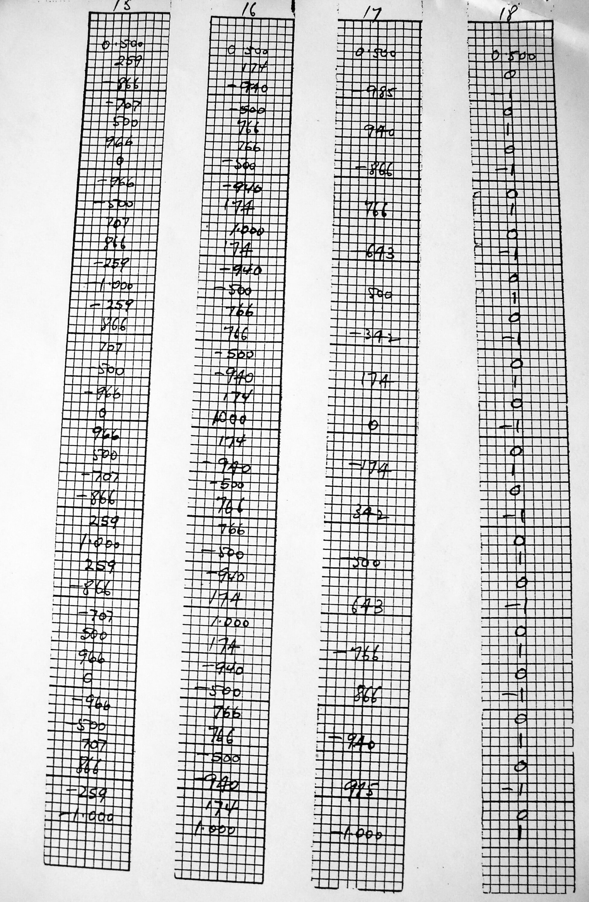
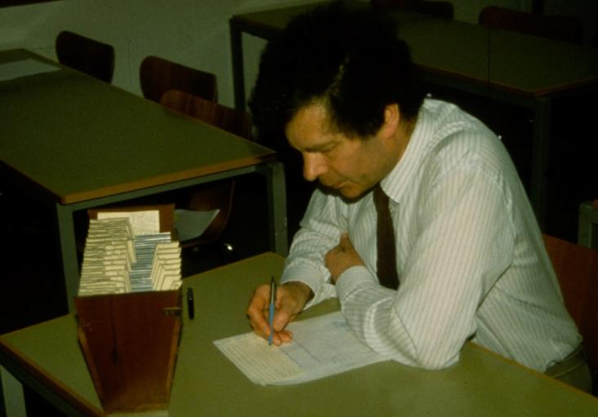
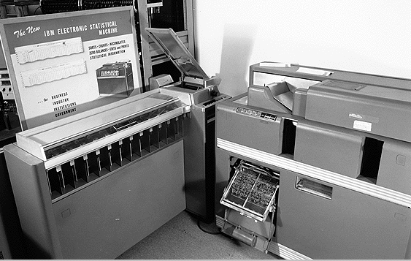
Fourier Transforms - 1953
Lipson-Beevers strips
25x25 array to 2 digits 1 person in 24 hours
Punched card tabulator
25x25 array to 3 digits in 8 hours (4 operators!)
Peter Scheuer with Lipson Beevers strips
21
Notes:
21
Peter Scheuer recreating the use of Lipson-Beevers strips in the 1950's (from Woody Sullivan 1988).
Removed Pearcey: Hollerith rolling-total tabulator for 2D Fourier synthesis

Slide 22
Fourier synthesis imaging - 1954
Bracewell and Roberts: Arial smoothing
introduces invisible distributions and the principal solution
Scheuer: Theory of interferometer methods
PhD chapter 5 (unpublished)
Full analysis of Fourier synthesis including indeterminate structure
Independent developments, but all acknowledge Ratcliffe’s lectures
22
Notes:
22
Delete Pawsey asked Jim Roberts to write this with Ron Bracewell after his colloquium
Aust J Phys 7, p615
Scheuer: theory of the phase switch

Slide 23
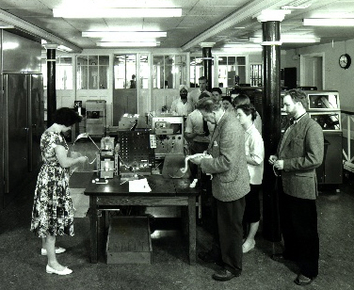
Computers and signal processing
1958
EDSAC II completed and applied to Fourier inversion problems
360 38-point 1D transforms took 15 hours (Blyth)
Output was contours!
1961
Jennison had acquired Ratcliffe's lecture notes on the Fourier transform and publishes a book on the Fourier Transform
Sandy Weinreb builds the first digital autocorrelator
1965
Cooley & Tukey publish a convenient implementation of the FFT algorithm
1960 user queue for programming the EDSAC 2
23
Notes:
FFT was known since Gauss 1805 and reinvented many times

Slide 24
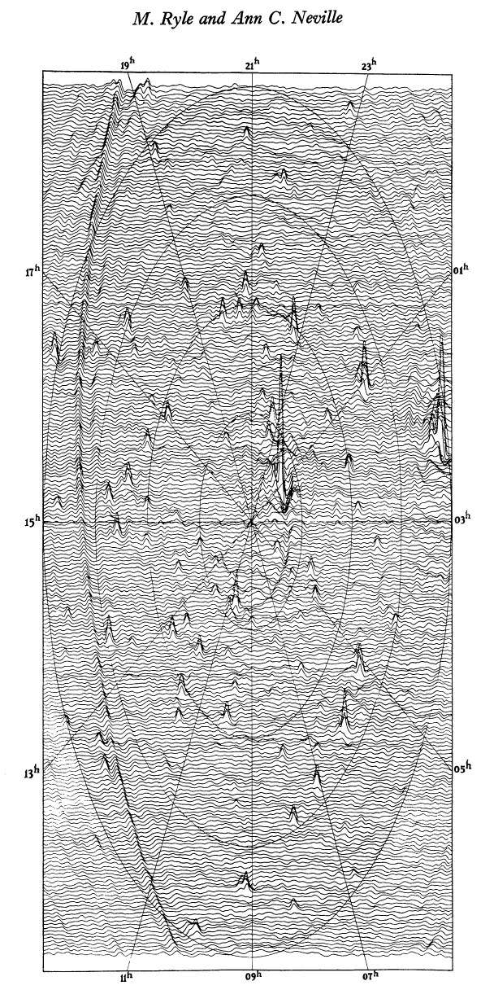
First Cambridge Earth Rotation Synthesis Image
Ryle & Neville, MNRAS 1962
North pole survey
178 MHz
200x200 pixels took a full night on EDSACII
Now Moore’s law and the massive improvements in computing power give us LOFAR and MWA
24
Notes:
June 1961
4C aerials
7 years after Christiansen
Similar results now being obtained by LOFAR & MWA!

Slide 25
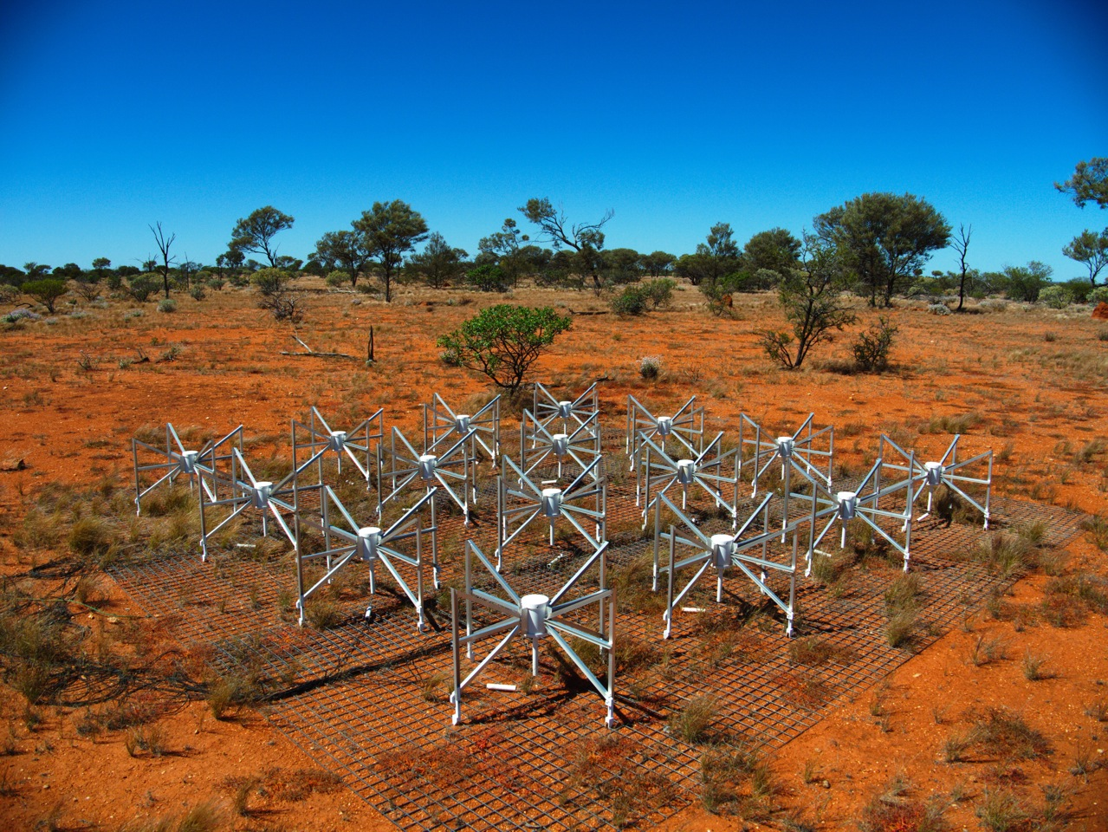
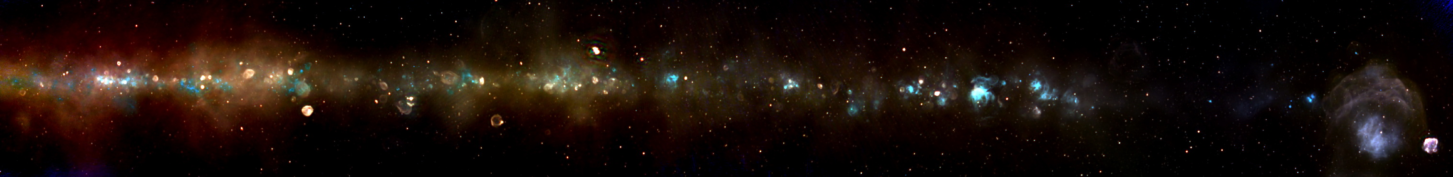
MWA Radio Continuum 80-300MHz
False colour spectrum
Thermal
Non thermal
128 tiles
Luke Hindson, University of Wellington

Slide 26
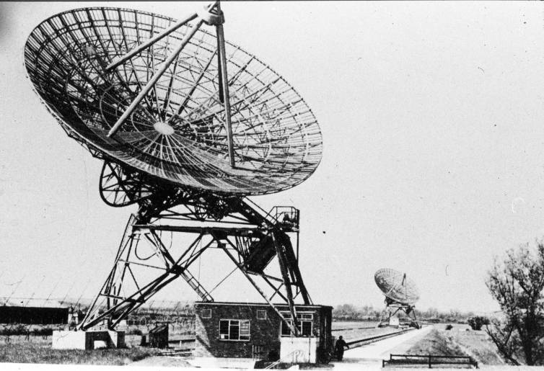
Cambridge One-Mile Telescope: 1962

Slide 27
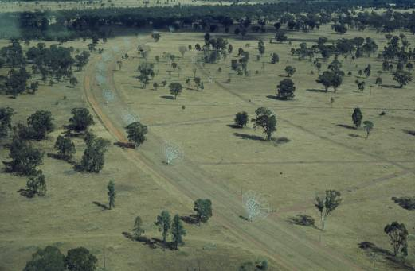
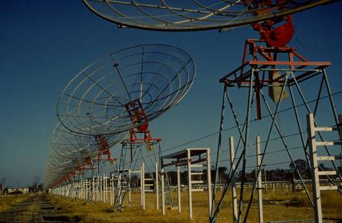
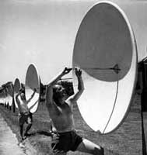
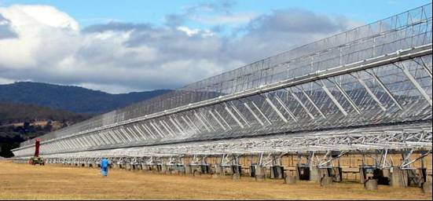
The early Australian arrays
A time variable sun needs instantaneous coverage
1951
Christiansen build the Potts Hill grating array
32 steerable paraboloids
No computer – hand calculations of Fourier Transforms!
First earth rotation synthesis image
1953
Chris Cross (Fleurs)
Mills cross
1967
Paul Wild solar heliograph
Uses J2 synthesis
electronic summation of Bessel functions
27
Notes:
27
Remove: an SKA path finder!

Slide 28
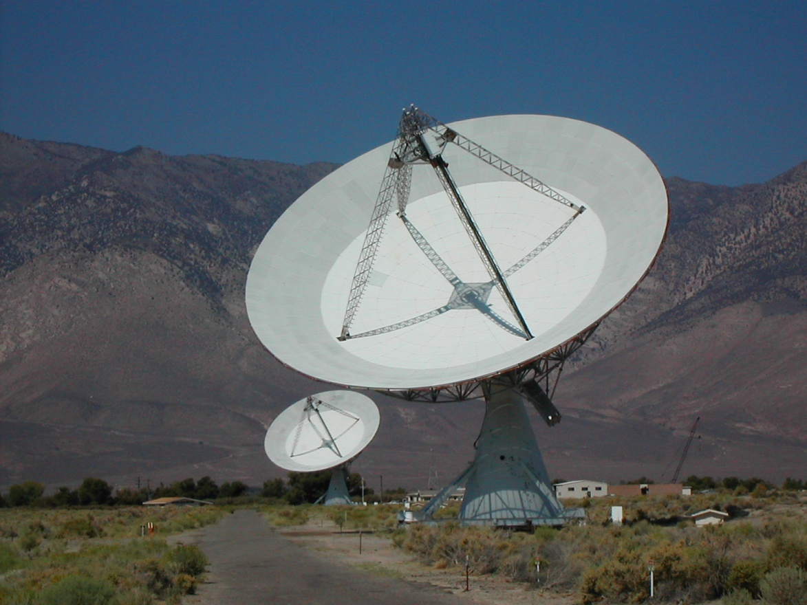
Dishes v Arrays circa 1957
Parkes 64m dish or a Super Mills Cross
The dish will be confusion limited at low frequencies
At high frequencies it will only see thermal emission which is boring
The array has high resolution at low frequency and you can map the distant universe
Bolton – build an interferometer with large dishes
OVRO
28
Notes:
28
There are two copies of this slide – one comes earlier when skipping imaging history

Slide 29
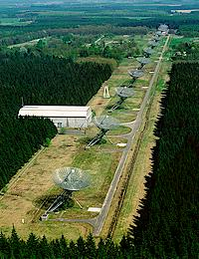
Westerbork: 1970
Oort 1961 vision
Bennelux Cross an International project
Hogbom (Cambridge)
+
Christiansen (Sydney)
⇨WSRT
12 x 25m dishes 1.5km
Two moveable
10 redundant spacings
Self calibration
HI and dark Matter (1978)
Notes:
Added dark matter
Dark matter – started in 1972 (Rogstad and Shostak) then Bosma WSRT 1978

Slide 30
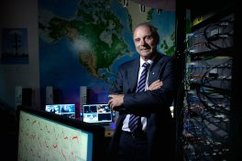
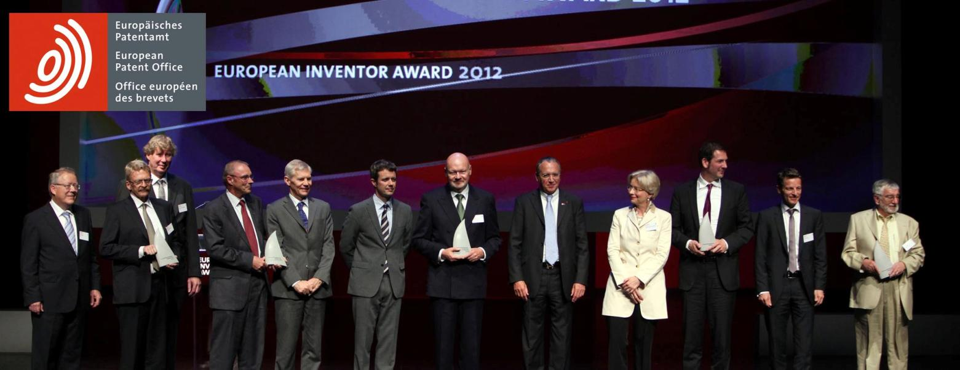
WiFi IEEE 802.11
European Inventor Award 2012
Inventors: Dr John O'Sullivan et al
Country: Australia
Invention: Wireless LAN for high speed data transfer
Notes:
European Patent Office
European Inventor Award 2012

Slide 31
WiFi - IEEE 802.11 wireless network standard
1970’s John O’Sullivan PhD using Fleurs Synthesis Telescope
1974 John O’Sullivan searches for Exploding Black Holes – “there has to be a better way!”
1977 explanation of why adaptive optics works
Noordam, Hamaker, O’Sullivan
Paper based on redundant calibration in radio astronomy
1980’s Fourier Transform on a chip
1996 CSIRO obtains US patent #5,487069
O’Sullivan, Daniels, Percival, Ostry, Deanne
2001 Skellern develops a wireless chip meeting IEEE standard
Notes:
Now includes PhD Fleurs link
Adapted for use with the exploding black hole lead in
Omit (out of date): 150 million devices sold using this technology
Estimated that 500 million will be sold by 2009

Slide 32
The IEE 802.11 and Redundant Spacing analogy
Redundant spacing interferometers
Redundant spacings measure the same Fourier component
If corrupted by the atmosphere they will not be equal and the peak image intensity must decrease
S/N is maximised when the atmosphere is correct
A broad band wireless link is corrupted by multiple reflections
Individual narrow Fourier components are not corrupted because delays are small
Each has a redundant low time resolution copy of the modulated signal
The S/N on the link is maximised when all these Fourier components are correctly aligned.
A 1D real time Fourier transform has to be implemented in the communication chip
Notes:
This is the RDE version of the analogy

Slide 33
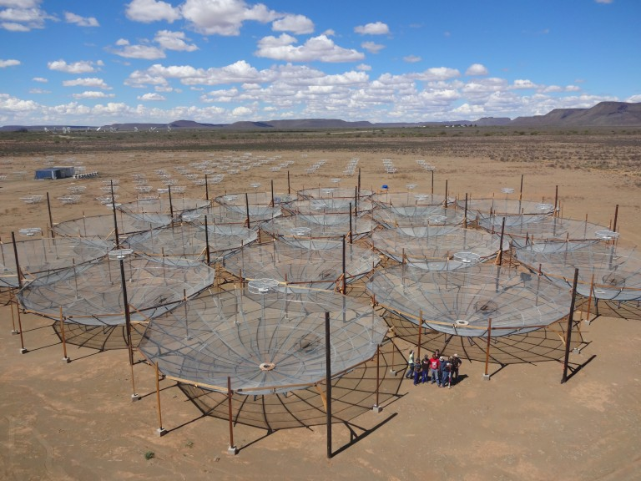
The Hydrogen Epoch of Reionization Array (HERA)
Maximum redundancy for calibration
South African Karoo
Notes:
HERA 19, at first light, 7 March 2016, South African Karoo Astronomy Reserve.
HERA is a second generation instrument which combines efforts and lessons learned from the Murchison Widefield Array (MWA) and the Donald C. Backer Precision Array for Probing the Epoch of Reionization (PAPER). The array is a large grid of 14 meter (42 ft) diameter non-tracking dishes packed into a hexagonal grid 300 m (900ft) across.

Slide 34
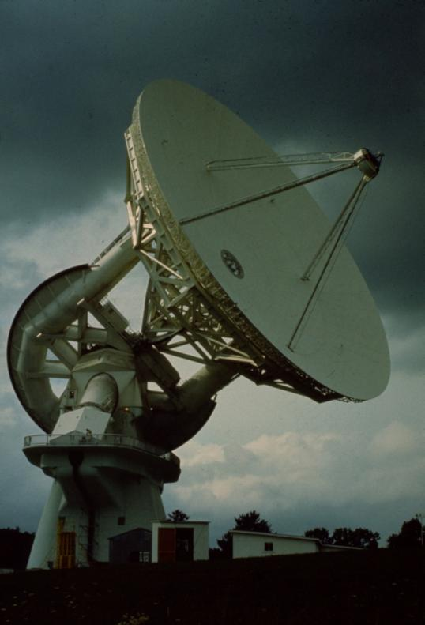
Equatorial v Alt-Az 1950s debate
Barnes Wallis
Master Equatorial
Coordinate conversion
Drive motor difficult with Alt-Az
Merle Tuve, Director DTM, Carnegie Institute
Greenbank 140’
Parkes 210’ (64m)
Notes:
Comments added for >2015 versions

Slide 35
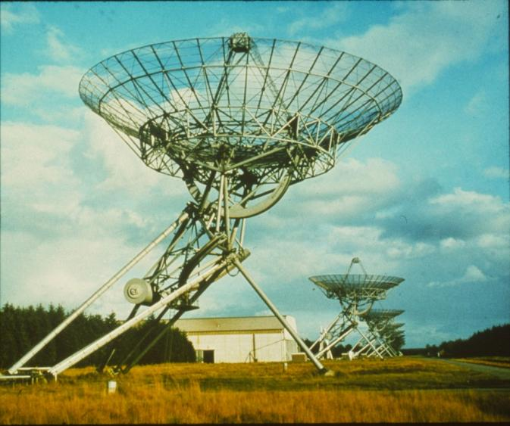
Equatorial v Alt-Az 1960s debate
Coordinate conversion no longer the issue
Alt-Az are cheaper but beams and sidelobes rotate on the sky limiting dynamic range
VLA alt-az
WSRT equatorial

Slide 36
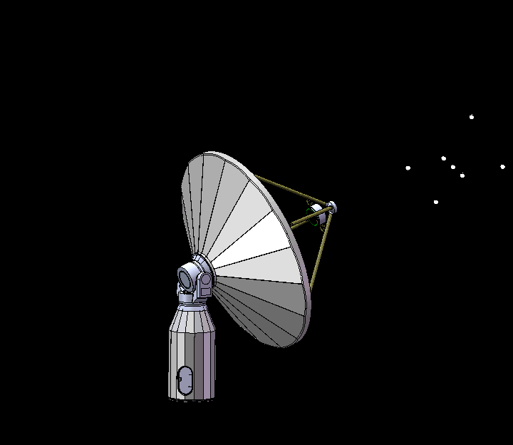
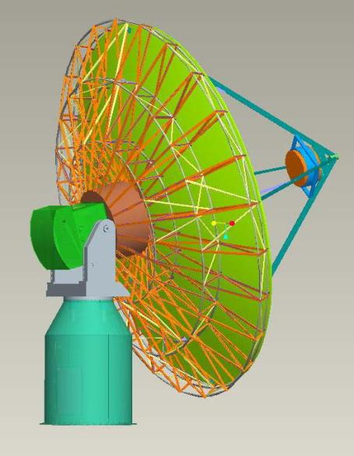
Roll axis
ASKAP antenna
CETC54
10% incremental cost for 3 axis mount

Slide 37
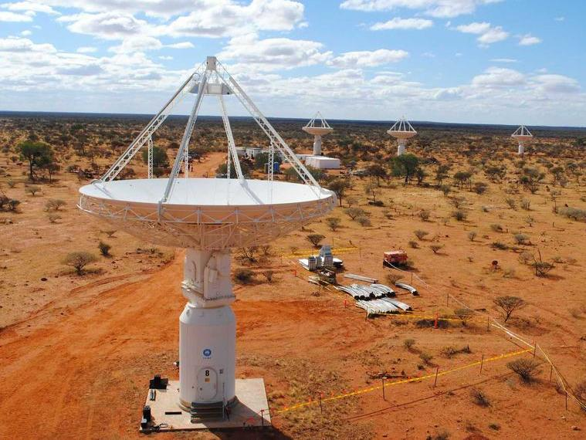
ASKAP antennas

Slide 38
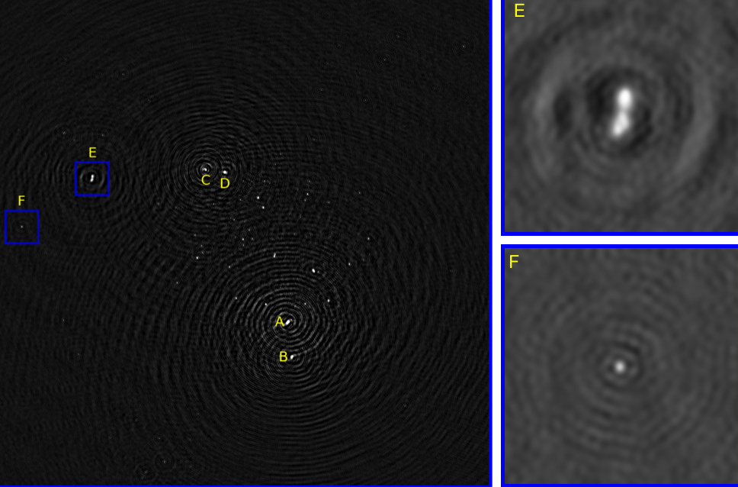
Effect of roll axis on image quality
ASKAP BETA array: 6 elements, 0.7-1GHz
Dynamic range about 3,000:1
Roll on
Ian Heywood
Notes:
Updated version substituted Oct 2014

Slide 39
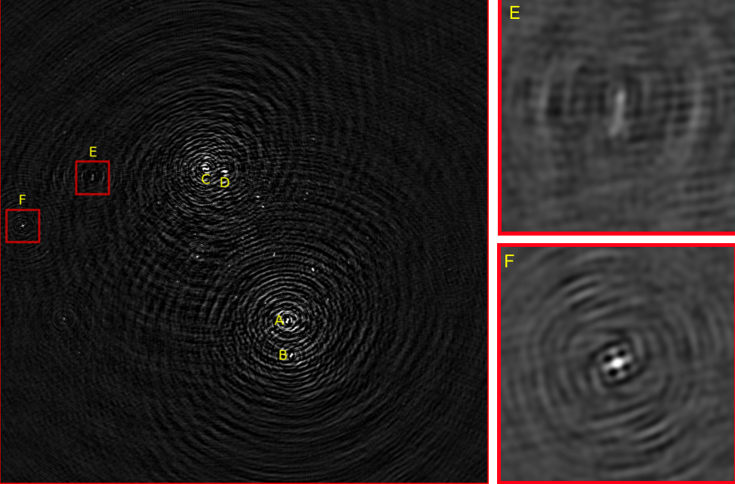
Effect of roll axis on image quality
ASKAP BETA array: 6 elements, 0.7-1GHz
Dynamic range about 3,000:1
Roll off
Ian Heywood
Notes:
Updated version substituted Oct 2014

Slide 40
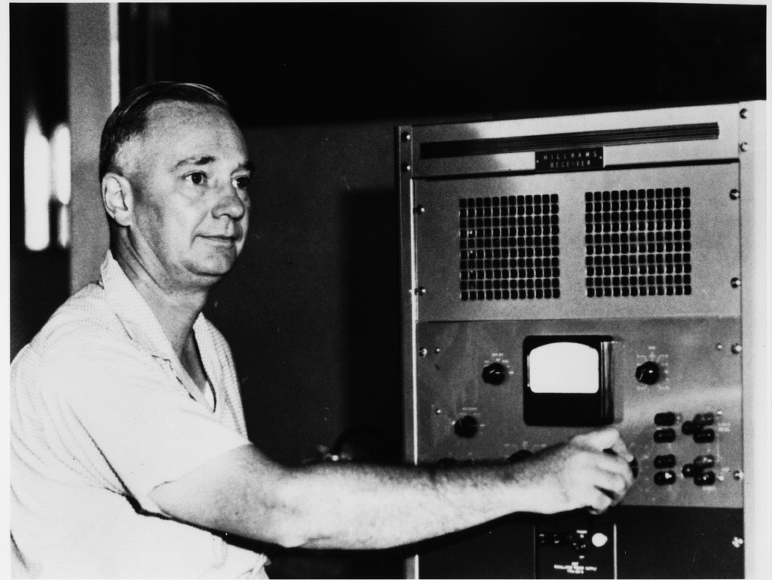
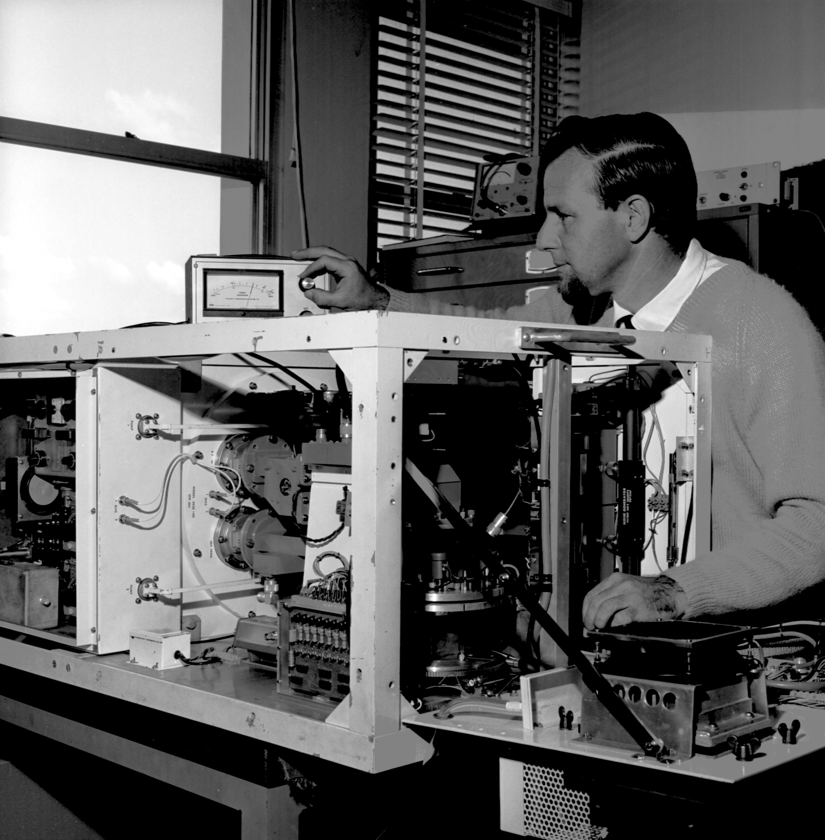
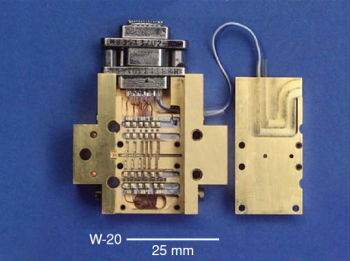
Receiver developments (Radio Astronomy)
1940 Vacuum tubes (>1000K)
1950 Crystal mixers (300K)
1960 Parametric amplifiers (100K)
1960 Masers (65K)
1960 Diode mixers
1965 Cryogenically cooled transistors (50K)
1980 GaAs FETs (20K)
1990 HEMT (10K)
2000 SIS (high frequency)
2020 Superconducting
paramp (0.3K)
Notes:
Information from Brian Cooper and Marian Pospieszalski
Maser discovered 1953 (Nobel prize Townes, Basov and Prokhorov 1964)
Updated after discussion with Sandy Weinreb Sep 2014
Maser for Radio Astronomy Giordmaine et al Proc IRE, 47 pp1062 (1959)

Slide 41
Receiver Sensitivity exponentials again!
Notes:
Added July 2015

Slide 42
MMIC (Transistors)
GAs -> InP
Extend frequency range 1GHz - > 150 GHz
Wide instantaneous bandwidth
Large scale integration
Complete receiver system on one chip
Focal plane arrays
Receivers embedded in feed structure
Integrated photonics

Slide 43
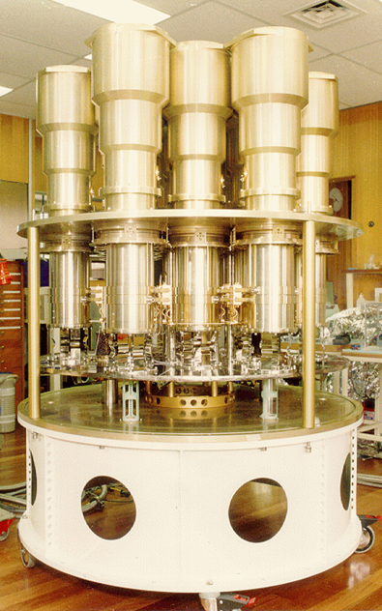
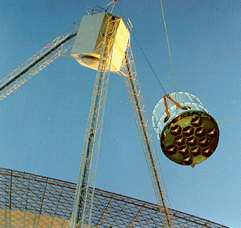
Parkes Multibeam Receiver
21 Jan 1997
Installing the Parkes 21cm Multibeam Receiver
13 beams
Same as 13 64m telescopes for surveys!
HI survey
Pulsar survey

Slide 44
Parkes Multi-beam receiver brief history
1975 Arecibo multi-bean survey (Condon et al)
1987 Multi element receiver for Green Bank 300’
1988 Receiver shipped to Parkes for PMN survey
Condon & Burke
Overcame local engineering conservatism
1996 Parkes 13 beam receiver
Digital signal processing opportunity created by a high yield for ATCA correlator chips
Very competent engineering (Warwick Wilson)
Science case was for a blind HI survey
Major impact was on pulsar survey science
2005 Copy installed on Arecibo
Notes:
Historical information on Arecibo survey supplied by Dave Jauncey after the Beijing talk

Slide 45
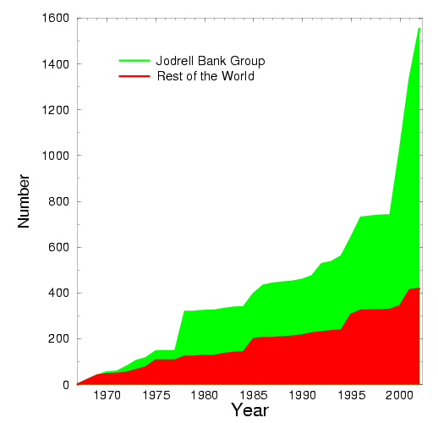
Pulsar discovery rate
Jodrell Bank and Parkes
Rest of the world
Parkes multibeam

Slide 46
Phased Array Feeds
Wide FoV at full sensitivity over whole field
Not just spatially continuous
Aperture illumination control
RFI mitigation
Can measure the very low spatial frequencies
Fourier transform into aperture plane
Corresponds to patches on surface of dish
Highly redundant
No shadowing
Eg large scale HI statistics at high z

Slide 47
PAF in Radio Astronomy brief history
1982 NRAO workshop
Weinreb discusses aperture correction using PAF
1985 Ekers discusses analogies between focal and aperture plane arrays
1988 Cornwell and Napier (Radio Science)
PAF can be placed anywhere between the aperture and the focus
1993 PAF design considered and rejected for Parkes multi-beam (Trevor Bird)
1995 Rick Fisher PAF element design
2004 PAF proposed for SKA survey
Van Ardenne and others also working on dense aperture arrays during this period
2006 Australian proposal for array using PAFs (ASKAP)
Notes:
Update to include ASKAP

Slide 48

Some PAF designs
Checker board - ATNF
Vivaldi - DRAO
Notes:
JOS and the ASKAP checker board array
Vivaldi array at DRAO

Slide 49

Algorithms
Deconvolution
Self Calibration
Mosaicing
Bandwidth Synthesis
Rotation Measure Synthesis
.......
Notes:
Hogbom CLEAN evolved from the concept of subtracting the grating responses from known strong point sources.
Other deconvolution algorithms included MEM (from 1D spectral line) and iterative negative removal.

Slide 50
Deconvolution
1962: Moffet using model fitting (OVRO)
Ekers (Parkes), Fomalont (OVRO)
1968: Hogbom does first clean experiments
NRAO 3 element data
Bad UV coverage
First cleaned image published in 1970
Rogsstad and Shostak (OVRO HI image)
1974
Hogbom publishes the CLEAN algorithm
Ables introduces Max Entropy Method (MEM)
Idea introduced from geophysics
Use of deconvolution very controversial in the 1970’s
Super resolution
Notes:
Hogbom CLEAN evolved from the concept of subtracting the grating responses from known strong point sources.
Other deconvolution algorithms included MEM (from 1D spectral line) and iterative negative removal.

Slide 51
Self Calibration
1958: Phase and amplitude closure
Jennison (Jodrell Bank)
1977: Redundant spacing interferometry
Hamaker , O’Sullivan, Noordam (Westerbork)
Equivalence to adaptive optics
1974-79: Phase closure in VLBI imaging
Rogers, Yee, Readhead, Cotton….
1980: Antenna based calibration
Clark, Schwab (VLA)
1983: Cornwall: Self cal ≡ phase closure ≡ adaptive optics
Triple correlation
1985: Nobel prize (chemistry) to Hauptman & Karles
Structural invariance ≡ phase closure
Notes:
Added Hauptman & Karles for RRI
1974: Adaptive optics, Muller & Buffington
Note that MWA/low frequency radio astronomy is moving closer to X-ray crystallography as the UV coverage improves and the phase errors become the main issue.

Slide 52
Mosaicing
1975 WSRT
Needed short spacing for spectral line synthesis
Difficulty in obtaining adequate single dish data
Primary beam scanned interferometer invented
Ekers & Rots IAU-C49 76 , 61 (1979) see Astroph 1212.3311
1983-1988 VLA (VTESS)
Cornwell explores algorithms for mm arrays
Cornwell A&A 202 , 316 (1988)
MEM joint deconvolution algorithm (VTESS)
1990 ATCA (MOSMEM, MOSSDI)
routine use results from an effective implementation
Notes:
Cornwell (1988) provided a clear formulation of Ekers & Rots with a brilliant conceptual leap to joint deconvolution description. Elegant implementation in VTESS but not adopted by VLA users due to operational issues

Slide 53
Computational Issues
software
treat as capital investment not an operating cost
prepare software before the survey starts
involve science teams early
hardware
exponential growth of digital electronics (MMIC)
ASIC ⬄ FPGA ⬄ GPU ⬄ general purpose computer
treat as operating cost and make continual upgrades

Slide 54

Evolution of Computer Power
Notes:
From Dan Werthimer 2015
Block robot display on right to simplify

Slide 55
Two Impressions
Chris Christiansen (Sydney)“The further development of this technique required a faster way to make the Fourier Transforms and this discouraged use of this technique in Australia. The turning point took place in Cambridge when digital computers revolutionised the speed of computation. The importance of the Cambridge work is well known and perhaps this is why the more humble first use of the technique in a distant land tends to be ignored.”
Q.J. RAS (1989) 30, 357
Graham Smith (Cambridge) “We took very little notice of any publications, either in journals or textbooks, and relied on Ryle's insight. We were indeed guilty of underestimating, for example, Pawsey, McCready & Payne-Scott's work on Fourier analysis. But we were in the full flood of discovery, and we were self-propelled.“
1988
Notes:
Delete “of the brightness distribution across the sun” from Graham Smith

Slide 56
Impact of Digital Computing
After Christiansen it was two decades before a non-solar synthesis image was computed in Australia!
Brouw (FST) and Schwartz (Parkes interferometer)
Australia's first digital computer, CSIRAC, was operating in the same building at this time but the radio astronomers took no advantage of the new computer age.
Cambridge went on to exploit aperture synthesis using digital electronic computers

Slide 57
Examples

Slide 58


VLA New Mexico
1980
Notes:
58
Plot from: The scientific productivity of the Gemini Telescopes
Jean-René Roy, Phil Puxley & Dennis Crabtree
GSC/AOC-G Meetings, 12-14 Oct. 2004 -- Waikoloa, Hawaii

Slide 59
VLA New Mexico
1980
Notes:
59
No productivity plot

Slide 60
Performance Design Goals for VLA
Goal (1967) Achieved(1980) Factor
Resolution 1" 0" .1 10
Sensitivity 10⁻³-10⁻⁴ Jy 5 x 10⁻⁵ Jy 2
Sidelobes -20 dB -30 dB 10
FoV 1' to 10' 1' to 30‘ 3
Wavelengths 5, ll cm 1.2, 2, 6, 20cm 2
Speed 3 images/day 100 images/day 30
Spectral Line Not excluded 256 channels
Map Size -100 x 100 512 x 512 (routine) 25
Notes:
Note that speed had a typo in original PPT version

Slide 61
VLA Science
Funding Proposal (1967)
Key scientific drivers (8 pages)
radio galaxies, quasars, cosmology
Other science which may benefit
planets, galactic studies, 21cm Hydrogen line
Science being done (1980-1991)
stars (16%)
galaxies (14%)
radio galaxies (13%)
Quasars (9%)
star formation (9%)
solar system (6%)
AGN (5%)
Supernovae (4%)
Interstellar medium (4%)
cosmology (4%)
molecules (3%)
galactic centre (3%)
VLBI (3%)
pulsars (2%)
X-ray etc (1%)
Astrometry (1%)

Slide 62


SKA
The excitement of these powerful new instruments is not in the old questions they will answer but in the new questions they will raise.
Notes:
Richard Schilizzi, Cape Town, Feb 2009

