Slide 1
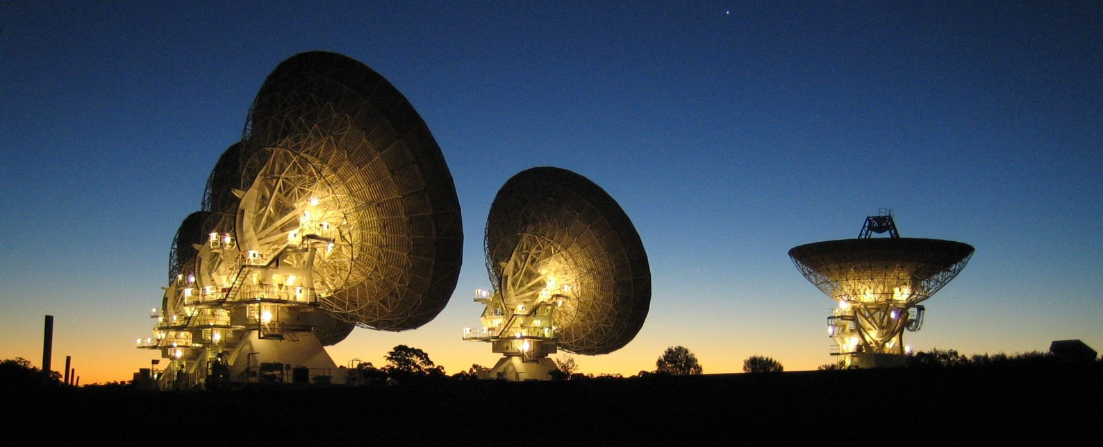
Imaging and Deconvolution
ATNF Radio Astronomy School 2017
Mark Wieringa
26 September 2017
Add Business Unit/Flagship Name

Slide 2
Topics
Interferometry and Fourier basics
Visibilities and the uv-plane
Creating Images
  gridding, weighting, resolution, fov, mfs, cubes
Deconvolution Methods
  clean, mem

Slide 3
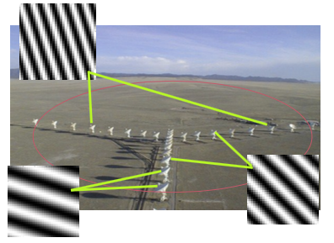
Interferometry
Long baseline
  Delay variation of many wavelengths across field,
  narrow fringe pattern,
  extended sources average out
  high resolution
Short baseline
  Small delay variation across field
  wide fringe pattern,
  flux from extended sources adds up
  low resolution
Notes:
Like double slit interference pattern, but complex, with antennas as coherent transmitters
Point source has same response on all baselines (in amplitude, rotates in phase)

Slide 4
Response of single interferometer
V(u,v) – complex visibility = coherence between average electric fields across FOV of two antennas (i and j) separated by a baseline (u,v) = Fourier transform of sky brightness
Baseline coordinates (u,v) – also called spatial frequencies, in E-W and N-S direction
  attached to the earth: rotates with time relative to sky
  measured in wavelengths: changes with frequency
I(l,m) – sky brightness distribution
  l,m coordinates on the sky, tangent plane projections of RA and Dec
Single u,v point measures response at one spatial frequency in one direction
For a good image of the sky we try to fill the uv plane with measurements:
Use as many antennas, times and frequencies as we can to achieve this

Slide 5
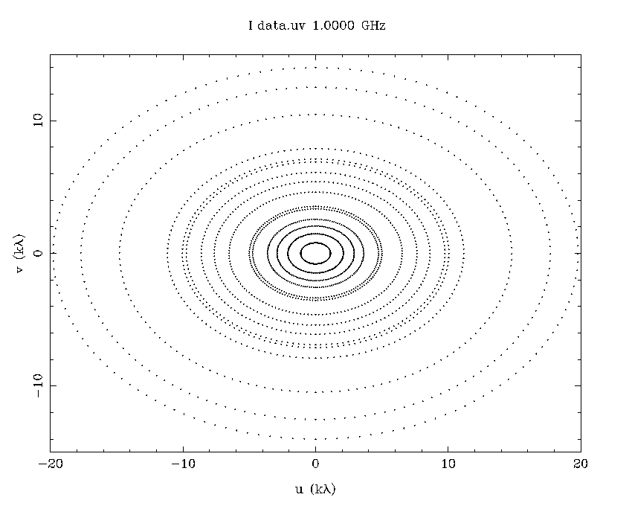
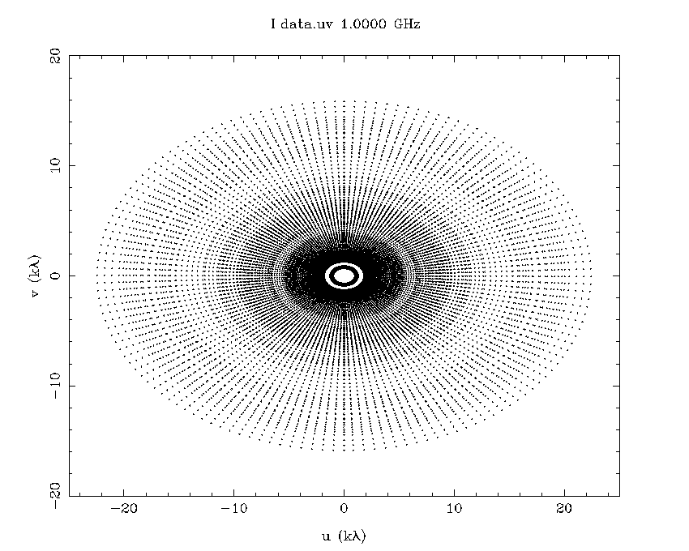
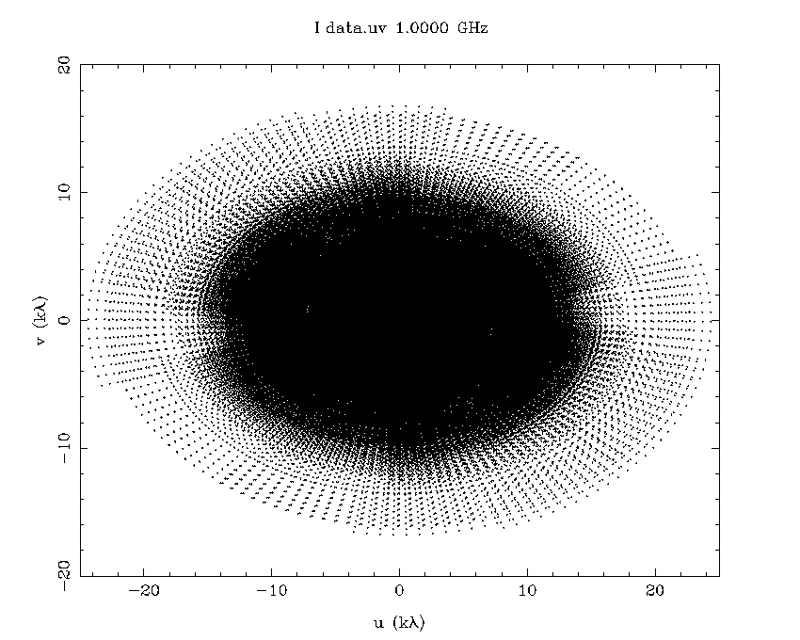
Filling the uv plane
Earth rotation synthesis
ATCA 1 to 12 h
6km array
Multi frequency synthesis
ATCA 1 to 10 channels
30% bandwidth
6km array
Adding more antennas
ASKAP 2 to 36 antennas
6h, 30% bandwidth

Slide 6


Fourier Basics
Image
uv plane
f(l,m)
Large
Constant
Real
Multiply f g
Shift f(l+a,m)
Add f+g
Rotate
Gaussian
F(u,v)
Small (brighter)
δ(u,v) ”zero spacing”
Hermitian F(u,v)=F(-u,-v)*
Convolve F*G
Phase Gradient F(u,v)e^{2πiau}
Add (F+G)
Rotate
Gaussian
FT
Notes:
Large/Small works both ways: point sources in image spread over entire uv plane

Slide 7

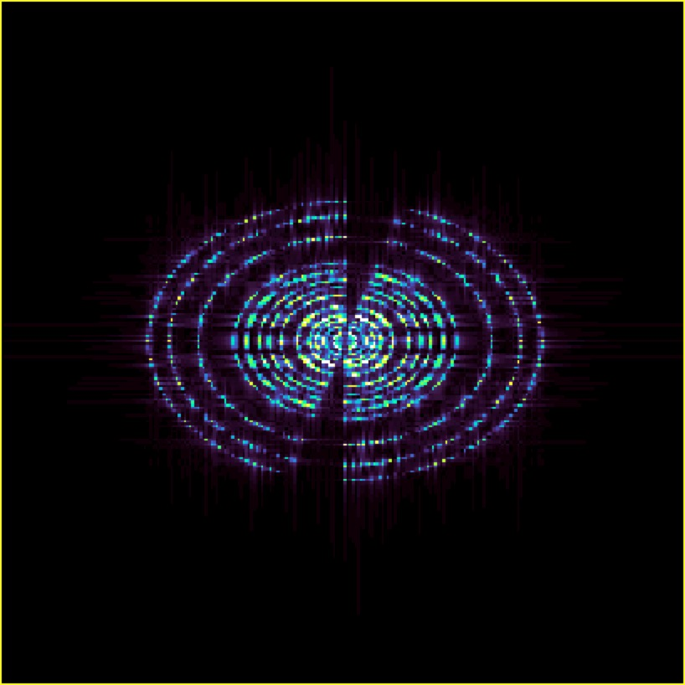
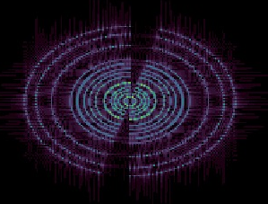
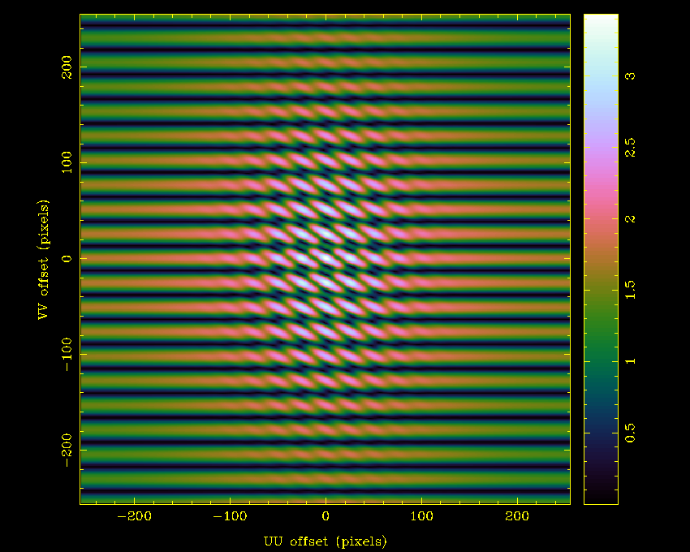
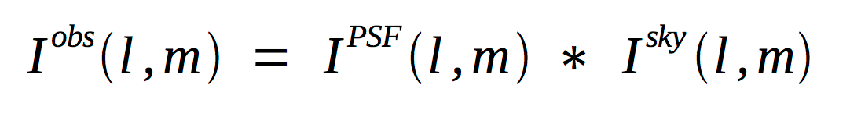
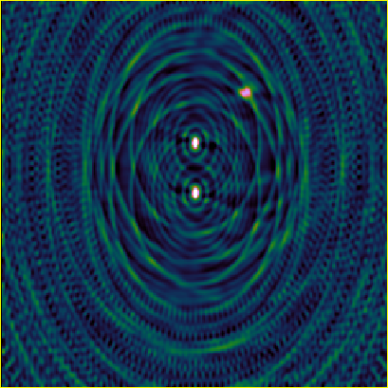
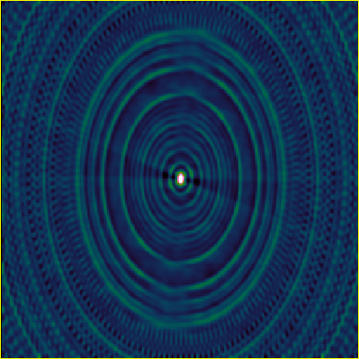
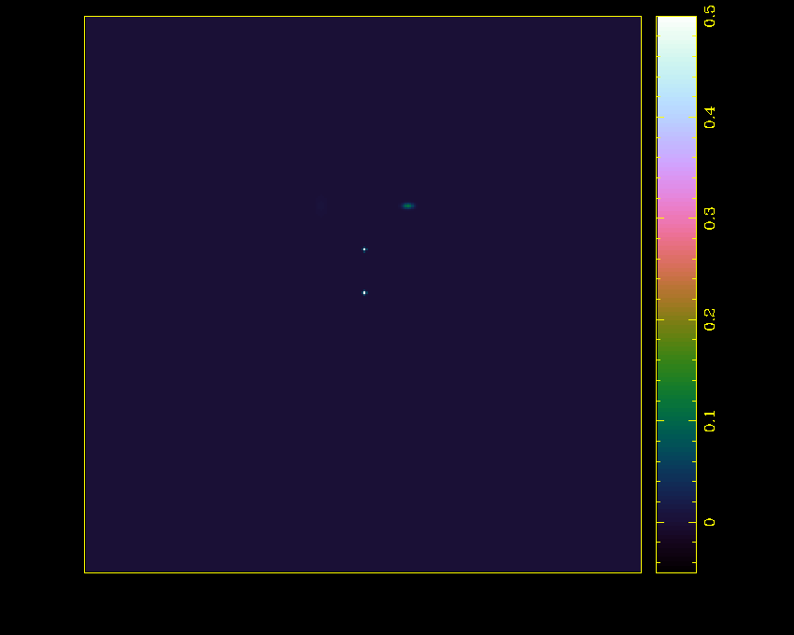
Imaging
We observe the visibility V for the positions (u,v) where we have measurements:
the uv coverage is a sampling function
Taking the Fourier transform, this corresponds to:
‘Dirty image’
‘Dirty beam’

Slide 8
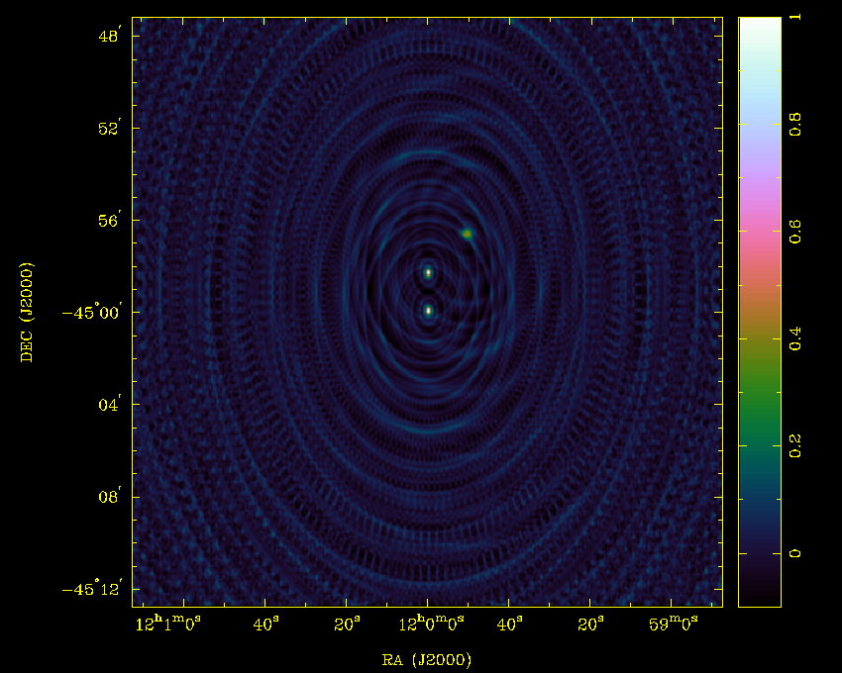
Earth rotation synthesis integrate in time: 1 to 12 h, ATCA 6km array
Notes:
E-W array needs large hour angle range for good uv plane coverage

Slide 9
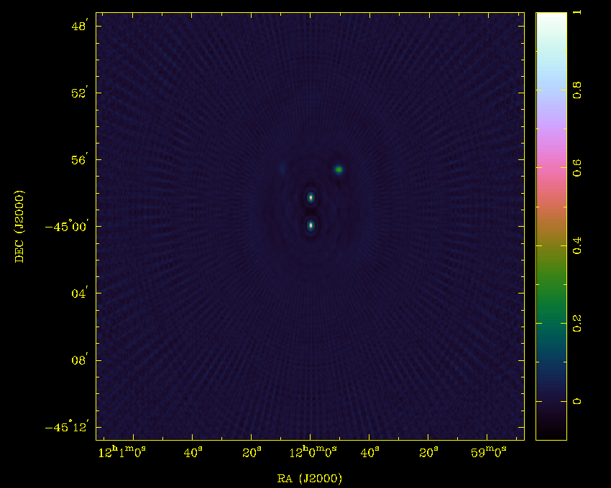
Multi-frequency synthesis integrate in frequency: 1 to 10 channels over 30% bandwidth, 12h
Notes:
Filling uv plane better reduces sidelobes

Slide 10
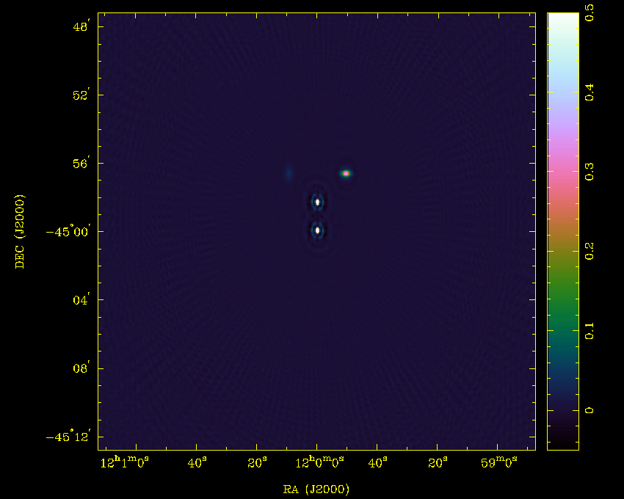
Adding more antennas
ASKAP 2➔36 antennas, 6h, 10 freq (30% bw)
Notes:
2D array needs less time to fill uv-plane

Slide 11
Fourier pairs in radio astronomy
Sky
uv-plane

Slide 12
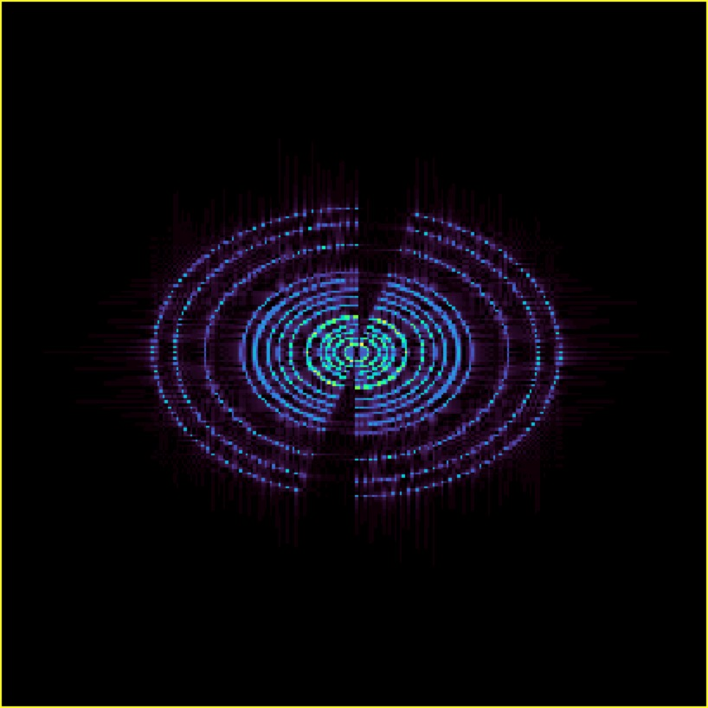
Fourier pairs in radio astronomy
Dirty beam, PSF
Gridded uv-coverage
Peak of PSF is 1
Surrounded by positive and negative sidelobes
Points in uv plane gridded to nearest pixels using convolution with ‘prolate spheroidal’ function – suppresses aliasing

Slide 13
Fourier pairs in radio astronomy
Dirty Image
Gridded visibilities
Each source surrounded by positive and negative sidelobes
Points in uv plane gridded to nearest pixels using convolution with ‘prolate spheroidal’ function

Slide 14
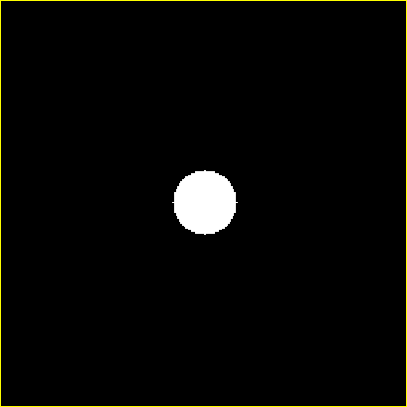
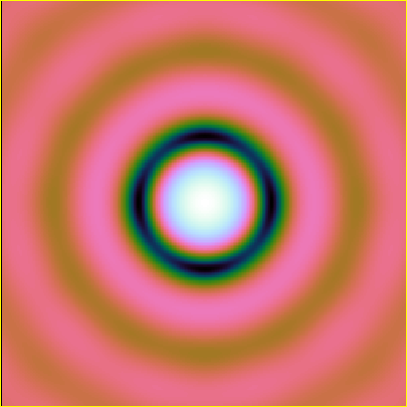
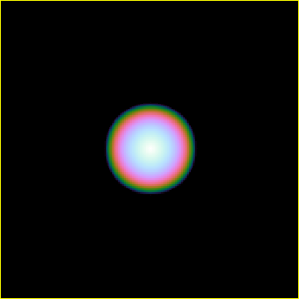
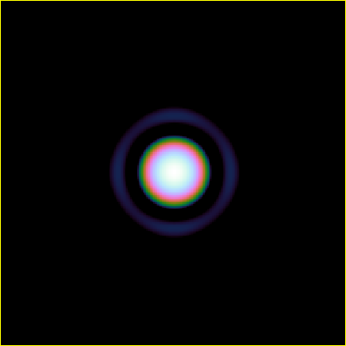
Fourier pairs in radio astronomy
Dish illumination pattern
Voltage beam
FT
Cross corr. of ill. pattern
Primary Beam
FT
PB=VBxVB*
Notes:
Top to bottom: convolution on left, multiplication on right

Slide 15
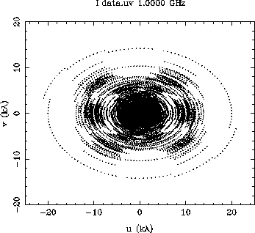
UV plane features
ATCA
Dense tracks
  Baselines – tracks in (u,v) plane
Low level in between tracks
  Gaps in coverage, missing information
Hole in center
  No information on low spatial frequencies, i.e., largest scale structures filtered out
Outer boundary
  No info on small scale structure – resolution limit
Ways to Fill the UV Plane
  Centre: add single dish data, mosaicing
  Gaps:
    multiple configurations (750m,1.5km,3km)
    Multi-frequency synthesis
    Time/Earth rotation
ASKAP

Slide 16
Image size and resolution
Some decisions best made at proposal or observing stage, some at imaging stage
Field of view (FOV, λ/D) – Image size
  Determined by primary beam size, more with mosaicing (multiple fields)
    ATCA 21cm – 33' beam, 3mm – 30'' beam
    ASKAP ~1 degree FOV (x36 beams: ~25-30 sq deg for combined image)
    may need to image larger field to remove sidelobes from distant sources
      image to first or second sidelobe at 1 GHz (or whole sky for MWA)
  Shortest baseline determines largest structure we can image well (λ/Bmin)
  Resolution (λ/Bmax), pixel (or cell) size
  Need >2 pixels/beam for Nyquist sampling – use more (3-5) for better deconvolution
  Longest baseline determines limit to resolution (ATCA 21cm, ASKAP36: 6km– 7”)
  For small sources use high resolution configurations – need many pixels for large FOV
  For extended, low surface brightness sources use compact configurations
    e.g., EW352, H75 and exclude long baselines (CA06)
    This lets you use larger pixels for the same FOV and greatly improve surface brightness sensitivity

Slide 17
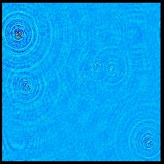
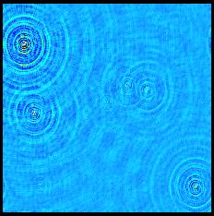
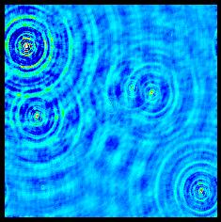
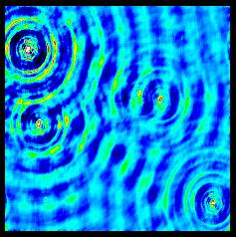
Weighting schemes
  Uniform (lowest sidelobe level) – equal weight for all filled uv cells
  Natural (lowest noise level) – equal weight for all visibilities
  Robust/Briggs - optimal combination of above two ⬅use these
  Taper (decrease resolution) – weight=gaussian(u,v) 
  S/N Weighting – weight=1/σ² –σ can depend on time/baseline/freq
  Tapering and S/N weighting can be combined with the others
Uniform R=-2 Robust=0.5 Robust=1.0 Natural R=2
Beam: 7x5” 8x6.5'' 9.6x7.5'' 12x8''
Sens.: 1.45 1.16 1.06 1.0
Notes:
Use tapering and/or R>0 to improve sensitivity to extended emission

Slide 18
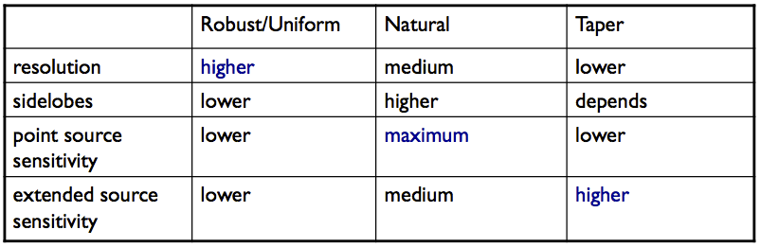
Weighting schemes
Choose weighting based on science goals
Point source detection experiment: Natural with S/N weighting
Easy imaging of bright object: Uniform, no S/N weighting
Low surface brightness, extended: Tapering, Robust
Busy field: Robust (0-1) – good sensitivity with low sidelobes

Slide 19
Continuum vs Spectral line imaging
  Continuum
    Create single output image at ‘average’ frequency
    wide bandwidth – 2 GHz (ATCA) , 300 MHz (ASKAP)
    combine channels (ATCA continuum obs. Has 2048 x 1MHz channels)
    possibly combine multiple centre frequencies (MFS)
      E.g., for max. sensitivity at 4cm use 5.5 & 7.5 GHz, each with 2048 channels over 2GHz.
  Line – image one or more spectral lines
    ATCA can do 32 simultaneous ‘zooms’ – 1 or 16 MHz bands with 2048 channels
    ASKAP has 16000 channels over 300 MHz
    Creates output image cube (2048³=8 Gpixel)– image for each frequency channel (RA,Dec,Vel)
    Check velocity frame(lsr/bary), Doppler correction
    Specify spectral resolution & velocity range
    May need to remove continuum emission first (uvlin, uvmodel)
    Cannot use MFS to improve uv coverage
      uv coverage poorer and noise higher (small bw)
      results in lower DR images

Slide 20
Beyond the dirty image…
Calibration, weighting and Fourier transform get us to the best possible dirty image
Infinite number of ‘invisible distributions’ between our uv points
To improve things further we want to:
  Remove the sidelobes of the dirty beam from our image (clean…)
Dirty Image = Sky convolved with dirty beam
  Need a deconvolution procedure
    Linear?
    Non-linear?

Slide 21

Linear deconvolution …
Noise properties are well understood
Generally non-iterative and computationally cheap
But
It does a very poor job in interferometry
  basically the same as uniform weighting!
Linear deconvolution is fundamentally unable to extrapolate to unmeasured spatial frequencies.

Slide 22
Non Linear Deconvolution
A good non-linear deconvolution algorithm is one that picks plausible (‘invisible’) distributions to fill the unmeasured parts of the uv plane.
  Avoids too much extrapolation (stick to resolution limit)
Need to make assumptions to get a realistic estimate
  Main assumption: Real sky does NOT look like typical dirty beam
    Rings, spokes, negative regions, infinite extent: all very unlikely
Different algorithms make different assumptions:
  CLEAN (pixel based), Point Source Fitting
    Sky is mostly empty, with occasional peaks
  Scale-sensitive algorithms: multi-scale clean, Gaussian Source fitting
    Sky consists of bounded, overlapping, regions of emission
  MEM (Maximum Entropy Method) (pixel based)
    Sky is uniform (& positive) – favours smooth distributions of flux
  MORESANE/IUWT – Combination of multi-scale and MEM type approaches
    Sky decomposed into wavelets, with conj. gradient deconvolution
    Available in wsclean
Notes:
See Tim’s advanced imaging talk for more on multi scale methods

Slide 23
CLEAN
Original version by Högbom (1974)
  Purely image based – subtract scaled beam from image (minor iterations only)
Clark
  Use small patch of beam, subtract model from gridded visibilities using FFT (major/minor iterations)
Cotton-Schwab
  Like Clark, but subtract from ungridded visibilities and re-image residuals
SDI (Steer/Dewdney/Ito)
  try to cope with extended emission by subtracting patch of pixels above ~90% of peak (avoids ‘corrugations’)
Basic assumption: Highest peak in dirty image is real

Slide 24
Restoring the image
After deconvolution we are left with a residual image
  Noise
  Weak source structure below the CLEAN cutoff limit
    5σ (large area), 2-3σ (clean boxes)
  Sidelobes of faint and extended sources
Restored Image
  Take residual image
  Add point components convolved with gaussian fit to central peak of dirty beam
  Resulting image is best guess of real sky with measurement noise
  Avoids ‘super-resolution’ of component model

Slide 25
CLEAN Algorithms
  Make image
    grid/weight visibilities ➔ gridded visibilities
    fft gridded visibilities ➔ (residual) dirty image
  Find position of highest peak in image
  Subtract a fraction of this peak (‘gain factor’) using a scaled dirty beam(patch) at this position (usually gain~0.1)
  Add model component to list or build up model image
  Go to 2, unless prescribed flux limit or iteration limit reached
  If doing major iterations
    subtract current model from gridded or ungridded visibilities and
    goto 1 (Clark 1b, CS 1a) unless final flux or iteration limit reached
  Restore model convolved with gaussian beam to residual image
major
minor
Notes:
Major cycles with ungridded visibilities can be slow for large datasets

Slide 26
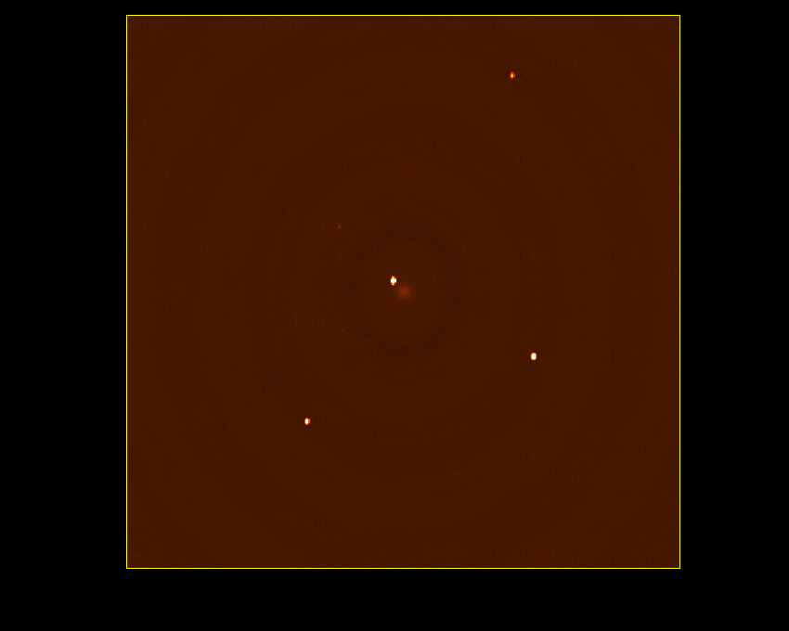
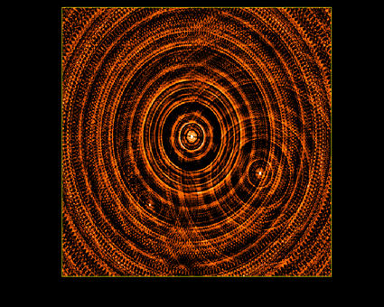
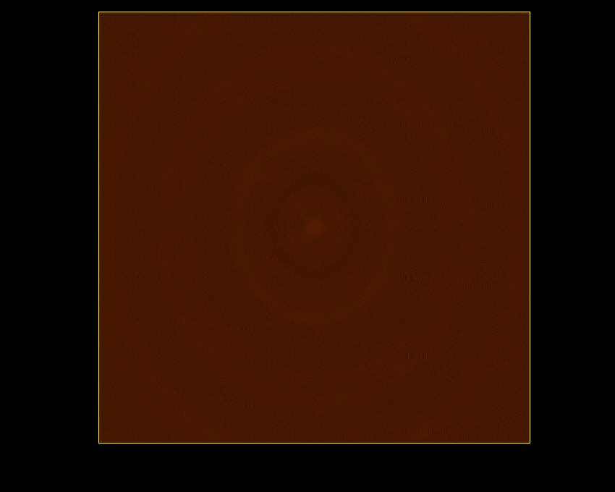
CLEAN example 1
Model: 5 point sources + 1 gaussian
Point: 1,0.5,0.25,0.1,0.01 Jy
Gaussian: 0.1Jy, 10”x10”
Restored
1,5,10,20,50,100,200,500, 1000 CC’s
Residual
Dirty image

Slide 27
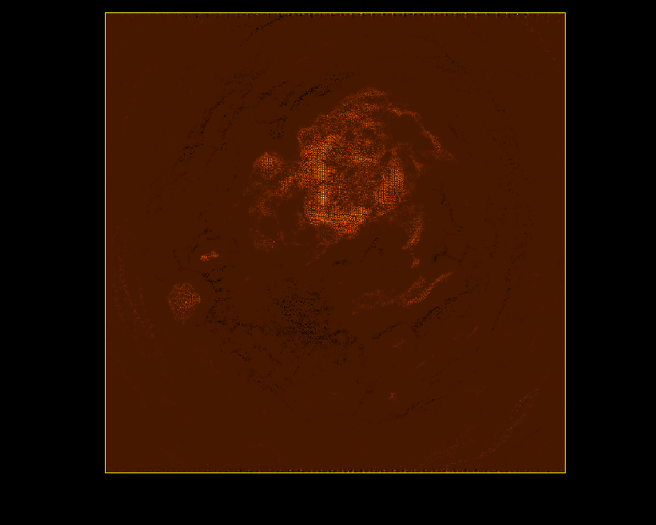
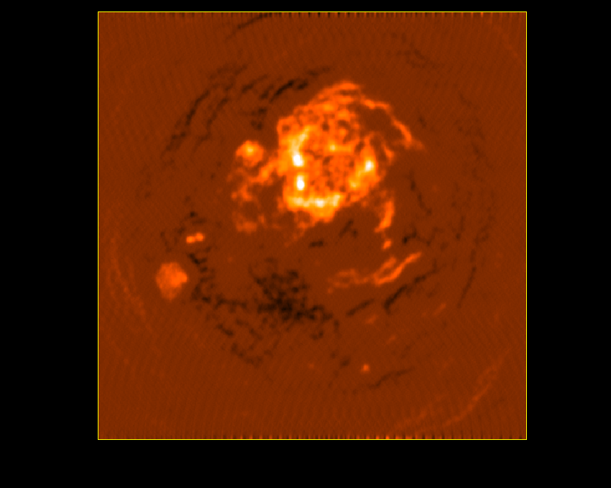
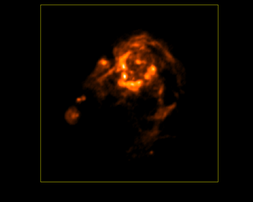
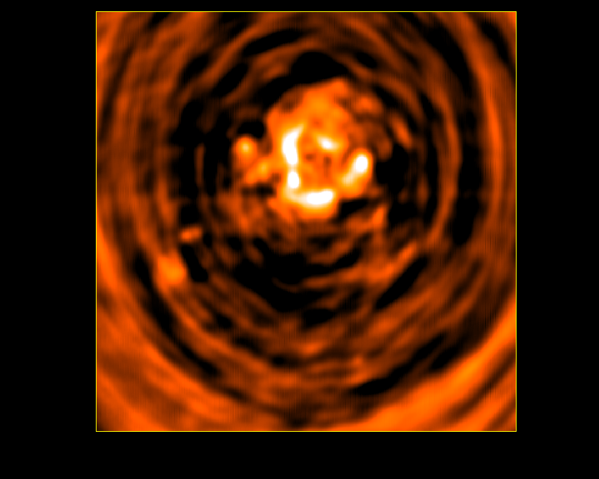
CLEAN example 2
Clean Model
1, 10, 100, 1000, 10000, 100000 CC’s
True Sky
Restored Image
Dirty Image

Slide 28
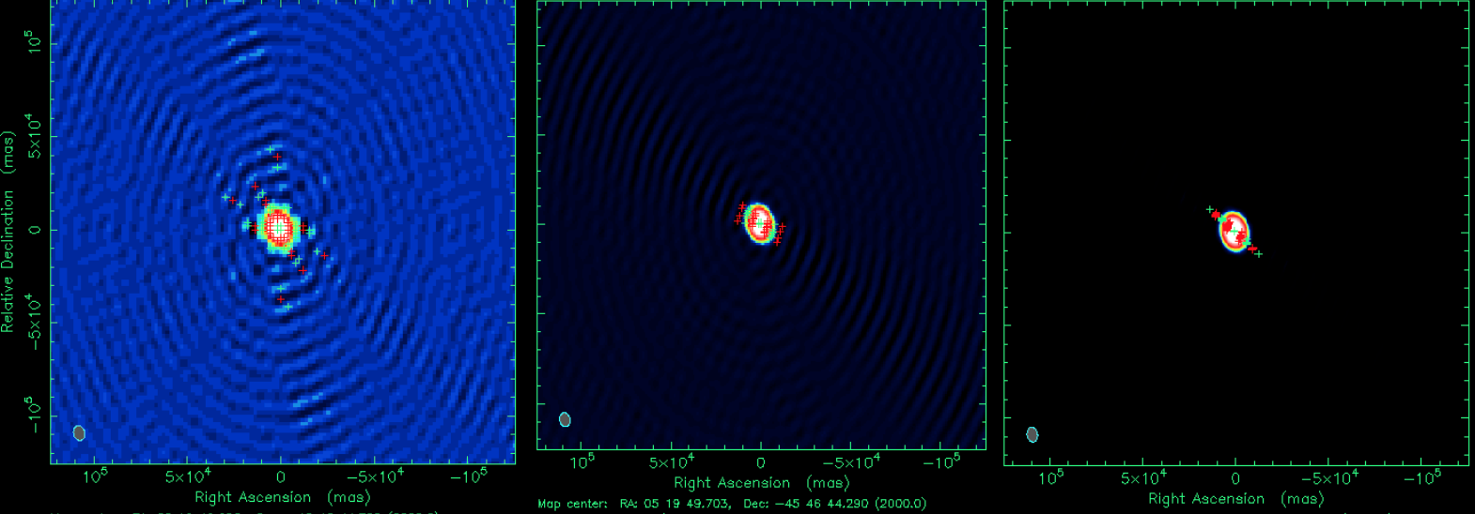
Clean – effect of cell size
3 pixels/beam 6 pixels/beam 12 pixels/beam
A strong point source between pixels takes a lot of positive and negative components to clean and causes Dynamic Range problems (1000:1)
Fix: put the source on a pixel or (if >2) use smaller pixels to limit size of errors

Slide 29
CLEAN Strengths & weaknesses
CLEAN works well for fields with many compact sources
Effect of defects (RFI, source variability, gain errors) is generally very local (unlike MEM)
Algorithm can be generalized
  Deal with wide bandwidth
    MFS Taylor Term imaging
  Deal with extended emission
    using Multiple Scales
Standard CLEAN works poorly for very extended objects:
  Slow (too many faint point components needed)
  Corrugation instability
  Negative bowl effect – large source surrounded by negative pixel
CLEAN Bias (`overcleaning’)
  artificially low noise, wrong fluxes
  Affects snapshot/mosaic/line observations with sparse uv coverage
  Fix: clean boxes, fewer iterations, joint deconvolution
Clark CLEAN can diverge
  Poor beam, large # iterations
  Fix: extend size of beam patch, use Högbom Clean instead or do major iteration sooner

Slide 30
MEM
MEM – Maximum Entropy Method
  Tries to find the ‘smoothest’ image that is consistent with the data
  Image with lowest ‘information content’ for given total flux
  No data → flat image
Define smoothness via the ‘entropy’ H
  H = -∑_{k}I_{k} ln(I_{k}/M_{k}e), I_{k}=pixel k in the image
  Use of logarithm enforces positivity constraint
    negative sidelobe suppression
M_{k} is the prior image - a flat default image can be used, but a good low resolution image, if available, is better
Data constraints are added via χ²=∑_{i}(V_{i}^{obs} –V_{i}^{mod})²/σ_{i}²

Slide 31
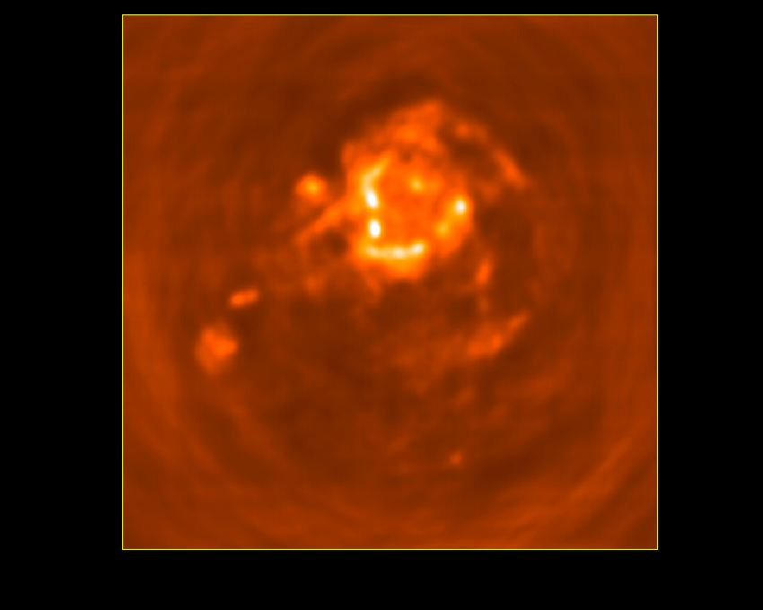
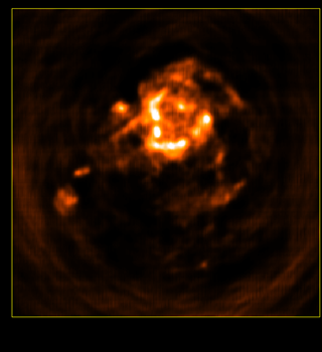
MEM
Dirty Image MEM restored image Final MEM model
25 iterations of MEM
Final image = Converged solution

Slide 32
MEM Strengths/Weaknesses
In MEM it is easy to add multiple constraints
  E.g. information from overlapping fields – mosaicing
  Single dish image added to interferometer data
Works well for extended images
  Can be much faster than CLEAN for extended structure
  Tends to fail for point sources embedded in extended emission
More sensitive to data defects (calibration problems etc)
  Effect of errors not localized, may affect convergence

Slide 33
Scale sensitive methods
Both CLEAN and MEM work on single pixels
  No inherent notion of source size
  When we look at an image we identify a collection of sources of different sizes – makes physical sense too
  Adjacent pixels in an image are NOT independent
    Resolution limit
    Intrinsic source size
    E.g., a gaussian source covering 1000 pixels can be represented by only 6 parameters instead of 1000.
Scale sensitive algorithms try to capture this extra information about a ‘plausible sky’
  Reduces number of degrees of freedom in solution
  Separation of signal and noise easier
’

Slide 34
Scale sensitive methods
SDI Clean (Steer-Dewdney-Ito)
  One of the early attempts to make CLEAN cope with extended structure
  Subtracts scaled beam from a patch of pixels around each peak found
Multi-resolution CLEAN (Wakker-Schwarz)
  Make images at 2-4 different resolutions, clean lowest resolution first, then clean residuals at higher resolution
  Combined model sensitive to all scales with greatly decreased number of iterations
Multi-scale CLEAN (Cornwell-Holdaway)
  Similar, but cleans all scales simultaneously – more robust
  Find peak across all images
  Remove fraction of peak at that scale from all images
  Add corresponding ‘blob’ to model
  Iterate until we reach the noise level in all images

Slide 35
Miriad & CASA
 | Miriad | CASA – tclean task
Clean algorithms | clean | tclean (newer) and clean task
Joint Pol. clean | cclean (Q&U) | deconvolver=‘clark’ (IQUV)
Multi-frequency Clean | mfclean (I, Iα) | nterms=2,3,4..
Maximum entropy | maxen | deconvolver=‘mem’
Mosaicing (max entropy, clean) | mosmem mossdi | tclean gridder=‘mosaic’
Joint polarimetric MEM (single pointing or mosaicing) | pmosmem | -
W-term or 2d beam | No | gridder=‘wproject’/‘awproject’

Slide 36
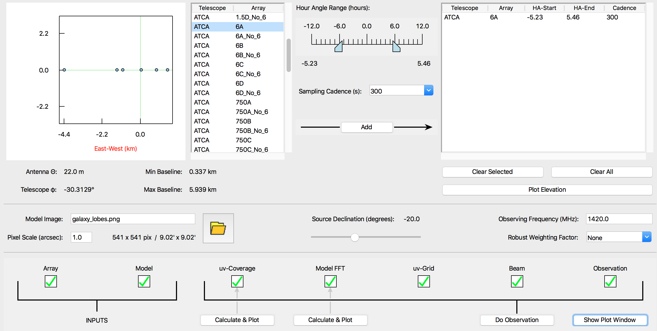
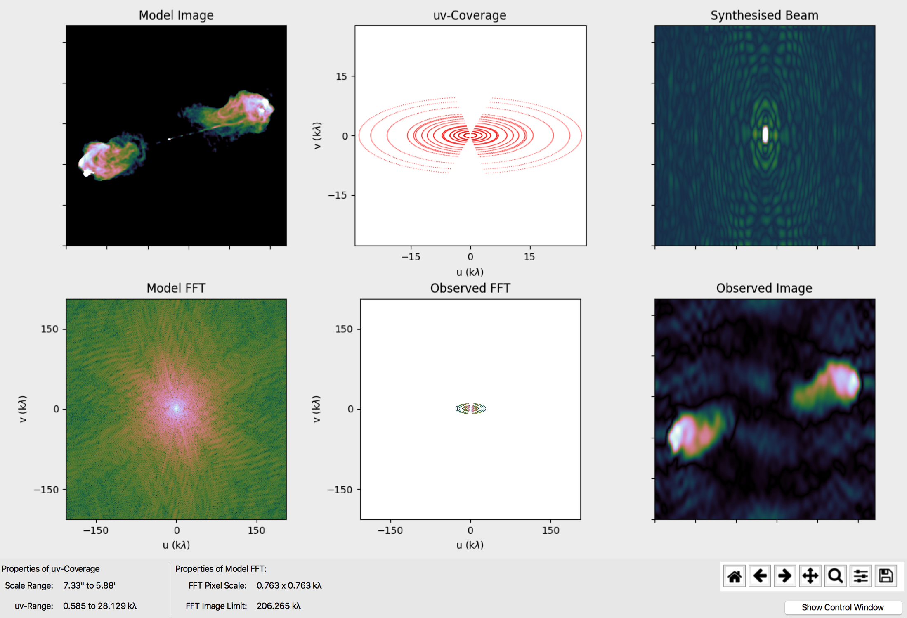
Friendly Virtual Radio Interferometer
Great tool to get familiar with imaging and Fourier Transforms
See Tutorial
(Cormac Purcell)

Slide 37
Acknowledgements
Previous Imaging talks by Emil Lenc, Urvashi Rau, David Wilner
References
Thompson, A.R., Moran, J.M. & Swenson, G. W. 2017, “Interferometry and Synthesis in Radio Astronomy” 3rd edition (OPEN ACCESS ebook)
NRAO lectures: http://www.aoc.nrao.edu/events/synthesis/

