Slide 1
The Parkes Single Digital Backend?
Matthew Bailes, Jonathon Kocz, Willem van Straten, Andrew Jameson
Centre for Astrophysics
And
Supercomputing
Swinburne University of Technology
Lister Staveley-Smith
ICRAR/UWA

Slide 2
Postulate #1:
Given a sufficiently large amount of:
  high-speed A/Ds,
  network bandwidth
  computational power
We can emulate any of the current instruments at Parkes in software.

Slide 3
ASKAP Single Digital Backend?
192 x 36 x 300 MHz x 2 x 8 bits
  = 33 Tb/s.
13 x 2 x 1 x 400 MHz x 2 x 8
  = 0.166 Tb/s
  Q. Why not start with the Parkes Single Digital Backend with 0.5% of the data and <<1% of the computations?

Slide 4
Postulate #2:
If we can process the data from the largest bandwidth instruments, we can process the smaller bandwidth instruments.

Slide 5
Maximum Receiver Bandwidths?
Parkes Multibeam
    13 x 2 x 400 MHz
10-50cm Receiver
    1 GHz at 10cm
    64 MHz at 50cm

Slide 6
A/Ds?
Require 13 pairs of A/Ds + a couple of spares
Spec:
  8 bits
  2 GHz real samplers (1.6 GHz confirmed in lab)
A/D
A/D
x13
A/D

Slide 7
Boards
ROACH Boards
3K each + FPGAs (buy 16 for 50K)
4 x 10 Gb ethernet from each
Reprogrammable via Linux
A/D
Roach
A/D
Roach
x13
A/D
Roach

Slide 8
Data Transport
Commodity off the Shelf 10Gb ethernet
A/D
Roach
64 Port 10Gb
Ethernet
A/D
Roach
x13
A/D
Roach

Slide 9
VLBI Anyone?
Add 1 Server + a RAID box
96 TB disk
12.8 Gb/s
10 Gb/s
To Pawsey
Dell R610
A/D
Roach
64 Port 10Gb
Ethernet
A/D
Roach
x13
A/D
Roach

Slide 10
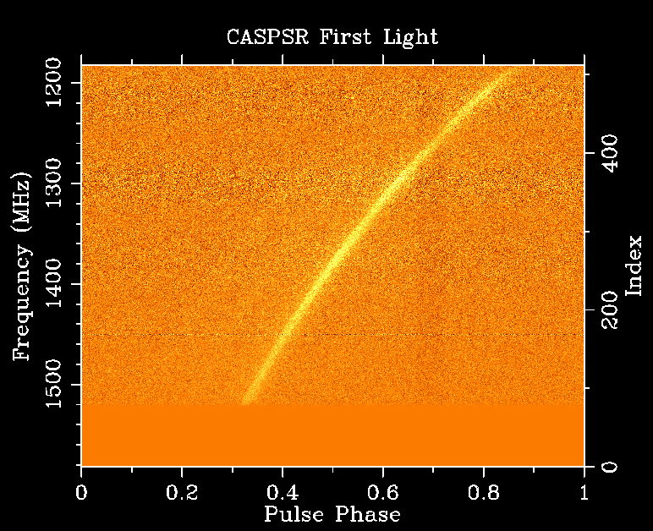
Pulsar Work?
Add Coherent Dedispersion Machines
96 TB disk
12.8 Gb/s
10 Gb/s
To Pawsey
Dell R610
A/D
Roach
64 Port 10Gb
Ethernet
A/D
Roach
x13
A/D
Roach
IB
GPU
DeMUX
IB Switch
GPU
GPU
GPU
GPU

Slide 11
Pulsar Work?
Add Coherent Dedispersion Machines
96 TB disk
12.8 Gb/s
10 Gb/s
To Pawsey
Dell R610
A/D
Roach
64 Port 10Gb
Ethernet
A/D
Roach
x13
A/D
Roach
IB
GPU
DeMUX
IB Switch
GPU
GPU
GPU
GPU

Slide 12
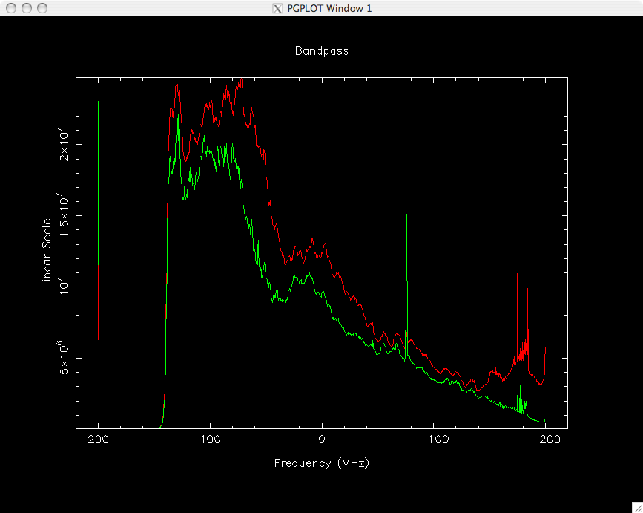
Spectroscopy?
Add GPU Machines to make Polyphase Filters
96 TB disk
131,072 Channels
12.8 Gb/s
10 Gb/s
To Pawsey
Dell R610
x13
A/D
Roach
64 Port 10Gb
Ethernet
GPU
GPU
GPU
A/D
Roach
GPU
GPU
GPU
x13
GPU
GPU
A/D
Roach
GPU
GPU
IB
GPU
DeMUX
IB Switch
GPU
GPU
GPU
GPU
X 5

Slide 13
Spectroscopy?
Add GPU Machines to make Polyphase Filters
131,072 Channels
96 TB disk
12.8 Gb/s
10 Gb/s
To Pawsey
Dell R610
x13
A/D
Roach
64 Port 10Gb
Ethernet
GPU
GPU
GPU
A/D
Roach
GPU
GPU
GPU
x13
GPU
GPU
A/D
Roach
GPU
GPU
IB
GPU
DeMUX
IB Switch
GPU
GPU
GPU
GPU
X 5

Slide 14
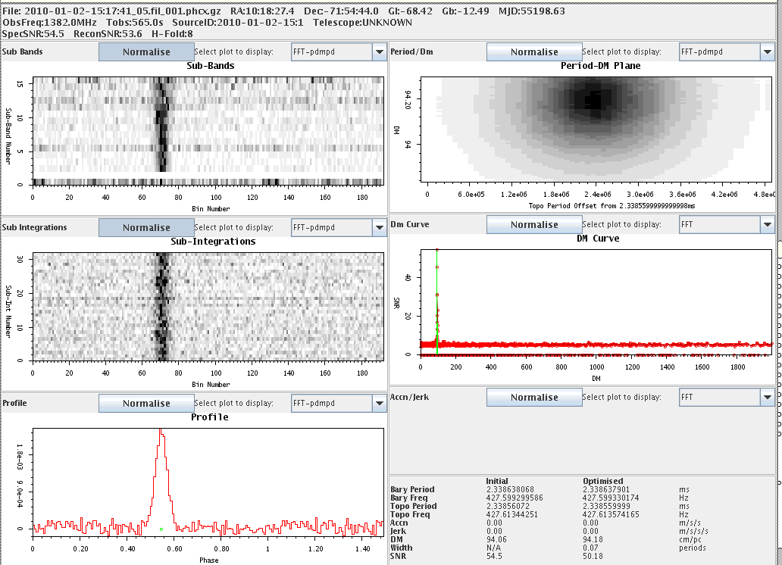
Pulsar Searching?
Re-use GPU Machines to make 2/4/8-bit Filterbanks
96 TB disk
12.8 Gb/s
131,072 Channels
10 Gb/s
To Pawsey
Dell R610
x13
A/D
Roach
64 Port 10Gb
Ethernet
GPU
GPU
GPU
A/D
Roach
GPU
GPU
GPU
x13
GPU
GPU
A/D
Roach
GPU
GPU
IB
GPU
DeMUX
IB Switch
GPU
GPU
GPU
GPU
X 5

Slide 15
Pulsar Searching?
Re-use GPU Machines to make 2/4/8-bit Filterbanks
96 TB disk
12.8 Gb/s
131,072 Channels
10 Gb/s
To Pawsey
Dell R610
x13
A/D
Roach
64 Port 10Gb
Ethernet
GPU
GPU
GPU
A/D
Roach
GPU
GPU
GPU
x13
GPU
GPU
A/D
Roach
GPU
GPU
IB
GPU
DeMUX
IB Switch
GPU
GPU
GPU
GPU
X 5

Slide 16
Pulsar Searching?
Re-use GPU Machines to make 2/4/8-bit Filterbanks
96 TB disk
12.8 Gb/s
131,072 Channels
10 Gb/s
To Pawsey
Dell R610
x13
A/D
Roach
64 Port 10Gb
Ethernet
GPU
GPU
GPU
A/D
Roach
GPU
GPU
GPU
x13
GPU
GPU
A/D
Roach
GPU
GPU
IB
GPU
DeMUX
IB Switch
GPU
GPU
GPU
GPU
X 5

Slide 17
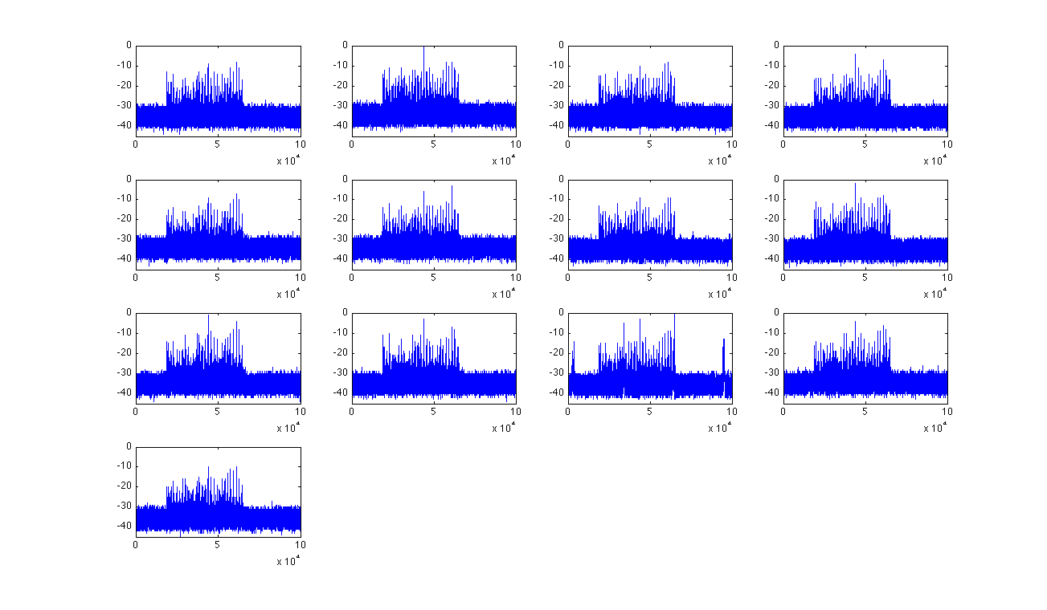
RFI Mitigation?
Spatial Filtering Techniques:
  Most RFI is in far sidelobes and common to all beams:
13 beams, total power, astonishing correlation.

Slide 18
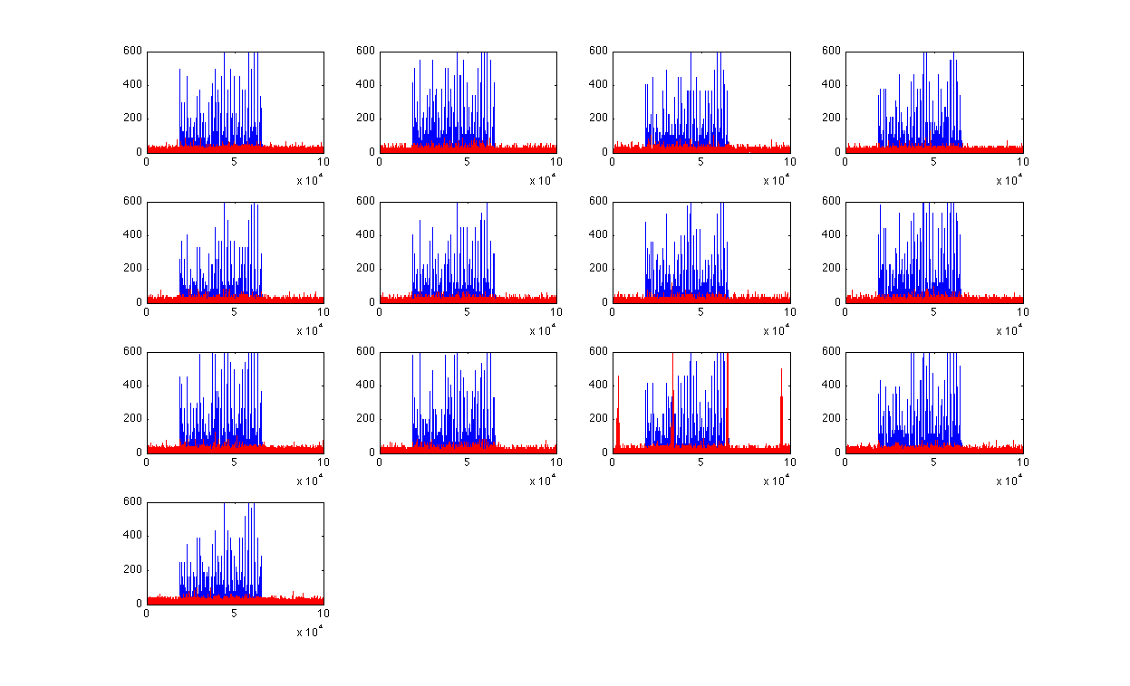
RFI Mitigation?
Spatial Filtering Techniques:
  Most RFI is in far sidelobes and common to all beams:
13 beams, total power, astonishing correlation.
Blue = Before RFI mitigation, Red = Afterwards

Slide 19
RFI Mitigation?
Spatial Filtering Techniques:
  Most RFI is in far sidelobes and common to all beams:
Real Pulses!
13 beams, total power, astonishing correlation.

Slide 20
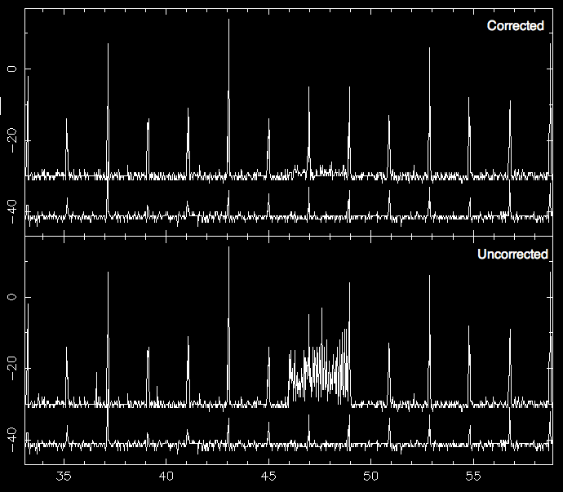
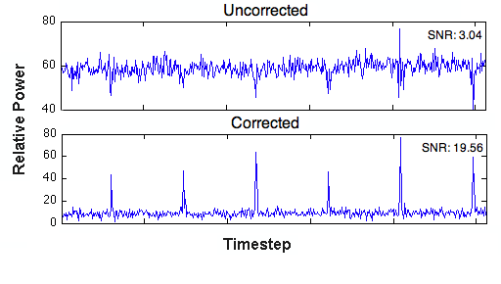
RFI Mitigation?
Spatial Filtering Techniques (Kocz & Briggs):
  Group spectra by common frequencies/time
  Determine common signals
  Subtract RFI from voltages?

Slide 21
RFI Mitigation?
Spatial Filtering Techniques (Kocz & Briggs):
  Group spectra by common frequencies/time
  Determine common signals
  Subtract RFI from voltages?

Slide 22
Summary
Proposed Backend:
  Is just a big computer.
  Has built-in redundancy.
  Is all software controlled.
  Computers easier to diagnose faults in/replace than Custom FPGA boards.
  Enables new powerful RFI mitigation strategies.

