Slide 1
Time Domain Astronomy
ATUC Science Day
Sydney, 24 Oct 2011
Ron Ekers
CSIRO, Australia
Notes:
Review of Time Domain Astronomy (invited)
Abstract: I will review the range of phenomena that have generated time variable signals at radio wavelengths and comment on the different instrumental requirements for signals with structure in time, space or frequency. The time scales involved range from decades to nanoseconds and require totally different observational techniques. I will look at the historical context and speculate about future opportunities.

Slide 2
Why me?
No erudite overview of the field
I have observed all the classes of variables listed
  And a few more
I will make various personal observations and anecdotes based on my experience

Slide 3
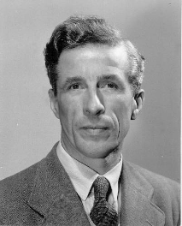
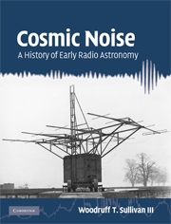
Cygnus A strongest radio source in sky
Hey 1946
  source with variable intensity
  time scale of seconds to minutes
  must be small diameter
  the first “radio star”
What was it?
  no optical counterpart
  was the whole galactic plane was made of such stars?
  no theory linking diffuse galactic emission to cosmic rays
Notes:
Hey, Phillips and Parsons, Nature 158, p234 (1946)

Slide 4
The Variable Radio Sun
It changed the course of radio astronomy
Cambridge (Ryle) and Sydney (Pawsey) are in competition to build the first radio astronomy telescopes
  Both observing the sun
Sydney gets ahead on solar imaging
  Time variable sun need instantaneous UV coverage
  This leads to large arrays of small dishes
Cambridge shifts to static (extragalactic) radio sources
  Movable baseline arrays with large elements

Slide 5
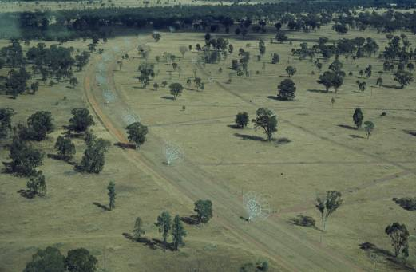
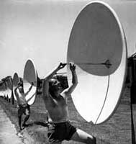
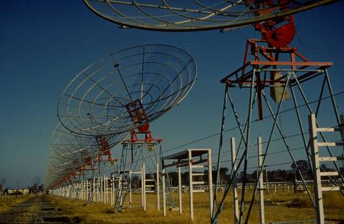
The Australian arrays
A time variable sun needs instantaneous coverage
1951
  Christiansen build the Potts Hill grating array
    32 steerable paraboloids
1953
  Chris Cross (Fleurs)
1967
  Paul Wild solar heliograph
5
Notes:
5

Slide 6
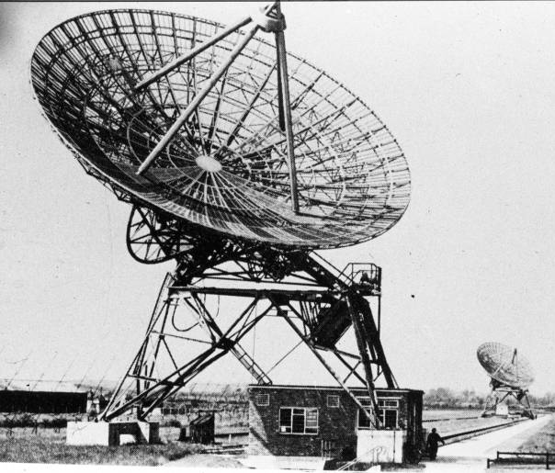
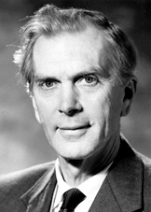
Cambridge One-Mile Telescope: 1962
Sir Marin Ryle
Nobel Prize 1974
for his observations and inventions, in particular of the aperture synthesis technique
6

Slide 7
Interplanetary Scintillation
1962: Margret Clarke observes intensity fluctuations
  Notes that only small diameter sources scintillate
  Deduces distance much further than the ionosphere
  Notes proximity to sun and correctly identifies the solar corona as the cause
Aug 1964: Margret Clark (now in Australia) submits PhD thesis
Sep 1964: Hewish publishes IPS discovery
  Margret is acknowledged but is not an author !
  She knew nothing of the paper until it was published
Jan 1965: Parkes starts IPS observations
1975: Scintillation theory now clarified (Thanks Bill Coles)
  Russians: Tatarsky, Shishov, .....
  Power law turbulence and both diffractive and refractive components
  Hewish model with Gaussian structure and diffractive scintillation was incorrect and misleading

Slide 8
Interplanetary Scintillation
Solar wind velocity
Jan 1965: Parkes starts IPS observations
Mid 1967: Measured solar wind velocity
  Parkes - Molongolo
1968: Goldstone measurement of solar wind velocity close to Sun
  Observed acceleration confirming the Parker model
  Effect of multiple velocity components studied
  EKERS, R.D. & LITTLE, L.T.: "The motion of the solar wind close to the sun". Astron. Astrophys., 10, 310-316 (1971)
  LITTLE, L.T. & EKERS, R.D.: "A new method for analyzing drifting random patterns in astronomy and geophysics". Astron. Astrophys., 10, 306-309 (1971).

Slide 9
Jupiter
OVRO measures offset in Jupiter’s radiation belt
Parkes saw no position oscillation with rotation
  ROBERTS, J.A. & EKERS, R.D.: "The position of Jupiter's Van Allen Belt". Icarus, 5, 149-153 (1966).
Glen Berge re-interprets the OVRO result as the effect of changing circular polarization
Variations in intensity with rotation used to model the synchrotron beaming
  ROBERTS, J.A. & EKERS, R.D.: "Observations of the beaming of Jupiter's radio emission at 620 and 2650 Mc/sec". Icarus, 8, 160-165 (1968).

Slide 10
AGN – Intensity Interferometer
Woomera (Aus) – Goldstone (USA)
First trans continental interferometery?
  Is an intensity interferometer VLBI?
Source size larger than light travel time since flare
First evidence for superluminal expansion
  GUBBAY, J., LEGG, A.J., ROBERTSON, D.S., MOFFET, A.T., EKERS, R.D. & SEIDEL, B.: "Variations of a small quasar component at 2300 MHz". Nature, 224, 1094-1095 (1969).
DSTO group disbanded and telescope demolished
  CSIRO advised that a telescope so far away was of little value!

Slide 11
AGN
EKERS, R.D., WEILER, K.W. & VAN DER HULST, J.M.: "A study of the variable source BL Lacertae in total intensity and linear and circular polarization". Astron. Astrophys., 38, 67-73 (1975).
EKERS, R.D., FANTI, R. & MILEY, G.K.: "Variability at 5GHz in low luminosity radio nuclei of galaxies and quasars". Astron. Astrophys., 120, 297-301 (1983).
Massardi, M.; Bonaldi, A.; Bonavera, L.; López-Caniego, M.; De Zotti, G.; Ekers, R. D., "The Planck-ATCA Co-eval Observations (PACO) project: the bright sample", submitted to MNRAS 2011 eprint arXiv:1101.0225. (2011)

Slide 12
SgrA*
1975 – WSRT search for the periodicity related to black hole orbital time scales
  No variability on hourly time scales
1989 - Variability eventually found using VLA
  Due to scintillation
  ZHAO, J.-H., EKERS, R.D., GOSS, W.M., LO, K.Y., NARAYAN, R.: "Long-term variations of the compact radio source Sgr A at the galactic center." IAU Symp. 136 (1989).

Slide 13
Pulsars
Goldstone used for pulsar observations
  Before first publication (LGM1,2,3)
  Already set up for IPS experiments
  S/N good enough to study structure in individual pulses
  Developed interactive graphics software
  Influenced the development of the Gipsy interactive data reduction package
EKERS, R.D. & MOFFET, A.T.: "Further observations of pulsating radio sources at 13 cm.". Nature, 220, 756-761 (1968).

Slide 14
Supernovae
Continuum and HI imaging of M101 at 21cm
Early detection of an extragalactic supernovae
  GOSS, W.M., ALLEN, R.J., EKERS, R.D. & de BRUYN, A.G.: "Variable radio emission from the extragalactic supernova 1970g, in M101". Nature Phys. Science, 243, 42-44 (1973).
Anne Wherle and the missed type IV SN in NGC891
  VLA normal galaxy continuum survey
  misidentified as an AGN

Slide 15
Exploding black holes
Dwingeloo used to search for exploding black holes
  Predicted by Martin Rees as a consequence of the Hawking radiation theory
  No black holes found
John O’Sullivan gets idea which leads to 802.11 wireless internet
O'SULLIVAN, J.D., EKERS, R.D. & SHAVER, R.A.: "Limits on cosmic radio bursts with microsecond time scales". Nature, 276, 590-591 (1978).

Slide 16
M87 millipulses
Millisecond pulses coming from M87detected at Arecibo
Not confirmed
  HANKINS, T.H., CAMPBELL, D.B., DAVIS, M.M., FERGUSON, D.C., NEIDHOFER, J., WRIGHT G.A.E., EKERS, R.D. & O'SULLIVAN, J.D.: "Searches for the radio millipulses from M87 Virgo A". Astrophys. J., 244, L61-L64 (1981).

Slide 17
SETI
Pulses are just as likely as CW signals
Parkes experiment using the exploding black hole backend
  COLE, T.W. & EKERS, R.D.: "A survey for sharply pulsed emissions". Proc. Astron. Soc. Aust., 3, 328-330 (1979).

Slide 18
Transient sources
Dec 1990 VLA – A new radio source appears in the Sgr A field
  Keep your eyes open
Increased for 1 month then 3 month to decay
Front cover of Science
Unlike any other class of source - interpretation unknown
  ZHAO, J-H., ROBERTS, D.A., GOSS, W.M., FRAIL, D.A., LO, K.Y., SUBRAHMANYAN, R., KESTEVEN, M.J., EKERS, R.D., ALLEN, D.A., BURTON, M.G., & SPYROMILIO, J. "A transient radio source near the center of the Milky Way Galaxy". Science, 255, 1538-1543 (1992)

Slide 19
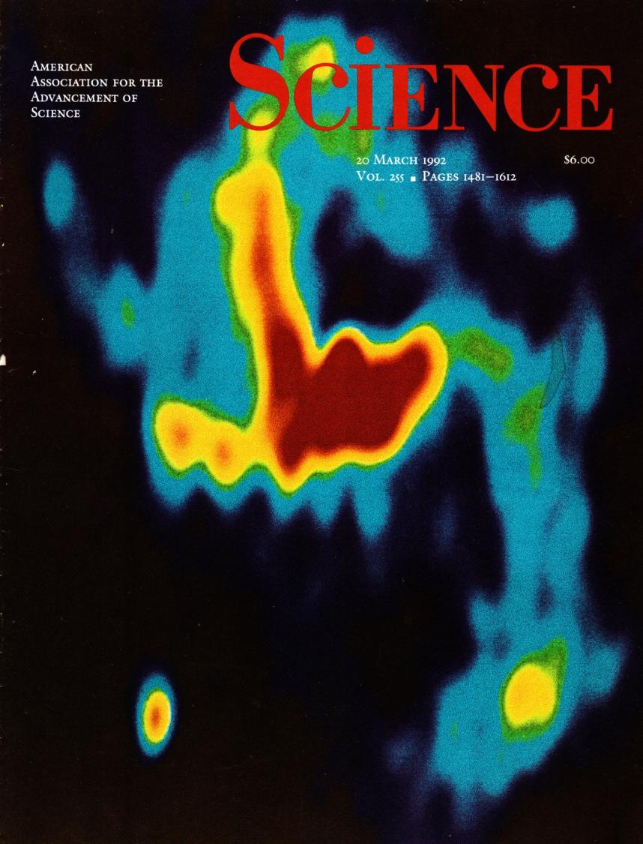
Sgr A transient
Test case for ASKAP?
Complex field
Measured HI & OH absorption
  Located at galactic centre
Spectra at 4 frequencies
  Steep spectrum
Weekly samples
transient

Slide 20
GRB and SN 1998bw
ATCA observations of SN 1998bw
  ATCA-AAO collaboration and rapid followup after lunch discussion in the Marsfield canteen
  timing and position coincidence
  establishes the first SN – GRB link
  Basis for the “Hypernovae” model
  My most cited paper
  KULKARNI, S.R., FRAIL, D.A., WIERINGA, M.H., EKERS, R.D., SADLER, E.M., WARK, R.M., HIGDON, J.L., PHINNEY, E.S. & BLOOM, J.S. "Radio emission from the unusual supernova 1998bw and its association with the gamma-ray burst of 25 April 1998". Nature, 395, 663-669 (1998).

Slide 21
Perytons the Lorimer type bursts
Sarah Burke finds Lorimer burst look-alikes in multiple multi-beam beams
  Must be coming through sidelobes
  Tropospheric origin likely
  “dispersion” due to plasma frequency drift as seen in type IIII solar bursts
  Difficulty publishing
    If it’s tropospheric it’s not interesting
  Burke-Spolaor, S.; Bailes, M.; Ekers, R.; Macquart, J.-P.; Crawford, F. III., "Radio Bursts with Extragalactic Spectral Characteristics Show Terrestrial Origins", The Astrophysical Journal, Volume 727, Issue 1, article id. 18 (2011).
Phenomenon still not understood

Slide 22
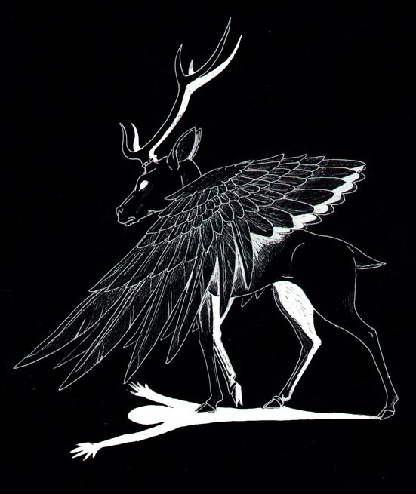
Perytons
Not what they seem to be!

Slide 23
UHE neutrinos
First search for Lunar Cerenkoff pulses from UHE neutrinos
  HANKINS, T.H., EKERS, R.D. & O'SULLIVAN, J.D. "A search for lunar radio Cerenkov emission from high-energy neutrinos". MNRAS, 283, 1027-1030 (1996).
Spectacular Parkes photograph by Seth Shostack
Most sensitive Lunar Cerenkof pulse search
  See talk by Justin Bray
  EKERS, R.D., JAMES, C.W., PROTHEROE, R., McFADDEN, R.A., "Lunar radio Cherenkov Observations of UHE Neutrinos", Nuclear Instruments and Methods in Physics Research Section A, Volume 604, Issue 1-2, p. S106-S111. (2009).

Slide 24
Parkes
2001
Seth Shostack, SETI institute

Slide 25
Atmospheric
Cosmic Ray Showers
Really high energy cosmic rays are very rare
There direction composition and energy are of great interest
  They may be heavy nuclei
  They may show the GKZ cutoff
  Cen A may be a source
Fluorescence detectors require clear dark moon nights
  Duty cycle about 10%
  Very few rare events are captured
Pulsed radio emission may be a viable alternative
  100% duty cycle
  100 η sec resolution
  Near field, anisotropic, time dependent structure

Slide 26
References
ROBERTS, J.A. & EKERS, R.D.: "The position of Jupiter's Van Allen Belt". Icarus, 5, 149-153 (1966).
EKERS, R.D. & MOFFET, A.T.: "Further observations of pulsating radio sources at 13 cm.". Nature, 220, 756-761 (1968).
GUBBAY, J., LEGG, A.J., ROBERTSON, D.S., MOFFET, A.T., EKERS, R.D. & SEIDEL, B.: "Variations of a small quasar component at 2300 MHz". Nature, 224, 1094-1095 (1969).
EKERS, R.D. & LITTLE, L.T.: "The motion of the solar wind close to the sun". Astron. Astrophys., 10, 310-316 (1971).
GOSS, W.M., ALLEN, R.J., EKERS, R.D. & de BRUYN, A.G.: "Variable radio emission from the extragalactic supernova 1970g, in M101". Nature Phys. Science, 243, 42-44 (1973).
EKERS, R.D., WEILER, K.W. & VAN DER HULST, J.M.: "A study of the variable source BL Lacertae in total intensity and linear and circular polarization". Astron. Astrophys., 38, 67-73 (1975).
O'SULLIVAN, J.D., EKERS, R.D. & SHAVER, R.A.: "Limits on cosmic radio bursts with microsecond time scales". Nature, 276, 590-591 (1978).
COLE, T.W. & EKERS, R.D.: "A survey for sharply pulsed emissions". Proc. Astron. Soc. Aust., 3, 328-330 (1979).
HANKINS, T.H., CAMPBELL, D.B., DAVIS, M.M., FERGUSON, D.C., NEIDHOFER, J., WRIGHT G.A.E., EKERS, R.D. & O'SULLIVAN, J.D.: "Searches for the radio millipulses from M87 Virgo A". Astrophys. J., 244, L61-L64 (1981).
EKERS, R.D., FANTI, R. & MILEY, G.K.: "Variability at 5GHz in low luminosity radio nuclei of galaxies and quasars". Astron. Astrophys., 120, 297-301 (1983).
COWAN, J.J., EKERS, R.D., GOSS, W.M., SRAMEK, R.A., ROBERTS, D.A. & BRANCH, D. "G25.5 + 0.2: a very young galactic supernova remnant". Mon. Not. R. Astron. Soc., 241, 613-623 (1989).
ZHAO, J.-H., EKERS, R.D., GOSS, W.M., LO, K.Y., NARAYAN, R.: "Long-term variations of the compact radio source Sgr A at the galactic center." IAU Symp. 136: The Center of the Galaxy, Los Angeles, July 1988, 535-541 Kluwer (1989).
ZHAO, J.-H., ROBERTS, D.A., GOSS, W.M., FRAIL D.A. & EKERS, R.D. "A transient radio source in Sgr A West", IAU Circular, no. 5210 (1991).
SRAMEK, R.A., COWAN, J.J., ROBERTS, D.A., GOSS, W.M. & EKERS, R.D. "A VLA search for young galactic supernova remnants". Astron. J., 104, 704-718 (1992).
ZHAO, J-H., ROBERTS, D.A., GOSS, W.M., FRAIL, D.A., LO, K.Y., SUBRAHMANYAN, R., KESTEVEN, M.J., EKERS, R.D., ALLEN, D.A., BURTON, M.G., & SPYROMILIO, J. "A transient radio source near the center of the Milky Way Galaxy". Science, 255, 1538-1543 (1992)
HANKINS, T.H., EKERS, R.D. & O'SULLIVAN, J.D. "A search for lunar radio Cerenkov emission from high-energy neutrinos". MNRAS, 283, 1027-1030 (1996).
SHOSTAK, S., EKERS, R.D. & VAILE, R. "A search for artificial signals from the Small Magellanic Cloud". AJ, , 164-166 (1996).
KULKARNI, S.R., FRAIL, D.A., WIERINGA, M.H., EKERS, R.D., SADLER, E.M., WARK, R.M., HIGDON, J.L., PHINNEY, E.S. & BLOOM, J.S. "Radio emission from the unusual supernova 1998bw and its association with the gamma-ray burst of 25 April 1998". Nature, 395, 663-669 (1998).
EKERS, R.D., JAMES, C.W., PROTHEROE, R., McFADDEN, R.A., "Lunar radio Cherenkov Observations of UHE Neutrinos", Proceedings of ARENA 2008, 3rd international workshop on the Acoustic and Radio EeV Neutrino Detection Activities, June 25-27, 2008, Rome Italy. Nuclear Instruments and Methods in Physics Research Section A, Volume 604, Issue 1-2, p. S106-S111. (2009).
Burke-Spolaor, S.; Bailes, M.; Ekers, R.; Macquart, J.-P.; Crawford, F. III., "Radio Bursts with Extragalactic Spectral Characteristics Show Terrestrial Origins", The Astrophysical Journal, Volume 727, Issue 1, article id. 18 (2011).
Massardi, M.; Bonaldi, A.; Bonavera, L.; López-Caniego, M.; De Zotti, G.; Ekers, R. D., "The Planck-ATCA Co-eval Observations (PACO) project: the bright sample", submitted to MNRAS 2011 eprint arXiv:1101.0225. (2011)

