Slide 1

Probing AGN physics with VLBI at Parkes
Stas Shabala
University of Tasmania

Slide 2
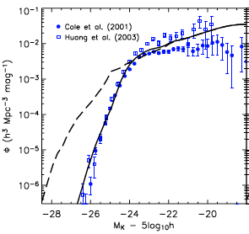
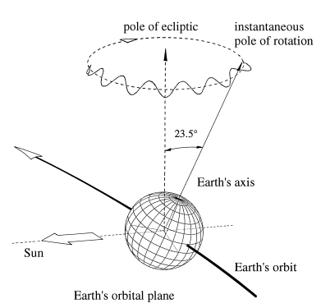
Why study AGN
AGN physics
  Brightest objects in the Universe, yet we don’t know:
    Composition
    Accretion / outflow connection
    Details of interaction with environment
Feedback
  Galaxies
  Clusters
Probes
  ISM
  HI in and outside galaxies
  High z Universe
  Earth !
SKA Key Science
Probing the Dark Ages ✓
Galaxy evolution + cosmology ✓
Cosmic magnetism ✓
Gravity with pulsars/BHs ✓
Cradle of life
Croton et al. 2006
Beutler 2004

Slide 3
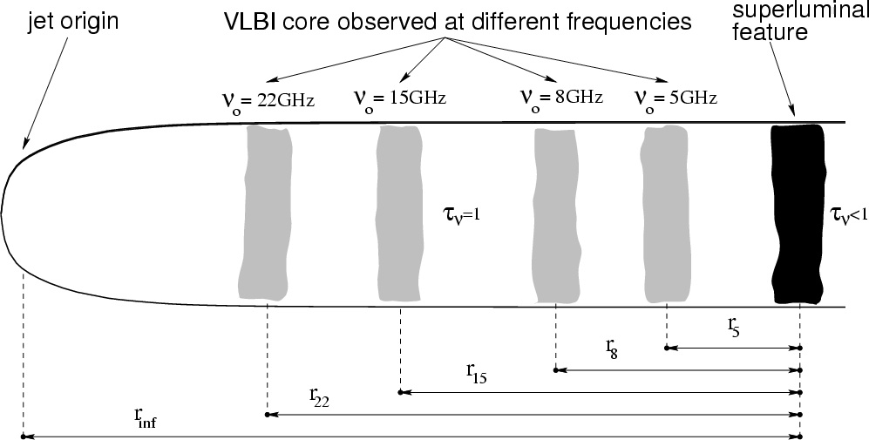
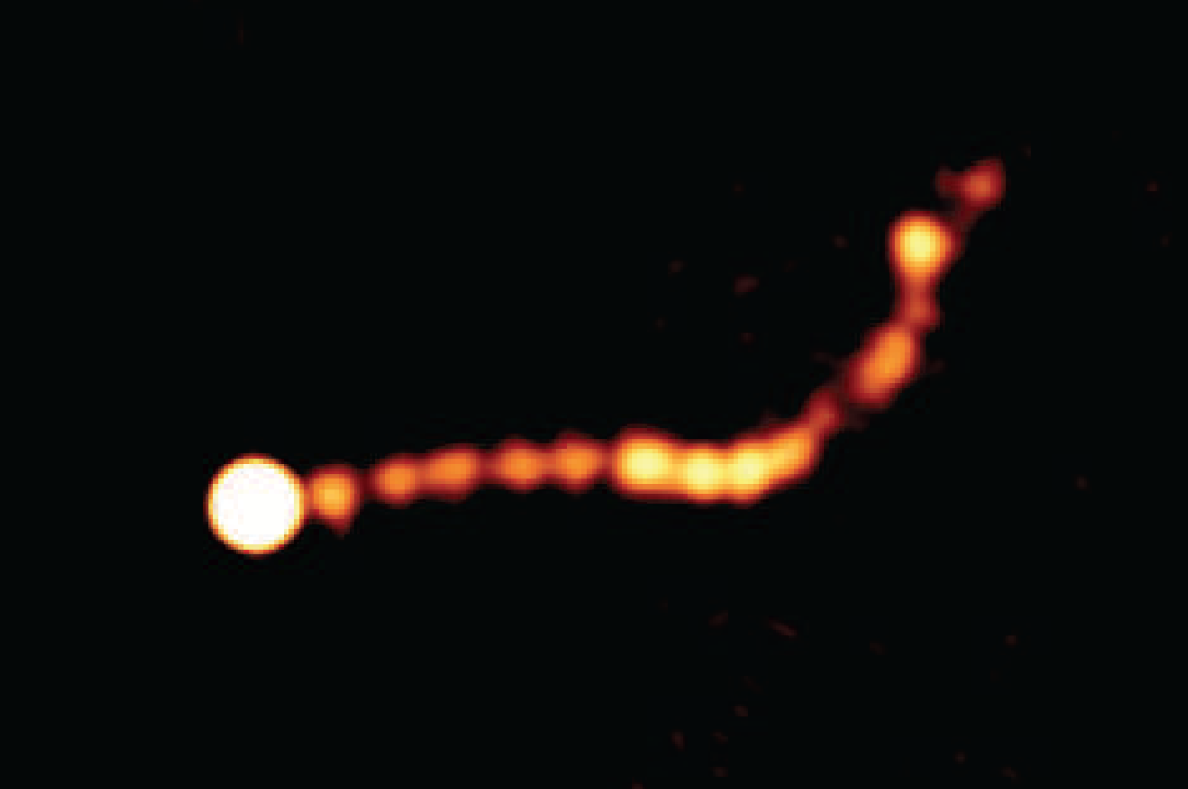
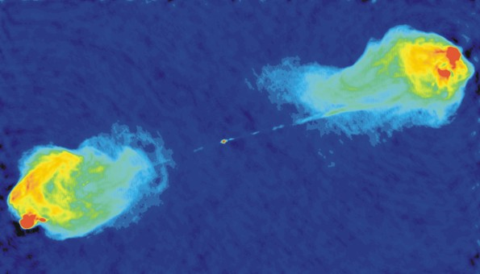
AGN at high angular resolution
Cores
  Survey follow up: AGN and/or SF (Falcke+04, Middelberg+12)
  Self – absorption
    AGN energetics and feedback (Lobanov 96, Kovalev+08)
    Geodesy (Porcas 09)
Jets
  Composition: Faraday depolarization, jet powers (O’Sullivan+11)
  Propagation + interaction: KHI, entrainment (Lobanov 96, Croston+03)
  Physics: B-field, central engine modulation,
  standing shocks, binary BHs… (O’Sullivan & Gabuzda 09, Godfrey+12)
Lobes
  Ageing: backflow + large-scale dynamics (Alexander & Leahy 87)
Hotspots
  AGN energetics (Godfrey & Shabala 12)
Kovalev et al. 2008, A&A 383, 759
Godfrey et al. 2012, ApJ 758, 27
Image: R. Perley / NRAO
Notes:
High Ang. Res. -> get close to jet base
Important to all parts of AGN
Most basic: separate AGN and SFs

Slide 4
Multi – frequency VLBI
Cores
  Survey follow up: AGN and/or SF
  Self – absorption
    AGN energetics and feedback
    Geodesy
Jets
  Composition: Faraday depolarization, jet powers
  Propagation + interaction: KHI, entrainment
  Physics: B-field, central engine modulation,
  standing shocks, binary BHs…
Lobes
  Ageing: backflow + large-scale dynamics
Hotspots
  AGN energetics
GPS sources: turnover frequency ➔ z
frequency – dependent core shift
rotation measures
Godfrey et al. 2012, ApJ 758, 27
break frequency
spectral index
Image: R. Perley / NRAO
Notes:
High Ang. Res. -> get close to jet base
Important to all parts of AGN
Most basic: separate AGN and SFs

Slide 5
Multi – frequency VLBI
Cores
  Survey follow up: AGN and/or SF
  Self – absorption
    AGN energetics and feedback
    Geodesy
Jets
  Composition: Faraday depolarization, jet powers
  Propagation + interaction: KHI, entrainment
  Physics: B-field, central engine modulation,
  standing shocks, binary BHs…
Lobes
  Ageing: backflow + large-scale dynamics
Hotspots
  AGN energetics
GPS sources: turnover frequency ➔ z
frequency – dependent core shift
rotation measures
Godfrey et al. 2012, ApJ 758, 27
break frequency
spectral index
Image: R. Perley / NRAO
Notes:
High Ang. Res. -> get close to jet base
Important to all parts of AGN
Most basic: separate AGN and SFs

Slide 6
Core shift jet powers
Kovalev et al. 2008, A&A 383, 759
particles
B-field
rest mass
Step 1 : relate other variables to B (equipartition)
Step 2 : find B from core shift
➔ Jet power
Weak jets at high z are Doppler boosted
LBA v469: core shifts without
optically thin jets
Shabala+ 2012, ApJ 756, 161
Notes:
High Ang. Res. -> get close to jet base
Important to all parts of AGN
Most basic: separate AGN and SFs

Slide 7
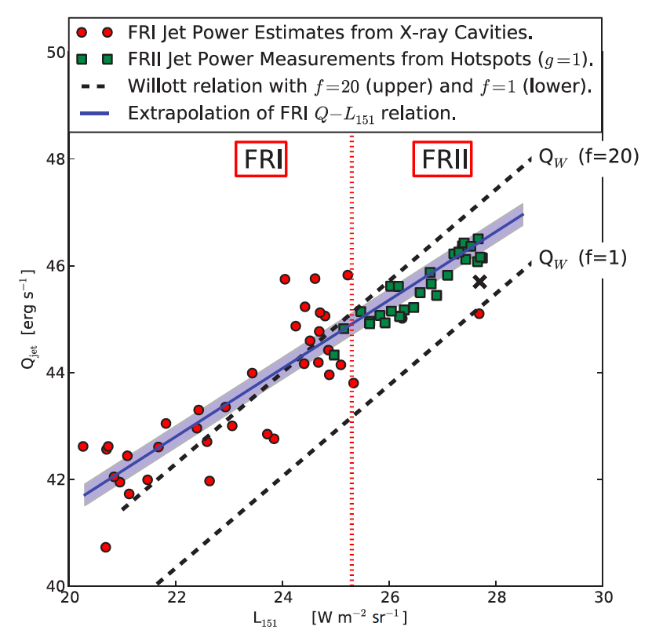
Hotspot jet powers
spectral index
Hotspot size + luminosity + spectral index
➔ Jet power
Comparison:
Hotspot vs core shift jet powers
Godfrey & Shabala 2012, submitted to ApJ
Notes:
High Ang. Res. -> get close to jet base
Important to all parts of AGN
Most basic: separate AGN and SFs

Slide 8
Why southern hemisphere
Parkes
VLBA issues
SKA pathfinders
Geodesy
  Structure + core shift
  Southern Hemisphere most affected
  (O. Titov’s talk)
  Flux density + geodetic + LBA
unstable quasar
stable quasar
VLBI core shift ?
  ➔ jet evolution
AGN physics
Scintillation
10 μas
Intrinsic
100 μas
Intrinsic
1 mas
Geodesy
Notes:
High Ang. Res. -> get close to jet base
Important to all parts of AGN
Most basic: separate AGN and SFs

Slide 9
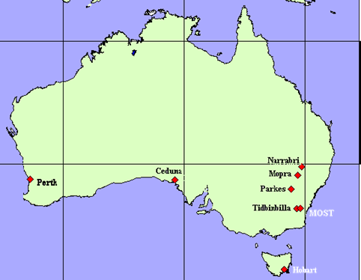
Which receivers ?
Multi – frequency science
  Core shifts, Faraday depolarization
  hotspots, lobes
LBA: 1.4 – 22 GHz
Geodesy + astrophysics
  VLBI 2010: S / X ➔ 2 – 14 GHz
  Timelines uncertain
Consequences of losing S / X
  AuScope needs Parkes for sensitivity (12 x 64 m)
    astrometry ~ SNR
  no simultaneous multi – λ on long baselines
    E.g. with 4 GHz ⬆ broadband receiver (need 2.3 GHz)
  Geodesy impossible without S / X ➔ AGN physics loses out
  AGN studies need quasi-simultaneous multi – λ observations
    Core shift ~ ν⁻¹
AuScope 12m:
Yarragadee +
Katherine
LBA Sep 2012

