Slide 1
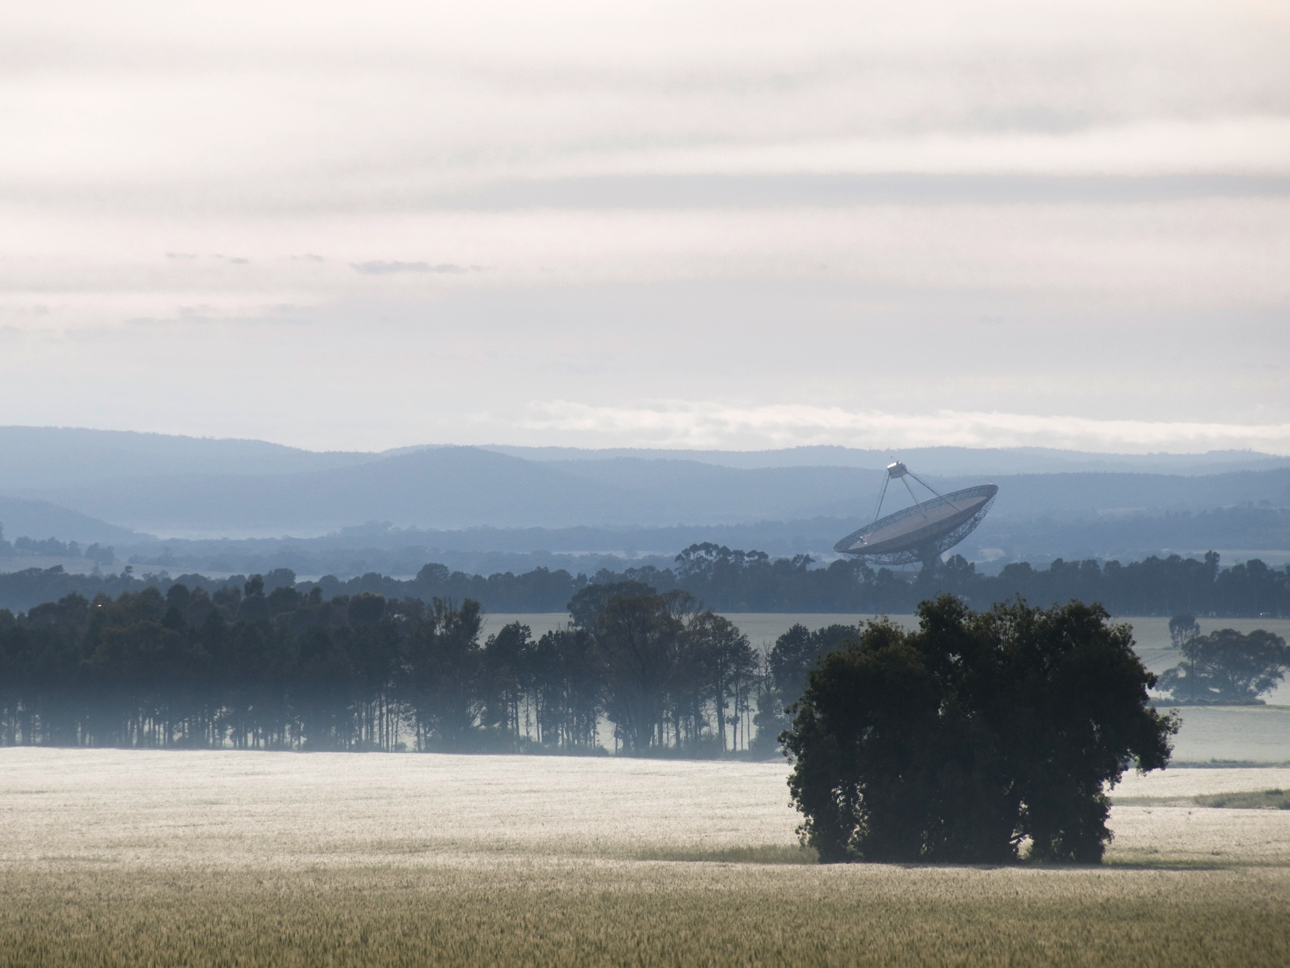
ATNF Operations
Douglas Bock
ATUC – 25 November 2014

Slide 2
From the June ATUC meeting …
Budget implications – this presentation and Director’s report
Training and observer qualification – this presentation
CABB modes – Tasso’s talk
Off-axis polarisation calibration – Phil’s talk

Slide 3
ATNF Telescope Availability

Slide 4
Parkes and ATCA
Removal of most visitor services at Narrabri and Parkes
Maintaining levels of scientific user support, but now in Marsfield
Parkes power & automation upgrades now complete
Focus on ATCA automation (Jamie’s talk)
Decrease in engineering operations effort for Parkes/ATCA by ~4 FTE from this year
Capabilities:
Parkes receivers MB-20 + 10/50 cm for Oct 2014 and Apr 2015
Parkes receivers ? + {20cm} + 10/50 cm for Oct 2015
Will consider other receivers for exceptional cases or where operationally convenient
No current changes to ATCA capabilities but studying options for next FY

Slide 5
LBA and Tidbinbilla
No changes to LBA operations, but Parkes receiver availability will limit choices (typ. 20 cm + 1-2 higher frequencies, 1 per semes.)
LBA developments focussed on sustainable operations
5% host country access to Tidbinbilla telescopes (limited support)
Seeking a more effective use of host country time on Tidbinbilla 70m, for VLBI in particular

Slide 6
Mopra
Current agreement with NAOJ and UNSW/Adelaide expires October 2014
CSIRO funding for depreciation and management will terminate October 2014
April 2015 the last semester for ATNF access
CSIRO will shortly begin an expressions of interest process to find new operators &/or owners for Mopra.
Information on telescope status for 2015APR is available at http://www.atnf.csiro.au/observers/apply/avail.html

Slide 7
User Support and Qualification

Slide 8
Observer “qualification”
Why? To maximise scientific impact from the facilities:
By optimising design and conduct of observations
By facilitating interactions between CSIRO staff and observers that guide support and future instrumentation, etc
We still hold this principal, but are seeking other ways to satisfy it

Slide 9
Observer/user qualification (PKS and ATCA)
Current scheme
Requires annual visits but observer skills still vary widely
Not a large number of failed or sub-optimal observing strategies
Efficiency may be lower for remote observers (ATUC: users’ input…)
Main limit on productivity is may be data reduction/analysis; follow-through support (speculative – what does ATUC know about this?)
Are we placing our support effort in the right place?

Slide 10
Observer/user qualification (PKS and ATCA)
Proposed
Increased emphasis on friend support through co-location
Training tools – checklists/videos, etc
Active measurement of support quality and commitment to improve
1-yr return requirement for most observers, but review need in 6-12 months
2-yr return requirement for experienced regular observers
Satisfy goal of interactions between CASS and users by improving in-person support and visitor schemes (ATUC: how?)

Slide 11
Alternative support models (ATCA)
Existing DA + Friend (better given friends now co-located with Obs.)
~ Parkes project expert scheme [but ATCA projects smaller and typically fewer “experts”]
Project-by-project (Friend only) support
Increased automation -> lower observer skill requirements

Slide 12
Training & support – Marsfield SOC
 | Parkes | ATCA
Observing project design support | Friend | Friend
Telescope orientation | SO staff (JS) | Duty Astronomer
Observing training | Friend -> Project Expert | Duty Astronomer
Observer competence evaluation | Friend | SO staff (RW/BI)
Observing BH support | Project Expert & SO staff | Duty Astronomer
Observing AH support | Project Expert | Duty Astronomer
Data reduction/analysis support | Friend | Friend

Slide 13
Training & support – Remote
 | Parkes | ATCA
Observing project design support | None | None
Telescope orientation | N/A | N/A
Observing training | None | None
Observer competence evaluation | Friend | SO staff (RW/BI)
Observing BH support | Project Expert | Duty Astronomer
Observing AH support | Project Expert | Duty Astronomer
Data reduction/analysis support | None | None

Slide 14
Training & support – Definitions & Notes
Observing project design | Schedule file preparation – especially calibration strategy
Telescope orientation | Which window does what (VNCs, TCS, caobs, CABB, and many more)
Observing training - Parkes | What backend; how to start; setting up an observation with TCS; real-time displays; data inspection
Observer training - ATCA | Project-specific calibration (esp. mm); monitoring spectra; data inspection
Observer competence evaluation | Evaluation by both observers and DA/SO staff on observer skills in observation set-up, error and fault responses, data quality assessment
Friend | CASS Astronomer
Typical training | One-to-one: 1-2 hrs (first time); 30 mins (each observing run)

Slide 15
Issues & questions for ATUC
Feedback on the proposed support model – what is the users’ perspective?
It this model likely to see users come voluntarily to Marsfield?
How can we make it attractive for users to stay longer?
How much training would users like to receive?
Do users find remote observing less efficient/effective?
Strategy for Parkes & ATCA – the next meeting
Legacy projects
Model in the SKA1 era

Slide 16
Key user contacts:
Jamie Stevens, Lead Scientist ATCA Ettore Carretti, Lead Scientist Parkes
Chris Phillips, Lead Scientist LBA
Balt Indermuehle, Mopra support
Yanett Contreras, ATNF Friend for Tidbinbilla
CSIRO Astronomy and Space Science
Douglas Bock Research Director – ATNF Operations
t +61 2 9372 4276
e douglas.bock@csiro.au
w www.atnf.csiro.au
CSIRO Astronomy and Space Science

