Slide 1
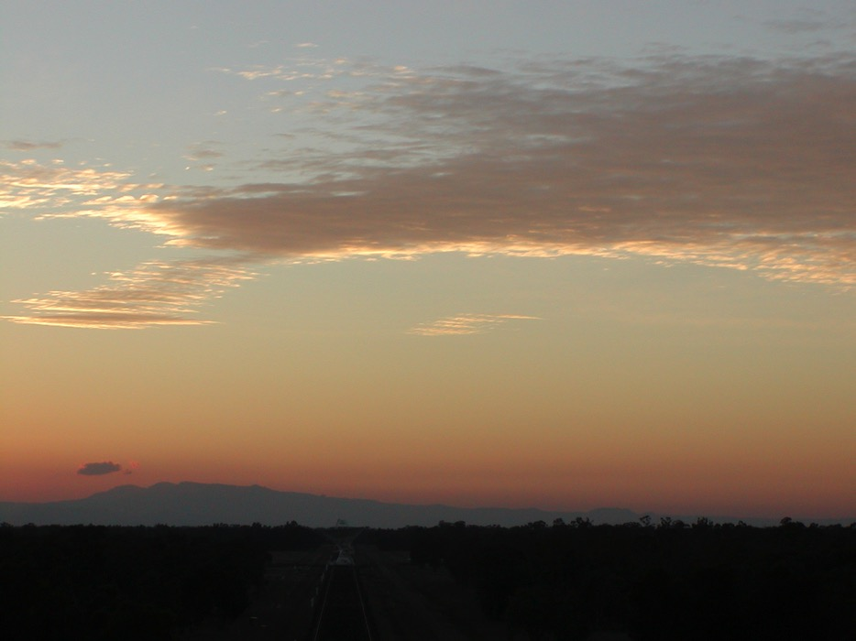
Technologies for Radio Astronomy
CSIRO Astronomy and Space Science
Tasso Tzioumis
Facilities Program Director – Technologies
November 2016

Slide 2
Directions for ATNF Engineering
(Update since last ATUC meeting) - Review
Broad directions largely unchanged (Nov 2016)
ASKAP & SKA: Core business of the Engineering Program.
Most of the program’s people and effort at present.
Development projects for all ATNF facilities. Budget??
Strategic developments – develop capabilities.
External contracts – maintain capabilities.
FAST 19-beam system high priority in the last 6 months.

Slide 3
Available resources & allocations
FY 2016-17: ~50 FTEs!! (includes Workshop+Store ~7 FTE)
→ Current allocations:
ASKAP : ~ 15FTE → Ongoing commitment
ASKAP production → Secondments (2); Terms and casuals (4)
Nominally finish end 2016. Mostly extended by ~6 months.
SKA: ~ 12 FTE → CSP ; Dish; AIV; PAF
+ additional ~2-3 FTE internal for PAF developments
FAST: ~ 5 FTE (finish system End 2016!!) + Workshop time
UWB: ~5 FTE (primarily in 2017) – after FAST ends
Other projects: ~ 5 FTE (PAF@Parkes; Rocket PAF; RFoF; Ops support; …)
New recruits (replacing resigned or retired)
1 Digital engineer (started end’Oct 2016)
1 Mechanical engineer (starting Jan’2017)

Slide 4
CABB (unchanged since Jun2016)
Formal CSIRO commitment to new functionality ceased Sept 2014
Now ALL tasks covered by post-retirement fellows!!
Adequate spares for operations and short-term support.
Unlikely that 16 MHz would be completed!
ATCA CABB upgrade?: GPU cluster based
Leverage on GPU developments at Parkes
Software correlation would allow unlimited zooms?
Digital systems from UWB and SKA developments
Hardware: ~$0.5M for replacing CABB
Scalable for more bandwidth.
>~$1M+ for realistic project
External funding!! → Priority??

Slide 5
FAST 19-beam Receiver - Status
Receiver system for FAST 500m telescope
Contract with NAOC
Contract delivery by Feb 2017
Try to complete within 2016
Mechanical parts (Dewar; Feed horns; OMTs)
Construction completed
Testing in RF range completed.
Integration and cooling in Nov
Low noise amplifiers (LNAs)
In production
RF “warm” electronics – Control and Monitor
Designs finalised; Production started
To be completed in 2016
2nd milestone - testing report on feeds → Invoice; This week!!
Construction to be completed by end’2016
Integration & Testing – may extend to January.
Shipping and Installation – early 2017
Photo credit: Wheeler Studios

Slide 6
Ultra-wideband (UWB) for Parkes - summary
Observed band 700 - 4000 MHz; Tsys < 20K over most of band
ARC LIEF grant: $370k awarded for 2015 ~40% of direct costs
Institutions: CSIRO, Curtin, MPIfR, Melbourne, Monash, NAO/CAS, Swinburne, Sydney, Western Australia
Contribute ~ 60% of direct costs
CSIRO in-kind ~9 FTE total (over ~2-3 years)
Lead Institution is Swinburne. Managing external funds.
Collaboration agreement signed June 2015
Project plan in place – October 2015 → Funds available
BUT: Slow-down in delivery due to commitments to ASKAP, SKA, FAST.

Slide 7
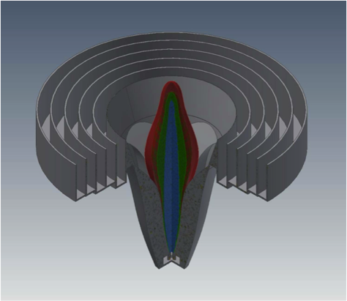
Parkes UltaWideBand system (UWB) - status
Band 700 – 4000 MHz; Tsys <20K
Consortium funding + ARC + CASS (labour)
Prototype feed built and design verified
Patent and Publication
Cooled Rx version to be built in 2017
LNAs designed – foundry run underway (Dec’16)
Sampler/digitiser and timing (Back-end)
Fully prototyped and tested
Limited (4 channel) production – to be used with older Parkes receivers – March’17
Full production run in 2017
Ethernet switch and GPU cluster – Ready!!
Bought in early 2016 & used by PAF@ Parkes
Software needed – Pulsars via Swinburne
Other: Spectrometry,… - Need to develop.
RFI mitigation built-in – reference antenna
Full construction – 1st half of 2017
Installation – mid- 2017
Commissioning – 2nd half of 2017
Credit: Alex Dunning

Slide 8
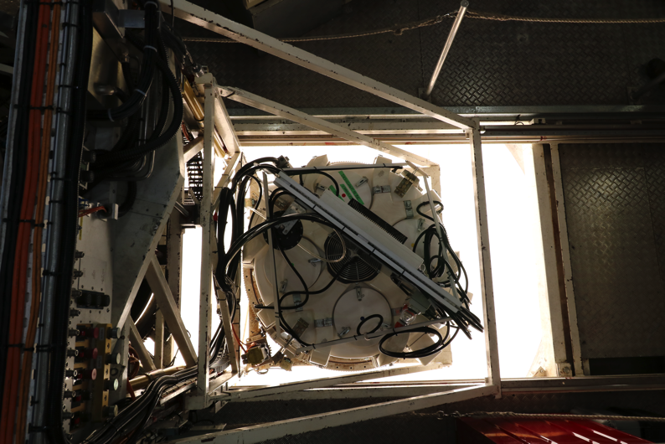
ADE PAF system for MPIfR → Parkes
Contract for standard ASKAP PAF for Effelsberg telescope.
RFI environment at Effelsberg & Parkes → mods to PAF filtering
Funded by MPIfR
Modified beamformer outputs → Ethernet output
Strategic use of PAF. Single-dish demonstration → Bonn PAF at Parkes
Commissioning/Early science
Collaborative Project:
CASS- MPIfR
Open to community. NOT NF
Proposals Dec15 for APR2016
Must bring resources
FRBs – primary targets
PAF to Bonn in Oct 2016

Slide 9
Bonn PAF at Parkes –Timelines
Install/Commission: Planned for OCT2015 semester
Bonn PAF filter modifications – Dec 2015 → Done in Jan 2016
Test digital/GPU system in Sydney – Dec 2015 ✔
Parkes preparations: Early in semester
Fibre wiring ~ 2 week shutdown: Started 23/11/15!! ✔
Racks mods; Install GPUs and Back-end – Jan 2016 ✔ (end)
PAF Install: 8-17 Feb 2016. Replace MB system for ~8 months. ✔
Control computer via TOSS. Jan 2016 ✔
Engineering Commissioning: Feb-Mar 2016 ✔
Extensive beamforming tests and developments. ✔
2-3 engineers/scientists external support
Germany and Jodrell Bank – 3 MPIfR engineer visit – Dec & Feb ✔
Joint CSIRO/MPIfR post-doc – Started 1 Nov 2015 (full time) ✔
Science Commission & Scientific Observations: APR2016 semester
Ethernet Firmware mods – end March & continued support ✔
Software by Bonn & Jodrell Bank: Protracted Commissioning!
PAF to Bonn after Oct 2016 – Un-installed Nov’17 ✔
Results – see talk by Aaron Chippendale

Slide 10
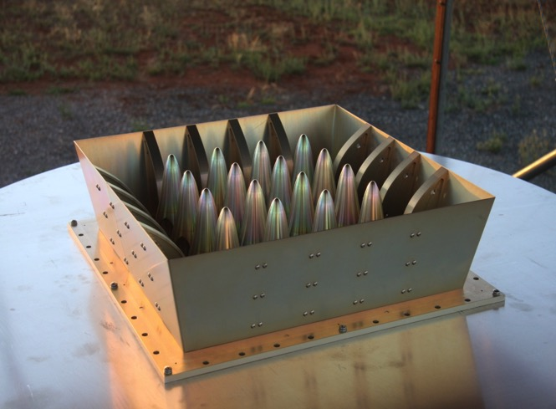
PAF R&D - the “Rocket” PAF
PAF R&D under SKA-survey
Continues as an Advanced Instrumentation Program (AIP)
Pre-construction AIP consortium at next SKA Board meeting
As Observatory Development Program (ODP) in SKA construction phase
Key technology for CASS – world leader! → “Rocket” PAF (Alex Dunning)
Complete picture of the 5×4 test PAF array with the new “rocket” design, where the new central and edge element designs are visible.
more amenable to cryo cooling
→ Cryo PAF system with <20K Tsys!!
Superb for single-dish large telescopes!
Cooled PAF for Parkes??
~$2M+. Funding??
See Parkes talk by Jimi Green.

Slide 11
Rocket PAF performance (5x4 prototype)

Slide 12
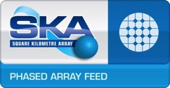
SKA PAF Consortium
The SKA Organisation has agreed to set up a PAF Consortium as an Observatory Development Programme (ODP)
The PAF Consortium aims to:
continue existing room-temp & cryo PAF development to establish a performance benchmark in mid-2018,
develop requirements and performance metrics for SKA PAFs,
establish science & business cases to support further PAF development and deployment of PAFs as a test array (TBC) prior to SKA Stage 2 construction.
Consortium partners include CSIRO (lead), ASTRON, JBO, INAF, OSO, JLRAT & MPIfR.

Slide 13
Future technical Projects (2018+)
SKA & ASKAP
SKA Construction/Verification/Commissioning. Start??
Expect key Australian role. CASS in CSP-Low – follow-up
ASKAP enhancements
Tied-array: In ASKAP specs but NOT funded!
Expert group report. ~$400k + 5.5 FTE (Firmware+Software)
Transients: (Cf CRAFT)
Add transient mode. Firmware only. ~5FTE effort. NOT Commensal.
ASKAP upgrades. (mainly sensitivity improvements)
“Transparent” legs. Reduce scatter. Improve Tsys by 10-20K.
Initial investigations now. See talk by Keith! **
Estimated cost ~$1.5M h/w + Labour!! Funding?
“Skirts”: Reduce spillover. Better illumination. ~10K to Tsys?
New PAFs (keep back-end) e.g. “Rocket” PAF.
~15K in Tsys + Better illumination. BUT many $$M?
Air shower detection by ASKAP (Ekers proposal..)

Slide 14
Future Projects & External Contracts
N.B: Most single-dish cryo systems cost >$2M!!
UWB high (4-25 GHz) for Parkes. Considered in ATUC before.
Leverage on SKA & UWB(low); use UWB GPU cluster & software
~$1.5-2M; timeline ~2-3 years; Priority??
External funds – AAL; LIEF; Collaborators – overseas?
External contracts: Maintain/develop capabilities. Strategic.
Present UWB systems. Strong interest from collaborators!
2-3 contracts in 2017+ timescale?
PAFs
Current generation to Jodrell Bank. Contract executed. Funds received.
Cryo PAFs for large singe-dishes. ~20K Tsys
1st system for Parkes. Collaborative funding. Start in 2017-18?
Good external candidates (MPIfR; JB; FAST; ….)

Slide 15
Future technical Projects (2018+)
PAFs & Others
SKA R&D
SKA PAF test array. Up to 4 antennas. Under ODP?
Rocket PAF → Cryo PAF systems . <20K Tsys
Higher frequency PAFs: SKA; Arrays; Single-dish
mm PAFs e.g. for ALMA (cf NRAO)
Dual band PAFs
MMIC packaging
16-25 GHz PAF on ATCA. Transformative for surveys!?
Collaborative effort? E.g. SRT?
Aperture array applications:
SETI; Array of PAFs; Needs Massive digital and GPU resources.
Filled aperture array at ~100 MHz. All sky coverage.
Other technologies
RF-over-fiber developments
UWB in other bands
Signal processing FPGA platforms
Signal processing - GPUs

Slide 16
Summary
CASS Engineering/Technologies: (from ATSC presentation)
World-class radio-astronomy instrumentation
Pioneering cutting-edge technologies: PAF; UWB; DSP; RFoF
For world-wide radio-astronomy facilities
International reputation – Key player in SKA
--> MUST maintain/enhance/develop
Issues for ATUC??
Feedback on Scientific Priorities / Choices → Funding?
ASKAP tied array mode
ASKAP “upgrades”: e.g. transparent legs (~10K Tsys improvement?)
UWB “high” at Parkes (4-25 GHz)?
ATCA CABB upgrades? – GPUs; more BW; …
Future PAF systems, beyond cryo-PAF@Parkes; e.g. 20 GHz PAF?
Low-freq arrays; Aperture arrays; ??
….

Slide 17
Thank you
Astronomy & Space Science
Tasso Tzioumis
t +61 2 9372 4350
E Tasso.Tzioumis@csiro.au
w www.csiro.au/cass

