Slide 1
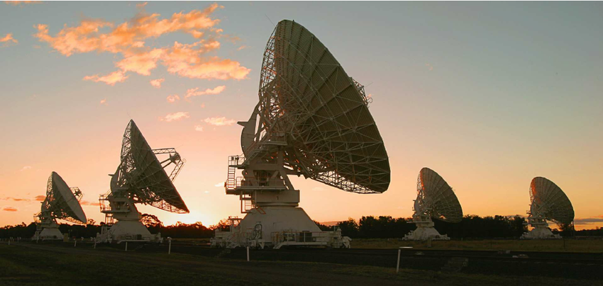
BIGCAT
Chris Phillips | BIGCAT Project Lead
8th November 2021
CSIRO Astronomy and Space science
ATUC Open Session April 4, 2022

Slide 2
ATCA-BIGCAT upgrade
BIGCAT: Broadband Integrated Gpu Correlator for ATca
Replacement of CABB digitisers and correlator with a hybrid FPGA+GPU backend
LIEF funded, lead by WSU (PI Ray Norris)
Key aspects of BIGCAT:
Double instantaneous bandwidth to ~8 GHz
Flexible spectral resolution
Improved reliability
More flexibility:
Many more options wrt. frequency resolution and integration times
Ability to change quickly between different observing modes
More adaptable to automated observing (e.g. rapid ToO follow-up)
Retain standard CABB features (e.g. mosaicing)

Slide 3
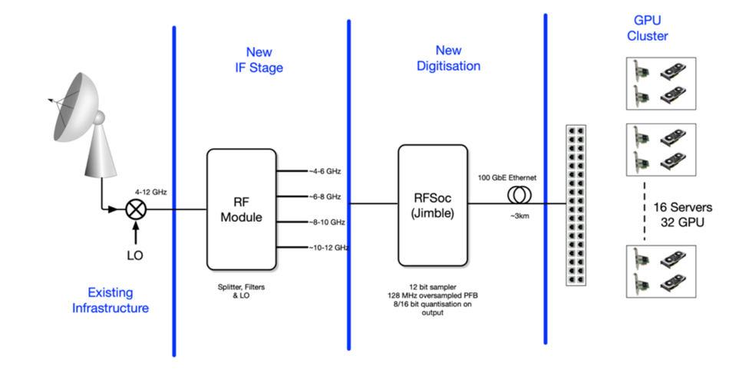
ATCA-BIGCAT signal chain
https://www.atnf.csiro.au/research/bigcat/BIGCAT_Overview.pdf
Notes:
Show diagram of CABB – what elements are changing for BIGCAT (i.e. practically all of it except the antennas/receivers)
Key points here:
Note jimble will be common digitizer between Parkes and ATCA (cryoPAF)

Slide 4
Status Update
Feedback on Scientific Requirements incorporated
Delay in re-distribution because of COVID
Work on caobs underway to support software based correlation
Will remove overheads such 3 cycle scan startup
Eventual support of subarrays and other new modes
Design of GPU correlator well progressed
RF upgrade delayed due to contention between projects
CABB Jimble replacement will occur before bandwidth upgrade
Jimble design progressing but delay with hardware design
PLL chip not satisfactory, different chip needed and re-spin of prototype hardware
CABB Zoom issues – see Jamie’s talk
Planning on using (A)SDM for output – with Miriad/CASA support

Slide 5
BIGCAT Timelines DRAFT TBC
Jimble production now September/October 2022
No way of bringing forward
Jimble installation Feb 2023 (CABB Replacement)
1 month installation
2 month commissioning/shared risk
Some modes (e.g. pulsar binning) unlikely to be initially available
Don’t fear the CABB Zoom mode rollout problems!
RF upgrade delayed till mid 2024
Contention with other projects for RF team members

Slide 6
Feedback and questions:
Elizabeth Mahony BIGCAT Project Scientist
Elizabeth.Mahony@csiro.au
(On Leave)
Chris Phillips BIGCAT Project Leader
Chris.Phillips@csiro.au
Jamie Stevens ATCA Systems Scientist
Jamie.Stevens@csiro.au
BIGCAT Overview: https://www.atnf.csiro.au/research/bigcat/BIGCAT_Overview.pdf
BIGCAT Requirements: https://www.atnf.csiro.au/research/bigcat/bigcat_techreq.pdf

Slide 7
Thank you
Space and Astronomy
Chris Phillips BIGCAT Project Leader
+61 2 9273 4608
Chris.Phillips@csiro.au

