Slide 1
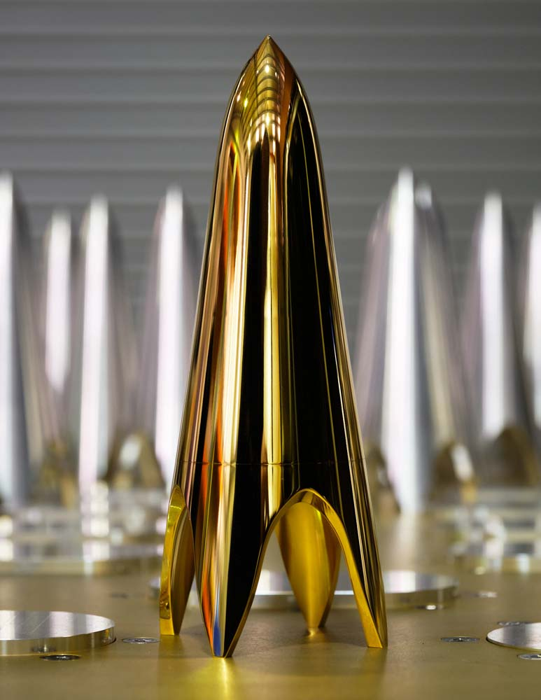
Radio Astronomy Technologies at CSIRO
Tasso Tzioumis | 4 April 2022

Slide 2
Overview

Slide 3
ATNF Technologies Capabilities
Antennas & Receivers (Front-end) (~18): RF technologies (Feeds; OMTs; LNAs; RF Electronics; Cryogenic systems; Mechanical design; …)
    Workshop (~6): Mechanical systems (Machining; Fitting; Production;…)
Signal processing (Back-end) (~22→25): Digital technologies (RFoF; Samplers/Digitisers; Timing systems; Beamformers; Correlators;…) - Digital Signal Processing & FPGAs
Scientific Computing (~13): Control and monitoring systems; calibration strategies and algorithms; data processing (e.g ASKAPsoft).
Engineering Generalists (~5): System Scientists/Engineers; System integrators; New Ideas; …
(SKA Construction Group –Manage SKA1-LOW construction contracts.
  FTE 6+ to grow to 15+
  Contacts signed or negotiations in progress.)
** Produce fully integrated radio telescope systems!
    Concept; design; construction; testing; commissioning; operation; science.
    Growth due to Quasar & SKAO

Slide 4
Next generation Radio Astronomy Technologies
CSIRO Astronomy Research and Development:
  Phased Array Feed systems (PAFs)
  Ultra Wide Band systems (UWBs)
  FPGA-based Digital Signal Processing (DSP systems)
  COTS-based back-end systems – (GPU, ALVEO-FPGA, Switch)
Complementary R&D activities
  Space systems?
    CSIROSat-1 (Cubesat)
  Commercialisation
    New spin-out company QUASAR for satellite tracking with PAFs (April 2021)
    Leveraging cryoPAF technologies.
  Balance Impact on ATNF & New resources
R&D effort: Sustain at about 25-30% of engineering effort
  In-project R&D – most of our projects are novel and unique
  Focused R&D – new ideas & exploiting new disruptive technologies
Scalable!
R&D areas

Slide 5
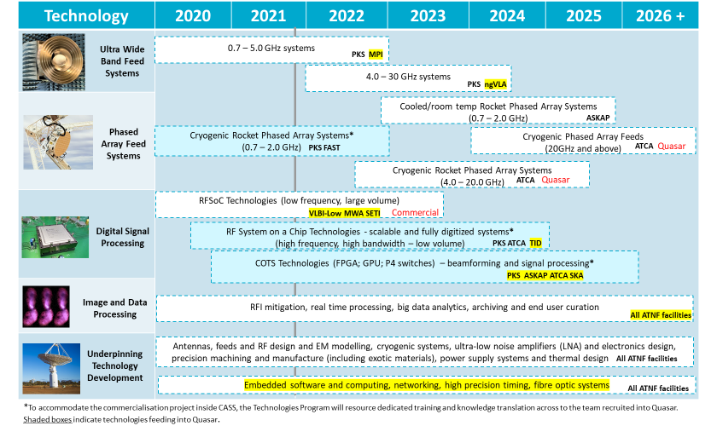

Slide 6
Projects
cryoPAF (separate talk)
UWBs (Alex Dunning)
Digital Systems (overview)
CRACO (Keith Bannister)

Slide 7
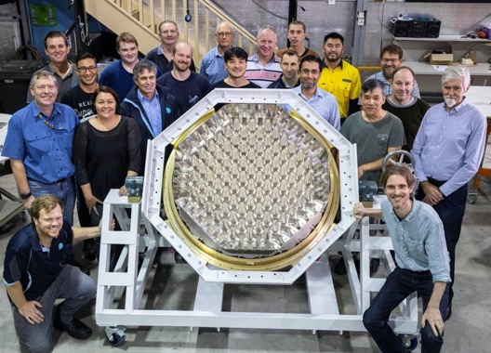
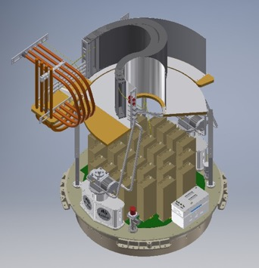
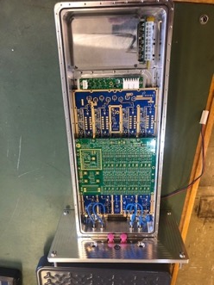
Parkes cryo-Cooled
Phased Array Feed
Funded and construction underway
ARC LIEF funding: PAF + “front-end” systems
CSIRO funding: Digital systems; GPU; Labour
Specification summary
Band 700 MHz - 1950 MHz; ~20-25 K System Temperature
~3 x Multibeam footprint ; 10-30 fold survey speed increase; ~1.5 deg² FoV
Up to 70 x 2 pol beams ; Multiple modes – many commensal
RFSoC board for digitisation at front-end (screened)
    “Jimble” board under testing. (Rev4)
COTS beamformer – designed and under testing
  using ALVEO technologies & P4 Tofino switches
New GPU cluster at Parkes
Extensive Parkes infrastructure upgrades
  He-lines; Optical fibres; Co-axial cables; GPU cluster update.
Production underway. Operational 2023
Details: Separate cryoPAF talk (Steve Barker)

Slide 8
Parkes UWL improvements
Many small improvements would be beneficial:
  Notch filters
  Down-conversion
  Jimble digitizer
  Over-sampled filterbanks
  Improved LNAs
  Improved vacuum window
  New noise injection system
Must fit around other projects or be a result of other projects

Slide 9
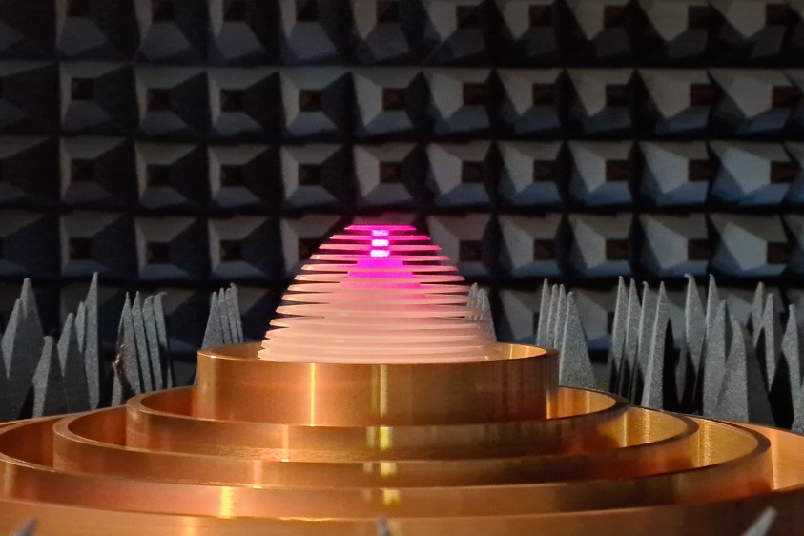
UWB for Effelsberg
Higher frequency than Parkes to avoid RFI, 1.2-6GHz
Recently arrived in Bonn, will be integrated into an MPIfR receiver shortly
Challenging due to a short focal length prime focus antenna but should be a very good system

Slide 10
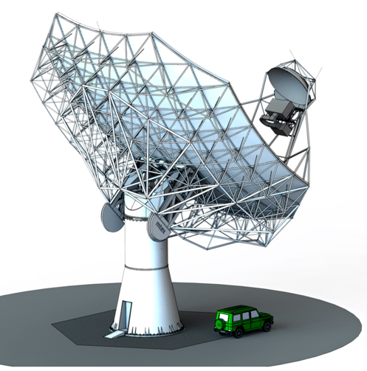
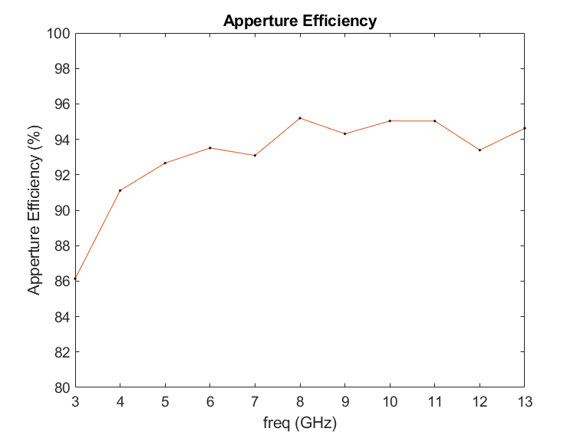
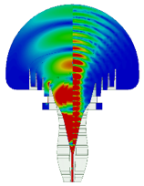
ngVLA feed design study
Design study of a wideband feed covering 3.4-12.3GHz
Excellent dish geometry for UWB feeds
Great opportunity to show what can be achieved with this technology

Slide 11
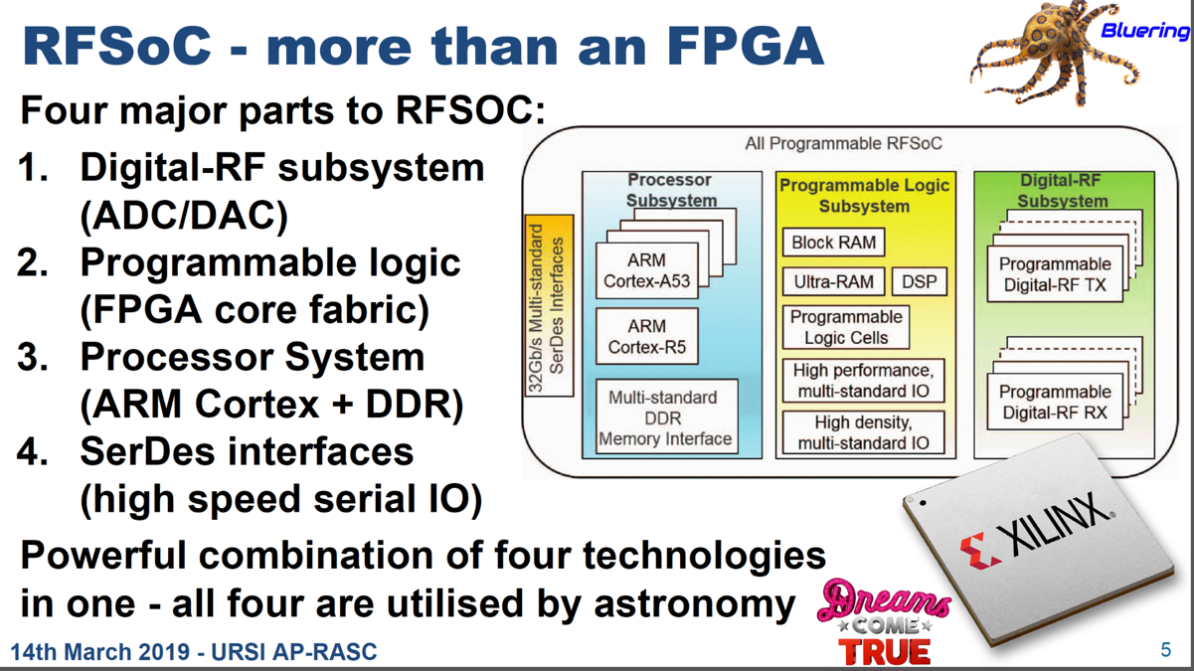
RFSOC based digital back-ends

Slide 12
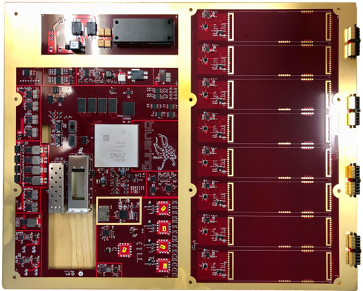
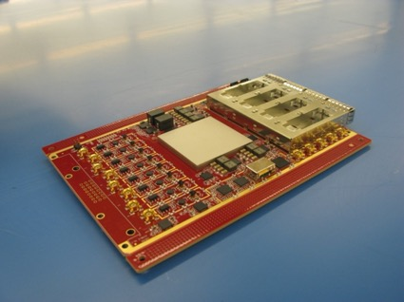
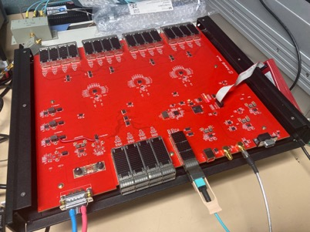
BLUERING
CSIRO RFSoC boards
Synchronisation board
JIMBLE
IRUKANDJI
8 x 2 GHz inputs; 12-bit outputs
Optical outputs only (100 Gbps channels)
Designed to be screened - install near feed.
Adopted for cryoPAF, UWL, BIGCAT
Versatile and programmable
JIMBLE testing – Rev4
CryoPAF; BIGCAT; UWBs; (Quasar)
Development Delays (H/W; supply chain)
16 x 1 GHz inputs; 12-bit outputs
Optical outputs
Option for daughter RF input boards
Great for low-freq arrays – LBA-Low?
Protype built and tested – going to Rev4?
Test R&D array under development
  MWA tile(s) @ Narrabri - Proof of Concept
LBA-Low & (MWA; SETI) – under discussion

Slide 13
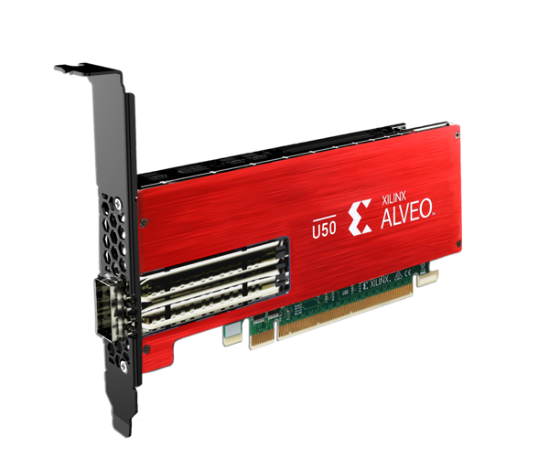
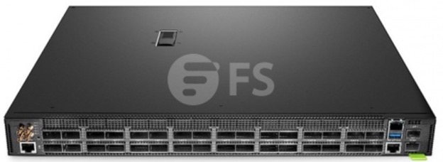
COTS digital back-ends (ALVEO & P4 Switch)
Xilinx Alveo U50 HBM Board.
Very small & low power – 20 in server!
8GB HBM; 5952 DSP; 1x100GbE
FPGA-based accelerator boards
Bare metal h/w switch
Fully user programmable
P4 Tofino
Versatile for one-way traffic
System under testing in CSIRO.
Faster and cheaper than own FPGA boards
Many variants and prices cheaper than FPGA chip!
Adopted and under testing for cryoPAF (and QUASAR)
Adopted for SKA1-LOW BF-Cor
ASKAP coherent FRB detector (CRACO) - U280 (prototype); U55 production – See Keith’s slides

Slide 14
GPU & ALVEO - BIGCAT & CRACO
PARKES
GPU computer clusters at Parkes – collaboration with Swinburne & Fourier Space
The UWL uses the “Medusa” cluster & Breakthrough Listen a cluster for SETI
The cryoPAF ALVEO beamformer will also feed into a new GPU cluster.
ATCA
BIGCAT (Broadband Integrated GPU Correlator for the Australia Telescope)
  Partly funded via ARC LIEF proposal and construction underway
  Use “Jimble” RFSoC digitizer board (8 x 2GHz) and 12-bit (delays)
  Phase 1: CABB correlator replacement with GPU cluster - critical
    Flexible and versatile - new modes → New science
  Phase 2: 8 GHz of BW (x2 current capability) – some delays
ASKAP
CRACO – Coherent FRB detection @ ASKAP – Funded ARC LIEF!!
  Slides by Keith Bannister below
Chris Phillips talk

Slide 15
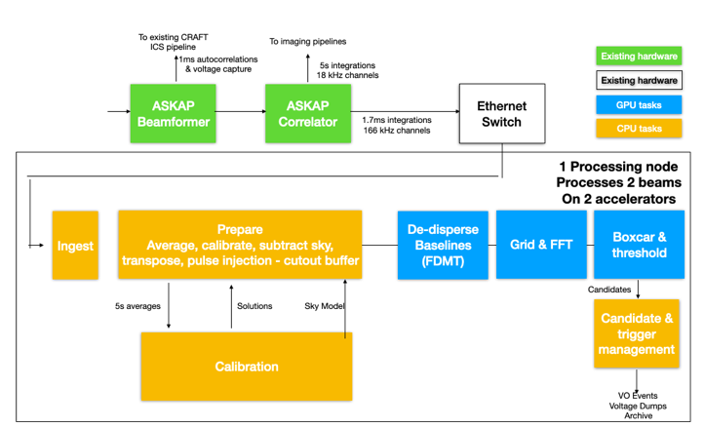
CRACO: CRAFT Coherent Upgrade for FRB detection
Coherent FRB detection on ASKAP
Improves detection rate to ~ 1 FRB per day.
Fully commensal: Fast products produced by correlator upgrade.
~arcsecond localisations through existing voltage dump infrastructure
Form and process ~20 trillion pixels per second – equivalent to about 1M people watching Youtube.

Slide 16
CRACO status
Change of scope: will improve scientific performance and de-risk firmware.
Production cluster will be installed at MRO (originally: Pawsey).
Upgrade to 2 Alveo U55C per beam – should give double the processing power = double the number of DM trials
Will still upgrade the Pawsey link, but only to 100 Gbps (originally 400 Gbps).
First light May 2022.
$2.1M LIEF approved and signed
Alveo U280 FPGA-based detection pipeline successfully prototyped
Pilot cluster (20 beams) installed at MRO
Correlator firmware upgrade progressing well.
But: Firmware could not achieve the original averaging requirement. It will sum to 166 kHz (originally: 1 MHz)

Slide 17
Possible Future ATNF developments?
Consistent with Roadmap!!
RFI mitigation for all ATNF observatories
  Coordination and enhancement of effort. Underway.
  R&D difficult. New Ph.D. student started.
Future possible LIEF projects (next 2-3 years) – (~$1-3m)
  LBA-Low: (MWA; SKA) - (George Heald talk – ATUC Nov 2021)
    Prototype and test technologies with stations at Parkes and ATCA.
    First science with MWA and also GMRT and FAST.
    High sensitivity VLBI at Low Frequencies
  ASKAP tied array – always part of ASKAP plans but not funded
    High sensitivity VLBI station. Greatly enhance LBA.

Slide 18
Ideas for Longer term ATNF developments
Full LBA-Low implementation
  Work with MWA & SKA1-Low
Upgrade of ASKAP beyond current surveys
    Rocket PAF upgrade to improve sensitivity??
    H/W; Firmware; Software – upgrades?
  Different PAFs at higher frequencies?
  Need to start thinking where to go - Science case
New ideas!!? – MUST be driven by Science cases
Feedback from ATUC: Current projects progress & Future Projects selection

Slide 19
Thank you
Space and Astronomy
Tasso Tzioumis
Program Director, Technologies for Radio Astronomy
P: +61 2 9372 4350
E: tasso.Tzioumis@csiro.au

