Slide 1
A quantitative explanation of the Radio – X-ray correlation in BHXRBs
Nick Kylafis
University of Crete
(with Pablo Reig and Alexandros Tsouros)
Kerastari, 14-6-2023

Slide 2
Introduction (1/2)
The standard picture of BHXRBs in the hard state consists of
a hot corona (where the hard X-rays are produced by Compton upscattering of soft disk photons)
and a jet (where radio emission occurs by synchrotron).
However, the jet and the corona do not “talk to each other” (next slide).
The corona feeds the jet, but the jet “does not talk back” to the corona.

Slide 3
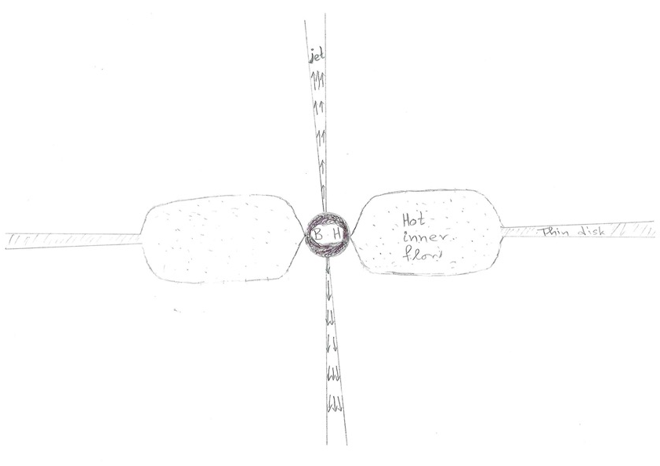
Schematic of the accretion flow and the jet (not to scale!)

Slide 4
Introduction (2/2)
If the corona and the jet do “talk to each other”, we need to decipher their language. As yet, we have not.
No doubt then that the well-known Radio – X-ray correlation in BHXRBs has not yet been explained, apart from a scaling relation (Heinz & Sunyaev 2003; Merloni, Heinz, \& di Matteo 2003).
For GX 339-4, the correlation is shown in the next slide.

Slide 5
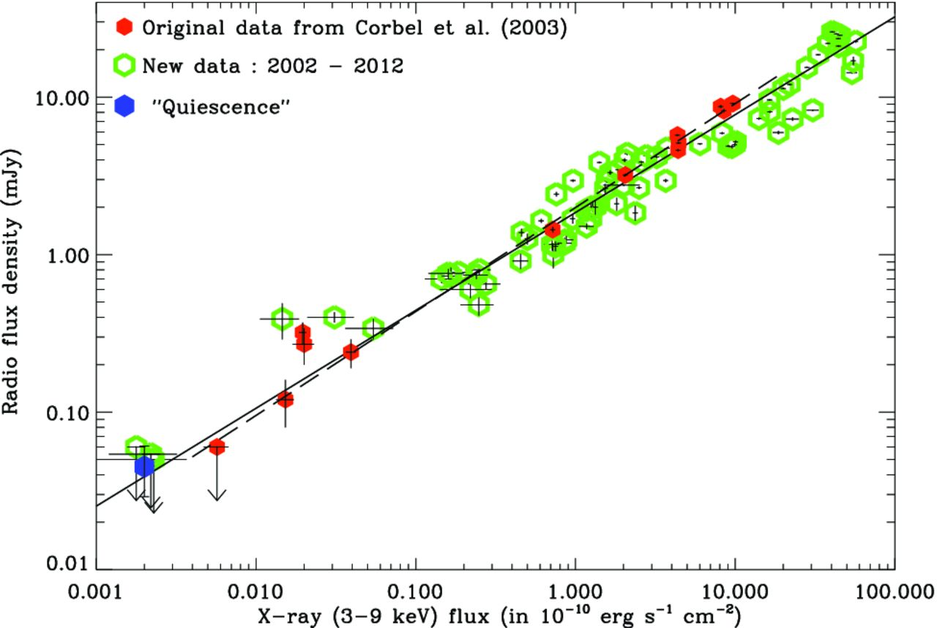
GX 339-4 Corbel et al. (2013)

Slide 6
Current status
In my opinion, there is no way to explain the Radio – X-ray correlation unless the same region emits both the hard X-rays and the radio waves.
Then, the same electrons do the Comptonization and the synchrotron emission.
Even then, it is not obvious that the theoretical correlation will be the same as the observed one.
Some correlation though is expected in such a case, and it should be investigated whether it is the correct one.
This is what I intend to do here.

Slide 7
The outflow model
As I have already said, in BHXRBs, the hot inner flow is typically taken as the corona.
However, an outflow MUST emanate from the hot inner flow (Blandford & Begelman 1999) and there is no boundary between the two (next slide).
Our community has, unfortunately, not paid proper attention to this fact.

Slide 8
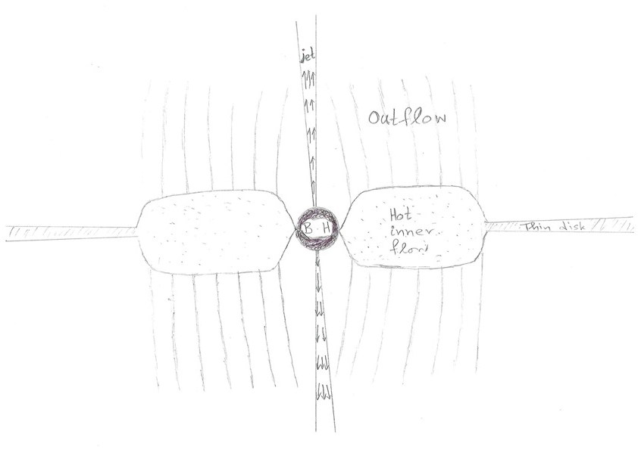
Schematic of the accretion flow, the jet, and the outflow (not to scale!)

Slide 9
The outflow model
Thus, if Compton up-scattering occurs in the hot inner flow, it will continue in the outflow. It is inevitable!!!
In other words, the corona is really the whole outflow.
The outflow is typically larger in size (vertically) than the hot inner flow, so one can have large time lags due to Comptonization. Time lag means that the hard photons come to the observer later than the soft ones.
This is because the harder photons have scattered more times than the softer ones, so they are delayed.
Our community is allergic to Comptonization as the cause of time lags, but please wait till the end.

Slide 10
Radio – X-ray correlation in BHXRBs
The million-dollar question is:
Can the hot outflow model explain the Radio – X-ray correlation in BHXRBs?
The answer is yes. Else, I would not pose it. ☺

Slide 11
Observations
The hard X-rays in BHXRBs exhibit a power law with index Γ.
From observations, we constructed a correlation between the X-ray flux $F_{x}$ and the photon-number spectral index Γ for GX 339-4.

Slide 12
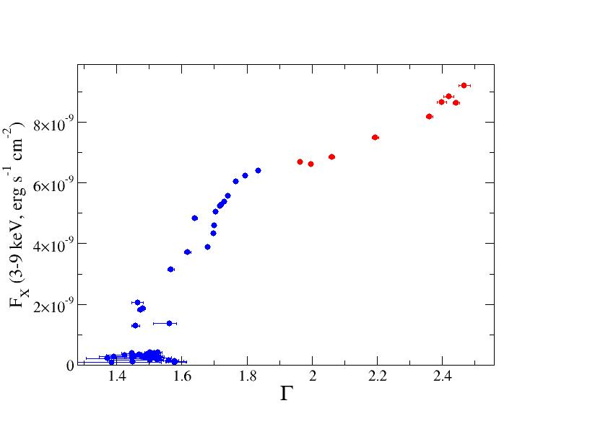
Observations: $F_{x}$ - Γ for GX 339-4, in the hard and hard intermediate states

Slide 13
Model
From our published models (to be discussed below), we have the X-ray spectrum, i.e., Γ, and we can calculate the 8.6 GHz flux that is emitted from the hot outflow.
Thus, we are able to correlate $F_{radio}$ with Γ.
This is shown in the next slide.

Slide 14
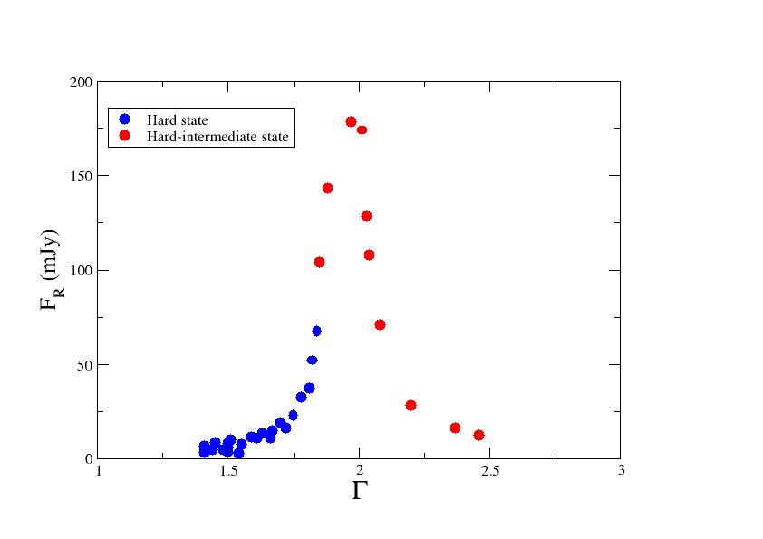
Model: $F_{radio}$ – Γ for GX 339-4 in the hard and hard-intermediate states

Slide 15
Prediction
This plot is entirely theoretical. No such plot exists observationally.
Therefore, it is a prediction that can be checked at the next outburst of GX 339-4. Possibly with already existing observations.

Slide 16
Last step
Divide the axis Γ, in both figures, into small bins.
For each Γ bin, compute the average $F_{x}$ and $F_{radio}$.
Then plot $F_{x}$ versus $F_{radio}$ for both the hard and the hard-intermediate states.
And the result is

Slide 17
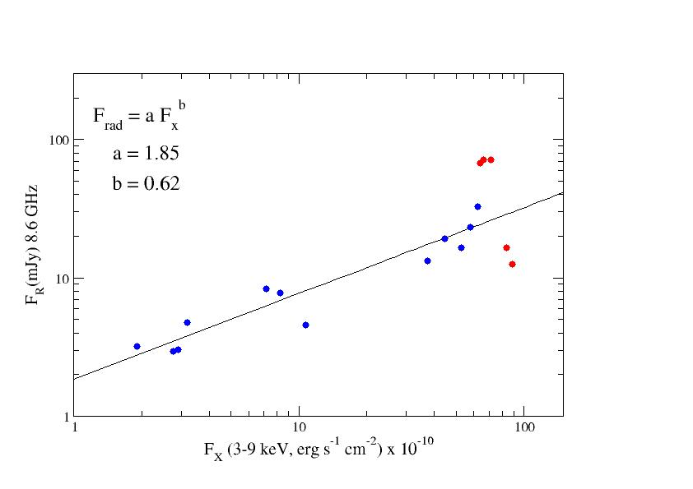
$F_{radio}$ vs. $F_{x}$ Solid line: Corbel et al. (2013)

Slide 18
Prediction
It is well known that the radio/IR emission in the hard intermediate state drops sharply (Gallo et al. 2003; Homan et al. 2005; Coriat et al. 2009) and we have reproduced it.
For GX 339-4, we predict that the radio emission at the end of the hard state will first increase sharply and then it will decrease also sharply.

Slide 19
Let’s look at the above from an observer’s point of view
From observations alone, we have that
$F_{x}$ correlates with Γ (observations).
$F_{x}$ correlates with $F_{radio}$ (the radio - X-ray one). Let’s assume for the moment that our prediction for the hard-intermediate state has been confirmed.
Then, $F_{radio}$ must correlate with Γ in the way we have already seen, namely

Slide 20
Correlation demanded by the observations

Slide 21
Remark
Our published models (see below) reproduce this observational correlation.
Competing models must also reproduce it, if they are to be taken seriously.
I cannot see how a jet, which is in “non-speaking terms” with the corona, can reproduce this $F_{radio}$ - Γ correlation, but people are smart.

Slide 22
Time lags as a function of Fourier frequency
Since Comptonization produces hard lags, it is important to see whether our model reproduces the observed time lags as a function of Fourier frequency,
and indeed it does.

Slide 23
Time lag vs Fourier frequency for Cyg X-1 $t_{lag}\sim ν^{−0.8}$ (Pottschmidt et al. 2000)
Time lag

Slide 24
Explanation. Compton scattering acts like a filter.
It cuts off the high frequencies.
If (period of variability) < (time lag), the variability is washed out.
Therefore, frequencies > 1/(time lag) are not observed.

Slide 25
Schematic picture of the hot outflow
t_{lag}
R₃
t₃
t₃
t₂
R₂
t₂
t₁
R₁
t₁
1/t₃
1/t₂
1/t₁
ν

Slide 26
Our hot outflow model reproduces the result that $t_{lag}\sim ν^{−0.8}$(Reig, Kylafis, Giannios 2003)

Slide 27
Other correlations
Our model explains quantitatively several other correlations, which the competing models do not.
Due to luck of time, I will show you only one.

Slide 28
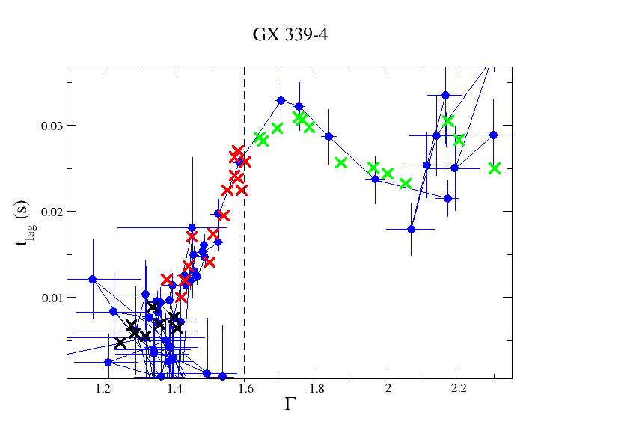
Kylafis & Reig (2018)

Slide 29
Explanation of the $t_{lag} − Γ$ correlation
The same model (hot outflow) that explained the $t_{lag}$ – Fourier-frequency correlation, explains nicely the $t_{lag}$ – Γ correlation.
The parameters that we have varied are: The size (radius) of the hot outflow and its optical depth $τ_{||}$.
It is exactly these models that we have used to explain the radio -- X-ray correlation.

Slide 30
Remark
I find it amazing that this simple outflow model can explain quantitatively so many correlations.
The values of the parameters of the outflow are reasonable and the same for ALL the correlations!!
${1≲τ}_{∥}≲10$
${10≲R}_{0}/R_{g}≲1000$
Remarkably, $τ_{⊥}>τ_{∥}$ in our models. Scattering at the base of our outflows should produce polarization $∥$ to the flow, as observed.
In addition, the outflow model predicts that the polarization vector will change as the source goes from the low hard state, to the hard state proper, and to the hard-intermediate state.

Slide 31
Final remark
As the statistician George E. P. Box said, “all models are wrong, some are useful”.
In my opinion, the outflow model seems to be useful.
Nothing more than this!
THANKS

