Slide 1
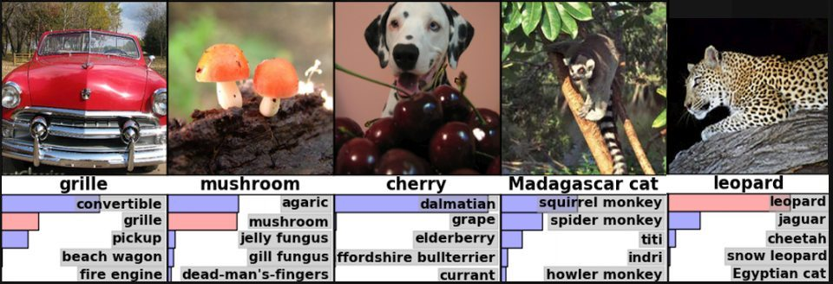
Neural Networks and Deep Learning
Is AI Finally Arriving?
Arkadi Kosmynin
6 December 2018
CSIRO Astronomy and Space Science

Slide 2
Machine Learning
Wikipedia: Machine learning (ML) is the study of algorithms and mathematical models that computer systems use to progressively improve their performance on a specific task.
Main idea: learn behaviour of algorithm (model) from data.
Data samples
Labels
Optimisation problem
X¹ = (x¹₁, x¹₂, x¹₃ … x¹_{N})
y¹
$$\sum_{i}{\left|zi −yi\right|→min}$$
X²
y²
Training set
X³
y³
Results
More practical
X⁴
z⁴
y⁴
$$\sum_{i}{\left(zi−yi\right)2→min}$$
X⁵
z⁵
y⁵
Test set
X⁶
z⁶
y⁶

Slide 3
Machine Learning
Supervised
Unsupervised
Semi-Supervised
Relatively small part of data is labelled. Use mix of supervised and unsupervised learning to guess new labels and then use data samples where new labels were assigned with high enough confidence for next round of learning with a larger labelled sample set.
Reinforcement Learning
Software “agents” interacting with environment and learning in order to maximise some cumulative reward

Slide 4
Recommended resources
Java
Weka 3: Data Mining Software in Java
Weka is a collection of machine learning algorithms for data mining tasks. It contains tools for data preparation, classification, regression, clustering, association rules mining, and visualization.
https://www.cs.waikato.ac.nz/ml/weka/
Python
scikit-learn: Machine Learning in Python
Is a free software machine learning library for the Python programming language. It features various classification, regression and clustering algorithms and is designed to interoperate with the Python numerical and scientific libraries NumPy and SciPy.
https://scikit-learn.org/stable/

Slide 5
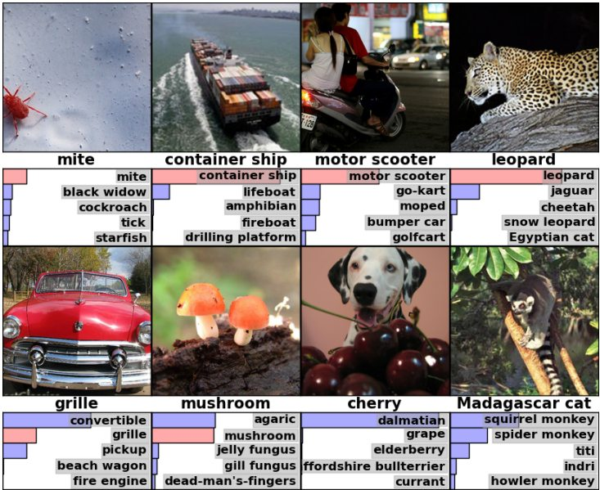
AlexNet at ImageNet 2012
ImageNet Project:
14,000,000+ hand annotated images
20,000+ categories
1,000,000+ images have bounding boxes
ImageNet Large Scale Visual Recognition Challenge (ILSVRC) on 1,000 categories
“Good” error rate in 2011 was around 25%
By 2015 NNs outperformed humans*
Krizhevsky, A., Sutskever, I. and Hinton, G. E. ImageNet Classification with Deep Convolutional Neural Networks Advances in Neural Information Processing 25, MIT Press, Cambridge, MA

Slide 6
Progress

Slide 7
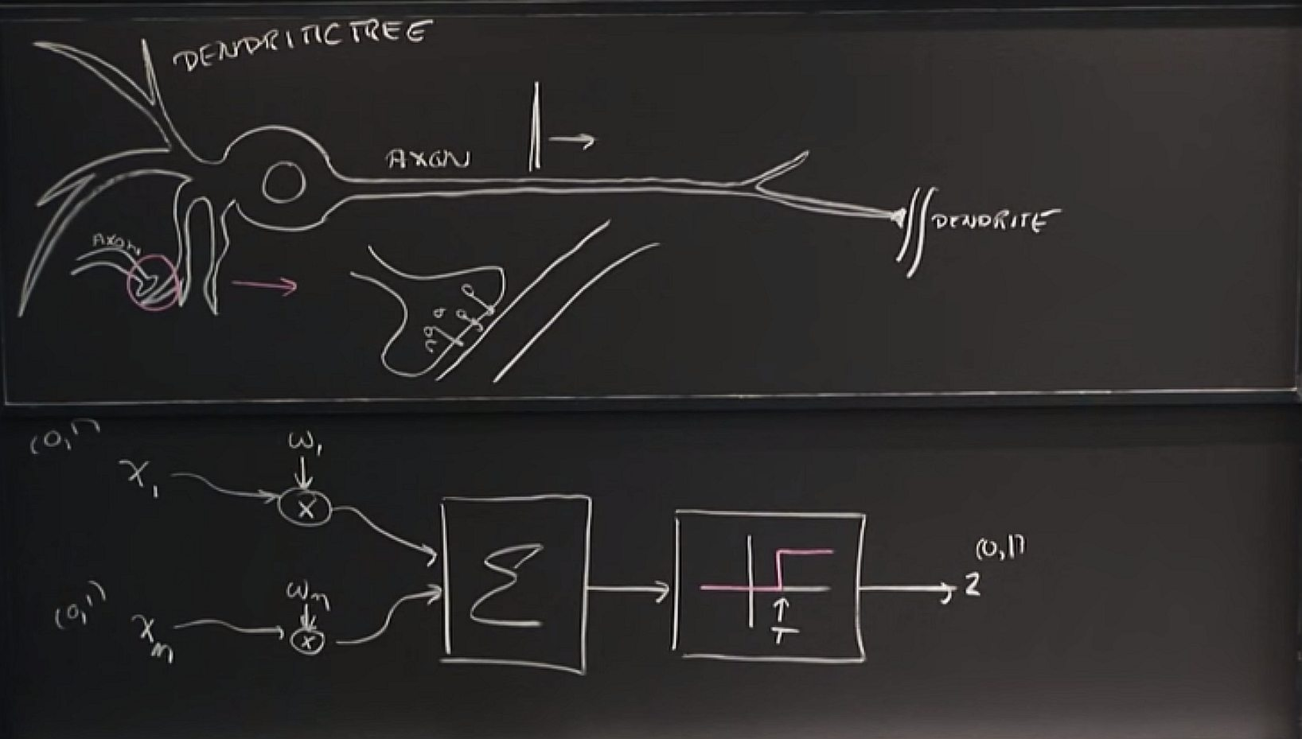
How do they do it?

Slide 8
Combining neurons into a network…
Input layer
Hidden layer 1
Hidden layer 2
Output layer
Credit: Arden Dertat, Applied Data Learning – Part 1: Artificial Neural Networks

Slide 9
Gradient descent
Training
Starting from the first level, calculate output: multiply input by weights and apply the activation function
Repeat on the next levels using output from the previous level as input
Calculate loss value
Calculate weights’ gradients for the last level and adjust weights in directions of the gradients
Repeat on the levels to the left using known gradients on the processed levels
Repeat until converges or you loose patience

Slide 10
Main types of neural networks
Multilayer Perceptron networks
The “classic” ones
Convolutional networks
Good for image processing
Have special layers for input filtering/subsampling
These layers work as automatic feature extractors
Recurrent networks
Good for sequence processing
Remember state
Long Short Term Memory (and Gated Recurrent Unit) networks
Even better for sequence processing
Learn what to remember longer
Combined networks
NNs are relatively easy to combine

Slide 11
Deep Learning
“When you hear the term deep learning, just think of a large deep neural net. Deep refers to the number of layers typically and so this kind of the popular term that’s been adopted in the press. I think of them as deep neural networks generally.”
Andrew Ng
Deep Learning for Building Intelligent Computer Systems
2016
“For most flavors of the old generations of learning algorithms … performance will plateau. … deep learning … is the first class of algorithms … that is scalable. … performance just keeps getting better as you feed them more data”

Slide 12
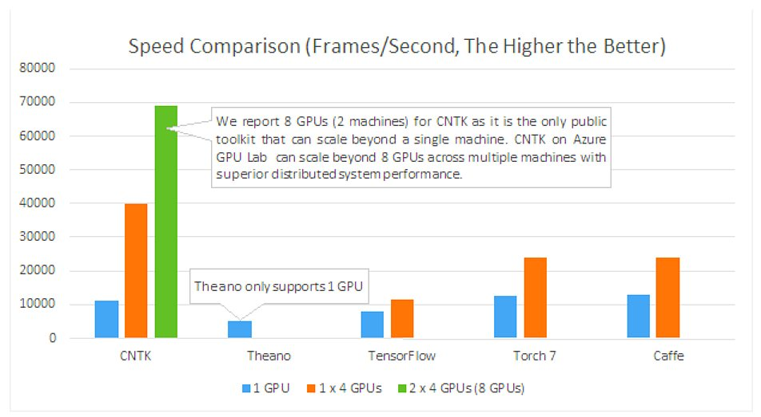
Tools
Credit: Microsoft

Slide 13
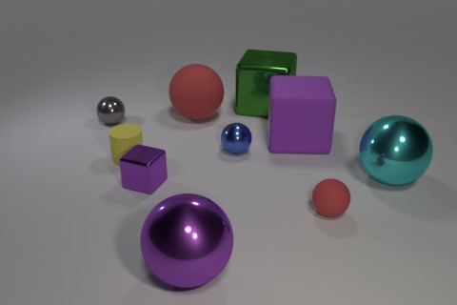
Are we there yet?
AdaNet (Google, 2018) – learns architecture
Stanford University, 2018
Compositional Attention Networks for Machine Reasoning
Drew A. Hudson, Christopher D. Manning
“…effectively learns to perform iterative reasoning processes that are directly inferred from the data in an end-to-end approach.”
98.9% (record) accuracy
Requires up to 5x less data for training
Is computationally efficient
Q: Do the block in front of the tiny yellow cylinder and the tiny thing that is to the right of the large green shiny object have the same color?
A: No

Slide 14
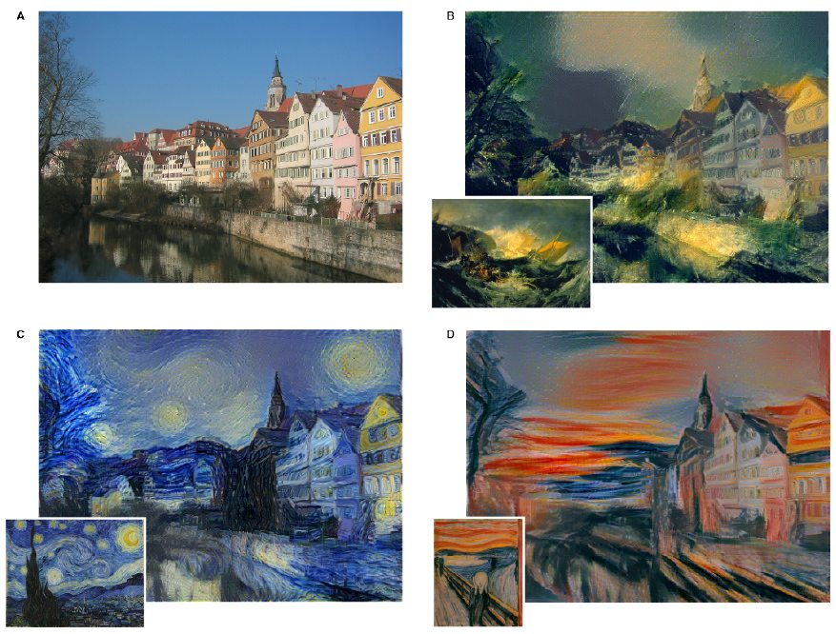
Some fun
A Neural Algorithm of Artistic Style
Leon A. Gatys, Alexander S. Ecker, Matthias Bethge

Slide 15
Recommended resources
Stanford University Computer Vision Course on YouTube (presented mostly by Andrej Karpathy) https://www.youtube.com/playlist?list=PLf7L7Kg8_FNxHATtLwDceyh72QQL9pvpQ
Natural Language Processing with Deep Learning (Stanford University, Christopher D. Manning et. al.) https://www.youtube.com/playlist?list=PL3FW7Lu3i5Jsnh1rnUwq_TcylNr7EkRe6
MIT 6.S191 Lectures on YouTube
Andrew Ng Talks
Microsoft Cognitive Toolkit
https://www.microsoft.com/en-us/cognitive-toolkit/
Keras: The Python Deep Learning library
https://keras.io/

Slide 16
Thank you
Arkadi Kosmynin
t +61 2 9372 4633
e Arkadi.Kosmynin@csiro.au
CSIRO Astronomy AND Space Science

