Slide 1
Doug’s Aha Moment on Conjugate Match Beamforming
Doug Hayman

Slide 2
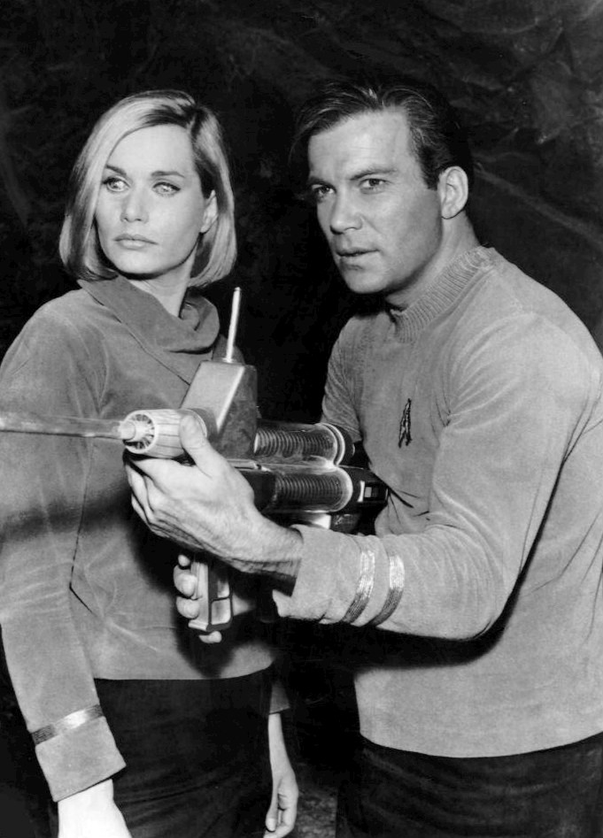
Phasors
By McFadden, Strauss Eddy & Irwin for Desilu Productions - eBay itemphoto frontphoto back, Public Domain, https://commons.wikimedia.org/w/index.php?curid=20656372
www.netanimations.net/Reflections-in-water-animated-gifs.htm
By Gonfer at English Wikipedia, CC BY-SA 3.0, https://commons.wikimedia.org/w/index.php?curid=11313700

Slide 3
Phasors 2
$$v_{y}\left(t\right)=Re\left\{Ye^{jφ}e^{jωt}\right\}$$
Im
$$v_{y}\left(t\right)=Y\cos\left(ωt+φ\right)$$
$$Y$$
$$φ$$
Re
$$y= Ye^{jφ}$$

Slide 4
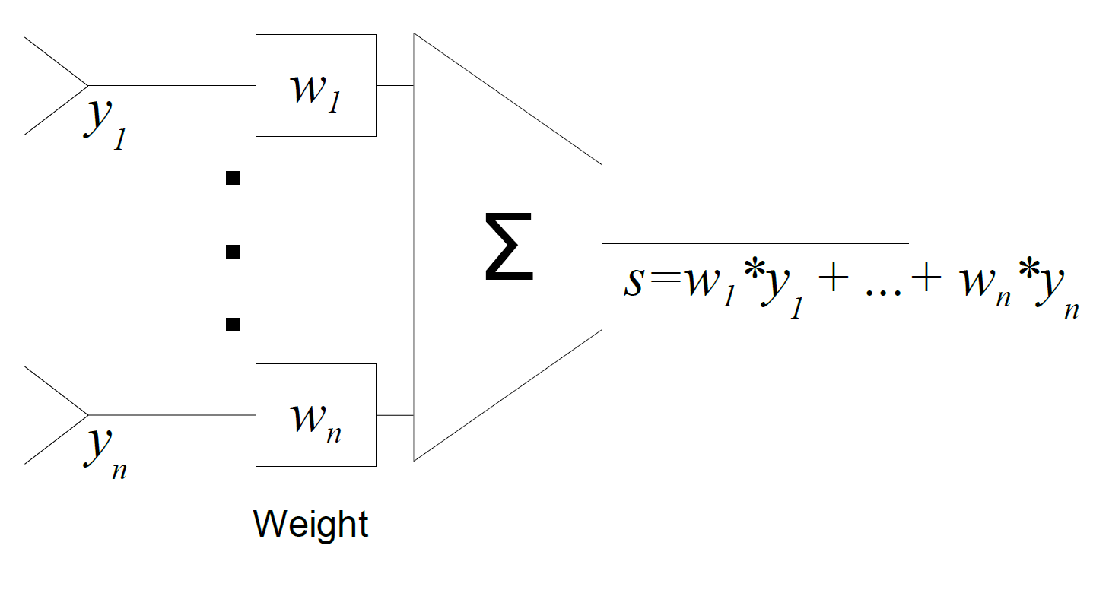
$$s=w_{1}^{∗}y_{1}+⋯+w_{n}^{∗}y_{n}=w^{H}y$$

Slide 5
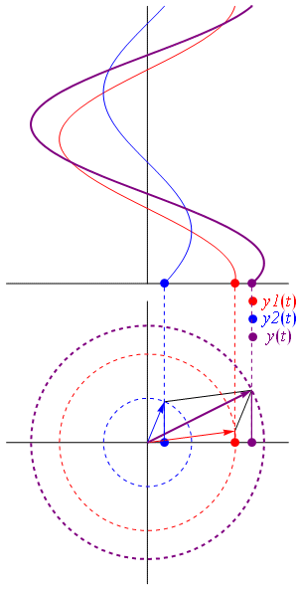
Two element beamformer
$$v_{s}\left(t\right)=W_{1}Y_{1}cos\left({ωt+φ}_{w1}+φ_{y1}\right)$$
$$+W_{2}Y_{2}cos\left({ωt+φ}_{w2}+φ_{y2}\right)$$
By Gonfer - en wikipedia, CC BY-SA 3.0, https://commons.wikimedia.org/w/index.php?curid=7026837

Slide 6
Maximize response to desired signal
$$v_{s}\left(t\right)=W_{1}Y_{1}cos\left({ωt+φ}_{w1}+φ_{y1}\right)$$
a₂
$$+W_{2}Y_{2}cos\left({ωt+φ}_{w2}+φ_{y2}\right)$$
Weights need a constraint
Limit on total power into next stage
Most cases gain increases also increase noise
Zero added power
$$\left\|w\right\|=1$$
a₁
$\left\|w\right\|=\sqrt{w_{1}^{∗}w_{1}+⋯+w_{n}^{∗}w_{n}}= \sqrt{w^{H}w}$

Slide 7
Phase relationship
$$s=w_{1}^{∗}y_{1}+⋯+w_{n}^{∗}y_{n}=w^{H}y$$
Im
To maximize S make $w_{i}^{∗}y_{i}$ all align with real axis.
$$w_{1}^{∗}y_{1}$$
$$w_{2}^{∗}y_{2}$$
Re
$$s$$

Slide 8
Phase relationship
Note the convention of multiplying by the conjugate of the weight vector implies the phases
Im
$$φ_{w1}^{}=φ_{y1}$$
$$φ_{w2}^{}=φ_{y2}$$
$$w_{1}^{∗}y_{1}$$
$$w_{2}^{∗}y_{2}$$
Re
$$s$$

Slide 9
Magnitude
$$s=w_{1}^{∗}y_{1}+⋯+w_{n}^{∗}y_{n}=w^{H}y$$
With aligned phases, let $\left|w_{i}\right|=u_{i}$ & $\left|y_{i}\right|=x_{i}$
Deal with just magnitudes
$s=w_{1}^{∗}y_{1}+⋯+w_{n}^{∗}y_{n}=u_{1}x_{1}$ $+⋯+u_{n}x_{n}=u\text{•}x$
Aha! That looks familiar
Dot products are projections
$u\text{•}x=\left\|u\right\|\left\|x\right\|\cos{θ}$

Slide 10
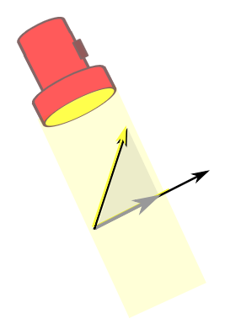
What is a projection?
a₂
$$x$$
$$u$$
$$u\text{•}x=\left\|u\right\|\left\|x\right\|\cos{θ}$$
is maximized when $u$ and $x$ are aligned
$$θ$$
$$\left\|u\right\|\cos{θ}$$
a₁
$$u_{1}=\frac{x_{1}}{\left\|x\right\|}$$
$$\left|w_{1}\right|=\frac{\left|y_{1}\right|}{\left\|y\right\|}$$
$$\left\|u\right\|=1$$

Slide 11
Put it all together
Recall phases were made equal
$w_{1}=\frac{y_{1}}{\left\|y\right\|}, w_{2}=\frac{y_{2}}{\left\|y\right\|}$
Or compactly
And
$$w=\frac{y}{\left\|y\right\|}$$
$$s=w^{H}y=\frac{y^{H}y }{\left\|y\right\|}=\left\|y\right\|$$

Slide 12
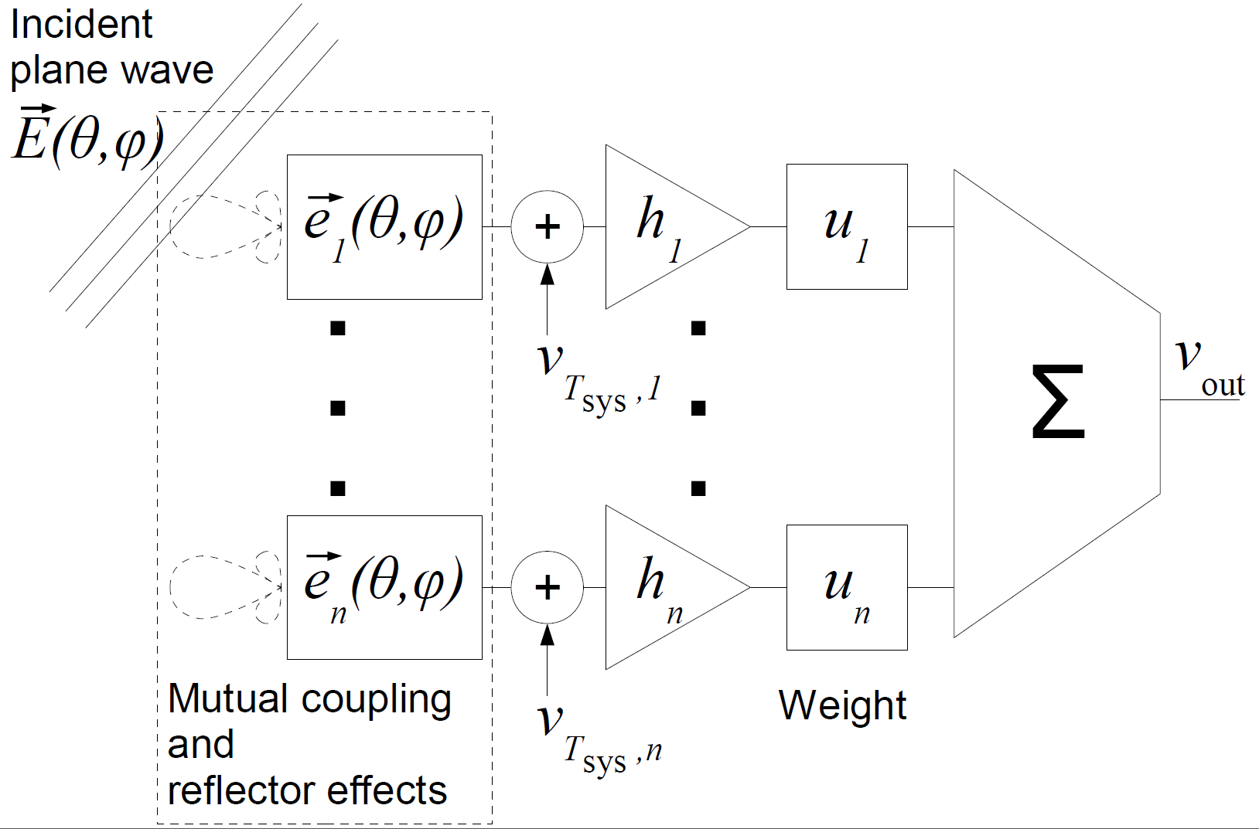
Other beamformers

