Slide 1
“Artificial Intelligence in 2030 and beyond”: lessons from the Science and Technology in Society forum
S&A Co-learnium
Adriana Parra
November 27, 2025

Slide 2
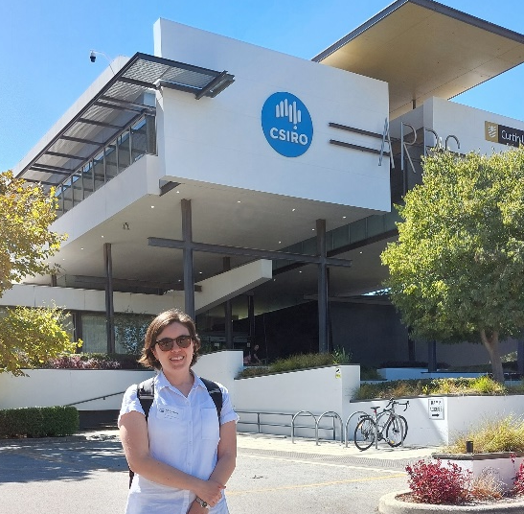


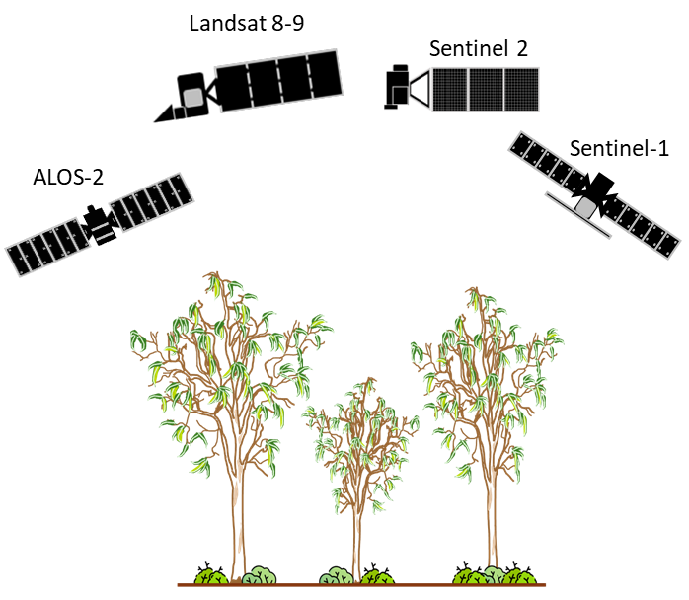
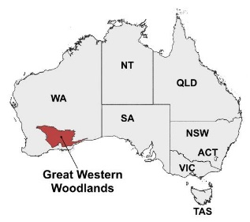



Some background information
CERC postdoc working with the CSIRO Centre for Earth Observation.
Landscape ecologist and a remote sensing scientist.
My current research focuses on monitoring biodiversity using Earth Observation data.
First day at CSIRO. Photo by Zheng-Shu Zhou
Earth Observation data
Demonstrator site
Analysis reproducibility
2

Slide 3
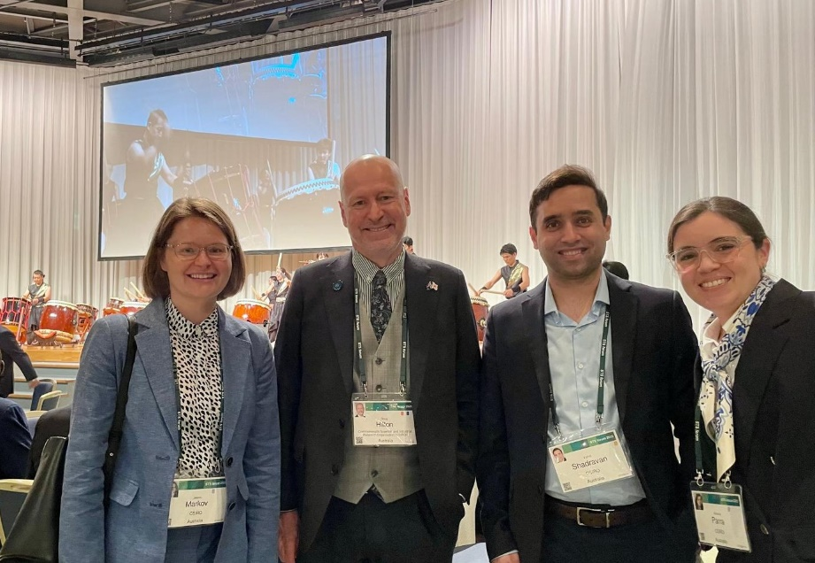
The Science and Technology in Society forum
It is an annual forum that aims to bring together scientists and global leaders from politics, business and academia to discuss issues related to science and technology and their implications for society.
It is not a decision-making meeting, but a forum to foster discussion and facilitate networking and collaboration.
This year’s meeting focused on Artificial Intelligence and the benefits and drawbacks of AI across different sectors of society.
CSIRO delegation
3

Slide 4
The Science and Technology in Society forum
The forum covers a lot of topics related to sustainability:
Path to sustainability towards a zero-carbon society
Digital technology for sustainability
Biodiversity
Circular society and growth
Sustainability for Nature Positive Economy
My main goals for the forum:
Learn about future research needs on biodiversity and sustainability.
How can the Earth Observation community support future societal needs?
4

Slide 5
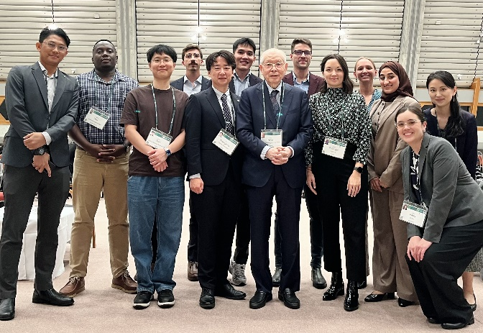
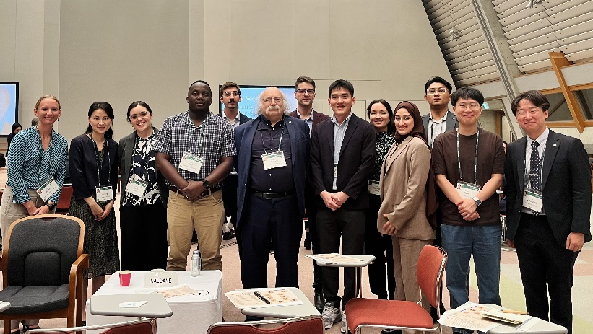
Dialogue between Young Leaders and Nobel Laureates
For this activity we were divided in groups and had two rounds of conversation with different Nobel Laureates.
The group included young leaders from different disciplines, and we covered topics related to professional development and personal life.
Ryoji Noyori (2001 Nobel Prize in Chemistry)
Duncan Haldane (2016 Nobel Prize in Physics)
5

Slide 6
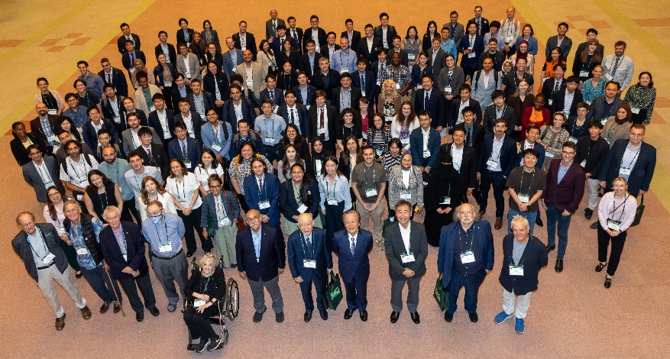
Dialogue between Young Leaders and Nobel Laureates
Both Nobel Laureates covered similar topics during our conversations:
Science is about finding the right question – Producing a good answer is easier than producing a good problem or difficult question.
We need to break out of our own silos – Break walls – Get feedback from other people – attend talks from different disciplines – Hear about different things.
This should be the era of cooperation – We need solidarity to solve current problems.
Stay curious – Stay crazy!
Young leaders and Nobel Laureates group photo
6

Slide 7
Global impact of AI by 2030
This technological revolution is already happening, and the speed of development will be fast.
Deeply embedded across different society sectors
Healthcare
Business
Government
Education
AI
2030
Rapidly being incorporated in daily life
7

Slide 8
Global impact of AI by 2030
We need strong partnerships and collaboration to take advantage of this technological revolution.
Technological progress does not equate to equitable progress.
International policies are required to guarantee an equitable distribution of benefits and risks.
Science can build bridges where politics cannot.
Misinformation, hallucinated outputs, cybersecurity, privacy, and job elimination.
8

Slide 9
AI and sustainability
Cons
Pros
AI
Facilitating monitoring and measuring
Produce new models for tracking deforestation/desertification/climate change
Develop new business ideas
Improve the efficiency of processes
Higher demand for energy, land, and resources.
Carbon emissions
Technological waste
9

Slide 10
AI and sustainability
Cons
Pros
AI
Facilitating monitoring and measuring
Produce new models for tracking deforestation/desertification/climate change
Develop new business ideas
Improve the efficiency of processes
Higher demand for energy, land, and resources.
Carbon emissions
Technological waste
What is needed
Roadblocks
Energy transition: nuclear energy, hydrogen, biomass
Circular economy to achieve carbon neutrality
Long-term investment on research
Geopolitical situation
Lack of political will
Competitiveness and consumer selection
10

Slide 11
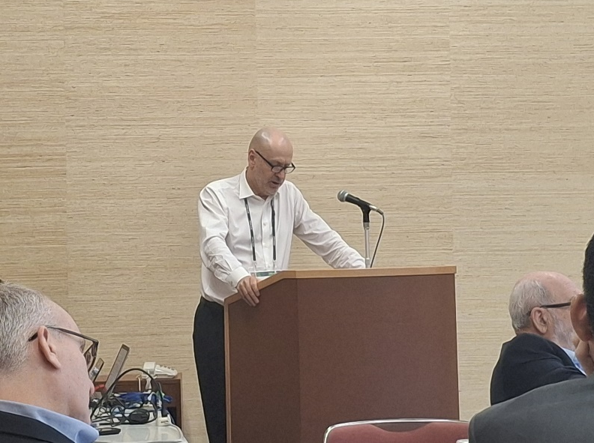






Future challenges for Biodiversity
Biodiversity is not seen as a national urgency - It is not recognised by policymakers and the public
Although the biodiversity crisis has global effects, management strategies are typically at the local scale.
Doug Hilton during the Biodiversity session
11

Slide 12
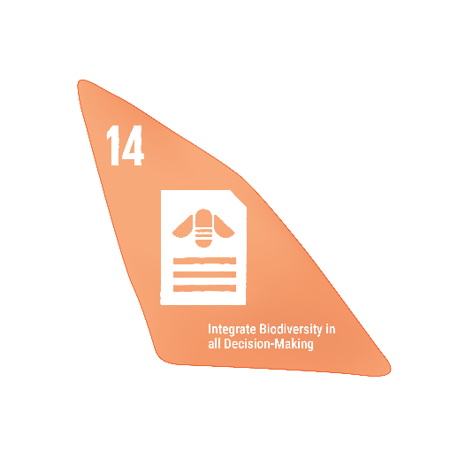

Future challenges for Biodiversity
We need to find ways to include natural capital/biodiversity into public policy thinking and economic and financial decision making
Communication and education are essential to bring biodiversity knowledge to the public
Measuring and monitoring, financing, restoration and work with indigenous and local communities
12

Slide 13
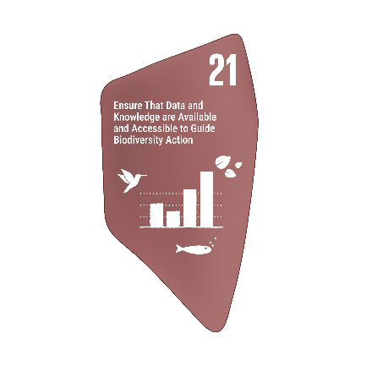
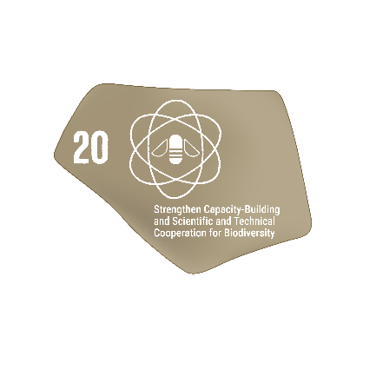

Lessons from the forum
To take advantage of AI, we need to build capacity within the EO community but also for end users
Data is no longer the constraint for taking action, we need to democratize access to data and technology
EO will be fundamental for monitoring impacts on natural resources
We need to break out of silos
Science communication and science diplomacy are fundamental
13

Slide 14
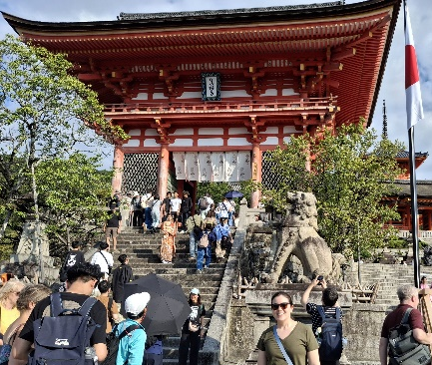
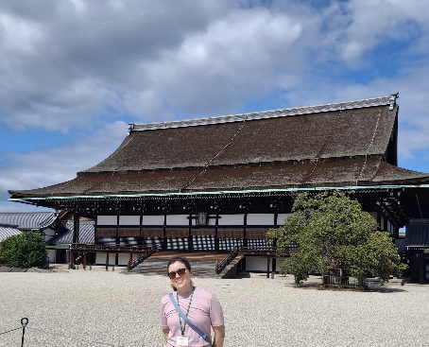
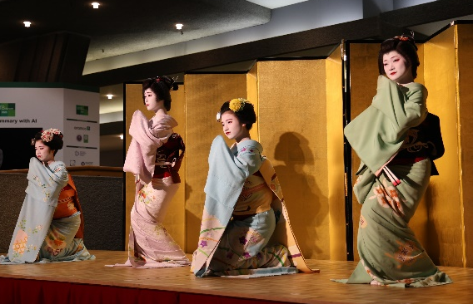
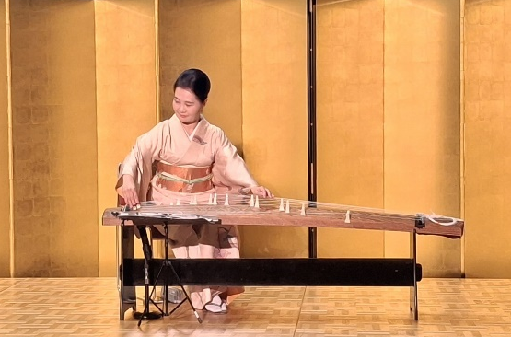
Thank you
Adriana Parra CERC Postdoctoral fellow
adriana.parraruiz@csiro.au

