Slide 1
Surya: Foundation Model for Heliophysics
Advanced modeling of solar and space weather phenomena
Notes:
AI-generated content may be incorrect. ---

Slide 2
Introduction and Motivation
Notes:
--- This slide references information from the following file: https://office.com?path=93617c79-8c94-4159-8dad-75c731580de1,https://arxiv.org/html/2508.14107v1,https://ntrs.nasa.gov/api/citations/20250008498/downloads/SuryaFM%20Paper.pdf Motivation for Surya

Slide 3
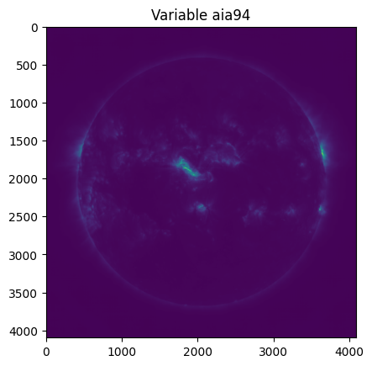
Motivation for Surya
Importance of Heliophysics
Heliophysics is essential for forecasting space weather that affects satellites and Earth’s infrastructure.
Limitations of Existing Models
Current models are task-specific and limited by small labeled datasets, lacking generalization.
Surya’s AI Foundation Model
Surya uses vast solar data to learn physics-aware representations for improved solar activity prediction.
Unified and Efficient Approach
Surya unifies multiple heliophysics tasks, reducing training costs and enhancing space weather readiness.
Notes:
--- This slide references information from the following file: https://office.com?path=93617c79-8c94-4159-8dad-75c731580de1,https://arxiv.org/html/2508.14107v1,https://ntrs.nasa.gov/api/citations/20250008498/downloads/SuryaFM%20Paper.pdf Heliophysics plays a critical role in understanding and forecasting space weather events that can significantly impact satellites, power grids, and communication systems on Earth. The Solar Dynamics Observatory (SDO) has provided over 15 years of high-resolution solar data, yet most existing models remain task-specific and constrained by limited labeled datasets. This limitation hinders their ability to generalize across diverse solar phenomena. Surya addresses these challenges by introducing a general-purpose AI foundation model for heliophysics. Unlike traditional models, Surya leverages vast quantities of solar data to learn physics-aware representations, enabling improved predictions of solar activity and space weather. The motivation behind Surya is to create a unified model that can handle multiple heliophysics tasks efficiently, reduce the cost of training for specialized applications, and enhance operational readiness for mitigating space weather risks. By integrating advanced AI techniques with rich observational data, Surya represents a paradigm shift in how scientists approach solar modeling and forecasting.

Slide 4
Overview of Surya
Notes:
--- This slide references information from the following file: https://office.com?path=93617c79-8c94-4159-8dad-75c731580de1,https://www.heliofm.org/,https://www2.hao.ucar.edu/introduction-surya-foundation-model-heliophysics What is Surya?

Slide 5
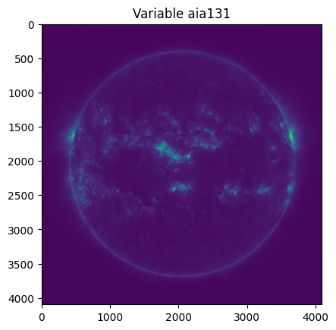
What is Surya?
Foundation Model for Heliophysics
Surya is the first foundation model designed specifically for heliophysics with 366 million parameters, trained on high-resolution solar data.
Multi-Instrument Learning
The model integrates eight AIA channels and five HMI products to capture comprehensive solar activity and dynamics.
Advanced Architecture
Surya uses a spatiotemporal transformer with spectral gating and attention mechanisms to capture local and global solar dynamics.
Forecasting and Adaptability
Surya enables zero-shot forecasting of solar events and can be fine-tuned for solar wind prediction and region segmentation.
Notes:
--- This slide references information from the following file: https://office.com?path=93617c79-8c94-4159-8dad-75c731580de1,https://www.heliofm.org/,https://www2.hao.ucar.edu/introduction-surya-foundation-model-heliophysics Surya is the first foundation model specifically designed for heliophysics. It consists of 366 million parameters and is trained on full-resolution data from NASA's Solar Dynamics Observatory (SDO), which includes 4096×4096 pixel images captured at a 12-minute cadence. The model incorporates multi-instrument learning by utilizing eight channels from the Atmospheric Imaging Assembly (AIA) and five products from the Helioseismic and Magnetic Imager (HMI). Surya employs a spatiotemporal transformer architecture enhanced with spectral gating and long–short range attention mechanisms to capture both local and global solar dynamics. Its pretraining objectives include solar image forecasting and autoregressive rollout tuning, enabling the model to predict solar evolution over extended time horizons. Surya's design allows it to perform zero-shot forecasting of solar dynamics and flare events, and it can be fine-tuned using parameter-efficient methods like Low-Rank Adaptation (LoRA) for specialized downstream tasks such as solar wind prediction and active region segmentation.

Slide 6
Architecture and Key Features
Notes:
--- This slide references information from the following file: https://office.com?path=93617c79-8c94-4159-8dad-75c731580de1,https://github.com/NASA-IMPACT/Surya Model Architecture, Key Features

Slide 7
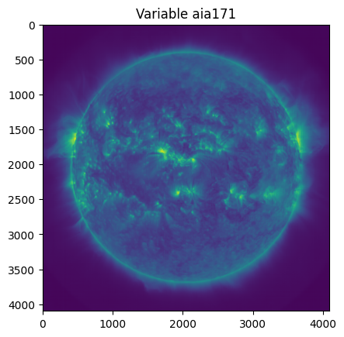
Model Architecture
Spatiotemporal Transformer Framework
The architecture uses a spatiotemporal transformer to model solar phenomena across multiple scales effectively.
Spectral Gating and Frequency Filtering
Spectral gating filters frequency-domain data to highlight important solar activity signals within the model.
Time Advancement Pretext Task
The model learns temporal dependencies by predicting future states through a time advancement task.
Parameter-Efficient Fine-Tuning
LoRA enables efficient fine-tuning of the model for varied heliophysics tasks without full retraining.
Notes:
--- This slide references information from the following file: https://office.com?path=93617c79-8c94-4159-8dad-75c731580de1,https://github.com/NASA-IMPACT/Surya Surya's architecture is built around a spatiotemporal transformer framework that integrates spectral gating for frequency-domain filtering and long–short range attention to effectively model solar phenomena across different scales. The model uses time advancement as a pretext task, which helps it learn temporal dependencies critical for forecasting solar activity. This approach enables Surya to capture complex interactions between solar features over time. Additionally, the architecture supports parameter-efficient fine-tuning through LoRA, allowing researchers to adapt the model for various heliophysics applications without retraining from scratch. The combination of spectral gating and attention mechanisms ensures that Surya can process high-resolution data efficiently while maintaining accuracy in predictions. These architectural innovations make Surya a versatile and powerful tool for advancing heliophysics research and operational forecasting.

Slide 8
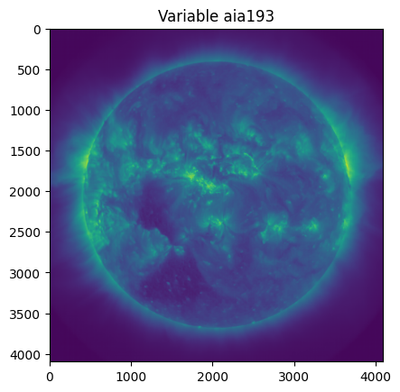
Key Features
High Resolution Data
Surya operates at native SDO resolution (4096×4096) with a 12-minute cadence for accurate solar dynamics capture.
Zero-Shot Forecasting
Surya forecasts solar phenomena without additional training, demonstrating strong zero-shot capability.
Versatile Fine-Tuning
Supports LoRA fine-tuning for solar wind prediction, active region segmentation, and EUV spectral modeling.
Superior Prediction Accuracy
Surya reduces computational costs and surpasses benchmarks with accurate predictions across heliophysics applications.
Notes:
--- This slide references information from the following file: https://office.com?path=93617c79-8c94-4159-8dad-75c731580de1,https://github.com/NASA-IMPACT/Surya Surya offers several key features that distinguish it from traditional heliophysics models. First, it operates at the native resolution of SDO data (4096×4096 pixels) with a 12-minute cadence, ensuring high fidelity in capturing solar dynamics. Second, it demonstrates zero-shot capabilities, meaning it can forecast solar phenomena without additional task-specific training. Third, Surya supports versatile fine-tuning through LoRA, enabling efficient adaptation for tasks such as solar wind prediction, active region segmentation, and EUV spectral modeling. These features collectively allow Surya to generalize across multiple heliophysics applications, reduce computational costs, and provide accurate predictions that surpass existing benchmarks. By leveraging these capabilities, Surya sets a new standard for AI-driven modeling in solar physics.

Slide 9
Applications and Performance
Notes:
--- This slide references information from the following file: https://arxiv.org/html/2508.14107v1,https://github.com/NASA-IMPACT/Surya,https://www2.hao.ucar.edu/introduction-surya-foundation-model-heliophysics Applications of Surya, Performance Metrics

Slide 10
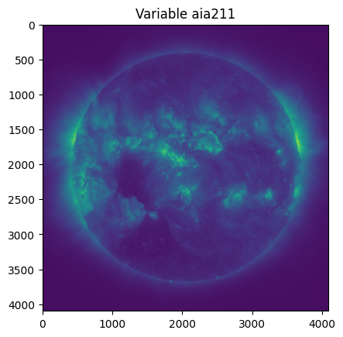
Applications of Surya
Solar Flare Prediction
Surya predicts solar flares to help anticipate high-energy events disrupting satellites and communication systems.
Solar Wind Speed Estimation
Surya estimates solar wind speed, aiding protection of astronauts and spacecraft from solar particle effects.
Active Region Identification
Surya identifies active solar regions to map areas likely driving significant solar activity and events.
EUV Spectral Forecasting
Surya forecasts EUV spectra to understand solar radiative output and its effects on Earth's atmosphere.
Notes:
--- This slide references information from the following file: https://arxiv.org/html/2508.14107v1,https://github.com/NASA-IMPACT/Surya,https://www2.hao.ucar.edu/introduction-surya-foundation-model-heliophysics Surya can be applied to a wide range of heliophysics and space weather forecasting tasks. Key applications include solar flare prediction, which is critical for anticipating high-energy events that can disrupt satellite operations and communication systems. The model also excels in solar wind speed estimation, providing valuable insights for protecting astronauts and spacecraft. Additionally, Surya supports active region identification, helping scientists map areas on the solar surface that are likely to drive significant activity. Another important application is EUV spectral forecasting, which aids in understanding the Sun's radiative output and its impact on Earth's upper atmosphere. These capabilities make Surya an indispensable tool for both scientific research and operational space weather preparedness.

Slide 11
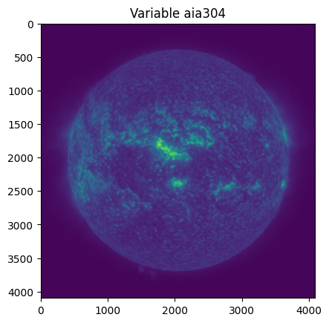
Performance Metrics
Improved Solar Flare Forecasting
Surya achieves a 15% improvement in predicting M/X-class solar flares compared to previous models.
Advanced Active Region Segmentation
Surya outperforms baselines with IoU score of 0.768 and Dice coefficient of 0.853 in active region segmentation.
Early Solar Feature Prediction
The model predicts solar disc features up to two hours ahead, aiding timely space weather alerts.
Notes:
--- This slide references information from the following file: https://arxiv.org/html/2508.14107v1,https://github.com/NASA-IMPACT/Surya,https://www2.hao.ucar.edu/introduction-surya-foundation-model-heliophysics Surya demonstrates superior performance compared to existing heliophysics models. In solar flare forecasting, it achieves a 15% improvement over previous benchmarks, particularly in predicting M/X-class flares. For active region segmentation, Surya outperforms baseline models with an Intersection over Union (IoU) score of 0.768 and a Dice coefficient of 0.853. The model can predict solar disc features up to two hours in advance, providing critical lead time for space weather alerts. These results highlight Surya's ability to deliver accurate and timely predictions, making it a valuable asset for both research and operational applications in heliophysics.

Slide 12
Open Science and Future Directions
Notes:
--- This slide references information from the following file: https://www.heliofm.org/,https://www2.hao.ucar.edu/introduction-surya-foundation-model-heliophysics Open Science Initiatives, Future Directions

Slide 13
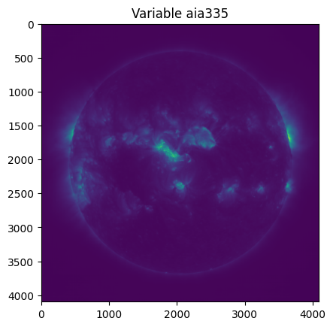
Open Science Initiatives
Open Access to Resources
Surya's model weights, configurations, and notebooks are openly available on platforms like GitHub and Hugging Face.
Transparency and Reproducibility
Open science principles promote transparency and reproducibility in research using Surya's openly shared resources.
Global Collaboration
Scientists, startups, and agencies collaborate worldwide to experiment and improve Surya through open contributions.
Democratizing AI Access
Making advanced AI models accessible fosters innovation and broader participation in heliophysics research.
Notes:
--- This slide references information from the following file: https://www.heliofm.org/,https://www2.hao.ucar.edu/introduction-surya-foundation-model-heliophysics Surya is openly available to the scientific community through platforms like GitHub and Hugging Face. These resources include model weights, configuration files, preprocessing pipelines, and example notebooks for downstream tasks. By embracing open science principles, Surya promotes transparency, reproducibility, and collaboration among researchers worldwide. This approach enables scientists, startups, and agencies to experiment with the model, fine-tune it for specific applications, and contribute to its ongoing development. The availability of Surya as an open-source tool marks a significant step toward democratizing access to advanced AI models in heliophysics.

Slide 14
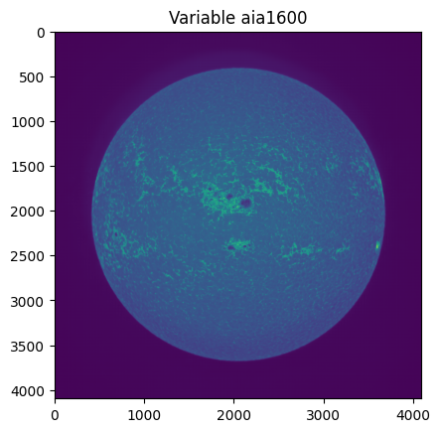
Future Directions
Predicting Solar Events
Surya aims to predict coronal mass ejections and solar energetic particles to protect space missions and Earth infrastructure.
Integration with Space Weather Systems
Plans include integrating Surya with operational space weather systems for enhanced real-time forecasting and decision-making.
Community-Driven Innovation
Surya promotes a collaborative approach to fine-tune and benchmark its models, fostering research innovation and progress.
Notes:
--- This slide references information from the following file: https://www.heliofm.org/,https://www2.hao.ucar.edu/introduction-surya-foundation-model-heliophysics Future plans for Surya include extending its capabilities to predict coronal mass ejections (CMEs) and solar energetic particles (SEPs), which pose significant risks to space missions and terrestrial infrastructure. Researchers aim to integrate Surya with operational space weather systems to enhance real-time forecasting and decision-making. Additionally, the Surya project envisions a community-driven approach to fine-tuning and benchmarking, fostering innovation and accelerating progress in heliophysics research. These initiatives will ensure that Surya continues to evolve as a cutting-edge tool for understanding and predicting solar phenomena.

Slide 15
Summary
Notes:
--- This slide references information from the following file: https://office.com?path=93617c79-8c94-4159-8dad-75c731580de1,https://ntrs.nasa.gov/api/citations/20250008498/downloads/SuryaFM%20Paper.pdf Key Takeaways

Slide 16
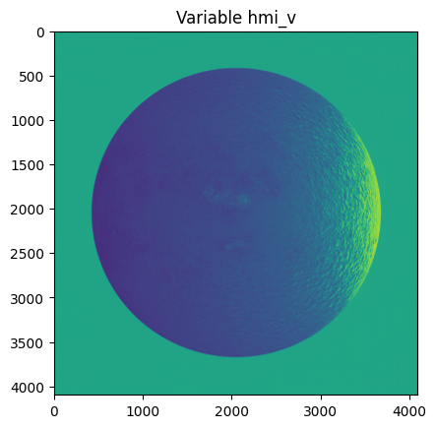
Key Takeaways
Advanced Heliophysics Modeling
Surya introduces a foundation model that learns physics-aware representations from detailed solar data to improve heliophysics research.
Accurate Solar Forecasting
Surya’s architecture enables superior forecasting of solar activity and space weather events, enhancing prediction accuracy.
Open Science Collaboration
By fostering community collaboration and open science, Surya promotes innovation and future breakthroughs in solar research.
Protecting Earth Technologies
Surya contributes to safeguarding critical Earth technologies and infrastructure by improving space weather preparedness.
Notes:
--- This slide references information from the following file: https://office.com?path=93617c79-8c94-4159-8dad-75c731580de1,https://ntrs.nasa.gov/api/citations/20250008498/downloads/SuryaFM%20Paper.pdf Surya represents a transformative advancement in heliophysics modeling by introducing a foundation model that learns physics-aware representations from high-resolution solar data. Its innovative architecture, versatile features, and superior performance enable accurate forecasting of solar activity and space weather events. By adopting open science principles and fostering community collaboration, Surya sets the stage for future breakthroughs in solar research and operational preparedness. This model not only enhances our understanding of the Sun but also contributes to safeguarding critical technologies and infrastructure on Earth.

