Slide 1
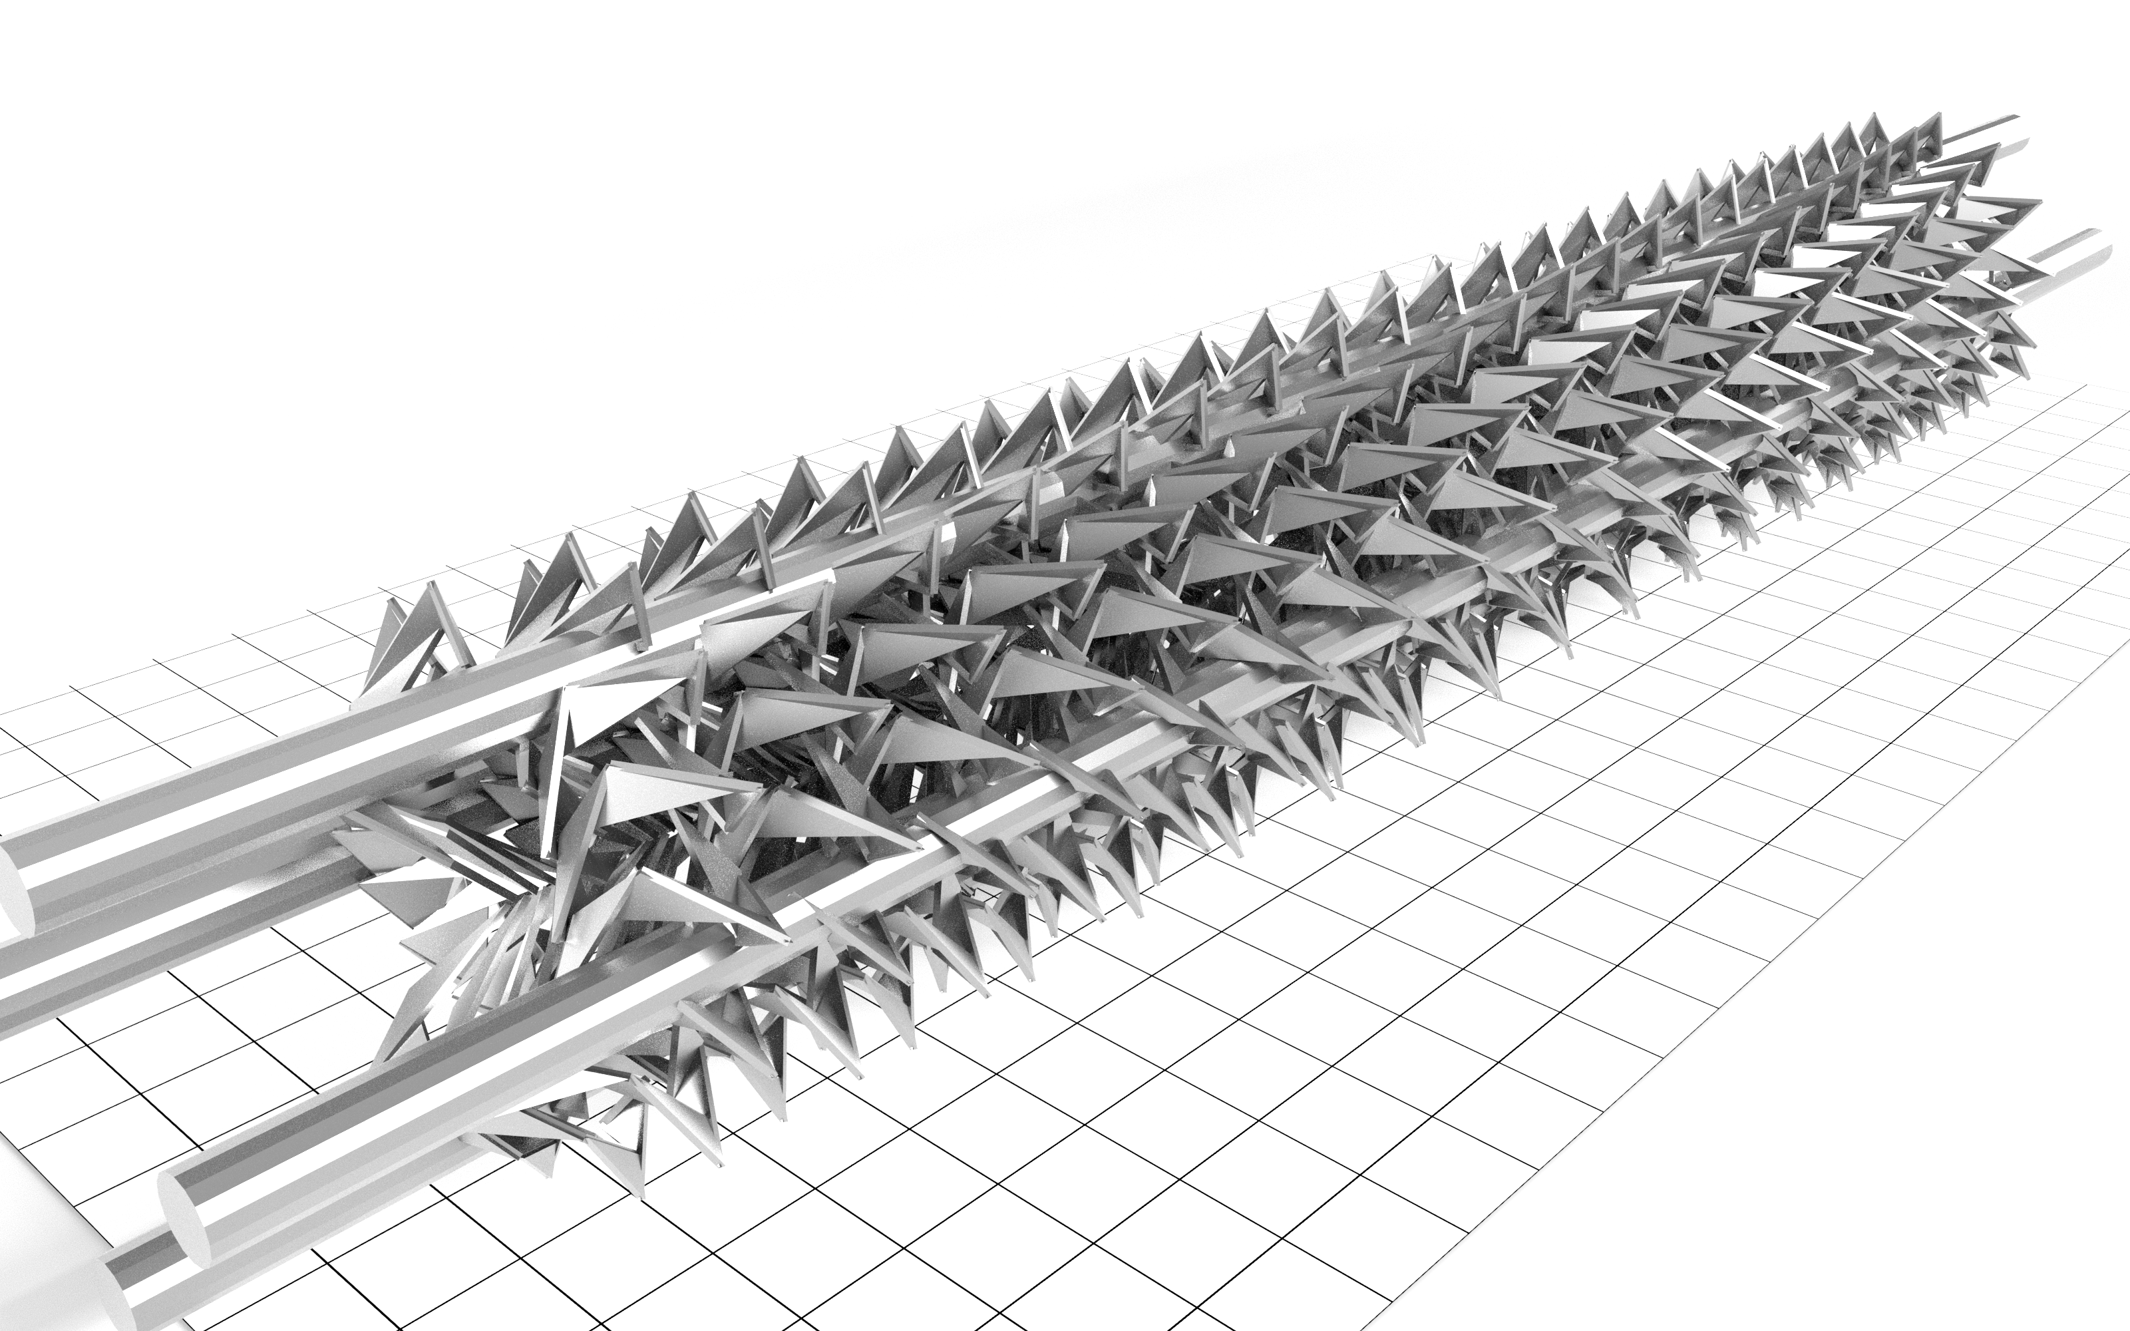
Evolution as an Invention Machine:
How a Computer Autonomously Designed Industrial Static Mixers
Part of AI4Design Research Portfolio in CSIRO
Paulus Lahur | Colearnium, 16 July 2026
Collaborators: Gerald G. Pereira, David Howard, Michael Breedon, Phil Kilby, and Christian H. Hornung

Slide 2
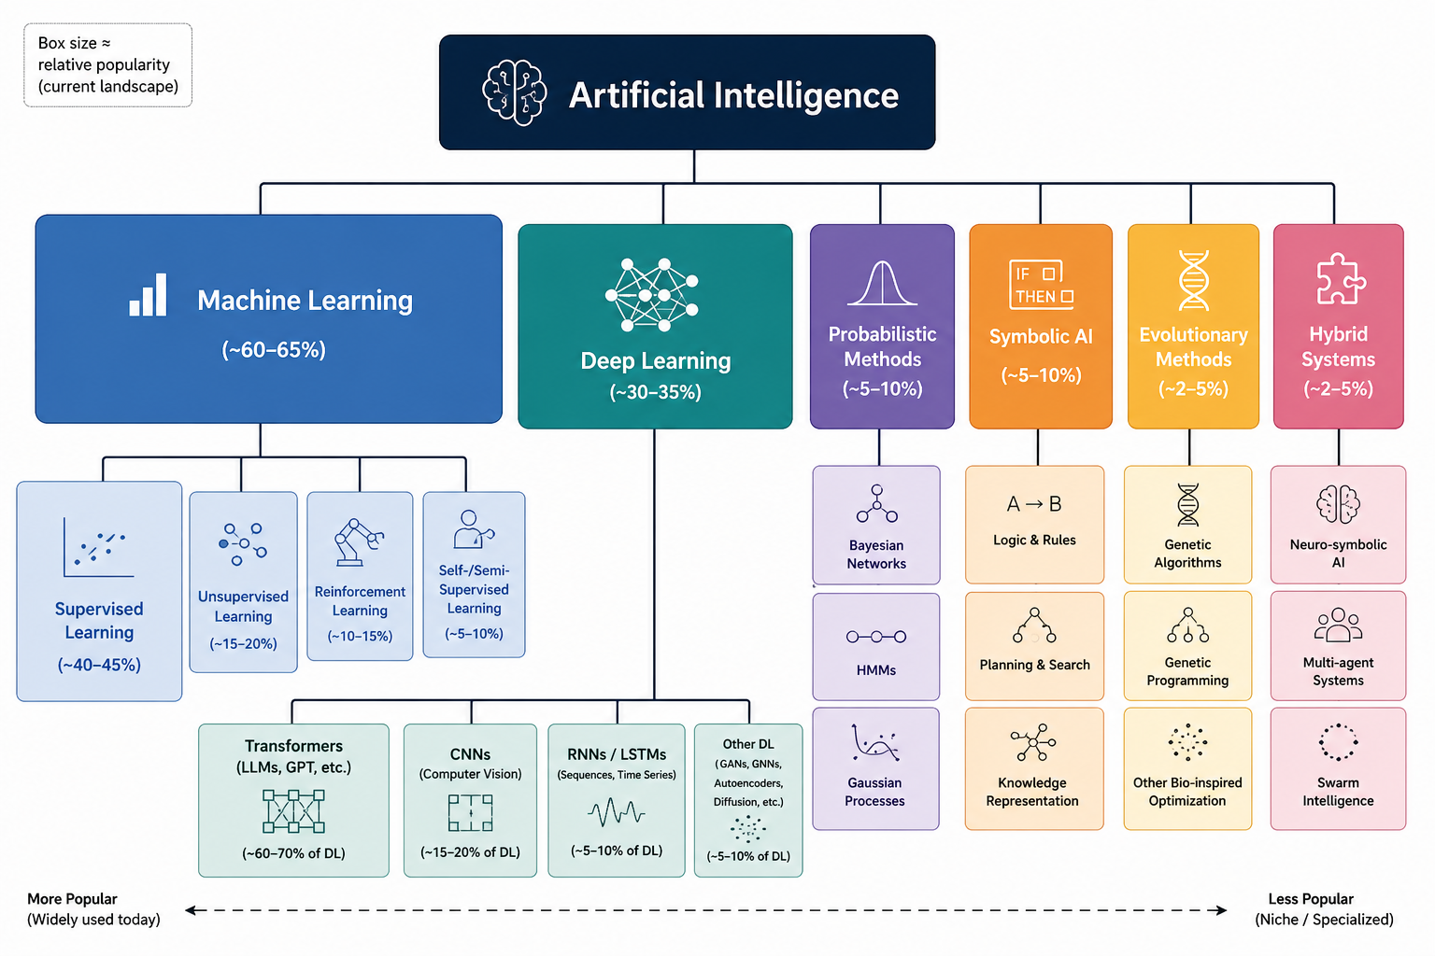
One Big AI Family
Generated using ChatGPT

Slide 3
Machine Learning vs Genetic Algorithm
Machine Learning:
“Learn from this body of knowledge, then answer questions based on that knowledge”
➔ Use existing knowledge.
Evolution/Genetic Algorithm:
“Given a challenging environment, come up with increasingly better solutions that can survive in that environment”
Invent something new.

Slide 4
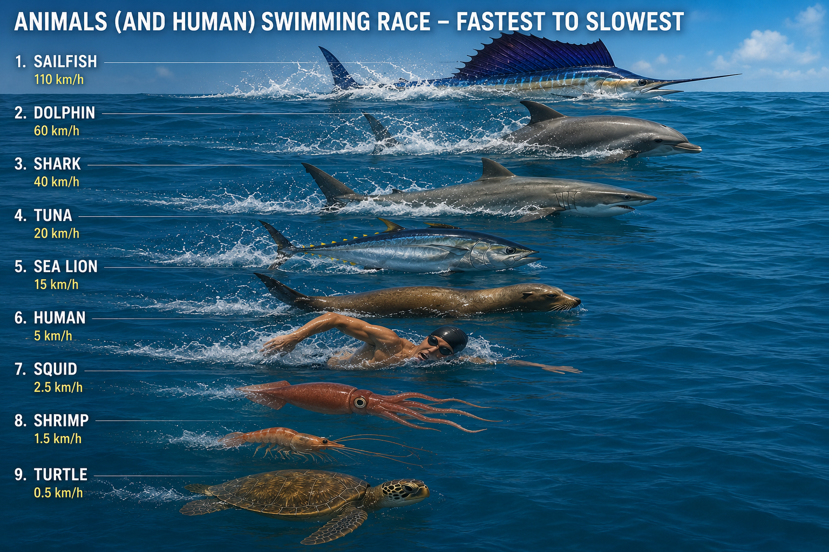
Mimicking Nature
Certain shapes are good for certain environments.
Mimic the way Nature produces “shapes”:
  Living things:
  DNA ➔ cell building blocks ➔ cells ➔ tissues ➔ body. Too many stages!
  Computational model:
  Design parameters (DNA) ➔ body.
Generated using ChatGPT

Slide 5
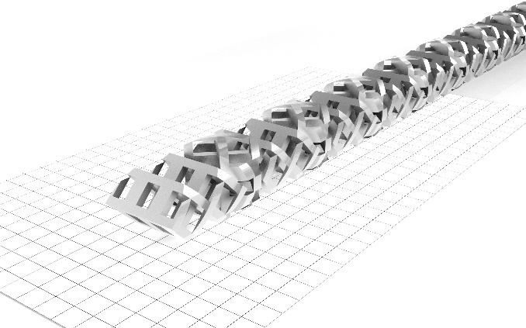
Application: Design of Static Mixer
Static mixer: a device that mixes fluid without any moving part.
More than just mixing: chemical reaction, heat transfer, extracts material from solutions, etc.
The challenge: use Genetic Algorithm to design a better static mixer (than human-designed one) for removing copper ion from a solution.
Benchmark mixer (human-designed)

Slide 6
The System: High-Fidelity, Automated & Robust
Computational Fluid Dynamics (CFD) on HPC: must be high fidelity, fast & robust. Lattice-Boltzmann method ➔ computationally very expensive!
Genetic information: geometric parameters
parents
No human in this loop
child
Evolutionary Algorithm “NSGA-II”:
Population
Gene crossover
Gene mutation
Fitness
Selection
Verification by human, using lab experiments ➔ labour intensive!
Select individuals in the new generation from Pareto front
K. Deb, A. Pratap, S. Agarwal, and T. Meyarivan. A fast and elitist multiobjective genetic algorithm: nsga-II. Trans. Evol. Comp, 6(2):182–197, April 2002.

Slide 7
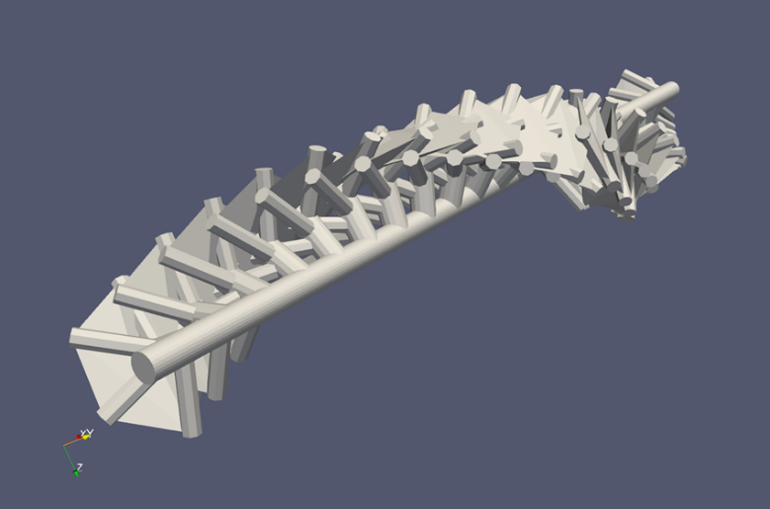
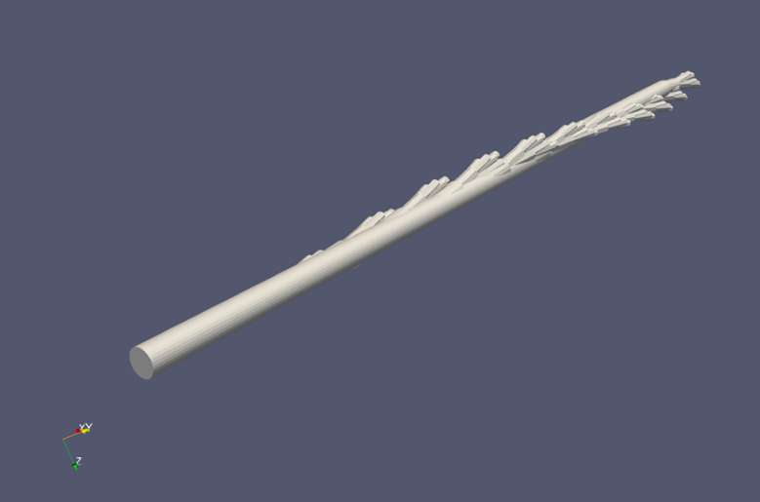
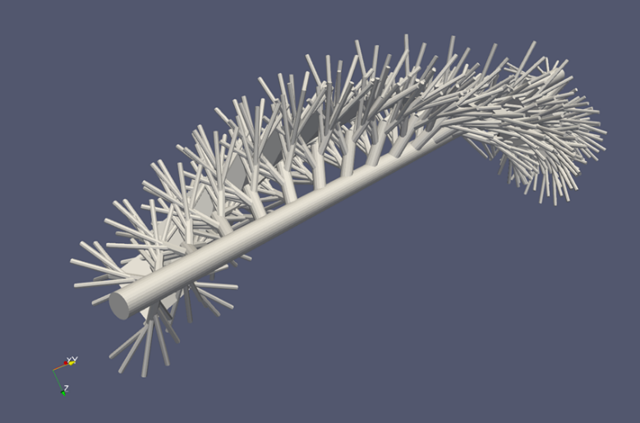
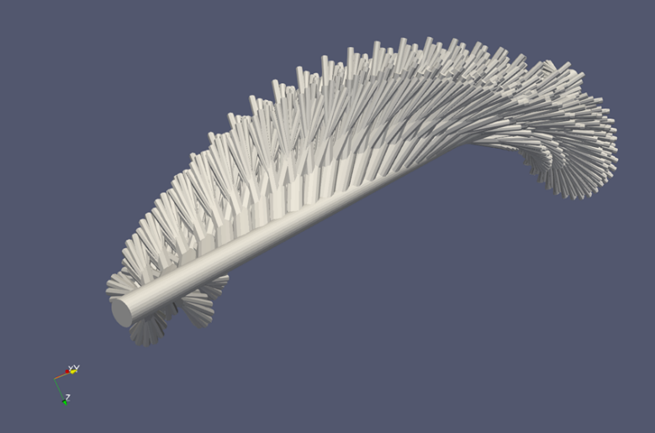
“Tree-based” Mixers
Large shape variety.
Recursive ➔ branch.
10 parameters ➔ compact design space ➔ faster to explore.

Slide 8
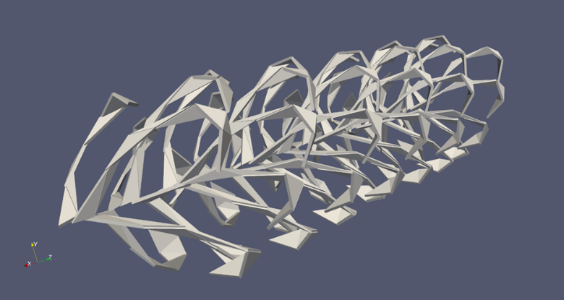
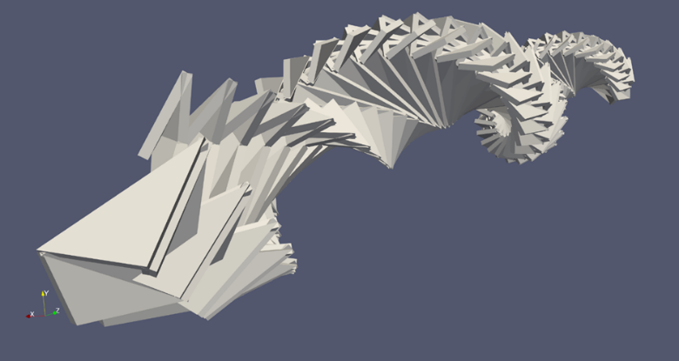
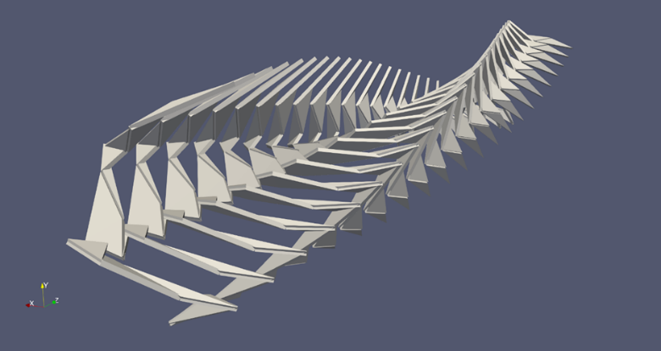
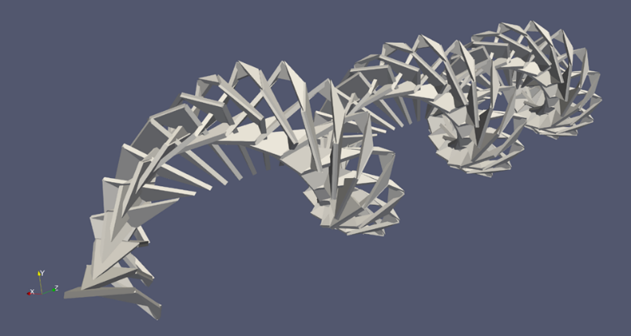
“Ribbon-based” Mixers
Large shape variety.
Non recursive.
30 parameters ➔ large design space ➔ slower to explore.

Slide 9
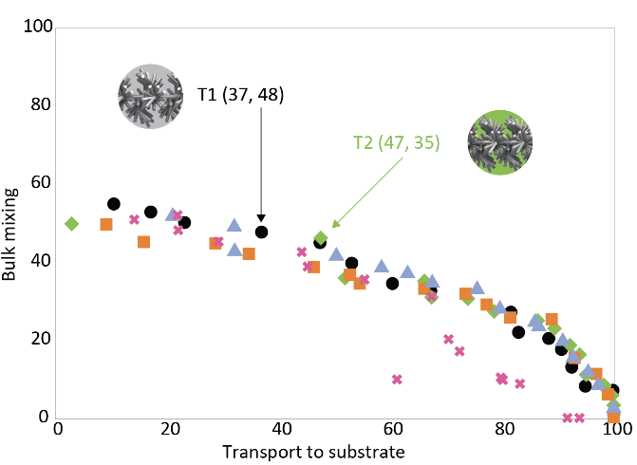
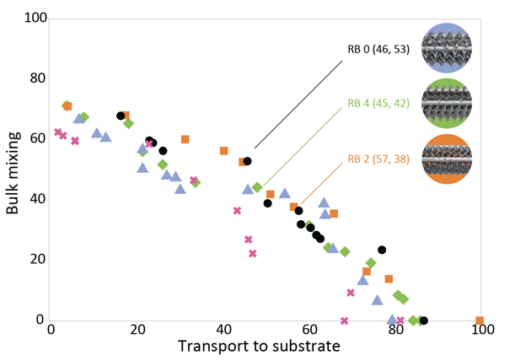
Results of Computations
Typical computation: 150 generations, 16 individuals in population, weeks of compute time.
Tree-based geometry
Ribbon-based geometry

Slide 10
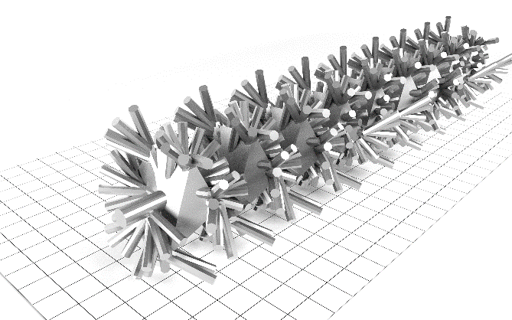
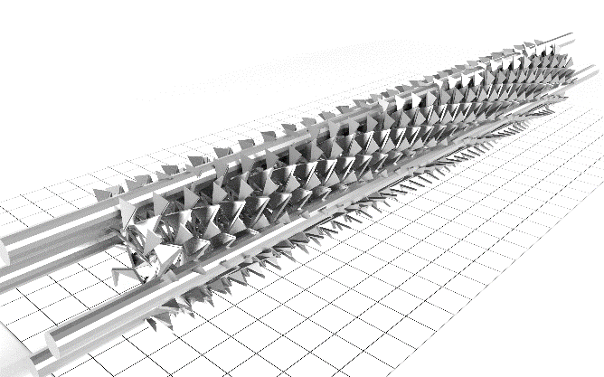
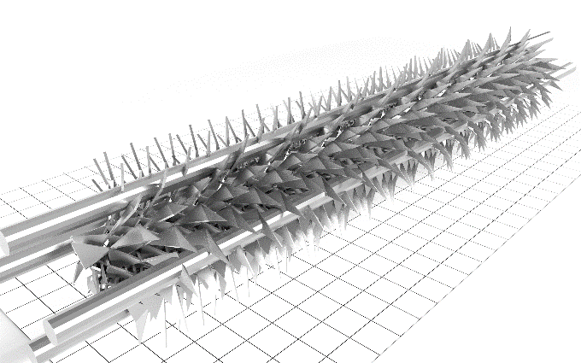
Champion Mixers (as Produced by Geometry Generators)
Tree-based geometry
Ribbon-based
geometry

Slide 11
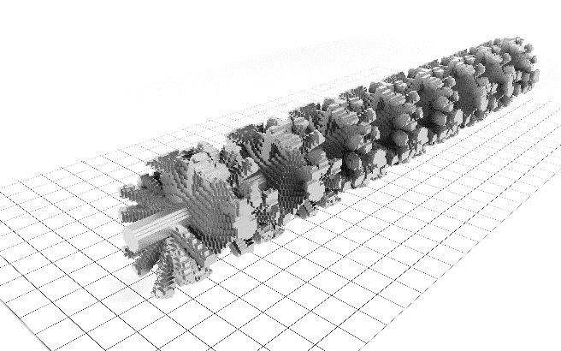
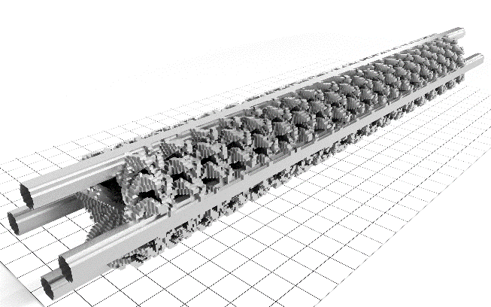
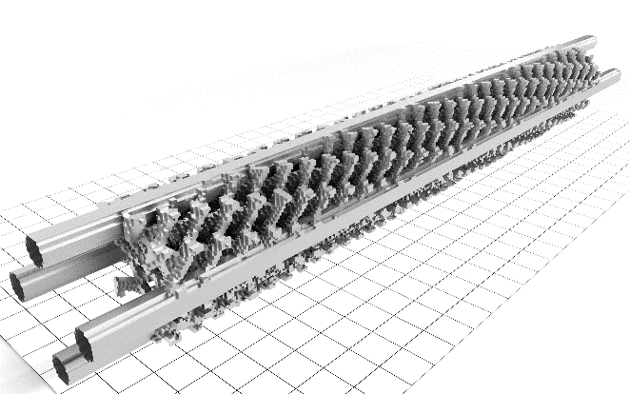
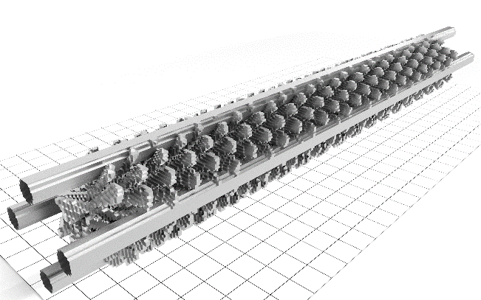
Champion Mixers as Processed by CFD & 3D Printer
Tree-based geometry
Ribbon-based
geometry

Slide 12
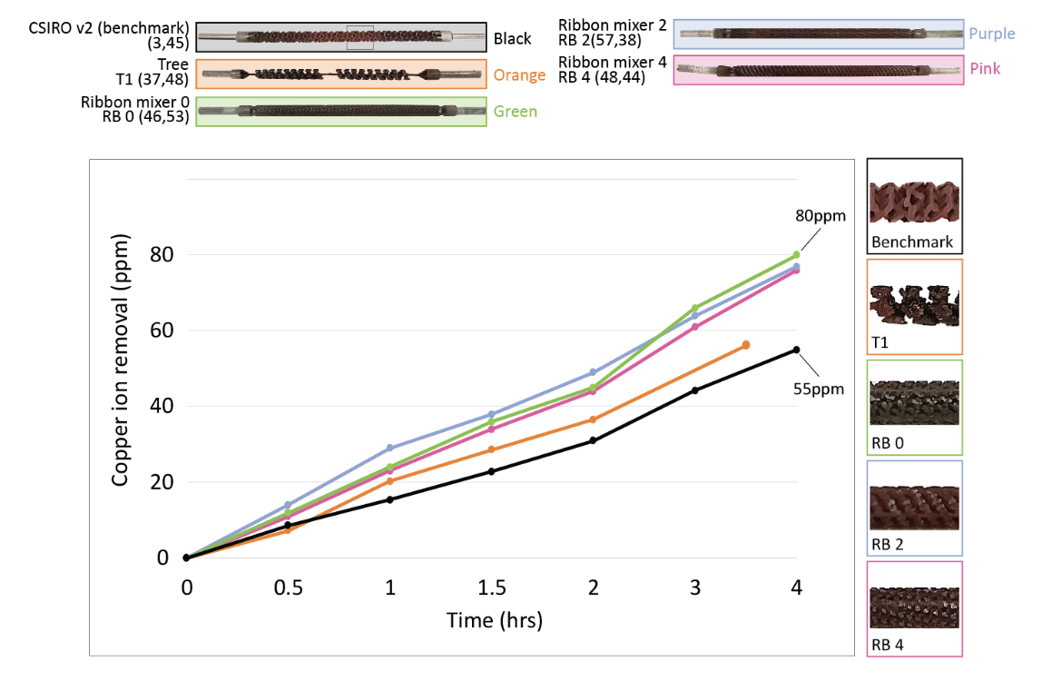
Experimental Verification
Remove copper ion from solution ➔ more is better
Ribbon-based geometries ➔ 45% better than benchmark
Tree-based geometry
Benchmark

Slide 13
Achievements
Journal
  Freeform Generative Design of Complex Functional Structures, Gerald G. Pereira, David Howard, Paulus Lahur, Michael Breedon, Phil Kilby, and Christian H. Hornung, Scientific Reports, 14, 11918, (2024)
Three patents
Resulted in more projects & collaborations
  More applications: Carbon Capture, Hydrogenation, Fermentation, Polymerisation, Airlift, Distillation.
  Explored more geometry generators: Lindenmeyer system, TPMS (Triply Periodic Minimal Surface) etc.
  Explored Bayesian Optimisation in place of Genetic Algorithm.
  Explored additional component: Machine Learning ➔ evolve & learn at the same time.
Funding situation is always challenging …

Slide 14
Example from NASA
Hornby, Gregory S.; Al Globus; Derek S. Linden; Jason D. Lohn (2006). "Automated antenna design with evolutionary algorithms". Space. American Institute of Aeronautics and Astronautics

Slide 15
Concluding Remarks
Evolutionary Algorithm is a powerful method
  It works without prior knowledge ➔ innovation.
  Physics simulation can be very expensive.
  High fidelity, robust and automated system is a must.
  Domain knowledge to set up the system is key.
Promising avenues for further research
  Incorporate Machine Learning to reduce the cost of physics simulation (e.g. surrogate model, Physics-Informed Machine Learning).
  Bayesian Optimisation (instead of Genetic Algorithm) to guide exploration.

Slide 16
Acknowledgement
We are immensely grateful to all collaborators in AIM FSP Static Mixer program and AI4Design research portfolio, as well as other colleagues who have helped in all aspects of the project, which includes 3D printing, experimentation, material analysis & computing.
This work was initially funded by AIM FSP program. Later it was funded by FDMF via AI4Design research portfolio.
Computations were facilitated by CSIRO's HPC, the National Computational Infrastructure (NCI) and Pawsey.

Slide 17
Thank you
Further information
  Paulus Lahur
  paulus.lahur@csiro.au
    www.csiro.au

