Slide 1
Introduction to Anthropology
By Vanessa Chapman

Slide 2
Etic: to look in from the outside
Emic: to view from the inside
Anthropology:
The holistic and comparative study of human beings
The most humane of the sciences and the most scientific of the humanities

Slide 3
“Make the strange familiar, and the familiar strange”

Slide 4
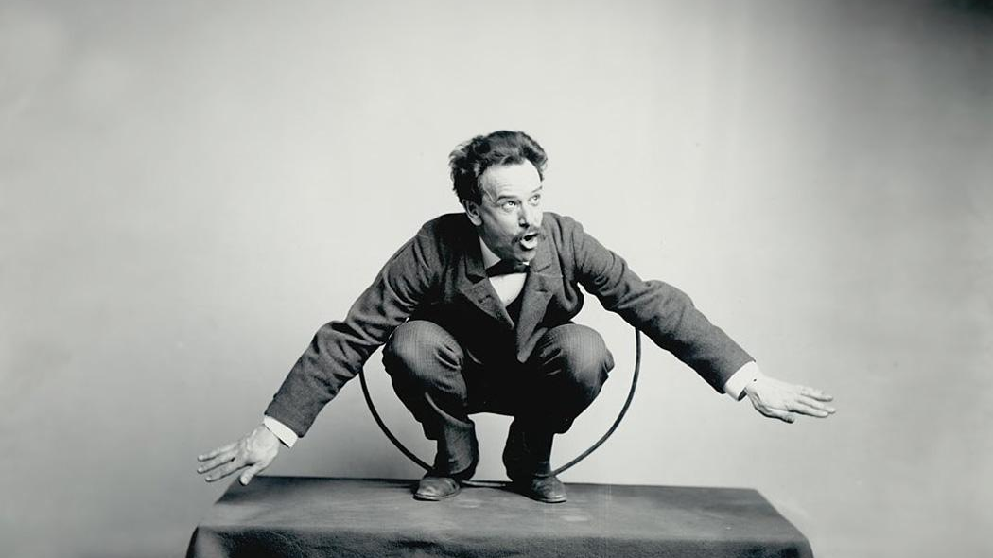
Franz Boas
Cultural Relativism
All cultures are relative to each other through the lens of the culture of the observer
Image: JSTOR

Slide 5
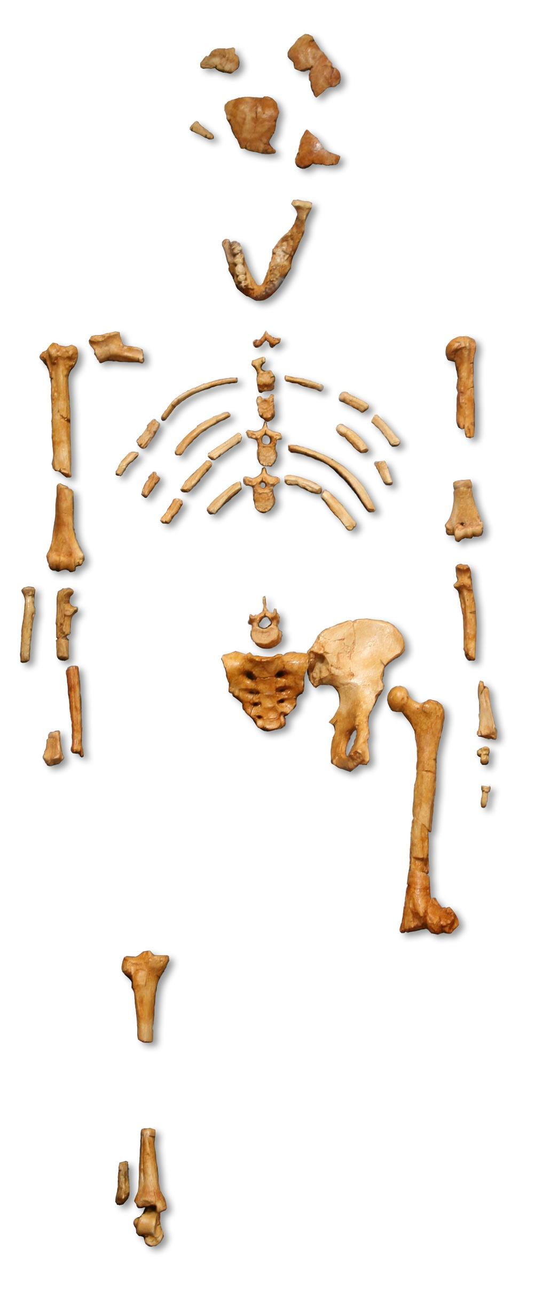
Types of Anthropology
Cultural Anthropology
Archaeology
Biological Anthropology
Linguistic Anthropology
Quotes for illustration purposes only
Image: Wikipedia

Slide 6
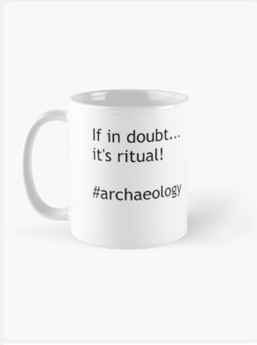
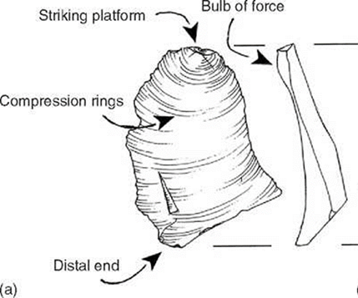
Archaeology Fieldwork
Image: USQ Lecture
Image: Redbubble

Slide 7
Anthropology Fieldwork
Participant observation
Surveys
Interviews
Site Documents
Written notes on observations and activities
Forms for informants to complete
Ethnography
Written notes and recorded
History and information about the site

Slide 8
Example of Ethnography
2nd year anthropology at USQ
“How do public spaces contribute to a sense of belonging?”
Local park
Jugger
German sport based on an 80’s movie
Final report: “Juggers, Joggers, and Pokemon: an ethnographic study of Upper Queens Park, Toowoomba”

Slide 9
Excerpt
“[The] quiet cacophony is broken by a voice calling ‘3, 2, 1, jugger!’, and the steady beat of a drum starting, loud and clear. A few people swivel their heads, searching for the source of the sound. They find it in the centre of Upper Queens Park, where something is taking place on the football field. A group of people, no older than 40, no younger than 16, are running across the field with strange objects in their hands, and have begun hitting each other and yelling, with a unique mix of cohesion and chaos. This is the sport of jugger. “

Slide 10
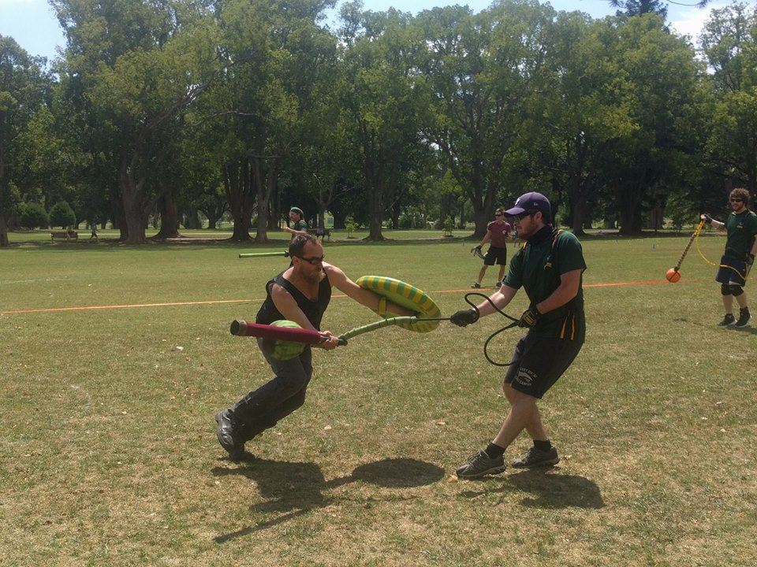
Image: Facebook

Slide 11
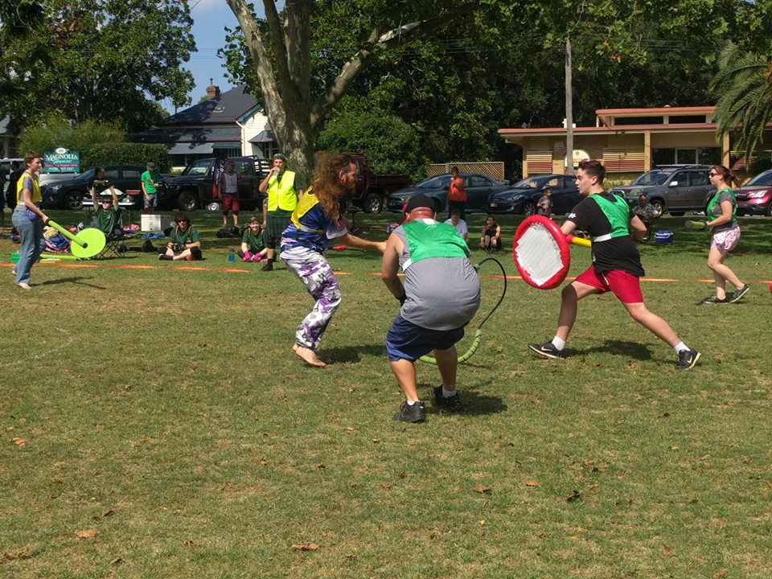
Image: Facebook

Slide 12
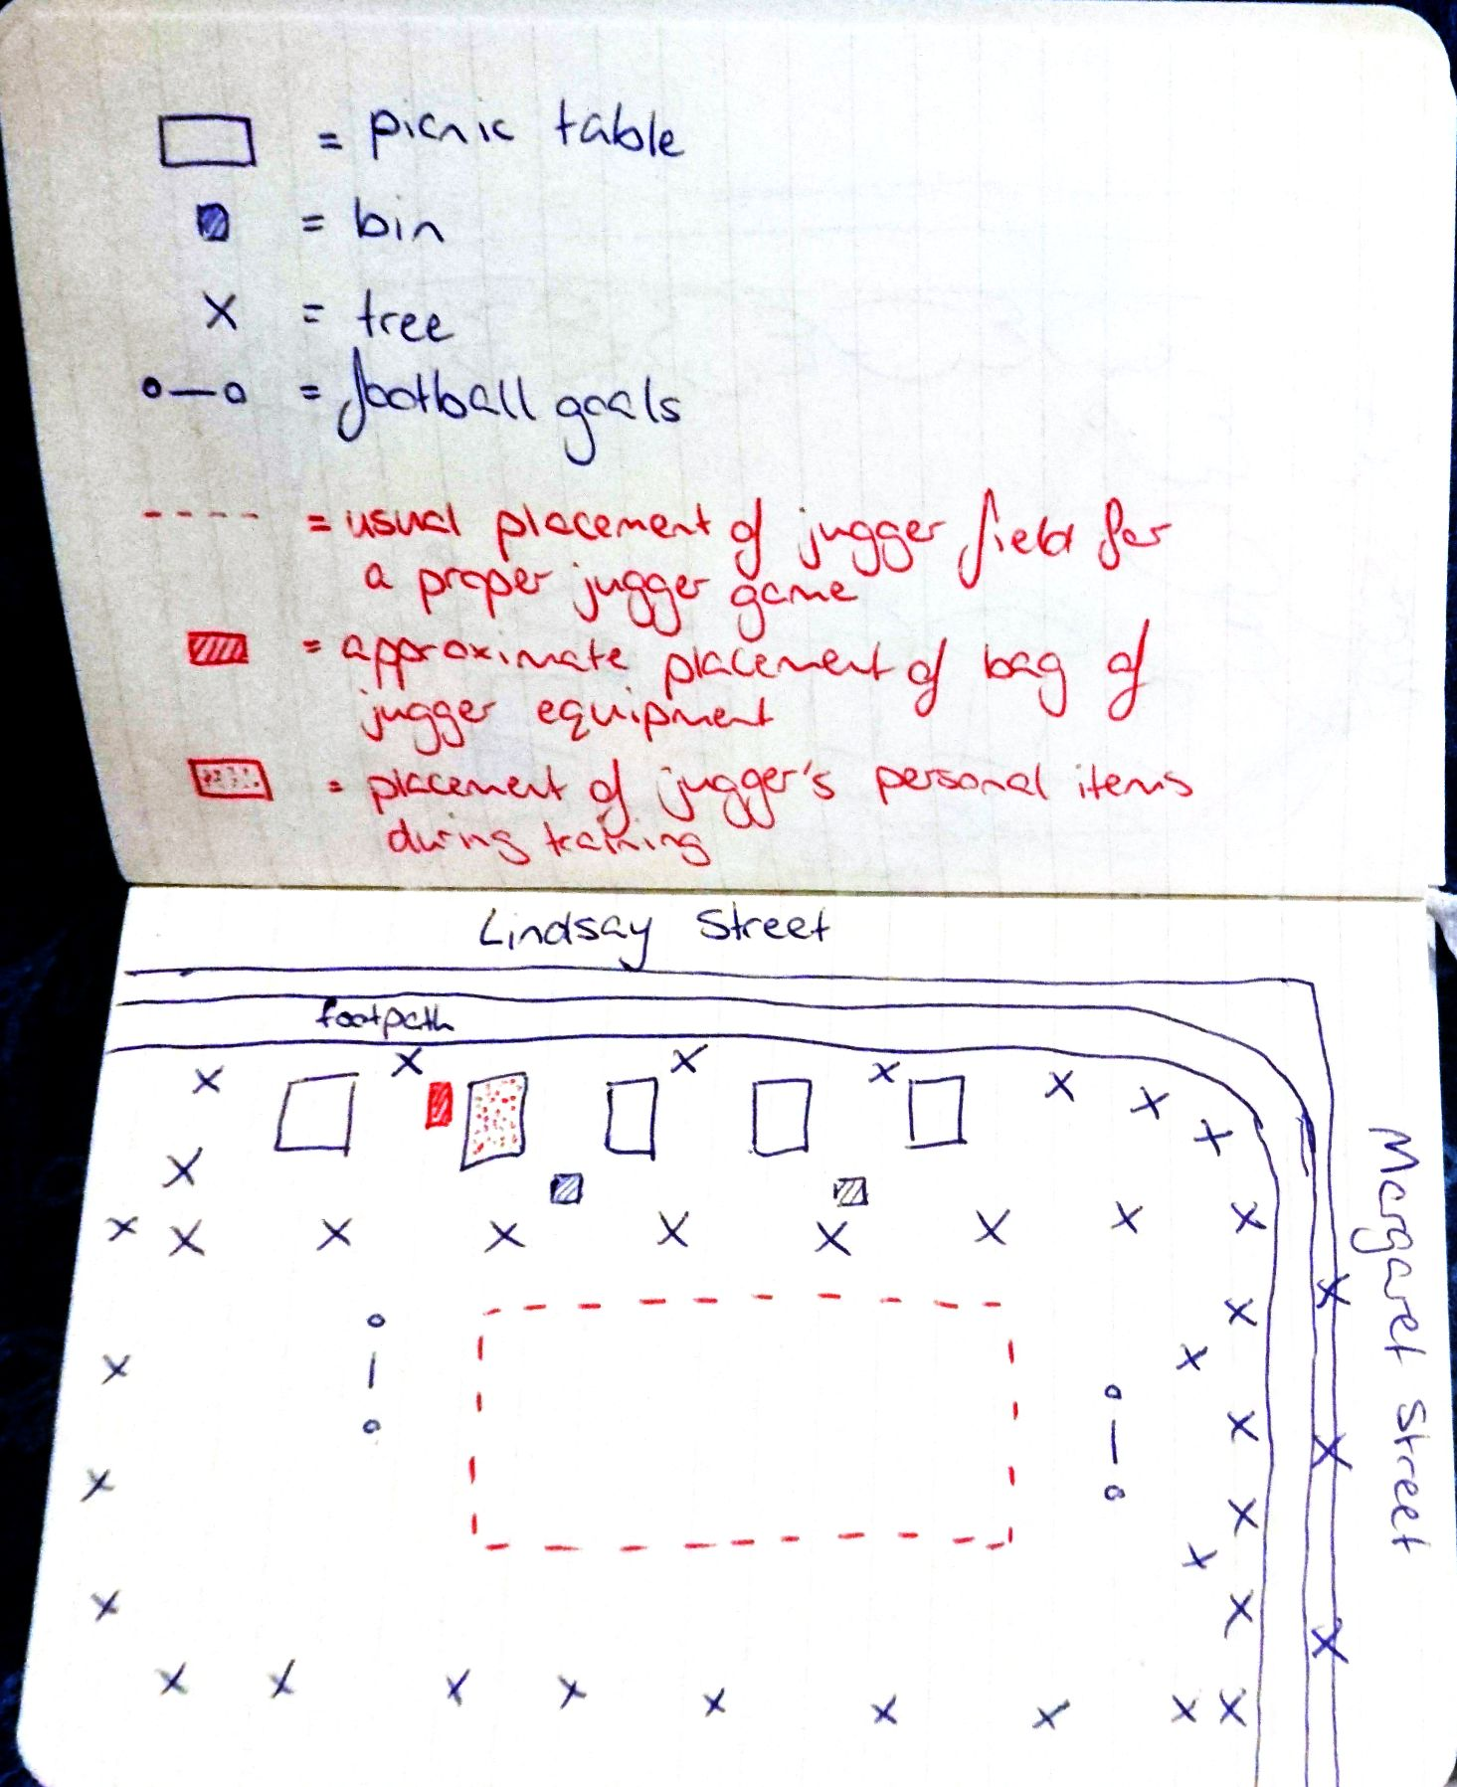
Image: Personal sketch

Slide 13
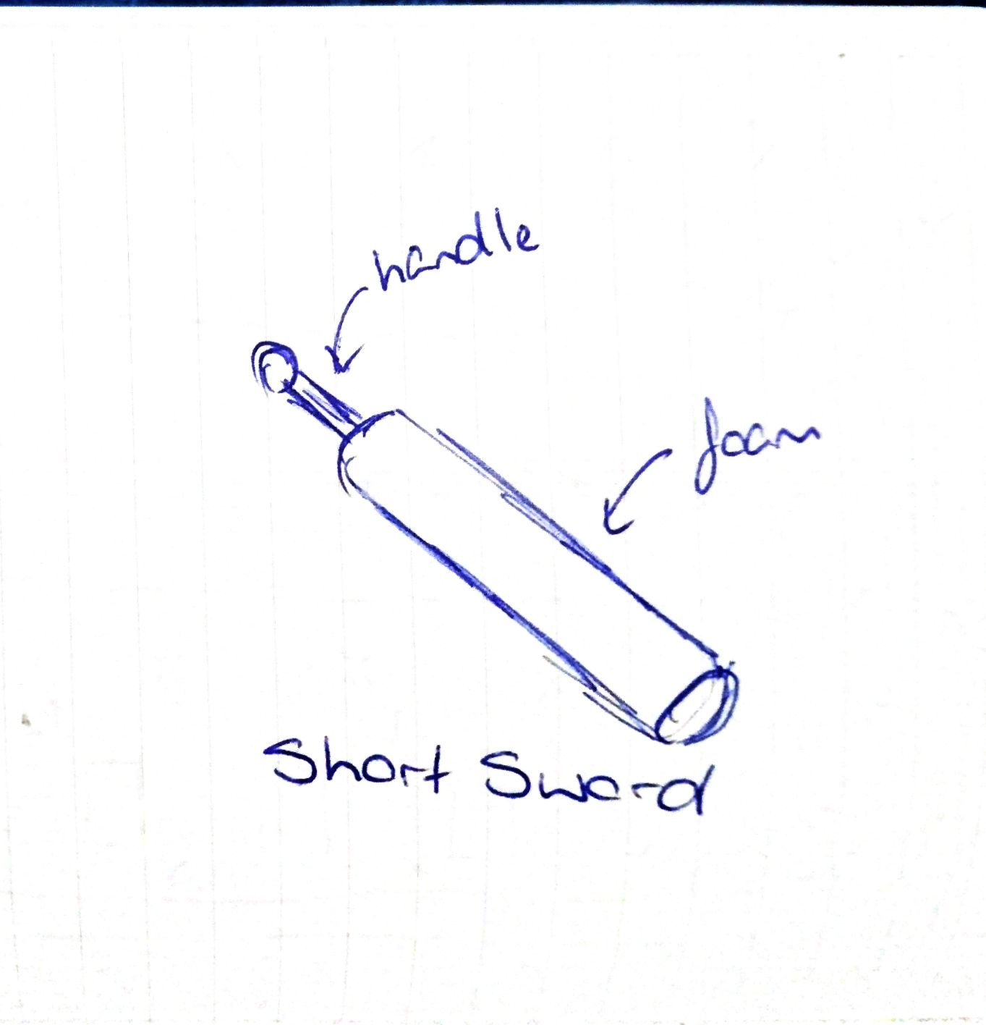
Image: Personal sketch

Slide 14
Image: Personal sketch

Slide 15
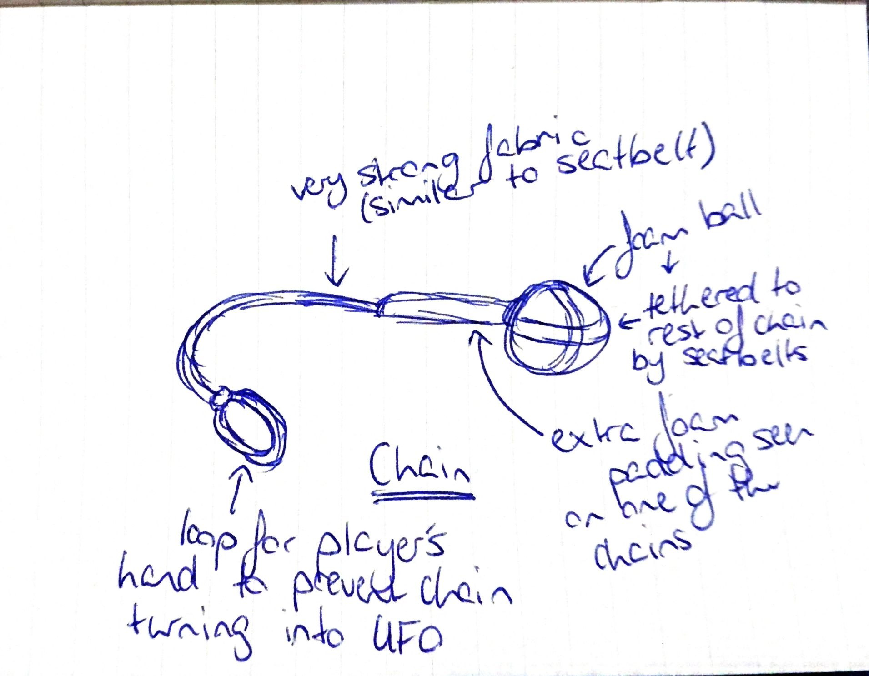
Image: Personal sketch

Slide 16
“Younger anthropologists have the notion that anthropology is too diverse. The number of things that can be done under the name of anthropology is just infinite; you can do anything and call it anthropology.”
- Clifford Geertz

