Slide 1
How do we work with SMEs? & what is the SME Collaboration Nation Mission?
George Feast | 27 February 2020

Slide 2
SME Connect – What we do
Connect Australian SMEs and start-ups with the best researchers at universities, CSIRO and public research organisations.
Facilitate relationship building, project scoping and contracting.
Provide end-to-end engagement support.
Deliver three dollar-matched funding programs.
Funding Programs
Innovation Connections | CSIRO Kick-Start | STEM+ Business
200+ Grants p.a. | $25M total research p.a.

Slide 3
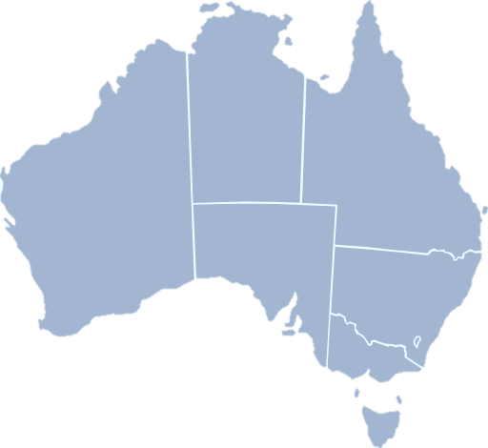
CSIRO SME Connect Where we are located
We are based in 8 locations and facilitate projects Australia wide!
Brisbane
Newcastle
Sydney
Perth
Wollongong
Adelaide
Canberra
Melbourne

Slide 4
SME Connect Programs Our funding programs
 |  |  | UP TO $115K PER ANNUM
 |  | 2 × UP TO $50K (+ $30K graduate)
MATCHED FUNDING | 2 × UP TO $50K
PROGRAM | CSIRO KICK-START | INNOVATION CONNECTIONS | STEM+ BUSINESS
SME ELIGIBILITY | < $1.5 million OR <3 years trading | $1.5M–100M AND >3 years trading | Completed Innovation Connections Project
PROJECT LENGTH | Up to 1 year | 2–12 months | 2–3 years
RESEARCH ORGANISATIONS | CSIRO only | All Public Research Organisations | All Public Research Organisations
$=$

Slide 5
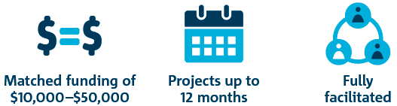

CSIRO Kick-Start How it works:
For innovative start-ups and small businesses
Access to dollar-matched funding to undertake research activities
Research with CSIRO
2021!

Slide 6


Slide 7

























CSIRO Kick-Start Kick-Start companies:

Slide 8
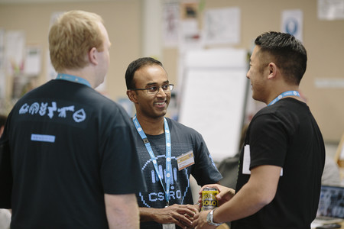

CSIRO Kick-Start Case Study:
LeaseInfo
Sydney-based lease management technologies company
Approached Kick-Start team March 2017
Partnered with CSIRO’s Data61 to incorporate machine learning technologies
Launched Accurait® August 2018
Company accesses further $400k+ in IC, NSW and STEM+ Business R&D grants
20+ New customers including NSW Government

Slide 9

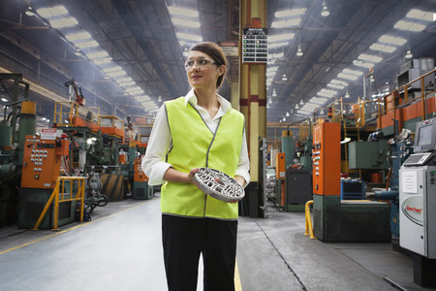
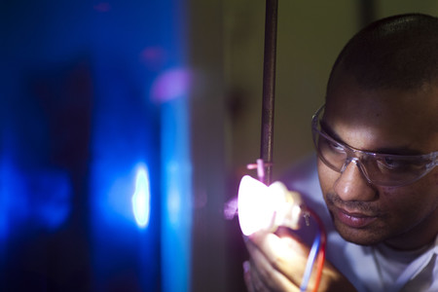
Innovation Connections How it works:
Non-competitive, based on company eligibility
Fast, simple application process, fully facilitated
Grants to support researchers to work with the business on a specific, innovative project
Available for projects with CSIRO, universities and other publicly funded research organisations

Slide 10
Innovation Connections Entrepreneurs’ Programme
Three types of grants:
Researcher Placement Grants
Researcher is employed by research organisation
Up to $50,000 matched at least dollar for dollar by company
Business Researcher Placement Grants
Researcher is employed by the company
Up to $50,000 matched at least dollar for dollar by company
2 max
Graduate Placement Grants
Recent graduate is employed by the company
Up to $30,000 matched at least dollar for dollar by company
1 max
Maximum $130,000 funding per company
2nd grant application must be submitted within 10 weeks of the end date of the 1st project

Slide 11

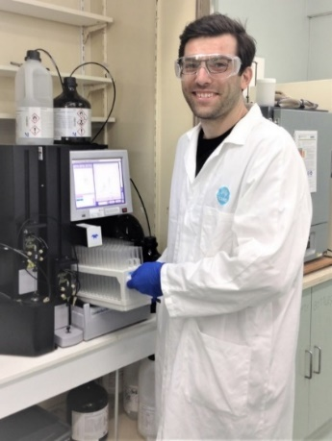
Metcalf STEM+ Business Grant allocation:
Up to $115,000 per annum to support 2-3 years projects
GST registered company (with an ACN)
Annual turnover or operating expenditure $1M-$100M
Have completed an Innovation Connections project
Collaboration between SMEs and early career researchers (ECRs)

Slide 12




Double the number of Australian SMEs that collaborate with publicly-funded research organisations by 2025
Australian Jobs
Innovative industries
Environmental Prosperity
Notes:
Triple Bottom line – People, Profits, Planet

Slide 13







Facilitate collaborations
Capability
development
Exchange of knowledge
Grow SME markets
Translation efficiency
Establish hubs
Notes:
KPIs could include:
# of businesses that collaborate with the research sector through SME programs
# of R&D projects delivered by CSIRO and PFROs to SMEs
Establish at least X industry sector hubs (which may be virtual or physical)
# of scientists and engineers trained in industry-relevant skills
Tracking progress of post-engagement SMEs for growth into $1 billion companies
# of licenses/tech-transfer agreements signed between PFROs and SMEs

Slide 14
Thank you
Services
Dr George Feast SME Collaboration Nation Lead
03 9545 2617
0472 824 798
george.feast@csiro.au
www.csiro.au/smeconnect

Slide 15



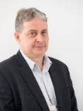
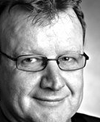

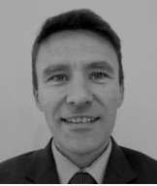




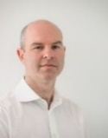

CSIRO SME Connect
Director
Innovation Connections
Simon Hanson
03 9545 2752
simon.hanson@csiro.au
Scott McNeil
Brisbane
07 3327 4427
scott.mcneil@csiro.au
Hayley McGillivray
Perth
08 6436 8545
hayley.mcgillivray@csiro.au
CSIRO Kick-Start
Peter Milic
Sydney
02 9325 3040
peter.milic@csiro.au
David Monck
Adelaide
08 8303 8874
david.monck@csiro.au
Megan Sebben
03 9545 8543
megan.sebben@csiro.au
James Robinson
Canberra
0459 876 082
james.robinson@csiro.au
Dave Fleming
Newcastle
02 4960 6008
dave.fleming@csiro.au
George Feast
03 9545 2617
george.feast@csiro.au
Kevin Thomson
Melbourne
0438 155 815
kevin.thomson@csiro.au
Joe Dodd
Melbourne
03 9545 2277
joe.dodd@csiro.au
STEM+ Business
Jason Barkla
03 9545 8246
jason.barkla@csiro.au
Bruce Thomson
Wollongong
0409 513 906
bruce.thomson@csiro.au

Slide 16
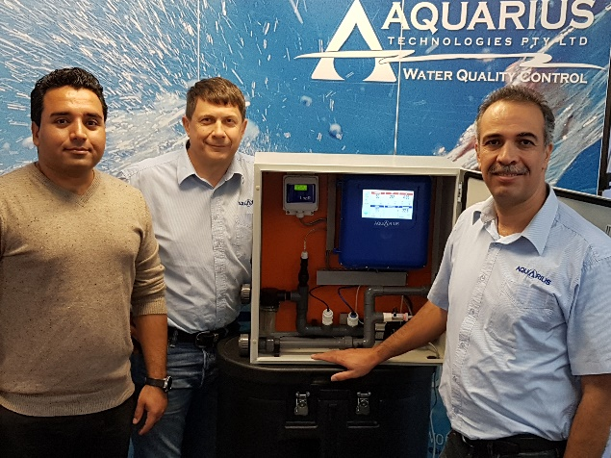



STEM+ Business Case Study – Aquarius Technologies
Manufacturer of water treatment controller – Ultima
First collaborated with support of Innovation Connections grant
3 year STEM+ Business Fellowship with Chemical Engineer ECR
Developed new carbon nanodot sensing system
Now exporting globally to water treatment plants
Aquarius & Griffith awarded 5yr $5M ARC Industrial Transformation Hub

Slide 17
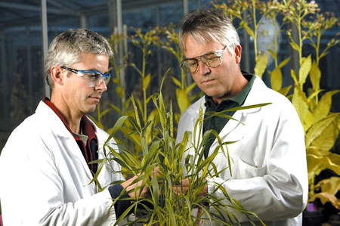

Innovation Connections Research Case Study:
UrbanVirons
Large-scale horticultural service company based in SA for 35 years
Global shift to reduce the amount of herbicides and pesticides used
Need to innovate in order to remain competitive
New non-herbicide weed management idea, but unsure how to formally engage research expertise
Consulted Innovation Connections Facilitator

