Slide 1
Geometric Intuition and Image-plane Methods for Measuring Closure Phases in Interferometry
Thyagarajan & Carilli, 2020, arXiv: 2012.05254
Nithyanandan Thyagarajan (NRAO*)
Chris Carilli (NRAO)
Acknowledgements:
Rajaram Nityananda (Azim Premji University)
Arul Lakshminarayanan (IIT Madras)
Jim Moran (CfA, Harvard)
David Buscher (Cambridge)
Rick Perley (NRAO)
Craig Walker (NRAO)
Sanjay Bhatnagar (NRAO)
Michael Carilli
Kumar Golap (NRAO)
Copyright © 2020 AUI/NRAO. All Rights Reserved.
Notes:
My name is Nithya. I recently joined CSIRO as a research scientist. And was formerly a Jansky fellow at NRAO.
We’d like to gratefully acknowledge the valuable inputs and feedback received from the people listed below on this subject.
The subject of this talk is to present a geometrical insight and understanding into the meaning of an interferometric concept called closure phase in the image/focal plane going beyond the standard perspective usually presented from the aperture- or Fourier-plane measurements.

Slide 2
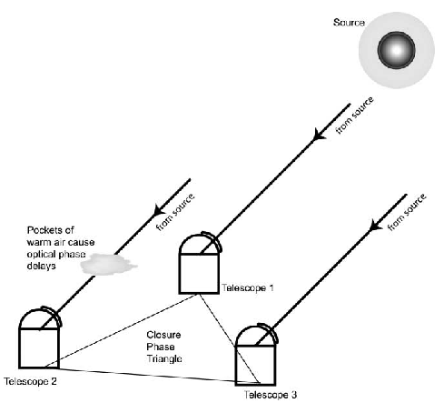
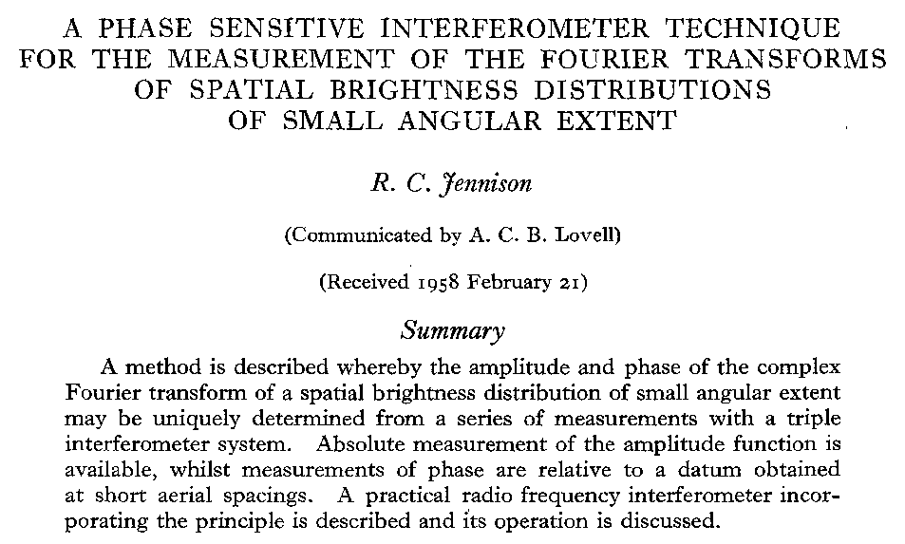
Closure Phase
Provenance
Monnier+(2006)
Bispectrum: V^{m}_{abc} = V^{m}_{ab}V^{m}_{bc}V^{m}_{ca}
Closure phase is independent of antenna-based gain corruptions*
Aperture-plane view straightforward
Image-plane view??
Copyright © 2020 AUI/NRAO. All Rights Reserved.
*Caveats apply: Baseline-dependent, direction-dependent and polarization leakage terms
can violate this relationship
Notes:
Here is a quick background of the closure phase concept in interferometry.
The very first mention of closure phase in radio astronomy can be traced back to this cool paper by Jennison in 1958.
The first image depicts 3 antennas observing a source but the wavefronts and their phases are inevitably corrupted by the propagation medium and the antennas themselves. These corruptions are mostly characterizable as complex antenna-based gains with their own amplitudes and phases.
Then we measure visibilities or spatial correlations on the antenna spacings, usually referred to as baseline vectors as shown in the second figure.
The measured visibility is a corrupted version of the true visibility, and the corruption is given by these two antenna-based gain terms that make up that baseline.
A triple-product of these visibilities (called bispectrum) is formed. When the phase of the bispectrum, which is nothing but the closure phase, is calculated, the complex antenna gain terms completely drop out, essentially allowing us to measure the true closure phase (which is the sum of the phases of the three true visibilities) + noise. (Note that there are certain exceptions and caveats that should be kept in mind)
Two key points to note:
The closure phase is independent of antenna-based gain corruptions
A closed loop of baselines, as shown in the second figure, is essential for this property of closure phase to hold
This aperture-plane and rather mathematical view has been known for more than half a century. The question we ask is: what is the corresponding geometrical view of closure phase in the image plane?

Slide 3
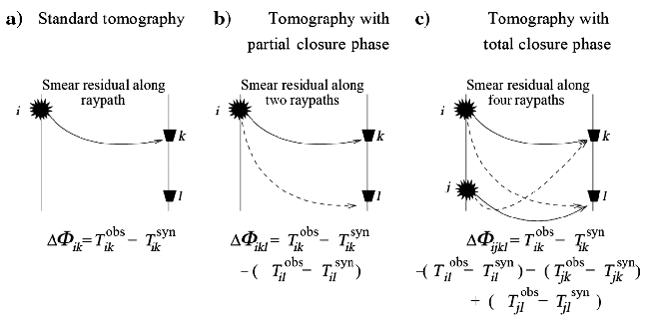
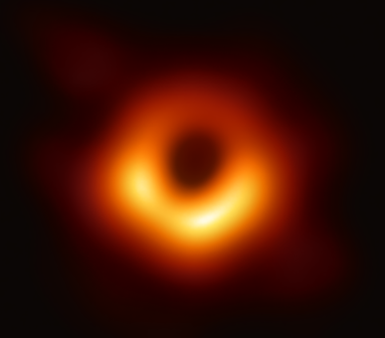
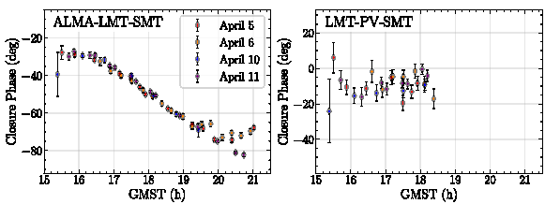
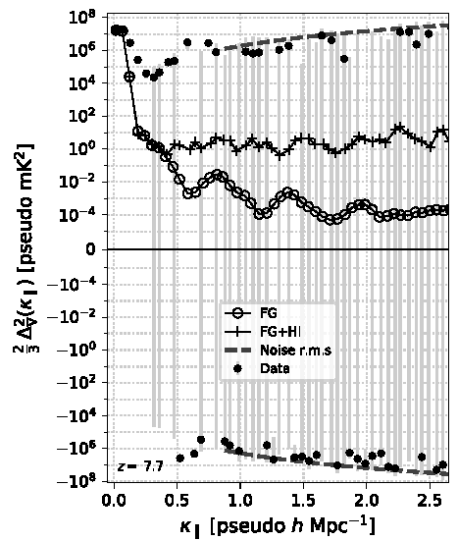
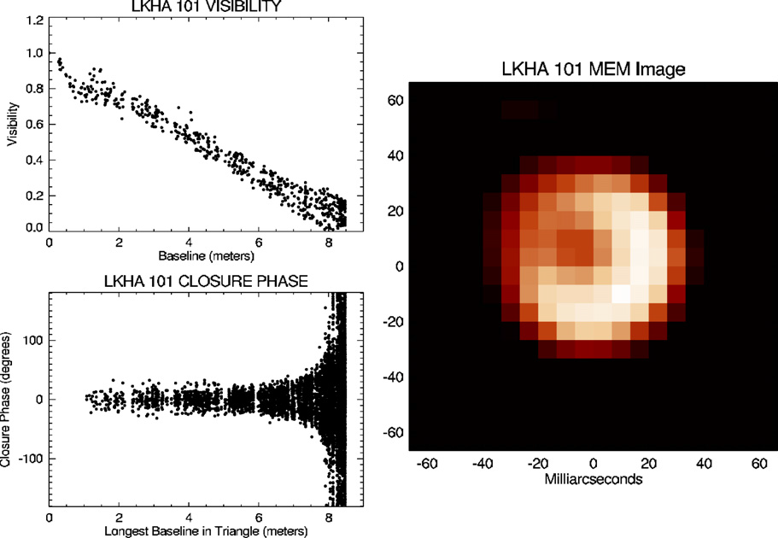
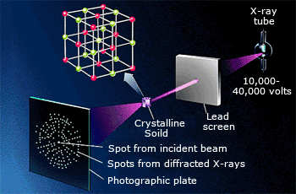
Growing list of applications
Seismic imaging/ Geophysics,
Schuster+2014
EHT image of M87 SMBH, VLBI, EHT+2019
Invariance to element-based gain corruptions => very valuable in applications where calibration/phase determination is challenging
Dust shells around stars
Optical Interferometry
Monnier+2007
21cm cosmology, Thyagarajan+2020
X-ray crystallography
Copyright © 2020 AUI/NRAO. All Rights Reserved.
Notes:
Before answering that question, it must be emphasized that…
Closure phase is not just an elegant and theoretical mathematical concept with the property of invariance to antenna-based gain corruptions. It has been been extensively applied and in fact been critical to the success of a variety of applications where calibration or phase determination is very challenging. These range from:
Very Long Baseline Interferometry, including the EHT imaging of the SMBH at the center of M87
Seismic imaging
Imaging of the surface of stars and dust shells around them
X-ray crystallography in determining the crystal lattice structure
More recently towards detecting the large-scale structures in the intergalactic medium during the cosmic reionization era

Slide 4






Geometry of Interferometric Fringes
Measurement
(Van Citterte-Zernike Theorem)
Image Synthesis
Correlation in Radio
Inverse FT in Optical
Synthesized in Radio
Intrinsic in Optical
Inverse Fourier
Series Summation
Fringe
Measured in Radio
Not measured in Optical
Null Phase Curve (NPC):
Phase-position relation:
Fringe NPC (straight line): Fringe Phase = 0
NPC slope = -u/v (Fixed for a given baseline vector)
NPC offset encodes visibility phase and corruptions
Any phase corruption results in parallel displacement of fringe NPC
Visibility phase = (2π / fringe spacing) x perpendicular offset of NPC from phase center
𝜹s₂₃
𝜹s₁₂
𝜹s₃₁
Fringe Slope = -u/v
Fringe Spacing
Δ Phase = 2π
Copyright © 2020 AUI/NRAO. All Rights Reserved.
Thyagarajan & Carilli, 2020, arXiv: 2012.05254
Notes:
Now let’s get into the geometric visualization of interferometry basics and then of closure phases.
Interferometric imaging is governed by the van-Cittert Zernike theorem which relates the image on the sky or the focal plane to the spatial coherence or visibilities on the aperture plane through a Fourier transform.
The reverse problem of image synthesis from the visibilities is obtained by an inverse Fourier series summation of the visibilities, which is equivalent to summing the image-plane responses of individual visibilities from individual baselines, called fringes. A fringe is the image-plane response of a single measured Fourier component, namely, the visibility, and it looks like a sinusoid pattern filling the field of view.
Three fringe patterns from three visibilities from a triad of baselines are shown in the figure, one panel for each fringe. The following features are noted:
The maxima of the fringes, marked by straight lines, denote the null phase curves (or zero phase contours). The principal null phase curve is when the phase is zero (shown in black) and parallel gray lines denote when the phase is some multiple of 2 pi.
The spacing between these null phase curves, referred to as the fringe spacing, is equal to the inverse of the baseline length and corresponds to a phase difference of 2 pi
The slope of the fringes is determined by the orientation of the baseline vector
The visibility phase is proportional to the position offset of the principal null phase curve from the phase center, which is marked by the purple line segments. The relation between the visibility phase and the position offset from the phase center is derived from the fact that the fraction of position offset relative to the fringe spacing must be equal to the fraction of the visibility phase relative to 2 pi.
And importantly, any corruption of the visibility phase results in a displacement of its fringes, but the corrupted fringe pattern is constrained to be parallel to the uncorrupted pattern because the fringe slope depends only on the baseline orientation.

Slide 5
Geometry of Closure Phase (Visualization & Invariance): Shape-Orientation-Size (SOS) Conservation Theorem
Baselines/slopes unchanged => Parallel displacements
Antenna phase affects two fringe phases equally and oppositely => Constrained displacements
Shape, orientation, and size (SOS) of triangle preserved (only translation allowed) => Invariance (SOS conservation)
Ideal
Mis-calibrated
Translated
SOS
conservation
Thyagarajan & Carilli, 2020, arXiv: 2012.05254
Shape, size, orientation (SOS) of fringe triangle preserved
Closure phase invariant to (mis-)calibration/translation
Copyright © 2020 AUI/NRAO. All Rights Reserved.
Notes:
This slide and the next present the key results, where we visualize the fundamental nature of closure phase in the image plane geometrically and present the key finding of this work that we call as the Shape-Orientation-Size (SOS) Conservation theorem.
Consider the left panel in the figure, which corresponds to an ideal, uncorrupted 3-fringe interference pattern. The principal fringe null phase curves are shown in black lines and they generally enclose a triangle (denoted by the gray shaded region). The origin shown in magenta denotes the phase center, and the three magenta line segments, which are the perpendicular position offsets of the these three fringes from the phase center, correspond to the three visibility phases whose sum is simply the closure phase.
Now remember that the choice of phase center is actually arbitrary, and it can be chosen based on convenience. In this case, consider a new phase center to be at the intersection of any two of the three fringes. In other words, one of the vertices of the triangle, denoted by O-prime in red, brown, or blue. Just to be specific, let’s choose the top vertex, the red O-prime as the phase center. Now, since two principal null phase curves pass through this phase reference point, by definition, they both contribute zero phase to the closure phase. The only phase contribution now comes from the third null phase curve that is not involved in that intersecting vertex, that is, the dotted black line. Its visibility phase relative to the new phase reference point is related to the red dotted line segment, which is the perpendicular dropped from the new phase center (the red O-prime) to the opposite side, which is the third fringe. And this will be identical to the sum of the three visibility phases corresponding to the three magenta line segments based on the original phase center.
Now consider a miscalibration of one or more antenna phases (shown in the middle panel). Each of these phase corruptions affects two or more visibilities whose baselines contain this antenna. Thus, those two fringes are shifted but those shifts are governed by two important constraints– they have to shift parallel to themselves, and they have to shift by equal but opposite values of phases by definition of the measured visibility. These two constraints will ensure that the SHAPE, ORIENTATION, and SIZE of the triangle enclosed by the null phase curves is preserved. The only degree of freedom for this triangle is a translation in the image plane relative to the ideal case as seen in the middle panel. We refer to this property of closure phase in the image plane as the triangle SOS conservation, where SOS stands for shape-orientation-size.
An interesting point to note is: antenna phase miscalibration leads to an overall translation as we just saw, and conversely, a translation can be considered equivalent to antenna phase miscalibration. The two are essentially equivalent.
In summary, the SOS conservation of the triangle enclosed by the three fringes IS THE image-plane equivalent of the statement that closure phase is invariant to antenna-based calibration as well as to translation in the image plane.

Slide 6


Geometric Estimation of Closure Phase
1. “Phase-position” method*
2. “Product of Areas” method*
SOS
conservation
Choose phase center at one of the intersections from two NPCs
Measure perpendicular position offset to third NPC (the other two have zero offsets)
Use phase-position relation
Estimate area of triangle enclosed by array elements in the aperture plane
Estimate area of triangle enclosed by fringe NPCs in the image plane
Thyagarajan & Carilli, 2020, arXiv: 2012.05254
=
X
*Caveats apply: If array elements are collinear, fringes are parallel and don’t intersect. These relations are valid but hard to implement. Nevertheless, closure phase is well-defined.
Copyright © 2020 AUI/NRAO. All Rights Reserved.
Notes:
Based on this geometric understanding of closure phase and its invariant nature, namely the SOS conservation property in the image plane, we propose two image-plane methods to estimate the closure phase of a 3-element array and neither of them requires the aperture-plane visibility information.
The first method, that we call the phase-position method, is based on choosing the phase center at one of the vertices of the triangle enclosed by the 3-fringe interference pattern. Then the perpendicular position offset of this vertex from its opposite side will simply give the closure phase via the phase-position relation as highlighted.
The second method is called the “product of areas” method. (SOS conservation implies that the area of the triangle enclosed by the three fringes is also conserved.) It can be shown that the product of the area of the triangle enclosed by the three fringes in the image plane and the area enclosed by the three array elements in the aperture plane is proportional to the square of the closure phase. The exact relation is highlighted here.

Slide 7
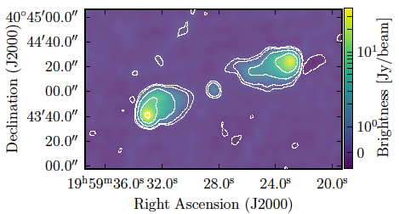
Image Domain Closure Phase Measurement using VLA data
3C 286
Cygnus A
Sebokolodi+ 2020
9.4 GHz, 20sec, 20 MHz; 𝝈_{th}/vis = 33 mJy
Flux density = 4.4 Jy
Point source: calibrated vs. uncalibrated
Triad baselines = 7km to 15km
98% correlated flux on selected baselines => 𝝍₃ ∼ 0
8.0 GHz, 8sec, 8 MHz; 𝝈_{th}/vis = 82 mJy
Flux density = 23 – 38 Jy
Complex source: Calibrated vs. corrupted
Triad baselines ∼ 0.8km (equilateral)
≤ 22% correlated flux on selected baselines => 𝝍₃ ≠ 0
Copyright © 2020 AUI/NRAO. All Rights Reserved.
Notes:
Now we will verify our new geometric understanding of closure phase using two examples of real radio interferometric data from the VLA. The observation details are listed below. It is useful to note that these are short-duration single snapshot, and single spectral channel of data, but both of these are high SNR examples, and that is just to keep things simple.
In the first example, we take data from observations of 3C286. Here, the comparison will be between data that are calibrated as well as uncalibrated for the antenna phases. 3C286 is, for all practical purposes, a point source at these frequencies. Hence, its closure phase is approximately zero.
In the second example, we take Cygnus A data. Here, we will compare calibrated data against intentionally corrupted data where one of the antenna phases was corrupted by 80 deg. Cygnus A has a complex morphology, and therefore, its closure phase is expected to be non-zero.

Slide 8
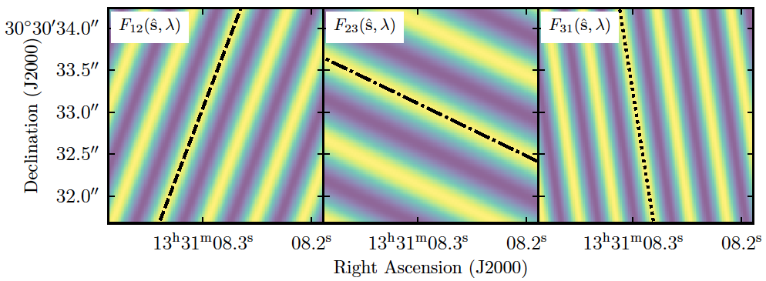
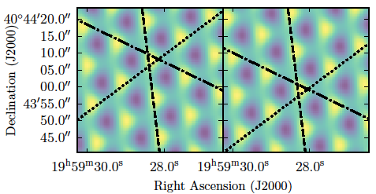
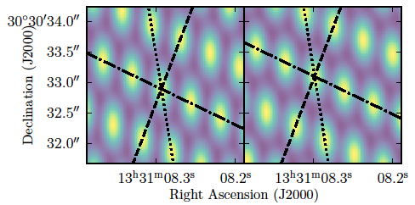
Image Domain Closure Phase Measurement using VLA data
3C 286
Cygnus A
calibrated
corrupted
𝜹s’
Shift along uncorrupted fringe
calibrated
uncalibrated
Translation occurs along uncorrupted baseline fringe
𝝍₃ = 113º ± 1.5º from both image-plane methods and consistent with the aperture-plane method
SOS conservation verified
Point source => 𝝍₃∼ 0 => three fringes intersect in grid of points
Shift of pattern but no change in the grid structure
Measured closure phase consistent with 0 using both image-plane methods as well as the well-known aperture-plane method
Copyright © 2020 AUI/NRAO. All Rights Reserved.
Notes:
In the top panel on the left, the three fringes with the null phase curves determined geometrically for 3C286 are shown. Because 3C286 is a point source, its closure phase is expected to be zero. Indeed, we see that the fringes intersect in a grid of points, while the three null phase curves intersect at a single point, that is a triangle with all its vertices coincident, indicating the closure phase is necessarily zero.
Between calibrated and uncalibrated data, the three-fringe interference pattern appears shifted but there is no change in the grid structure. The measured closure phase in either case is consistent with zero using both image-plane methods as well as the well-known aperture-plane method of summing the three visibility phases.
On the right, we show the three-fringe interference pattern of Cygnus A data. Knowing that Cygnus A has a complex morphology, the three null phase curves enclose a clearly finite-sized triangle, indicating the closure phase is definitely non-zero. When a single antenna’s phase is corrupted, the interference pattern simply shifts along the null phase curve of the fringe that does not contain the corrupted antenna. But the triangle’s shape-orientation-size (or the SOS) characteristics are preserved precisely. The closure phase for Cygnus A is measured to be about 113 degrees from both the image-plane methods and is consistent with the standard aperture-plane method as well.
Thus, with these two examples, we have verified the key SOS conservation theorem which forms the basis for the invariance of closure phase to antenna-based phase corruptions as well as the geometrical methods to estimate closure phase in the image plane.

Slide 9
VLBI Example (EHT imaging of M87)
EHT’s network-calibrated data is insufficient for imaging
Self-calibration is essential to get the phases in order
Regardless of phase corruptions, closure phase is unaffected
𝝍₃ = 38º from both image-plane methods and consistent with the aperture-plane method
SOS conservation verified in VLBI regime as well
Copyright © 2020 AUI/NRAO. All Rights Reserved.

Slide 10
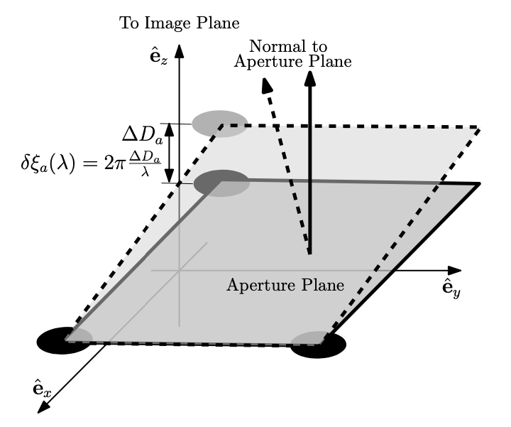
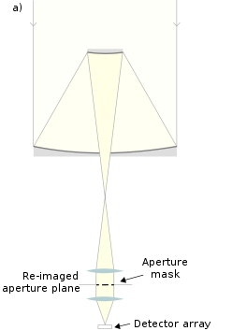
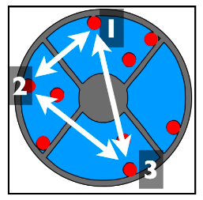
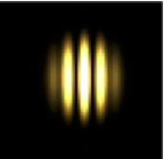
Aperture Masking in Optical Interferometry
Thyagarajan & Carilli, 2020, arXiv 2012.05254
Three points define a plane
Phase corruption of one element => change optical path-length to focus
Corresponds to a ‘tilt’ of the triad in aperture plane, leading so a shift of the fringe pattern in the image plan
Copyright © 2020 AUI/NRAO. All Rights Reserved.
Notes:
The geometric ideas we have presented here can be readily applied to the field of optical interferometry, where image-plane fringes are formed directly on a CCD, for example. The idea of optical interferometric imaging using aperture-masking can be used to further understand the reason for the translation of the image when antenna-based phase corruption occurs, while preserving all other image characteristics.
Consider small, unmasked apertures (shown by the red circles) on a large mirror (shown in blue) in the aperture plane as shown on one of the panels on the left. Now let’s pick any three of these small apertures as indicated by the numbers.
In the figure on the right, these three points shown by the black circles define a plane as shown by the dark gray region. When one of the aperture element’s phases is corrupted, this phase offset results in an additional path length to the focal/image plane as shown by the effective virtual displacement of that aperture element. Now, the three small apertures correspond to a TILTED plane (shown by the light gray region) which redirects the light in a different direction that then results in the entire interference pattern shifting to a new location in the image plane corresponding to the angle of the tilt. And THIS IS THE reason why the interference pattern is translated but the overall image characteristics remain unchanged.

Slide 11
Effect of baseline-dependent phase error
3C 286 example
Displaced fringe NPC
(baseline-based phase error = 80º)
Original fringe NPC
(calibrated)
Thyagarajan & Carilli, 2020, arXiv 2012.05254
Antenna-based phase errors
constrained translation of fringes
SOS conservation
Closure phases preserved
Baseline-based phase errors
unconstrained translation of fringes
SOS not conserved
closure phases not preserved
Copyright © 2020 AUI/NRAO. All Rights Reserved.

Slide 12
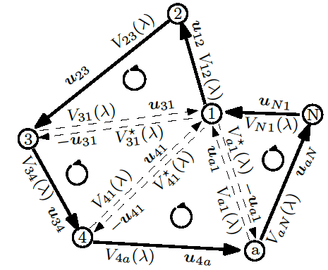

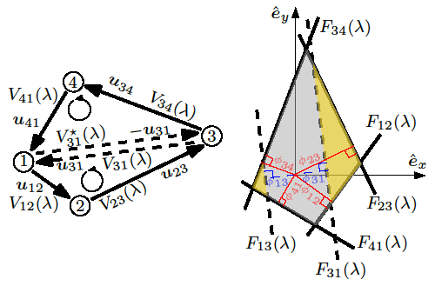

Closure Phase generalized to N-polygons
Thyagarajan & Carilli, 2020, arXiv 2012.05254
“Phase-position” and “product of areas” relations extended to closed N-polygons
Copyright © 2020 AUI/NRAO. All Rights Reserved.

Slide 13
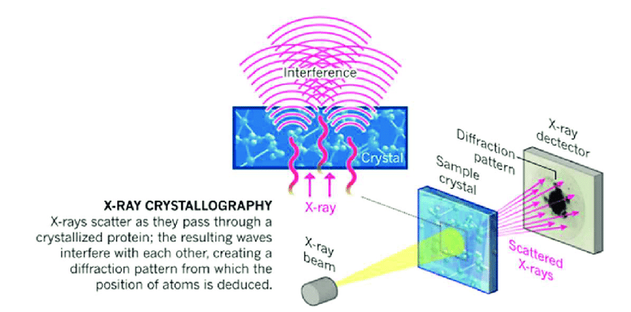


Connection to Crystallography
X-ray/electron/neutron Crystallography
Radiation scatters as it passes through crystal
Diffraction pattern (reciprocal space) is FT of electron density distribution (real space)
Need Fourier inversion to determine electron density distribution and atomic/molecular structure
But usually, only intensities of diffraction pattern available → |F_{H}|², and phases of F_{H} are lost (called the “phase problem”)
Direct Fourier inversion not possible
Use structure invariants -- triplet and quartet phases (or closure phases)* -- to determine phases with a priori knowledge of symmetries and structures using forward-modeling
The geometric picture of closure phase is easily extended to 3D crystal structure analysis
Diffraction
pattern
Electron
Density
* Nobel prize in chemistry awarded to Herbert Hauptman & Jerome Karle in 1985 "for their outstanding achievements in the development of direct methods for the determination of crystal structures” which relied heavily on the use of structure invariants
Copyright © 2020 AUI/NRAO. All Rights Reserved.
Notes:
Closure phase in interferometry has a close connection to a similar concept called “structure invariants” in crystallography that is used to determine the atomic structure of crystals. In X-ray crystallography, for example, a beam of X-rays is made to pass through the crystal which produces a diffraction pattern. This diffraction pattern in the so-called reciprocal (or Fourier) plane has a Fourier transform relation with the electron density distribution in the crystal lattice, which in turn determines the crystal’s atomic structure. This requires an inverse Fourier transform of the diffraction pattern. However, usually only the amplitudes of the diffraction pattern are measured in the form of intensities, while the phase information is lost and this is called the “phase problem”, thereby making a direct Fourier inversion not possible.
The use of so-called structure invariants, particularly, the triplet and quartet phases, which are mathematically equivalent to 3- and 4-element closure phases, has been critical in determining many important crystal structures by estimating the phases through use of a priori knowledge of symmetries and structures in the crystal. Thus, the geometric picture of closure phases presented earlier can be directly extended to three-dimensional analysis of crystal structures as well.

Slide 14
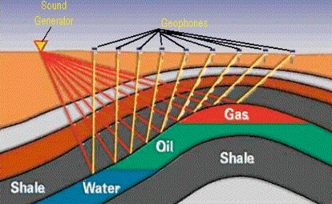
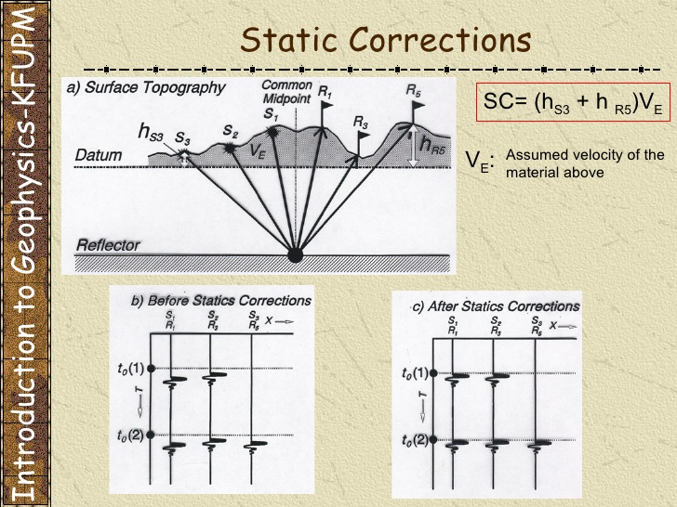
Connection to Seismic Imaging
Source statics
Receiver statics
Local velocity anomalies due to surface topography called “statics”
Statics affect time-delay measurements
Statics (seismic imaging) ⬄ Phase errors (radio interferometry)
Combining delays (phases) around a closed network of sources and receivers eliminate these statics
Thyagarajan & Carilli, 2020, arXiv 2012.05254
See Schuster+ 2014 for review
Copyright © 2020 AUI/NRAO. All Rights Reserved.

Slide 15
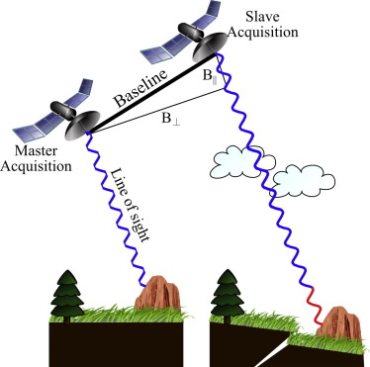
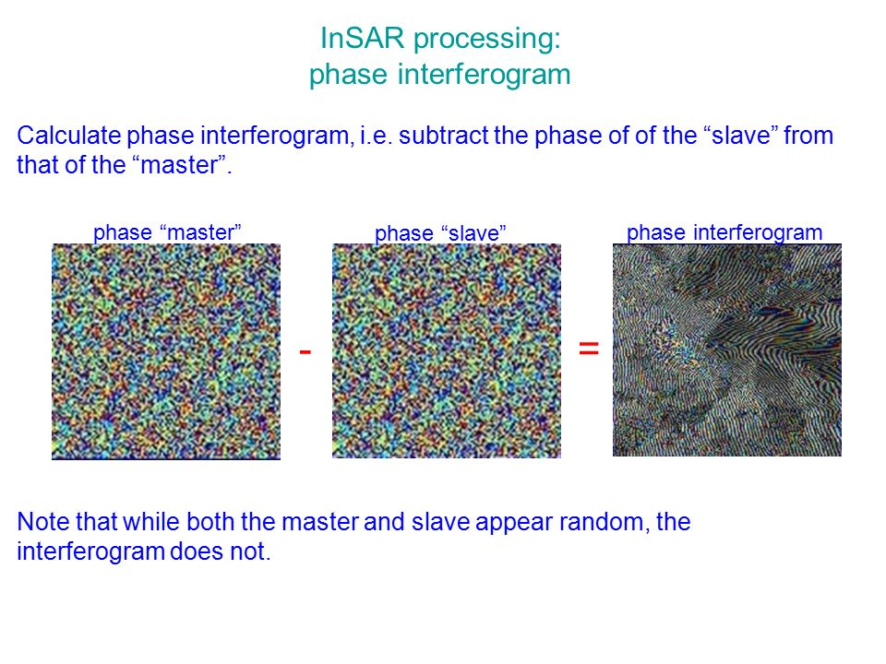
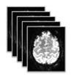
Connection to Interferometric Synthetic Aperture Radar (InSAR) and Medical Imaging
time
Coregistered phase-coherent images
(holographic images with phase information)
Closure phase image from three times
Repeat-track interferometry (Same orbit)
t₁-t₂
InSAR great for studying topography and surface changes
Repeat-track interferometry provides stack of co-registered phase coherent E-field images
Phase difference interferogram could be phase-corrupted
Closure phase images between three different times (if non-zero) robustly measures structural changes
t₂-t₃
t₃-t₁
Mt. Etna (above)
but could be medical images!
Copyright © 2020 AUI/NRAO. All Rights Reserved.

Slide 16
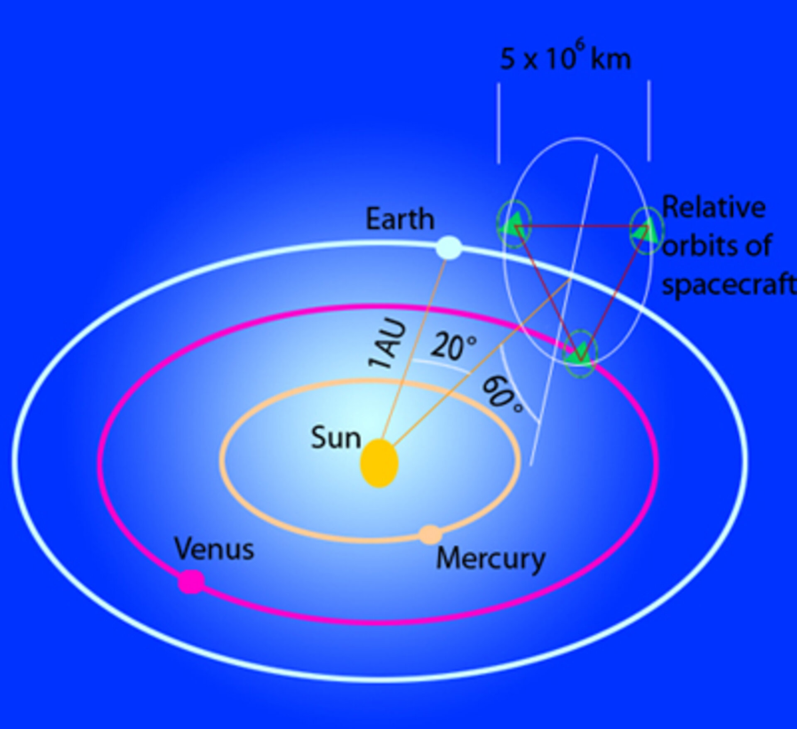
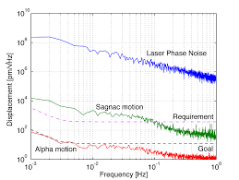
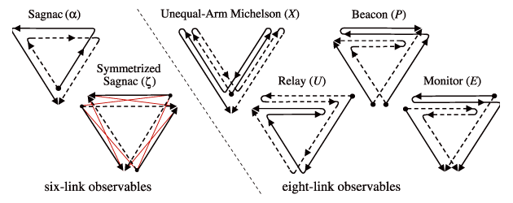
Connection to TDI in GW detection using LISA
Vallisneri (2005)
Laser phase noise is overwhelming source of noise (by >7 orders of magnitude)
Unequal and changing arm lengths need to be accounted for
Solution: Time Delay Interferometry (TDI)
TDI = linear combinations of time-delayed phases of laser beams on closed loops between spacecrafts
They cancel spacecraft motion effects and intrinsic phase noise
Critical for successful GW detection
LISA will detect GW from Galactic WD binaries at mHz frequencies
Three spacecrafts with arm lengths ~5 million km
Short wavelengths => Time dependence of spacecraft motion and Laser phases important
Time Delay Interferometry (TDI) in GW ⬄ Time-dependent closure phase
Copyright © 2020 AUI/NRAO. All Rights Reserved.

Slide 17


Connection: Quantum Mechanics & Polarized Light
Phase of N-vertex Bargmann invariants
Bargmann invariants are gauge-invariant to any local phase factors affecting the quantum states
Closely resemble closure phase definition and properties
Phases of Bargmann invariants = Geometric phase = Berry phase = Pancharatnam Phase
On a cyclical path through multiple polarized states on the Poincare sphere, the geometric phase = (1/2) solid angle subtended by the path = change in vector angle during parallel transport
Related to the intrinsic curvature
Copyright © 2020 AUI/NRAO. All Rights Reserved.

Slide 18
Summary
Closure phases -- very valuable for phase-sensitive applications – VLBI and radio interferometry, Optical Interferometry, GW, X-ray crystallography, seismology, Interferometric Synthetic Aperture Radar (InSAR), ….
but lacked geometric insight
Geometrical estimation methods:
“Phase-position” method
“Product of areas” method
Geometric insight = SOS conservation in the 3-fringe interference pattern in image plane
Invariance to antenna-based (mis-) calibration and translation demonstrated geometrically using real data as well as theory
Potential applications of this geometric insight are being explored
Thyagarajan & Carilli, 2020, arXiv: 2012.05254
Copyright © 2020 AUI/NRAO. All Rights Reserved.
Notes:
In summary, closure phases have been very useful for phase-sensitive interferometry applications spanning radio and optical astronomy, crystallography, geophysics, etc. In this work, we have presented a geometric insight into this valuable interferometric concept by linking it with the shape-orientation-size preserving property of the 3-element interference pattern in the image plane. Using this, we have proposed two geometrical methods to estimate closure phase entirely in the image-plane without a need for aperture-plane visibility information.
We have validated this geometric understanding using real radio interferometric data. Currently, we are exploring potential applications of this geometric insight.
Finally, we encourage you to look into our recently submitted paper (specified here) for more details and will greatly appreciate your feedback.
Thank you!

Slide 19
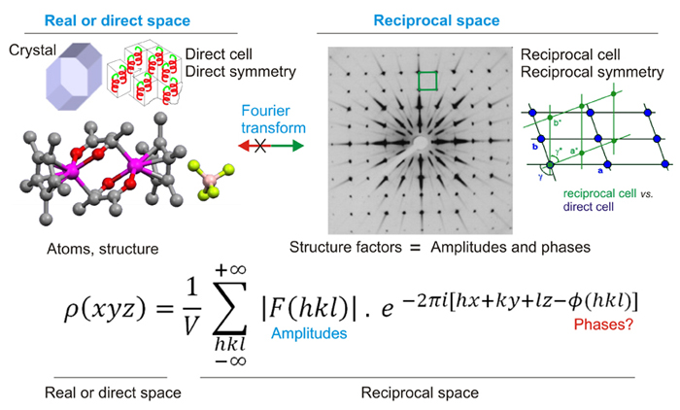
Phase problem and Structure Invariants in Crystal Structure Analysis
Only intensities of diffraction pattern available → |F_{H}|²
Phases of F_{H} are lost
Direct Fourier inversion not possible
Arbitrary origin => Arbitrary phases
Use structure invariants -- triplet and quartet phases (or closure phases)* -- to determine phases with a priori knowledge of symmetries and structures using forward-modeling
The geometric picture of closure phase is easily extended to 3D crystal structure analysis, but benefits/applications yet to be understood.
Ideas??
* Nobel prize in chemistry awarded to Herbert Hauptman & Jerome Karle in 1985 "for their outstanding achievements in the development of direct methods for the determination of crystal structures” which relied heavily on the use of structure invariants
Copyright © 2020 AUI/NRAO. All Rights Reserved.

Slide 20
80º antenna-based phase error: SOS conserving
80º baseline-based phase error: SOS non-conserving
Calibrated

