Slide 1
Following the Money!
Maria Cunningham
UNSW
The role of ALMA in following Energy flow through the ISM to the very smallest scales, and its effect on star formation

Slide 2
We still do not know how stars form
This is particularly true for massive stars, and for clustered star formation.
As ~90% of stars form in clusters, this really means most stars.
The problems in understanding star formation:
Relatively low efficiency of star formation c.f. free-fall time for gas in Galaxy.
Inability of models to explain for formation of stars greater than ~ 8 M, despite the existence of stars significantly more massive on this.

Slide 3
Regulation of Star Formation
Turbulence and magnetic fields have both been proposed to regulate star formation.
They are not independent, as magnetic fields are carried by the ionized fraction of the interstellar gas.
Both are likely to be important.
ALMA will be able to measure both, in the same gas.
This talk is addressing turbulence and the flow of energy.

Slide 4
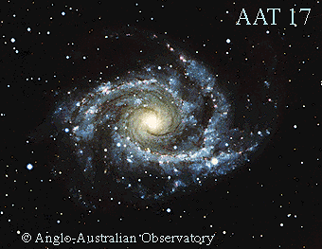
Energy transfer in the ISM
Turbulence is about the transfer of scales in the interstellar medium from large to small scales.
Turbulence can both trigger and disrupt star formation.
It links the large and small scales.
There is a clear link between position in the Milky Way galaxy and local star formation outcomes (Luna et al., 2006, ApJ 641, 938).
Is the turbulent cascade the link between the scales.

Slide 5
Energy flow and star formation
Relative importance of the driving scales for turbulence: Galactic scale, stellar feedback – outflow, expanding HII regions, supernovae? (Mopra, NANTEN2)
At what scale does the turbulent cascade stop influencing star formation? (ALMA)
Do the turbulent properties of a region determine whether massive star formation proceeds by core-accretion or competitive accretion? (ALMA)
Linking large-scale mapping (e.g. Mopra, NANTEN2) with observations at small scales can determine this!

Slide 6
Large scale kinematics and dynamics
Statistical analysis of large-scale maps of star formation regions with different properties.

Slide 7
Spatial Power Spectrum
Work by Paul Jones
The Spatial Power Spectrum (SPS) is obtained as the power (P) in the image, as a function of spatial scale
The power here, in the statistical sense, is the square of the amplitude of the Fourier Transform of the image, which we plot in the FT domain as a function of spatial frequency (k).
The SPS algorithm is then:
- (Fast) Fourier Transform the 2-D image to get
P = A² = (Re)² + (Im)²

Slide 8
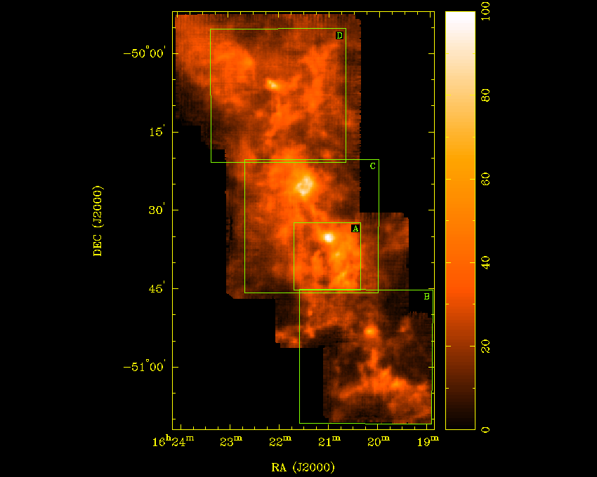
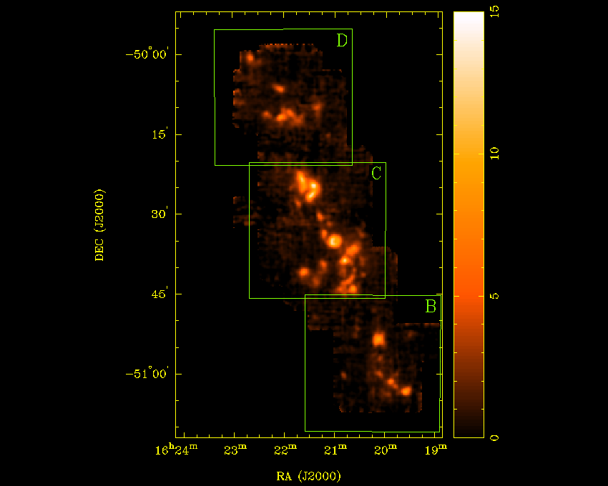
Mopra Observations of G333
¹³CO N₂H⁺

Slide 9
Mopra Observations of G333
Bains I et al., 2006, MNRAS, 367, 1609
Bains I et al., 2009, PASA, 26, 110
Breen S.L. et al., 2007, MNRAS, 377, 491
Lo N et al., 2007, MNRAS, 381, L30
Lo N et al., 2009, MNRAS, 395, 1021
Lo N et al., accepted for publication in MNRAS, 17/03/2011
Wong T et al., 2008 MNRAS, 386, 1069

Slide 10
Some results:

Slide 11
Some Results
The data generally fit a good power law (scales ~1 to 20 pc)
Optical depth affects the slope for ¹³CO (flattens slope)
The slope depends on the velocity smoothing (2D -> 3D Kolmogorov)
The slope depends on the area within the G333 complex
The slope does NOT change much for the different molecules (perhaps surprisingly)‏
BUT there is a deficit of large-scale power for molecules other than CO

Slide 12
Other Statistical Techniques
Delta-Variance analysis (P Jones)
Statistically more robust, less easy to explain in 30 seconds
Principal component analysis (PCA) (N Lo)
Determines the turbulent velocity width in a region of gas.
Comparison of models of turbulent forcing with observations (Federrath) (Federrath et al., 2010, A&A, 512, A81
Determine which regions have large-scale injection, and which have smaller-scale.

Slide 13
Linking to small scales
Does the turbulent cascade continue to the scale where stars are forming, affecting the way stars form – competitive accretion v. core accretion?
Eventually ALMA will be able to map the smaller scales, including total power (with ACA), and we can use the same statistical techniques.
This is down track, and will take a lot of time.
However, radiative transfer modelling can give us a lot of the information we need.

Slide 14
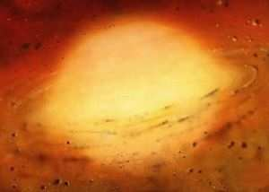
Which one?
Accretion onto massive core?
Competitive accretion?

Slide 16
Modelling with MOLLIE
Radiative transfer code, includes many molecules.
Code of Keto and Redman. Handles multiple sources, infall, outflow, turbulent velocities.
Produces model maps of spectra over a region, for comparison for with observed spectra.
Can determine whether infall velocity to central object is turbulent.

Slide 17
Combining Mopra and ATCA
The cold core G333.125-0.562 Lo et al. accepted, MNRAS
Mopra resolution ~36 arcsec, ATCA ~ 5 arcsec

Slide 18
Results
Two sources present: Massive, young, no HII region
Out of thousands of RT models, only a handful fit the multiple molecular lines observed, and the parameters derived varied by less than a factor of two.
A central source which is thermal – dust, no HII region.
The velocities within the core are turbulent, indicating that the turbulent cascade continues to the scale of ~0.1. pc.

Slide 19
Energy transfer to small scales with ALMA
Observations of SiO, HCO⁺ and N₂H⁺ provide a good collection for finding outflow, infall and the properties of the dense central cores.
The three molecules can be then modelled to constrain the infall, outflow velocities and masses, and core mass.
Simultaneous continuum observations will determine the degree of clumping within cores.
Linking energy transfer from larger scales to turbulent infall at smaller scales, and the type and mass of star formation occurring will determine if the turbulent cascade is the dominant mechanism linking the well determined correlation between the large-scale Galactic environment and small-scale star formation outcomes.

Slide 20
The possibilities with ALMA
Multiple lines simultaneously to constrain models.
High resolution, ~0.5 arcsec, ( ~0.01 pc at 4 kpc) even with early science.
wide bandwidth for continuum sensitivity – able to routinely find continuum sources before HII region develops –very earliest stages can be probed.
high sensitivity to maser and complex molecular line emission gives an excellent chance to determine the ages of the cores.
The high continuum sensitivity will allow determination of the degree of fragmentation of cores, to c.f. turbulence – distinguish between different models of star formation.

Slide 21
The possibilities with ALMA
For phase 0, 1 source will need ~ 1 hour to map to 1 arcmin for matching with Mopra and NANTEN2 scales (see talk by Burton for estimates to different sensitivities).
With more antennas on the mountain, this time will decrease significantly.
Regions with MOPRA and NANTEN2 maps will allow comparison between a large number of cores within and between regions.
The MALT90 survey (MOLLIE RT modelling), combined with MALT Mopra 7mm mapping (statistical analysis of energy transfer at larger scales) will make an excellent finding survey for finding a large range of different conditions.

